Slide 1
Figure 1. Wavelength dependence of normalized blackbody radiation at 6000 Kelvin degrees (Sun) and 285 Kelvin degrees (Earth).

Slide 2
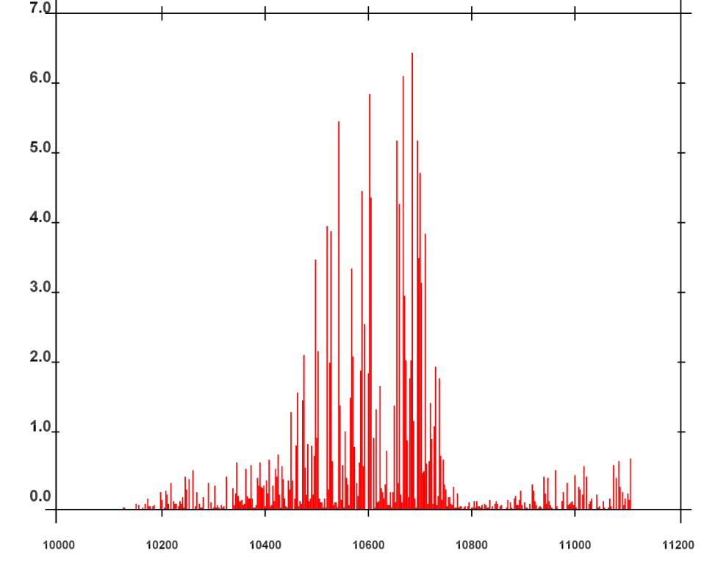
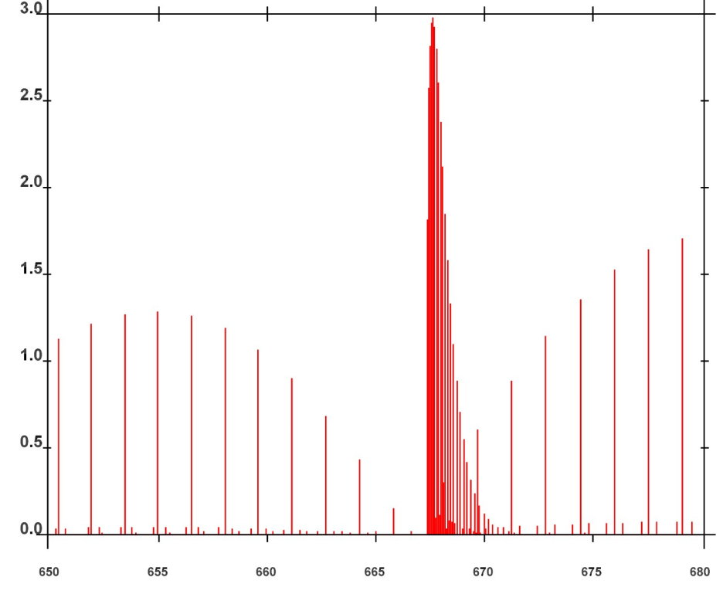
Absorption line intensity in cm⁻¹/(molecule x cm⁻²) at 296 Kelvin Degrees
10⁻²²
10⁻¹⁹
(a) H₂O
(b) CO₂
Wavenumber (cm⁻¹)
Wavenumber (cm⁻¹)
Figure 2. (a) Intensity of absorption of shortwave radiation by a water vapor molecule in the spectral range of 10000 cm⁻¹ (1 micrometer) to 11200 cm⁻¹ (0.89 micrometer). (b) Intensity of absorption of longwave radiation by a carbon dioxide molecule in the spectral range of 650 cm⁻¹ (15.38 micrometer) to 680 cm⁻¹ (14.71 micrometer).

Slide 3
Figure 3. Angular distribution of scattered radiation of an incident visible light at 0.7 micrometer wavelength from the left by a liquid water particle of radius (a) 1 micrometers, (b) 10 micrometers.

Slide 4
q = condensed water mass
N = drop number concentration
Melting
q, N
q, N
Cloud Droplets
Freezing
Cloud Ice
Deposition Sublimation
(macrophysics)
Evaporation Condensation
(macrophysics)
q
-
Autoconversion
Breakup
Water Vapor
Breakup
Autoconversion
Evaporation Sublimation
q, N
Melting
q, N
Rain
Freezing
Snow
Figure 4. Schematics of some of the cloud and precipitation microphysical processes.

Slide 5
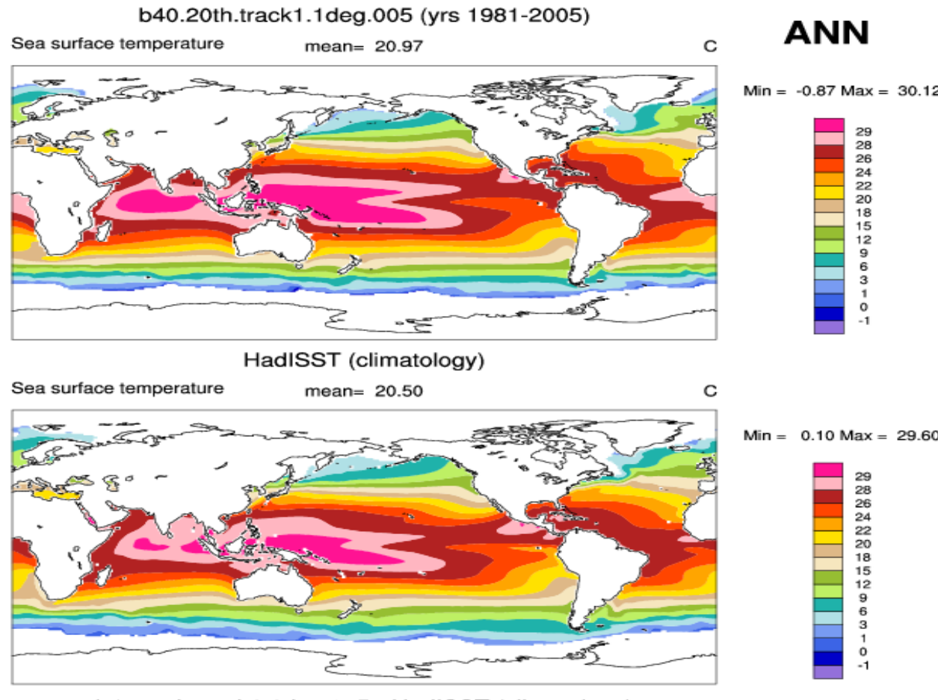
Figure 5. Annual mean sea surface temperature: (a) Simulation by the Community Earth System Model Version 1; (b) observation.

Slide 6
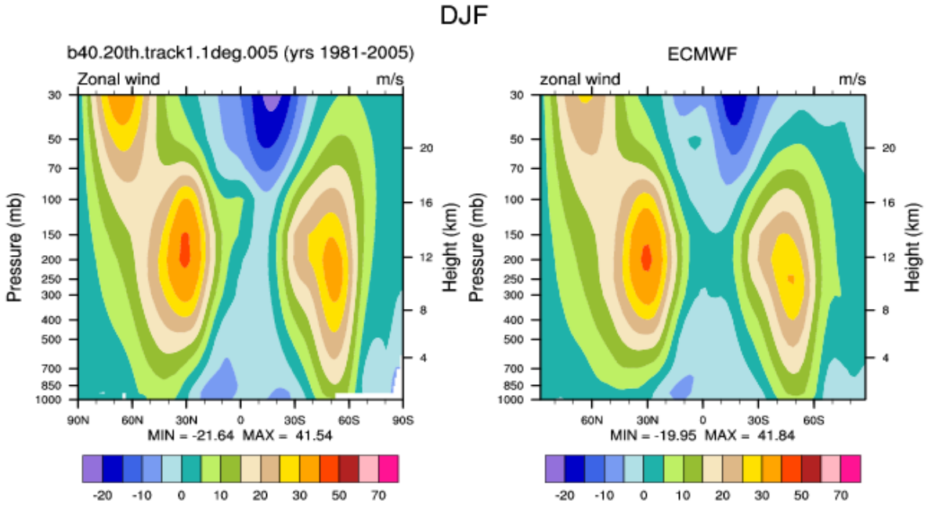
Figure 6. Height-latitude cross section of eastward atmospheric wind averaged over all longitudes: (a) Simulation by the Community Earth System Model Version 1; (b) observational estimates.

Slide 7
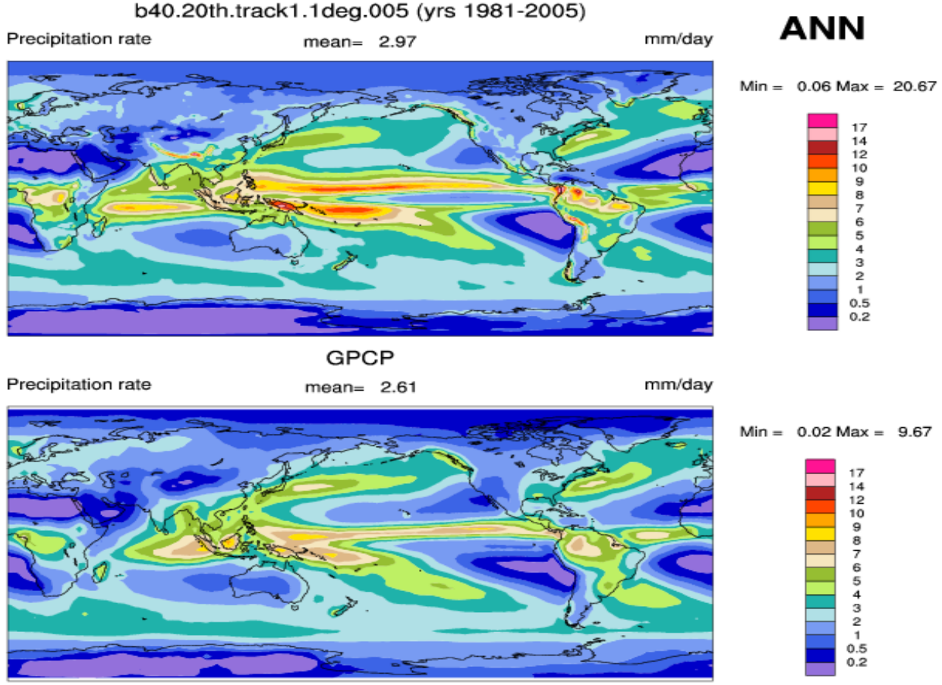
Figure 7. Annual mean precipitation: (a) Simulation by the Community Earth System Model Version 1; (b) observation.

