Slide 1
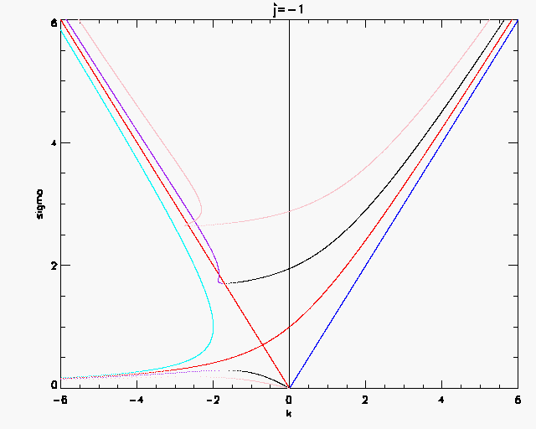
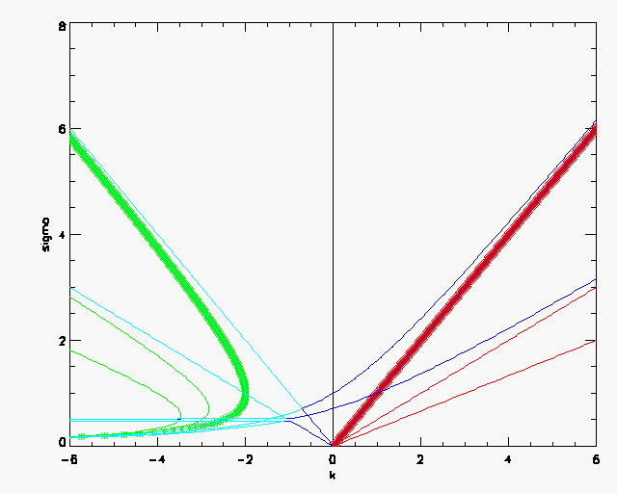
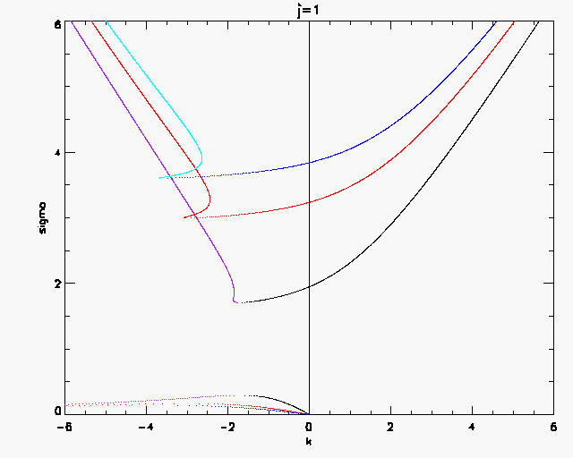
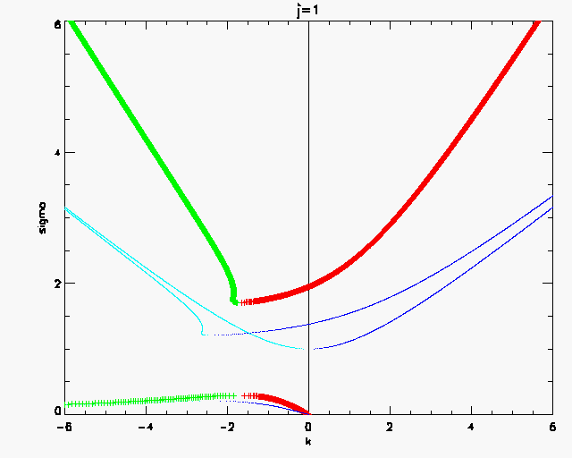
J=-1 blue, cyan
J=0 Red
J=1 black
J=3 Purple
M=1
J=-1 m=1,2,3 Red, green
J=0 m=1,2, Blue and Cyan
J =1 with approximation
J=1,2,4 m=1

