Slide 1
Design and UX-UI Features
webmaster@tel2geo.fr
Sept-oct 2016

Slide 2
What is tel2geo ?
An idea, or a lack of ideas to collaborate..
A website & blog with , some Services OA
API (applications programming interface)
Data Visualisation
Innovation
Web dev / and mobile dev
Engineering, consulting, bcp
Startup spirit

Slide 3
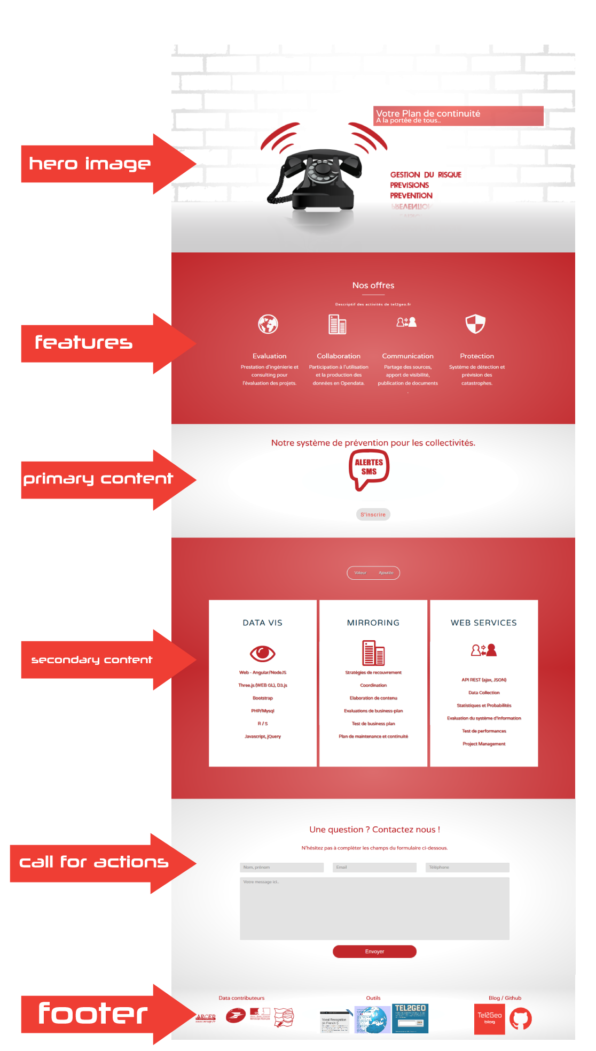
Design UX-UI Landing Page
Bootstrap 4
Easings
Custom Fonts
Scroll-downs
Responsive
Pricetable

Slide 4
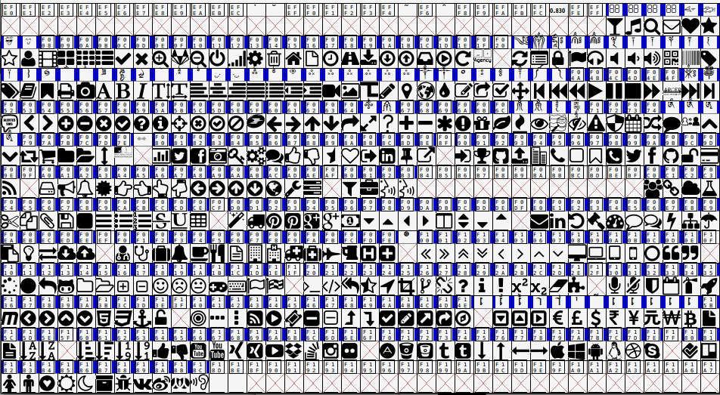
Customized Awesome Fonts

Slide 5
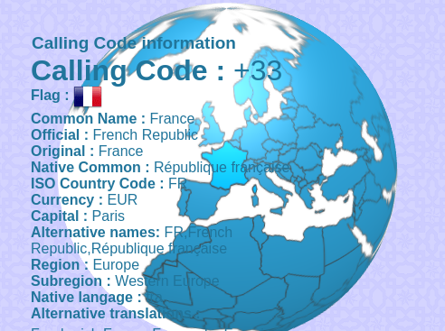
Calling-code data visualisation with d3.js and webgl

Slide 6
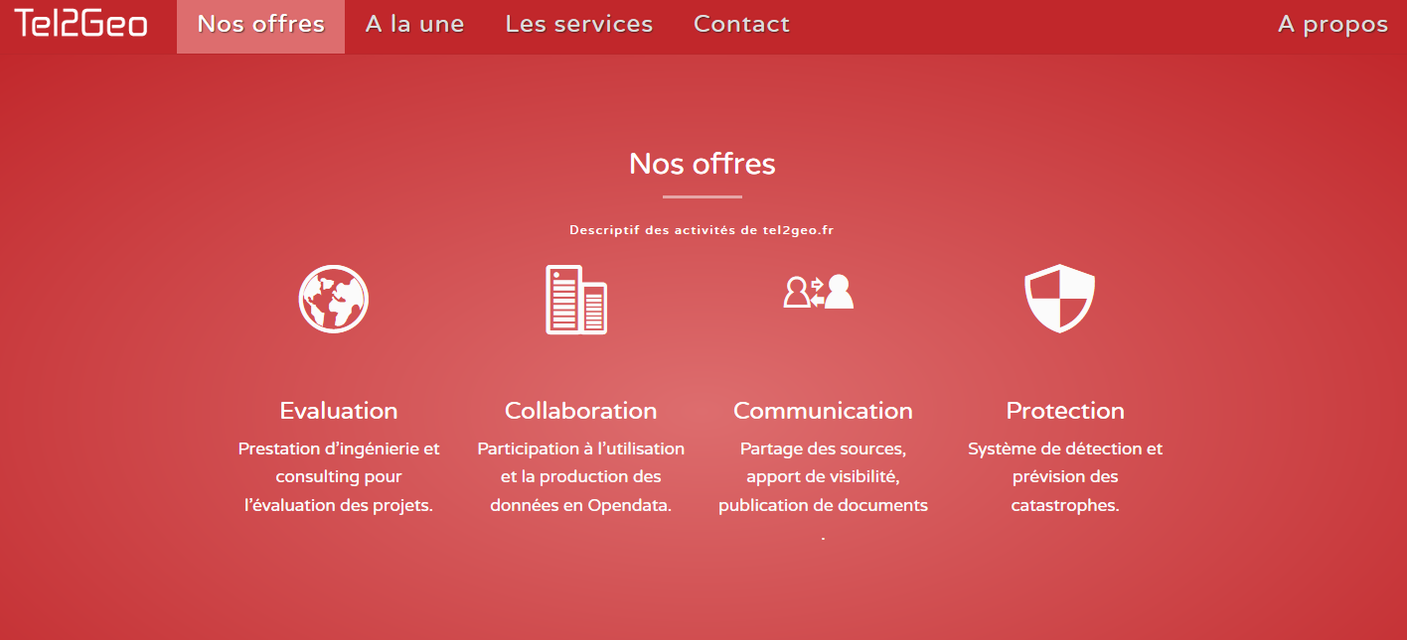
Offers example – with custom icons effects

Slide 7
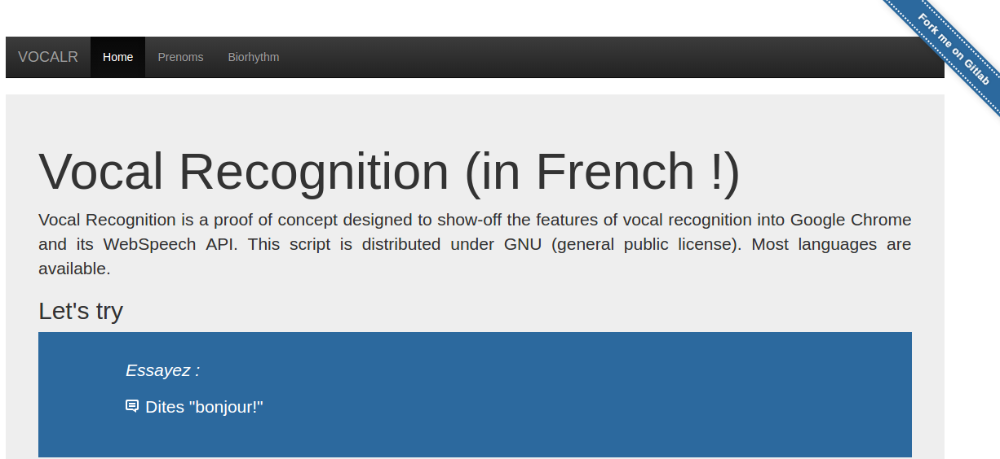
Bootstrap 2 (jumbotron) Responsive vocalR website

Slide 8
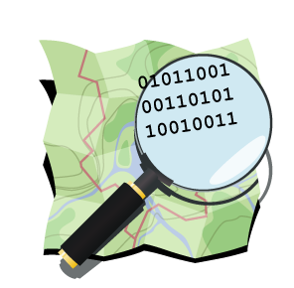


Data Collaboration

Slide 9

Links
https://github.com/tel2geo/t2g/

Slide 10
Thanks

