Slide 1

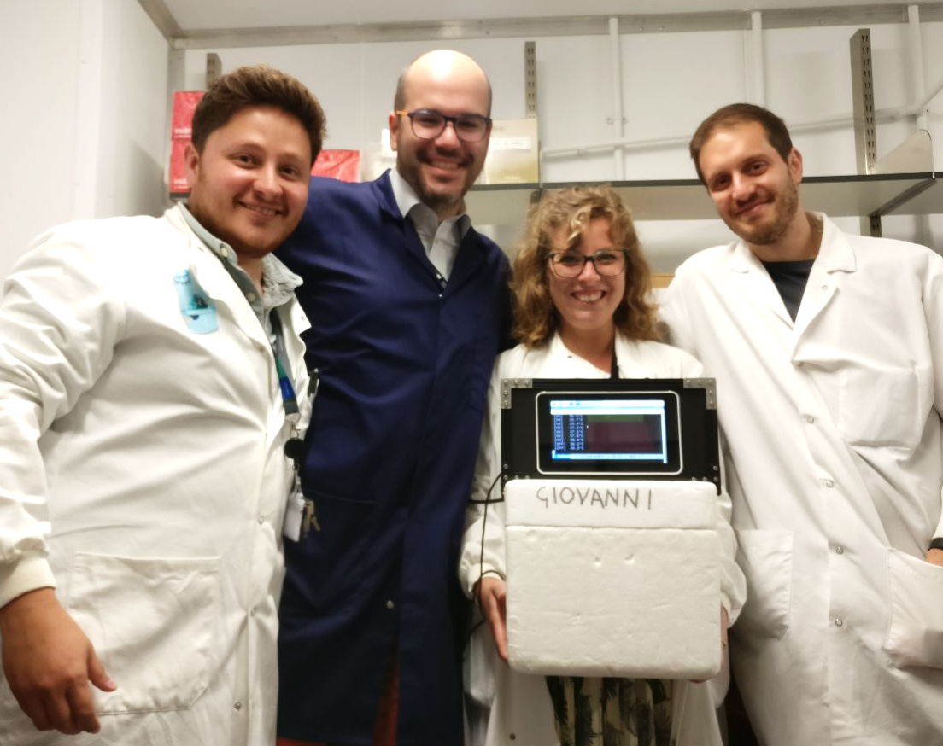

IoHeat
a contained oasis in the cold room
IoHeat
a contained oasis in the cold room
Erika Coletto, Dimitris Latousakis,
Andrea Telatin, Oscar Gonzalez
Erika Coletto, Dimitris Latousakis,
Andrea Telatin, Oscar Gonzalez
Norwich Research Park
29th July 2019, Cambridge
Norwich Research Park
29th July 2019, Cambridge

Slide 2



Why IoHeat
Mammalian cell cultures need a regular medium change, sometimes to be performed during the weekend.
Growth medium need to be stored at 4°C,
but must be warmed at 37°C before use.
This takes up to 20 minutes, so the poor researcher needs to arrive 30 minutes before only to warm the medium.

Slide 3
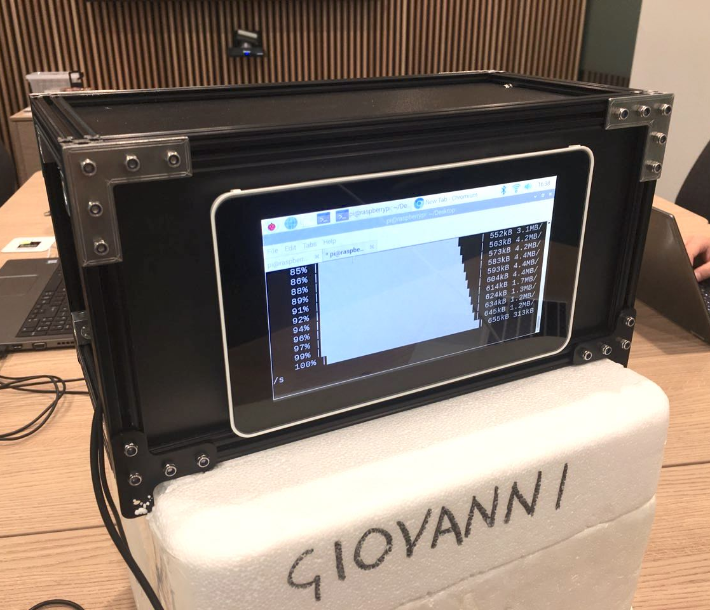

What IoHeat is
A medium incubator (with autonomous heating unit) to be place in the cold room.
Raspberry Pi + Relays + Thermo unit
Programmable and remotely controlled to heat the medium before arriving at work!
• Via Telegram messages • Via web app (to do)

Slide 4


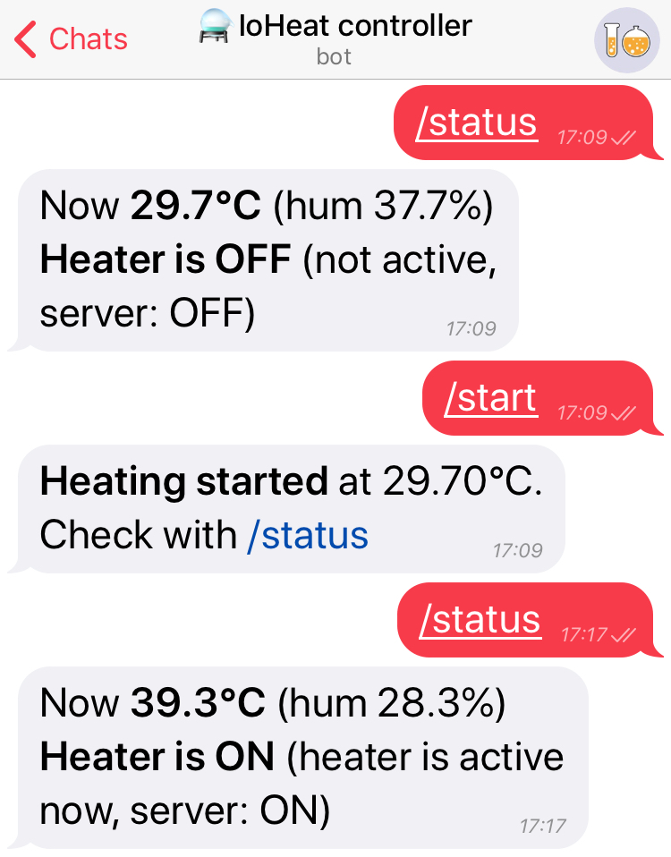

Progress and Follow up
Prototype box: with power supply, fuses, switch, thermo sensor, thermoelectric unit, wired to a Raspberry Pi with touchscreen
Prototype interface: Telegram Bot →
To do: add cooling system,
Build a web app, improve the controlling software, calibrate the unit

Slide 5



https://www.hackster.io/ioheat

