Slide 1
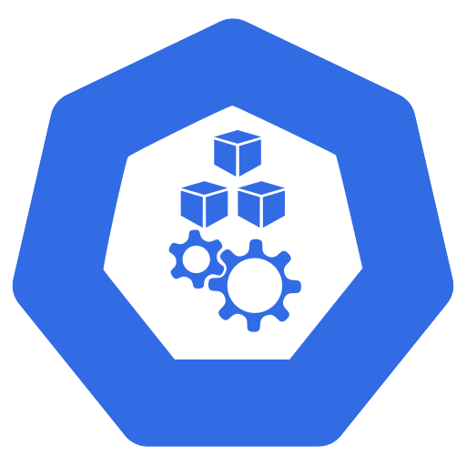
It works on my machine
✗
✓
Developer
laptop
ship it
Production server
Library
version
Config
file
Operating
system
Kubernetes from Zero · 1
Notes:
It works on my machine.
Most of us have said it at least once. And if you work in operations, you've heard it far too often.
Here's what it usually looks like. On the developer laptop, the app runs, the tests pass, everything is green.
Then we ship it to the production server, and it falls over.
Maybe it's a different library version. Maybe it's a missing config file. Maybe it's a slightly different operating system.
Here's the thing. That one sentence is the reason containers exist.
And containers are the reason Kubernetes exists.
If you're new here, hi, and welcome. I'm a solution architect, and this is episode one of Kubernetes from Zero.
Here's the big idea for today.
Containers make your app run the same everywhere, and Kubernetes keeps all those containers running the way you asked.
We'll go from physical servers, to virtual machines, to containers, and finally to Kubernetes, including what it doesn't do.
So, let's go back in time, to where it all started.

Slide 2
Traditional deployment
!
Billing
Search
Reports
No resource
boundaries
Operating system
Hardware
Kubernetes from Zero · 2
Notes:
The short version is this: in the early days, every app shared one machine, and nothing kept them apart.
The docs call this the traditional deployment era.
At the bottom, the hardware. On top of it, one operating system. And on top of that, every app the company needed. Billing, search, reports, all on the same machine.
So here's the problem. There was no way to draw resource boundaries between those apps.
If billing suddenly ate all the memory, search and reports slowed down with it.
The usual fix was to give every app its own physical server.
That works, but most of those servers sat almost idle, and each one cost real money to run.
So the industry went looking for a better way, and that brings us to virtual machines.

Slide 3
Virtualized deployment
VM
+ guest OS
Billing
VM
+ guest OS
Search
VM
+ guest OS
Reports
Extra
weight
Hypervisor
Hardware
Kubernetes from Zero · 3
Notes:
Virtual machines fixed the isolation problem, but they made everything heavier.
Same hardware at the bottom, but now there's a new layer on top: the hypervisor.
In simple terms, the hypervisor lets one physical machine pretend to be several computers. We call each one a virtual machine, or VM.
Each VM is a full computer in software, with its own guest operating system.
So billing lives in one VM, search in another, and reports in a third.
Now the apps are isolated. One can't steal another's memory, or read another's data.
But look at what each VM carries. A full operating system, every single time.
That means gigabytes of disk, minutes to boot, and patches and licences for every copy.
So we isolated our apps, but we paid for it with a lot of extra weight.
Which brings me to the idea that changed everything: the container.

Slide 4
Container deployment
Billing
Search
Reports
Light-
weight
Container runtime
Host OS kernel
Hardware
Kubernetes from Zero · 4
Notes:
Containers keep the isolation, but drop the weight.
This is the container deployment era. Same hardware.
But this time, there's just one operating system, and every container shares the host OS kernel.
On top of it sits a program that starts and stops containers. We call that a container runtime, and two common ones are containerd and CRI-O.
Kubernetes plugs into them through a standard called the Container Runtime Interface, or CRI. And images you build with Docker run on all of them.
And each app, billing, search, and reports, now runs in its own container.
Containers are isolated like VMs, but they share the host operating system instead of bringing their own. That's what makes them so lightweight.
A container starts in seconds, sometimes in less than one. An image is often tens of megabytes, not gigabytes.
Same image format, same tools, and you can pack hundreds of them onto one machine.
A VM virtualizes the hardware. A container virtualizes the operating system.
So, let's open one of those boxes, and see what's really inside.

Slide 5
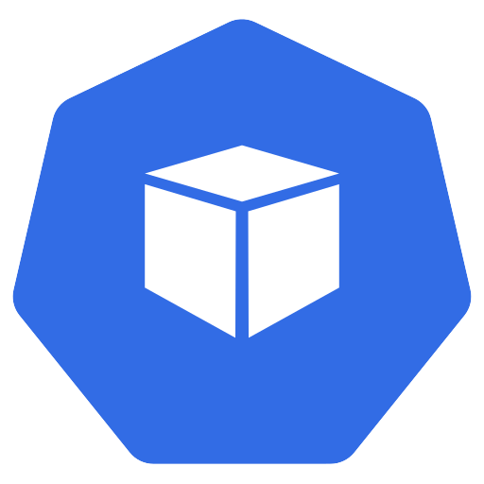
What is a container?
Dockerfile
Container
image
Image
registry
build
push
run
Running
container
Namespaces
(what it can see)
cgroups
(what it can use)
Kubernetes from Zero · 5
Notes:
Here's the surprise: a container is just a normal program, with a fence around it.
It begins with a recipe, usually a file called a Dockerfile.
You build that recipe into a container image.
The image is a ready-to-run package: your code, the runtime it needs, its libraries, and its default settings.
And crucially, it's immutable. Once it's built, it doesn't change.
Then you push the image to a shared library of images. We call that an image registry, like Docker Hub, or your company's private one.
Any machine can pull it from there, and start a running container. Same image, same behaviour, on a laptop or in production.
Now, under the hood, there's no magic. A container is a normal Linux process, with two kernel features wrapped around it.
The first one controls what the process can see: its own files, its own network, its own process list. Linux calls these namespaces.
The second one controls how much it can use: how much CPU, and how much memory. Linux calls these cgroups.
So, in one line, a container is a process that sees less, and is allowed to use less.
But please don't just take my word for it. Let me show you.

Slide 6
Demo: a container is just a process
$ docker run alpine
$ ps
Own process list
$ hostname
Own hostname
--memory 256m
Memory limit
$ exit
Container gone
Kubernetes from Zero · 6
Notes:
Let's prove it on a real machine.
I'll start a tiny container with docker run alpine, and open a shell inside it.
Look how fast that was. Well under a second.
Now I'll run ps, to see the process list.
Inside the container, my own process list has just two entries: the shell, and ps itself.
The shell even thinks it's process number one. That's a namespace at work.
Next, let's type hostname. The container has its own hostname, a random ID, and not my laptop's name.
Now, a memory limit. If I start the container with dash dash memory two hundred fifty six m, a cgroup caps it at two hundred fifty six megabytes.
Go over that limit, and the kernel stops the process.
Finally, I type exit, and the container is gone.
No VM to shut down. Nothing to clean up.
So that's what a container is. Now let's talk about why everyone fell in love with them.

Slide 7
Why teams love containers
1
2
3
Consistency
Portability
Isolation
4
5
Density
Fast
delivery
Kubernetes from Zero · 7
Notes:
Containers won because they make life easier for developers, for operations, and for the people paying the bill.
First, consistency. Dev, test, and production all run the exact same image. So goodbye, works on my machine.
Second, portability. The same container runs on Ubuntu, on bare metal, or on any major cloud.
Third, isolation. Each app brings its own dependencies, so two apps can need two versions of the same library, and nobody fights.
Fourth, density. Light containers mean more apps per server, and a smaller bill.
And fifth, fast delivery. You build the image once, test it, ship it, and roll back to the previous image if something breaks.
But, as you'll see, they also created a whole new problem.

Slide 8
Hundreds of containers at scale
?
?
Crash
Traffic
spike
?
Server
failure
Hundreds of
containers
?
?
Placement
New
version
Kubernetes from Zero · 8
Notes:
So, containers solve packaging, but they don't run themselves.
One container on your laptop is easy.
Now imagine hundreds of containers, spread across dozens of servers, in production, at three in the morning.
First, a crash. A container dies. Who restarts it?
Then, a traffic spike. Who adds more copies, and who removes them when it's over?
Then, a server failure. A whole machine disappears. Who moves its containers somewhere healthy?
Next, you ship a new version. How do you roll it out with zero downtime, and roll it back if it's bad?
And every time you start a container, which server has room for it? That's the question of placement.
Doing all of that by hand, with scripts and late-night pages, simply doesn't scale.
We need something that runs our containers for us.
And that's exactly where Kubernetes comes in.

Slide 9
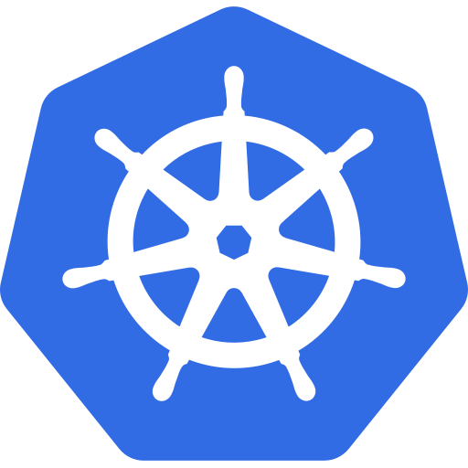
Meet Kubernetes
Nickname
K8s
Open-sourced
by Google
Greek for
helmsman
Fifteen years
of Borg
First CNCF
graduate
Portable, extensible, open source
platform
Kubernetes from Zero · 9
Notes:
Kubernetes is the system that runs your containers for you.
The name is literally Greek for helmsman, the person who steers the ship.
That's why the logo is a ship's wheel.
You'll often see the nickname K8s, said "kates". There are eight letters between the K and the s.
Kubernetes was open-sourced by Google, in twenty fourteen.
It builds on more than fifteen years of Borg, which is Google's internal system for running its own workloads at scale.
And in twenty eighteen, it became the first project to graduate from the Cloud Native Computing Foundation, the CNCF.
Kubernetes is a portable, extensible, open source platform for managing containerized workloads and services.
In plain words: you tell it what you want running, and it keeps it running.
So, how does it actually keep things running? That's the most important idea in this whole series.

Slide 10
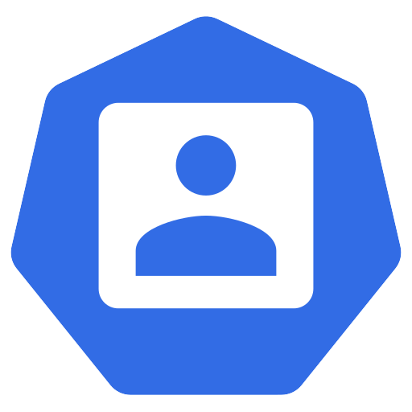
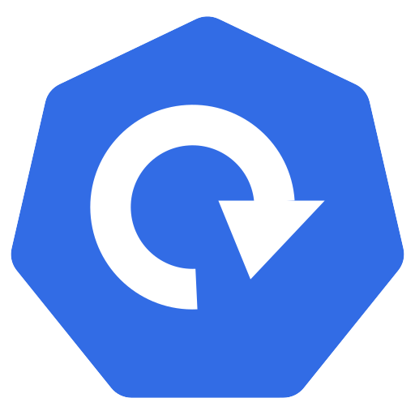
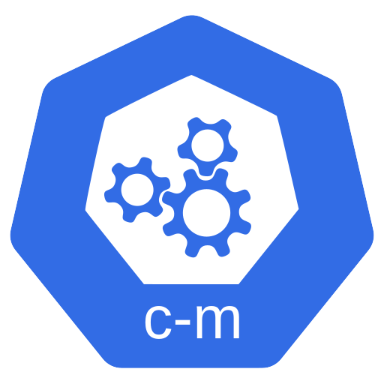
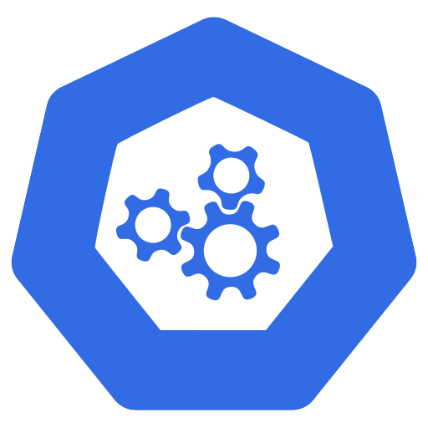
Desired state and the control loop
act
declare
observe
YAML
manifest
Control
loop
You
Cluster
Observe → Compare → Act
Kubernetes from Zero · 10
Notes:
Kubernetes doesn't follow your steps. It chases the result you describe.
The docs call that result the desired state.
It starts with you. You write down what you want, in a small text file. We call it a YAML manifest.
Something like: three copies of my web app, using this image, reachable on this port.
Then a control loop takes over.
The loop watches the cluster, and asks one question, over and over.
Does what's running match what was asked for?
If yes, it does nothing. If no, it acts to close the gap.
So it's observe, compare, and act.
So if one of your three copies crashes, nobody runs a restart script.
The loop sees two, where you asked for three, and starts a new one.
The docs put it nicely: Kubernetes is a set of independent control processes, constantly driving the current state toward the desired state.
Now, I'd rather show you this than just talk about it. So let's go to the terminal.

Slide 11
Demo: self-healing
$ kubectl create deployment
replicas=3
3 pods running
✓
$ kubectl delete pod
New pod
created
Kubernetes from Zero · 11
Notes:
Let's watch a control loop do its job.
I've got a small local cluster running. We'll build one together in episode three, so please don't worry about the setup yet.
First, I'll run kubectl create deployment.
I'm asking for a web app, using the nginx image, with three replicas.
Then kubectl get pods. And there they are: three pods, all running.
A pod is the smallest thing Kubernetes runs. For now, just think of it as a wrapper around a container.
Now, let's be a bit mean. I'll run kubectl delete pod, and pick one of them.
Watch the list.
The old one is terminating, and a new pod is created within a second or two.
I didn't restart anything, and I didn't write a script.
The desired state said three. The current state dropped to two. And the control loop closed the gap.
So, self-healing is one thing Kubernetes gives you. Let's look at the rest.

Slide 12
What Kubernetes gives you
Self-healing
Scaling
Rollouts &
rollbacks
Service discovery &
load balancing
Bin
packing
Config &
secrets
Kubernetes from Zero · 12
Notes:
Kubernetes answers every one of our three-in-the-morning questions.
First, self-healing. Kubernetes restarts crashed containers, replaces them, and moves work away from failed servers.
Second, scaling. You add or remove copies with one command, or automatically, based on CPU usage.
Third, rollouts and rollbacks. You ship a new version gradually, and if it misbehaves, you go back in one step.
Fourth, finding and sharing traffic. Each group of containers gets a stable name, and traffic is spread across the healthy copies. The docs call this service discovery and load balancing.
Fifth, fitting containers onto servers. You say how much CPU and memory each one needs, and Kubernetes packs them in, a bit like a game of Tetris. That's called bin packing.
And sixth, settings and passwords live outside your image, so you can change them without rebuilding. That's config and secrets.
That's a long list. So, to be fair, let me also tell you what Kubernetes is not.

Slide 13
What Kubernetes is not
✗
✗
✗
✗
Not a full
PaaS
Doesn't build
your code
No built-in
database
No mandated
logging
You get building blocks
Kubernetes from Zero · 13
Notes:
Kubernetes is a set of building blocks, not a finished product.
It's not a traditional, all-inclusive platform as a service, or PaaS.
For example, it doesn't build your code. Your build pipeline makes the image, and Kubernetes runs it.
It has no built-in database, and no built-in message queue. You run those on top of it, or you use a managed service.
And it doesn't force a logging or monitoring tool on you. You pick one, and plug it in.
Honestly, I think that's a strength. You decide how to put the building blocks together.
So, let's put everything we've seen today together.

Slide 14
Recap
Containers
package the app
Desired state
drives everything
Kubernetes
runs the fleet
Kubernetes from Zero · 14
Notes:
Let's look back at where we've been. Physical servers, then virtual machines, then containers.
Containers package the app, with everything it needs, into one immutable image.
Kubernetes runs the fleet. It places, heals, scales, and updates containers across many servers.
And desired state drives everything. You declare what you want, and control loops make it true.
That's really the whole story of today. Containers make your app run the same everywhere, and Kubernetes keeps them running the way you asked.

Slide 15
Next: Kubernetes architecture
Episode 2
Control
plane
schedules
Worker
nodes
Kubernetes from Zero · 15
Notes:
What's your best "works on my machine" story? Drop it in the comments. I read every one.
This is a forty-five episode series, so if you want to follow it from zero, subscribe.
Because next time, we open the hood. Who actually runs those control loops? And where do your containers really live?
We'll meet the control plane, which is the brain of the cluster. And the worker nodes, where your containers actually run.
See you there.

