Slide 1
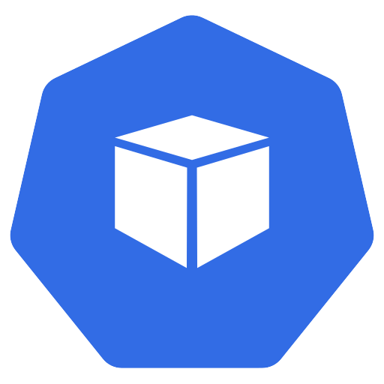
What happens after kubectl apply?
?
Black
box
$ kubectl apply
Running
container
Kubernetes from Zero · 1
Notes:
You type one command, and a container starts on a machine you never touched.
That command is kubectl apply. A few seconds later, there's a running container, somewhere in your cluster.
But in between, there's a black box.
Who decided which machine? Who pulled the image? And who remembers that this app should exist at all?
This is episode two of Kubernetes from Zero, and today we open that black box.
Let me give you the short answer first.
The control plane decides, the nodes do the work, and everything talks through the API server.
First, we'll look at the big picture. Then we'll meet each component, one at a time. And finally, we'll follow one request, from your keyboard to a running container.
So, let's start with the big picture.

Slide 2
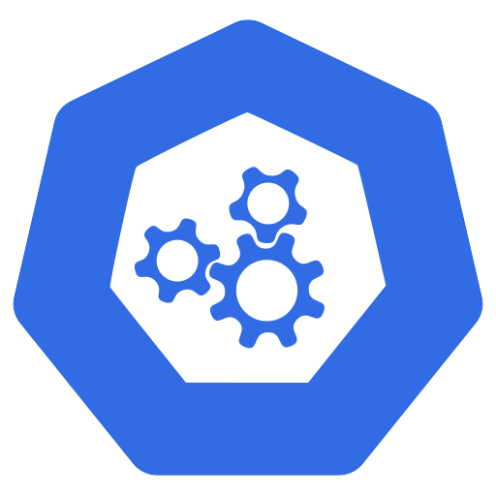
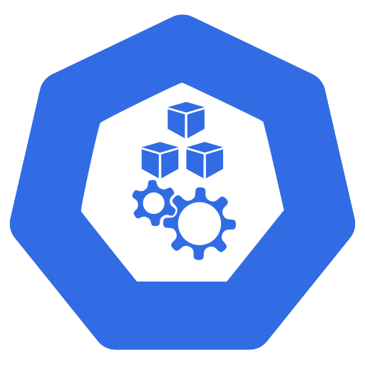
A cluster = control plane + nodes
cluster
Control plane
(the brain)
decides
run
Worker nodes
(the muscle)
Pods
Kubernetes from Zero · 2
Notes:
A Kubernetes cluster has two halves: a brain, and the muscle.
The first half is the control plane. That's the brain.
It makes the big decisions, like where things run. And it notices and reacts to events, like a crashed container.
The second half is the worker nodes. That's the muscle.
A node is a machine, physical or virtual, that actually runs your containers.
Your containers live inside pods, and pods only ever run on nodes.
Every cluster needs at least one worker node. In production, you'll usually have many.
And the control plane normally runs on its own machines, so a busy app can't starve the brain.
Here's something a lot of people don't know. On managed services like GKE, EKS, or AKS, the cloud provider runs the control plane for you.
You never see those machines. But they're still there, doing exactly the same job.
So, let's look inside the brain first.

Slide 3
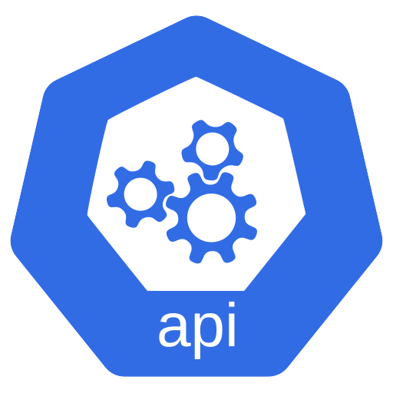
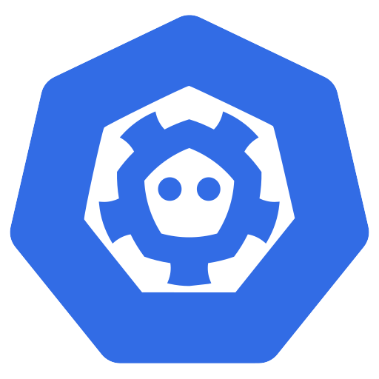

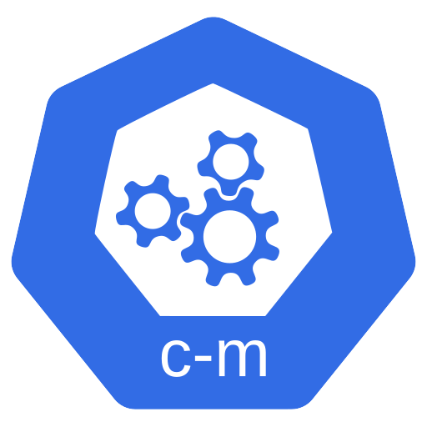
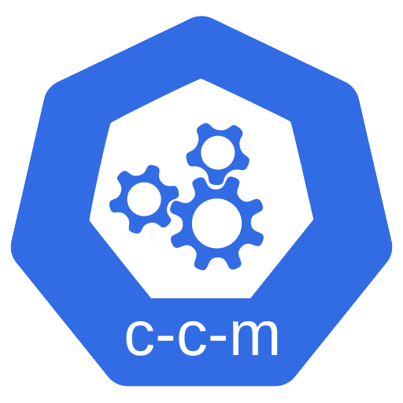
The control plane components
API server
etcd
Scheduler
Controller manager
Cloud controller
manager (optional)
Kubernetes from Zero · 3
Notes:
The control plane isn't one program. It's a small team of programs.
There's the API server.
There's a database, called etcd.
There's the scheduler.
There's the controller manager.
And there's one more that's optional: the cloud controller manager.
So, five pieces. Let's meet them one at a time, starting with the front door.

Slide 4
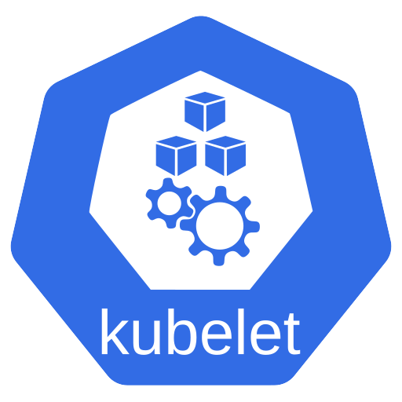
The API server is the front door
Controllers
kubectl
HTTPS
API server
kubelet
Authenticate →
authorize → validate
etcd
Kubernetes from Zero · 4
Notes:
The API server is the front door of the cluster, and every request goes through it.
No exceptions.
When you run kubectl, it's really just sending web requests to the API server.
And here's a nice trick. Add dash v equals six to any kubectl command, and you'll see those requests for yourself.
The controllers talk to the API server. The agent on every node, the kubelet, talks to the API server too.
And the API server is the only component that talks to the database, etcd.
We call this a hub and spoke design. The API server is the hub, and everything else is a spoke.
Now, before the API server accepts a request, it checks three things.
Who are you? Are you allowed to do this? And does this object make sense?
In other words, authenticate, authorize, and validate.
Only then is the change saved. And that brings us to where it's saved.

Slide 5
etcd is the cluster's memory
etcd
Key-value
store
Source of
truth
3 or 5
members
!
Backups
Kubernetes from Zero · 5
Notes:
Everything is saved in etcd, and etcd is the cluster's memory.
In simple terms, it's a reliable database that stores keys and values. The docs call it a consistent, highly available key-value store.
Every object in your cluster lives here. Every deployment, every pod, every secret.
That makes etcd the cluster's single source of truth.
If it's not in etcd, as far as Kubernetes is concerned, it doesn't exist.
In production, etcd runs as a small group, usually three or five members.
It's an odd number, so the members can always agree on a majority. With three, you can lose one and keep going.
And because everything lives here, crucially, you need backups.
Lose etcd without a backup, and you've lost the cluster's memory. We'll do a real backup and restore later in the series, in episode forty-four.
So, the change is saved. Now, who decides where it runs?

Slide 6
The scheduler picks a node
Score
Bind
Unscheduled
pod
Filter
Decides where. Doesn't start anything.
Kubernetes from Zero · 6
Notes:
The scheduler decides which node runs each pod.
It watches for one thing: an unscheduled pod. That's a pod that exists, but has no node yet.
For each one, it runs two steps.
First, filter. It throws out every node that can't run the pod. Not enough CPU? Not enough memory? Out.
Second, score. It ranks the nodes that are left. Which one has the most room? Which one spreads the app out best?
And if no node passes the filter, the pod simply waits, in Pending, until one does.
Finally, it picks the winner, and does the bind.
Bind just means writing the node's name into the pod.
So the scheduler decides where a pod runs. But it doesn't start anything.
Which raises a fair question: who makes sure things actually happen?

Slide 7
The controller manager runs control loops
Controller manager
Node
Job
EndpointSlice
ServiceAccount
Observe → compare → act
Kubernetes from Zero · 7
Notes:
The controller manager is where the control loops live.
Remember episode one? Observe, compare, act? This is the home of those loops.
Each loop is called a controller, and each one looks after one kind of object.
For example, the Node controller notices when a node stops answering.
The Job controller creates pods to run a task to the end.
The EndpointSlice controller keeps track of which pods sit behind each Service.
And the ServiceAccount controller creates a default account in every new namespace.
There are many more. Deployments and ReplicaSets have their own controllers too.
Here's the neat part. Each controller is separate in theory, but they all run together as one program, to keep things simple.
There's one more piece in the brain, and it only matters in the cloud.

Slide 8
The cloud controller manager
Cloud provider
API
Cloud controller
manager
Nodes
Routes
Load
balancers
Kubernetes from Zero · 8
Notes:
The cloud controller manager connects your cluster to your cloud provider.
It talks to the cloud provider's API, and keeps cloud-specific code out of the core of Kubernetes.
It has three main jobs.
First, nodes. If a virtual machine is deleted in the cloud, it removes that node from the cluster.
Second, routes. It sets up network routes inside the cloud.
And third, load balancers. When you ask for one, it creates a real cloud load balancer for you.
On a local cluster on your laptop, you won't have one at all. And honestly, that's fine.
So that's the brain. Now, let's look at the muscle.

Slide 9
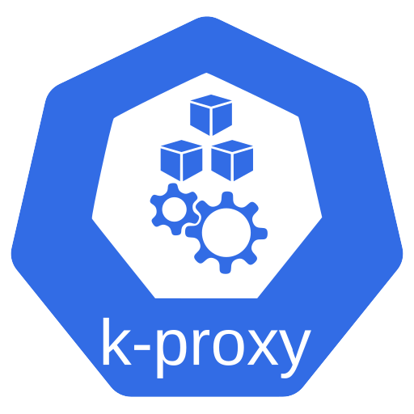
Inside a worker node
Container
runtime
CRI
kubelet
kube-proxy
Your pods
Kubernetes from Zero · 9
Notes:
Every worker node runs three programs, and then your pods.
First, the kubelet.
The kubelet is an agent on every node. It makes sure the containers in each pod are running, and healthy.
It also restarts containers that fail their health checks. And it sends a regular heartbeat to the API server, so the brain knows the node is alive.
Second, the container runtime. As we saw last time, that's usually containerd or CRI-O. The kubelet tells it what to run.
Third, a network helper called kube-proxy. It keeps network rules on the node, so traffic sent to a Service reaches the right pods.
Some network plugins replace it, so on some clusters you won't see it.
And then, of course, the reason the node exists at all: your pods.
There are just a few more pieces that make a cluster complete.

Slide 10
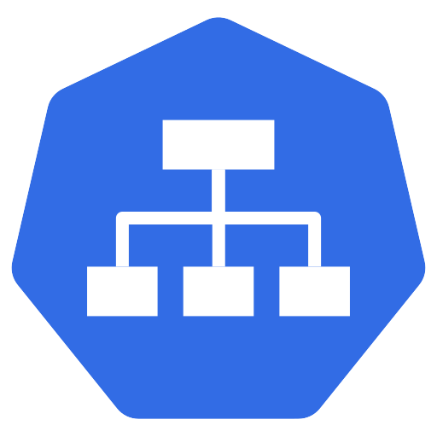
Add-ons complete the cluster
CNI network
plugin
Cluster DNS
(CoreDNS)
Metrics
Dashboard
Logging
Kubernetes from Zero · 10
Notes:
On top of the core, clusters run add-ons.
The most important one is cluster DNS. It lets pods find each other by name, and it's usually a program called CoreDNS.
Next, you need a network plugin. It gives every pod its own IP address, and it follows a standard called CNI. We'll spend all of episode fifteen on it.
And then there are optional extras: metrics, a web dashboard, and logging.
Right. We've met every piece. So now, let's watch them work together.

Slide 11
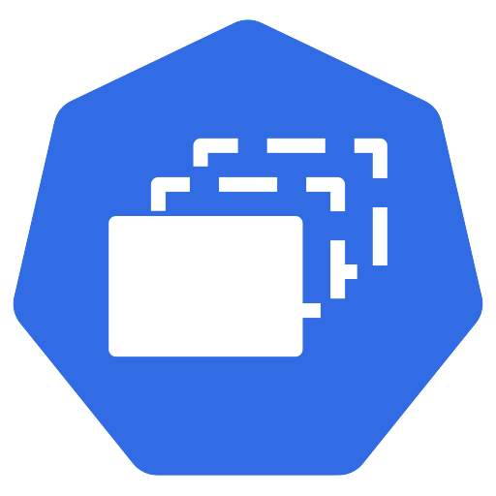
Life of a deployment, part one
1
$ kubectl apply
store
API server
etcd
2
3
3 pods
(no node yet: pending)
ReplicaSet
Kubernetes from Zero · 11
Notes:
Let's follow one request, from your keyboard to a running container.
You run kubectl apply, with a deployment that asks for three copies.
Step one. kubectl sends it to the API server.
The API server checks who you are, checks your permissions, validates the object, and stores it in etcd.
Step two. The deployment controller is watching. It sees the new deployment, and creates something called a ReplicaSet.
Step three. The ReplicaSet controller sees that, and creates three pods.
But here's the thing. Those three pods have no node yet. They're pending.
So, who picks them up? Let's find out.

Slide 12
Life of a deployment, part two
4
5
6
Container
runtime
bind
Scheduler
kubelet
7
Status: running
Everyone watches the API server
Kubernetes from Zero · 12
Notes:
Step four. The scheduler spots three unscheduled pods. It filters, scores, and binds each one to a node.
Step five. On each chosen node, the kubelet is watching. It sees a pod for its own node, and says, that one's mine.
Step six. The kubelet tells the container runtime to pull the image, and start the containers.
Step seven. The kubelet reports back: running.
Now, notice something. Nobody called anybody directly. Every component just watches the API server, and reacts to what changed.
Here's a question people often get in interviews.
What happens if the whole control plane goes down?
Your running pods keep running. The kubelet doesn't need the brain to keep containers alive.
But nothing new can happen. No scheduling, no scaling, no self-healing, until the control plane is back.
That's why production clusters run the control plane on three or more machines.
Enough theory. Let's look at a real cluster.

Slide 13
Demo: look inside a real cluster
$ kubectl get nodes
$ kubectl get pods -n kube-system
$ kubectl get events
Kubernetes from Zero · 13
Notes:
This is a small local cluster. We'll build it together next episode.
First, kubectl get nodes. Here's my node, with its role, its Kubernetes version, and its container runtime.
Now, kubectl get pods, in the kube-system namespace.
Look at this. There's etcd. There's the API server. There's the controller manager, and the scheduler.
On this kind of cluster, the control plane itself runs as pods. So it's Kubernetes, running Kubernetes.
And here's kube-proxy, and two CoreDNS pods.
Now, let's create a deployment with three replicas, and look at the events, with kubectl get events.
Let's read them top to bottom. The deployment controller scaled up a ReplicaSet. The ReplicaSet controller created the pods.
The scheduler assigned each pod to a node. Then the kubelet: pulling the image, created, started.
That's the whole life story, told by the cluster's own events.
Let's recap, and I'll use one quick comparison to make it stick.

Slide 14
Recap: the cluster as a restaurant
Front desk = API server
Order book = etcd
Host = scheduler
Managers = controllers
Cooks = kubelet
Kubernetes from Zero · 14
Notes:
Picture a restaurant, just for a moment.
The API server is the front desk. Every order goes through it.
etcd is the order book. If it's not written there, it didn't happen.
The scheduler is the host, deciding which station gets each order.
The controllers are the managers, always checking that what was ordered is what's being served.
And the kubelet is the cook at each station, actually making the food.
And that's the short answer we started with. The control plane decides, the nodes do the work, and everything talks through the API server.

Slide 15
Next: set up a local cluster
kind
minikube
k3d
Episode 3
Kubernetes from Zero · 15
Notes:
Which component surprised you most? Let me know below.
And subscribe if you'd like to build along with me.
So far, you've watched me use a cluster. Next time, you'll build your own, on your laptop, for free.
We'll compare three tools: kind, minikube, and k3d. And I'll tell you which one I picked for this series, and why.
See you there.

