Slide 1
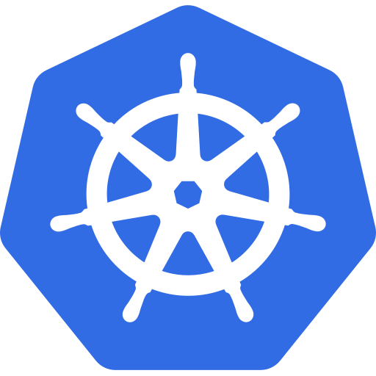
A Kubernetes cluster on your laptop
Your
laptop
kind
Kubernetes cluster
Kubernetes from Zero · 1
Notes:
A three-node Kubernetes cluster, on your laptop, in under a minute.
That's what we're building today.
Not in the cloud. No credit card. And no surprise bill at the end of the month.
Just your laptop, and a real Kubernetes cluster running on it.
Welcome to episode three.
In the last two episodes, you watched me use a cluster. From today, you'll have your own, and you can follow every demo in this series.
The whole setup comes down to three roles.
Docker runs the containers, a cluster tool builds the cluster, and kubectl talks to it.
First, what you need. Then how kubectl finds a cluster. Then three tools, and which one I picked. And finally, we build one together.
So, let's start with your shopping list.

Slide 2

What you need
Docker
(or Podman)
kubectl
A cluster tool
Kubernetes from Zero · 2
Notes:
You need just three things, and they're all free.
First, Docker, or Podman.
All three tools we'll look at today run Kubernetes inside containers. So you need something that runs containers. Docker Desktop and Podman both work.
My advice: give Docker room to breathe. Four CPUs and eight gigabytes of memory is a comfortable starting point.
And if you're on Windows, turn on WSL two. Docker Desktop uses it under the hood, and everything runs much faster.
Second, kubectl. This is the command-line tool you'll use to talk to every Kubernetes cluster, local or in the cloud.
And third, a cluster tool. Something that builds the cluster for you.
So, Docker runs the containers. The cluster tool builds the cluster. And kubectl talks to it.
But before we build anything, there's one question worth answering. How does kubectl know where your cluster is?

Slide 3

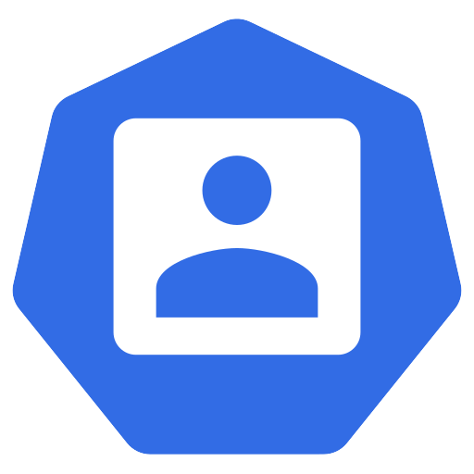
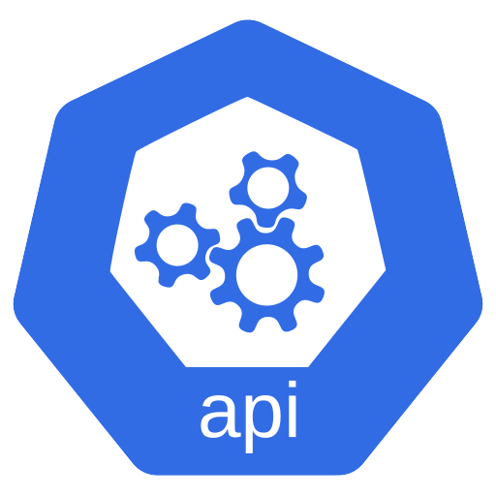
How kubectl finds your cluster
kubectl
reads
You
kubeconfig
~/.kube/config
API server
Stay within one minor version
Kubernetes from Zero · 3
Notes:
kubectl finds your cluster through one small file.
It starts with you, typing a command.
Now, kubectl doesn't know where your cluster lives. So it reads that file first.
The file is called the kubeconfig. It's a small YAML file, usually in your home folder, under dot kube, slash config.
Inside, there are three lists. Clusters, which are addresses. Users, which are credentials. And contexts, which pair one cluster with one user.
And one line, called current-context, says which context kubectl uses right now.
So kubectl reads that, and then sends your request to the cluster's API server.
Here's the good news. Every tool in this video writes that file for you.
One version rule worth knowing. The docs say kubectl should stay within one minor version of your cluster.
So a version one thirty-four kubectl is fine with a one thirty-three, one thirty-four, or one thirty-five cluster.
Right. Now, let's pick the tool that builds the cluster.

Slide 4
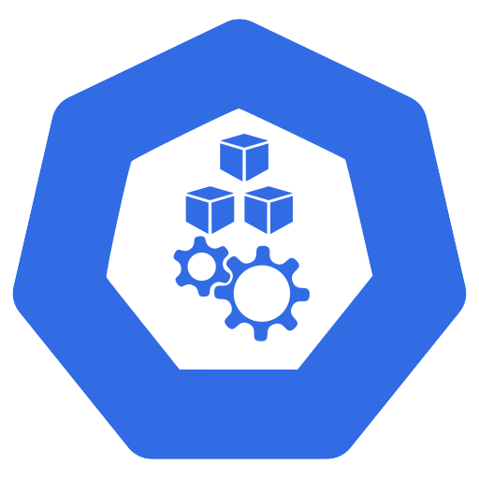
Three local options
kind
minikube
k3d
Kubernetes from Zero · 4
Notes:
There are three popular tools for running Kubernetes on your laptop, and they all work.
The first is kind.
The second is minikube.
And the third is k3d.
You might also have seen Kubernetes built into Docker Desktop, or Rancher Desktop. Those work too. But these three are the most common, and honestly, the most flexible.
They all give you a working cluster, but they make different trade-offs.
So, let's look at each one, starting with the one I use.

Slide 5
kind = Kubernetes IN Docker
Docker
kind-control-plane
kind-worker
kind-worker2
Real, upstream Kubernetes
Kubernetes from Zero · 5
Notes:
kind stands for Kubernetes IN Docker, and that's exactly what it does.
Remember the nodes from last episode? Normally, a node is a machine.
With kind, each node is just a Docker container.
So when I build a three-node cluster, I get one container called kind-control-plane, and two more called kind-worker, and kind-worker2.
Inside each one runs a real kubelet, and a real container runtime. So it's genuine, upstream Kubernetes.
Fun fact. kind was built to test Kubernetes itself. The Kubernetes project uses it in its own test pipelines.
That makes it fast to create, fast to delete, and very close to the real thing.
There's one small catch. On your laptop, there's no cloud to hand out load balancers.
So kind has a small helper project for that, called cloud-provider-kind. We'll use it when we get to services.
Next up, the oldest of the three.

Slide 6
minikube: batteries included
Drivers:
Docker or
virtual machine
Addons
Dashboard
Single node
Kubernetes from Zero · 6
Notes:
minikube is the batteries-included option.
It's the oldest of the three, and it's maintained by the Kubernetes project too.
By default, it gives you a single node.
It can run that node in different ways, and minikube calls them drivers. The Docker driver runs it as a container. Other drivers run it in a full virtual machine.
Now, minikube's superpower is addons. With one command, you can turn on extras, like an ingress controller, or the metrics server.
And there's a built-in web dashboard. Type minikube dashboard, and it opens in your browser.
The everyday commands are simple: minikube start, minikube stop, and minikube delete.
If you like a guided, batteries-included experience, minikube is a great pick.
And now, the lightest of the three.

Slide 7
k3d = k3s in Docker
Lightweight
Traefik
ingress
Local-path
storage
k3s
Kubernetes from Zero · 7
Notes:
k3d gives you the fastest, lightest cluster.
It runs something called k3s inside Docker.
In simple terms, k3s is a small version of Kubernetes. It's packaged as a single binary, and it's popular on edge devices and small servers.
Because it's so lightweight, k3d clusters start very fast, and use little memory.
k3s also ships with a few things built in. Traefik as the ingress controller, and a provisioner for local-path storage.
That's convenient. But it also makes it a little different from a plain upstream cluster. So watch for that when you follow tutorials.
So, three good tools. Which one should you actually pick?

Slide 8
Which one should you pick?
Learn upstream,
multi-node
→ kind
Addons and
dashboard
→ minikube
Fastest and
lightest
→ k3d
This series: kind
Kubernetes from Zero · 8
Notes:
My short answer: it depends on what you want to learn.
If you want to learn upstream Kubernetes, and easily build multi-node clusters, pick kind.
If you want addons, a dashboard, and a guided experience, pick minikube.
If you want the fastest and lightest cluster possible, pick k3d.
For this series, I'm using kind.
It's close to upstream, a multi-node cluster takes one small file, and it's what you've already seen in my demos.
But please, don't feel locked in. Everything we do will work on minikube and k3d too.
So, let's install it.

Slide 9
Install kubectl and kind
macOS: brew
Windows: winget
Linux: binary
$ kubectl version --client
$ kind version
Kubernetes from Zero · 9
Notes:
Installing takes two commands on most machines.
On macOS, the easiest route is Homebrew. brew install kubectl, and brew install kind.
On Windows, use winget, or Chocolatey. Both have packages for kubectl and kind.
On Linux, you download a single binary for each tool, make it executable, and move it onto your path.
I'll put every install link in the description.
When you're done, check that it worked. Run kubectl version, with dash dash client. And then, kind version.
Everything installed? Then let's build a cluster.

Slide 10
Demo: create a three-node cluster
kind-config.yaml
nodes:
- role: control-plane
- role: worker
- role: worker
control plane
worker
worker
$ kind create cluster
$ docker ps
Kubernetes from Zero · 10
Notes:
First, a small config file. I'll call it kind-config.yaml.
It says: kind, cluster. And then a list of nodes.
One node with the role control plane. And two with the role worker. That's the whole file.
Now, kind create cluster, with the name k8s-zero, and dash dash config, pointing at that file.
kind pulls a node image, starts three containers, and joins them into one cluster.
Under the hood, kind uses kubeadm, which is the official tool for setting up clusters.
Done. And notice the last line. kind has already added a context to our kubeconfig, and made it the current one.
Now, kubectl get nodes. Three nodes. One control plane, two workers. All Ready.
And here's the fun part. Let's run docker ps.
There they are. Our three nodes, as three Docker containers.
So, we have a cluster. Let's put something on it.

Slide 11
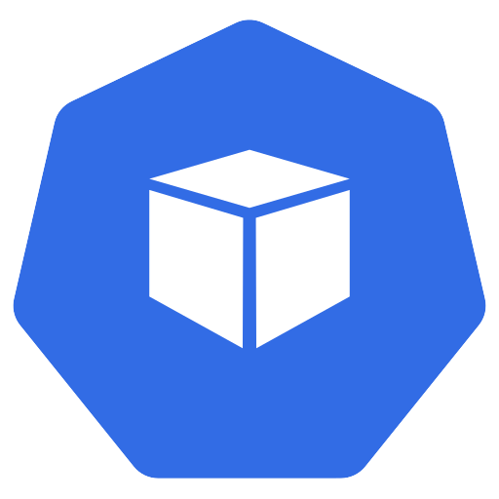
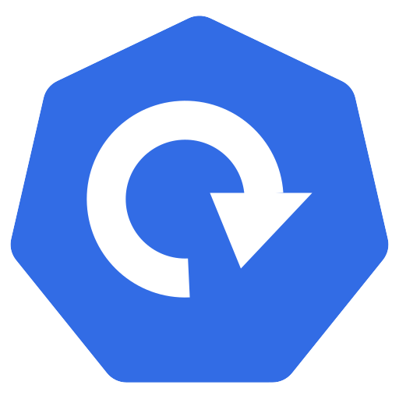
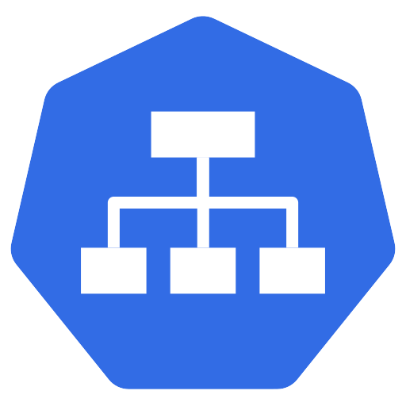
Demo: your first app
Your
browser
Pod
port-forward
Deployment
hello
Service
Pod
localhost:8080
Kubernetes from Zero · 11
Notes:
I'll run kubectl create deployment hello, with the nginx image, and two replicas.
That creates a deployment, and the deployment creates the pods.
Now, kubectl get pods, dash o wide.
Two pods, both running. And look at the node column. The scheduler spread them across both workers.
Next, kubectl expose deployment hello, on port eighty.
That gives our pods one stable front door, and we call that a service. We'll go deep on services in episode sixteen.
Finally, kubectl port-forward, to that service, from port eighty eighty on my laptop.
Now, open your browser, and go to localhost colon eighty eighty.
Welcome to nginx. Served from your own cluster.
Press control C to stop the port-forward. The app keeps running. Only the tunnel to your laptop closes.
Now, one more thing you'll use every single day.

Slide 12
Switching clusters with contexts
kind-k8s-zero
minikube
$ kubectl config
use-context
kubeconfig
k3d-dev
Kubernetes from Zero · 12
Notes:
Switching clusters takes one command.
Run kubectl config get-contexts. It lists every context in your kubeconfig.
Each tool adds its own, with a name that tells you who made it.
kind gives you a context like kind-k8s-zero.
minikube names its context just minikube.
And k3d adds a k3d prefix, like k3d-dev.
To switch, run kubectl config use-context, and the name.
Many people also install a small helper called kubectx, or show the current context in their terminal prompt.
Here's my honest advice. Always check your context before you run a command. Deleting something in the wrong cluster is a classic, painful mistake.
Let's finish with how to clean up.

Slide 13
Clean up and tips
$ kind delete cluster
Watch Docker resources
$ kind load docker-image
Kubernetes from Zero · 13
Notes:
When you're done for the day, clean up with one command.
kind delete cluster, with the name k8s-zero. It's gone in seconds, and you can rebuild it just as fast.
Two quick tips.
First, watch your Docker resources. If pods get stuck in Pending, Docker may simply be out of memory.
Second, kind can't see images you built on your laptop by itself. Use kind load docker-image, to copy your local image into the cluster.
So, let's wrap up what we did today.

Slide 14
Recap
Docker + kubectl
+ a cluster tool
One context
per cluster
kind / minikube / k3d
Kubernetes from Zero · 14
Notes:
So, what did we cover?
You need Docker, plus kubectl, plus a cluster tool.
The three tools are kind, minikube, and k3d. kind runs nodes as containers, minikube brings addons, and k3d runs lightweight k3s.
And kubectl finds your clusters through the kubeconfig, with one context per cluster.
Three roles, then. Docker runs the containers, a cluster tool builds the cluster, and kubectl talks to it.
And you now have a real, three-node Kubernetes cluster, on your own laptop.

Slide 15
Next: kubectl and YAML
kubectl
YAML manifest
Episode 4
Kubernetes from Zero · 15
Notes:
Which tool are you using: kind, minikube, or k3d? And why? I read the comments.
The next episodes all build on this cluster, so subscribe if you don't want to miss them.
So far, I've been typing commands, and you've been copying them. Next time, we slow down, and really learn kubectl.
The commands you'll use every day, and how to read and write a YAML manifest, line by line.
See you there.

