Slide 1

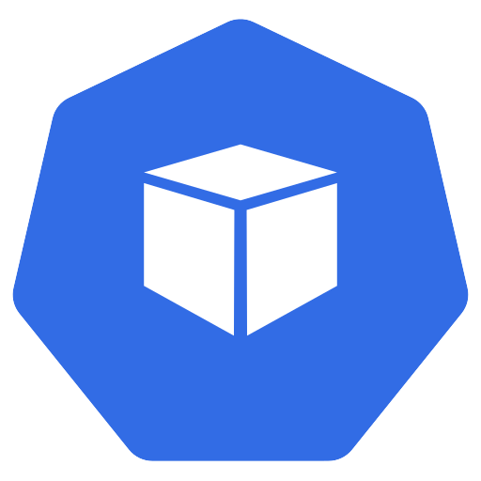
What you asked for vs what you got
match?
What you asked for
What you got
Kubernetes from Zero · 1
Notes:
Every object in Kubernetes has two halves.
What you asked for, and what you actually got.
You write the first half. Kubernetes writes the second. And the whole system exists to make those two halves match.
Welcome back. This is episode five, and today we look inside a Kubernetes object.
Two halves, written by two different authors. In one line:
You write what you want in the spec, Kubernetes writes what it got in the status, and labels tie everything together.
We'll start with what an object is. Then spec and status. Then the API, names, labels, and annotations. And finally, two demos, including a little magic trick.
So, first things first.

Slide 2


An object is a record of intent
metadata
spec
status
etcd
Kubernetes from Zero · 2
Notes:
A Kubernetes object is a record of what you want, and Kubernetes keeps working to make it true.
The docs call it a record of intent. More formally, it's a lasting entry, stored in etcd, that describes part of your cluster.
A deployment is an object. So is a pod, a service, and a namespace.
Once you create one, Kubernetes constantly works to make sure it exists, and looks the way you described.
You usually write objects in YAML. kubectl turns that YAML into JSON, and sends it to the API server. The API server checks it, and stores it in etcd.
And every object is made of the same three building blocks. The metadata, the spec, and the status.
So, let's look at the two halves that matter most.

Slide 3
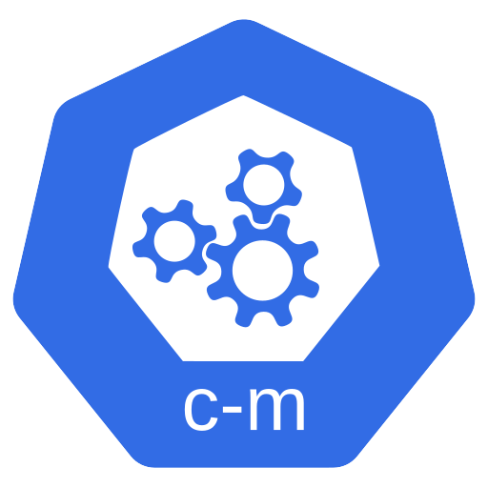
Spec vs status
reads
acts
spec
(desired state)
status
(current state)
Controller
generation = observedGeneration
Kubernetes from Zero · 3
Notes:
The spec is what you want, and the status is what you've got.
The spec is the desired state. You write it.
The status is the current state. Kubernetes writes it, and keeps it up to date.
Between the two sits a controller, running its control loop. It reads the spec, looks at the status, and acts to close the gap.
Let's make that concrete. Take a deployment with three replicas in its spec.
Its status says how many replicas exist right now, how many are ready, and how many are up to date.
If the status says two, and the spec says three, the controller gets to work.
Here's a detail worth knowing. Every time you change the spec, a counter in the metadata, called generation, goes up by one.
And the status has its own counter, called observedGeneration. When the two numbers match, you know the controller has seen your latest change.
So, you never edit the status yourself. It's the cluster's answer, not your request.
Now, all these objects live behind one API. Let's see how it's organised.

Slide 4
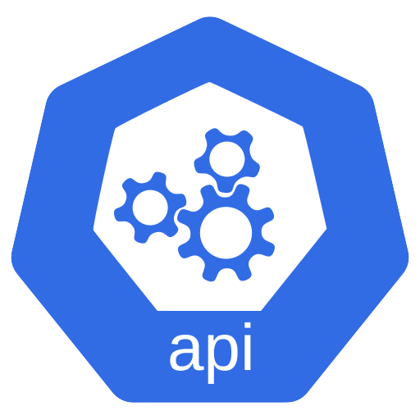
The Kubernetes API: groups and versions
API server
apiVersion: v1
Core group
apiVersion: apps/v1
Named groups
alpha → beta → stable
kubectl api-versions
Kubernetes from Zero · 4
Notes:
The apiVersion line in your YAML tells Kubernetes which group, and which version, your object belongs to.
All objects live behind one API, served by the API server. Every type of object has its own address.
And those types are organised into API groups.
The original group is called the core group. It holds the oldest types, like pods, services, and namespaces. Its apiVersion is just v one.
Newer types live in named groups. Deployments live in the apps group, so their apiVersion is apps slash v one.
Each group also has versions. Alpha versions can change, or disappear. Beta versions are well tested. And plain v one means stable.
Kubernetes follows a deprecation policy. Before an old version is removed, you get warnings, and time to move.
That's why every upgrade guide says, check your apiVersions.
And if you're curious, run kubectl api-versions, to see every one your cluster serves.
Next, how does Kubernetes tell one object from another?

Slide 5
Names and UIDs
UID: unique for the cluster's lifetime
DNS names: lowercase, dashes, dots
Name: web
Kubernetes from Zero · 5
Notes:
Every object has two identities: a name you choose, and an ID Kubernetes gives it.
First, the name. A name is unique for each kind, inside a namespace.
So you can have a pod called web, and a service called web. But not two pods called web, in the same namespace.
Most names must be valid DNS names: lowercase letters, numbers, dashes, and dots. So no capitals, and no underscores.
Second, the UID.
The UID is generated by Kubernetes, and it's unique for the cluster's whole lifetime.
So if you delete a pod called web, and create a new one with the same name, it gets a brand-new UID. Same name, different object.
Now, names are useful. But the real flexibility in Kubernetes comes from somewhere else.

Slide 6
Labels are sticky notes
Recommended:
app.kubernetes.io/
name
app=web
tier=frontend
env=production
app=api
tier=backend
env=production
Kubernetes from Zero · 6
Notes:
Labels are what make Kubernetes so flexible.
Labels are key and value pairs that you stick on objects, to describe things that mean something to you.
Think of them as sticky notes.
So one pod might carry app equals web, tier equals frontend, and environment equals production.
Another might carry app equals api, tier equals backend, and environment equals production.
Kubernetes doesn't care what your labels mean. But it lets you pick objects by them.
Teams use labels for all kinds of things. Which release, stable or canary. Which environment, dev, QA, or production. Or which team owns it.
A quick rule. A label key can have an optional prefix, then a slash, then a name. The name and the value can each be up to sixty-three characters.
And the docs recommend a shared set of labels, all under the app dot kubernetes dot io prefix. Things like name, instance, version, and part-of.
But labels on their own are just notes. What makes them powerful is the next part.

Slide 7
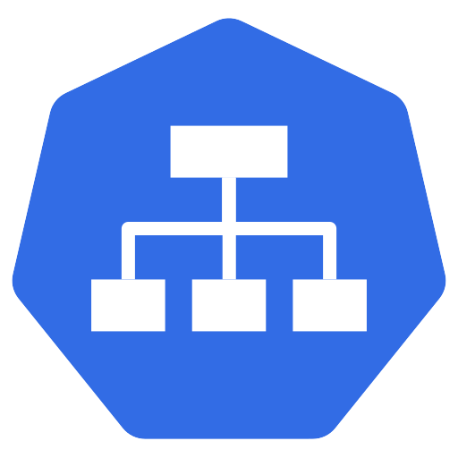
Selectors find objects by label
Equality
= == !=
$ kubectl get pods
-l app=web
Set-based
in · notin · exists
Service
Deployment
Objects connect by labels, not names
Kubernetes from Zero · 7
Notes:
Selectors find objects by their labels.
A label selector picks out a group of objects, based on the labels they carry.
There are two styles. First, equality. Equals, or not equals. For example, environment equals production.
Second, set-based. That's in, not in, and exists. For example, environment in production or QA.
On the command line, you use dash l. So, kubectl get pods, dash l, app equals web.
And here's the thing. This is how Kubernetes connects objects to each other.
A service finds its pods with a selector. A deployment finds the pods it owns with a selector.
So objects connect by labels, not by names. Change the labels, and you change what belongs together.
One small detail. Services only support the equality style. Deployments, ReplicaSets, and Jobs also accept the set-based style.
Now, labels have a quieter cousin.

Slide 8
Annotations are notes for tools
git commit
✗
Can't select
build time
change-cause
Annotations
Kubernetes from Zero · 8
Notes:
Annotations are notes for tools and people, not for grouping.
They look just like labels. Keys and values, in the metadata.
But there's one big difference. You can't select by annotations.
Annotations hold extra information, for tools, libraries, and humans.
Things like the git commit an image was built from, a build time, or who to call when it breaks.
Many tools store their settings in annotations, and kubectl does too.
One you'll meet soon is kubernetes dot io slash change-cause. Put a short message there, and it shows up in your rollout history, as the reason for each change.
So here's my rule of thumb. If you'll ever want to select by it, make it a label. If it's just information, make it an annotation.
There's one last way to filter.

Slide 9
Field selectors
$ kubectl get pods --field-selector status.phase=Running
spec.nodeName
Kubernetes from Zero · 9
Notes:
Field selectors filter by a field's value, instead of a label.
For example, kubectl get pods, dash dash field-selector, status dot phase equals Running.
Or you can list every pod on one node, using spec dot nodeName.
Only a small set of fields is supported, so labels are still your main tool. But field selectors are handy in a pinch.
Right. Let's see all of this on our own cluster.

Slide 10
Demo: spec and status
$ kubectl get deploy web -o yaml
spec
status
$ kubectl scale
Kubernetes from Zero · 10
Notes:
Our deployment web, from last episode, is still running.
I'll run kubectl get deploy web, dash o yaml.
Let's scroll down. Here's the spec. Replicas, five. That's what we asked for.
Keep scrolling, to the very bottom. Here's the status.
Ready replicas, five. Available replicas, five. And a list of conditions, like Available, with a reason and a timestamp.
We never wrote any of that. The deployment controller did.
Now, kubectl scale, to four replicas. And then dash o yaml again.
The spec says four. And a moment later, the status catches up. Four ready.
So that's spec and status, live. Now for the magic trick.

Slide 11
Demo: labels and the magic trick
$ kubectl get pods --show-labels
✓
app=web
app=web
app=web
app=debug
New pod
Kubernetes from Zero · 11
Notes:
First, kubectl get pods, dash dash show-labels.
Every pod carries app equals web, plus a pod-template-hash label the deployment added.
Now, kubectl get pods, dash l, app equals web. Only our web pods.
Here's the trick. I'll take one of these pods, and change its label from app equals web, to app equals debug.
Then, let's list the pods again.
There are now five pods.
The pod I relabeled is still running. But it no longer matches the selector, so the ReplicaSet doesn't count it any more.
It saw only three, so it created a new pod.
And that's a real technique. You can pull a misbehaving pod out of rotation, keep it alive, and debug it in peace.
Finally, kubectl annotate deploy web, team equals platform. And describe shows the annotation, right there in the metadata.
Before we wrap up, let me pull the main ideas together.

Slide 12
Recap
Labels · selectors ·
annotations
spec + status
Names + UIDs
Kubernetes from Zero · 12
Notes:
Let's pull it together.
Every object has metadata, a spec you write, and a status Kubernetes writes.
The apiVersion names the group and the version. Names are unique per kind and namespace. And UIDs are unique forever.
Labels identify. Selectors group. And annotations carry information for tools.
Two halves, two authors. You write what you want in the spec, Kubernetes writes what it got in the status, and labels tie everything together.

Slide 13

Next: namespaces
Namespaces
Episode 6
Kubernetes from Zero · 13
Notes:
Have you ever used the relabel trick to debug a pod? I'd like to hear how it went.
And if you're following the series, make sure you're subscribed.
Here's something you might not have noticed. We've been working in one namespace all along.
So next time, we look at namespaces. How to split one cluster into many virtual ones, and when you honestly shouldn't bother.
See you there.

