Slide 1
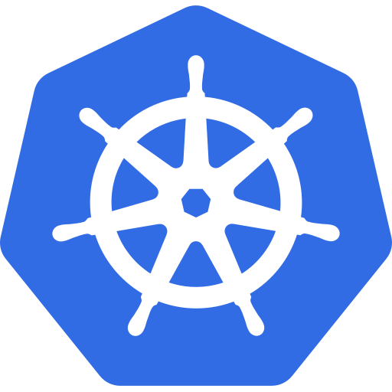

One cluster, many teams
One cluster
dev: web
prod: web
Kubernetes from Zero · 1
Notes:
Two teams. One cluster. And both want an app called web.
So, who gets the name?
With namespaces, the answer is: both of them.
This is episode six, the last episode of Part one.
The one thing I want you to leave with is this.
A namespace gives each team its own space in a shared cluster, but it's a naming boundary, not a security wall.
We'll cover what a namespace is, and the ones every cluster starts with. Then how they shape DNS. Then, just as important, what they don't do, and when you shouldn't use them. And then two demos.
So, let's start with the basics.

Slide 2
A namespace divides one cluster
Names unique
within a
namespace
Building = cluster
Floor = namespace
Kubernetes from Zero · 2
Notes:
A namespace divides one cluster into separate groups of resources.
Think of the cluster as an office building, and the namespaces as its floors.
Every floor can have a meeting room called Blue. But on any one floor, there's only one room called Blue.
And that's the core rule. Names must be unique within a namespace, but not across namespaces.
So the team on the dev floor can run a deployment called web. And the team on the prod floor can run their own deployment called web. No conflict.
A namespace name follows the DNS rules. Lowercase letters, numbers, and dashes, up to sixty-three characters.
One small detail. Kubernetes automatically adds a label to every namespace, with its own name. That makes namespaces easy to select later.
Namespaces also give you a place to hang rules. Who can do what, and how much they can use. We'll get to those later in the series.
Now, a new cluster isn't empty on day one.

Slide 3
The four starting namespaces
default
kube-system
kube-public
kube-node-lease
Reserved prefix: kube-
Kubernetes from Zero · 3
Notes:
Every new cluster starts with four namespaces, and you should know what each one is for.
The first is default. It's where your objects go when you don't name a namespace. Everything we've done so far, we did in default.
The second is kube-system. That's home to the objects Kubernetes creates for itself.
Remember the API server, etcd, CoreDNS, and kube-proxy from episode two? They live in kube-system.
My advice: look, but don't touch. Never deploy your own apps into kube-system.
The third is kube-public. It's readable by everyone, even clients that haven't logged in. It's mostly kept for cluster-wide information.
And the fourth is kube-node-lease. It holds one small object for every node, called a Lease. The kubelet updates it as a heartbeat, so the control plane knows each node is still alive.
One rule from the docs. Don't create your own namespaces starting with kube dash. That prefix is reserved for Kubernetes.
Now, here's something that surprises a lot of people.

Slide 4
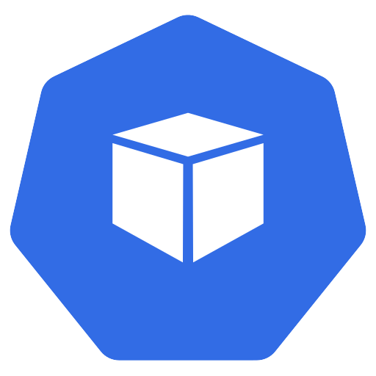

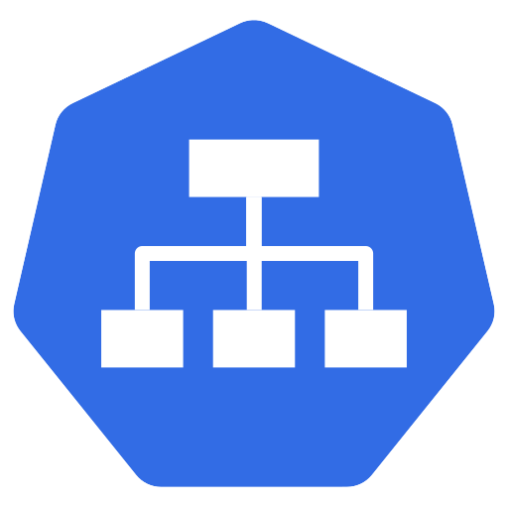
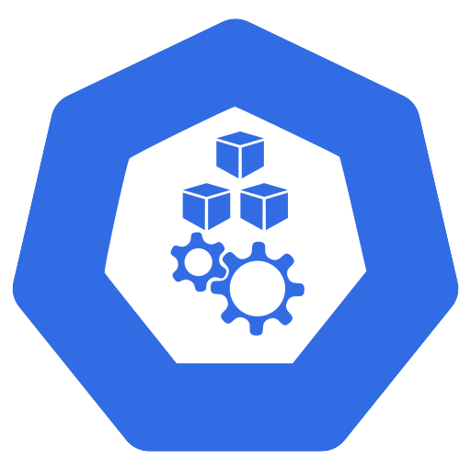
Namespaced vs cluster-wide
Namespaced
Cluster-wide
Pods
Deployments
Services
Nodes
Namespaces
$ kubectl api-resources --namespaced
Kubernetes from Zero · 4
Notes:
Not every object lives in a namespace.
Most of the things you create day to day are namespaced. Pods, deployments, services, ConfigMaps, and secrets.
But some objects belong to the whole cluster. We call them cluster-wide.
Nodes, for example. A node isn't owned by one team. It belongs to the cluster.
The same goes for persistent volumes, storage classes, and namespaces themselves. A namespace can't live inside another namespace.
If you're ever unsure, run kubectl api-resources, with dash dash namespaced equals true, or false. It tells you which types are namespaced.
Next, namespaces also change how your apps find each other.

Slide 5
Namespaces and DNS
web . prod . svc.cluster.local
Same namespace:
web
Other namespace:
web.prod
Kubernetes from Zero · 5
Notes:
Every service gets a DNS name, and that name includes its namespace.
It's built from three parts. The service name, the namespace, and then svc dot cluster dot local.
So a service called web, in the prod namespace, is web dot prod dot svc dot cluster dot local.
From a pod in the same namespace, you just say web.
From a different namespace, you add the namespace. So, web dot prod.
The docs add a subtle warning here. Avoid naming a namespace after a public top-level domain, like com, or org. Otherwise a short name inside the cluster could point to your service, instead of the real website.
Here's a common gotcha. Your app works perfectly in one namespace, then fails in another, because it used a short name that now points somewhere else.
Now, this next part is the one I really want you to remember.

Slide 6

What namespaces don't do on their own
A naming boundary, not a security wall
RBAC
Resource quotas
Network policies
Kubernetes from Zero · 6
Notes:
A namespace on its own is a naming boundary, not a security wall.
So by default, pods in one namespace can talk to pods in any other namespace. And a user with broad permissions can see across all of them.
To turn namespaces into real isolation, you add three other features.
First, RBAC, which controls who can do what, in which namespace. That's episode thirty-nine.
Second, resource quotas, which cap how much CPU, memory, and how many objects each namespace can use. That's episode twenty-six.
And third, network policies, which control which pods can talk to which. That's episode twenty-one.
So, when should you actually use namespaces?

Slide 7
When to use namespaces
Big boundaries → namespaces
Small differences → labels
Many users,
many teams
Kubernetes from Zero · 7
Notes:
Honestly, the docs are refreshingly direct about this.
Namespaces are meant for clusters with many users, spread across many teams, or projects.
If you only have a few to tens of users, you may not need to create them at all.
Good reasons to create one are a separate team, a separate project, or a separate stage, like dev and prod, in a shared cluster.
In practice, you'll see three common patterns. One namespace per team. One per environment. Or one per application.
But please don't use namespaces to tell apart slightly different versions of the same app. For that, use labels.
So, big boundaries, use namespaces. Small differences, use labels.
Now, let's look at the commands you'll actually type.

Slide 8
Working with namespaces
$ kubectl get ns
$ kubectl create namespace dev
-n dev · -A
$ kubectl config set-context
--current --namespace=dev
Kubernetes from Zero · 8
Notes:
You only need a handful of commands to work with namespaces.
kubectl get namespaces lists them all. The short name is ns.
kubectl create namespace, and a name, creates one. For example, dev.
Dash n, and a name, runs any command in that namespace. And dash capital A runs it across all of them.
But typing dash n every time gets old fast. So you can change your default namespace.
kubectl config set-context, dash dash current, dash dash namespace equals dev. From then on, dev is your default.
And just like kubectx for contexts, there's a small helper called kubens, that switches your default namespace with one short command.
In YAML, you can set the namespace in the metadata. But many teams leave it out, and choose it when they apply. That way, the same file works everywhere.
Before the demo, one warning. And it's a big one.

Slide 9
Deleting a namespace deletes everything
!
$ kubectl delete namespace
Everything
inside is gone
Terminating
Kubernetes from Zero · 9
Notes:
Deleting a namespace deletes everything inside it.
kubectl delete namespace, and a name, removes the namespace, and every deployment, every pod, every service, and every secret inside it.
While that happens, the namespace shows a status of Terminating. It waits until everything inside has been cleaned up.
Sometimes a namespace gets stuck in Terminating. That's usually a finalizer, waiting for something that will never finish. We'll take finalizers apart in episode fourteen.
So, namespaces are perfect for throwaway environments. And very dangerous in production. Please, always check the name twice, because once it's gone, it's gone.
Right. Let's try all of this for real.

Slide 10
Demo: two namespaces, one name
dev
web
prod
web
$ kubectl get deploy -A
Kubernetes from Zero · 10
Notes:
First, kubectl get ns. There are our four starting namespaces, plus a local-path-storage namespace that kind adds.
Then, kubectl get pods, dash n kube-system. The control plane, CoreDNS, and kube-proxy, just as I promised.
Now, kubectl create ns dev, and kubectl create ns prod.
I'll create a deployment called web, in dev. And another deployment called web, in prod.
Same name, twice. And no error.
Now, kubectl get deploy, dash capital A. Two deployments called web, side by side, one per namespace.
Finally, I'll make dev my default, with kubectl config set-context. And now a plain kubectl get deploy shows only the dev one.
So that's two namespaces, and one name. Now let's see how they reach each other.

Slide 11
Demo: DNS across namespaces
✓
✗
web
(short name)
wget
busybox in dev
web.prod
Kubernetes from Zero · 11
Notes:
First, I'll expose the prod deployment as a service called web.
Then I'll start a temporary busybox pod, in the dev namespace, and call web dot prod.
There's the nginx welcome page. It's coming from prod, even though I'm in dev.
Now, let's call just web, the short name. It fails. There's no service called web in dev.
So, short names stay inside your own namespace. Adding the namespace takes you to another one.
Finally, let's clean up. kubectl delete ns, dev and prod. Both namespaces terminate, and everything inside goes with them.
And I'll set my default back to the default namespace.
So, let's wrap up Part one.

Slide 12
Recap
Unique names
per namespace
default · kube-system ·
kube-public · lease
DNS includes
the namespace
Teams → namespaces
Versions → labels
Kubernetes from Zero · 12
Notes:
Let's recap the last topic of Part one.
A namespace divides one cluster into groups. Names are unique inside a namespace, but not across them.
Every cluster starts with default, kube-system, kube-public, and kube-node-lease.
Services get DNS names that include the namespace. And on its own, a namespace is not a security wall.
Use namespaces for teams and environments. And use labels for small differences.
And the thing I asked you to leave with: a namespace gives each team its own space in a shared cluster, but it's a naming boundary, not a security wall.

Slide 13
Next: Part 2, workloads
Lifecycle
Pod
Episode 7
Kubernetes from Zero · 13
Notes:
How do you split your clusters: by team, by environment, or by app? Share it in the comments.
That's the end of Part one, the foundations. You now know why Kubernetes exists, how it's built, how to run it, how to talk to it, and how its objects work.
Next time, we start Part two: workloads. And we begin with the smallest thing Kubernetes runs: the pod. Its lifecycle, its phases, and its restart policies.
See you there.

