Slide 1
Secure access, data residency and hybrid
SECTION 8 · LECTURE 8.3
Who gets in, where the data stays, and what runs outside the Region
Notes:
(About 40 seconds)
In the last lecture, / we connected generative AI to the systems you already run. / Now we lock it down. [pause] Three questions. / **Who** gets in? / **Where** does the data stay? / And what do you do when the model has to run **outside** an AWS Region? [pause]
If I had to sum it up in one sentence, / it would be this. [pause] Give every user a proper **identity**, / keep the traffic **private**, / and decide **where** the data lives before you build. [long pause]
Transition: So, / who are your users?

Slide 2
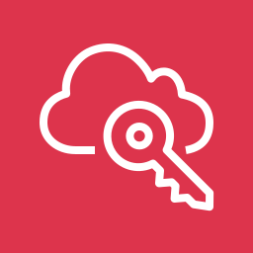


Two kinds of users, two front doors
IDENTITY
Your workforce
Your customers
AWS IAM Identity Center
Amazon Cognito
Single sign-on with your corporate directory
Permission sets map groups to roles
Short-lived credentials, no IAM users
User pools handle sign-up and sign-in
Your API checks the token in API Gateway
Identity pools swap tokens for AWS credentials
Either way, an IAM role calls Bedrock. Users never hold long-lived keys, and the role allows only the models the app needs.
Notes:
(About 1 min 30 seconds)
There are two kinds of users, / and each one gets its own front door. [pause]
▶ CLICK
First, / your **workforce**. / Your employees and contractors. / For them, / you use **AWS IAM Identity Center**. / They sign in once with your corporate directory, / permission sets map their groups to roles, / and they get short-lived credentials. / No IAM users, / and no access keys sitting on laptops.
▶ CLICK
Second, / your **customers**. / People signing up in your web or mobile app. / For them, / you use **Amazon Cognito**. / User pools handle sign-up and sign-in. / Your API checks the token, / for example with a Cognito authorizer in API Gateway. / And if the app really needs to call AWS directly, / identity pools can swap that token for temporary AWS credentials.
▶ CLICK
And here's the part that ties it together. / Either way, / an **IAM role** is what actually calls Bedrock. / Users never hold long-lived keys, / and the role allows only the models that app needs. / So if you see a question where an app stores access keys in its code, / that's the wrong answer. [long pause]
Transition: Next, / how does the request reach the model?

Slide 3
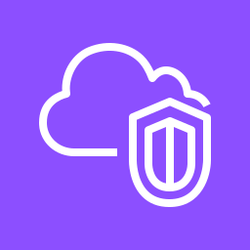
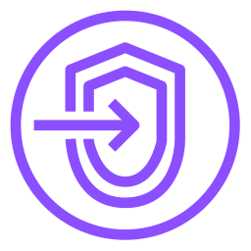
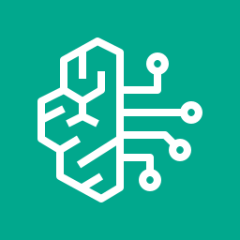
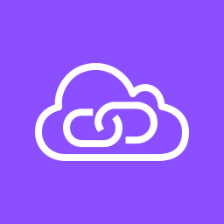
Keep model traffic off the internet
PRIVATE NETWORK
Your app in a VPC
→
VPC endpoint
→
Amazon Bedrock
Private subnets, no internet gateway needed
Interface endpoint on AWS PrivateLink
Requests stay on the AWS network
Lock it down in three layers
Endpoint policy: which principals and models can use this endpoint
IAM policy: which actions and model ARNs each role can call
Condition keys: deny calls that don't come through your endpoint
Notes:
(About 1 min 30 seconds)
By default, / your app calls Bedrock on its public endpoint. / Encrypted, / yes, / but over the internet. / Many companies don't allow that. [pause]
▶ CLICK
So, / first, / your app runs in a **VPC**, / in private subnets. / It doesn't even need an internet gateway.
▶ CLICK
Second, / you create a **VPC endpoint** for Bedrock. / It's an interface endpoint, / powered by **AWS PrivateLink**, / and you create one for each Bedrock API you use. / The runtime API for model calls, / and the agent runtime API for Knowledge Bases and agents.
▶ CLICK
Third, / **Amazon Bedrock** receives the request, / and the traffic never leaves the AWS network.
▶ CLICK
Then you lock it down in three layers. [pause] An **endpoint policy** says which principals and models can use this endpoint. / An **IAM policy** says which actions and model ARNs each role can call. / And **condition keys** let you deny any call that doesn't come through your endpoint. / That last one is what turns "we have a private path" into "the private path is the only path". [long pause]
Transition: Now, / where does the data actually go?

Slide 4


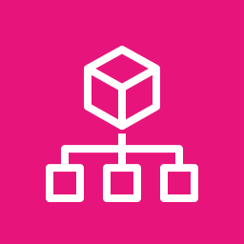

Decide where the data is processed and stored
DATA RESIDENCY
Pick the Region
Processed where you call it. Prompts and answers aren't stored or used for training.
Use a geographic inference profile
US, EU or APAC profiles spread load but stay inside that geography. A global profile can route anywhere.
Keep your own data local
Logs, Knowledge Base sources and vector stores live in buckets and stores you place in that Region.
Enforce it with an SCP
Deny the Regions you don't use, but allow the ones your inference profile routes to.
"Data must stay in the EU": EU Region, EU profile, and an SCP that blocks the rest.
Notes:
(About 2 min)
Data residency comes up in almost every regulated project. / Here are the four decisions. [pause]
▶ CLICK
First, / **pick the Region**. / Bedrock processes the request in the Region you call. / And it doesn't store your prompts or answers, / or use them to train the models.
▶ CLICK
Second, / if you need more capacity, / use a **geographic inference profile**. / A US, / EU / or APAC profile spreads the load across several Regions, / but it stays inside that geography. [pause] Be careful with a **global** profile, / though. / It can route the request anywhere in the world. / So if residency matters, / don't use it.
▶ CLICK
Third, / keep **your own data** local. / Your invocation logs, / your Knowledge Base sources / and your vector store all live in buckets and stores that **you** place. / So put them in the same Region.
▶ CLICK
Fourth, / **enforce** it. / With AWS Organizations, / a service control policy can deny the Regions you don't use. / One catch. / If you use a geographic profile, / allow the Regions it routes to, / or your calls will fail.
▶ CLICK
So, / when a question says "data must stay in the EU", / the answer has three parts. / An **EU Region**, / an **EU inference profile**, / and an **SCP** that blocks the rest. [long pause]
Transition: But what if the data can't go to a Region at all?

Slide 5
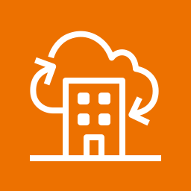



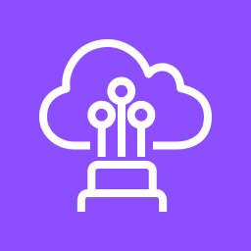
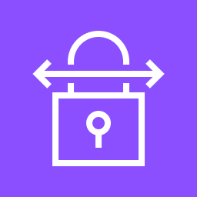
When it has to run outside the Region
HYBRID AND EDGE
AWS Outposts
AWS Local Zones
AWS Wavelength
AWS racks or servers in your own data center
AWS infrastructure close to a large city
AWS compute inside a 5G carrier network
Data can't leave the site
Very low latency for users in that city
Lowest latency to mobile devices
Bedrock runs only in AWS Regions. So you have two options:
Self-host an open-weight model on GPU instances at the edge, where they're offered.
Keep data on site, call Bedrock privately over Direct Connect or VPN, then a VPC endpoint.
Notes:
(About 2 min)
Sometimes the model has to run **outside** a Region. / AWS gives you three ways to get there. [pause]
▶ CLICK
First, / **AWS Outposts**. / AWS racks or servers in **your own** data center. / You use it when the data can't leave the site, / like a factory, / a hospital, / or a bank's own data center.
▶ CLICK
Second, / **AWS Local Zones**. / AWS infrastructure close to a large city, / for very low latency to the users there.
▶ CLICK
Third, / **AWS Wavelength**. / AWS compute inside a 5G carrier network, / so you get the lowest latency to mobile devices.
▶ CLICK
Now here's the catch. [pause] **Bedrock runs only in AWS Regions.** / It doesn't run on Outposts, / in Local Zones / or in Wavelength. / So you have two options. [pause] Option one, / **self-host an open-weight model** on GPU instances at the edge, / where those instances are offered. / You manage the model yourself. [pause] Option two, / keep the **data** on site, / and call Bedrock **privately**. / Direct Connect or a VPN into your VPC, / and then the VPC endpoint we just saw. [pause] If the data can leave the building but not the network, / that's option two. / If nothing can leave, / that's option one. [long pause]
Transition: Let's practice reading these constraints.

Slide 6
Read the constraint, pick the service
MATCH THE REQUIREMENT
Employees sign in with the corporate directory
IAM Identity Center
Customers sign up in a mobile app
Amazon Cognito
No model traffic over the public internet
Interface VPC endpoint
Data must stay in one geography
Region, geographic profile, SCP
Data can't leave the factory
Self-hosted model on Outposts
Lowest latency for 5G devices
Wavelength
Notes:
(About 2 min)
Exam questions give you a constraint, / and you match it to a service. / Here are six you'll see. [pause]
▶ CLICK
Employees sign in with the corporate directory? / **IAM Identity Center**.
▶ CLICK
Customers sign up in a mobile app? / **Amazon Cognito**.
▶ CLICK
No model traffic over the public internet? / An **interface VPC endpoint** for Bedrock.
▶ CLICK
Data must stay in one geography? / The **Region**, / a **geographic** inference profile, / and an **SCP**.
▶ CLICK
Data can't leave the factory? / A **self-hosted model on Outposts**.
▶ CLICK
And the lowest latency for 5G devices? / **Wavelength**. [pause] Notice that the constraint word does all the work. / "Corporate directory", / "public internet", / "can't leave". / Find that word, / and the answer follows. [long pause]
Transition: Let's wrap up.

Slide 7
Three things to remember
LECTURE RECAP
1
Two front doors
Identity Center for your people, Cognito for customers, IAM roles behind both.
2
Private and in place
VPC endpoints for traffic. Region, geographic profile and SCP for data.
3
Edge means self-hosting
Run your own model there, or connect privately back to Bedrock.
Next: Lecture 8.4 · CI/CD for GenAI and the GenAI gateway
Notes:
(About 1 min)
So, / let's bring it together. [pause]
▶ CLICK
First, / two front doors. / IAM Identity Center for your people, / Cognito for your customers, / and IAM roles behind both.
▶ CLICK
Second, / private and in place. / VPC endpoints keep the traffic private. / The Region, / geographic profiles / and SCPs keep the data where it belongs.
▶ CLICK
And third, / the edge means self-hosting. / Outposts, / Local Zones / and Wavelength run **your own** model, / or connect privately back to Bedrock. [pause]
So, / back to our one sentence. [pause] Give every user a proper **identity**, / keep the traffic **private**, / and decide **where** the data lives before you build. [long pause]
Transition: Next, / we look at how you ship changes safely, / and how one gateway can sit in front of every model.

