Slide 1
CI/CD for GenAI and the GenAI gateway
SECTION 8 · LECTURE 8.4
Ship prompt and model changes safely, and put one front door on every model
Notes:
(About 40 seconds)
This is the last lecture of Section 8. / Two ideas. [pause] First, / how you ship changes to a generative AI app **safely**, / when a one-word change to a prompt can change every answer. / And second, / the **GenAI gateway**, / one front door that sits in front of every model your company uses. [pause]
If I had to sum it up in one sentence, / it would be this. [pause] Test **behavior** before every release, / and send every model call through **one gateway**. [long pause]
Transition: So, / what actually changes in a GenAI app?

Slide 2
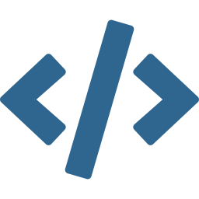


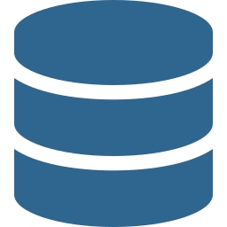

Four things can change, and each can break quality
WHAT CHANGES
Code
Prompts
Models
Retrieval
Your app, your Lambda functions, your tools
Templates, system prompts, few-shot examples
A new model ID, version or inference setting
Source documents, chunking, embeddings
So the pipeline tests behavior, not just code. All four are versioned in Git or config, and all four go through the same gate.
Notes:
(About 1 min 30 seconds)
In a normal app, / you ship code. / In a GenAI app, / four things can change, / and each one can break the quality of the answers. [pause]
▶ CLICK
First, / **code**. / Your app, / your Lambda functions, / the tools your agent calls.
▶ CLICK
Second, / **prompts**. / The templates, / the system prompts, / the few-shot examples. / Change one word, / and the answers change.
▶ CLICK
Third, / **models**. / A new model ID, / a new version, / or just a different temperature.
▶ CLICK
Fourth, / **retrieval**. / The source documents, / the chunking, / the embedding model. / New documents in a Knowledge Base can change answers too.
▶ CLICK
So here's the shift. / The pipeline has to test **behavior**, / not just code. / All four are versioned, / in Git or in configuration, / and all four go through the **same gate** before they reach users. [long pause]
Transition: So, / what does that pipeline look like?

Slide 3

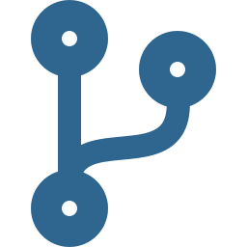
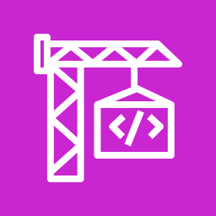

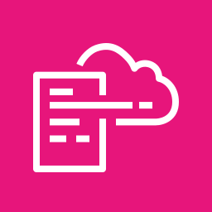
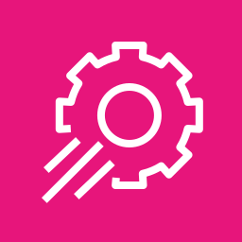
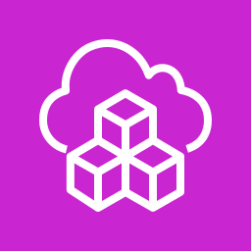
Source, build, evaluate, deploy, release
THE PIPELINE
Source
Build
Evaluate
Deploy
Release
→
→
→
→
Code, prompts and IaC in Git
Unit tests and a smoke test
Golden set against the baseline
IaC to staging
Gradual rollout
CodePipeline, GitHub Actions or GitLab all work. The stages are the same. What's new for GenAI is the evaluation gate in the middle.
Notes:
(About 1 min 30 seconds)
Five stages, / from left to right. [pause]
▶ CLICK
First, / **source**. / Code, / prompts / and infrastructure all live in Git. / A pull request starts the pipeline.
▶ CLICK
Second, / **build**, / for example in AWS CodeBuild. / Unit tests, / plus a quick smoke test that calls the model once.
▶ CLICK
Third, / **evaluate**. / This is the new stage. / Run the golden test set, / score the answers, / and compare them with the version in production.
▶ CLICK
Fourth, / **deploy** to staging, / with infrastructure as code. / CloudFormation, / or the CDK on top of it.
▶ CLICK
And fifth, / **release** to production, / gradually, / for example with AWS AppConfig.
▶ CLICK
Now, / you can run this in AWS CodePipeline, / GitHub Actions / or GitLab. / It doesn't matter. / The stages are the same. / What's new for generative AI is that **evaluation gate** in the middle. [long pause]
Transition: So, / what does that gate check?

Slide 4

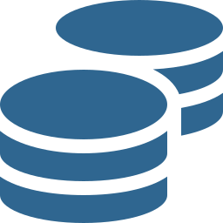

Fail the build if the answers get worse
THE EVALUATION GATE
Quality
A model as judge, compared with the version in production
Safety
Red-team prompts must still be blocked or refused
Format
Outputs still match the JSON schema your code expects
Cost and latency
Tokens and response time per request stay within budget
No score, no release. Bedrock evaluations can run the test set for the pipeline.
Notes:
(About 1 min 30 seconds)
The rule is simple. / If the answers get worse, / the build **fails**. / Four checks. [pause]
▶ CLICK
First, / **quality**. / Score the answers with a model as judge, / and compare with the version that's in production today.
▶ CLICK
Second, / **safety**. / Your red-team prompts, / the jailbreaks and the harmful requests, / must still be blocked or refused.
▶ CLICK
Third, / **format**. / If your code expects JSON, / the output must still match the schema. / A prompt change that breaks the format breaks the app.
▶ CLICK
Fourth, / **cost and latency**. / Tokens and response time per request must stay within budget. / A better answer that costs three times as much isn't always better.
▶ CLICK
No score, / no release. / Amazon Bedrock evaluations can run the test set for you, / and the pipeline just reads the result and decides. [long pause]
Transition: And once it passes, / how do you release it?

Slide 5
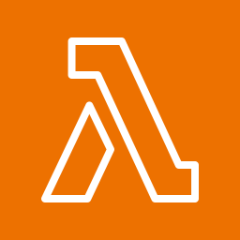
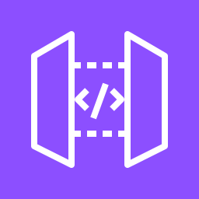

Canary or blue/green, with a fast way back
RELEASING CHANGES
Canary
Blue/green
Send a small share of traffic to it
Watch errors, latency and quality
Roll forward or back automatically
Run old and new side by side
Switch all traffic at once
Switch back if something breaks
The trigger is a CloudWatch alarm. AppConfig, and CodeDeploy with Lambda aliases, shift traffic step by step and roll back when the alarm fires.
Notes:
(About 1 min 30 seconds)
You never switch everyone at once without a way back. / Two patterns. [pause]
▶ CLICK
First, / **canary**. / You send a small share of traffic, / say five percent, / to the new version. / You watch the errors, / the latency, / the user feedback / and the quality scores. / Then you roll forward, / or roll back, / automatically.
▶ CLICK
Second, / **blue/green**. / You run the old and the new version side by side, / switch all the traffic at once, / and switch back if something breaks.
▶ CLICK
Either way, / the trigger is a **CloudWatch alarm**. / AWS AppConfig can shift a new prompt or model ID step by step, / and roll back when the alarm fires. / CodeDeploy does the same for Lambda aliases. [pause] And notice why this works so well. / The prompt version and the model ID are **configuration**, / so a rollback is just pointing back to the old value. [long pause]
Transition: Now, / the second big idea. / The gateway.

Slide 6





One front door for every model
THE GENAI GATEWAY
or
Models
The gateway
Amazon Bedrock
Teams and apps
→
API Gateway with Lambda, or a gateway service on ECS. It owns the policy, so the apps don't have to.
→
Chatbots, internal tools, batch jobs. Each one calls the same API.
SageMaker AI endpoints
Other providers
Only the gateway's role can call the models. Apps can't go around it, so every request gets the same checks.
Notes:
(About 1 min 30 seconds)
Picture a company with twenty teams building with generative AI. / Without a plan, / every team calls the models in its own way. / Different keys, / different limits, / no idea who spent what. / The gateway fixes that. [pause]
▶ CLICK
On the left, / your **teams and apps**. / Chatbots, / internal tools, / batch jobs. / They all call the same API.
▶ CLICK
In the middle, / **the gateway**. / Usually Amazon API Gateway with Lambda behind it, / or a gateway service running on Amazon ECS. / It owns the policy, / so the apps don't have to.
▶ CLICK
On the right, / the **models**. / Amazon Bedrock, / SageMaker AI endpoints, / and other providers if you use them.
▶ CLICK
And here's what makes it work. / Only the gateway's **IAM role** is allowed to call the models. / The apps can't go around it, / so every single request gets the same checks. [long pause]
Transition: So, / what are those checks?

Slide 7

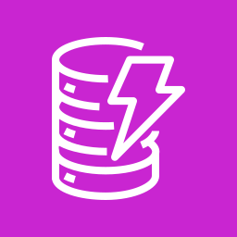
Five jobs in one place
WHAT THE GATEWAY DOES
Authenticate
Know which team or app is calling
Throttle and set quotas
Usage plans and rate limits per team
Route
Pick the model for the use case, fall back when one fails
Apply guardrails
The same content filters and PII rules for everyone
Log and attribute cost
Tokens and cost per team, for chargeback
Notes:
(About 1 min 30 seconds)
The gateway does five jobs, / in one place. [pause]
▶ CLICK
First, / **authenticate**. / With Cognito or IAM, / it knows which team or app is calling.
▶ CLICK
Second, / **throttle and set quotas**. / API Gateway usage plans give each team its own rate limit and quota, / so one runaway job can't use up everyone's capacity.
▶ CLICK
Third, / **route**. / It picks the right model for the use case, / and falls back to another one when the first is throttled or down.
▶ CLICK
Fourth, / **apply guardrails**. / The same Bedrock Guardrails, / the same content filters and PII rules, / for every app.
▶ CLICK
And fifth, / **log and attribute cost**. / Tokens and cost per team, / stored in CloudWatch and DynamoDB, / so you can charge each team for what it uses. / Bedrock application inference profiles help here too, / because you can tag them per team. [pause] So when a question says "many teams", / "central control" / or "cost per team", / think **gateway**. [long pause]
Transition: Let's wrap up.

Slide 8
Three things to remember
LECTURE RECAP
1
Test behavior, not just code
Code, prompts, models and data all pass the same evaluation gate.
2
Release gradually
Canary or blue/green, with a CloudWatch alarm that rolls back.
3
One gateway for every model
Auth, quotas, routing, guardrails and cost per team in one place.
Next: Lecture 9.1 · Sync, async and streaming invocation
Notes:
(About 1 min)
So, / let's bring it together. [pause]
▶ CLICK
First, / test behavior, / not just code. / Code, / prompts, / models / and retrieval data all pass the same evaluation gate.
▶ CLICK
Second, / release gradually. / Canary or blue/green, / with a CloudWatch alarm that rolls back for you.
▶ CLICK
And third, / one gateway for every model. / Authentication, / quotas, / routing, / guardrails / and cost per team, / all in one place. [pause]
So, / back to our one sentence. [pause] Test **behavior** before every release, / and send every model call through **one gateway**. [pause] And that's the end of Section 8. / You can host models the right way, / plug them into the systems you already run, / secure them, / and ship changes safely. [long pause]
Transition: In the next section, / we go deeper into the model APIs themselves. / Sync, / async / and streaming calls, / and the patterns that keep your app fast and resilient.

