Slide 1
Choosing a vector store
SECTION 4 · LECTURE 4.3
The options on AWS, what each one is good at, and where DynamoDB fits
Notes:
(About 40 seconds)
Every RAG system needs somewhere to keep its vectors. / And on AWS, / you've got more than one choice. [pause] In this lecture, / I'll show you what a vector store actually does, / how Amazon Bedrock Knowledge Bases fits on top, / the five stores you should know, / and how to pick one. / And we'll see where DynamoDB fits, / because it's not where most people expect. [pause]
If I had to sum it up in one sentence, / it would be this. [pause] Every vector store does the **same job**, / so you choose on **cost, / scale / and features**, / not on the name. [long pause]
Transition: So, / what is that job?

Slide 2
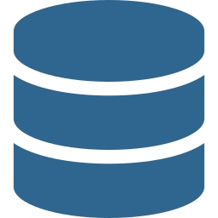



What a vector store does
THE JOB
Stores
Searches
Filters
Each chunk's vector, its text and its metadata
Finds the nearest vectors to the question's vector
Narrows results on metadata like source, date or team
Same job everywhere. What changes is cost, scale, latency, search features, and what your team already runs.
Notes:
(About 1 min 20 seconds)
A vector store does three things. [pause]
▶ CLICK
It **stores**. / For each chunk of a document, / it keeps the vector, / the original text, / and the metadata that describes it.
▶ CLICK
It **searches**. / You turn the user's question into a vector, / with the same embedding model, / and the store finds the vectors **nearest** to it. / Nearest in meaning, / not in spelling.
▶ CLICK
And it **filters**. / Before or during that search, / it can narrow the results on metadata. / Only this product, / only this year, / only this team's documents.
▶ CLICK
Here's the good news. / Every option we'll look at does those three things. [pause] What changes is the **cost**, / how far it **scales**, / how fast it answers, / which search features it has, / and what your team already knows how to run. [long pause]
Transition: But before we compare stores, / who does the work of filling them?

Slide 3
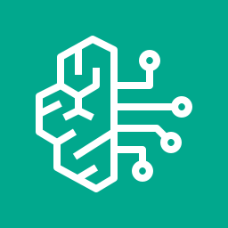

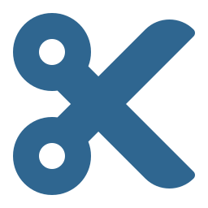
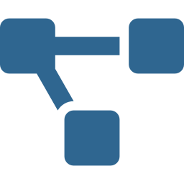

Managed RAG, with your choice of store
AMAZON BEDROCK KNOWLEDGE BASES
Connects
Embeds
Writes
Retrieves
→
→
→
Reads documents from your data sources
Splits documents and turns them into vectors
Puts the vectors into the store you picked
Returns chunks, or a full answer with citations
Knowledge Bases runs the pipeline. The vector store underneath is still your decision.
Notes:
(About 1 min 20 seconds)
On AWS, / that's usually **Amazon Bedrock Knowledge Bases**. / It's managed RAG. / It runs the whole pipeline for you. [pause]
▶ CLICK
First, / it **connects** to your data sources / and reads the documents.
▶ CLICK
Second, / it **chunks** each document, / and calls the embedding model you chose / to turn every chunk into a vector.
▶ CLICK
Third, / it **writes** those vectors, / with their text and metadata, / into the vector store you picked.
▶ CLICK
And fourth, / it **retrieves**. / The Retrieve API gives you the matching chunks, / and RetrieveAndGenerate goes one step further, / and has a model write the answer with citations.
▶ CLICK
So remember this. / Knowledge Bases runs the pipeline, / but the **vector store** underneath / is still your decision. / Some stores it can create for you, / and others you bring yourself. [long pause]
Transition: So, / which stores are we choosing between?

Slide 4
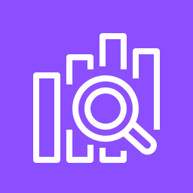
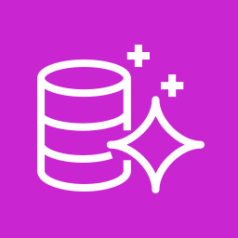

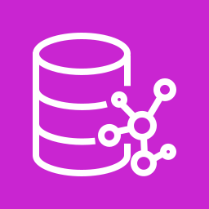
Five vector stores to know
THE OPTIONS
STORE
GOOD AT
WATCH OUT FOR
OpenSearch Serverless
Managed, hybrid search, scales on its own
A minimum capacity cost
OpenSearch Service cluster
Full control of shards, nodes and tuning
You run and size the cluster
Aurora PostgreSQL + pgvector
Vectors next to your SQL data
Scale tied to the database
Amazon S3 Vectors
Huge scale at the lowest cost
Slower queries, fewer search features
Neptune Analytics
Graph relationships, GraphRAG
Only when links between facts matter
Notes:
(About 2 min)
There are five you should know. / For each one, / think about what it's good at, / and what to watch out for. [pause]
▶ CLICK
**Amazon OpenSearch Serverless**. / It's fully managed, / it scales on its own, / and it supports **hybrid search**, / so keyword and semantic search together. / That's why it's the default for so many Knowledge Bases. / The catch? / There's a **minimum capacity cost**, / even when nobody's searching.
▶ CLICK
**An Amazon OpenSearch Service cluster**. / Same engine, / but you control the shards, / the nodes / and the tuning. / That's great for very high query rates. / The catch is that **you** run and size the cluster.
▶ CLICK
**Aurora PostgreSQL with pgvector**. / If your application already lives in PostgreSQL, / your vectors can sit right next to your business data, / and you can join them with plain SQL. / The catch is that your vector search now scales with the database.
▶ CLICK
**Amazon S3 Vectors**. / Vector storage built into S3. / It's made for **huge** numbers of vectors, / at the **lowest cost**. / The catch is that queries are slower than an in-memory engine, / and it has fewer search features.
▶ CLICK
And **Neptune Analytics**. / It's a graph. / Knowledge Bases can use it for **GraphRAG**, / where the answer depends on how people, / products / or events connect to each other. / Only reach for it when those links really matter. [pause] There are third-party options too, / like Pinecone or MongoDB Atlas, / but these five are the AWS ones to know. [long pause]
Transition: So, / how do you actually pick?

Slide 5
Match the store to the requirement
HOW TO CHOOSE
Fastest path, fully managed, keyword plus semantic search
→
OpenSearch Serverless
The app already runs on PostgreSQL
→
Aurora pgvector
Billions of vectors, cost first, sub-second is fine
→
S3 Vectors
Strict tuning or very high query rates
→
OpenSearch cluster
Answers depend on how entities connect
→
Neptune Analytics
Notes:
(About 1 min 30 seconds)
Start from the requirement, / and the store usually picks itself. [pause]
▶ CLICK
You want the **fastest path**, / fully managed, / with keyword and semantic search together. / That's **OpenSearch Serverless**.
▶ CLICK
Your app **already runs on PostgreSQL**, / and you want one database to manage. / That's **Aurora with pgvector**.
▶ CLICK
You've got **billions** of vectors, / cost comes first, / and an answer in under a second is fine. / That's **S3 Vectors**.
▶ CLICK
You need strict tuning, / or very high query rates, / and you've got the people to run a cluster. / That's an **OpenSearch cluster**.
▶ CLICK
And the answers depend on **how entities connect**. / That's **Neptune Analytics**. [pause] When you read a scenario, / listen for those clues. / Words like "lowest cost", / "existing PostgreSQL", / "hybrid search" / or "relationships" / point straight at one of these. [long pause]
Transition: And now, / where does DynamoDB fit?

Slide 6
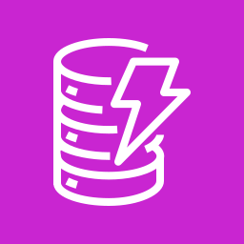




DynamoDB holds the metadata, not the vectors
AMAZON DYNAMODB
Document registry
Access rules
Conversation state
ID, source, version, owner, last indexed time
Which teams or tenants may see each document
Session history for multi-turn chat
Fast lookups by key. DynamoDB has no similarity search, so the vectors live in one of the stores you just saw.
Notes:
(About 1 min 20 seconds)
DynamoDB shows up in almost every GenAI architecture. / But it holds the **metadata**, / not the vectors. [pause]
▶ CLICK
First, / a **document registry**. / For every document, / its ID, / where it came from, / its version, / its owner, / and when it was last indexed. / That's how you know what's in your vector store, / and what's out of date.
▶ CLICK
Second, / **access rules**. / Which teams or tenants are allowed to see each document. / Your app reads them, / and turns them into metadata filters on the search.
▶ CLICK
Third, / **conversation state**. / The session history for a multi-turn chat, / so the next question has context.
▶ CLICK
What DynamoDB is great at / is fast lookups **by key**. / It doesn't do similarity search. / So the vectors themselves / live in one of the stores you just saw. [long pause]
Transition: Let's wrap up.

Slide 7
Three things to remember
LECTURE RECAP
1
One job, several stores
Store, search and filter vectors. Knowledge Bases manages the pipeline.
2
Pick by requirement
Managed and hybrid, existing SQL, lowest cost at scale, or tuning.
3
DynamoDB for metadata
Registry, access rules and state. Not similarity search.
Next: Lecture 4.4 · Metadata, scaling and keeping vectors fresh
Notes:
(About 1 min)
So, / let's bring it together. [pause]
▶ CLICK
First, / every vector store does one job. / It stores, / searches / and filters vectors. / And Knowledge Bases manages the pipeline that fills it.
▶ CLICK
Second, / pick the store by the requirement. / OpenSearch Serverless for managed and hybrid search, / Aurora pgvector when you already run PostgreSQL, / S3 Vectors for the lowest cost at scale, / and an OpenSearch cluster when you need tuning.
▶ CLICK
And third, / DynamoDB holds the **metadata**. / The registry, / the access rules / and the conversation state. / Not the similarity search. [pause]
So, / back to our one sentence. [pause] Every vector store does the **same job**, / so you choose on **cost, / scale / and features**, / not on the name. [long pause]
Transition: In the next lecture, / we make retrieval precise with metadata, / and keep those vectors fresh.

