Slide 1
Deep Learning - Optimization
OPTIMIZERS
Francesc Cabrera
Hamza Errahmouni
David Molins
Guillem Viladrich

Slide 2
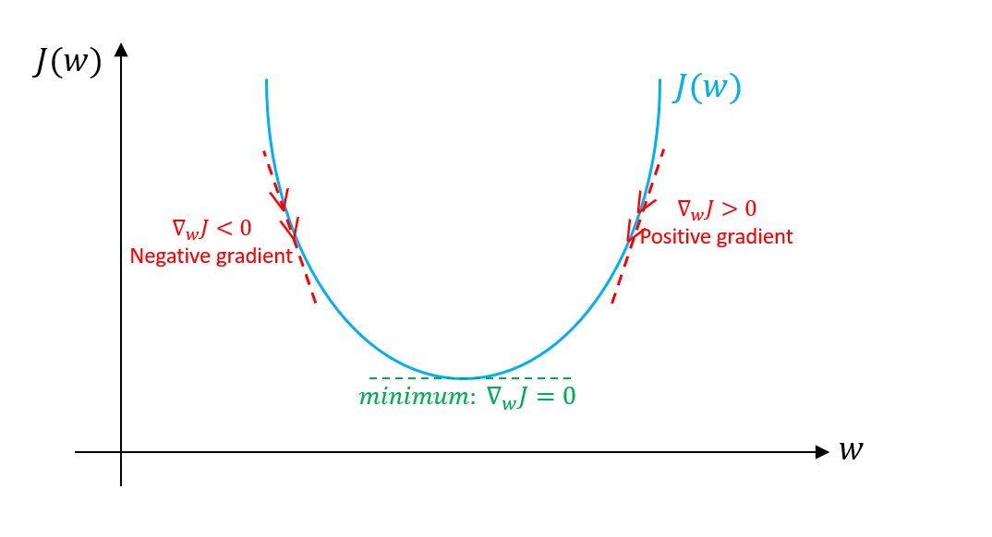
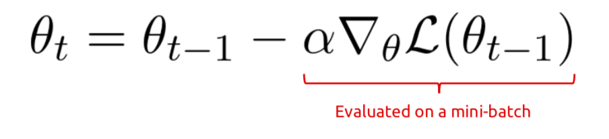
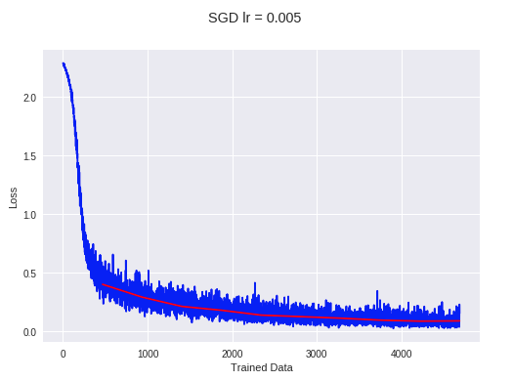
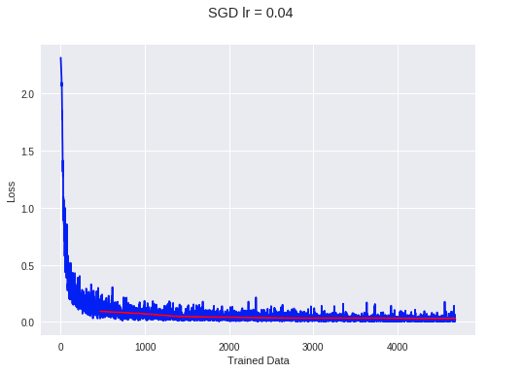
Deep Learning - Optimization
Stochastic Gradient Descent
Learning Rate
Notes:
SGD does away with this redundancy by performing one update at a time. It is therefore usually much faster and can also be used to learn online. SGD performs frequent updates with a high variance that cause the objective function to fluctuate heavily
SGD's fluctuation, on the one hand, enables it to jump to new and potentially better local minima. On the other hand, this ultimately complicates convergence to the exact minimum, as SGD will keep overshooting.
However, it has been shown that when we slowly decrease the learning rate, SGD shows the same convergence behaviour as batch gradient descent, almost certainly converging to a local or the global minimum for non-convex and convex optimization respectively.

Slide 3
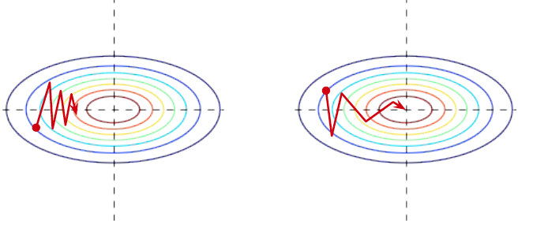


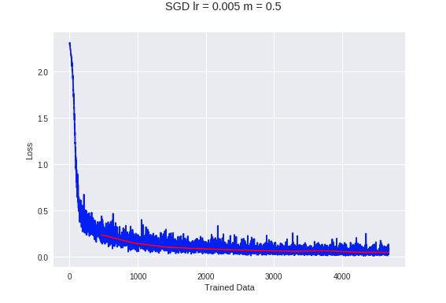
Deep Learning - Optimization
Stochastic Gradient Descent
Momentum

Slide 4

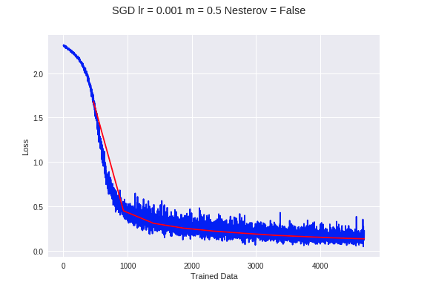
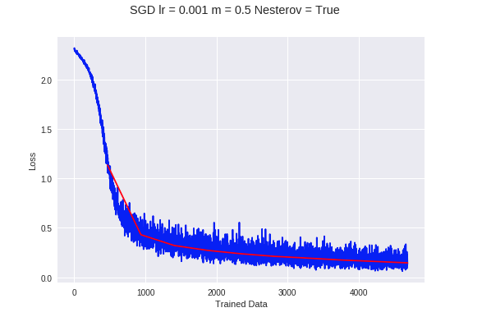
Deep Learning - Optimization
Stochastic Gradient Descent
Nesterov momentum

Slide 5
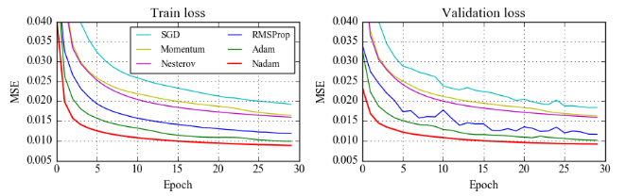
Deep Learning - Optimization
From the Adam analysis, in general, you must know that:
Adaptive Moment Estimation (Adam) is an algorithm that computes adaptive learning rates for each parameter.
Also, it keeps an exponentially decaying average of past gradients similar to momentum.
Each beta is for one of the 2 estimations that you make, they are estimates of the first moment (the mean) and the second moment (the uncentered variance) of the gradients respectively, hence the name of the method
Adam
Actual step size taken by the Adam in each iteration is approximately bounded the step size hyper-parameter. This property add intuitive understanding to previous unintuitive learning rate hyper-parameter.
Step size of Adam update rule is invariant to the magnitude of the gradient, which helps a lot when going through areas with tiny gradients (such as saddle points or ravines). In these areas SGD struggles to quickly navigate through them.
However, after a while people started noticing that despite superior training time, Adam in some areas does not converge to an optimal solution.

Slide 6
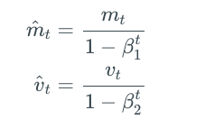
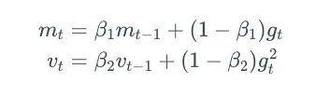
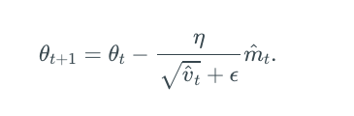
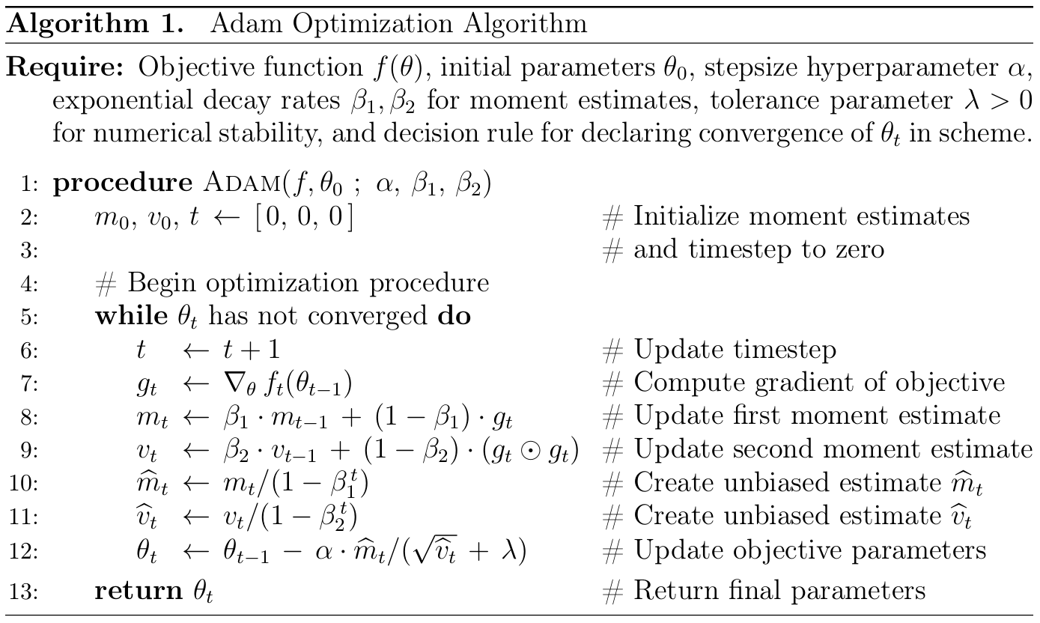
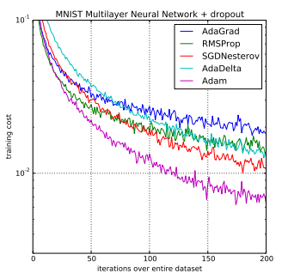

Slide 7
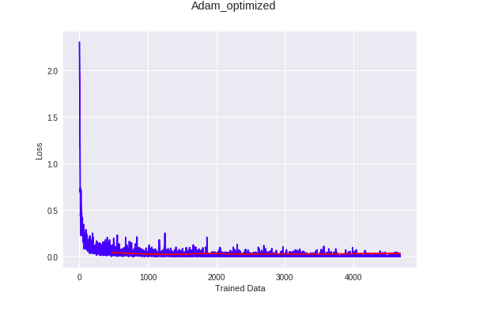
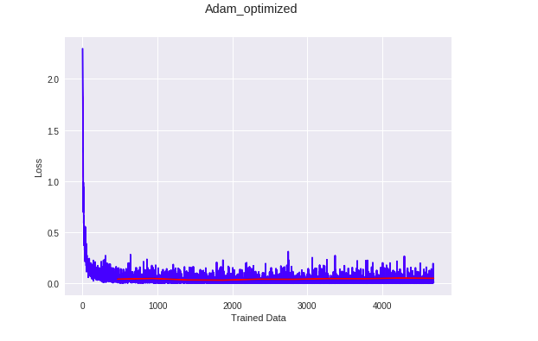
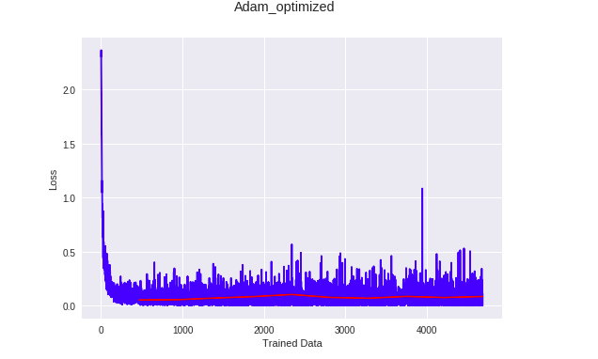
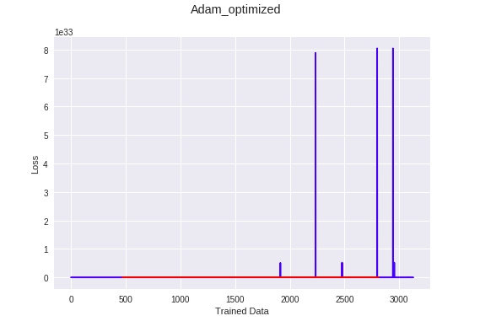
Deep Learning - Optimization
Effect on the betas
β1 = 0.9
β2= 0.99
lr = 0.001
β1 = 0.9
β2=0.99
lr < 0.001
β1 > β2
β1 = 0.01
β2= 0.01

Slide 8
Deep Learning - Optimization
Adadelta
Adadelta is a more robust extension of Adagrad that adapts learning rates based on a moving window of gradient updates, instead of accumulating all past gradients. This way, Adadelta continues learning even when many updates have been done, the recommended initialization values for pytorch are the following:
rho (float, optional) – coefficient used for computing a running average of squared gradients (default: 0.9)
eps (float, optional) – term added to the denominator to improve numerical stability (default: 1e-6)
lr (float, optional) – coefficient that scale delta before it is applied to the parameters (default: 1.0)
weight_decay (float, optional) – weight decay (L2 penalty) (default: 0)

Slide 9
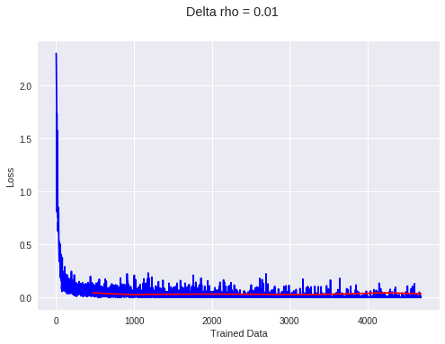
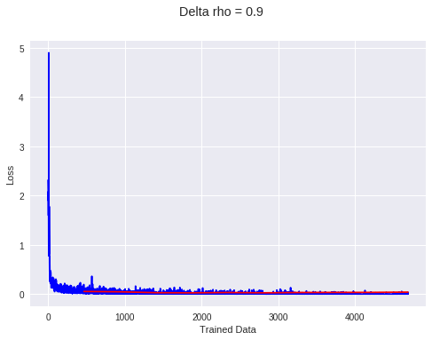
Deep Learning - Optimization
Adadelta
We tested Adadelta changing rho between 0.01 and 0.9 (recommendation):
As we can see there is not much difference between one case and the other, there’s more loss when rho=0.01, but the accuracy is 99% in both cases. So we can assume Adadelta is so robust that can adapt its parameters properly.

Slide 10
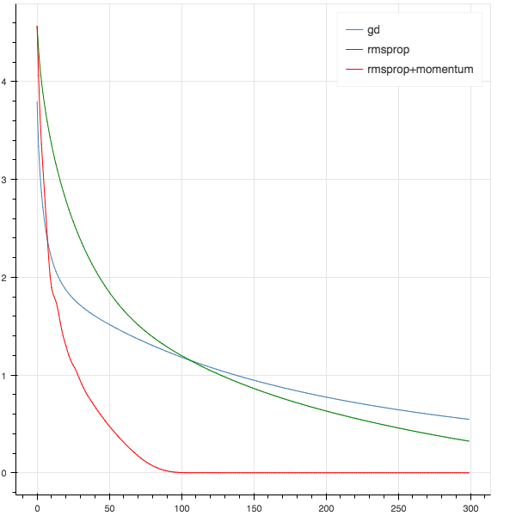
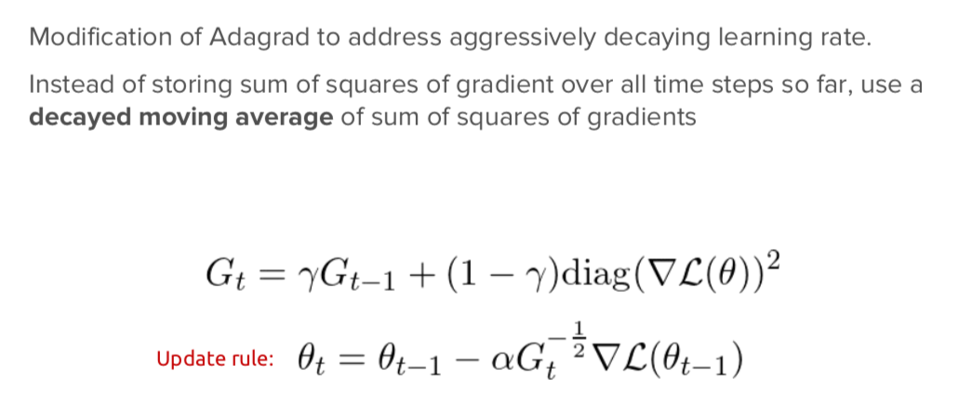
Deep Learning - Optimization
RMSprop
The RMSprop optimizer is similar to the gradient descent algorithm with momentum.

Slide 11
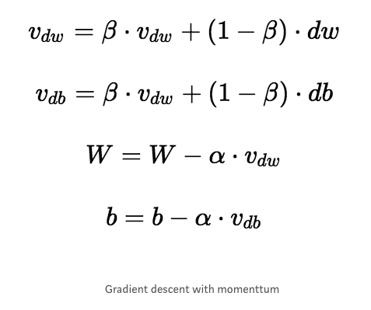
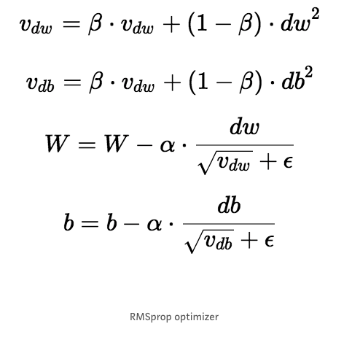
Deep Learning - Optimization
RMSprop
The RMSprop optimizer restricts the oscillations in the vertical direction. Therefore, we can increase our learning rate and our algorithm could take larger steps in the horizontal direction converging faster.
The difference between RMSprop and gradient descent is on how the gradients are calculated. The value of momentum is denoted by beta and is usually set to 0.9. A good default value for the learning rate is 0.001.

Slide 12
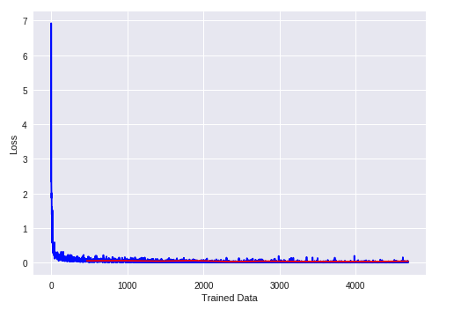
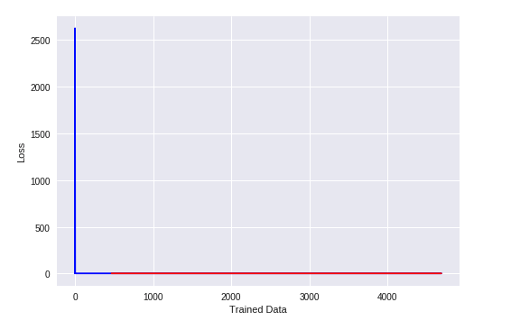
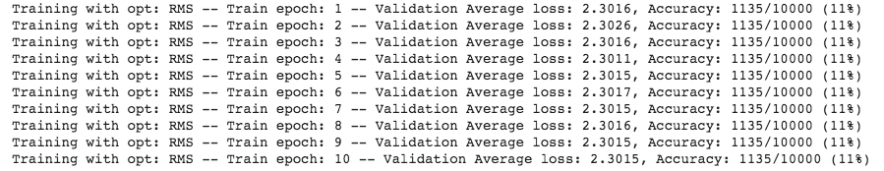
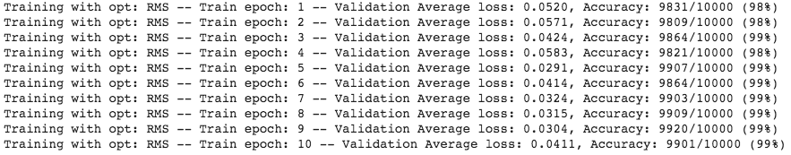
Deep Learning - Optimization
RMSprop
RMSprop ( Parameter Group 0 alpha: 0.99 centered: False eps: 1e-08 lr: 0.001 momentum: 0 weight_decay: 0 )

Slide 13
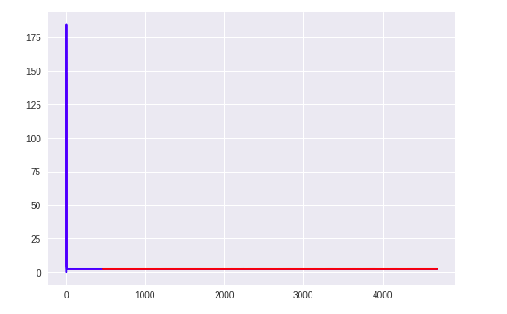
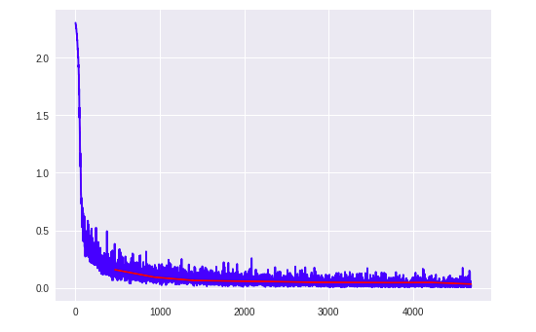
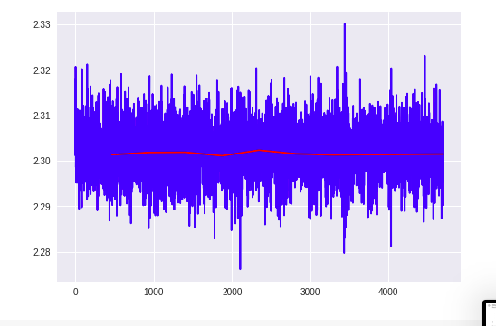
Deep Learning - Optimization
SGD lr = 0.01
ADAM lr = 0.035
RMSprop lr = 0.01

Slide 14
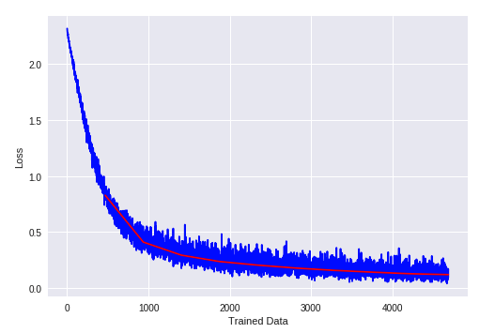
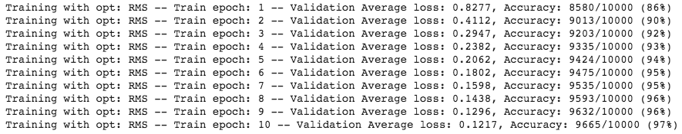
Deep Learning - Optimization
RMSprop
RMSprop ( Parameter Group 0 alpha: 0.99 centered: False eps: 1e-08 lr: 1e-05 momentum: 0 weight_decay: 0 )

Slide 15
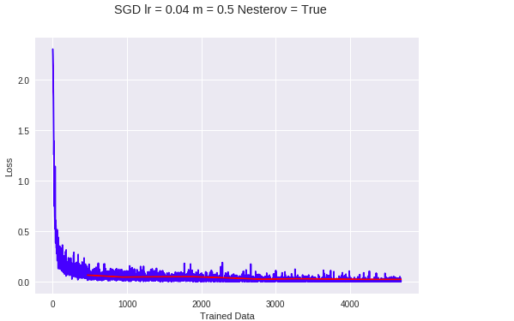
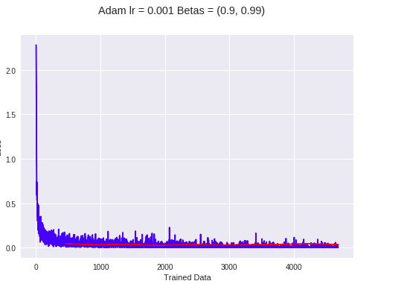
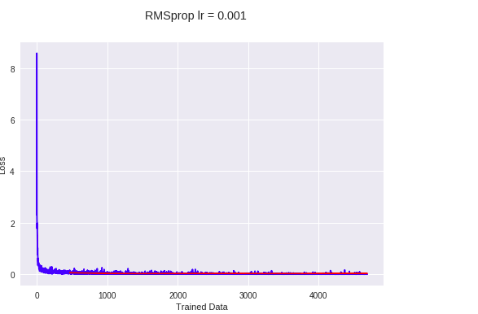
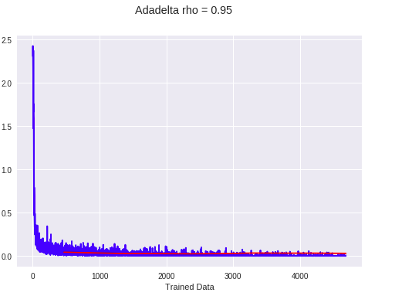

Slide 16
Analysis:
We’ll observe how the optimizers work on the accuracy, convergence and its speed.
These factors vary a lot depending on the learning rate if we talk about SGD, Adam and RMSprop, so we’ll analyse them depending on the value of this hyper parameter that we have.
At the same time, the effect on the betas on Adam vary a lot so we’ll analyze the general case scenarios
Adadelta depends specifically on the parameter rho.

Slide 17
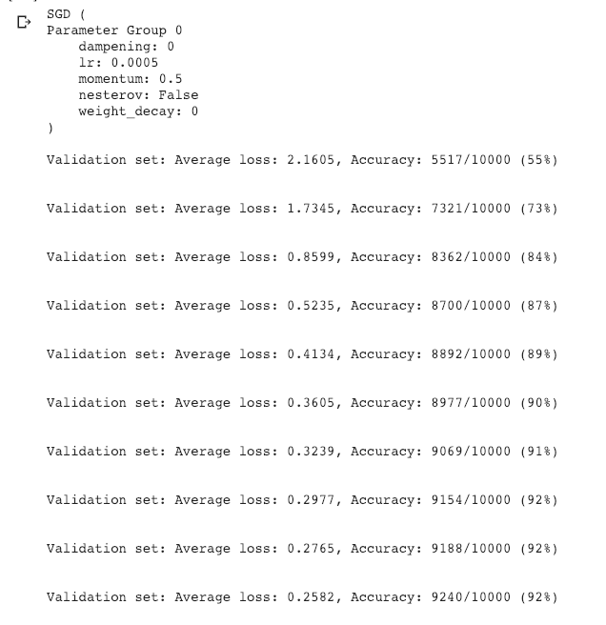
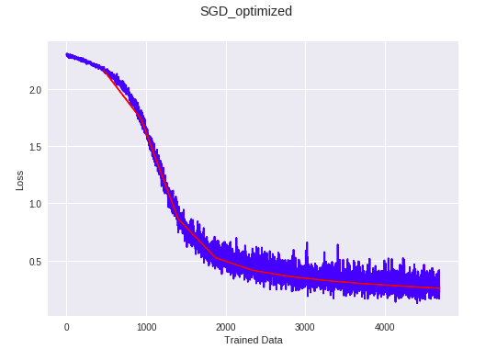
Deep Learning - Optimization
SGD lr = 0.0005

Slide 18
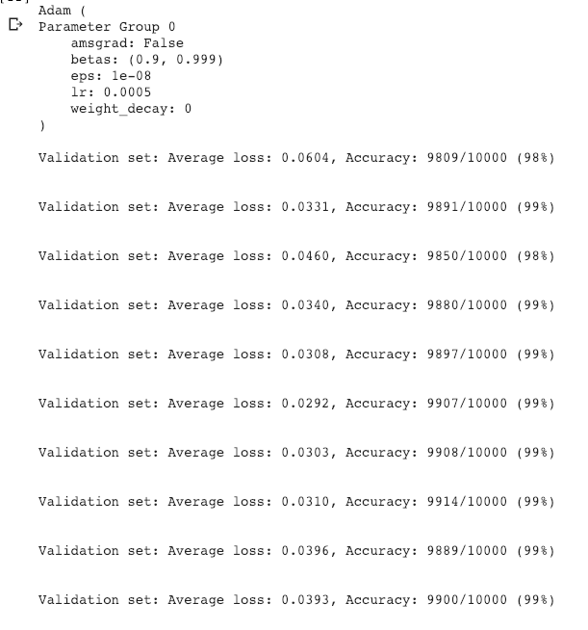
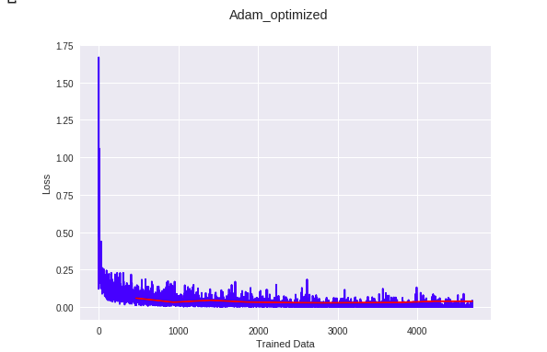
Deep Learning - Optimization
ADAM lr = 0.0005

Slide 19
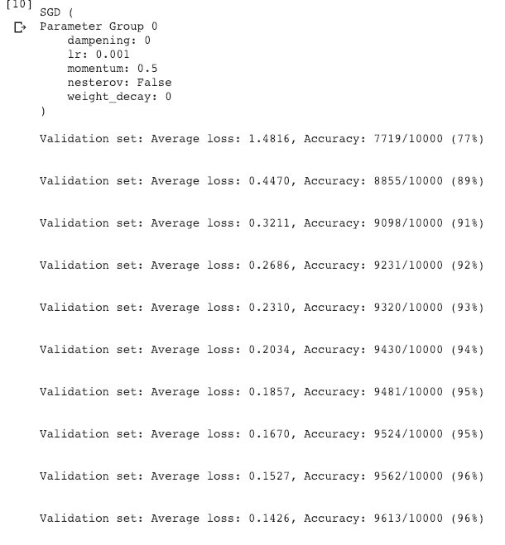
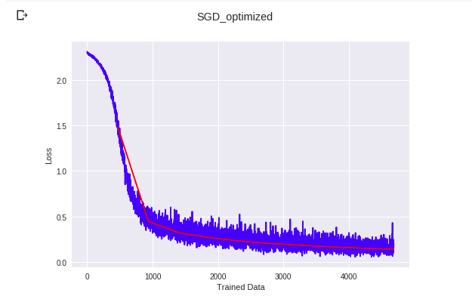
Deep Learning - Optimization
SGD lr = 0.001

Slide 20
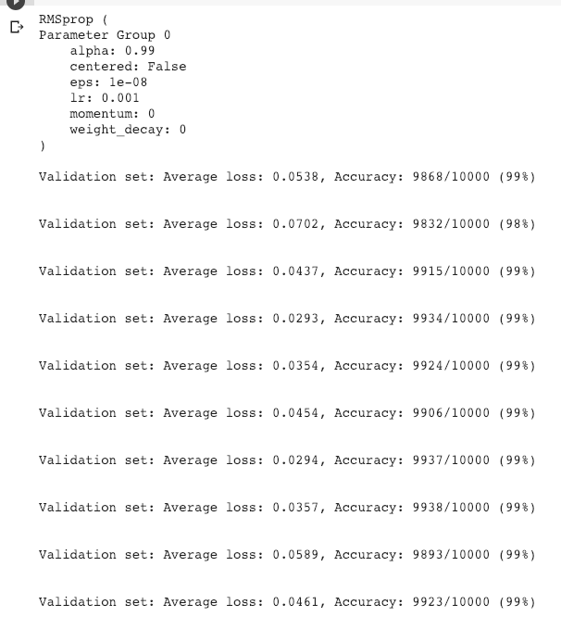
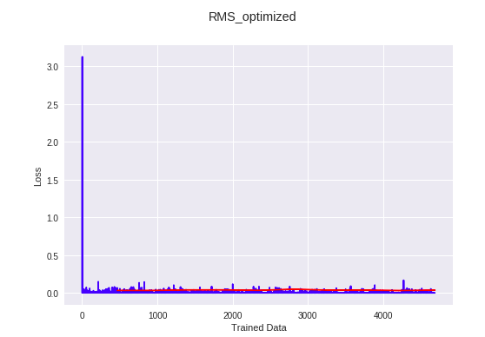
Deep Learning - Optimization
RMSprop lr = 0.001

Slide 21
Deep Learning - Optimization
RMSprop
RMSprop ( Parameter Group 0 alpha: 0.99 centered: False eps: 1e-08 lr: 0.01 momentum: 0 weight_decay: 0 )

Slide 22
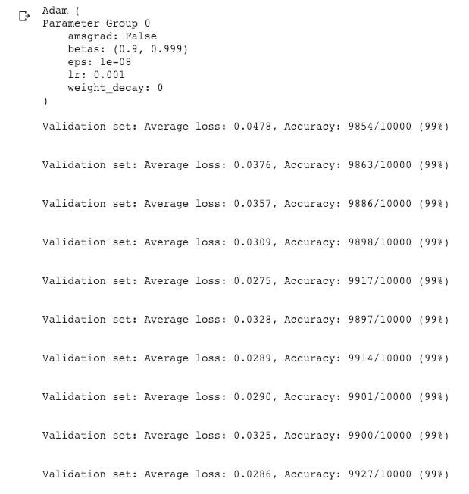
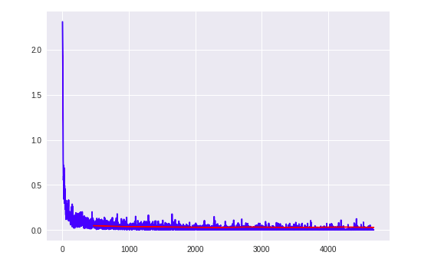
Deep Learning - Optimization
ADAM lr = 0.001

Slide 23
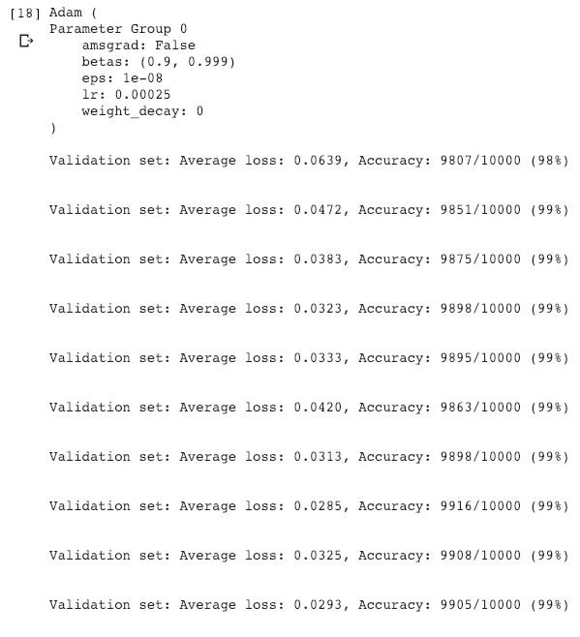
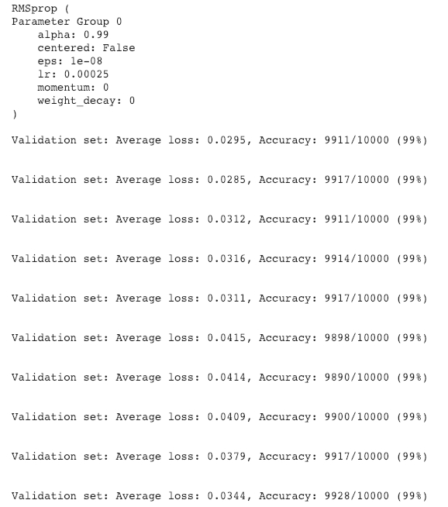
Deep Learning - Optimization
ADAM lr = 0.00025
RMSprop lr = 0.00025

Slide 24
Conclusions

