Slide 1

Speechalyzer – The T-Labs Text annotation tool.
Felix Burkhardt

Slide 2
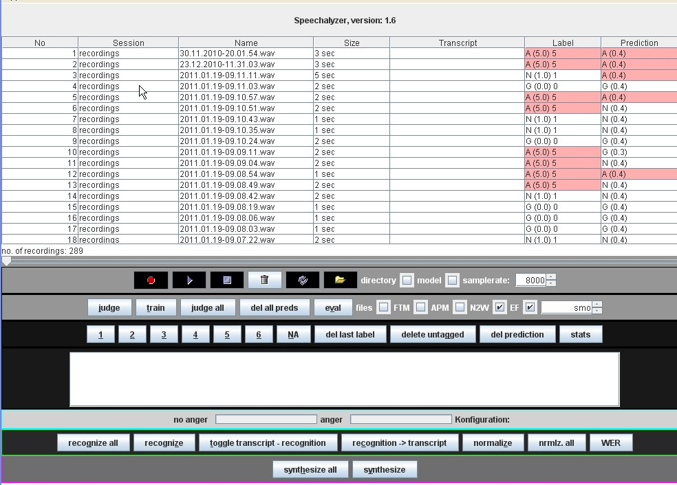
Speechalyzer – The T-Labs Text annotation tool.
Overview
Overview
Tool to process speech data, written in Java , interfaces external modules, in client –server architecture to manage centrally stored data. Easily extendable and configurable through full access to source code.
Features:
  Fast transcription of audio data
  Fast labeling (class annotation)
  Automatic classification
  Automatic speech recognition
  Speech synthesis
  Performance evaluation like Word Error Rate, classifier performance etc.
  Command line interface
GUI with all interfaces activated

Slide 3
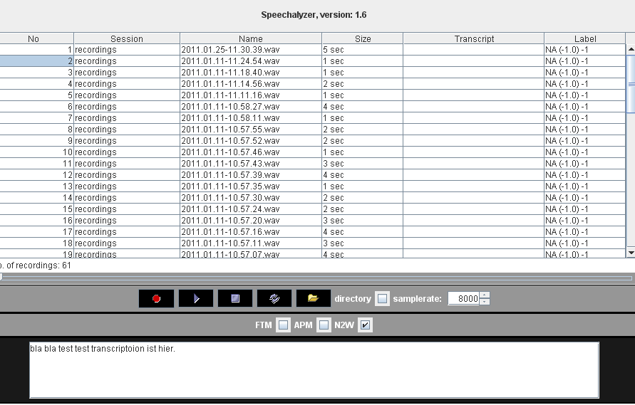
Speechalyzer – The T-Labs Text annotation tool.
Transcription.
Features
Optimized for very fast transcription of audio data in raw, wav or a-law format.
Play audio, pause, resume, scroll.
Fast transcription mode without need to use mouse.
User defined automated short-cuts.
User defined automatic replacement of key strings.
Automatic number-to-word conversion.
Automatic tagging of word classes.
GUI of the transcription interface

Slide 4
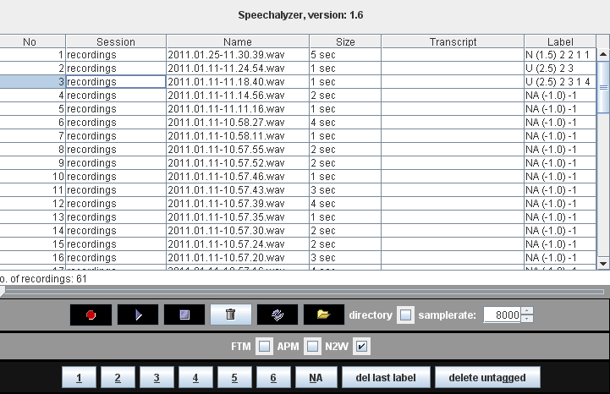
Speechalyzer – The T-Labs Text annotation tool.
Labeling.
Features
Optimized for real time labeling without need to use mouse (listen, judge with one click).
User definable number and names of categories.
Multi labeler architecture with automatic fusion of labels.
GUI of the labeling interface

Slide 5
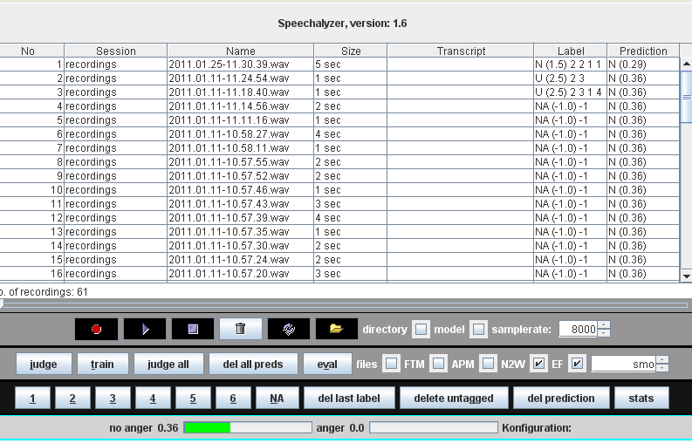
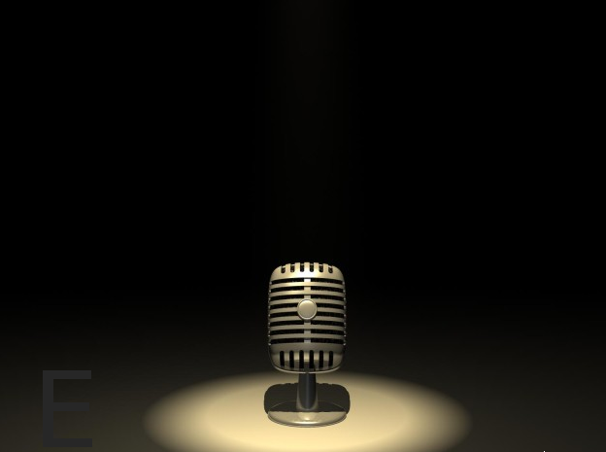
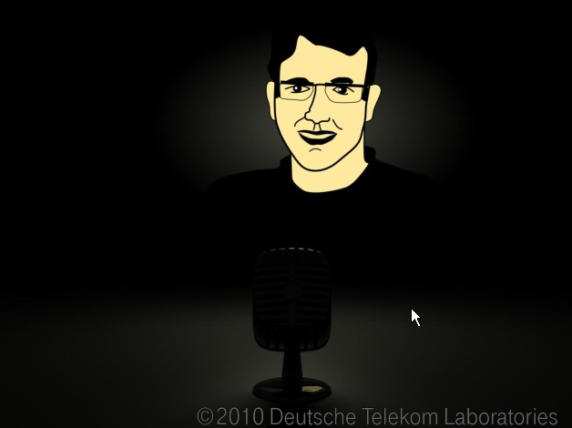
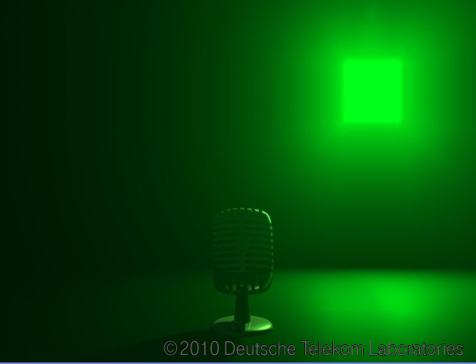
Speechalyzer – The T-Labs Text annotation tool.
Classification.
Features
Age, gender and emotion classification modules provided, includes demonstrators.
Acoustic features extraction interfaced by framework, openEAR, Sympalog and PRAAT extraction tools are interfaced.
Classification module interfaces either the WEKA toolkit (Univ. of Waikato) or Sympalog.
Audio recording built-in to test classification on the spot.
GUI of the classification interface
Speech based classification demonstrator interface

Slide 6
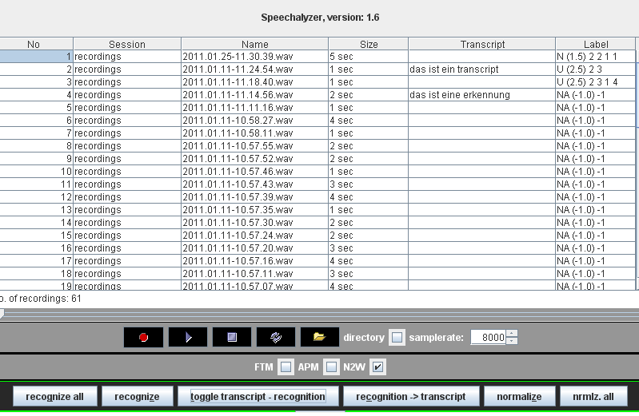
Speechalyzer – The T-Labs Text annotation tool.
Speech Recognition.
Features
Interface to EML voice-to-text speech recognition server.
Results can be used as transcription suggestions or compared with manual transcription to compute word error rate.
Automatic normalization of recognition/transcription built in via pattern matching, e.g.
  abbreviations,
  capitalization,
  number conversion,
  class tagging etc.
GUI of the speech recognition interface

Slide 7
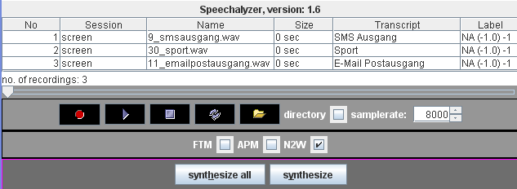
Speechalyzer – The T-Labs Text annotation tool.
Speech Synthesis.
Features
To test recognition, classification or for automated prompting; text to speech modules are interfaced:
  SVOX classic non-uniform unit selection TTS.
  MBROLA, academic free of charge diphone synthesizer with emotional expression synthesis Emofilt.
Simple text file with format <path-to-file> <text-to-synthesize> can be loaded and generated on the spot.
Includes pre-processing of text, e.g. automated insertion of speech pauses. by pattern matching.
GUI of the speech synthesis interface

Slide 8
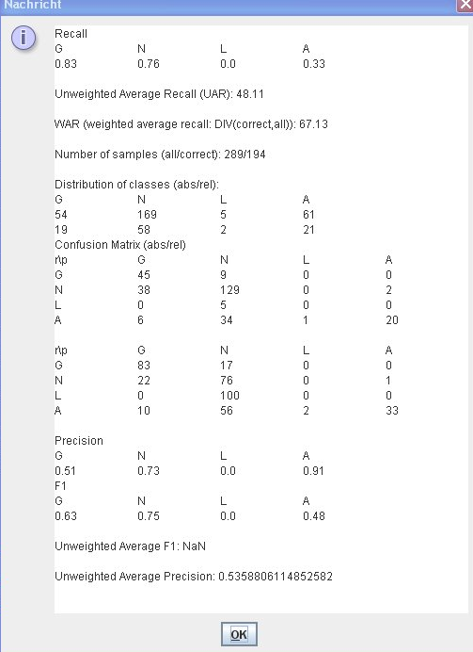
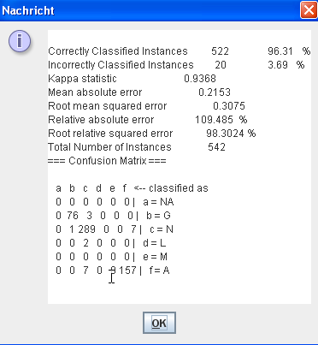
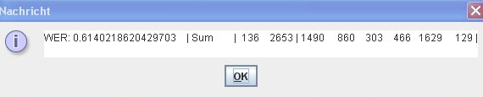
Speechalyzer – The T-Labs Text annotation tool.
Evaluation.
Features
Ex- and internal tools interfaced to evaluate recognition / classification performance:
  Sclite, NIST tool to compute word error rate WER.
  Weka to compute 10-fold cross validation on classification models.
  Recall and precision analysis provided by internal module.

Slide 9
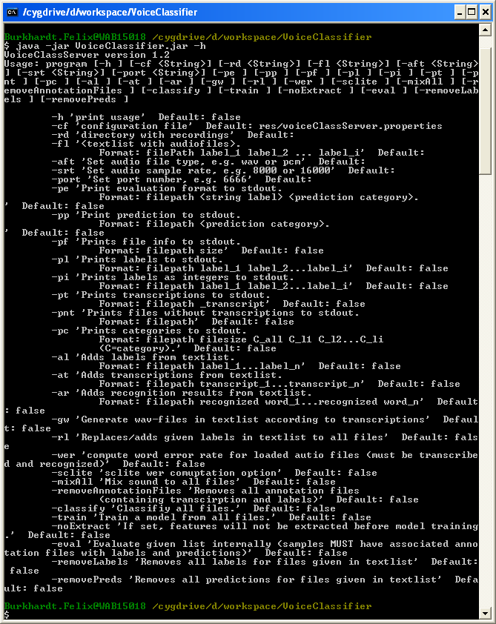
Speechalyzer – The T-Labs Text annotation tool.
Command line interface.
Features
Whole functionality can be accessed by command line call, in order to use the Speechalizer for automated batch processing.
Plus some additional functionality like mixing speech data with (street) noise for evaluation purpose.

Slide 10
Thank you.
Notes:
16.09.2009
<Nummer>
Autor / Thema der Präsentation

