Slide 1
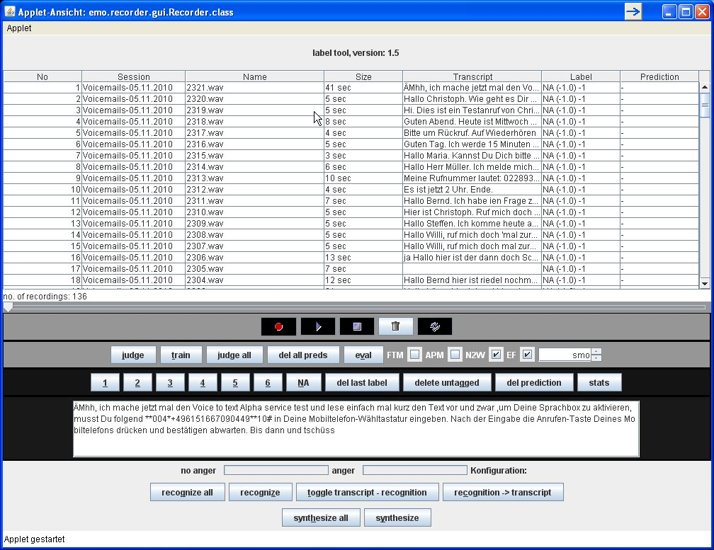
Audio file list with transcript, size and labels
Play progress slider
Record from local audio system (e.g. microphone)
Play / resume
Delete audio and transcipt
Refresh from file system
Predict class with automatic classifier
Train classifier
Predict all files
Remove predictions
Print out evaluation report (recall & precision)
Activate fast (single click) transcription mode
Activate fast (single click) play mode
Activate automatic number to word conversion
Activate feature extraction before classification
Choose classifier algorithm,
Assign label (number and naming configurable)
Remove last label assignment
Delete all files without labels
Delete all files without a prediction
Printout file statistics (number, length, etc)
Transcription editor with
  Number to word conversion
  Automatic XML tagging
  Shortcut expansion
TTS synthesize the transcript of all files
  SVOX TTS
  Mbrola TTS (with emotions)
Synthesize single
ASR (currently EML system) on all files
ASR on single file
Toggle transcript view between ASR result and transcript
Overwrite transcript with ASR result
Display classification result

