Slide 1
Fichier des paramètres sables/vases
NEW BED MODEL = / NEW_BED_MODEL logical
TYPE OF SEDIMENT = NCO,NCO,NCO,CO,CO/ TYPE_SED permet de remplir SEDCO()
X COHESIVE SEDIMENTS /SEDCO(NSICLA)
XNUMBER OF SIZE-CLASSES OF BED MATERIAL /NSICLA
X BED-LOAD (CHARRIAGE) = O / CHARR
X BED LOAD FOR ALL SANDS = / CHARR
XBED-LOAD TRANSPORT FORMULA FOR ALL SAND = X / ICF
XBED-LOAD TRANSPORT FORMULA = X / ICF
XSUSPENSION TRANSPORT FORMULA FOR ALL SAND = X / ICQ (pas de choix : Krone et Part en automatique pour les vases)
XREFERENCE CONCENTRATION FORMULA /ICQ
X SUSPENSION = O / SUSP
X SUSPENSION FOR ALL SAND = / SUSP
X SHIELDS PARAMETERS / AC(NSICLA) prevoir -9 = (default)calcul auto
X SETTLING VELOCITIES /XWC(NSICLA) prevoir -9 = (default)calcul auto
X NON COHESIVE BED POROSITY /XKV(NOMBLAY)
X HIDING FACTOR FORMULA /HIDFAC
X HIDING FACTOR PAR CLASSE GRANULO /HIDI(NSICLA)
X D90 /FD90(NSICLA)
X SEDIMENT DIAMETERS /FDM(NSICLA)
X MEAN DIAMETER OF THE SEDIMENT (doublon) calcule dans mean_grain_size.f
IF (MEAN DIAMETER OF THE SEDIMENT) IN FICHIER CAS -> REPLACED BY SEDIMENT DIAMETERS
X CRITICAL SHEAR STRESS FOR MUD DEPOSITION X /TOCD (NSICLA) modif a fairre dans les sub
X CRITICAL SHEAR VELOCITY FOR MUD DEPOSITION /VITCD
X FORMULATION FOR DEPOSITION AND EROSION= X;X/ PAS UTILISE? -> METTRE QUE KRONE ET PART
X PARTHENIADES CONSTANT / PARTHENIADES (NOMBLAY)

Slide 2
Fichier des paramètres sol
X BED MODEL= / BED_MODEL
1. Simple multilayer
X NUMBER OF BED LOAD MODEL LAYERS= /NOMBLAY
X MUD CONCENTRATION PER LAYER : x;x;x / CONC_VASE (NOMBLAY)
X CRITICAL EROSION SHEAR STRESS OF THE MUD= x; x; x / TOC_MUD (NOMBLAY) on rempli après TOCE_VASE pour l’ancien modèle dans lecdon et TOCE_MUD(NOMBLAY,NPOIN2) dans ini_sediment.f pour nouveau modele
2. Multilayer with consolidation
X MASS TRANSFER PER LAYER /TRANS_MASS (NOMBLAY)
3. Multiilayer with activ layer
X ACTIVE LAYER THICKNESS /ELAY0 directement dans BED_MODEL
X CONSTANT ACTIVE LAYER THICKNESS / CONST_ALAYER
4. Multilayer with consolidation based on Gibson theory
X GEL CONCENTRATION / CONC_GEL
X MAXIMUM CONCENTRATION / CONC_MAX
X PERMEABILITY COEFFICIENT / COEF_N
X INITIAL FRACTION FOR PARTICULAR SIZE CLASS /AVA0(NSICLA)
X CONCENTRATION VOLUMIQUE DU LIT COHESIF /CSF\_VASE
X GRAIN-FEEDING
SEDIMENT SLIDE /SLIDE -> verifier avec nouveau modele
X CONSOLIDATION MODEL /ITASS
X NUMBER OF LAYERS OF THE CONSOLIDATION MODEL /NCOUCH_TASS

Slide 3
Nouvelles subroutines
Suspension_deposit.f
Suspension_erode.f
Suspension_computation_cae.f
Bed_consolidation_layer.f
Bed_update.f
Update_activelayer_hirano.f
Subroutines modifiees pour nouveau modele
Sisyphe.dico
Declaration_sisyphe.f
Point_sisyphe.f
Lecdon_sisyphe.f
Init_sediment.f

Slide 4
SUITE LECTURE FICHIER DES PARAMETRES:
CALCULER NSICLA dans lecdon.f pour nouveau modèle -> NSICLA donné par la taille du vecteur
REMPLIR SEDCO(NSICLA) avec type de SEDIMENT dans LECDON
DEFINIR NSAND ET NMUD -> tableau de correspondance dans LECDON
ISAND =NUM_ICLA-ISAND(ICLA) ICLA=NUM_ISAND-ICLA(ISAND) pour nouveau modele
IMUD =NUM_ICLA-IMUD(ICLA) ICLA=NUM_IMUD-ICLA(IMUD) pour nouveau modele
REMPLIR CHARR (si au moins 1 bedload) et SUSP (si au moins 1 susp) dans LECDON pour nouveau modele
-> PAS CLAIRE
XTOCE_VASE(NOMB_LAY), -> à remplir à partir de TOC_MUD(NOMBLAY) dans lecdon pour ancien modele
X XWSAB(IMUD) transforme XWC (NUM_MUD-SICLA(IMUD)) -> PAS CLAIRE
TOCE_MUD(ILAYER,IPOIN)
TOCE_SAND(ISAND)
MASS_SAND(ISAND,ILAYER,IPOIN)
MASS_MUD(IMUD,ILAYER,IPOIN)
MASS_MIX_TOT(ILAYER,IPOIN)
MASS_SAND_TOT(ILAYER,IPOIN)
MASS_MUD_TOT(ILAYER,IPOIN)
RATIO_SAND(ISAND,ILAYER,IPOIN)
RATIO_MUD(IMUD,ILAYER,IPOIN)
RATIO_MUD_SAND(ILAYER,IPOIN)
ES(IPOIN,ILAYER)

Slide 5
VERIFICATION COMPATIBILITE DES CHOIX DE TRANSPORT → DECIDER QUAND ON LE FAIT
Do ISICLA=1,NSICLA
sable -> bedload et/ou suspension
vase -> suspension
si bedload -> formules: si pas houle
1 : MEYER-PETER (charriage)
2 : EINSTEIN-BROWN (charriage)
3 : ENGELUND-HANSEN + CHOLLET ET CUNGE (VERSION 5.3)
30: ENGELUND-HANSEN (total)
4 : BIJKER (charriage + suspension)
5 : SOULSBY - VAN RIJN (charriage + suspension)
6 : HUNZIKER (uniquement granulometrie etendue)
DE MASQUAGE DE HUNZIKER APPLIQUEE
et mot-cle HIDING-FACTOR not used
7 : VAN RIJN (bed load)
8 : BAILARD (charriage + suspension)
9 : DIBAJNIA ET WATANABE (total)
sinon
4 : BIJKER (charriage + suspension)
5 : SOULSBY - VAN RIJN (charriage + suspension)
8 : BAILARD (charriage + suspension)
9 : DIBAJNIA ET WATANABE (total)
si suspension et vase -> Krone et parth si houle stop pour l’instant
si suspension et sable -> si houle: bijker
sinon bijker ou fredsoe
Enddo
Si NSAND.NE.0 et NMUD.NE.0 -> bedload pas possible pour l’instant → PAS CLAIRE

Slide 6
VERIFICATION COMPATIBILITE DES CHOIX DE MODELE DE SOL
Si 1sable et pas de vase -> Multicouche simple
Si plusieurs sable et pas de vase
Multicouche simple
Multicouche avec couche active
Si 1 vase et pas de sable
Multicouche simple
Multicouche avec tassement
Modele de Thiebot (Theorie de Gibson)
Si plusieurs vases et pas de sable
Multicouche simple
Multicouche avec tassement
Modele de Thiebot (Theorie de Gibson) A programmer avec total des vases
Si au moins une vase et au moins un sable
Multicouche simple
Multicouche avec tassement

Slide 7
MOTS CLES A CHANGER POUR validation dans le mode ANCIENNE VERSION
TYPE OF SEDIMENT = NCO,NCO,NCO,CO,CO/ TYPE_SED permet de remplir SEDCO()
Instead of:
X SEDIMENTS COHESIFS /SEDCO(NSICLA)
XNUMBER OF SIZE-CLASSES OF BED MATERIAL /NSICLA
XCHARRIAGE = O / CHARR
X SUSPENSION = O / SUSP
XBED-LOAD TRANSPORT FORMULA FOR ALL SAND = X / ICF
Instead of:
XBED-LOAD TRANSPORT FORMULA = X / ICF
XSUSPENSION TRANSPORT FORMULA FOR ALL SAND = X / ICQ (Krone et Part en automatique pour les vases)
XREFERENCE CONCENTRATION FORMULA /ICQ
Instead of:
X CRITICAL SHEAR STRESS FOR MUD DEPOSITION X /TOCD (NSICLA) modif a fairre dans les sub
X CRITICAL SHEAR VELOCITY FOR MUD DEPOSITION /VITCD

Slide 8
MANDATORY KEYWORDS
TYPE OF SEDIMENT
BED LOAD FOR ALL SANDS
SUSPENSION FOR ALL SANDS
BED-LOAD TRANSPORT FORMULA FOR ALL SANDS
SETTLING VELOCITIES
SHIELDS PARAMETER

Slide 9
New_SISYPHE.f
IN BLACK: ORIGINAL SISYPHE NON MODIFIED
IN BLACK: MOVED
IN RED: ORIGINAL SISYPHE MODIFIED
IN GREEN: NEW SUBROUTINE

Slide 10
INITIALIZATION
Suite de calcul et sauvegarde variable sol a faire
CONDIM_SISYPHE.f
NOEROD.f (not necessary made in init sediment.f)
INIT_SEDIMENT.f (S.PAVAN+Y.AUDOUIN)
BED_UPDATE.f (R.WALTHER + J. FONTAINE) NOT NECESSARY AT THIS STAGE;
ONLY CALLED AFTER BEDLOAD/SUSPENSION/…TO UPDATE MASS, RATIO, THICKNESS AND COTE DE FOND (ZF)
CALCUW.f
CALCURMS.f (R.WALTHER + J. FONTAINE) use in Soulsby-VanRin and others but remplaced with UW in sisyphe!!
TOB_SISYPHE.f
INIT_TRANSPORT.f voir au moins CHARR SUSP
….
KF_SISYPHE.f
COEFRO_SISYPE.f
If(HOULE)then
TOBW_SISYPHE.f
TOBCW_SISYPHE.f (R.WALTHER + J. FONTAINE) total shaer strees wave + current (non linear)
endif

Slide 11
LOOP on time
MEAN_GRAIN_SIZE.f (M.DELINARES + P. TASSI)
If (HOULE) then
CALCUW.f
CALCURMS.f (R.WALTHER + J. FONTAINE) use in Soulsby-VanRin and others but remplaced with UW in sisyphe!!
Endif
TOB_SISYPHE.f (R.WALTHER + J. FONTAINE) total shaer strees wave + current (non linear)
IF (BEDLOAD) THEN
BEDLOAD_MAIN.F
Up date the bottom
LAYER.F or CVSP_MAIN.F
If (CONSOLIDATION)THEN -> consolidation corresponds to TASS?
STOP ‘Not programmed yet’
Endif
if (NLAYER>1 .AND.NSICLA .GT.1.AND.(.NOT. TASS) then
UPDATE_ACTIVELAYER_HIRANO.f (M.DELINARES + P. TASSI)
endif
BED_UPDATE.f (R.WALTHER + J. FONTAINE)
ENDIF
BEDLOAD_DIFFIN.f
BEDLOAD_SOLIDISCHARGE.f
(M.DELINARES + P. TASSI) compute solidischarge if ratio_mud < 30%.
BEDLOAD_EVOL.f
COMPUTE_BEDLOAD_FLUER_MUD.f (M.DELINARES + P. TASSI) compute mud contained in the volume of bed that have moved with bedload.
NESTOR.f?

Slide 12
IF (SUSPENSION) THEN
SUSPENSION_MAIN.F
LAYER.F or CVSP_MAIN.F
If (CONSOLIDATION)THEN -> consolidation corresponds to TASS?
STOP ‘Not programmed yet’
Endif
if (NLAYER>1 .AND.NSICLA .GT.1.AND.(.NOT. TASS) then
UPDATE_ACTIVELAYER_HIRANO.f (M.DELINARES + P. TASSI)
endif
BED_UPDATE.f (R.WALTHER + J. FONTAINE)
ENDIF
MAXSLOPE.f
LAYER.F or CVSP_MAIN.F
BED_UPDATE.f (R.WALTHER + J. FONTAINE)
If (consolidation) then
TASSEMENT.f
BED_CONSOLIDATION_LAYER.f
(R.WALTHER + J. FONTAINE)
.or.
TASSEMENT2.f (Gibson with only NSAND=0)
(R.WALTHER + J. FONTAINE)
BED_UPDATE.f (R.WALTHER + J. FONTAINE)
Endif
BILAN_SISYPHE.f
FLUSEC_SISYPHE.f
….
SUSPENSION_DISPERSION.f
SUPENSION_COMPUTATION.f
SUSPENSION_ERODE.f
(R.WALTHER + J. FONTAINE)
If (3D)THEN
SEND TO TELEMAC3D (FLUER + FLUDPT)
**FLUDPT: CONDITIONS LIMITES
(?+?)
ELSE
SEND TO TELEMAC2D (FLUER + FLUDPT)
**FLUDPT: TERMES SOURCES
.OR. (for this time)
SUPENSION_COMPUTATION.f
(?+?)
ENDIF
RECEIVE FROM TELEMAC2D/3D (FLUDEP)
(?+?)
SUSPENSION_DEPOSIT.f
(R.WALTHER + J. FONTAINE)
SUSPENSION_LISTING.f
(?+?) check compatibility
SUSPENSION_BILAN.f
(?+?) check compatibility
SUSPENSION_COMPUTE_CAE.f
(R.WALTHER + J. FONTAINE)
TELEMAC3D.f tracers convection
(R.KOPMANN + T.BENSON)
SUSPENSION_CONV.f
SUSPENSION_EROSION.f
SUSPENSION_EROSION_COH.f
SUSPENSION_FLUX_MIXTE.f
SUSPENSION_DEPOT.f
DIFFIN.f
CHARRAC.f
CVDFTR.f
+ CALCUL DE FLUDEP
SUSPENSION_EVOL.f
SUSPENSION_LISTING.f
SUSPENSION_BILAN_COH.f
SUSPENSION_BILAN.f
TELEMAC3D.f tracers convection
(R.KOPMANN + T.BENSON)

Slide 13
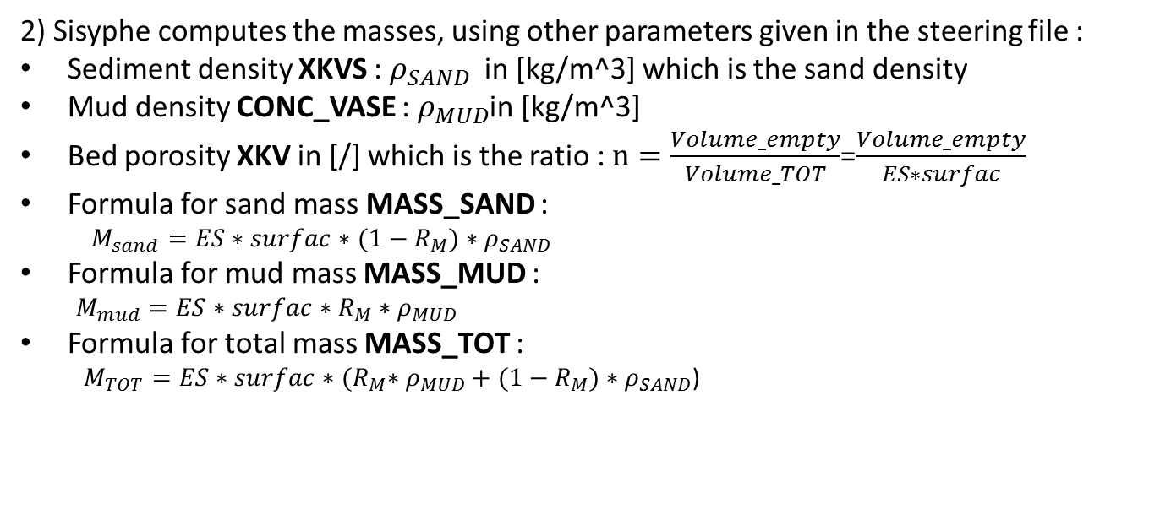
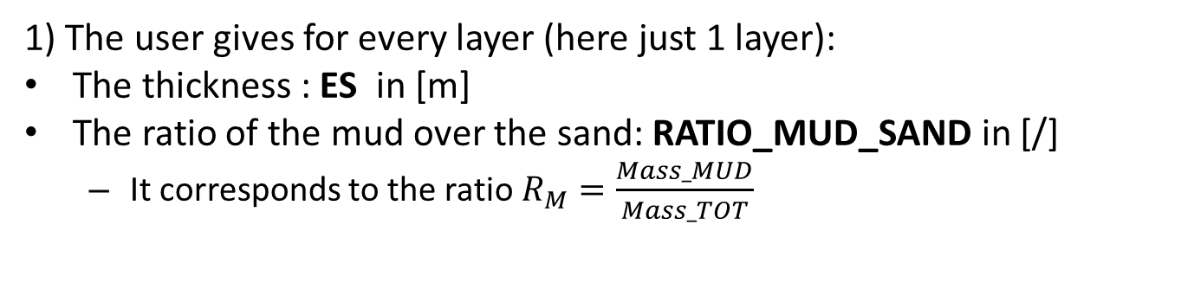
INIT_SEDIMENT
Case A : 1 layer with 1 mud and 1 sand
1) The user gives for every layer (here just 1 layer):
The thickness : ES in [m]
The ratio of the mud over the sand: RATIO_MUD_SAND in [/]
It corresponds to the ratio $R_{M}=\frac{Mass_MUD}{Mass_TOT}$
2) Sisyphe computes the masses, using other parameters given in the steering file :
Sediment density XKVS : $ρ_{SAND}$ in [kg/m^3] which is the sand density
Mud density CONC_VASE : $ρ_{MUD}$in [kg/m^3]
Bed porosity XKV in [/] which is the ratio : $n=\frac{Volume_empty}{Volume_TOT}$=$\frac{Volume_empty}{ES∗surfac}$
Formula for sand mass MASS_SAND :
$M_{sand}=ES∗surfac∗(1−R_{M})∗ρ_{SAND}$
Formula for mud mass MASS_MUD :
$M_{mud}=ES∗surfac∗R_{M}∗$ $ρ_{MUD}$
Formula for total mass MASS_TOT :
$M_{TOT}=ES∗surfac∗{(R}_{M}∗$ $ρ_{MUD}+(1−R_{M})∗ρ_{SAND}$)

Slide 14
OLD INITIALIZATION (init_sediment)
1. ELAY = ZF - ZR
Volumetric ratio = 1
Mean diameter = FDM(1)
If MUD → init_mixte
=1
2. NSICLA
A. Not mixte
1) init_avai
2) Mean diameter for active layer and under-layer
B. Mixte
1) init_mixte
2) Mean diameter of the active layer
>1
3. Computation of
SETTLING VELOCITIES
SHIELDS PARAMETER
4. If mixte then definition of TOCE_SABLE

Slide 15
INIT_MIXTE
* Only case not computation continued
1. Init_compo_coh
Initialization of layer thickness, concentration and volume fraction (ES , EPAI_VASE , EPAI_SABLE , ES , CONC , AVAIL )
2. Re-computation of thickness in order to have ES = ZF - ZR
3. Check sum ELAY= ZF-ZR = sum(ES)
4. Mass computation : sand and mud
4. Mass balance

Slide 16
INIT_AVAI
1. Init_compo
what’s the difference between ncouche in init_compo and nomblay?
2. Check sum(ES).LE. ZF - ZR
3. Thickness of supplementary layers set to 0
4. Last layer thickness enlarged if necessary
1st layer must be larger than active layer
ES(1)>ELAY0
1st layer divided between active layer and substratum; volume fraction are consequently defined : ES, NLAYER, ELAY0, AVAIL,ELAY, ESTRAT
5. Definition of active layer and substratum
6. Computation of total volume of sediment in each class

