Slide 1
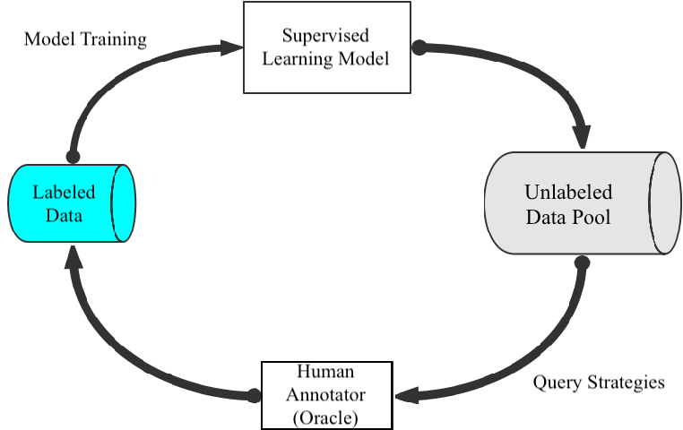
Initial Model
Supervised Learning Model
Model Training
Unlabeled
Data Pool
Labeled
Data
Human Annotator
Query Strategies

