Slide 1


Package | Description
teleop_grasp | Packages related only to the ROVI project.
teleop_grasp | Integration of packages to provide a teleoperation/grasp pipeline.
rovi_models | Gazebo models and worlds for the the ROVI workcell.
rovi_planner | Interpolation-based trajectory generation.
rovi_vision | Computer vision-based pose estimation methods for objects in the ROVI workcell.
franka_ros | Integration of UR5 manipulator into ROS/Gazebo/MoveIt ecosystem.
franka_controllers | ros_control controllers and interface for the Franka robot.
... | URDF descriptions of the UR5 robot.
ros_utils | Utilities for interfacing ROS/Gazebo/MoveIt/Eigen etc.

Slide 2
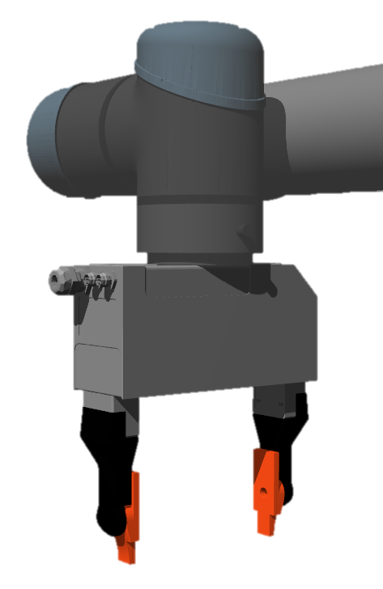
Flange (EE)
Gripper (TCP)

