Slide 1
Transportation for Visually Impaired
Development Team:
Tyler Espy
Taylor Lucy
Aymeric Zuurhout

Slide 2
Customer Vision
Product Specifications (1)
Create an easy to use calendar for visually impaired workers
Must be able to keep up with 50-60 people/reservations per month
Prefer compatibility with:
JAWS
http://www.freedomscientific.com/Products/Blindness/JAWS
ZoomText
http://www.boundlessat.com/ZoomText

Slide 3
Customer Vision
Forms
Create Information Insertion Form
Status:
Accomplished to Customer Satisfaction
Create Print Out Form
Status:
Accomplished to Customer Satisfaction

Slide 4
Customer Vision
Calendar
Attributes
Have Display Options for Month, Week, Day
Show Driver/Car Availability Real Time
Distinguish Between Vehicles
Different Colors Preferred
Reservations Shown on Date
Each Day is linked to Information Insertion Form

Slide 5
Cycle 1 Goals
Add Reservation Insertion Form Features
Create Print Out Form
New Calendar View
Insert schema’s into database
Driver
Car
Reservation

Slide 6
Cycle 1 Progress
Reservation Insertion Form:
Completed
Create Print Out Form
Completed
New Calendar View
In Progress
Database Schema
In Progress

Slide 7
Challenges
Time Management

Slide 8
Design Description:
Reservation Insertion Form:

Slide 9
Calendar Design Description:
Once a date is selected the user has the multiple options to choose from:
Get Reservations– which looks at the day selected and see all the reservations all put in.
Get Driver Availability – which check to see if there is any driver free or currently working a that moment.
Get Vehicle Availability – which sees if there is any service vehicles are no in use.

Slide 10

Calendar Design Description:
Now if there is not a reservation and one is needed, the user simple selects the “Make a new Reservation” link
Doing this directly sends the user to the form that will be filled out

Slide 11
Registration Form
When the user reaches the form, they will be asked a few necessary questions in-order to proceed and create a reservation.
Some general questions:
Client Name
Disability
Emergency Contact Information
Pickup Location
Pickup Time
Reason for Appointment
Drop-off Location
New Patient

Slide 12
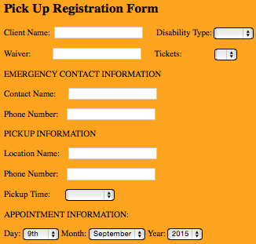
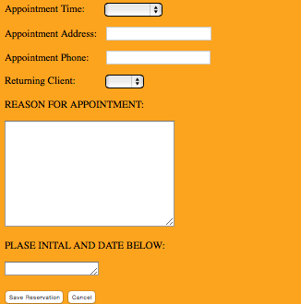
Registration Form

