Slide 1
Transportation for Visually Impaired
Development Team:
Tyler Espy
Taylor Lucy
Aymeric Zuurhout

Slide 2
Customer Vision
Product Specifications (1)
Create an easy to use calendar for visually impaired workers
Must be able to keep up with 50-60 people/reservations per month
Prefer compatibility with:
JAWS
http://www.freedomscientific.com/Products/Blindness/JAWS
ZoomText
http://www.boundlessat.com/ZoomText

Slide 3
Customer Vision
Product Specification (2)
Digitalize Transportation Form
Drop Boxes Preferred

Slide 4
Customer Vision
Calendar Attributes
Show Driver/Car Availability Real Time
Distinguish Between Vehicles
Different Colors Preferred
Driver/Vehicle Determined upon reservation
Reservations Shown on Date

Slide 5
Customer Vision
Car Attributes (4)
Name
Designated Color
Current Status
Available
Busy
Maintenance

Slide 6
Customer Vision
Driver Attributes
Name
Current Status
Available
Not Available

Slide 7
Customer Vision
Client
Name
Disability
Waiver
Emergency Contact Name
Emergency Phone Number
New Patient
Yes
No

Slide 8
Customer Vision
Accessibility Preference
Public Access
From AIDB Home Page on PC
Prefer IOS wrapper

Slide 9
Architectural Spike Overview
Goals:
Create initial HTML Calendar/Date Selector
Convert Paper Form to Initial Digital Form

Slide 10
Challenges
Communication was difficult
Distance is a plausible factor
IT manager implied we would be given access to a development server, but was later revoked
Familiarizing ourselves with languages hindered progress
Changes in design

Slide 11
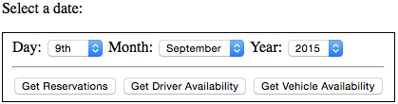
Calendar Design Description:
Our Customer was very excited about adding drop downs
Instead of creating a visual calendar that may be hard to see, we implemented a date selection form with dropdown options.

Slide 12
Calendar Design Description:
Once a date is selected the user has the multiple options to choose from:
Get Reservations– which looks at the day selected and see all the reservations all put in.
Get Driver Availability – which check to see if there is any driver free or currently working a that moment.
Get Vehicle Availability – which sees if there is any service vehicles are no in use.

Slide 13

Calendar Design Description:
Now if there is not a reservation and one is needed, the user simple selects the “Make a new Reservation” link
Doing this directly sends the user to the form that will be filled out

Slide 14
Registration Form
When the user reaches the form, they will be asked a few necessary questions in-order to proceed and create a reservation.
Some general questions:
Client Name
Disability
Emergency Contact Information
Pickup Location
Pickup Time
Reason for Appointment
Drop-off Location
New Patient

Slide 15
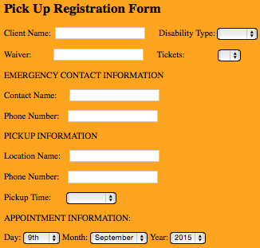
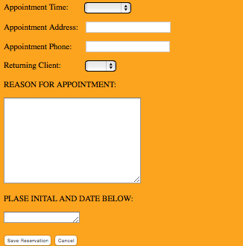
Registration Form

