Slide 1

Transportation for Visually Impaired
Development Team:
Tyler Espy
Taylor Lucy
Aymeric Zuurhout

Slide 2
Customer Vision
Product Specifications (1)
Create an easy to use calendar for visually impaired workers
Must be able to keep up with 50-60 people/reservations per month
Prefer compatibility with:
JAWS
http://www.freedomscientific.com/Products/Blindness/JAWS
ZoomText
http://www.boundlessat.com/ZoomText

Slide 3
Customer Vision
Product Specification (2)
Digitalize Transportation Form
Drop Boxes Preferred

Slide 4
Customer Vision
Calendar Attributes
Show Driver/Car Availability Real Time
Distinguish Between Vehicles
Different Colors Preferred
Driver/Vehicle Determined upon reservation
Reservations Shown on Date

Slide 5
Customer Vision
Car Attributes (4)
Name
Designated Color
Current Status
Available
Busy
Maintenance

Slide 6
Customer Vision
Driver Attributes
Name
Current Status
Available
Not Available

Slide 7
Customer Vision
Client
Name
Disability
Waiver
Emergency Contact Name
Emergency Phone Number
New Patient
Yes
No

Slide 8
Customer Vision
Accessibility Preference
Public Access
From AIDB Home Page on PC
Prefer IOS wrapper

Slide 9
Architectural Spike Overview
Goals:
Create initial HTML Calendar/Date Selector
Convert Paper Form to Initial Digital Form

Slide 10
Challenges
Communication was difficult
Distance is a plausible factor
IT manager implied we would be given access to a development server, but was later revoked
Familiarizing ourselves with languages hindered progress
Changing design

Slide 11

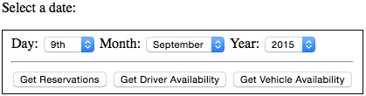
Calendar Design Description:
Our Customer was very excited about adding drop downs
Instead of creating a visual calendar that may be hard to see, we implemented a date selection form with dropdown options.

Slide 12
Calendar Design Description:
Once a date is selected the user has the multiple options to choose from:
Get Reservations– which looks at the day selected and see all the reservations all put in.
Get Driver Availability – which check to see if there is any driver free or currently working a that moment.
Get Vehicle Availability – which sees if there is any service vehicles are no in use.

Slide 13

Calendar Design Description:
Now if there is not a reservation and one is needed, the user simple selects the “Make a new Reservation” link
Doing this directly send the user to the form that will be filled out

Slide 14
Form
When the user reaches the form, they will be asked a few necessary questions in-order to proceed and create a reservation.
Some general questions are like
Client Name
Disability
Emergency Contact Information
Pickup Location
Pickup Time
Reason for Appointment
Drop-off Location
New Patient

Slide 15
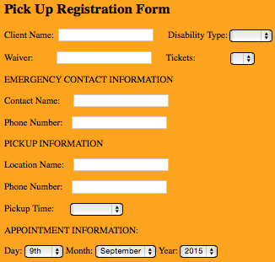
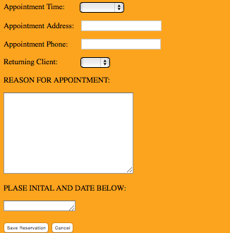
Form

