Slide 1
Ensemble Classification & Regression
Ensemble methods
Basic idea: use multiple models to get better performance
Main theory: Bias-variance-covariance decomposition
Improved performance of an ensemble over its constitute base predictors with diversities in
data, parameter, structure
Conventional ensemble methods include:
Bagging, boosting, and stacking based methods
Key point:
If we are able to design low-correlated individual learners, we can expect an increase in performance
[Ref: Ren, Zhang & Suganthan, “Ensemble Classification and Regression – Recent Development, Applications and Future Direction”, IEEE Computational Intelligence, Feb 2016]

Slide 2
Our Concerns: Bias and Variance
There are always two competing forces that govern the choice of learning method i.e. bias and variance.
Bias of learning methods refers to the error that is introduced by modeling a real life problem (that is usually extremely complicated) by a much simpler model.
For example, linear regression assumes that there is a linear relationship between Y and X. It is unlikely that, in real life, the relationship is exactly linear so some bias will be present. Suits (Bias towards) specific ‘linear’ problems

Slide 3
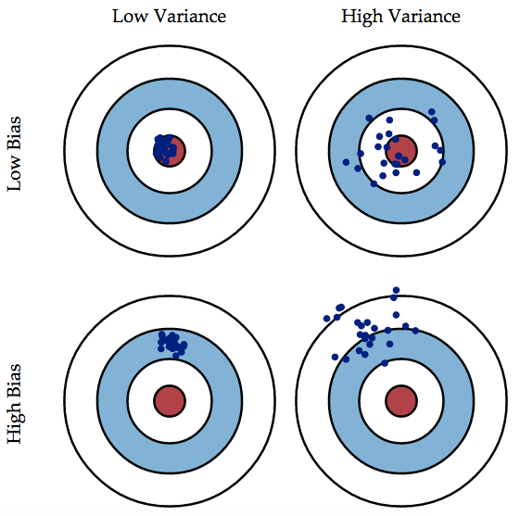
Our Concerns: Bias and Variance (cont.)
Variance of learning methods refers to how much your estimate for f would change by if you had a different training data set.
The more flexible a method is
the more variance it has.
The more variance/complex a
method is the less bias it will
generally have.

