Slide 1
Data Analysis & Programming for Operations Management (DAPOM)
Wout van Wezel (Coordinator)
w.m.c.van.wezel@rug.nl

Slide 2
Contents
Final assignment

Slide 3
Final assignment
The assignment is insprired by Belsimpel, but the specific context and assumptions are all hypothetical!
Assumptions:
The current warehouse is too small to handle the increased sales
A second warehouse cannot offer 1-day delivery
Loss of sales when a product is stored at the second warehouse
Your task: decide which products will be stored at the second warehouse, given limited capacity of the main warehouse
Additional data: dimensions of products and profit margins

Slide 4
Final assignment
The assignments uses the various elements from the course:
Create it in Phyton
Use Elasticsearch to store/retrieve data
Use Pandas for numerical analyses
Matplotlib for visualization
Gurobi for optimization
Do not start the assignments before you master the corresponding chapters in the practical manuals

Slide 5
Final assignment, basic approach
Determine basic stock level per product: expected weekly sales plus a bit of safety stock
Assume weekly replenishment, so at least one time per week, space is needed for the basic stock level.
Determine, for each product how many storage locations are needed (==> basic stock level * dimensions)
Now decide per product, whether it will be in the main warehouse or in the second warehouse.
If it is in the second warehouse, profit goes down by:
% loss of demand * (profit margin * demand)

Slide 6
Final assignment
We have list with days/product numbers:
"day","product_id"
1,"794"
1,"261"
1,"492"
...
730,"704"
730,"42"
730,"95"
730,"42"
730,"628"
730,"842"

Slide 7
Final assignment
We have list with days/product numbers. This list is now quite small, but it will grow in the future.
So we cannot assume it is possible to load the entire list in Pandas.
To determine the best solution, the data can be aggregated to average daily demand per product:
"product_id" "average_daily_demand"
"794", "1"
"261", "1"
...
"704", "1"
"42", "2"

Slide 8
Final assignment
In these kinds of tasks, you need a mix of technologies. In this case:
You need to optimize, but the mathetmatical model of Gurobi cannot magically handle a list with orders.
To calculate the data necessary for Gurobi, you can use Pandas.
Pandas, however, cannot handle big data
To handle big data, you can use Elasticsearch
(ES could also be used for the calculations, but is not as powerful as Pandas)

Slide 9
Final assignment
Tools for the final assignment:
Use Elasticsearch to aggregate orders (which could be an unlimited amount) to daily demand per product.
Data per day per product is something we can handle in Pandas.
Transfer ES results to Pandas to:
Calculate average demand per product over all days
Draw graphs to get a feel of the data
Calculate the volume needed per product in the warehouse
Use the data in Pandas to build a model for Gurobi

Slide 10
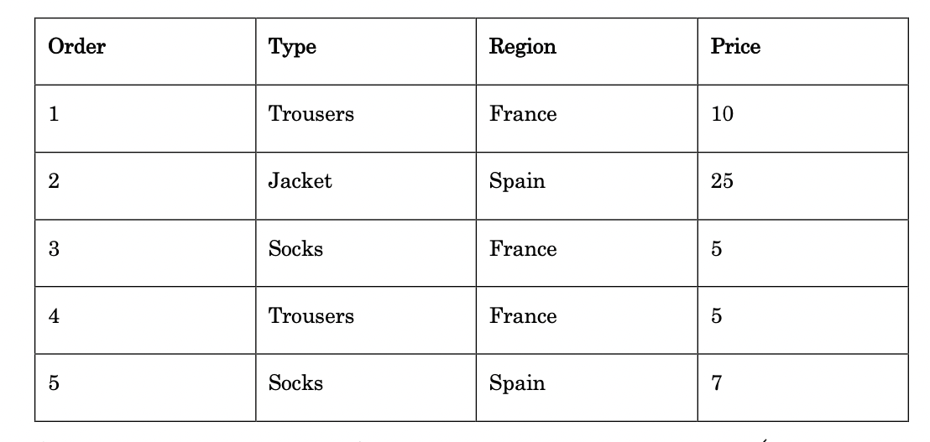
How aggregate data in ES?
From the manual:

Slide 11
How aggregate data in ES?
We don't need the underlying records themselves; only the aggregated results.
(example from practical manual)
search_body = {
"size": 0,
"aggs": {
"countPerRegion": {
"terms": {
"field" : "region.keyword"
}
}
}
}
The name you use for the
Aggregation.
The field/column you want to aggregate on.
(If it is a numeric field, the .keyword is not necessary)

Slide 12
Aggregation
You could add a query/filter here
search_body = {
"size": 0,
"aggs": {
"countPerRegion": {
"terms": {
"field" : "region.keyword",
"size": 10000,
"order": {
"_key": "asc"
}
}
}
}
}
Give me back all products (otherwise it is limited to 10)
Sort the results by product_id (not really necessary here)

Slide 13
{
..blabla..
"hits":{..blabla..},
"aggregations":{
"countPerRegion":{
"doc_count_error_upper_bound":0,
"sum_other_doc_count":0,
"buckets":[
{
"key":"france",
"doc_count":3
},
{
"key":"spain",
"doc_count":2
}
]
}
}
}

Slide 14
Tip 1 (step 1.1)
With json_normalize, you can get the ES results in Pandas
For our orders file:
from pandas import json_normalize
result = es.search(index="dapom_orders", body=search_body) dfProducts = json_normalize(result['aggregations']['days']['buckets'])
dfProducts.rename(columns={'key': 'product_id'}, inplace=True)
'days' is the name I gave to the aggregation
I rename 'key' to something more sensible

Slide 15
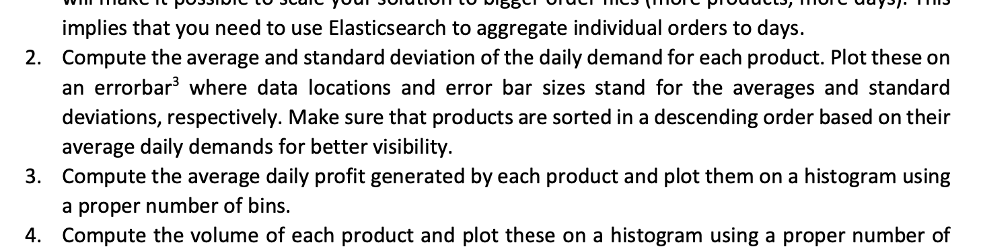
Aggregation
We need to get the average and standard deviation of daily demand per product. 700 days x 1200 products = 840.000 data points
Elasticsearch prefers to do multiple smaller tasks instead of one big task. Reasons are, for example: memory overload, time-out on http.
Possible solution:
Iterate the list with products
Ask Elasticsearch for the number of orders per day for that product
Transfer the list to Pandas
Calculate the average and standard deviation in Pandas

Slide 16
Source data
day | product
1 | a
1 | b
1 | a
2 | a
2 | c
3 | b
3 | a
3 | c
Step 1
product
a
b
c

Slide 17
Step 2
product | day | total
a | 1 | 2
 | 2 | 1
 | 3 | 1
b | 1 | 1
 | 2 | 0
 | 3 | 1
c | 1 | 0
 | 2 | 1
 | 3 | 1
Step 1
product
a
b
c

Slide 18
Step 2
product | day | total
a | 1 | 2
 | 2 | 1
 | 3 | 1
b | 1 | 1
 | 2 | 0
 | 3 | 1
c | 1 | 0
 | 2 | 1
 | 3 | 1
Step 3
product | average
a | 1.3
b | 0.7
c | 0.7

Slide 19
 | day | total
a | 1 | 2
 | 2 | 1
 | 3 | 1
b | 1 | 1
 | 2 | 0
 | 3 | 1
c | 1 | 0
 | 2 | 1
 | 3 | 1
Pandas
 | avg
a | 1.3
b | 0.7
c | 0.7
ES
ES
a
b
c
row | day | product
1 | 1 | a
… | … | …
2.000.000 | 700 | c

Slide 20
Tip 2 (step 1.2)
..ask ES for a list with unique products using aggregation..
..convert it to a dataframe dfProducts
for index, row in dfProducts.iterrows():
..do a combined filter query (only current row['product_id']),
and aggregate on the "day" field in ES..
..transfer result to a new Pandas dataframe..
..ask Pandas for the mean and standard deviation
..add those as additional columns to the dataframe
with products*
*Example: dfProducts.at[index, "averageDemand"] = dfDemandPerProductForDay["doc_count"].mean()

Slide 21
Further tips
Do not start the assignments before you master the corresponding chapters in the practical manuals.
Go step by step.
Print and analyse your data each step before continuing.
Most steps in the assignment are between 1 and 10 lines of code.
There are many ways to model your data. If you have a question, be prepared to explain to us what you did.

Slide 22
Any questions?

