Slide 1
Data Analysis & Programming for Operations Management (DAPOM)
Wout van Wezel (Coordinator)
w.m.c.van.wezel@rug.nl

Slide 2
Contents
Final assignment
Correlation matrix
Deliverables

Slide 3
Final assignment
Email support
Don't ask 'how should I do this' without any code in which we can see what you attempted.
Send your code so we can run it. No screenshots, and if you send a file, make sure we can trace what happens (i.e., what is the input)
If running all queries takes long each time you run: store the resulting dataframes in a file, and next time, load the dataframes from file.

Slide 4
Correlation
The degree to which a pair of variables are linearly related.
For example, between hours of sunshine and average temperature:
tempPerDay = [23, 16, 18, 17, 15, 12, 17] sunHours = [8, 4, 5, 6, 4, 2, 5] plt.scatter(tempPerDay, sunHours) plt.show()

Slide 5
Correlation
The degree to which a pair of variables are linearly related.
tempPerDay = [23, 16, 18, 17, 15, 12, 17] sunHours = [8, 4, 5, 6, 4, 2, 5] corr = pearsonr(tempPerDay, sunHours) print("a: ", corr) df = pd.DataFrame(columns=['temp', 'sun']) df['temp']=tempPerDay df['sun']=sunHours corr2 = df['temp'].corr(df['sun']) print("b: ", corr2)

Slide 6
Correlation
Correlations between more than two sets
rainPerDay = [0, 2, 5, 0, 9, 14, 4] df['rain']=rainPerDay # If the row is observation and column is variable or feature pearsons_coefficient = np.corrcoef(df, rowvar=False) print(pearsons_coefficient)
[[ 1. 0.960228 -0.78259806]
[ 0.960228 1. -0.84169026]
[-0.78259806 -0.84169026 1. ]]

Slide 7
Correlation
In the assignment, you need to do the same:
1263 products, demand per day, for 730 days
So a matrix of 1263 x 730
Load this into a Dataframe through Elasticsearch
Calculate the correlation

Slide 8
Correlation
1.15: pairs such that (1) the correlation coefficient between their daily demands is larger than or equal to the threshold value and (2) the first product belongs to a higher class than the second product.
This is an approximation, because we do not have actual orders with items within each order.
Rationale for 'higher class': I don't want to lose sales of a phone because the screen protector has a two day delivery time.
Correlation between expensive items (e.g., phones) is probably caused by new introductions.

Slide 9
Deliverables
Report: max 3 pages excluding code, figures, tables, etc.
Code as appendix. Make sure it is readable (watch out for line breaks)
Use a highlighter, for example:
https://highlighter.christof.weickhardt.ch/

Slide 10
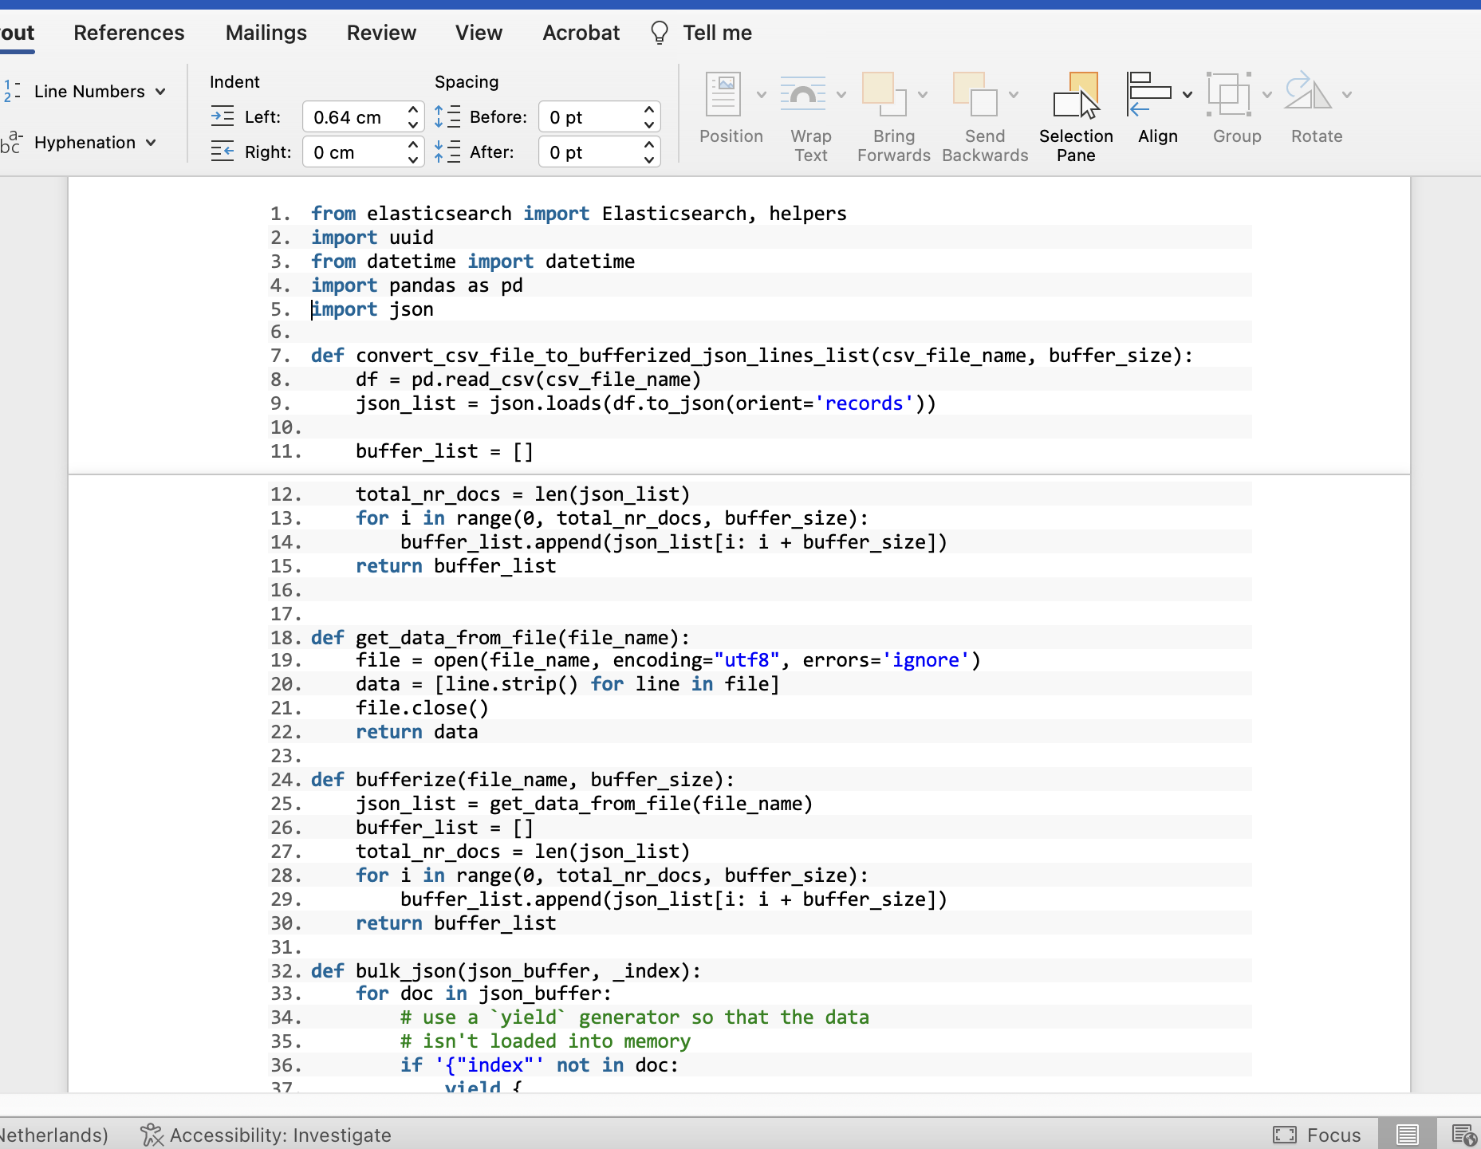
LINE NUMBERS
KEYWORD
HIGHLIGHTING
ALTERNATING
ROW COLORS

Slide 11
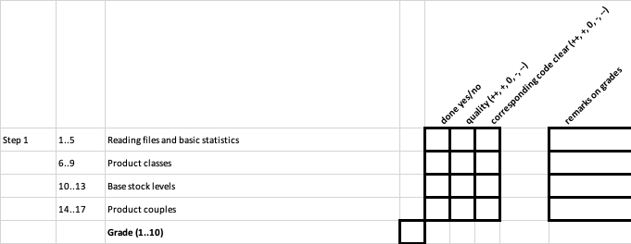
Assessment form

Slide 12
Assessment form
Step 1 1..5 Reading files and basic statistics
6..9 Product classes
10..13 Base stock levels
14..17 Product couples
Step 2 1 Daily loss
2 Heuristic 1
3 Heuristic 2
4 IP model
5..6 Comments

Slide 13
Step 3 1..6 Basic functionality
Report 1 Argumentation
2 Vizualization
3 Completeness (intro, sections, conclusion)
4 Max 3 pages of text (excluding graphs etc.)
Code 1 Completeness
2 Readability
3 Use of good programming style
Approximate weights: Step 1: 40%, Step 2: 35%, Code: 15%, Report: 10%
The teacher can decide to deviate from these percentages.
Use functions and
modules.
Use sensible variable names.

Slide 14
Any questions?

