Slide 1

Group 22 ：9961244 吳德霖
9960101 施佑儒
9962319 呂佳鴻

Slide 2
C
urriculum
A
rrangement
ecommendation
R
ystem
S

Slide 3
Outline
Motivation
Introduction
Algorithm & Design
Result & Conclusion
Demo

Slide 4

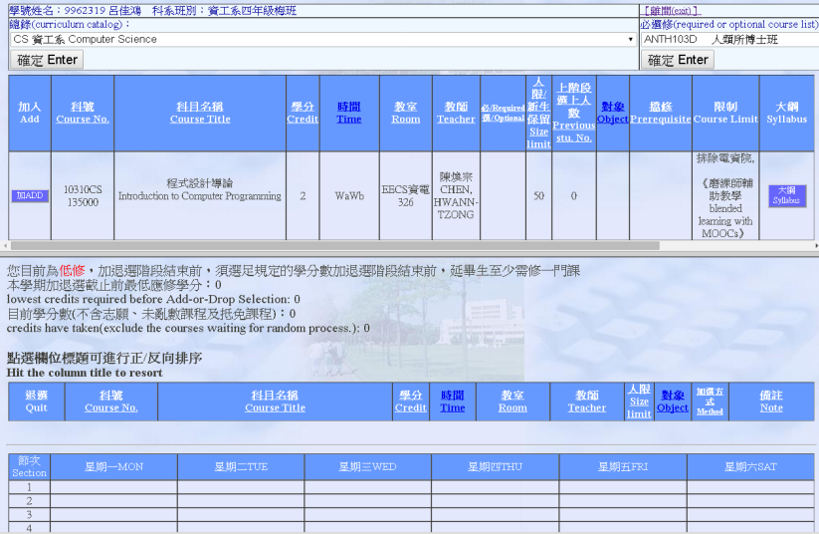



Motivation
Notes:
Kaggle Expedia Hotel recommendation system
Selecting courses is an extremely tedious work

Slide 5



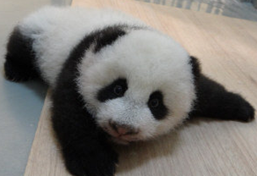



Introduction

Slide 6
Algorithm & Design

Slide 7
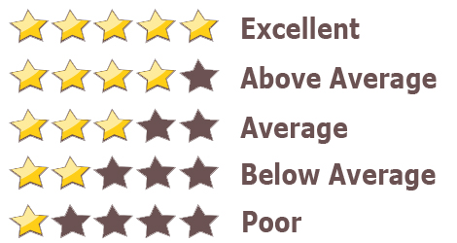

What do we care about ...
When selecting courses?
Notes:
我們選課時會在乎些甚麼attributes?
上課的內容有不有趣? 課程編排是否紮實? 老師教得好不好?
當然不是…XD

Slide 8


What do we do ...
When selecting courses?
Notes:
在選課時，我們會做些甚麼來決定最後的選填?
問學長姊 以學長姊的經驗?
必修或必選修?
Focused on CS and GE

Slide 9
Process Flow

Slide 10
Data Pre-processing
Map Reduce
Inverted-Index-like method
Sort By Course
Upload to HBase

Slide 11
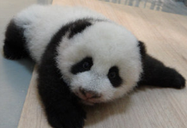

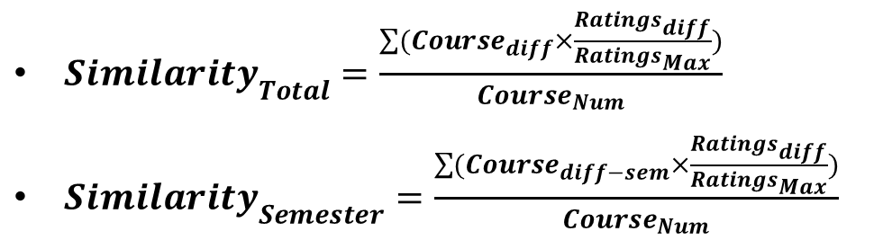
Compare the similarity
$Similarity_{Total}=\frac{\sum{(Course_{diff}×\frac{Ratings_{diff}}{Ratings_{Max}})}}{Course_{Num}}$
$Similarity_{Semester}=\frac{\sum{(Course_{diff−sem}×\frac{Ratings_{diff}}{Ratings_{Max}})}}{Course_{Num}}$
Map Reduce
Exactly the same course +1.0
Within the same category +0.5

Slide 12
Query & Ranking (CS)
Failed required courses retaking priority
A/B/C Categories Priority
Sort with respect to rating
Output the toughness

Slide 13
Query & Ranking (GE)
5 / 7 Categories Priority
Sort with respect to rating
Warning of too many selectors
Output the toughness

Slide 14
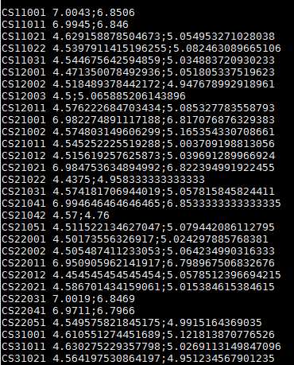
Result & Conclusion

Slide 15
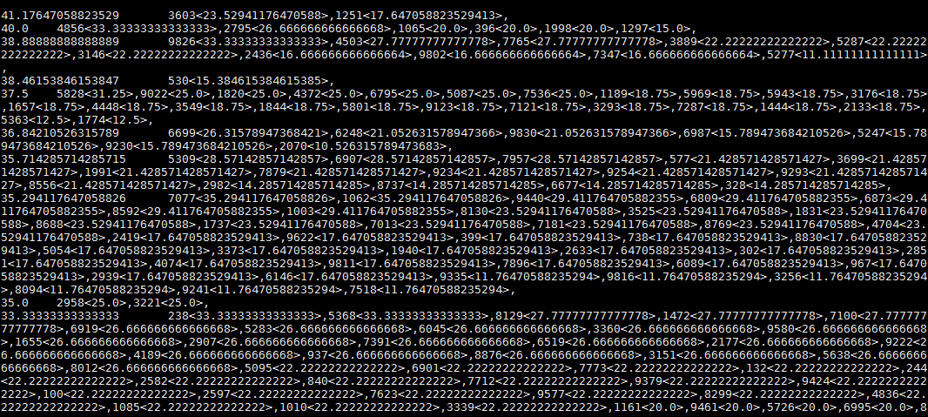
Result & Conclusion

Slide 16
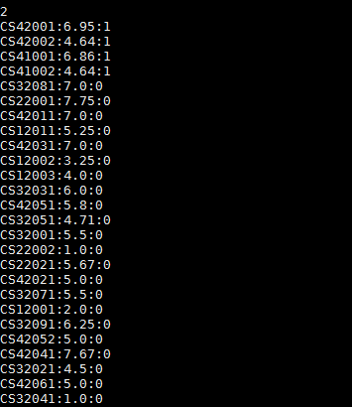
Result & Conclusion

Slide 17
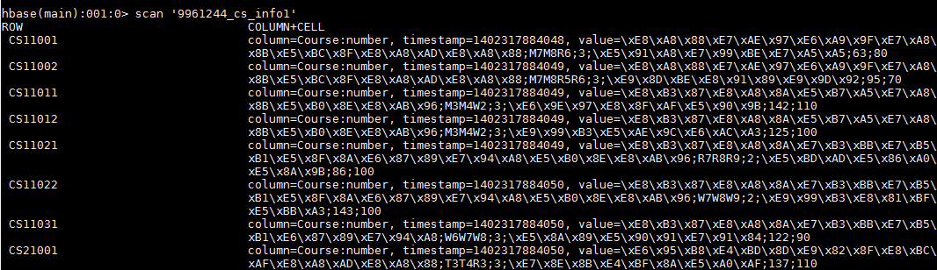
Result & Conclusion

Slide 18
Demo
file:///C:/Users/albert/Documents/Cloud/Final_Presentation/main.html

Slide 19
Thank you for your attention

