Slide 1

COVID -19 FUTURE FORECASTING Using Supervised Machine Learning Models REVIEW-1
Team Members:
NIKHIL KUMAR Reddy b– 221003068
Allapureddy Niranjan reddy – 221003006
PROJECT Guide:
Mr. arulmani k

Slide 2
AGENDA
Objectives
Problem Formulation
Literature Survey
Methodology
Proposed Work Plan
Supervised Machine Learning models
procedures
Evaluation parameters

Slide 3
OBJECTIVES
COVID-19 declared as a global pandemic by WHO, has emerged as the most aggressive disease, impacting more than 90% countries of the world. The number of infected and deceased patients has been increasing at an alarming rate in almost all the affected nations.
Forecasting techniques can be inculcated thereby assisting in designing better strategies and in taking productive decisions
Machine learning (ML) based forecasting mechanisms have proved their significance to anticipate in perioperative outcomes to improve the decision making on the future course of actions.
This study describes the capability of ML models to forecast the number of upcoming patients affected by COVID-19 which is presently considered as a potential threat to mankind.

Slide 4
PROBLEM FORMULATION
In particular, the standard forecasting models have been used in this study to forecast the threatening factors of COVID-19
Support vector machine (SVM)
Least absolute shrinkage and selection operator (LASSO)
Exponential smoothing (ES)
Linear Regression (LR)
Three types of predictions are made by each of the models, such as 1.The number of newly infected case 2.The number of deaths and 3.The number of recoveries in the next 10 days.
These techniques assess the situations of the past thereby enabling better predictions about the situation to occur in future.

Slide 5
LITERATURE SURVEY
In the literature, forecasting has been done based on various forecasting techniques and different data sources.
Categorization is also done based on techniques that are used for forecasting, i.e., data science/machine learning techniques. However, there are also a few other categories that are used in the literature for forecasting. In nutshell, these categories are broadly divided into the following four sets:
Big data.
Social media/other communication media data.
Stochastic theory/mathematical models.
Data science/Machine learning techniques.

Slide 6
LITERATURE SURVEY
In the literature, many studies are also carried out on clinical data also.
These studies may be useful for physician, doctors, and researchers in the medical domain for investigating better diagnostic methods and for pharmaceutical industries in formulating vaccines.
Various statistical, analytical, mathematical and medical parameters are taken into consideration for analysis. However, major significant parameters are listed below:
Daily death count.
Transmission rate.
Social distancing, quarantine, isolation.
Mobility.
Underlying disease, etc.

Slide 7
METHODOLOGY
The COVID-19 dataset contains the number of confirmed cases, deaths, and recoveries in the past number of days from which the pandemic started.
Initially, the dataset will be preprocessed for this study to find the global statistics of the daily number of deaths, confirmed cases, and recoveries.
After the initial data preprocessing step, the dataset has been divided into two subsets: a training set (56 days) to train the models and testing set (10 days).
The Supervised learning models such as SVM, LR, LASSO, and ES will be used for the future forecasting of COVID-19.
These models have been trained on the newly confirmed cases, recovery, and death patterns.
The learning models have then been evaluated based on some important metrics.

Slide 8
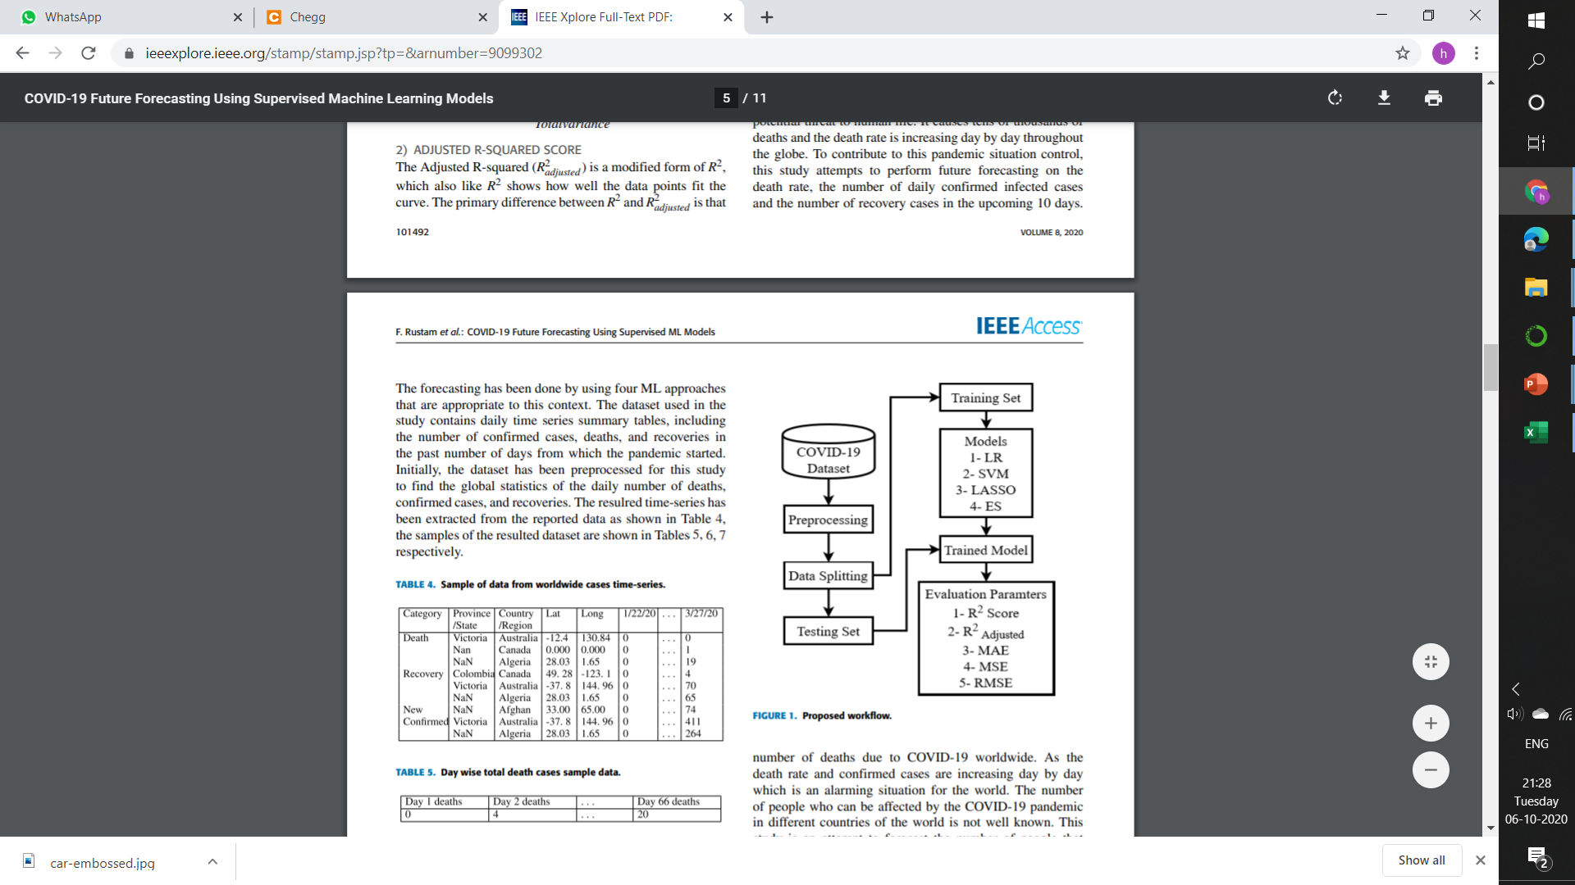
PROPOSED WORK PLAN

Slide 9
SUPERVISED MACHINE LEARNING MODELS
LR - Regression models a target prediction value based on independent variables. Used for finding out the relationship between variables and forecasting.
SVM - SVM regression being a non-parametric technique depends on a set of mathematical functions. The set of functions called KERNEL, transforms the data inputs into the desired form.
ES - It is a time series forecasting method for univariate data that can be extended to support data with a systematic trend or seasonal component. Forecasting is done based on previous periods’ data.
LASSO - It is a regression model belongs to the linear regression technique which uses shrinkage. Shrinkage in this context refers to the shrinking of extreme values of a data sample towards central values. It makes it more stable and reduces errors.

Slide 10
LINEAR REGRESSION
Here we predict scores on one variable from the scores on a second variable.
Variable we are predicting is called the criterion variable and is referred to as Y.
Variable we are basing our predictions on is called the predictor variable and is referred to as X.
When there is only one predictor variable, the prediction method is called simple regression.
Predictions of Y when plotted as a function of X form a straight line.
Linear regression consists of finding the best-fitting straight line through the points. The best-fitting line is called a regression line.
the regression line is typically computed with statistical software.

Slide 11
COMPUTING REGRESSION LINE
In age of computers, the regression line is typically computed with statistical software. However, the calculations are relatively easy, and are given here for anyone who is interested.
The formula for a regression line is Y' = bX + A
The slope (b) can be calculated as follows:
b = r s_{Y}/s_{X}
and the intercept (A) can be calculated as
A = M_{Y} - bM_{X}
M_{X} is the mean of X and M_{Y} is the mean of Y.
s_{X} is the standard deviation of X and s_{Y} is the standard deviation of Y.
r is the correlation between X and Y.

Slide 12
SUPPORT VECTOR MACHINE
Support Vector Machines (SVMs) are well known for both regression and classification problems.
The use of SVMs in regression is are known as Support Vector Regression (SVR).
SVR gives us the flexibility to define how much error is acceptable in our model and will find an appropriate line (or hyperplane in higher dimensions) to fit the data.
The objective function of SVR is to minimize the coefficients — more specifically.
The error term is instead handled in the constraints, where we set the absolute error less than or equal to a specified margin, called the maximum error, ϵ (epsilon).

Slide 13
SUPPORT VECTOR MACHINE
SVM solves the regression problems using a linear function, so while dealing with problems of non-linear regression, it maps input vector(x) to n-dimensional space called a feature space (z).
The linear function can be depicted as: f (x) = x’β + b
The objective is to make it as flat as possible thus to find the value of f (x) with (β’β) as minimal norm values.
So the problem fits in minimization function as:
J(β) = 1/2 β’β
with a special condition of the values of all residuals not more than ε, as in the following equation: ∀n : |yn − (x’n β + b)| ≤ ε

Slide 14
EXPONENTIAL SMOOTHING
In exponential smoothing family methods, forecasting is done based on previous periods’ data.
The past data observations’ influence is decaying exponentially as they become older.
Thus the weight assigned to different lag values is geometrically declined.
ES is a very simple powerful time series forecasting method specifically for univariate data.
The forecast for the current time (Ft) in ES is given by:
F(t) = αA(t−1) + (1 − α)F(t−1)
Here, α smoothing cost where 0 ≤ α ≤ 1,
A(t−1) is the actual value of the previous period in time series,
F(t−1) is the forecast value of the previous forecast.

Slide 15
DATASET DESCRIPTION
Future forecasting of COVID-19 spread focusing on the number of new confirmed cases, the number of deaths, and the number of recoveries.
It contain data from 30/1/2020 to 05/10/2020
All data are from the daily case report and the update frequency of data is one day.
This dataset has information from the states and union territories of India at daily level.
State level data comes from Ministry of Health & Family Welfare
Individual level data comes from covid19india

Slide 16
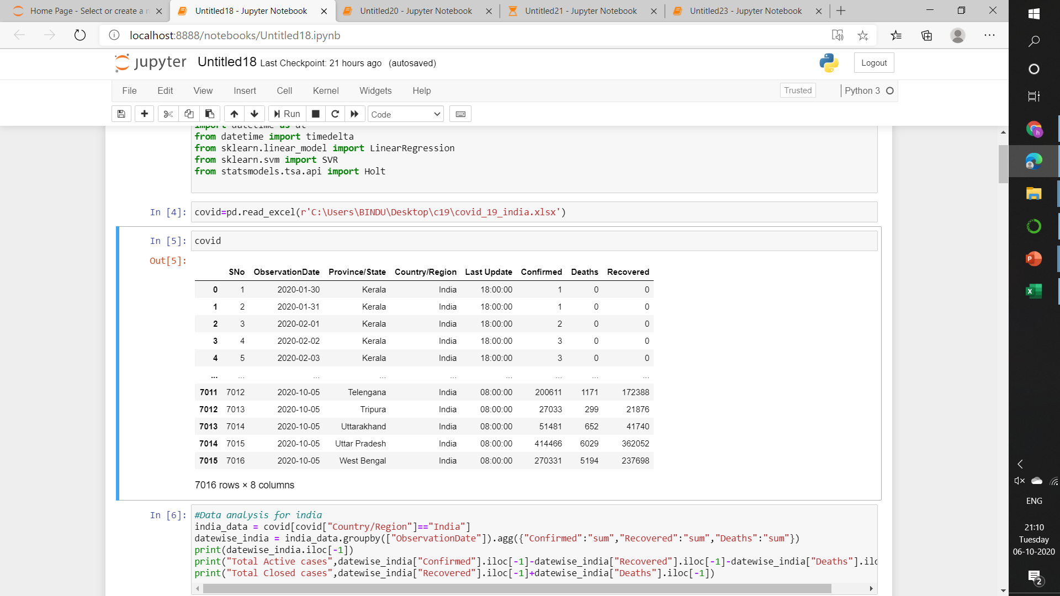
DATA SET

Slide 17
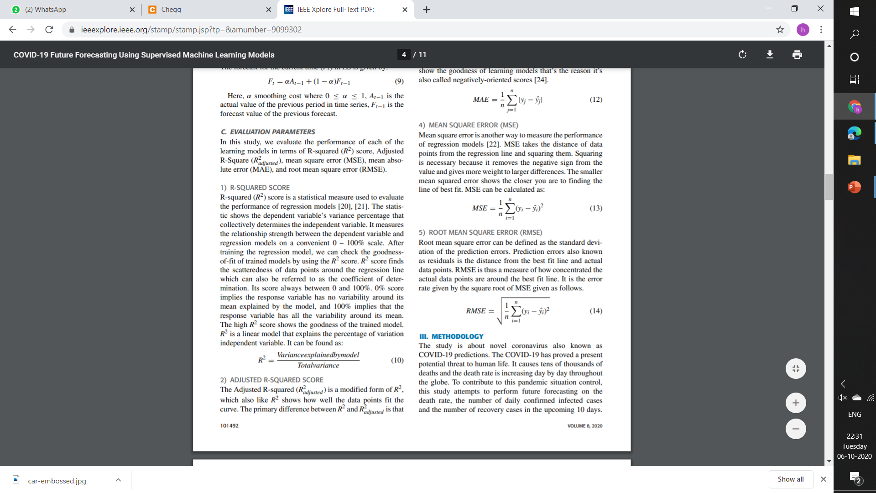
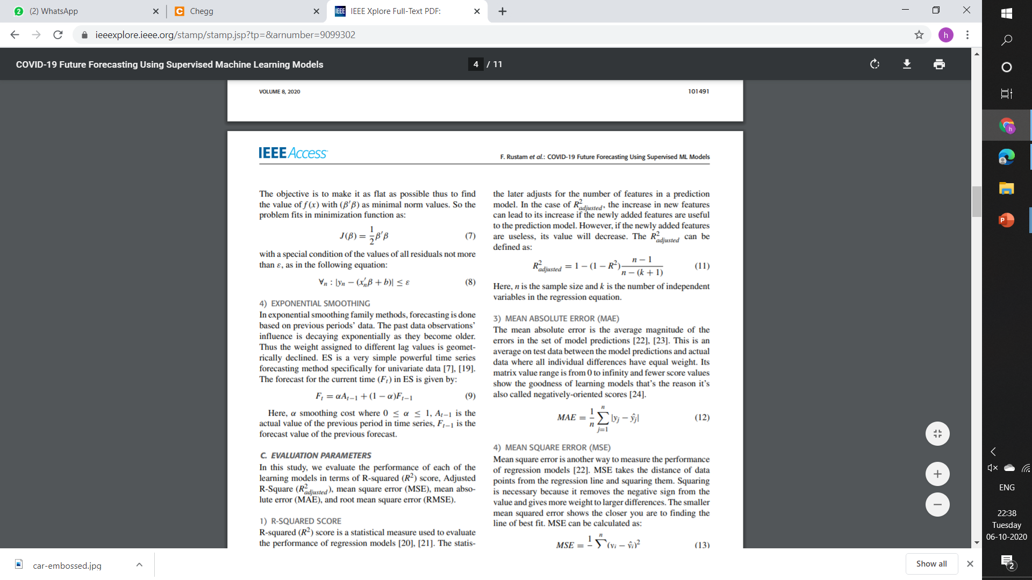
EVALUATION PARAMETERS
In this project, we evaluate the performance of each of the learning models in terms of below-
R-SQUARED SCORE - R^2 is a statistical measure that explains the percentage of variation independent variable. The high R^2 score shows the goodness of the trained model.
ADJUSTED R-SQUARED SCORE - The primary difference between R^2 and R^2 adjusted is that the latter adjusts for the number of features in a prediction model.

Slide 18
EVALUATION PARAMETERS
MEAN ABSOLUTE ERROR (MAE) - It is the average magnitude of the errors in the set of model predictions. Fewer score values show the goodness of learning models
MEAN SQUARE ERROR (MSE) - It takes the distance of data points from the regression line and squaring them. The smaller MSE shows the closer you are to finding the line of best fit.
ROOT MEAN SQUARE ERROR (RMSE) - RMSE is thus a measure of how concentrated the actual data points are around the best fit line. It is the error rate given by the square root of MSE.

Slide 19
THANK YOU.

