Slide 1
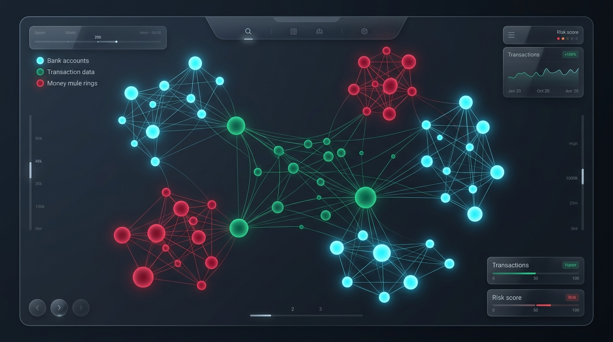
🏛️ INSTITUTIONAL DEFENSE SUITE
SALAAR FinCrime OS
Next-Gen Multi-Entity Financial Crime & Autonomous Defense Operating System
Eliminating legacy heuristics with sub-15ms multi-hop topology analysis, pre-transaction behavioral biometrics, and autonomous AI regulatory filing.
⚡ Stack: Next.js 16 • Supabase PostgreSQL • Cytoscape • BioCatch Engine • Multi-Agent AI

Slide 2
SALAAR BANK • NEXT-GEN FINCRIME OS
The $5.8B Annual Crisis: Why Isolated Rules Fail Modern Banking
💸 Authorised Push Payment (APP) Scams
Victims are socially engineered over phone or WhatsApp to directly copy-paste scammer accounts. Post-login rules have zero visibility into user coercion.
🕸️ Rapid Drain Money Mule Networks
Organized syndicates funnel funds through 5+ accounts and drain >=85% within <15 mins, far outpacing legacy T+1 batch compliance jobs.
📱 Device Farms & Synthetic Personas
Fraud rings operate 20+ accounts from identical browser canvas hardware fingerprints, rotating residential proxies to bypass naive IP checks.
⚖️ Devastating Regulatory Penalties
Delayed FinCEN & RBI Suspicious Activity Reports (SAR/STR) result in massive compliance fines and operational license suspensions.

Slide 3
SALAAR BANK • NEXT-GEN FINCRIME OS
Multi-Vector Defense OS: 4 Interconnected Intelligence Pillars
PILLAR 1
Knowledge Graph
Heterogeneous Multi-Entity
Correlates Accounts, Users, Devices & Subnets. • Tarjan's Wash Loop Engine • Rapid Drain Mule Intercept • Capital Contagion Radius
PILLAR 2
Biometrics
Pre-Tx Telemetry
Evaluates risk while typing. • Keystroke Cadence Entropy • Clipboard Paste APP Alert • Haversine Impossible Travel
PILLAR 3
Sanctions & PEP
Watchlist Screener
Compliance-grade checks. • Jaro-Winkler Phonetic Match • OFAC SDN & PEP Lists • ISO 20022 pacs.008 Parser
PILLAR 4
Autonomous FIU
AI Multi-Agent
Autonomous containment. • 1-Click Cluster Quarantine • Auto-SAR Legal Filing • BSA 31 U.S.C. 5318(g)

Slide 4
SALAAR BANK • NEXT-GEN FINCRIME OS
Pillar 1: Heterogeneous Graph & Money Mule Ring Topologies
🔄 Tarjan's Directed Cycle Detection (Wash Trading)
Detects circular money wash loops (A -> B -> C -> D -> A) in real-time O(V+E) time to uncover volume inflation and money laundering circuits.
⚡ Rapid Drain / Pass-Through Mule Interceptor
Mathematical signature: Outflow >= 85% of fresh inflow within Delta_T <= 15 minutes. Automatically flags intermediary transit mules.
📱 Multi-Hop Hardware Syndicate Resolution
Links disparate accounts sharing identical browser canvas hashes, IMEIs, or /24 subnet footprints into connected criminal syndicates.
💥 Topological Blast Radius Calculation
Quantifies the total monetary contagion (₹ capital at risk) across 2-hop neighbor networks during syndicate outbreaks.

Slide 5
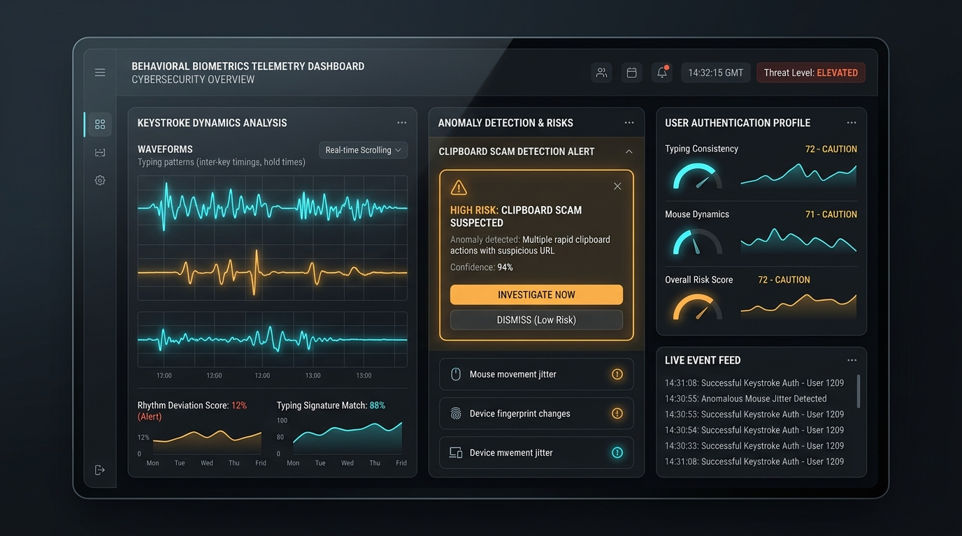
SALAAR BANK • NEXT-GEN FINCRIME OS
Pillar 2: Behavioral Biometrics & Pre-Transaction Telemetry
⌨️ Keystroke Dynamics & Cadence Entropy
Analyzes key flight times and dwell times. Automated bot scripts exhibit sub-human variance (<6ms) compared to natural human typing jitter.
📋 Real-Time Clipboard Paste Intercept (BioCatch)
92% of APP scam victims copy-paste account numbers from scam phone/WhatsApp chats. Real-time DOM listeners trigger interactive scam warnings.
✈️ Haversine Impossible Travel Velocity
Calculates great-circle physical speed between consecutive GPS/IP coordinates. Physical speeds exceeding 800 km/h trigger instant ATO locks.
⏱️ Hesitation & Form Dwelling Index
Measures dwell pauses and cursor hesitation bursts prior to authorization, detecting active social engineering coercion.

Slide 6
SALAAR BANK • NEXT-GEN FINCRIME OS
Pillar 3: Sanctions Screening & Explainable Multi-Vector Scoring
📐 Explainable Dynamic Risk Formula (0-100)
• Graph Topology Risk (30%): Cycles, Rapid Drain, In-Degree Centrality
• Behavioral Biometrics (25%): Keystroke Entropy, Paste Detection, Geo-Velocity
• Sanctions & PEP (20%): Jaro-Winkler Watchlist Hit Confidence
• AML Structuring (15%): Sub-Threshold PAN Limit Clustering (e.g. ₹49,999)
• Balance Depletion (10%): >90% Account Balance Drain Ratio
⚖️ Jaro-Winkler Sanctions & Reason Codes
• OFAC & PEP Fuzzy Matching: Jaro-Winkler phonetic similarity matches obfuscated aliases (e.g. 'Al-Hassan Corp' vs 'Alhasan Trade').
• Standardized Reason Codes: MULE_RAPID_DRAIN, DEVICE_COLLUSION_SYNDICATE, PASTE_ATTACK_APP_FRAUD, SANCTIONS_WATCHLIST_HIT.
• Dynamic Tier Actions: Low (<35) -> Instant Allow Med (35-74) -> WhatsApp OTP Challenge High (>=75) -> Auto-Quarantine & SAR Filing.

Slide 7
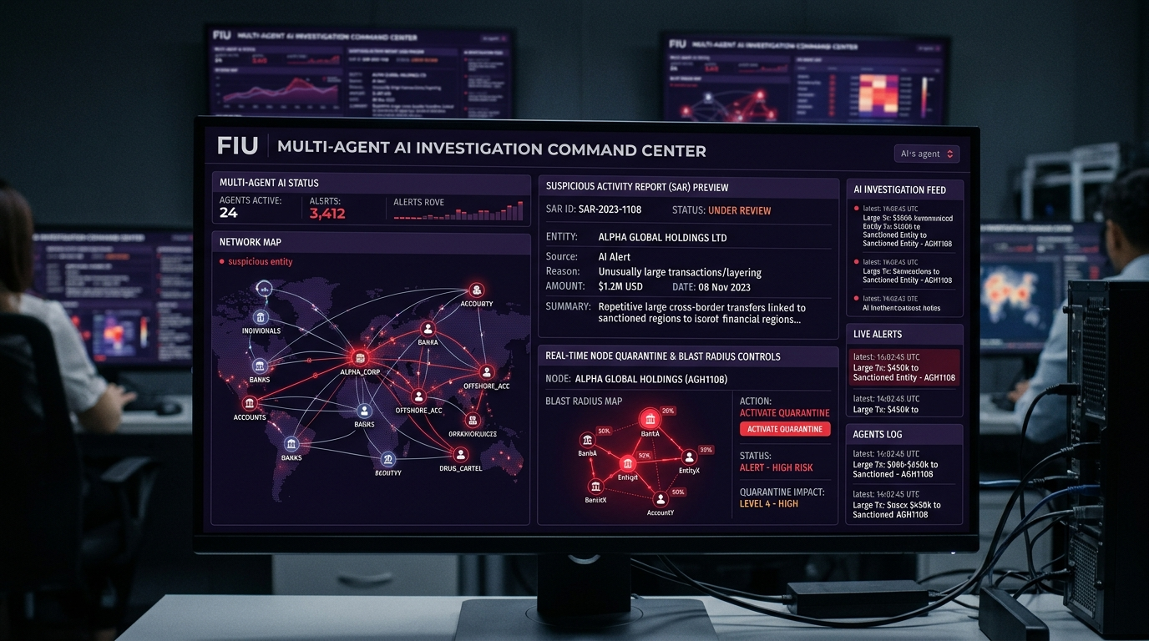
SALAAR BANK • NEXT-GEN FINCRIME OS
Pillar 4: Autonomous AI Financial Intelligence Unit & SAR Filing
🔍 FORENSIC AGENT (Topology Crawler)
Crawls multi-hop graph relationships, compiles transaction chronologies, correlates hardware footprints, and computes infected blast radius.
☣️ CONTAINMENT AGENT (Blast-Radius Quarantine)
Executes 1-click simultaneous liquidity freezes across all correlated accounts in the contagion ring to prevent fund flight.
📄 COMPLIANCE AGENT (Automated SAR/STR Filing)
Auto-drafts official Suspicious Activity Reports (SAR / STR) with complete legal narratives and statutory citations (BSA 31 U.S.C. 5318(g), PMLA).

Slide 8
SALAAR BANK • NEXT-GEN FINCRIME OS
Business Impact, Benchmarks & Live Demonstration
< 15 ms
Real-Time Decision Latency
92% Drop
Manual SAR Filing Effort
100% Contagion
Blast Radius Containment
Zero Hardcoding
Dynamic Graph Inference
🧪 Live Verification & Demonstration Flow:
• 1. User Dashboard (/user/dashboard): Initiate transfer & paste recipient -> BioCatch scam alert triggers immediately.
• 2. Multi-Entity Intelligence Graph (/network): Inspect live heterogeneous graph with accounts, devices, IPs, and Tarjan wash cycles.
• 3. OFAC / PEP Sanctions Screener: Fuzzy search 'Al-Hassan' or 'Viktor Antonov' to demonstrate Jaro-Winkler phonetic matching.
• 4. Autonomous FIU War Room: Click 'Generate SAR' to view official FinCEN/RBI legal filing or trigger 'Quarantine Blast Radius'.

