Slide 1
Ngrx – ecf.next
state management tool for angular applications

Slide 2
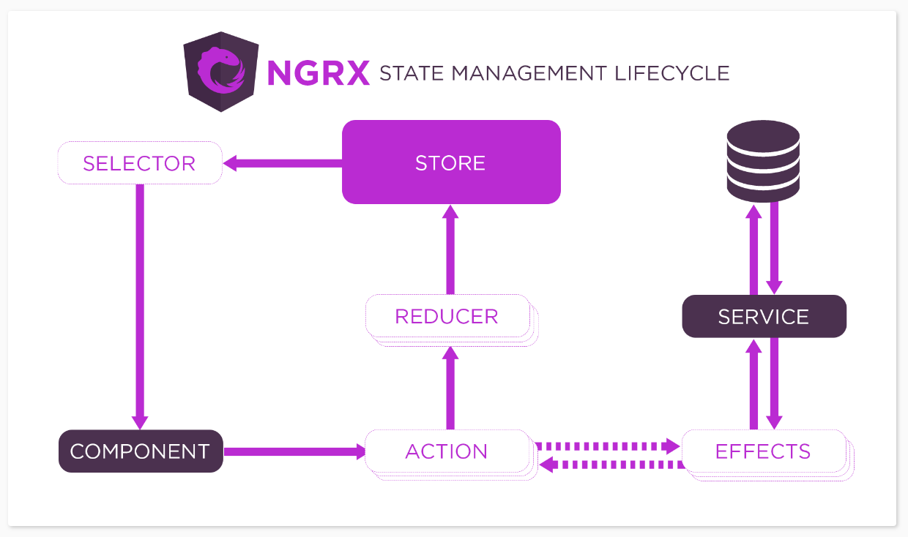
Ngrx overview https://ngrx.io/guide/store

Slide 3
Prism-case state flow
Rest-API
CaseSelectorSvc.retrieve
(Retrieve by source type –
PRISM, MAXIS, METS and
SSIS)
(PRISM,MAXIS, METS and SSIS
services calls)
case.state.reducer.ts
Prism and Other Components – Details/Address/SubHeader/ETC
LoadSuccessfully/Error/Clear
CaseStoreSvc.Retrieve
(retrieve by source type)
Case.GetContents (use in PRISM, MAXIS, SSIS and METS Effects)
Basic-Search Component

Slide 4
- chrome redux extension demo - Case Source code demo (base on time)
demo

Slide 5
Ngrx @data and @entity
@ngrx/data
NgRx Data is an extension that offers a gentle introduction to NgRx by simplifying management of entity data while reducing the amount of explicitness.
https://ngrx.io/guide/data
@ngrx/entity
Entity State adapter for managing record collections.
https://ngrx.io/guide/entity

Slide 6
Usage in ecf next
Case UI (PRISM, MAXIS, METS, SSIS) will not use @ngrx/data. These are just some reasons.
The services for the Case UI’s use specific Restful API endpoints (like /getFullPrismCaseDetails for PRISM). In order to use the flexibility of @ngrx/data, we will have to configure (using the DefaultDataServiceConfig) each entity. See https://ngrx.io/guide/data/entity-dataservice
All our services will have to inherit from DefaultDataService base class (I have a similar task). The problem is how would we deal with the situation of our headers. Like passing user objects, etc. With the @ngrx/data, the internals are using the HttpUrlGenerator. This object tries to generate an endpoint for each CRUD, using the below logic. It does not take into considerations of additional headers.
An fictitious example is, if the persistence action is to delete a PRISM Case with case id=42 and
the root path is '/HHSSystemServices/rest/CasePrismService' and
the entity name is ECFPrismCase', then
the GET request URL will be '/HHSSystemServices/rest/CasePrismService/ECFPrismCase/42'.
**Which will not work with our Restful API’s.**
NOTE: I did not research on headers, so there may be a way; but on this site - https://ngrx.io/guide/data - it does not explain.
In future UI’s, we may use @ngrx/data where applicable, base on the requirements of those screens and the determined technical or non-functional requirements. Looking at our current services, it would be a tough decision.
I tried to introduce @ngrx/entity for Advanced Search, but, I retracted that proposal because of how the UI functions.

Slide 7

Questions and concerns

