Slide 1
Ngrx
state management tool for angular applications

Slide 2
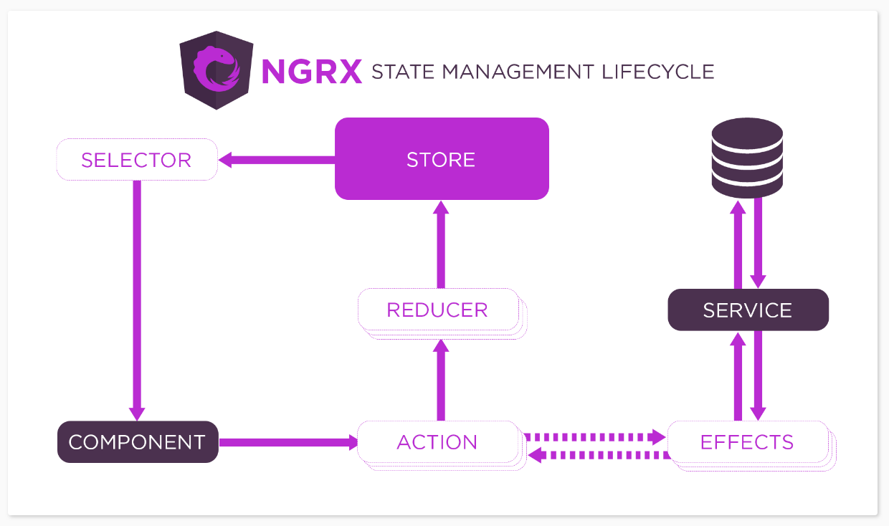
Ngrx overview https://ngrx.io/guide/store

Slide 3
- Application overview demo - chrome redux extension demo - counter form source code demo (base on time)
Demo
https://dev.azure.com/HCCollab/AngularDevelopers/_git/NgRx

Slide 4
Architecture concerns
Dealing with a lot of ngRx Artifacts
Repatative tasks – loading and saving
Effects coming in handy
Selectors
Security Concerns
Local and Session Storages VS ngRx
Production deployment of ngRx
Chrome REDUX Plugin
Debugging your actions
Seeing state changes
Subjects VS ngRx
When to use subjects with ngRx in your application
Updating UI
Showing/Hiding elements
Spinner/Progress Indicator
Cross-Component Communication
@ngrx/data – When to use
@ngrx/entity – When to use

Slide 5
Ngrx @data and @entity
@ngrx/data
NgRx Data is an extension that offers a gentle introduction to NgRx by simplifying management of entity data while reducing the amount of explicitness.
https://ngrx.io/guide/data
@ngrx/entity
Entity State adapter for managing record collections.
https://ngrx.io/guide/entity

Slide 6

Questions and concerns

