Slide 1
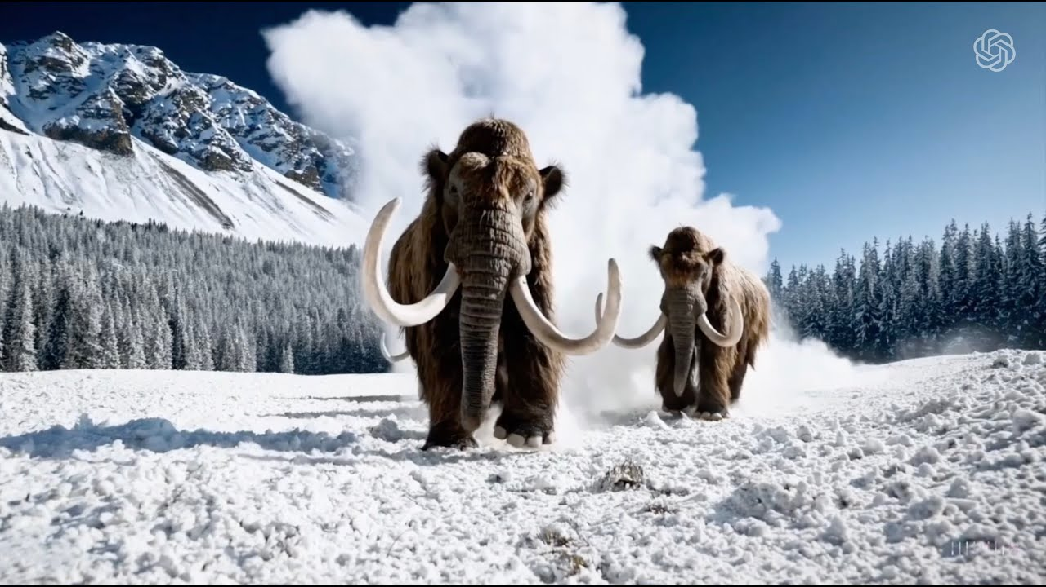
IN-BROWSER DEMO
Let's generate one right now
PRIMARY · AUDIO
suno.com/create
topic + genre + language → 30-sec track
BACKUP · IMAGE
firefly.adobe.com
OpenAI Sora · text-to-video frame from the prompt "woolly mammoths" · 2024
text prompt → photo in 5 sec
AI produces a production-quality artifact in seconds, with no special skills.
Open the URL on your phone →
QR
Music: composer + a week + $500-2000 → Suno · 30 sec · $0
Photo: freelance $50-200 + 1-3 days → Firefly · 5 sec · $0
suno.com · firefly.adobe.com · free trial access · 30 sec
Notes:
This lecture opens with a practical demonstration that creative AI in 2026 is no longer futurology but a capability available in under a minute. On suno.com/create, anyone with no musical training formulates a request for a track by theme plus genre plus language and gets a 30-second song track with vocals and instrumental accompaniment — in thirty seconds of generation, at zero cost on a trial account. Three years ago the same artifact would have cost $500-2000 from a studio composer and taken about a week of work. If the room has no audio channel, the demo switches to an image via firefly.adobe.com — there, from a text prompt, a realistic image is generated in five seconds that in 2022 would have required a freelance designer for $50-200 and one to three days, or a stock photo for $25-100 with license restrictions. These two options — the musical and the visual — illustrate one and the same baseline dynamic: an industrial-quality artifact in seconds with no specialized skills. Next we will work through what this capability gave the industry, how it changed the economics and the pipeline, and at the same time — which categories of failures and legal risks it opened up. Here, hold on to an important nuance: "industrial quality" in the sense of "technically acceptable for commodity use" is not the same as "industrial quality" in the sense of "flagship brand campaign"; the difference between these two levels is one of the lecture's key threads.

Slide 2
LECTURE
AI in the creative industries and media
08
What AI added, changed, and broke — and where to say "no".
Lecture 08 · 75 min · 39 slides
Notes:
This is the lecture's title slide. The topic is AI in the creative industries and media: film and video, music and sound, images and illustration, text and journalism. The lecture continues the course's industry block, which began with software development and passed through finance and retail, engineering design, medicine and pharmaceuticals. This one is the fifth industry lecture, and it differs from the previous ones in that creative AI produces a public, visible-to-everyone, and legally binding outcome: an AI-executed voice of a celebrity, billion-dollar Sony Music lawsuits, a deepfake CFO walking away with $25 million in one call. That is, the stakes are not only economic but also legal, reputational, and social. After a short pause we move straight to the lecture's central question on the next slide.

Slide 3
CENTRAL QUESTION OF THE LECTURE
What has AI done to the creative industry by 2026 —
and where should an engineer reasonably say
"AI is not needed here"?
Two-part by design — both parts matter equally.
Notes:
The central question of this lecture is this: what has AI done to the creative industry by 2026 — and where is an engineer wise to say "AI is not needed here." This question is two-part by design: both parts are equally important and both will be unfolded over the course of the lecture. The first part — "what AI has done" — unfolds through the keystone axis ADDED-CHANGED-BROKE, which structures the first three sections. This is a diagnostic block: which capabilities were added, how they changed the pipeline and the economics, what legal and reputational debt accumulated in parallel. The second part — "where to say 'no'" — is a normative block that culminates in a concrete checklist of negative-choice criteria. We do not teach students to deploy AI into any creative task — we teach them to recognize which tasks it is wise to put AI into and which to refuse it before the start. These two halves — the diagnostic and the normative — are parallel and equally important for qualified engineering judgment. If, by the end of the lecture, a student can name four concrete criteria for refusing AI in a creative project, they will carry away practical value that does not depend on which model they will be integrating a year from now.

Slide 4
Lecture map — 6 sections + Q&A
6 sections · 75 min · 1 checklist to take away
0
1
2
3
4
5
Opening + keystone axis
AI ADDED
AI CHANGED
AI BROKE
AI NOT NEEDED
What to do
3-tenses axis + 3 families
new capabilities
cost · speed · professions
12 failure cases
4 criteria for refusal
5-question checklist
+ Q&A
Notes:
The further structure of the lecture is six sections plus Q&A. Right now we are in Section zero, which has just begun: opening, central question, keystone axis. The next three sections are structured along this keystone axis: Section one — what AI ADDED, new capabilities that did not exist before; Section two — what AI CHANGED in existing pipelines and economics; Section three — what AI BROKE, the main failure budget with concrete landmark cases. After that, Section four switches the register from diagnostic to normative: where an engineer is wise to say "AI is not needed here," by what criteria. Section five gives a checklist — the practical deliverable a student takes with them. And the lecture closes with Q&A. On the way out — one checklist of five questions, applicable to any future creative task with an AI component. Section three, as the main failure budget, takes up nearly a third of the lecture — this is structurally important for the course's educational goal. This map slide will stay in memory as a landmark: if at some point you are unsure where we are and where we are going, recall these six cards.

Slide 5
AI added → changed → broke
Three tenses of one process — each generation of creative tools passes through them in months.
1
New capabilities — things that technologically did not exist before.
ADDED
Sora 2 · 25 sec text-to-video · sync audio. Midjourney Omni Reference. ElevenLabs — voice clone from 1 min.
2
Cost · speed · professions — the new economics of the creative industries.
CHANGED
Cost collapse of 100×–10,000× across asset types. Concept art: days → seconds. Upwork +70% year over year in AI/ML.
3
A new class of failures and legal debt.
BROKE
RIAA v. Suno, Sony's millions. Arup CFO deepfake $25.6M. SI — fake authors. NYT v. OpenAI — 20M logs.
This is an axis of three tenses of one process, not three parallel categories.
Notes:
This is the key conceptual axis of the whole lecture. The structure is built on one axis: AI ADDED — what AI CHANGED — what AI BROKE. These are three tenses of one process, not three parallel categories. Each class of creative tool, as it appears, sequentially passes through all three tenses in months. ADDED — the moment a new capability appears. Sora 2 added text-to-video with synchronized audio. Midjourney added character preservation across generations. ElevenLabs added voice cloning from a minimal sample. CHANGED — the moment a new capability penetrates an existing pipeline and changes its economics. Cost-per-asset falls a hundred to ten thousand times over. Generation speed collapses from days to seconds. New professions appear — prompt engineer, AI director — and at the same time old ones are washed out. BROKE — the moment a capability creates a new class of failures and legal debt. Sony Music sues Suno. The New York Times sues OpenAI over twenty million logs. An Arup CFO loses twenty-five million dollars to a deepfake. Why exactly this axis: for an industry lecture about creative tools there is a very strong temptation to read it as "top tools of 2026" — a Sora 2 vs Veo 3.1 vs Kling 3.0 review. Such a structure turns the lecture into a marketing sales brief. The "added-changed-broke" axis keeps a critical view: each tool class first appears as a capability, then changes the economics, and at the same time creates legal and reputational debt. This is the axis of three tenses of one process, and that is why it leads directly to thirty percent of content about failures and limitations without trampling over a tools review.

Slide 6
3 families of generative media models
Mental model: each family → its own fundamental limitations, independent of implementation quality.
1. Diffusion
2. Latent video transformers
3. Neural audio synthesis
PRINCIPLE
PRINCIPLE
PRINCIPLE
noise → reversal → image
latent space + temporal consistency
autoregressive + diffusion
TOOLS 2026
TOOLS 2026
TOOLS 2026
Stable Diffusion · Midjourney · Flux · DALL-E · Imagen · Adobe Firefly
Sora 2 · Veo 3.1 · Runway · Kling 3.0
Suno · Udio · ElevenLabs · Stable Audio
ENGINEERING CONSEQUENCE
ENGINEERING CONSEQUENCE
ENGINEERING CONSEQUENCE
"Commercial safety" depends on the training corpus, not on the architecture.
Sora's 25-sec limit — cost grows linearly + temporal drift after ~25 sec.
Voice clone from 1 min — fine-tuning a pretrained foundation model, not from scratch.
Notes:
Before working through the industry cases, one needs to understand architecturally how exactly one generative media tool differs from another. Not at the level of marketing promises, but at the level of fundamental limitations — that is, which boundaries are dictated by the architecture itself rather than by the quality of a particular implementation. The architectural families in creative AI by 2026 group into three key classes. The first family — diffusion models. This includes Stable Diffusion, Midjourney, DALL-E, Imagen, Flux, and Adobe Firefly. Principle of operation: the model learns to reverse the process of adding noise. The engineering consequence is critical: the "commercially safe" Firefly depends not on the architecture but on the training corpus — Adobe Stock plus licensed content. Firefly's architecture is the same diffusion. What makes Firefly safe for commercial use is exactly what the model was given during training, not how exactly the model is built. This basic distinction carries through the whole chapter: questions of copyright are questions about training data and output similarity, not about the mathematics of the architecture. The second family — latent video transformers: Sora 2, Veo 3.1, Runway, Kling 3.0. Video is represented not as a sequence of pixel frames but as a sequence of tokens in a latent space. The engineering consequence: Sora 2 has a 25-second limit not because OpenAI "didn't finish the job," but because cost grows linearly with the length of the latent sequence, and temporal consistency degrades after 25 seconds. This explains why cinematic AI video in 2026 is assembled from short blocks under human direction rather than generated from one long prompt. The third family — neural audio synthesis: autoregressive for speech and songs, diffusion for music. Voice cloning is possible from one minute of audio because the model does not learn a voice from scratch — it fine-tunes a pretrained foundation model on a minimal sample of a specific speaker's voice. Without this mental model a student will not be able to qualifiedly assess the fundamental limitations of any creative AI tool — they will repeat marketing claims.

Slide 7
1
SECTION
AI ADDED
New capabilities: text-to-video · character preservation across generations · voice cloning · world models.
0
1
2
3
4
5
Opening + keystone axis
AI ADDED
AI CHANGED
AI BROKE
AI NOT NEEDED
What to do
Notes:
We have just set out the conceptual axis and the three model families. Now we enter the first section — AI ADDED. Here we will work through which new capabilities appeared in the creative industry and did not technologically exist before. The section's seven slides cover text-to-video of the 2026 generation, character preservation across generations via cameos and Omni Reference, voice cloning and dubbing into multiple languages at the ElevenLabs level, world models on the example of Genie 3, the Russian context with Kandinsky and Shedevrum, and personalization at scale on the example of Adobe Firefly with Lionsgate. Each capability will have a mini-failure block — a small hint at what this same capability creates. The full unfolding of failures is in Section 3.

Slide 8
Text-to-video 2026 — production quality
3 flagship models define the state of the industry
Sora 2
Veo 3.1
Kling 3.0
OPENAI SORA · LAUNCH DEMO · YOUTUBE
OpenAI
Google
Kuaishou
25 sec · 1080p · sync audio
8 sec · 720p/1080p · native audio
15 sec · 4K · 60 fps
$0.10/sec 720p · cameos
$0.05/sec Lite
ELO #1 (1243)
openai.com/index/sora-2/
Google AI Ultra
Feb 5, 2026 · 60M creators
openai.com/index/sora-2/ · $0.10/sec
LESSON FOR THE ENGINEER
Mini-failure: 25 sec is not a film. A cinematic pipeline is assembled from short blocks under human direction (Lionsgate × Runway = augmentation, not replacement).
Notes:
By May 2026, text-to-video stopped being a demonstration technology. Three flagship models define the state of the industry. OpenAI Sora 2 — released in September 2026, maximum length of a single clip 25 seconds, resolution 1080p, synchronized audio, character cameos for multi-scene consistency. API price about ten cents per second at 720p, thirty-to-fifty cents at 1080p. Google Veo 3.1 — length four-to-eight seconds depending on tier, native audio, price five cents per second on Lite. Kuaishou Kling 3.0 — released February 5, 2026, up to fifteen seconds at native 4K and 60 fps; in blind tests on Video Arena, Kling 3.0 as of February 2026 takes first place with an ELO of 1243, ahead of Veo and Runway. What "production" means in the film industry. This is not replacement of the shoot, it is augmentation of pre-production and post-production. A concrete landmark — Lionsgate's partnership with Runway, announced in September 2024. Lionsgate provided Runway its IP corpus to train a custom model; the use — previsualization, storyboards, post-production backgrounds, VFX. On the quarterly earnings call in November 2024, Lionsgate Vice Chair Michael Burns confirmed that the AI pipeline saves millions and millions of dollars on pre/post-production. Critically — none of Lionsgate's statements say that AI replaced the shoot. Film production is still actors plus cameras plus locations; AI augments the stages before and after the shoot. An important mini-failure block for the entry into Section 3: 25 seconds is not a film. The cinematic pipeline is still assembled from short blocks. When Toys R Us tried to make a 66-second single Sora clip for an ad at Cannes Lions 2024, the result triggered a strong public backlash — we will work through this case in detail in the third section.

Slide 9
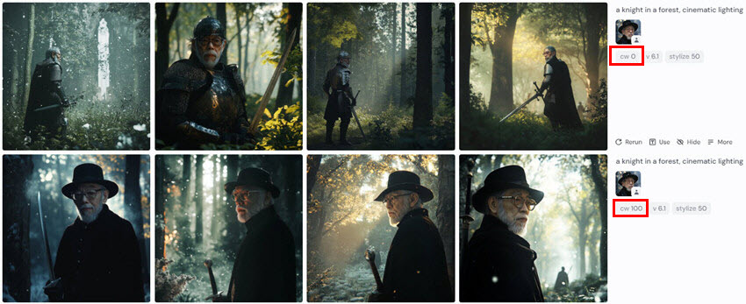
Character preservation: cameos and Omni Reference
Multi-scene narrative became possible. Without it, AI video does not work for storytelling.
Sora 2 cameos
MIDJOURNEY · CHARACTER REFERENCE · "knight in a forest" × "old man"
OpenAI + Disney partnership worth $1B+
A character is registered — called by name in prompts across multiple scenes.
Midjourney Omni Reference (v7)
Image-to-image accuracy 60% → 85%+
A character reference image preserves face/clothing/pose proportions.
Runway Gen-4 Director Mode
Scripting across scenes via structured objects
Character + locations + motion patterns as constants across all scenes.
LESSON FOR THE ENGINEER
Drift between scenes appears after 5-10 scenes. Continuity supervisor — a new profession in the creative pipeline.
Notes:
One of the most noticeable capability improvements of 2024-2026 is character preservation across generations, the ability to keep a character's visual characteristics across multiple generations. This is a critical capability for narrative: without it, AI video cannot be used for a multi-scene story. Sora 2 cameos: the mechanism — a user registers a "cameo" with defined visual attributes; in subsequent video prompts the cameo is invoked by name, and the model reproduces it consistently. OpenAI announced a partnership with Disney for a billion dollars and more for licensed character generation: Disney IP characters can officially appear in AI-generated videos under a Disney license. Midjourney Omni Reference in v7: one reference image of a character is used in subsequent prompts to preserve facial proportions, clothing, posture. Per Midjourney's statement, character-preservation accuracy grew from about sixty percent in v6 to above eighty-five in v7. Runway Gen-4 Director Mode — full scripting across scenes: the user defines characters, locations, motion patterns as structured objects. Anti-hype for this capability: character preservation across generations works significantly better than in 2023, but multi-scene narrative still has drift. After five-to-ten scenes, small details — a tattoo, a scar, a hair shade — may change. Industrial-quality use requires a continuity supervisor, a person who checks each scene for consistency. This is a new profession — we will return to it in the section on new roles.

Slide 10
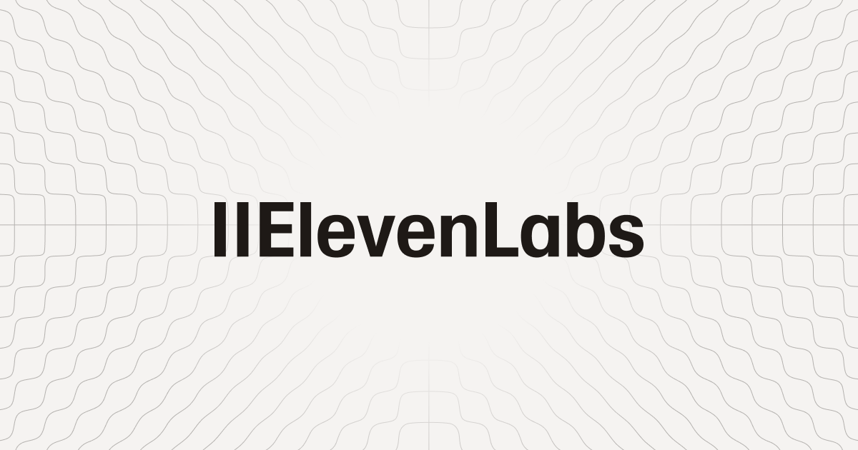
Voice cloning + dubbing into multiple languages
ElevenLabs: voice clone from 1 min of audio → 32+ languages. Production use in the corporate sector.
ELEVENLABS · OFFICIAL · elevenlabs.io
COST COLLAPSE: dubbing per language
$50-500 → <$1 /min
Long-form: weeks → minutes (Dubbing Studio, 29 languages)
PRODUCTION USE
Deutsche Telekom
Klarna
Multi-language
Voice 1 · Multilingual · expressive
Voice 2 · Russian · neutral
Voice 3 · EN-UK · narrator
LESSON FOR THE ENGINEER
Voice 4 · ScarJo-like soundalike
MINI-FAILURE: ScarJo v. OpenAI "Sky" (May 2024). OpenAI pulled the voice within a week — formally without a lawsuit. A de-facto win for the right of publicity: a voice clone requires explicit consent, even if it is technologically "merely similar".
Notes:
By 2026, ElevenLabs became the de facto standard for voice cloning and AI dubbing. The capability: a voice clone from one minute of original audio, speaking in thirty-two languages and more, preserving the voice's characteristics — timbre, pace, emotional coloring. Dubbing Studio is a production-ready tool for localizing long-form video across twenty-nine languages. Before this product, a traditional dubbing studio required a voice actor to read in the target language, a sound engineer to mix, optionally a post-sync editor to lip-sync. The cost — fifty-to-five-hundred dollars per minute of dubbing into one language. ElevenLabs Dubbing Studio — less than one dollar per minute per language, minutes instead of weeks. Production in the corporate sector: Deutsche Telekom uses ElevenLabs for multilingual customer-service agents — one prerecorded voice sample of the CEO, cloned into thirty languages and more for regional communication. Klarna — for autonomous customer-service AI agents. The mini-failure block: the voice-cloning capability simultaneously opens a new class of legal risks. Scarlett Johansson v. OpenAI "Sky" in May 2024: OpenAI demonstrated a "Sky" voice in ChatGPT extremely similar to Johansson's voice. Johansson had earlier refused to voice ChatGPT when Sam Altman personally approached her. OpenAI removed the "Sky" voice within a week; formally, no lawsuit was filed. This is a de facto win for right of publicity: the voice-cloning capability obligates explicit consent even if technologically the voice "merely resembles." This case builds a bridge to the third section, where we will work through other voice and likeness cases from a separate angle.

Slide 11
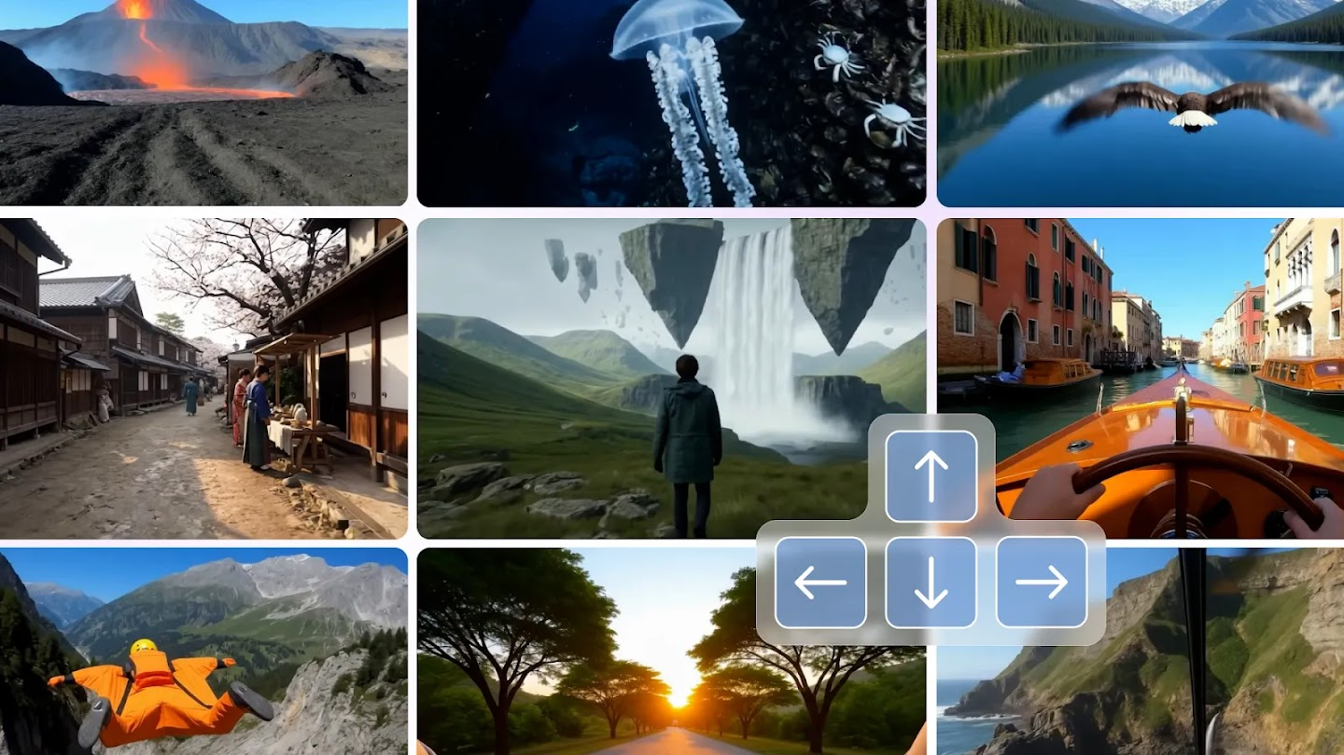
World models — Genie 3 (DeepMind)
Text → playable 3D world @ 24 fps. This is NOT video generation — it is a simulated environment.
GENIE 3 · DEEPMIND · OFFICIAL DEMO
CHARACTERISTICS
text → playable 3D world
24 fps · real time
720p · several minutes
LESSON FOR THE ENGINEER
This is not a video generator — it is a simulated environment. Production use: so far edge cases (game prototypes, location scouting). The frontier is still ahead.
deepmind.google/blog/genie-3-a-new-frontier-for-world-models
Notes:
Google DeepMind Genie 3 — public release on January 29, 2026 — represents a different class of tool that is often mistakenly compared with video generators. What Genie 3 does: from a text prompt — for example, "a medieval castle on a mountain, day, light wind" — the model generates a playable 3D world. This is an explorable, navigable environment in real time at twenty-four frames per second, resolution 720p, consistency maintained for several minutes. This is not a sequence of predefined frames as with Sora or Veo or Runway — it is an interactive environment reacting to user actions: camera, movement, object manipulation. Architecturally, Genie 3 is a combination of latent diffusion for visual generation with a world-model part that handles state transitions. Access — for US subscribers to Google AI Ultra. Anti-hype: Genie 3 is not a video generator. It is a simulated-environment generator. Direct production in the creative industries is so far edge cases. A couple of game studios are experimenting with Genie 3 for prototyping levels. A couple of film studios — for location scouting, generating a virtual location instead of traveling to a real one. The education sector — for immersive learning environments. Frontier-grade use in production is ahead, by the estimate of industry analysts. Genie 3 is an example of the symbiosis of several architectures in one AI system: latent diffusion like Sora plus a reinforcement-learning state model like game AI plus a transformer for language understanding. This illustrates the thesis: AI systems of 2026 are composite architectures, not monolithic models.

Slide 12
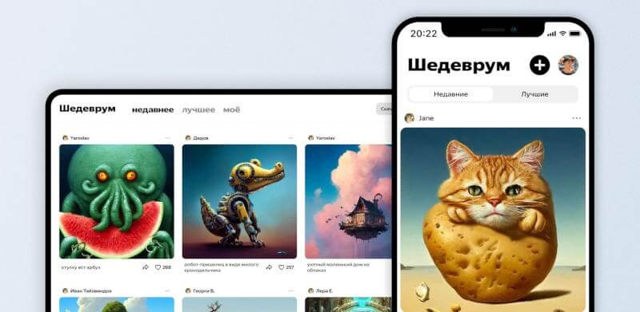
Russian context: local convenience vs the frontier
Russian GenAI is functional for the end user + mass-market premium; but not at the frontier in video and music. Structurally (capex/data), not ideologically.
SHEDEVRUM + KANDINSKY · OFFICIAL INTERFACES
Images
Video
Kandinsky 6.0 (MoE, free via GigaChat) Yandex Shedevrum · YandexART 2.7
Kandinsky 5.0 (Apache 2.0) Lags behind Sora/Veo/Kling
competitive
structural gap
Audio
Legal landscape
SymFormer · SaluteSpeech Yandex SpeechKit
Mintsifry (Russian Ministry of Digital Development) 03/18/2026 TDM* · content labeling · 09/01/2027
below ElevenLabs
in progress
Source: appleinsider.ru comparison of Shedevrum vs Kandinsky · 2023
* TDM = Text & Data Mining (research exception in law)
LESSON FOR THE ENGINEER
Local convenience (free · RU prompts · no VPN · rubles · legal perimeter) ≠ frontier-level in video and music. The concentration of R&D in the US/China is structural (GPU capex, video datasets), not ideological.
Notes:
The Russian generative-AI landscape by 2026 is functional but not frontier across most areas. On images. Sber Kandinsky 6.0 Image was announced on April 28, 2026. Architecturally — Mixture-of-Experts. It runs, per Sber's statement, up to two times faster than previous versions. Free access via the GigaChat assistant with no generation limit. Kandinsky 5.0 Video — released November 2025, open weights under Apache 2.0, up to ten seconds at 24 fps, resolution 768 by 512. Yandex Shedevrum — YandexART 2.7 and hybrid 3.0 beta February 2026, free from Russia without a VPN. On video — a frontier gap. A direct competitor to Sora 2 Pro, Veo 3.1, Kling 3.0 by length, resolution, physics, and audio sync in Russia as of the lecture is not confirmed. The explanation is structural, not ideological: frontier video models require capex — tens of thousands of GPU-hours in a cluster — and access to large licensed video datasets. The concentration of R&D is in the US and China. This is an objective distribution of capex and data access as of 2026. On music and sound. Sber SymFormer — entry-level vs Suno v5.5; Russian "solutions" are aggregator proxies of the GPTunneL, Chad AI, GenAPI type, wrapped over the Suno API. That is, the RU audience consumes the Western frontier anyway through local wrappers. Sber SaluteSpeech YourVoice — voice cloning from several hours of audio, unlike ElevenLabs with its one minute. On legal — the Mintsifry (Russian Ministry of Digital Development) bill of March 18, 2026: a TDM exception for training, mandatory labeling of AI content, authorship to the prompt user given a creative contribution, planned entry into force — September 1, 2027. The lesson for the engineer: Russian GenAI for media in 2026 is a local convenience: free of charge, RU prompts, access without a VPN, payment in rubles. But not frontier level in video and music. Where the task is fast mass-market premium content in Russian with a guaranteed legal contour — Kandinsky and Shedevrum are competitive; where cinematic video, professional vocals are needed — the choice remains with Sora and Suno.

Slide 13
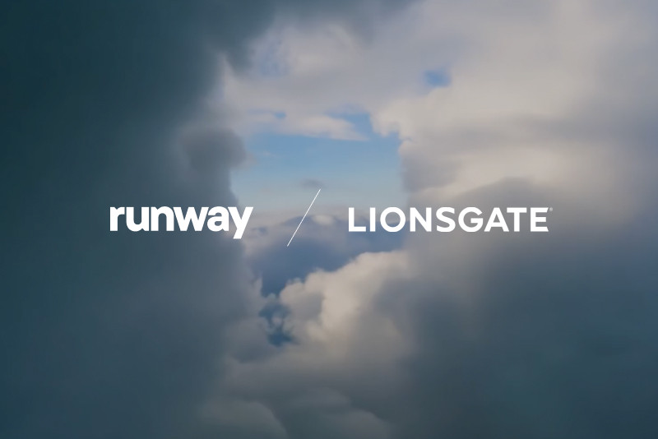
Personalization at scale + production use in Hollywood
Adobe Firefly: $400M direct revenue 2024-25. Lionsgate × Runway — augmentation, not replacement.
ADOBE FIREFLY · ENTERPRISE CLIENTS
METRICS 2026
Deloitte
Tapestry
Paramount+
22B+
Pepsi
dentsu
Stagwell
assets in <2 years
$400M
LIONSGATE × RUNWAY · SEP 18, 2024
direct revenue 2024-25
"...saving millions and millions of dollars on pre-production and post-production" — Michael Burns, Vice Chairman of Lionsgate
40%
Source: investors.lionsgate.com · quarterly earnings call, Nov 2024
of video ads — AI-generated (IAB 2026)
LESSON FOR THE ENGINEER
MINI-FAILURE: 86% of buyers use AI, but adoption ≠ success. Toys R Us Cannes 2024 — sentiment swing −10 pp.
Notes:
Personalization at scale is a capability that lets every customer receive their own clip, track, or image adapted to their profile. Before generative AI, personalization in the creative industry was limited to template substitution; now — full re-generation per user. The IAB 2026 Video Ad Spend Report: among ad buyers, twenty-one percent are already live with agentic AI for video campaigns, twenty percent testing, twenty-five planning. US digital video ad spend is projected above eighty billion dollars in 2026 — for the first time exceeding sixty percent of all TV/video ad spend. Adobe Firefly. By 2026 — twenty-two billion assets generated in two years; four hundred million dollars in direct revenue in fiscal year 2024-25; threefold QoQ growth in generation in Q4 FY2025. Corporate clients: Deloitte, Tapestry, Paramount+, Pepsi, dentsu, Stagwell — all production-ready. Adobe Firefly Foundry, announced at Adobe MAX 2025 in October — bespoke on-brand models trained on a client's IP corpus. For marketing agencies this is a critical capability: a model guaranteed to generate in a specific brand's style and tonality. Adobe Firefly is not only a model, it is a platform: twelve third-party models are integrated on it. The architectural aspect of the platform layer is covered in detail in Lecture 3. What "production" means in the film industry. Lionsgate's partnership with Runway, announced September 2024. Lionsgate — the studio behind "The Hunger Games," "Saw," "John Wick" — provided Runway its IP corpus to train a custom model. Uses: previsualization, storyboards, post-production backgrounds, VFX. Lionsgate Vice Chair Michael Burns on the November 2024 quarterly earnings call confirmed: the AI pipeline saves millions and millions of dollars on pre- and post-production. Critically: none of Lionsgate's statements say that AI replaced the shoot. Mini-failure: eighty-six percent of buyers use GenAI for video creative, forty percent of all video advertising in 2026 is AI-generated. But the Toys R Us 2024 Sora ad showed that adoption is not equal to success — we will work through it in Section 3.

Slide 14
2
SECTION
AI CHANGED
Cost collapse 100×-10,000× · speed days → seconds · new vs lost roles.
0
1
2
3
4
5
Opening + keystone axis
AI ADDED
AI CHANGED
AI BROKE
AI NOT NEEDED
What to do
Notes:
We finish Section 1 — AI ADDED, new capabilities. We move into Section 2 — AI CHANGED. Here we work through how the added capabilities penetrated the existing pipeline and changed its economics. The section's four slides cover the cost collapse — a catastrophic drop in cost-per-asset by hundreds and thousands of times; generation speed — collapses from days to seconds; new professions — prompt engineer, AI director, GenAI process specialist; displacement — graphic designers minus seventeen percent of jobs, Shutterstock photographers single-digit values per month, the Getty plus Shutterstock merger for three point seven billion dollars as defensive consolidation. The section's main mental model is bottom vs middle vs top market: AI washes out bottom-of-market commodity creative, leaves the top-of-market flagship campaign untouched, and creates a new middle segment — commercially safe corporate generation for real money.

Slide 15
Cost collapse: 100×–10,000× across asset types
The marginal cost of generation is 2-4 orders of magnitude cheaper. But the commercially-safe enterprise segment is separate.
ASSET
BEFORE
AFTER
×
MID SEGMENT ≠ FREE
1 image
$50-200 freelance $25-100 stock photo
$0-0.25
200×-10,000×
$400M
50 product images
$1-25K photoshoot
$0-1.50
>1,000×
Adobe Firefly direct revenue fiscal year 2024-25
1 min of 720p video
$1-50K shoot+post-production
~$6 Sora 2
150×-8,000×
licensed corpus + process + integration = enterprise SaaS stack The lower segment is washed out, the mid segment grows.
Dubbing $/min/language
$50-500 actor+studio
<$1 ElevenLabs
50×-500×
Source: ZSky AI, Sora 2 API Pricing, ElevenLabs pricing.
Notes:
The main economic change that AI brought to the creative industry is a catastrophic collapse of cost-per-asset. This is not "AI is a little cheaper"; it is two-to-four orders of magnitude cheaper, depending on the asset type. Concrete numbers by the table. One illustration: before AI — fifty-to-two-hundred dollars from a freelance designer, fifty-to-five-hundred from a stock photo. With AI — zero to twenty-five cents. Multiplier — two hundred to ten thousand times cheaper. Fifty product lifestyle images: before AI — a thousand-to-twenty-five-thousand dollars for full photography. With AI — zero-to-one-and-a-half dollars. Multiplier — more than a thousand times. One minute of 720p video: before AI — a thousand-to-fifty-thousand dollars for the shoot and post-production. With AI on Sora 2 standard, sixty seconds at ten cents — about six dollars. Multiplier — a hundred fifty-to-eight-thousand times. A dub of a minute of video into one language: before AI — fifty-to-five-hundred dollars, voice actor plus studio. With AI on ElevenLabs — less than one dollar. Multiplier — fifty-to-five-hundred times. What this table does not mean. It does not mean that the creative industry will "lose a thousandfold of jobs." It means the following: the marginal cost of generating an artifact fell by two-to-four orders of magnitude, but the value-add from human direction, curation, brand alignment did not fall; and corporate commercially-safe generation still costs money. Adobe Firefly's four hundred million dollars in direct revenue in 2024-25 shows that a licensed corpus plus process plus integration is a full corporate SaaS stack, not "free goods." What this table does mean. Bottom-of-market — commodity creative — is a market disappearing as a separately professionally-priced category. AI generates it in minutes for zero-to-one-and-a-half dollars. Top-of-market — flagship campaign direction, original brand campaigns, complex multi-scene narrative — is a market where human direction remains mandatory. Adobe Firefly's four hundred million in revenue is empirical proof that the middle segment — commercially-safe industrial-quality generation — is a separate, fast-growing segment, not bottom-of-market.

Slide 16
Speed: days → seconds
The iteration cycle becomes 10-100× tighter → new human skills.
Concept-art draft
days (freelance designer)
5-60 sec
Midjourney / Flux / Imagen
B-roll frame
hours of shooting + post-production
5-60 sec
Veo / Sora
Long-form dubbing
weeks in a studio
minutes
ElevenLabs Dubbing Studio
Concept exploration
half a week · 3-5 options
minutes · 10×+
tighter iteration
LESSON FOR THE ENGINEER
Engineering lesson: the iteration cycle is 10-100× tighter → new human skills — deciding "good enough / not good enough" faster, because more new options appear.
Notes:
The cost collapse is accompanied by a speed collapse. This is a second economic factor, separate from cost. A concept art draft — for game-dev, a film, an ad — traditionally takes days from a freelance designer or an in-house concept artist. Via AI — five-to-sixty seconds prompt-to-pixel in Midjourney, Imagen 4, Flux 2. A B-roll frame — filler for documentary or marketing video — traditionally takes hours of shooting plus post-production, or ten-to-a-hundred dollars per minute via stock footage providers. Via AI — five-to-sixty seconds via Veo 3.1 or Sora 2. Dubbing long-form video into a target language — traditionally weeks of studio work. Via AI on ElevenLabs Dubbing Studio — minutes. Concept exploration in design — three-to-five variants of a main idea for a client presentation — traditionally half a week of design. Via AI — minutes for dozens of variants. The engineering lesson. The speed collapse changes cycle time at every stage of the creative pipeline. Earlier the client saw the first concept in a week; now — in minutes. This is not just savings — it is a change of the work pattern. The iteration cycle becomes ten-to-a-hundred times denser. This, in turn, requires new skills from the human in the loop: the ability to formulate "pass/fail" criteria faster, because more new variants appear. If earlier one concept was discussed for half a day, now in half a day one can review fifty concepts and narrow the pool to three. This is a different mode of work — not "choose one from the finished set" but "quickly filter out the unsuitable."

Slide 17
New professions: prompt engineer · AI director · AI-workflow specialist
A specialized class between the AI tool and the final product (client deliverable).
UPWORK · AI/ML CATEGORY
4 NEW ROLES
Search: AI / ML / prompt engineering
Prompt engineer / AI artist
Shapes prompts + post-processing → a production-ready result
$25-80/hr
Prompt engineer · Midjourney expert · $35-65/hr
AI director / AI music producer
AI director / supervisor · $50-90/hr
Supervises model output: iterations + post-processing + multimodality
Analogous to an art director
AI-workflow specialist · enterprise · $60-120/hr
AI-workflow specialist
Integrator of AI tools into studios' production processes
Continuity supervisor · video · $40-75/hr
Adobe Firefly Foundry deployments
Continuity supervisor
Upwork +70% year over year · 52% of services volume — AI
Checks character/scene continuity across multi-frame sequences
Controls drift between scenes
LESSON FOR THE ENGINEER
New roles sit between the AI tool and the final product for the client. They grow fast, but are smaller than the displaced class.
Notes:
The cost and speed collapse created new market roles in the creative industries. These roles are not "AI replaced the designer," they sit between the AI tool and the final client deliverable. Prompt engineer and AI artist — a specialist who shapes prompts and post-processing to obtain production-ready output. Exists as a separate category on Fiverr and Upwork; starting rates on Upwork are twenty-five-to-eighty dollars per hour per 2026 data. AI director and AI music producer — supervise model output, bringing it to production-ready through iterations, post-processing, multimodal integration. An analog of the art director, but for the AI pipeline. AI-process specialist — an integrator of AI tools into studios' existing production pipelines. For example, does the Lionsgate plus Adobe Firefly Foundry integration for a marketing agency. Continuity supervisor — a relatively new role: a person who checks character and scene continuity across AI-generated multi-frame sequences. Growth metrics. Upwork internal data 2025-2026: seventy percent year-over-year growth in the AI/ML subcategory. Fifty-two percent gross services volume growth — AI-related. Per Upwork and MBO Partners reports, independent workers with AI/ML skills earn premium rates relative to the general freelance market. What "new professions" means. This is not a million new designers. This is a specialized class of workers between the AI tool and the client deliverable. They are necessary because raw AI output is not equal to production-ready output: curation, post-processing, brand alignment, legal review are needed. This class grows fast, but it is smaller than the displaced class — we will work through this on the next slide.

Slide 18
Displacement: −17% graphic design · Shutterstock isolated values
Wage decline from the bottom is structural, not temporary. Industry consolidation as the response.
UPWORK · GRAPHIC DESIGN · YEAR OVER YEAR
SHUTTERSTOCK · LICENSING FOR AI
INDUSTRY RESPONSE
−17%
2023
$104M
Getty + Shutterstock merger
$3.7B · Jan 2025 · Defensive consolidation
2024
$138M
SAG-AFTRA + WGA*
of graphic-design jobs
Digital-replica clause · 2026 · 4-year extension
40% of copywriter jobs $10-19/hr — detected as AI · <10% at $60+/hr · wage decline from the bottom
2027
$250M
Voice actors · worldwide
Commodity dubbing displaced · ElevenLabs in the corporate sector
pivot: photos → training data for AI
* SAG-AFTRA = Screen Actors Guild · WGA = Writers Guild of America
LESSON FOR THE ENGINEER
Structurally: AI washes out the lower segment and leaves the top segment protected. The clauses do not cover bottom-tier freelance.
Notes:
In parallel with the appearance of new professions, old ones are being displaced. This is not a debatable hypothesis — it is already a measurable process with concrete figures. Graphic designers on Upwork: minus seventeen point zero one percent of jobs in the graphic-design category after the release of the main GenAI image tools — Midjourney v6, DALL-E 3, Stable Diffusion XL. Wage compression: AI detection in forty percent of copywriter jobs paying ten-to-nineteen dollars per hour, versus under ten percent in jobs at sixty-plus dollars per hour. In other words, wage compression from the bottom: AI tools wash out precisely low-budget freelance, leaving high-value specialized roles untouched. This is structurally important: the classic prediction "AI augments human professionals" works only for the middle and top segment; the bottom segment is displacement, not augmentation. Stock photographers. Shutterstock contributors with hundreds of photo uploads per month have dropped to single-digit values per month, per microstock forums. Getty Creative segment revenue fell minus five percent year-over-year in 2024. Voice actors. The SAG-AFTRA strike of 2023 — July 14 to November 9 — was motivated directly by AI-displacement risks. In parallel, the adoption of ElevenLabs in the corporate sector led to mass displacement of Korean and foreign voice actors for commodity dubbing. Industry consolidation as a response. Getty plus Shutterstock merger — announced January 2025, deal value three point seven billion dollars, expected savings of one hundred fifty-to-two hundred million over three years. This is defensive consolidation against AI disruption. In parallel, Shutterstock licenses content to AI companies — one hundred four million in 2023, one hundred thirty-eight in 2024, two hundred fifty million projected for 2027. This is a pivot: Shutterstock stops earning from selling photos to photographers and moves to selling data to AI companies. For photographers this is structurally negative — they stop being a customer and become a data source. Hollywood: SAG-AFTRA plus WGA AI clauses of 2023 — Digital Replicas, Synthetic Performers. 2026 — a four-year extension. What these clauses do not cover: bottom-segment freelance, B-roll actors, extras, commodity voiceover — this market keeps shrinking.

Slide 19
3
SECTION
AI BROKE
12 cases: copyright × 4 + deepfakes × 2 + slop · fake authors · backlash · displacement + taxonomy.
0
1
2
3
4
5
Opening + keystone axis
AI ADDED
AI CHANGED
AI BROKE
AI NOT NEEDED
What to do
Notes:
We finish the second section on changes to the economics and move into Section three — the main failure budget of this lecture. This is the longest section: twenty-four minutes, twelve cases plus the taxonomy. Each case is structured identically: assertion, evidence from verified sources, implication, and an explicit "Lesson for the engineer" in an Ocean rounded box. This is deliberate — without an explicit lesson a case stays "an interesting story," and we need the student to carry away a transferable principle from each one. The twelve cases cover four landmark copyright lawsuits — NYT v. OpenAI, Getty v. Stability, Andersen v. Stability, RIAA v. Suno, plus Thomson Reuters v. Ross as the first US ruling rejecting "fair use"; then deepfakes — the Arup CFO scam for twenty-five point six million dollars and the Korea schoolgirl crisis; then content failures — slop, Sports Illustrated fake authors, Coca-Cola and Toys R Us marketing failure; and the section closes with a consolidated displacement view. After the twelfth case you should be able to see the pattern: AI failure in the creative field is not one type of risk but a family of different ones, and the engineer must be able to distinguish which class of risk applies to their specific task.

Slide 20
"AI and copyright" — 4 different categories of lawsuit
Not one legal question, but four. With different legal logic and outcomes.
1. Scraping for training
2. Output similarity
LESSON FOR THE ENGINEER
"AI copyright" is NOT one question, but 4 different categories of risk. Check which of the 4 applies to your process.
INPUT SIDE
OUTPUT SIDE
An AI company assembled a corpus WITHOUT a license
The model reproduces protected content verbatim
→ NYT v. OpenAI · Andersen
→ verbatim quotation of NYT · DMCA
3. Style imitation
4. Voice/likeness
"IN THE STYLE OF A SPECIFIC ARTIST"
RIGHT OF PUBLICITY
Class action by artists · style is not copyrightable, but DMCA + rights of publicity
Use of a voice/likeness without consent
→ Andersen v. Stability/MJ/Deviant
→ ScarJo v. OpenAI · SAG-AFTRA · Korea
Each of the 4 categories is examined next through a separate reference case.
Notes:
The "AI vs copyright" paradigm is not one legal question but four different categories of lawsuits, with different legal logic, different precedents, different outcomes. An engineer assessing an AI tool for a creative task must understand which of the four categories their process falls into in order to correctly assess the risk profile. Category one — training-data scraping without a license, input side. Lawsuits focus on the AI company having assembled a training corpus, including copyright-protected works, without a license from the rights holders. Theory of harm — the very fact of including a protected work in the training dataset is an infringement. The outcome depends on whether the court recognizes training as "fair use" in the US or its analogs in other jurisdictions. Category two — output similarity or memorization, output side. Lawsuits focus on the AI reproducing copyright-protected material in the output — the model memorizes and regurgitates training content. Theory of harm — not the manner of training but the model's ability to return protected content given the right prompt. Category three — style imitation. Lawsuits about generating "in the style of a specific artist." Style itself is not copyrightable in most jurisdictions, but a class action (a group lawsuit by a group of plaintiffs in the US) by artists can survive an MTD on DMCA and publicity rights. Category four — voice and right of publicity. This is a different class of legal regulation — right of publicity. ScarJo v. OpenAI Sky, SAG-AFTRA Digital Replicas clause. Lesson for the engineer: "AI copyright" is not one question but four different risk categories. Look at which of the four applies to your process. If you are building a product on a foundation model — categories one and two, the risk of NYT- and Getty-type lawsuits. If you are building a creator tool that generates "in the style of X" — category three, the risk of an Andersen class action. If you use the voice or face of specific people — category four, the risk of ScarJo and SAG-AFTRA clauses. This classification is the basis for all the next five cases of the section.

Slide 21
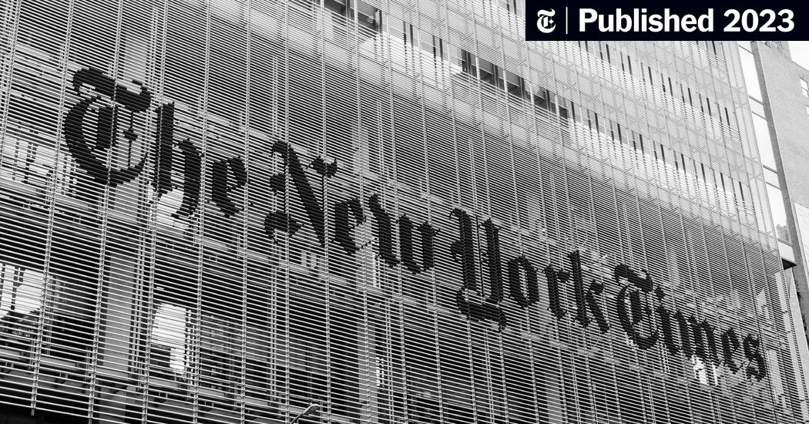
NYT v. OpenAI — training + output similarity (Case 1)
NYT v. OpenAI (Dec 2023): the court ordered OpenAI to produce 20M ChatGPT logs. Summary judgment (SJ*) deadline — Apr 2, 2026. Verbatim-quotation theory.
THE NEW YORK TIMES · DEC 27, 2023
TIMELINE
Dec 2023
NYT filed suit
2024-25
Discovery + fight over procedural motions
Apr 2, 2026
Summary judgment (SJ) deadline
20,000,000 · ChatGPT logs under discovery
* SJ = summary judgment (a ruling without a full trial)
LESSON FOR THE ENGINEER
If the model can quote your training corpus verbatim — that is NOT "fair use", it is evidence of infringement. Checking output similarity against the training data is mandatory.
Notes:
The first of four landmark copyright cases — the New York Times v. OpenAI. The lawsuit was filed in December 2023. NYT claims that OpenAI trained the GPT models on thousands of NYT articles without a license, and that ChatGPT reproduces protected content verbatim — this is the so-called verbatim-citation theory. During discovery, OpenAI was ordered by the court to produce twenty million ChatGPT logs — an enormous volume that will let NYT's lawyers search for specific examples of regurgitation. Bloomberg Law covers the case in the most detail. The summary judgment deadline — April 2, 2026, that is, two weeks after our lecture. This means that between the delivery of this lecture and a public ruling in the case literally a few weeks may pass. The exact outcome is an open question. What this case has already changed for the industry. Regurgitation as a theory of harm is not a theoretical dispute; it is a documented artifact of large language models, and any defendant in such cases will have to show that it has an output-similarity check. Lesson for the engineer: if the model can cite your training corpus verbatim — that is not "fair use," it is infringement evidence. An output-similarity check against training data is mandatory. What this means in practice. If you build a product on a foundation model, you must have a technical control that tracks how "too similar" the model's output is to its training data. Without such a control you bear regurgitation risk that can become your personal legal debt, not only the debt of the foundation-model vendor. This is a new class of engineering responsibility of 2025-2026 — and it does not appear in any earlier academic ML course.

Slide 22
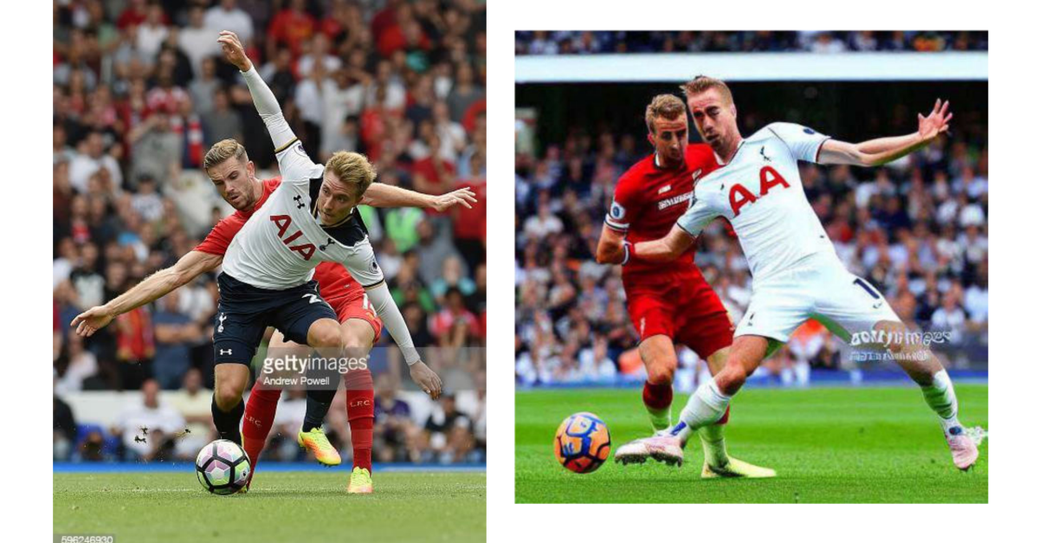
Getty v. Stability — a UK win vs a US wait (Case 2)
UK High Court 11/04/2025 — Stability won the main claims (weights ≠ a copy under CDPA*). The US case — motion to dismiss** 02/10/2026.
THE VERGE · GETTY vs STABILITY · FEB 2023
TIMELINE
Nov 4, 2025
UK · Stability won the main claims
Feb 10, 2026
US case · motion to dismiss expected
Pending
Trademark + passing-off — separate claims
UK: STABILITY WON the main claims under CDPA
* CDPA = UK Copyright, Designs and Patents Act 1988 · ** MTD = motion to dismiss
LESSON FOR THE ENGINEER
Jurisdictions diverge — what is legal in the UK under CDPA is ILLEGAL in the US under "fair use". For a global deployment, check both.
Notes:
The second copyright case — Getty Images v. Stability AI. This case illustrates a critically important fact for engineers: different jurisdictions issue different rulings on the same type of dispute. The UK High Court ruling of November 4, 2025: Stability AI won the primary copyright claims. The key legal logic under the UK Copyright, Designs and Patents Act 1988 — CDPA: the model's weights are not a "copy" in the sense of UK copyright law. Accordingly, training the model on Getty images is not an infringement of primary copyright under the CDPA. This is a win for the AI industry in the UK. In parallel runs the US case with motion-to-dismiss hearings on February 10, 2026. The US legal contour is fundamentally different: the "fair use" doctrine in Section 107 of the Copyright Act with a four-factor test. Here a completely opposite outcome is possible. Bird and Bird, which specializes in IP law, published a detailed analysis of the UK ruling, which we cite in the lecture materials. What this jurisdictional split means practically. Lesson for the engineer: jurisdictions diverge. What is legal in the UK under CDPA is not legal in the US under "fair use." For global deployment, check both. If you build a creative AI product for the global market, you must have a jurisdiction-aware compliance layer: the product may behave differently depending on where it is deployed. This is not a theoretical requirement — it is already an empirical fact of 2025-2026. And one more important nuance. Stability's UK win does not mean "no risk in the UK." It means only "primary copyright claims rejected." Secondary claims — for example, trademark or passing-off — may remain. And right of publicity in any jurisdiction is a separate, non-copyright class of legal regulation. The jurisdictional split is not "the UK legalized AI training," but only "a UK ruling on a specific type of claim."

Slide 23
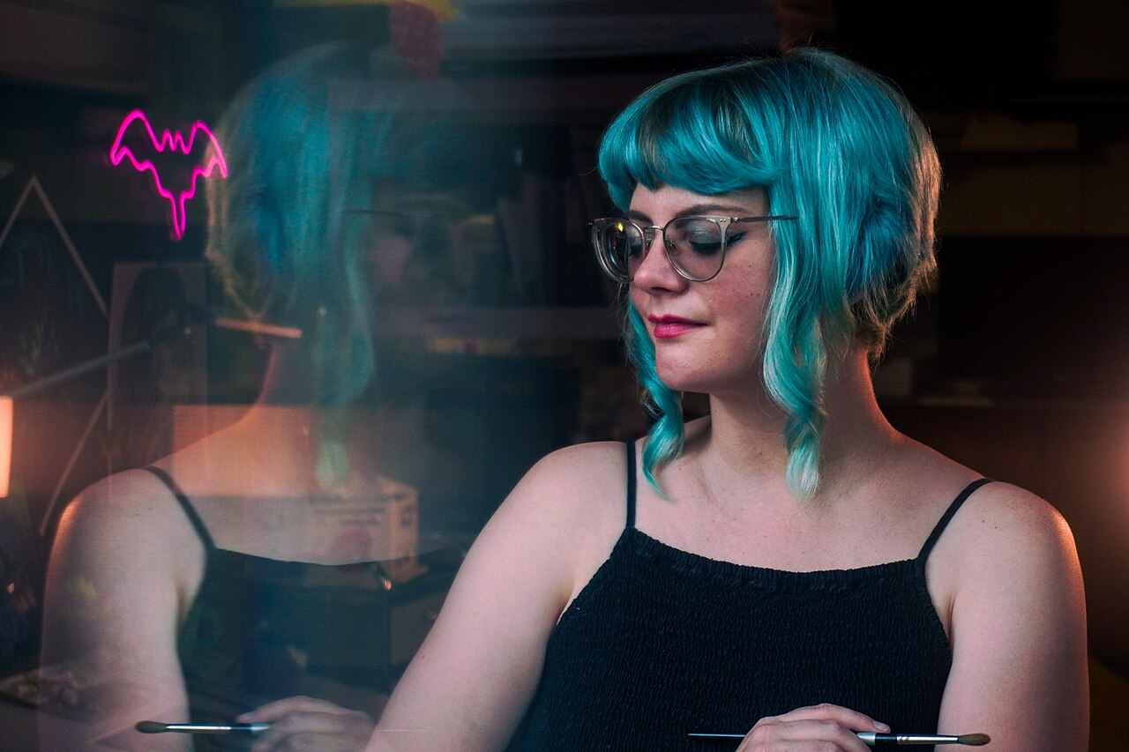
Andersen v. Stability/MJ/Deviant — style imitation (Case 3)
Class action by artists. The motion to dismiss* was denied in Aug 2024 → discovery. Third amended complaint — Feb 27, 2026. Trial — Sep 8, 2026.
KELLY McKERNAN (PLAINTIFF) · WIKIMEDIA COMMONS
TIMELINE
Jan 2023
Class action filed (10 artists)
Aug 2024
motion to dismiss denied (Judge Orrick) → discovery
Feb 27, 2026
3rd amended complaint
TRIAL DATE · SEP 8, 2026
* MTD = motion to dismiss
LESSON FOR THE ENGINEER
Style imitation "in the style of [a specific artist]" is UNSAFE, even if style is not copyrightable. Class actions survive the motion to dismiss on DMCA + rights of publicity.
Notes:
The third copyright case — Andersen plus McKernan plus Ortiz plus seven other artists v. Stability AI, Midjourney, and DeviantArt. This is a class action filed in January 2023 in the US District Court, Northern District of California. The main argument — generative AI tools let users generate images "in the style of [a specific artist]," which the artists consider an infringement of their publicity rights plus copyright plus DMCA. This is a category-three lawsuit under the previous slide's taxonomy — style imitation. Chronology. In August 2024, Judge Orrick denied a Motion to Dismiss for most claims. This means the class action survived the initial procedural challenge and moves into discovery. This is critically important — discovery in a class action in the US for AI companies means documented internal communications, training-data lists, model checkpoints, everything the plaintiffs' lawyers can demand via a subpoena. The third amended complaint was filed on February 27, 2026; the trial is scheduled for September 8, 2026, that is, four months after our lecture. What this case has already changed. Many adjacent AI image companies — for example, Adobe Firefly — position themselves as commercially safe precisely because Adobe trains Firefly on Adobe Stock plus licensed content, not on web-scraped data. This positioning is directly a response to Andersen-class risk. Lesson for the engineer: style imitation "in the style of a specific artist" is not safe just because style is formally not copyrightable. Class actions pass a motion to dismiss on DMCA plus publicity rights. If your product lets users generate "in the style of [a specific living artist]" — you have Andersen-class risk, and it must be accounted for in the product roadmap not as a theoretical scenario but as a realistic outcome. A practical solution — do not allow users to name living artists in prompts; a mask at the input-filtering stage.

Slide 24
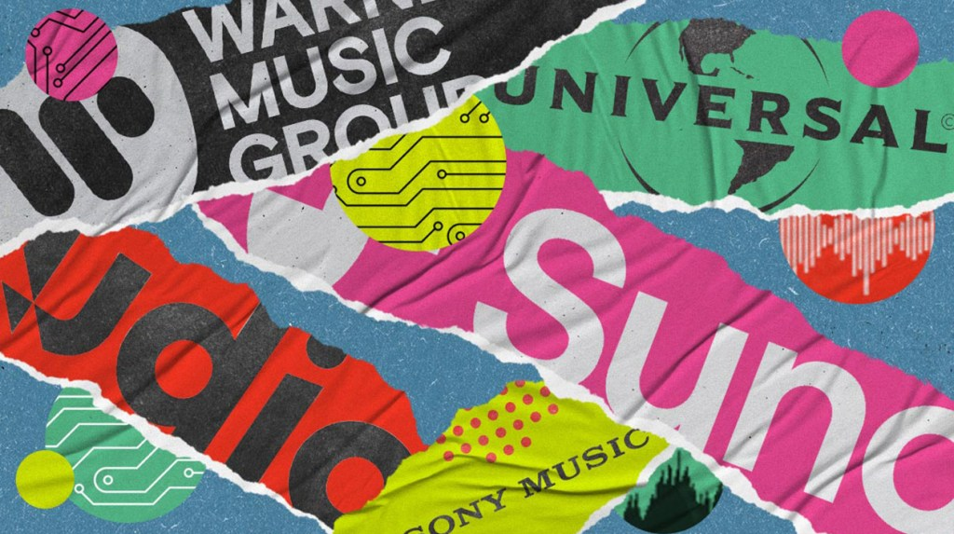
RIAA v. Suno/Udio — licensing under litigation pressure (Case 4)
RIAA filed suit 06/24/2024. UMG settled with Udio 10/29/2025; Warner settled with Suno Sep 2025. Sony is actively litigating against both.
BILLBOARD · MAJOR LABEL LAWSUIT · JUN 24, 2024
TIMELINE
Jun 24, 2024
RIAA files suit against Suno + Udio
Oct 29, 2025
UMG × Udio settlement → joint platform
Sep 2025
Warner × Suno settlement (royalties + stake)
Jul 2026
Suno SJ — Sony actively litigating against both
3 MAJOR LABELS × 2 DEFENDANTS — status
UMG × Udio: settled
UMG × Suno: negotiating
Warner × Suno: settled
* UMG = Universal Music Group (one of the 3 "Big Three" major labels)
Warner × Udio: litigating
Sony × Suno: litigating
Sony × Udio: litigating
LESSON FOR THE ENGINEER
Licensing under litigation pressure — the actual outcome: 4 of 6 plaintiff-defendant combinations are settled or in negotiation. This is a new layer of the business model, not a "ban on all AI music".
Notes:
The fourth copyright case — RIAA v. Suno and Udio. The lawsuits were filed on June 24, 2024, by the Recording Industry Association of America on behalf of the three major labels (the Big Three) — UMG, Warner, and Sony. Theory — Suno and Udio trained music-generation models on the major labels' catalogs without a license. The chronology of settlements is distributed unevenly across the 3-majors × 2-defendants matrix. On October 29, 2025, UMG settled with Udio — they formed a joint platform for 2026; UMG ↔ Suno is in talks. In September 2025, Warner signed a licensing deal with Suno (royalty plus equity), but Warner ↔ Udio — litigation continues. Sony Music — actively litigating with both defendants, pushing toward summary judgment. The Suno summary judgment hearing is scheduled for July 2026, the exact date subject to verification closer to the lecture. What this sequence means practically. This is not "all AI music banned." It is licensing under litigation pressure — a model in which initial lawsuits convert into licensing deals. Of the six lawsuit combinations (3 majors × 2 defendants), four are already settled or in talks. This is a pattern we have seen in the music industry more than once: Napster — banned, then Spotify — licensed; YouTube — initially a lawsuit with Viacom, then Content ID plus licensing. Generative AI music follows the same evolutionary path. Lesson for the engineer: licensing under litigation pressure is the actual outcome: four of six lawsuit combinations settled or in talks. This is a new business-model layer, not "a ban on all AI music." If you build a music-related AI product, expect a licensing requirement as part of the business model. This does not make the product unbuildable — it makes it more expensive and more legally compliant. Those who build without a licensing infrastructure will hit the same dead end that Suno hit at the stage of the initial RIAA lawsuit. Those who build with a licensing infrastructure from the start — follow the Adobe Firefly playbook, where a licensed corpus is a core business asset, not a nice-to-have. And most importantly — even after all the settlements, an output-similarity check remains mandatory regardless of the licensing status of the training data: licensing on the input does not release you from liability for an output that verbatim reproduces a specific protected song.

Slide 25
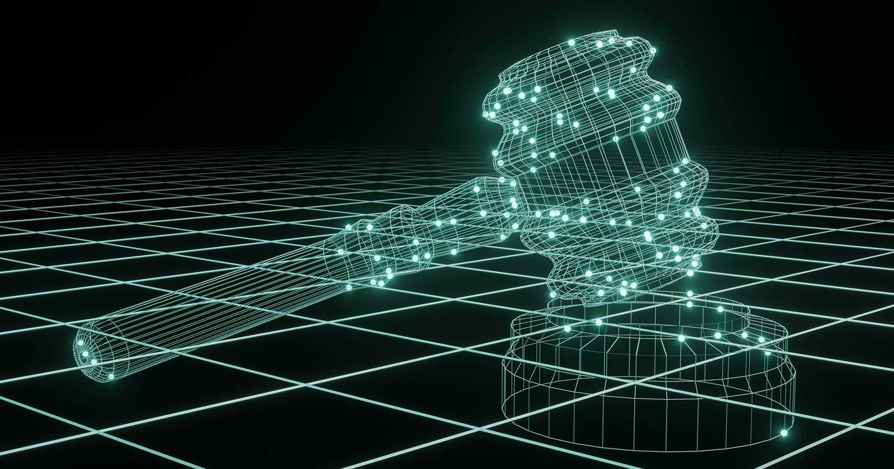
Thomson Reuters v. Ross — the first US denial of "fair use" (Case 5)
Feb 2025, Judge Bibas: 2200/3000 headnotes — infringement, "fair use" rejected. Caveat: Ross is a non-generative AI.
DAVIS WRIGHT TREMAINE · ROSS RULING · FEB 2025
TIMELINE
Feb 2025
Bibas · the first US denial of "fair use"
2200/3000
headnotes — infringement
Pending
Test cases for LLM/diffusion still ahead
"FAIR USE" 4-FACTOR TEST (Warhol v. Goldsmith)
1 · purpose
2 · nature
3 · amount
4 · market
Caveat: Ross — non-generative AI (legal search). Generative LLM/diffusion test cases are still ahead.
LESSON FOR THE ENGINEER
"Fair use" is NOT the default. Test cases for LLM/diffusion are still ahead. Do NOT build a product roadmap on the assumption that "fair use" will work as a defense.
Notes:
The fifth case — Thomson Reuters v. Ross Intelligence. This is the first ruling in the US that rejected "fair use" as a defense for AI training. The ruling was issued by Judge Bibas in February 2025. The specifics. Ross Intelligence — a company developing an AI-based legal search engine. To train the model, Ross used Westlaw headnotes — short summary annotations of court decisions that are copyright-protected content of Thomson Reuters. Of the three thousand headnotes used, two thousand two hundred were found infringed. The judge applied the Warhol v. Goldsmith four-factor test for "fair use" and concluded that Ross does not pass this test. An important caveat. Ross — non-generative AI. It is a legal search engine that used headnotes for indexing and matching, not for generating new content. The applicability of this ruling to LLMs and diffusion models is an open question. The test cases in that direction — NYT v. OpenAI, Andersen, Getty US — are still ahead. Reed Smith published a detailed analysis of the ruling, which we cite in the lecture materials. What this ruling has already changed for the industry. Before February 2025, a significant part of the AI industry operated on the assumption that training on copyright-protected content is transformative "fair use," and therefore defensible. The Bibas ruling signals that this assumption is not self-evident. The concrete outcome for generative AI is not yet determined, but the baseline has shifted: "fair use" must be proven, not assumed. Lesson for the engineer: "fair use" is not the default. LLM and diffusion test cases are ahead — NYT, Andersen, Getty US. Do not build a product roadmap on the assumption of "fair use" as a defense. If your business model is tied to using copyright-protected content without licensing — that is a business model on a legally unstable foundation. The alternative — a licensed-corpus model, like Adobe Firefly: training data is a core business asset, not a free externality. This now looks like a structural shift of the industry in 2025-2026: licensed data becomes more expensive, and this cost passes into product pricing.

Slide 26

Arup CFO deepfake — a $25.6M fraud (Case 6)
Hong Kong, Jan 2024 · A finance worker on a video call with a deepfake CFO + colleagues → 15 transactions.
CNN · $25M FRAUD IN HONG KONG · MAY 16, 2024
ATTACK SCENARIO
1
2
3
4
5
Email from the "CFO"
Invitation to a video call
Call with deepfakes
15 transactions
$25.6M lost
Arup · British engineering firm · Sydney Opera House
LESSON FOR THE ENGINEER
A video call ≠ identity verification in 2024+. Financial transactions require verification through an independent channel — a callback to a known number, multi-factor authentication, a documented process.
Notes:
The sixth case — the Arup CFO deepfake scam. January 2024, Hong Kong. Arup — a large British engineering firm, known as the designer of the Sydney Opera House and many other landmark structures. The attack scenario. An Arup finance worker in Hong Kong received an email from a person claiming to be the company's CFO, with an invitation to a video call to discuss a confidential transaction. The finance worker accepted the invitation. On the video call were the "CFO" plus five-to-six other company employees, with recognizable faces and voices. All were deepfakes. On the call the "CFO" gave instructions to make fifteen transactions totaling two hundred million Hong Kong dollars — twenty-five point six million US dollars. The finance worker, following the instructions of the person he recognized as his CFO on the video call, carried out all fifteen transactions. The money vanished. Arup discovered the scam only when the finance worker asked the CFO a routine question directly through another channel. CNN and Fortune published detailed coverage of the case. This is the first publicly documented case of corporate fraud of this scale via deepfake video, and it set a new baseline of corporate security risk. What this incident means practically. A video call has ceased to be identity verification. In 2024, real-time deepfake-video technology became commercially available and cheap. One scammer with access to public photos and videos of target persons can stage a video call with realistic deepfakes of eleven-to-twelve people at once. Lesson for the engineer: a video call is not equal to identity verification in 2024 and later. Financial transactions require verification through an independent channel — a callback to a known number, multi-factor authentication, ideally face-to-face confirmation for large sums. This case is a wake-up call for financial processes inside companies. If in your company transaction authorization is based only on recognition of "the CFO's face" via a video call — you have Arup-class risk, and it must be closed structurally: procedurally via a mandatory callback, technologically via cryptographic signatures or MFA on transactions.

Slide 27
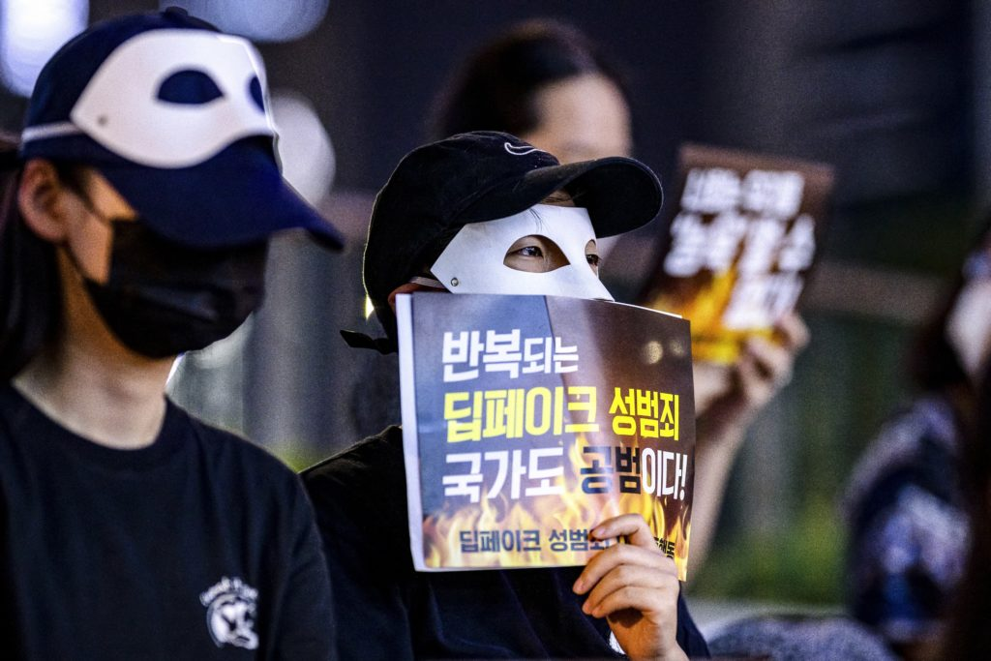
The schoolgirl deepfake crisis in Korea (Case 7)
Aug 2024 · >200 Telegram chats from selfies of classmates/teachers · 4× vs 2023.
PBS NEWSHOUR · PROTEST IN KOREA · 2024
CRISIS FIGURES
>200
Telegram chats with deepfake porn
6,500
takedown requests, Jan-Jul 2024 (4× vs 2023)
74%
of suspects — 10-19 years old
793 / 16
reports / criminal cases (2021 — Jul 2024)
LESSON FOR THE ENGINEER
An accessible capability + weak enforcement = mass collective harm. For consumer AI tools, a safety layer (NSFW-content detection + age verification + complaint-handling process) is mandatory BEFORE launch.
Notes:
The seventh case — the Korea schoolgirl deepfake crisis. August 2024, South Korea. I want to note up front — this is sensitive content and I will speak about it carefully. The context. In August 2024 in South Korea a mass scandal with deepfake porn occurred. An investigation uncovered more than two hundred Telegram chats where schoolchildren and students created and exchanged deepfake porn made from selfie photos of female classmates and teachers. Between January and July 2024, six thousand five hundred takedown requests were carried out — four times more than for all of 2023. Seventy-four percent of suspects — teenagers aged ten-to-nineteen. Between 2021 and July 2024, seven hundred ninety-three cases were officially reported to law enforcement, but only sixteen cases reached prosecution. That is, the enforcement rate is under two percent. NPR and the Daily Star published detailed coverage. What this epidemic means structurally. We have two factors: first — a widely accessible AI capability for generating realistic synthetic content; second — a weak legal enforcement infrastructure for regulating this capability. The result — mass class harm to minors. This case became one of the triggers of EU initiatives to criminalize deepfake porn (entry into force by mid-2027). Lesson for the engineer: an accessible capability plus weak enforcement equals mass class harm. For consumer AI tools, a safety layer is mandatory before launch. NSFW-content detection, age verification, a complaint-handling process for abuse — these are not nice-to-haves, they are must-haves for consumer products with a generative component. If you launch a product that can generate the likeness of a real person from an uploaded photo — you have an obligation to build this protective infrastructure before launch, not after the first incident. This is not just a moral obligation — after EU 2027 and analogous laws in other jurisdictions, it will be a legal obligation with real fines and criminal liability for founders.

Slide 28
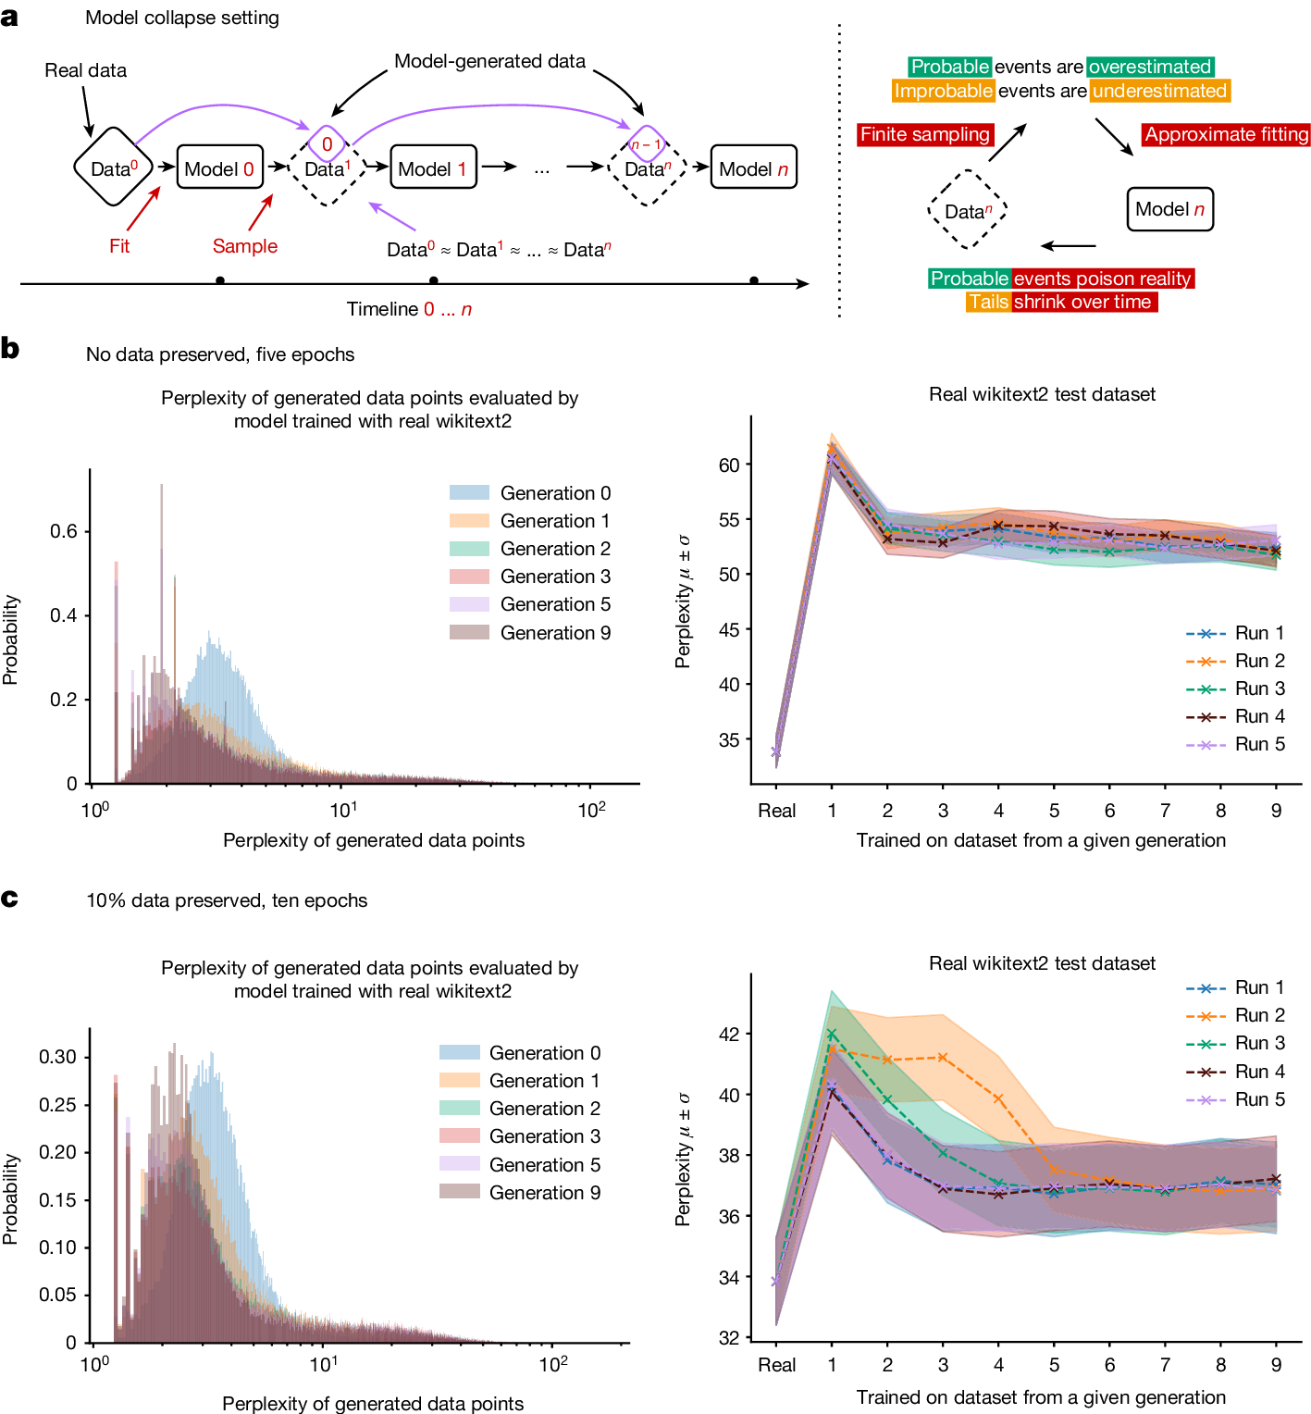
Slop + model collapse · Google AI Overviews (Case 8)
"Put glue on pizza" + "eat one rock per day". Shumailov, Nature 2024: recursive training → degradation.
GOOGLE AI OVERVIEW · real answers (May 2024)
LESSON FOR THE ENGINEER
Source quality matters more than volume. A model trained on unfiltered Reddit jokes loses to a model trained on a curated dataset — even if the curated one is 10× smaller. This explains why Adobe Firefly works: a licensed corpus, not data scraped from the web.
"how to keep cheese from sliding off pizza"
"how many rocks should I eat per day?"
→ AI Overview: "add ⅛ cup of non-toxic glue to the sauce"
→ AI Overview: "at least one small rock per day"
source: a Reddit joke (11 years old)
source: The Onion (satire)
NATURE · vol 631 · p 755-759 (2024)
Shumailov et al. — "AI models collapse when trained on recursively generated data"
MAD: Model Autophagy Disorder
Notes:
The eighth case — slop and model collapse. This is not a landmark lawsuit; it is an illustration of a structural problem of data quality for AI training. Slop is a colloquial term that entered use thanks to Bender, Marcus, and other AI researchers in 2024. The academic synonym — low-quality synthetic content. Concrete documented examples. May 2024, Google AI Overviews — a feature added to Google Search to generate summary answers to queries. To the question "how to keep cheese from sliding off pizza," AI Overview answered "add ⅛ cup of non-toxic glue to the sauce." This was a joke from Reddit eleven years ago, and the model reproduced it as factual advice. In parallel — to the question "how many rocks should I eat per day," AI Overview answered "at least one small rock per day." The source — The Onion satire. These cases quickly went viral, and Google removed most AI Overview features within a few weeks. What this illustrates. The Google Gemini model on which AI Overview ran was trained on a huge corpus of web data that — without curation — included both Reddit jokes and The Onion satire alongside real information. Without the contextual awareness that distinguishes serious sources from jokes and satire, the model reproduced content as fact. In parallel — an academic publication. Shumailov and colleagues, Nature 2024, volume 631, pages 755-759. This work documents the phenomenon of model collapse — recursively training a model on synthetic data generated by a previous model leads to progressive degradation and a narrowing of output diversity. The authors call this phenomenon MAD — Model Autophagy Disorder. This means that for next-generation frontier models, curation of training data is important — you cannot simply scrape the web and train on it, because the web increasingly contains AI-generated content. Lesson for the engineer: source quality matters more than volume. A model trained on Reddit jokes without a filter loses to a model on a curated dataset — even if the curated one is ten times smaller. This explains why Adobe Firefly on Adobe Stock plus licensed data works better than purely web-scraped-data models on some categories. It also explains why data curation by vendors costs real money and why the "free goods" of web-scraped data is a false economy.

Slide 29
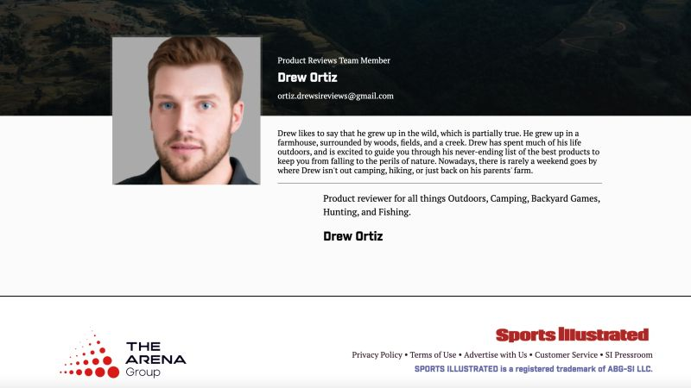
Sports Illustrated fake authors + Amazon fake books (Case 9)
SI, Nov 2023 · articles with AI-generated profile photos. Authors Guild: a surge of fake books on Amazon Kindle under AI pseudonyms.
CNN · SPORTS ILLUSTRATED FAKE AUTHORS · NOV 27, 2023
AMAZON KINDLE 2023-24 · AUTHORS GUILD
AI PSEUDONYMS
a surge of fake books (Authors Guild 2023-24)
AI-generated knockoffs pass themselves off as real jazz figures, financial advisors "Frank Gioia" · "Ted Alkyer" — fakes of real jazz personalities Amazon imposed a limit of 3 books/day + AI disclosure
"Drew Ortiz" — entirely fictional · AI portrait + AI text
LESSON FOR THE ENGINEER
Accumulated trust is a key brand asset. AI pseudonyms destroy it instantly. If you publish under a name — the name must be a real person OR the AI authorship must be explicitly disclosed.
Notes:
The ninth case — Sports Illustrated fake authors plus Amazon Kindle fake books. November 2023. Futurism, a technology magazine, published an investigative exposé: Sports Illustrated — one of the most famous American sports magazines — published articles under fake author names with AI-generated profile photos. For example, "Drew Ortiz," presented as an experienced sports writer with a photo of an ordinary American reporter, was entirely fictional. The photo was generated via AI services that sell face photos; the articles were, at least in part, AI-generated. The investigation then led to a public scandal and to a change of leadership at the SI publisher. A parallel pattern on Amazon Kindle. The Authors Guild over 2023-2024 recorded a surge of fake books on Amazon Kindle with AI pseudonyms imitating real jazz musicians, financial advisors, and other profession figures. Concrete documented cases — Frank Gioia, Ted Alkyer — fake author names passing themselves off as real jazz personalities. What these cases demonstrate structurally. Accumulated trust is a key brand asset for publishers. Sports Illustrated had many years of a reputation for quality sports journalism. AI pseudonyms in one investigative cycle destroyed this reputation — powerfully, visibly, and in the media. Similarly — Amazon Kindle ranking systems turned out to be easily exploitable by AI clones, which undermined trust in the Kindle bestseller list as a marker of quality. Lesson for the engineer: accumulated trust equals a key brand asset. AI pseudonyms destroy it instantly. If you publish under a name — the name must be a real person, or explicitly disclosed as AI-authored. This is not just an ethical principle — it is a competitive necessity for publishers who want to maintain the trust of their audience. If you build a content platform with AI-generated content — you must have a transparent disclosure layer. If you do not mark which content is AI-generated — you have SI-class risk, and its outcome is a public exposé plus lost audience trust. At the product level, this means — you must have UI patterns that explicitly show AI-generated content, and editorial policies that prohibit AI pseudonyms.

Slide 30
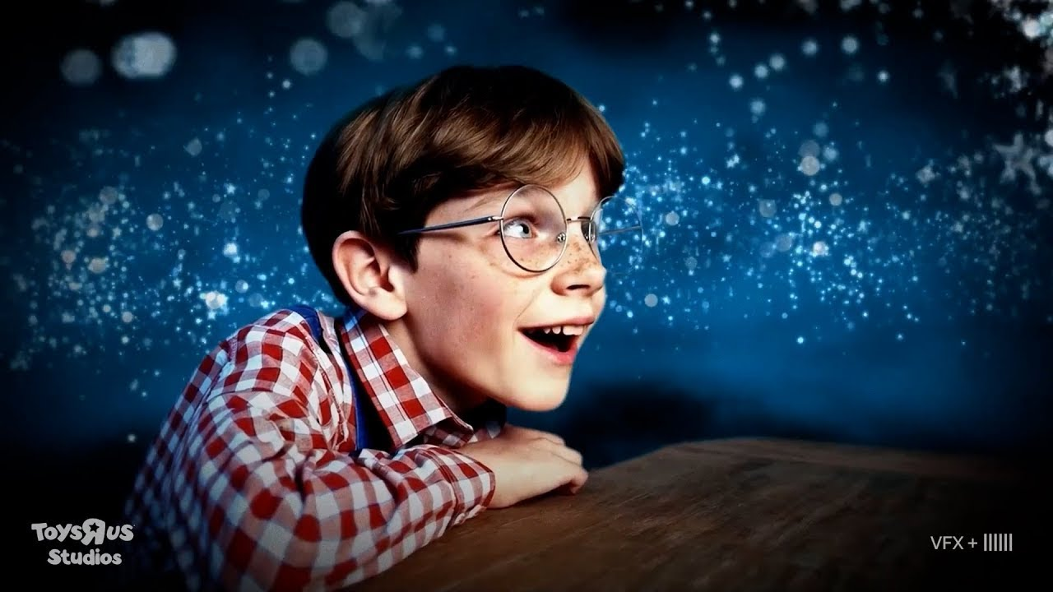

Marketing failure — Toys R Us + Coca-Cola (Case 10)
Toys R Us Cannes Lions 2024 — sentiment swing −10 pp. Coca-Cola Holidays 2024 AI ad — viral negativity.
TOYS R US STUDIOS · SORA AD · CANNES 2024
COCA-COLA · «HOLIDAYS ARE COMING» AI · 2024
TOYS R US · SENTIMENT SWING (June 2024)
COCA-COLA AI AD · NEGATIVE (Nov 2024)
POSITIVE
NEGATIVE
"soulless" · "creepy faces" · "the truck wheels spin the wrong way"
+12.2% → +3.4%
13.5% → 53.4%
100 employees · 70,000 AI clips · viral mockery
−8.8 pp positive · +39.9 pp negative
LESSON FOR THE ENGINEER
AI advertising is possible, but a flagship seasonal campaign WITHOUT human leadership = brand damage. Sentiment swing, NOT CTR, is the primary metric of brand-trust risk.
Notes:
The tenth case — Toys R Us and Coca-Cola marketing failure. These are two related cases of 2024. Toys R Us — a well-known American toy retailer that went through bankruptcy in 2017 and was partly revived. In 2024 the company tried to make a prestige creative comeback via AI: at Cannes Lions 2024 — the largest festival of the advertising industry — a 66-second single clip was presented, entirely generated via Sora 2. The idea was nostalgia-driven: to return to the founder figure Charles Lazarus with an AI-generated reconstruction. The public reaction was devastating. Sentiment analysis showed a sharp swing. Before the clip's release: positive sentiment around the brand — twelve point two percent, negative — thirteen point five. After the release: positive collapsed to three point four percent, negative spiked to fifty-three point four. This is a structural negative shift of forty percentage points in the negative direction. Joe Russo, a well-known film director, publicly quoted: "AI ads fucking suck." Coca-Cola — a parallel case. Christmas 2024, Coca-Cola released an AI-generated reconstruction of the flagship "Holidays are coming" campaign — a re-run of the flagship 1995 campaign. The reaction was tepid to negative — mass criticism of the "soulless" nature of AI-generated content where the audience expected emotional human direction. Despite this, Coca-Cola repeated the AI-ad pattern in 2025 too. This is an institutional commitment to AI cost savings even at measurable brand damage. What these cases demonstrate. An AI ad is possible in principle. But a flagship seasonal campaign is territory where the audience expects human direction, and an AI shortcut there creates measurable brand damage. Lesson for the engineer: an AI ad is possible, but a flagship seasonal campaign without human direction equals brand damage. Brand-trust risk is measured by a sentiment reversal, not CTR. CTR in one campaign may be normal — this does not mean the brand suffered no long-term damage. Sentiment analysis is the second mandatory layer of measurement for an AI-marketing rollout. And most importantly — where a brand's heritage is flagship, adopting an AI corner-cut is a structural decision against brand capital. This is not just "save costs" — it is "spend brand capital."

Slide 31
Displacement: the consolidated picture — a structural shift (Case 11)
Wage decline from the bottom is structural, not a temporary shock. The clauses help the top segment, not the bottom.
−17.01%
40% / <10%
4 years
graphic-design jobs Upwork year over year
jobs $10-19/hr vs $60+/hr · detected as AI
SAG-AFTRA + WGA extension 2026
Jobbers Index
wage decline from the bottom
Digital-replica clause
+ Getty + Shutterstock merger $3.7B (Jan 2025) — defensive consolidation
LESSON FOR THE ENGINEER
Displacement is structural, not a temporary shock. The clauses help, but wage decline from the bottom remains. Understand which class of workers your AI project will displace BEFORE launch.
Notes:
The eleventh case — the last in the section on AI BROKE. This is not a separate case story; it is a consolidated view of displacement, which we already partly addressed in Section 2. Here we focus on the critical inference: displacement is not a temporary shock but a structural shift, and the engineer must understand this before deploying an AI tool into the creative industry. Three key stats. First — minus seventeen point zero one percent of work in the Upwork graphic-design category after the release of the main GenAI image tools. This is no longer statistical noise — it is a structural displacement of bottom-segment graphic-design freelance. Second — income compression. AI detection in forty percent of copywriter jobs paying ten-to-nineteen dollars per hour, versus under ten percent in jobs at sixty-plus dollars per hour. Wage compression from the bottom. AI tools wash out the bottom segment of work, leaving high-value specialized roles untouched. Third — Hollywood's institutional response. SAG-AFTRA plus WGA signed a four-year extension with AMPTP in 2026. The AI clauses won — Digital Replicas, requiring informed consent plus compensation for using a real performer's likeness; Synthetic Performers regulation; on the WGA side — disclosure for AI-generated material. What these clauses do not cover — bottom-segment freelance, B-roll actors, extras, commodity voiceover. This market keeps shrinking. Industry consolidation as a response. Getty plus Shutterstock merger, three point seven billion dollars in January 2025 — defensive consolidation. This is an institutional acknowledgment that separately, stock providers cannot withstand the cost collapse. Lesson for the engineer. Displacement — structural, not a temporary shock. Clauses help only in the top segment of protected roles; bottom-segment wage compression remains. If you develop an AI tool that deploys into the creative industry, analyze before launch which class of workers your tool will displace. If it is bottom-segment commodity work — this is already happening, and it is "legal" in the sense of labor law but creates ESG plus regulatory pressure. If it is top-segment creative direction — this will not work, because it is precisely this zone that is protected by the value-add of human curation. Understanding this distinction is part of engineering maturity in 2026.

Slide 32
4
SECTION
AI not needed here
Criteria for negative selection · 3 human-only zones · empirical rejection by end users.
0
1
2
3
4
5
Opening + keystone axis
AI ADDED
AI CHANGED
AI BROKE
AI NOT NEEDED
What to do
Notes:
We finish the main failure budget — Section three — and move into Section four. This is a switch of register from diagnostic to normative. Up to this point we were working through what AI did — added, changed, broke. Now we are working through where an engineer is wise to say "AI is not needed here." The section's three slides cover: four criteria for refusing AI in a creative project — derived from the lessons of Section three; three human-only zones — where AI fundamentally should not replace a human; and empirical end-user rejection — the YouTube AI-thumbnail case as a signal that end users notice and punish an AI shortcut. This is not a "list of prohibitions" — it is a set of criteria for a deliberate choice. The student-engineer must be able to apply these criteria to a specific task, not memorize them as dogma. By the end of Section four you will have a mental toolkit for a negative choice. Section five translates this toolkit into an action checklist.

Slide 33
4 criteria for refusing AI in a creative project
The lessons learned from Section 3 → translated into a checklist.
1. License on training data
2. Output-similarity check
No documented licensed corpus → legal debt under category 1.
Outputs may reproduce protected content → liability under category 2.
→ Andersen v. Stability · RIAA v. Suno
→ NYT verbatim-quotation theory
Firefly = yes · Stable Diffusion = risks
A technical control is mandatory
3. Consent for voice/likeness
4. Brand-trust risk
No explicit consent → risk of the ScarJo + SAG-AFTRA + Korea class.
A flagship/historical campaign without human leadership → measurable backlash.
→ ScarJo v. OpenAI · the Korea crisis
→ Coca-Cola · Toys R Us · SI
Recognizable real people — always consent
Sentiment swing, not CTR
Notes:
This is the central normative slide of the lecture. Here we translate the lessons of Section three into four practical criteria for refusing AI in a creative project. Criterion one — training-data license. If the tool does not have a documented licensed training corpus — you have legal debt in category one — Andersen and RIAA. Concretely: using Stable Diffusion for a commercial output creates latent class-action risk. Using Adobe Firefly — no, because Firefly is trained on Adobe Stock plus licensed content. This is not a choice of tool by "quality," it is a choice by structural compliance with requirements. Criterion two — output-similarity check. If outputs may reproduce protected content verbatim — you have liability in category two, NYT verbatim citation. If you build a product on a foundation model, you must have a technical control that tracks the similarity of the output to protected source content. Without it you bear the verbatim-citation risk personally. Criterion three — voice and likeness consent. If the product uses the voice or face of specific people — explicit consent is needed. ScarJo-class risk applies not only to celebrities — to any recognizable real people. The Korea schoolgirl crisis showed that even minors' selfies fall under this criterion. Criterion four — brand-trust risk. If you deploy AI for a flagship or historical campaign — Coca-Cola Christmas, a Sports Illustrated by-line, an NYT investigation — this is a structural expenditure of brand capital. The sentiment reversal is measurable, and its loss does not recover in one cycle. These four criteria are not "a list of AI prohibitions." They are diagnostic questions. If on any of the four you identify a risk, you have three options. Option A — do not use AI, use a non-AI alternative. Option B — mitigate the risk structurally: a licensing layer, an output-similarity check, a consent-acquisition infrastructure, brand-aware design. Option C — accept the risk explicitly, with a documented business decision and a calibrated mitigation. What you cannot do is accidentally take on a risk without knowing about it. This four-point diagnostic is your protective layer.

Slide 34
3 zones where AI should not replace the human
"AI as a tool" works; "AI as replacement" does not.
Investigative journalism
Original creative direction
Coherent long-form narrative
NYT/WaPo guidelines prohibit AI for primary reporting
Flagship brand campaigns without human leadership = brand damage
50-min album · multi-act script — human for now
Source verification — human-only
Toys R Us Cannes 2024 — sentiment swing −10 pp
Character-continuity drift after 5-10 scenes
On-the-record interviews — human-only
Coca-Cola Christmas 2024 — a cool reception
Plot coherence across 90+ minutes — no
Accountability journalism — human responsibility is non-delegable
SI by-line — an investigative scandal
Voice coherence across a whole album — no
Here — AI only as a supporting tool under human supervision; never as a replacement layer.
Notes:
A slide about three zones where AI fundamentally should not replace a human. This is not "AI is prohibited" — it is "AI as a tool in a human's hands works, AI as a replacement for a human does not." Zone one — investigative journalism. Major newspapers The New York Times and The Washington Post have explicitly published AI guidelines prohibiting the use of AI for primary reporting. The concrete components of this prohibition. Source verification — the journalist must personally verify that a source exists and says what is quoted. AI hallucination of any level in this role creates a public risk of misinformation. On-record interviews — AI cannot physically conduct an on-record interview, and transcription via AI requires human review. Accountability journalism — fundamentally requires human responsibility, because a published story is the writer's commitment to truthfulness, and this responsibility is not delegable to an algorithm. Zone two — original creative direction. Here the main argument is empirical, not deontological. Toys R Us Cannes 2024 backlash. Coca-Cola Christmas 2024 cool reception. SI fake-authors investigation. All these cases show that when the audience expects human creative direction — a flagship campaign, by-line trust, an original brand voice — an AI corner-cut measurably damages the brand. This is not "AI is morally bad," it is "the audience notices." Zone three — long coherent narrative composition. This is a technical boundary, not a normative one. A coherent 50-minute album, a multi-act screenplay, a full-length novel — these are forms of narrative where coherence-through-length exceeds the current capability of AI models. Character continuity drift across five-to-ten scenes, plot consistency across 90 minutes, voice consistency across a full album — all these require human-driven narrative architecture. AI as a generator of individual elements works; AI as an architect of coherence through length — not yet. What this means practically. In these three zones, deploy AI only as an assistive tool under human supervision, never as a replacement layer. If your product positioning is "AI replaces the investigative journalist" or "AI generates a full coherent feature film" — this is positioning against structural boundaries, and the market will surface it negatively.

Slide 35
AI thumbnails on YouTube · 47.3% of creators opted out
Empirical rejection by end users · Social Blade Creator Survey · Dec 2025
#1
#2
#3
47.3%
−22% / −19%
−61.8%
of creators opted out of AI thumbnails
CTR drop: creepy skin / text failure on mobile
drop-off in the first 15 sec promise-content mismatch
LESSON FOR THE ENGINEER
End users notice and punish AI corner-cutting. Brand-trust risk is not theoretical — measurable CTR + drop-off + retention. If a product relies on AI visuals for end users, measure not only the cost of generation — measure CTR, retention, brand attitude.
Notes:
The final slide of Section four — YouTube AI thumbnails. This is empirical confirmation that end users notice and punish an AI corner-cut. It is a bridge to Section five — the action checklist. The context. By 2024-2025, the wide adoption of AI image generators led YouTube creators to start using AI to generate thumbnails — the most click-driving element of a video. AI thumbnails looked "professional," were cheap to generate (cents instead of $50-200 for a freelance designer), and spread quickly. The Social Blade Creator Survey of December 2025 showed a structural rejection by end users. Forty-seven point three percent of creators who tried AI thumbnails abandoned them. Not a temporary experiment — a final rejection. The reasons — three key ones. Minus twenty-two percent CTR — creepy smooth skin. AI image generators in the first generation produced "too smooth" faces that viewers perceive as unsettling, an uncanny-valley analog. Minus nineteen percent CTR — text failure on mobile. AI thumbnails often contain AI-generated text overlays that become unreadable at mobile resolution. Minus sixty-one point eight percent first-fifteen-second drop-off — a mismatched promise versus content. The AI thumbnail sells one promise, the video content delivers a different one — the viewer immediately sees the mismatch and leaves. What this empirical data means. Brand-trust risk is not theoretical — it is measurable CTR plus drop-off plus retention. This is not the abstract "AI looks soulless," it is concrete numbers on the YouTube analytics dashboard. Lesson for the engineer: end users notice and punish an AI corner-cut. If your product relies on consumer AI-generated visuals, measure not only generation cost — measure click-through, retention, brand sentiment. Empirical brand-trust risk is not theoretical. It is measurable, and the invisible direct "exchange rate" between cheap AI generation and lost engagement is a real business cost. This concludes Section four on negative-choice criteria. On the next divider — Section five with the action checklist.

Slide 36
5
SECTION
What the engineer should do
Action checklist · 5-question · the lecture's main takeaway.
0
1
2
3
4
5
Opening + keystone axis
AI ADDED
AI CHANGED
AI BROKE
AI NOT NEEDED
What to do
Notes:
Section five — the last content section. Here is the main takeaway of the lecture — a five-question action checklist. After the lecture, the student should be able to apply this checklist to any future creative task with an AI component. The section's one slide is the checklist itself. Structurally it is a flowchart decision tree: five questions in order, and for each — possible answers and a follow-up action. This is not just "a list of questions" — it is a decision framework with branches.

Slide 37
5-question checklist before AI in a creative project
Apply it BEFORE the start, not after. If even one "no/risk" — reconsider the approach.
1.
Is the tool's training data licensed?
IF "NO/RISK" — 3 OPTIONS
Firefly = yes (Adobe Stock + licensed content) · SD/Midjourney = Andersen-class risks
A.
Don't use AI
2.
Output-similarity check against protected content?
A non-AI alternative
NYT verbatim-quotation risk · a technical control is mandatory
3.
Consent for voice/likeness — if applicable?
B.
Mitigate structurally
ScarJo · SAG-AFTRA Digital Replicas · Korea — always consent for real people
Licensing + similarity check + consent infrastructure + brand accounting
4.
IP-clean tools for commercial use?
End-to-end pipeline: licensed corpus + similarity check + disclosure
C.
Accept the risk explicitly
5.
Brand-trust risk for flagship/historical campaigns?
A documented business decision + calibrated mitigation. NOT implicitly.
Coca-Cola · Toys R Us · SI — measurable spend of brand capital
Notes:
This is the final takeaway of the lecture — a five-question action checklist. Apply it before the start of any creative project with an AI component, not after. Question one — training-data licensing on the tool. Adobe Firefly — yes, a licensed corpus (Adobe Stock plus licensed). Stable Diffusion — no, web-scraped data, Andersen-class risk. Midjourney — debatable, there are risks. This is the first filter. If you build a commercial product on a foundation model — choose a tool with documented licensed training, otherwise you have structural legal debt. Question two — output-similarity check for protected content. The product must have a technical control that tracks whether the model's output verbatim or substantially reproduces a copyright-protected source. The NYT v. OpenAI verbatim-citation theory is no longer a theoretical risk, it is an active lawsuit. If you do not have such a control — you have the verbatim-citation risk personally. Question three — voice and likeness consent if applicable. If the product uses the voice or face of specific people — explicit consent is needed. ScarJo, SAG-AFTRA Digital Replicas, the Korea schoolgirl crisis — all cases show that without a consent-acquisition infrastructure you have exposure to risks. This includes the use of selfies, uploaded photos, voice samples — any recognizable real person. Question four — IP-clean tools for commercial use. This is the integration of questions one and two: for commercial deployment you must have an end-to-end IP-clean pipeline — a licensed training corpus plus an output-similarity check plus disclosure. Adobe Firefly Foundry presents this as a product. Models on scraped data are "cheap to start, expensive to bring to release." Question five — brand-trust risk, legacy and flagship campaigns. If you deploy AI for a category where the audience expects human creative direction — a flagship seasonal campaign, by-line trust, an original brand voice — this is structurally spending brand capital. Coca-Cola Christmas, Toys R Us Cannes, SI by-line — all show a measurable cost. If on any of the five questions the answer is "no" or "risk identified" — your choice must be one of three. Option A — a non-AI alternative, do not use AI. Option B — structural mitigation: a licensing layer, a similarity check, a consent infrastructure, brand-aware design. Option C — accept the risk explicitly, with a documented business decision and a calibrated mitigation. Do not make an implicit acceptance — that is the most expensive mistake. If you apply this five-question diagnostic to any creative task with an AI component, you will have a protective layer that ensures deliberate engineering judgment. This is the main takeaway of this lecture.

Slide 38
Q&A?
CENTRAL QUESTION — A REMINDER
What has AI done to the creative industry by 2026 — and where to say "no"?
BACKUP QUESTIONS
· Where are the limits of "fair use" in AI training?
· Sora vs Lionsgate — where is Hollywood in 2030?
· The Mintsifry bill — what changes for RU engineers?
Notes:
The Q&A section. An open field for questions from the audience. If questions don't come — three backup topics I've prepared for discussion. The first — where are the limits of "fair use" in AI training. Thomson Reuters v. Ross — the first US rejection. NYT v. OpenAI SJ — that's in two weeks. Andersen trial — September 2026. We can discuss how these rulings will come together into emerging case law by 2027. The second — Sora 2 vs Lionsgate, where is Hollywood in 2030. The Lionsgate partnership showed an augmentation model — Sora 2's capability showed a generation model. Which of them dominates in four years is an open question with a direct link to career direction for future creative engineers. The third — the Mintsifry (Russian Ministry of Digital Development) bill, what changes for RU engineers. Entry into force is planned for September 1, 2027. TDM exception, labeling of AI content, authorship to the prompt user — what concrete practical changes this will create for Russian AI startups and integrators. This is especially useful for the Bauman MSTU students, who will most likely work in the Russian regulatory context. If none of these topics sparks discussion — I'm also open to unrelated questions on any part of the lecture. Especially if there are questions on specific cases — Arup, ScarJo, RIAA, NYT — I can go deeper on any of the twelve cases we worked through.

Slide 39
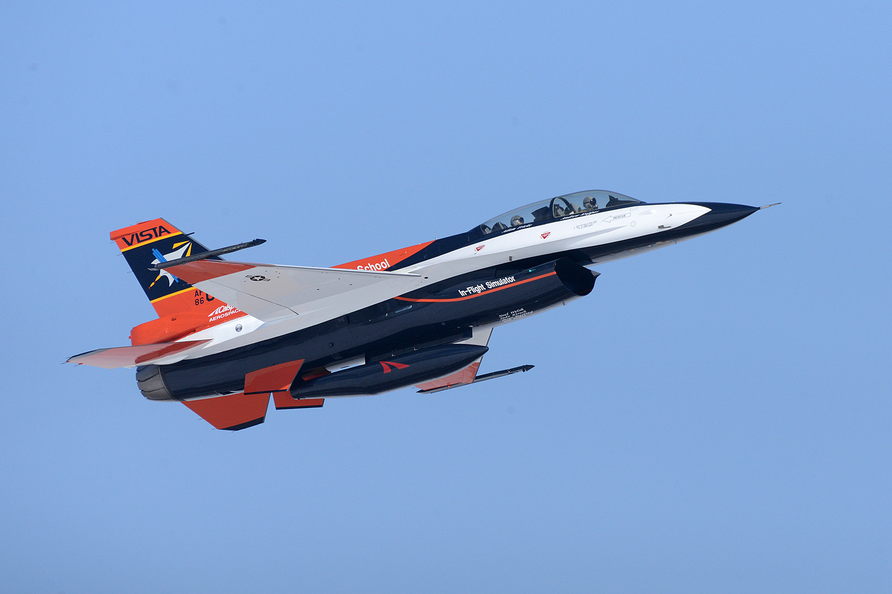
THANK YOU
for your attention
Checklist and sources — via the QR below
QR
Full bibliography of the lecture's sources (chapter.md + research dossier)
X-62 VISTA · USAF Test Pilot School · DARPA ACE AI dogfight 2023 · Wikimedia Commons
NEXT LECTURE
AI in the aerospace industry and the defense sector
From a public attack surface — to the safety-critical
Notes:
The final slide of the lecture. On it — thanks to the audience and an announcement of the course's next lecture. The next industry lecture — Lecture nine, AI in the aerospace industry and defense sector. This is a switch from creative industries with the widest public contact surface to an industry with the highest regulatory friction and the strictest safety requirements. The parallels are interesting. Where in creative AI the stakes are legal and reputational debt, in aerospace they are life-critical safety. Where in creative AI a failure leads to brand damage, in aerospace a failure leads to catastrophic loss. Where in creative AI the regulatory contour is only forming — the Mintsifry bill 2027, the EU AI Act creator guidelines — in aerospace the FAA and DoD regulators already have decades of structured certification frameworks. This contrast will give one more dimension for understanding where AI is applicable and where it is structurally harder to integrate. On the sources of this lecture. All the cited research, lawsuits, statistics, and URLs are available via the QR code or in chapter.md in the course repository. This includes the Sora 2 release reel, the Genie 3 DeepMind blog, the ElevenLabs voice library, the NYT complaint on Bloomberg Law, the Andersen docket, the RIAA press release, the Arup CNN coverage, the Korea NPR investigation, the Shumailov Nature paper, the Futurism SI exposé, and dozens of others. The checklist from Section five is also provided as a separate document in the lecture materials. Thank you for your attention.

