Slide 1
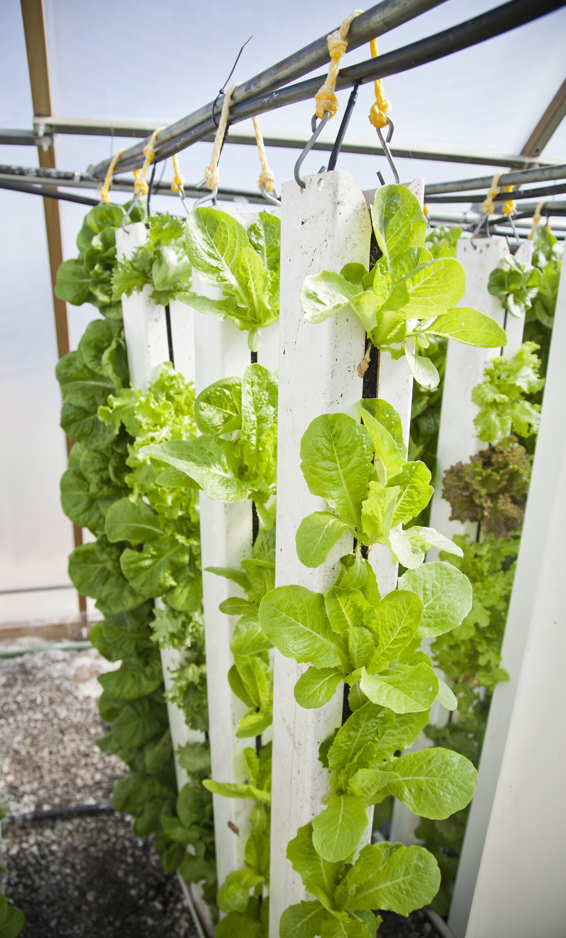
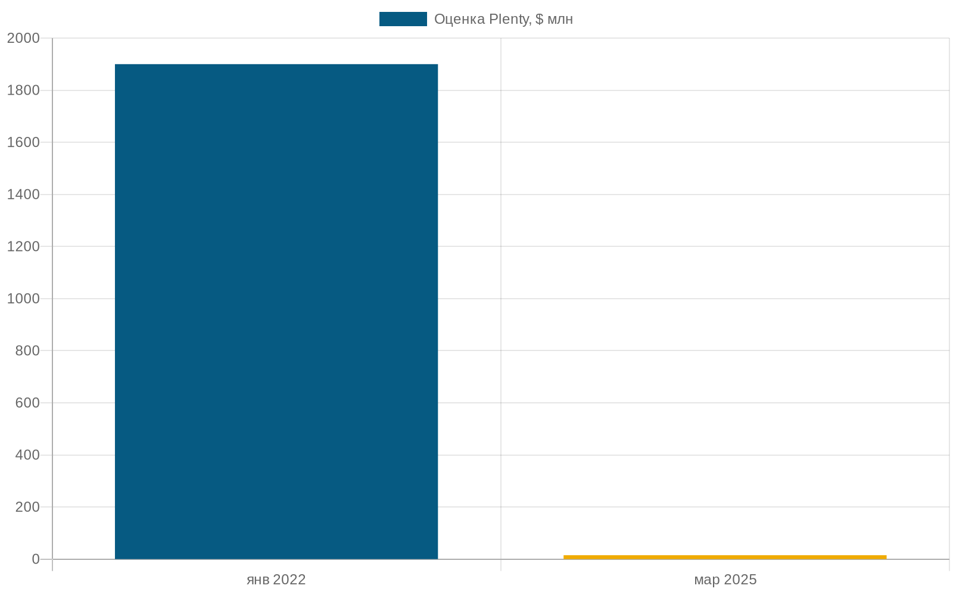
An AI-run farm promised a revolution. 19 months later — it shut down.
May 2023 · Plenty Compton opening
December 2024 · shutdown · Ch. 11 March 2025
$940M
capital lost
$1.9B → <$15M
valuation collapse –99% in 3 years
19 months
from opening to shutdown
Sources: Plenty press May 2023; TechCrunch 2025-03-24; Bloomberg Law 2025
Notes:
Let's start with one date and one figure that we'll need in order to understand the other five sections of the lecture. In May 2023, in the city of Compton, California, there was a grand opening ceremony for the flagship of American vertical farming — the Plenty Unlimited greenhouse. The mayor's delegation, the company's CEO, reporters, a promise of four and a half million pounds of leafy greens a year. Marketing pitched it as the most technologically advanced farm in the world — algorithms optimizing light, nutrition, and climate at the level of an individual plant.
Nineteen months later, in December 2024, the facility was shut down. In March 2025, the company filed for Chapter 11. Total losses were about nine hundred and forty million dollars of raised capital; the company's valuation collapsed from one point nine billion dollars in January 2022 to less than fifteen million by early 2025 — a collapse of roughly ninety-nine percent. A whole direction of major venture-capital investment activity was shut down, one that SoftBank, Walmart, and Jeff Bezos through Bezos Expeditions had all been putting money into.
Here it's worth pausing and asking the question we'll be answering for the whole lecture: what exactly did AI do in this failure — and in what sense was it unable to do it? This is not a "AI is bad" story. The Plenty greenhouse's microclimate controller worked. Computer vision recognized plant growth stages. Yield-forecasting models were trained and updated. What did not work was the arithmetic of energy: LED lighting on a closed floor consumes roughly one hundred times more energy than the same plant gets from free sunlight in an open field. AI, however well it optimizes the light-and-heat regime, cannot close a hundredfold gap in the cost of the denominator of the business model. We'll return to this answer at the end of the lecture — but for now remember the contrast: an opening with the mayor in May 2023 and a shuttered site in December 2024. And the question: where in this story was AI useful, and where could it not help for structural reasons?

Slide 2

10
Lecture 10 · AI in Agriculture · Year 3
AI in Agriculture
From field to shelf: the five-level ladder and five anti-AI criteria
Q&A at the end
Notes:
This is the title slide of Lecture 10 — the seventh industry chapter of the course. Agriculture is one of those fields where AI promises a revolution every two or three years, and each time a new generation of vendors claims that this time it will really work. By 2026 we have accumulated enough successes and enough failures to build a clear engineering apparatus for telling them apart. The tone of the lecture is trust-but-verify: neither evangelism nor contrarianism. We will walk through five levels of the AI ladder in agriculture — from the open field to the supermarket shelf — name every working solution and every failure by name, and in the finale we will formulate five anti-AI criteria that operationally answer the question of "when not AI".

Slide 3
Lecture map — the five-level ladder from field to shelf
0. Opening
1. L1 Field
2. L2 Robot
3. L3 Animal
4. L4 Chain
4-bis. Environment
5. L5 Shelf
Hook + axis + glossary
Open biology
Specialization > generality
Semi-closed environment, individual
Agentic AI leads
Connectivity · lock-in · regulation
+ 5 criteria + closing
5 cases · 3 failures
4 cases · 3 failures
4 cases · 3 lessons
4 cases · 2 failures
3 sub-blocks
L5 + 5 AP + checklist
Central question of the lecture:
Where on the L1→L5 ladder does AI work, where does it break — and which class of solution / alternative applies at each rung?
Notes:
The structure of the lecture mirrors the ladder of five levels of AI penetration into agriculture, which we'll be climbing from field to shelf. Before each section there is a short divider showing where we are.
Section 1 — L1 Field. The lowest level: an open biological environment, maximum unpredictability. Here we'll cover See & Spray Ultimate as the canonical success case, the L1 vendor matrix, the foundation models of 2026, and then three failures: the collapse of vertical farming, the hallucinations of a general-purpose LLM in the role of an agronomist, and Plantix accuracy.
Section 2 — L2 Robot. A semi-controlled environment. Narrow specialization works: LaserWeeder, Saga UV-C, Tevel. The universal "autonomous farm robot" goes bankrupt: Monarch, FarmWise. Here too is the critical comparison of Cognitive Pilot and ITELMA (a Russian automotive-electronics maker) as an architectural choice within the AI domain.
Section 3 — L3 Animal. A semi-closed environment with measurements at the level of an individual animal. AI works more reliably here: SenseHub, CattleEye, DeLaval VMS. The limitations — the physical barn configuration, Holstein bias, and the economics of small farms.
Section 4 — L4 Supply chain. Controlled cargo flows plus fast feedback in basis points. This is the place where agentic AI leads in production deployment: Cargill CMAX, Tract, Olam Mindsprint. But federal policy is a tail risk: the cancellation of USDA Climate-Smart Commodities in April 2025 showed this.
Section 4-bis — Environment. Connectivity, vendor lock-in, regulation. This is a cross-cutting meta-level, without which none of the rungs work.
Section 5 — L5 Consumer plus payoff. The most mature layer, the only one where AI works reliably for established players. And the main consolidation — the five anti-AI criteria plus a callback to Plenty Compton.
The central question at the bottom — keep it in mind throughout the lecture.

Slide 4
Two AI modes and five L4 terms — the shared language of the lecture
AI operating environment
5 supply-chain terms
Closed-loop
Agentic AI
ML + retrieval (RAG) + action pipeline + human-in-the-loop
Controlled environment (greenhouse, factory, warehouse). Every variable is measured. AI optimizes parameters. Production deployment is mature.
bp (basis point)
1 bp = 0.01%. A metric of trade slippage
Slippage
The gap between the planned trade and its actual execution
Open environment
Open biological environment (field, meadow). Weather, variable lighting, dust, shadows. AI works in narrow tasks. The generic "autonomous farm" goes bankrupt.
Scope-3 emissions
Indirect emissions across the supply chain
AI-MRV
AI monitoring, reporting, verification — climate accounting
Notes:
Before diving into the material, let's fix two sets of definitions that will be used throughout the lecture.
The left column — two environment formulations that explain why the same class of AI models works in one environment and breaks in another. Open-environment — a real field, real weather, real biology; the environment changes uncontrollably, feedback comes over seasons. Closed-loop — a greenhouse, a factory, an operating room; the environment is controlled, feedback comes within minutes or hours. This is a working formulation of the course; it appeared in Lecture 7 on medicine and carries over into Lecture 11 on manufacturing as a load-bearing bridge. Most of the failures in this lecture are either open-environment cases, in which models validated in the lab break, or attempts to close the environment, after which it turns out that in a closed loop the blast radius of any malfunction is multiplied.
The right column — five supply-chain-level terms that appear in the course for the first time on the industry specifics of L4. Agentic AI is not a one-step answer; it's an agent with an inference loop, use of external tools, and multi-step autonomous tasks. Basis points — a unit of measure for small changes in finance: one hundred basis points is one percent. Hedge slippage — the gap between the expected price of a hedge and the price actually executed; for a large hedge, a difference of tens of basis points turns into tens of thousands of dollars. Scope-3 — emissions across the whole supply chain, not from the company's own operations; this is part of the EU CSRD mandatory reporting since 2024. AI-MRV — AI systems for measurement, reporting, and verification of carbon credits — that is, inference with large uncertainty that is often marketed as precise measurement.
Remember these definitions; we'll return to each of them explicitly in the corresponding sections.

Slide 5
The AI ladder — five levels. Each rung works differently
L5
Shelf / store
Walmart Eden 2017+, Tesco 2017+, X5 2020+
↑ moving up the ladder
Fully digitized environment. AI is mature.
↑ controllability
Supply chain
of environment rises
L4
Cargill CMAX, Tract, Olam, Walmart×Cropin
Controlled goods flows + fast feedback
↑ measurable return
Animal
ROI rises
L3
SenseHub 2M cows, CattleEye, DeLaval V310
Semi-closed environment + individual-level measurement
↑ predictability
L2
Robot
of outcome rises
LaserWeeder G2, Saga UV-C, Tevel · vs Monarch/FarmWise
Specialization works; the generic one goes bankrupt
↓ biology
L1
Field
See & Spray works · Plenty/AppHarvest/Bowery failed
uncertainty falls
Open biology — the hardest
↑ environment controllability ↔ ↑ AI penetration · next — L11 cyber-physical manufacturing
Notes:
This is the keystone slide of the whole lecture, and it's worth examining closely — we'll come back to it between each of the following sections.
The keystone axis of this lecture is a ladder of five levels, along which AI climbs from field to shelf. From bottom to top, the degree of environmental control rises, biological unpredictability falls, and measurable return on investment rises.
L1 — Field. Open biological environment. Sun, rain, pathogens, dust — everything that is uncontrollable in an engineering sense. The canonical success is See & Spray Ultimate on five million acres. The canonical failure is the collapse of vertical farming to the tune of one point three seven billion dollars and more.
L2 — Robot, or machine. Semi-controlled: the machine moves across the field, but its own physics — vibrations, GPS receiver, camera optics — gives partial control over what the machine sees. Success — LaserWeeder G2 on two hundred fifty thousand acres. Failure — Monarch MK-V and the 2025 lawsuits over "autonomous" tractors that don't operate autonomously.
L3 — Animal. Semi-closed environment with measurements at the level of the individual animal. Success — SenseHub on two million cows, CattleEye, DeLaval VMS. Failure — Cainthus as an example of "partnership announced, deployment not verified".
L4 — Supply chain. Controlled cargo flows: containers, warehouses, exchanges, contracts. Here — gold accent — is the place of most active agentic AI in production deployment as of 2026. Cargill CMAX won the BIG AI Excellence Award in 2026. Failure — the cancellation of USDA Climate-Smart Commodities in April 2025, when $3.1 billion of program funding vanished by political decision.
L5 — Consumer, retail. Fully digitized environment: every SKU has a digital footprint, every transaction is logged. Walmart Eden ML since 2017, Tesco AI since 2017, X5 «Perekrestok» since 2020 — this is already world-class. There are essentially no failure cases here — this level reliably works for established players.
To the right of the ladder — an arrow with two labels. Upward rise controllability, ROI, predictability; downward falls biological unpredictability. That is the explanatory mechanism. And it's neither ideology nor a forecast; it's a 2026 observation. And it explains one seemingly paradoxical situation: venture investment in indoor farming and novel farming systems has collapsed — segment funding fell 53% year-over-year (AgFunder Global Report 2025: Q1-Q3 2025 $1.5B versus $3.2B for 2024). At the same time, investment in agentic AI for commodity trading and procurement is growing at double-digit rates. The explanation lies in the speed of feedback: at L4 traders measure the outcome of a hedge in basis points over minutes to hours; at L1 the farmer measures the result of a fertilizer over a season. The speed of feedback determines whether AI manages to pay off before the environment changes.
Each following section of this lecture is a motivated climb up one rung of the ladder. The axis does not "surface" somewhere in the middle; it opens here, at the very start, and returns as a callback in the finale.

Slide 6
1
Section 1 — L1 "Field"
Open biological environment: where AI works narrowly — and where it breaks even here
1 working case + 3 vendor matrix · 3 failures (vertical farming, ChatGPT, Plantix) · 2 anti-AI criteria
0. Opening
1. L1 Field
2. L2 Robot
3. L3 Animal
4. L4 Chain
5. Environment
6. L5 Shelf
Notes:
Next we enter the first rung of the ladder — L1 «Field». This is the lowest and hardest rung for AI: an open biological environment with maximal unpredictability. Sun, rain, pathogens, the individual peculiarities of a plot — everything that is uncontrollable in an engineering sense. And it's precisely here that the band of successful AI application is the narrowest.
In this section we'll examine, first, the canonical success case of L1 — John Deere See & Spray Ultimate. What works in it and why. Second, the L1 vendor matrix — five of the largest platforms with different operating modes and an important anti-hype caveat: brand is not the same as mode. Third, the foundation models of 2026 — TerraMind, Prithvi-EO 2.0 — and the vendor-concentration risks tied to them.
Then three failures that set the boundaries. The first — the collapse of the vertical-farming category to the tune of more than one point three seven billion dollars; we'll examine it through a five-why analysis and the thermodynamic gap in the cost of LEDs versus free sunlight. The second — the hallucinations of a generic LLM in the role of an agronomist; the controlled experiment by Tzachor et al. in Nature Food (November 2023, press coverage 2024-05). The third — Plantix's accuracy and why a ten-to-fifteen percent misdiagnosis rate at the scale of ten million downloads is a structural systemic risk.
At the end of the section — two anti-AI criteria: the first about the law of thermodynamics mattering more than ML, the second about the generic LLM as a categorical anti-pattern for advisory. And the Russian parallel — the main vivid lesson of L1 political risk, which we'll return to in Section 4-bis.

Slide 7
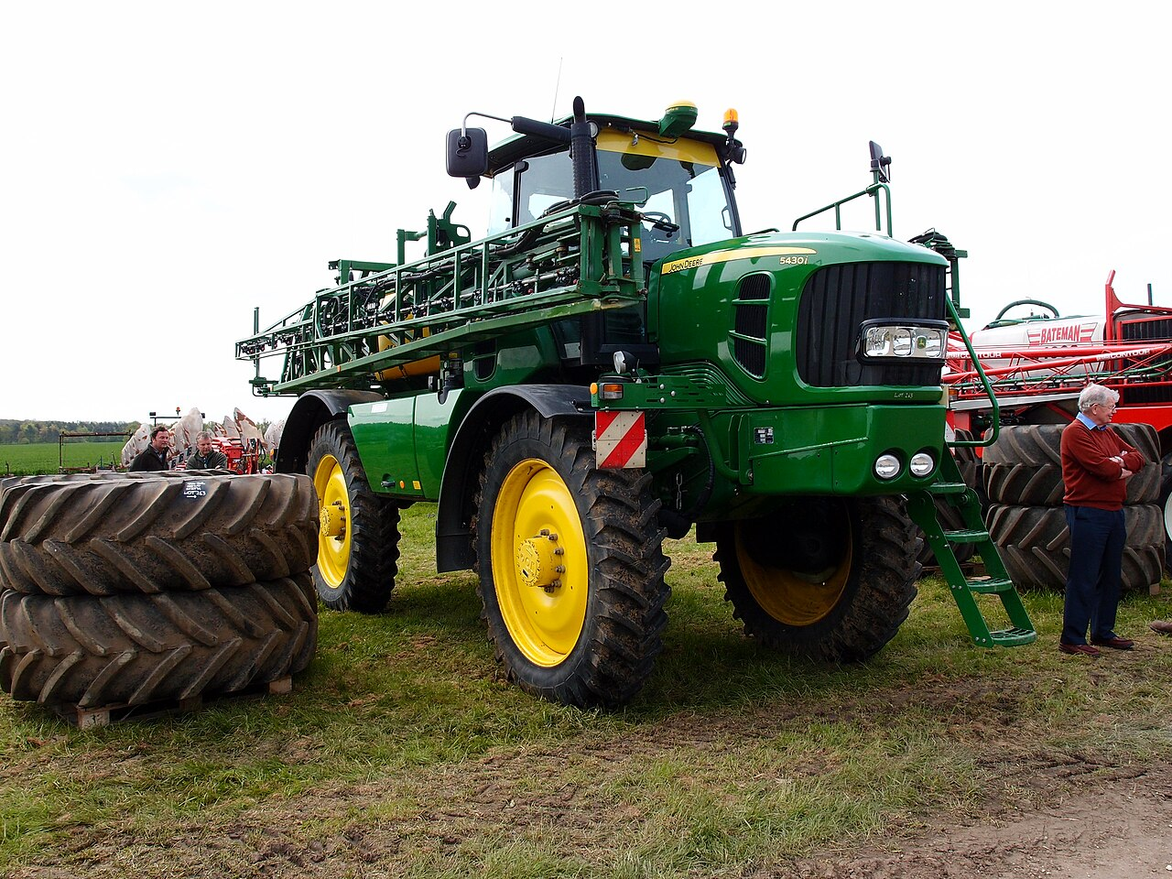
See & Spray Ultimate — the canonical L1 success
5M acres
≈0.55% of 900M-acre US ag total
2025 season
–50%
from baseline ≈1 lb/acre AI → ≈0.5 lb
contact herbicides
+2.0 bushels
from US avg ≈177 bu/A = +1.1%
soybeans per acre
36 cameras · CNN on millions of images (>1M) · NVIDIA Jetson edge · <50 ms
John Deere ExactApply + See & Spray Ultimate · November 2025
Sources: AgTechNavigator 2025-11-10; John Deere press release November 2025; GrowIWM 2024
Notes:
Let's begin the climb up the ladder from the very lowest level — the open field. This is an environment of maximal unpredictability, and the canonical L1 success case of 2026 is the John Deere See & Spray Ultimate system.
This is not an "autonomous tractor" and not an "AI farm assistant". It's a narrow application of computer vision for the selective application of herbicides. On a standard R-series sprayer, thirty-six cameras are mounted along the boom, pointed downward. Each camera scans about two and a half thousand square feet per second at a speed of twenty-five kilometers per hour. The frames pass through a convolutional neural network trained on millions of labeled images (per the primary Deere and Blue River sources — more than one million; the forty-million figure often confused with See & Spray belongs to a different product — LaserWeeder G2 from Carbon Robotics, which we'll examine in Section 2); the model distinguishes a crop plant from a weed by leaf shape, texture, density, and context. If a weed is detected in the frame, the corresponding nozzle fires within milliseconds and injects a droplet of herbicide only at that point.
An important architectural decision — inference is performed on the device. On each boom section an edge GPU of the NVIDIA Jetson class is installed. The latency from pixel to nozzle must be less than fifty milliseconds, otherwise the weed has already passed under the boom. This is edge ML in its canonical form — not a simplification of cloud ML, but a structural architectural decision fit to the task. A cloud uplink at twenty-five kilometers per hour in fields with variable cellular coverage would be a single point of failure.
The 2025 metrics: the system is deployed across more than five million acres per season — that's an area larger than the state of New Jersey. The average reduction of non-residual herbicides is about fifty percent; savings of roughly thirty-one million gallons of mix per season; a soybean yield gain of two bushels per acre on average, in the best cases up to four point eight. This is a rare example of an AgTech solution in which the numbers are confirmed by independent agricultural extension-service reports.
What makes the case canonical? Three structural conditions. First — the task is narrow: selective spraying on the binary feature "crop or weed", not "optimize the whole field". Second — feedback arrives within the same season: the amount of herbicide is compared with last year's, the yield gain is assessed at harvest. Third — the alternative (blanket spraying) is well known, and the difference in outcome is easily counted in dollars. This is not "magic AI"; it's a narrow application of CV at a point where economics and measurability allow AI to pay off in one or two seasons.
And there is a caveat. See & Spray works only in John Deere ExactApply systems; outside the US Midwest a validation bias is documented — on cotton in Texas it works (Palmer amaranth is represented in the dataset), but in Brazil's Cerrado early pilot farms reported detection degradation on broadleaf weeds not represented in the training data. Every CV-AI product has a zone of applicability, and the promise of universal application beyond it is usually vendor maskirovka.

Slide 8
L1 platforms — five vendors, different modes. Brand ≠ operating mode
Platform
Geography
Operating mode
Business model
BASF xarvio
EU, Japan (rice)
Subscription + advisory
Pay per acre
Climate FieldView
US (left Russia 2022)
Data warehouse
250M acres of subscriptions
Syngenta Cropwise
Global
Bayer Forward integration
Bundled in a package
Granular (Corteva)
US
Farm management
Cloud service
Taranis
Global
Computer vision + drones
Pay per acre
★ Key point on this slide — BASF xarvio in Japan: a rice-yield guarantee (October 2025)
The first case of a guaranteed yield under AI advisory: BASF pays compensation if the harvest falls short. A closed data loop + an insurance mechanism = the only known example as of 2026. The other 4 platforms in the matrix are for self-study; the "brand ≠ operating mode" criterion applies to each.
Source: BASF press release p-25-191 October 2025 · TAdviser FieldView 2022
Notes:
Beyond See & Spray, five more large platforms operate on the first rung. But the operating mode of each is worth understanding separately, because marketing of the "AI advisory" type conceals substantial differences — and an engineer evaluating a vendor is obligated to distinguish them.
The first is BASF xarvio FIELD MANAGER. More than one hundred thirty thousand farmers, twenty million hectares under management, more than one hundred countries. The operating mode is rule-based agronomic recommendations plus classical ML for optimization; not deep learning end-to-end. The most interesting development — in October 2025, BASF Japan launched the world's first outcome-based rice yield guarantee via xarvio with the Humus AI service. This is a fundamentally new model of AgTech-vendor responsibility: the vendor guarantees an output metric, not an input. This is the gold point of the map — the only example of an outcome-based contract at L1 in 2026.
The second is Climate FieldView from Bayer. More than two hundred fifty million subscribed acres in twenty-three countries; in the US that's more than half of all corn, soybean, and cotton acreage. And here is the critical anti-hype caveat: two hundred fifty million acres are subscriptions to the platform, not "AI optimizes every acre". Most of the functionality is visualization, weather forecasting, seed-hybrid recommendations; deep learning is applied in sub-tasks, but that is not the main operating mode. Plus vendor lock-in — the recommendations are tied to Bayer and Pioneer hybrids. And there is a political lesson: Climate FieldView left Russia in twenty twenty-two, and Russian agroholdings that had invested in the platform lost access all at once. We'll return to this in Section 4-bis.
The third is Cropwise from Syngenta. An open platform with a developer API, announced in October 2025; third parties develop agro applications on top. An intermediate position between a closed system and open source.
The fourth is Granular Insights, Corteva. A narrow focus on prescription planning; three-meter satellite imagery plus variable-rate prescriptions. Less functionality than FieldView, but within its niche — it works.
The fifth is Taranis. A premium product for large farms; high-resolution aerial imagery plus deep learning for disease and insect detection. Not for smallholders.
The main lesson of this slide — this is a family of products with different modes and different business models. "L1 AI platform" as a single category is marketing packaging; real analysis requires deconstructing "brand → operating mode → business model → geography". This is the first practical skill we'll train on concrete cases in this section.

Slide 9
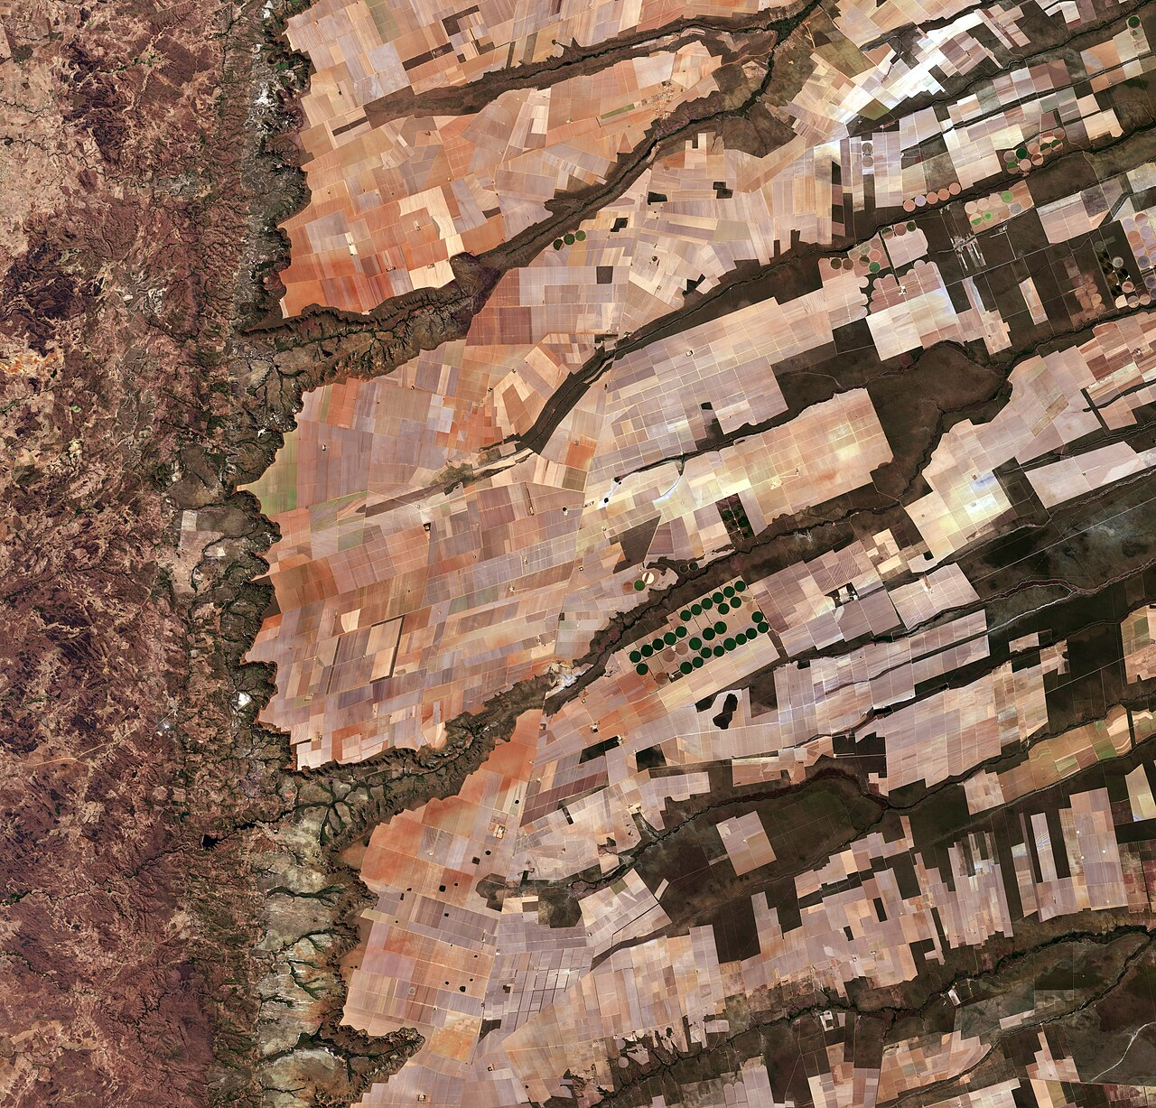
Foundation models 2026 — the barrier to entry dropped by 2-3 orders of magnitude
Vendor concentration risk
The entire L1 industry runs on 2-3 foundation models (IBM / NASA / ESA). A model shutting down = teams lose capabilities all at once.
The 2026 advisor architecture
Sentinel-2 / Copernicus (ESA, CC-BY-SA) — the data class for TerraMind
Foundation model (TerraMind) + retrieval (RAG) to the local regulator + LLM generation + explicit abstention at low confidence.
TerraMind (IBM + ESA, 2025)
"GPT-3 for Earth observation". A team of 3 fine-tunes on thousands of images instead of millions.
Sources: IBM Research, April 2025; NASA Earth Observatory 2025
Notes:
Two developments in 2025 changed the picture of the first rung on a three-to-five-year horizon, and an engineer should know about them.
TerraMind — a foundation model from IBM Research and the European Space Agency, released into open access in 2025. This is the first "GPT-3 moment" model for Earth observation: pretrained on one trillion tokens of satellite data, supporting several modalities — optical imagery, synthetic-aperture radar, multispectral images, time series, IoT-sensor metadata, agronomic reports in textual form. A dual-scale architecture links local pixel-level and global region-level context. Application in agriculture: variable-rate prescriptions, field-level yield forecasting, crop-stress detection weeks before visible symptoms.
Prithvi-EO 2.0 — a continuation of the joint IBM and NASA project, a specialized foundation model for agromonitoring. The main improvements from 1.0 to 2.0 are deeper metadata understanding and temporal capability: the model can work with time series of the same field, not only snapshots.
What does this change for the engineer? Previously, every AgTech startup team trained its own convolutional network from scratch on its own labeled datasets — that required millions of images, millions of dollars, years of work. A foundation model shifts the balance: a team of three can fine-tune TerraMind on a specialized task using thousands of images instead of millions. This lowers the barrier to entry for university teams and small startups.
But at the same time it creates a systemic risk. If all L1 AgTech solutions are built on two or three foundation models, the reliability of the entire layer depends on the continuity of those models. Three classes of risk. First — model shutdown: a Hugging Face account is deleted or a license is changed. Second — support degradation: the model isn't updated, the training data grows stale. Third — geopolitical unavailability: sanction restrictions, export controls on ML models. Russian teams formally have open access to Prithvi-EO via Hugging Face, but fine-tuning requires a GPU cluster of NVIDIA H100s or A100s, which are themselves under sanction restrictions.
A small but important technical correction: AgriFM is a publication by research groups at the University of Hong Kong and Wuhan University in May 2025, not Carnegie Mellon, as it's sometimes stated in survey materials. Crop Wizard is a RAG-grounded advisory application, not a separate "Crop-LLM" foundation model. This is an example of misattribution that our own fact-checking skills work against.
The advisor architecture of 2026 is a pattern, not a model. A foundation layer as perception plus RAG to a local regulator plus an LLM on top for generating a recommendation plus explicit abstention under low confidence plus a human in the loop for critical decisions. We'll return to this pattern in every following failure story.

Slide 10
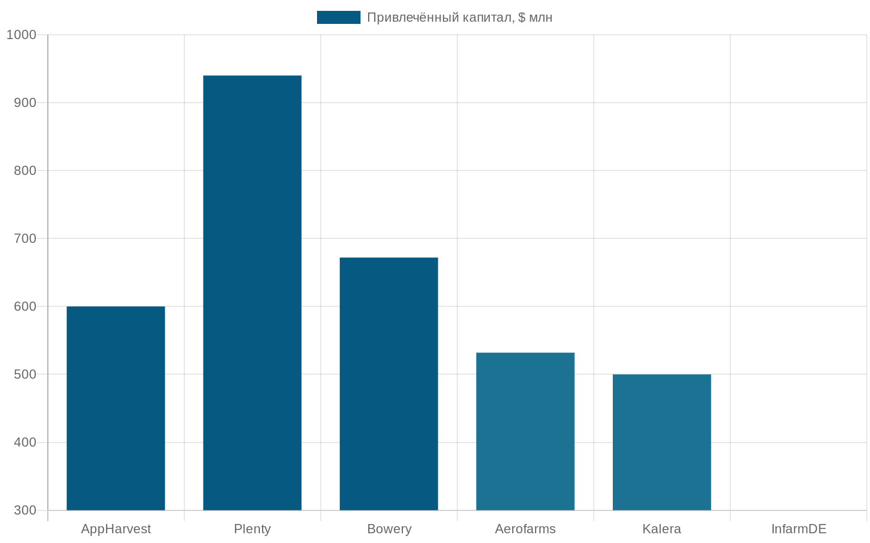
Vertical farms — a failure not caused by bad AI. AppHarvest, Plenty, Bowery
AppHarvest
Greenhouse, unprofitable 2023
$475M SPAC + $341M debt ≈ $816M
Plenty
Compton AI factory 19 mo → bankruptcy
$940M of $1B+ raised since 2014; –99% valuation
Bowery
Collapse before IPO, November 2024
>$700M raised; $32M never-used Locust Grove
$1.37B+ in losses, 14 bankruptcies in 2025. The energy arithmetic did not work.
The climate controllers worked. Computer vision recognized. The model predicted. LED ≈ 100× the energy of sunlight — AP1 thermodynamics > AI.
Sources: TechCrunch 2025-03-24, 2024-11-04 (Bowery); Agriculture Dive 689039 (AppHarvest)
Notes:
Let's move to the first big failure block. Vertical farming is an attempt to build a closed-loop AI-managed farm: LEDs instead of the sun, a nutrient solution instead of soil, climate control instead of weather, AI optimization of all parameters. The idea of 2018-2021 looked convincing: eliminate weather, seasonality, field pathogens; place production in cities. The result of 2022-2026 is a collapse of the category. Around three billion dollars of lost venture capital, no fewer than fourteen bankruptcies in 2025 alone worth about one billion three hundred seventy million dollars, minus 53 percent of funding for the novel farming systems segment year-over-year per the AgFunder Global AgriFoodTech Investment Report 2025 (Q1-Q3 2025 $1.5B versus $3.2B for 2024).
Three anchor cases. AppHarvest — the flagship of American indoor farming, at its peak valued at about a billion dollars via a SPAC deal in 2021; on the board — Martha Stewart, J.D. Vance, David Lee. Debt at the moment of bankruptcy — three hundred forty-one million against current assets of one hundred ten million. The cause — a combination of high Kentucky heating OPEX in the winter period and the tomato-mosaic virus, which, once it penetrated the flagship site in Morehead, spread through the entire greenhouse loop in days. This is precisely the "closed-loop ↑ blast radius" phenomenon: in an open field the same virus would spread across hectares over weeks; in a closed loop it covers the entire production capacity.
Plenty is the company we started the lecture with. Raised capital of nine hundred forty million from SoftBank, Walmart, Bezos Expeditions. Compton, California — four and a half million pounds of leafy greens per year as planned, opened May 2023, closed December 2024. Nineteen months. The direct cause in their own words: there is a large gap between what consumers are willing to pay for leafy greens and the cost of vertical farming. Energy in California ate the AI optimization.
Bowery Farming — at its 2021 peak valued at two point three billion dollars. Ceased operations on November fourth, 2024 via an ABC rather than Chapter 11. Raised capital of more than seven hundred million; the Locust Grove facility of two hundred thousand square feet — the largest vertical farm in history — went into liquidation with thirty-two million of new equipment that was never even started. This is an especially telling signal: capex first, AI after — there was nothing left to catch up with, because the business model failed before the AI infrastructure managed to get going.
The main idea of the slide: ML worked in every one of these cases. The climate controllers worked; CV recognized; yield models trained. What did not work is the arithmetic of energy: LED lighting on a closed floor consumes roughly one hundred times more energy than the same plant receives from free sunlight. And this is not "bad AI" — it's a law of thermodynamics that ML does not optimize. We'll move to this math on the next slide.

Slide 11
Five "whys" — why AI did not close the thermodynamic gap
1. Why did it close?
2. Why the capital?
3. Why don't they work?
4. Why 100×?
5. Can AI close it?
Capital ran out
Unit economics don't work
Cost of LED energy 100× sunlight
Law of thermodynamics
No: effect 5-15% vs a 100× gap
Root cause: a two-order-of-magnitude gap. No model will close it.
0.5 (sun→LED) × 0.7 (LED→plant) × 0.3 (plant→yield) ≈ 10.5% end-to-end. AI optimizes the denominator (5-15%); the gap is in the numerator.
AP1 in its strict form: "when AI optimizes an incorrectly formulated objective function — better not AI".
Analysis by Hannah Ritchie · MDPI Sustainability, 2024
Notes:
Let's apply a five-why analysis to the collapse of vertical farming, staying within a single causal chain: physics, then economics, then engineering architecture.
Why did Plenty close Compton nineteen months after opening? Because unit economics didn't add up — the cost of producing leafy greens in a closed farm turned out to be structurally higher than the selling price.
Why didn't unit economics add up? Because sixty to eighty percent of a closed farm's OPEX consists of electricity for LED lighting and climate control.
Why does LED energy so dominate OPEX? Because LED delivers roughly one hundred times less energy per unit of area than free solar radiation, and that difference has to be compensated with electricity from the grid.
Why didn't AI optimization close this gap? Because AI optimizes parameters within a given architecture — that is, it works on the denominator of the business model; the fundamental physical gap sits in the numerator, in the amount of energy that must be delivered to the plant. Optimizing efficiency by five, ten, twenty percent doesn't compensate for a two-orders-of-magnitude gap between grid LED energy and free sunlight. This is an arithmetic consequence, not a shortcoming of the model.
And the fifth step — the financial-narrative layer. Why did the category keep raising one billion three hundred seventy million plus before the collapse? SPAC capital of 2020-2022 provided a fast liquid exit for early investors before unit economics were verified. Celebrity backing — Martha Stewart at AppHarvest, Natalie Portman at Bowery — generated media attention. The AI-revolution-in-agriculture narrative of 2021-2023 crowded out the analysis of thermodynamics. Independent LED-versus-sunlight expertise on the investment side was insufficient. This is not physics — it's a story about how the financial-narrative layer is superimposed on the engineering one and goes uncorrected for a long time.
The numerical decomposition on the right is the breakdown of a vertical farm's end-to-end energy efficiency into components per Hannah Ritchie's analysis. LED lighting efficiency is about fifty percent: the rest is heat, IR radiation outside PAR. Grid electricity availability is about seventy percent on an annual average. Growing efficiency is about thirty percent for leafy greens under vertical conditions. End-to-end equals zero point five times zero point seven times zero point three, about ten and a half percent. Compared with free sun — that's about a hundredfold OPEX gap.
And the main conclusion. AP-one — the law of thermodynamics matters more than ML. This is the first of five anti-AI criteria we've arrived at. When the fundamental economics is an order of magnitude above the market price of the product, ML optimization doesn't close the gap, because it works on the denominator. The alternative: open ground where energy is under ten cents per kilowatt-hour; vertical farming is justified only for high-value crops where the premium covers the energetics.

Slide 12
ChatGPT and Bard as agronomists — "confidently wrong" in tens of percent of cases
Tzachor et al., Nature Food, November 2023
AP4 — a categorical anti-pattern
Reichman University · 184 questions (publication 11.2023, press 05.2024)
A generic LLM in the role of agronomist advisor — categorically inapplicable. Not "needs more work"; this is a different class of task.
GPT-3.5
32%
correct
Alternative: AI with source verification (RAG)
GPT-4
44%
correct
• A bounded farm knowledge base
Bard
29%
correct
• Retrieval + source citation
The other 56-71% of answers are confidently wrong: the model does not say "I don't know", it produces a confident answer with the wrong dosage / an unsuitable chemical. The failure mode is not "the model is bad", but "the application is outside its mode".
• Calibrated confidence: "I don't know" when it doesn't
• An audit trail for every recommendation
+ human-in-the-loop: the final recommendation is confirmed by an agronomist
Source: Tzachor et al., Nature Food, November 2023 (press coverage Phys.org 2024-05)
Notes:
The second failure block concerns a popular hope of the last three years: can a consulting agronomist be replaced by an LLM chatbot? This is especially tempting for developing regions, where the density of qualified agronomists is low but most farmers have smartphones with internet.
The Tzachor et al. study from Reichman University in Israel, published in Nature Food in November 2023 (with wide resonance in May 2024 thanks to a Phys.org review), is a controlled experiment on one hundred eighty-four questions about applying pesticides and herbicides to specific crops. GPT-3.5, GPT-4, and Google Bard were tested. The co-authors — research groups from the USA, the UK, Kenya, Nigeria, Colombia; the object — potential use scenarios for ChatGPT-like models by African farmers: cassava, fall armyworm, fertilizer timing. The result: the models confidently recommended the wrong application window for a significant share of questions. On average — tens of percent of confident-wrong answers. This is not "sometimes wrong"; it's a confidently wrong answer with no explicit expression of uncertainty.
An important caveat: this is a study, a controlled experiment, not a documented real-world catastrophe. But the significance is the same. Confident-wrong is more dangerous than admitted-don't-know. A farmer who hears "not sure — consult an expert" consults an expert. A farmer who hears a specific recommendation with a number carries it out. Had a farmer carried out the recommendation from such answers — significant crop damage depending on the crop and the regulator.
The failure mechanism. Generic LLMs are trained on an enormous volume of internet text, including old forums, contradictory sources, marketing materials. They have no grounding in local regulation — neither USDA-EPA, nor EU-EFSA, nor Rosselkhoznadzor — and no mechanism for explicit abstention under low confidence. When asked about a specific herbicide at a specific stage for a specific crop in a specific region, the model generates the most probable text resembling an agronomic recommendation — but without checking whether the product is approved, whether the recommendation is current today, whether the stage matches.
This is our second anti-AI criterion — AP-four. A generic LLM in advisor mode for high-stakes decisions is a categorical anti-pattern. The alternative on the right: a RAG-grounded architecture. Retrieval-Augmented Generation tied to the local regulator. The local regulator's database of approved products as the retrieval source; the farmer's query is turned into a structured query; the LLM generates a recommendation only within the retrieved documents; under low confidence — explicit abstention; logging of all recommendations for audit. This architecture doesn't eliminate errors entirely — but it turns a confidently wrong answer into an honestly uncertain one, which for critical decisions is a fundamentally different class of risk.

Slide 13
Plantix — 10-15% misdiagnosis × 10M+ downloads = ~100k wrong recommendations / year
Plantix · mobile app
What's wrong with "85-90% accuracy"
10+ million downloads
• Vendor self-report (no independent audit) • 10-15% misdiagnosis = 1-1.5M errors / year • Dose-critical errors (wrong chemical) • Chronic acceptance of false positives in an advisor
[ camera ]
Photo of a soybean leaf — analysis —
AP3 + alternative
Diagnosis: anthracnose
AP3: threshold accuracy ≠ readiness for deployment. Alternative — calibrated confidence + abstention: • output only at ≥90% confidence, • otherwise — "refer to a specialist", • + partition by dose criticality.
Confidence: 87%
Plantix.net (interface); data from Frontiers in Plant Science 2020 + Plantix self-report
Notes:
The third first-level failure is Plantix, a smartphone app that identifies a plant disease from a photo of a leaf and recommends a pesticide. Per Plantix's claims, the app has been downloaded more than ten million times, with about seven million active users in India, and a diagnostic accuracy of eighty-five to ninety percent on their own dataset. This is a popular example of "AI for smallholders": a free app that replaces an in-person visit from an agronomist where agronomists are scarce.
The failure mechanism matters in the details. The claimed accuracy is Plantix's self-assessment on their own image dataset, not an independent field validation. Real accuracy under field conditions is lower due to many factors: photo quality, disease stage, individual crop variability, the specific cultivar. Even if we grant ninety percent accuracy on ten million downloads and assume that only ten percent of downloads lead to a pesticide-application decision — that's about one hundred thousand wrong pesticide recommendations per year. Each such recommendation is either an incorrect application of chemicals with risk to the farmer's and consumer's health, or the absence of application where it is needed.
The breakdown on the right — ten to fifteen percent misdiagnosis by type. False-positive: the model recognized a disease, but the plant is actually healthy or has a different disease. Dose-criticality varies: if the recommendation is to treat with a nitrogen foliar fertilizer, the damage from the error is low; if with a systemic pesticide of a specific class, the damage is medium — yield loss from chemical stress; if with a category-B organochlorine insecticide, the damage is high — residue in the fruit and a health risk. False-negative: the model failed to recognize a disease and advised "all fine". A missed nutrient deficiency is treated in the next cycle; a missed fungal infection lowers yield by ten to thirty percent; a missed systemic viral infection like ToBRFV can destroy more than fifty percent of the planting.
An additional characteristic — geographic asymmetry. Plantix is trained predominantly on diseases dominant in India and Southeast Asia — fall armyworm, rice brown spot, rice blast, potato late blight. Applied under Russian conditions or in East Africa to cultivars not in the training set — accuracy falls below the claimed level. This is the same applicability gap as in L3 for Holstein bias, which we'll move to in Section 3.
And the main anti-AI criterion of the slide — AP-three. Threshold accuracy does not equal readiness for deployment. Ninety percent on a benchmark does not guarantee deployment quality. The alternative on the right — calibrated confidence plus abstention. The ML model estimates not only the disease class but also an uncertainty estimate for each prediction. When confidence is below eighty percent — abstain from the recommendation, switch to "contact a local extension agent". This is a working engineering pattern, not a "research idea"; it's implemented in production at several medical AI startups from Lecture 7 and appears in state-of-the-art plant-disease classification in the academic literature of 2024-2025.

Slide 14
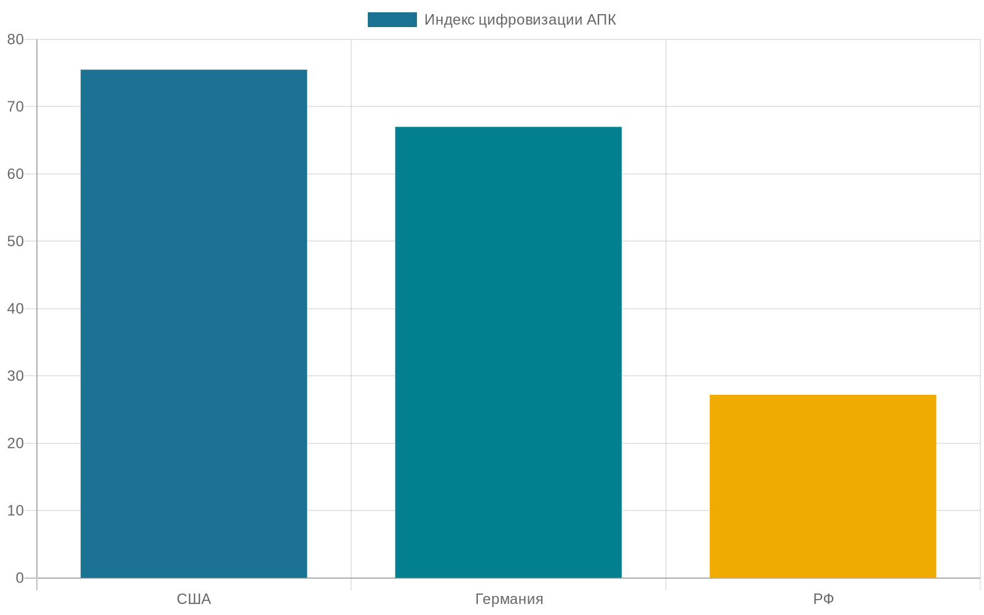
L1 in Russia — ExactFarming and Progress Agro at a digitalization index of 27.2
ExactFarming
12,700 farms · 9.8M ha
Field management + monitoring
Progress Agro group
+5% profitability
Internal measurement 2024
AP6 — Climate FieldView left Russia in 2022
L1 political risk: cloud services with foreign dependencies can be cut off by a vendor decision or by sanctions.
Sources: Yakov & Partners 2024 · ExactFarming.com · TAdviser 2022
Notes:
The Russian layer of the first rung is structured differently from the American Corn Belt, and understanding this asymmetry is part of the engineering skill.
The three key working solutions are ExactFarming, AgroSignal, and Progress Agro group. ExactFarming — a Russian SaaS for farm management, serving twelve thousand seven hundred farms and nine point eight million hectares as of 2024. AgroSignal — monitoring of fuel consumption and equipment movement, without AI capabilities in the proper sense of the word. This is an example of automation, not AI, and an important example of how digitalization in the industry does not always mean machine learning. Progress Agro group in Krasnodar Krai deployed variable-rate nitrogen application on two thousand eight hundred hectares with plus five percent wheat profitability. This is an internal company measurement, not peer-reviewed, but a public metric with a concrete scale.
Russia's agricultural digitalization index — twenty-seven point two out of one hundred versus seventy-five point five for the USA. This is a structural gap, not a matter of propaganda. It's explained by three factors: the small size of farms outside agroholdings, cheap labor relative to the USA, and sanction restrictions after 2022 that reinforced dependence on a limited set of domestic or gray-imported solutions.
And most important — the main vivid lesson of political risk on the first rung. Climate FieldView left Russia in 2022 together with the exit of Bayer Crop Science from the Russian market. Russian agroholdings that had invested in FieldView in 2018-2021 lost access to the platform with its dashboards, recommendations, and satellite analytics all at once. This is AP-six — the vendor lock-in trap. Every AI platform is a vendor control surface, and a subscription does not make the farmer the owner of the data and decisions. We'll return to this lesson in Section 4-bis, where we'll examine the double optic of vendor lock-in through the Melitopol remote-brick and FTC v. Deere.
The lesson for an engineer not tied to the Russian context: this same class of risk applies to any farm in any peripheral country dependent on a cloud-AI vendor from another jurisdiction. The Russian case is a natural experiment illustrating what happens when an imported AI stack becomes unavailable.

Slide 15
2
Section 2 — L2 “Robot”
Specialization beats generalization. Narrow wins against generic failures.
4 working specialization cases · 3 failures (Monarch, FarmWise, strawberry) · Russia parallel CV vs sensor-fusion
0. Opening
1. L1 Field
2. L2 Robot
3. L3 Animal
4. L4 Chain
5. Environment
6. L5 Shelf
Notes:
We climb to the second rung — L2, the level of autonomous machines and robots. This is a semi-controlled environment: the machine moves across the field, but its own physics — vibrations, GPS receiver, obstacle sensors, camera optics — gives partial control over what the machine sees and how it reacts. Logically it's a step between the first rung of the fully open field and the third rung of the semi-closed environment of a livestock farm.
And here one of the main lessons of AgTech 2026 emerges: specialization beats universality. Narrow specialized robots — LaserWeeder for weeds on specific crops, Saga Robotics Thorvald for UV-C night treatment of strawberries, Tevel Aerobotics for apple picking — work and scale. Universal "farm robots" — Monarch MK-V, FarmWise — go bankrupt.
In this section we'll examine four working specialization cases. Then three failures: the Monarch Tractor with 2025 lawsuits over "autonomous" with broken autonomy, the FarmWise wind-down plus Naïo recovery as the structural impossibility of a generic CV stack in a real field, and the drawn-out pilot phase of the strawberry-picking robot. In the finale — a critical comparison of Cognitive Pilot and ITELMA as an architectural choice within the AI domain, not as "AI vs. non-AI".

Slide 16
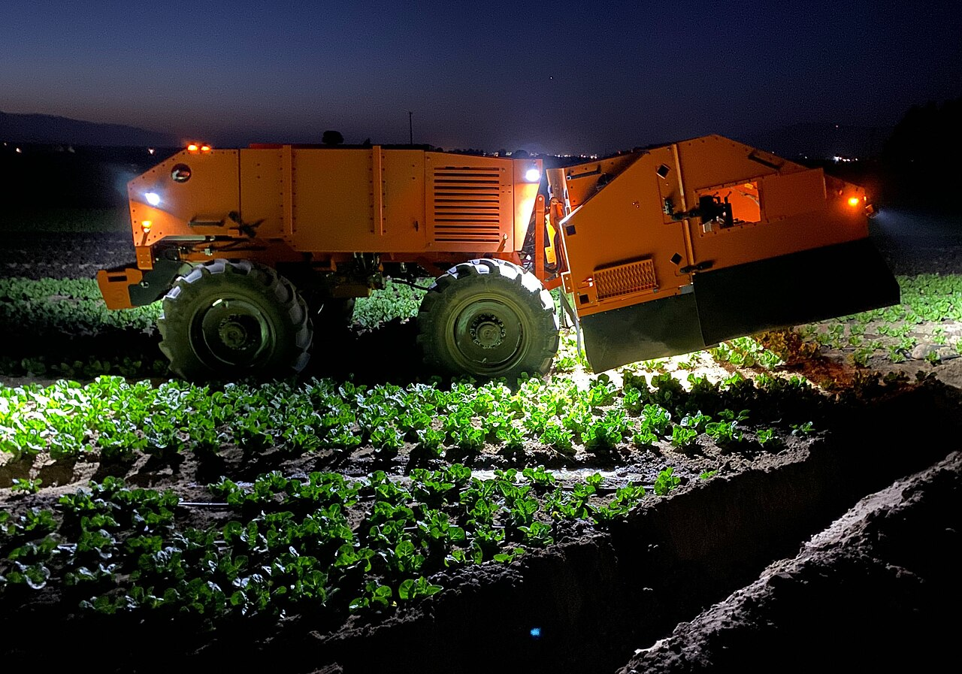
Carbon Robotics LaserWeeder G2 — the canonical L2 success
250,000 acres
≈0.028% of 900M acres US ag
15 billion
weeds killed
$1.4M
vs sprayer ~$50k + chemicals $200-400/acre → payback 3-4 years at 1k+ acres
240 W laser
AI-driven weeding robot (representative photo · “Titan / LaserWeeder” class)
+ CNN on 40 million images
Replacing chemistry with physics — a narrow operation substitution, not an “autonomous tractor.” The working L2 pattern.
Source: Carbon Robotics press release, businesswire 2025-02-10
Notes:
The canonical success case of the second rung in 2026 is the Carbon Robotics LaserWeeder G2. This is a machine towed behind a tractor across the field that destroys weeds with a laser pulse based on computer vision. Replacing chemistry with physics.
The architecture. Downward-pointing cameras are mounted along the machine's boom; the number depends on the width — from six to sixty feet; the G2 model, unveiled in February 2025, is modular. Each camera scans the ground in real time; a convolutional neural network trained on forty million labeled images distinguishes crop plants from weeds — the model recognizes more than one hundred crop species. When a weed is detected, a two-hundred-forty-watt laser is aimed at the point and delivers a pulse of about twenty-five milliseconds that burns out the meristem — the weed's growing point. The plant dies; the soil and crop plants are not damaged. No chemicals.
The 2025 metrics. Carbon Robotics reports: more than two hundred fifty thousand acres treated by LaserWeeder machines; more than fifteen billion weeds destroyed; about one hundred fifty machines deployed in fourteen countries; the cost of a machine — about one million four hundred thousand dollars per unit.
What makes the case canonical. Three structural conditions, analogous to See & Spray but with different emphases. First — a narrow task with a direct alternative: not an "AI-managed tractor", but laser destruction of weeds instead of chemical. The alternative — herbicides — is well known, as are its cost and risks. The difference in outcome is counted directly: gallons of herbicide saved times price times area. Second — replacing physics with physics, not talk of replacing a human. The LaserWeeder replaces neither the agronomist nor the farmer; it replaces the chemical spray with a laser. A very narrow substitution in which the gain is clear — no chemical residue on the crop and in the soil. Third — the gradualness of deployment. One point four million per machine is not an object of mass demand; it's a solution for large vegetable and specialized farms.
Limitations and caveats. The LaserWeeder's laser is a diode, two hundred forty watts of peak power, water-cooled. Power consumption is on the order of thirty to fifty kilowatts per machine; it runs off a generator on the towing tractor or off its own battery pack. This is high-energy electrical consumption — one of the main caveats: the machine is not an "eco-friendly replacement for herbicides" in the broad sense, since it shifts the ecological footprint from chemistry to electricity.
ML failure modes — when weed and crop are visually similar. A concrete example: pigweed in spinach. Pigweed and spinach are both of the amaranthus family; at the two-to-three-leaf stage their foliage is morphologically similar; the model may flag spinach as a weed and burn it with the laser. Carbon Robotics documents this failure mode and sells a "calibration mode" for test field runs before production treatment.
Per-acre economics. The cost of herbicide treatment in the US for vegetable crops is two hundred to four hundred dollars per acre per year. The LaserWeeder replaces this chemistry; the payback period is three to four years for a large farm with high-margin crops. Limitations: doesn't work in high-density crops with dense planting; doesn't work in muddy conditions; requires electrical power.
This is a working category: organic producers, specialized vegetable farms, buyer hostility to chemical residues. This is specialization in L2.

Slide 17
Cognitive Pilot and ITELMA are not AI vs non-AI; they are two different classes of AI
Cognitive Pilot · computer vision
ITELMA Kvadro · sensor fusion
“What I see”
Navigation + inertial + corrections: “where I am”
1700+ installations (tractors, combines)
GLONASS + GPS + Galileo + BeiDou
4 farmer lawsuits (~₽12.7M)
RTK correction: accuracy 2-5 cm
Failure mode:
Why it works:
• dust obscures the cameras • shadow shift changes the lighting • edge-row recognition breaks down • benchmark labeling ≠ field conditions • edge cases not in the training set
• sensors do not depend on lighting • multiple systems = redundancy • GLONASS works in Russia independently • stable in dust / fog / at night • compatible with deterministic guidance
Sources: RTVI 2025 (Cognitive Pilot lawsuits); Fontanka 2026-01-26 (ITELMA)
Notes:
The Russia parallel of Section 2 requires special attention, because this is an important case of architectural choice within the AI domain — and one of the places where the simplistic interpretation "AI versus non-AI" leads to the wrong conclusion.
Cognitive Agro Pilot is a computer-vision-based autopilot system for combines, a subsidiary of Sberbank and SberAgro. A camera mounted on the combine's cab recognizes the edge of the uncut field — the visual boundary between the already-cut and the uncut strip — and passes the signal to the onboard computer, which corrects the trajectory. Per the company's data as of May 2024, more than one thousand seven hundred installations on combines of Russian and foreign manufacturers (about one point three percent of roughly one hundred thirty thousand combines in Russia per Minselkhoz data). The claimed effects — plus twenty-five percent productivity, minus thirteen percent grain loss. This is a CV solution: the task is to recognize a visual feature and steer the machine along it.
In 2025 a problem surfaced. Four lawsuits from farmers for twelve million seven hundred thousand rubles against Cognitive Pilot over cases when the CV system couldn't handle the conditions: in heavy dust, typical during grain harvesting on fields with sandy or dry soils, in low sun, in rain — the edge stopped being read, and the combine began veering off the line or stopping. This is a classic CV failure of dust and lighting — the same as in FarmWise.
The alternative solution is ITELMA. In late 2025 the Russian company ITELMA, part of the Tractor Plants group, rolled out a satellite autopilot under the "Itelma Kvadro" brand on «Kirovets» K-7M models. And this is a different architecture — not CV. The machine determines its position in the field through processing signals from several GNSS constellations: GLONASS plus GPS plus Galileo plus BeiDou — with RTK corrections giving accuracy of two to five centimeters, plus Kalman filtering for smoothing and compensating for delays. This is sensor-fusion AI: machine learning works at the level of processing sensor data and predicting position, but not at the level of "visually recognize the field boundary". This class of solution is more robust to dust because it doesn't depend on optics, but requires functioning satellite reception — in GNSS-jamming zones, which we'll return to in Section 4-bis, this becomes a separate problem.
And the main point. These two solutions are not competitors but cover different functions. ITELMA is "where am I": precise field navigation with two-to-five-centimeter accuracy based on the satellite signal. Cognitive Pilot is "what do I see": CV recognition of the uncut edge, obstacles, contours. These are different classes of task, and the engineering-correct solution for a modern autonomous combine is a combination of both. GNSS navigation as primary plus CV as secondary for recognizing nonstandard situations. The "one is better than the other" comparison is a false simplification.
And this gives us the anti-AI criterion AP-two-a — architectural choice within the AI domain. When one class of AI solution, for example CV, structurally doesn't work in a given environment — another class of AI solution, for example sensor-fusion AI on multi-GNSS, may be more robust. The alternative is not "non-AI", but "a different AI architecture". This is critically different from AP-two-b — a genuine non-AI alternative — which we discussed in the FarmWise case. AP-two-a and AP-two-b are two different categories, and not confusing them is the main value of this section.

Slide 18



Narrow L2 wins — Solinftec, Saga UV-C, Tevel, AGCO Outrun
Solinftec Solix
Saga UV-C
Tevel
AGCO PTx Outrun
+243% year over year in 2025
20% of UK strawberries
Apple-picking drones
Retrofit for mixed fleets
Vendor self-report: ≤98% reduction in contact herbicides
Ultraviolet nighttime treatment. Not harvesting — disease control
Narrow niche — flying drones for picking apples
AGCO module for a mixed tractor fleet (not AGCO only)
The specialization pattern: every solution is narrow and measurable
⚠ Do not confuse: Saga UV-C ≠ Saga for harvesting. Those 20% of UK strawberries are disease control, not harvesting.
Sources: Solinftec.com · sagarobotics.com · tevel-tech.com · agcocorp.com 2025
Notes:
Beyond the LaserWeeder, four specialized platforms operate in L2 in 2026 — each in its own narrow niche.
Solinftec Solix — an autonomous field robot from the Brazilian company Solinftec, deployed in the US with two-hundred-forty-three-percent year-over-year expansion in 2025. As of the end of 2025 — more than one hundred robots in Illinois, Indiana, Kansas, Iowa, Wisconsin, Texas. Vendor self-report — up to ninety-eight percent reduction in herbicide volume. This number is from the company, not an independent validation; it should be treated as a marketing caveat. Twenty-four-seven operation on solar power plus self-refilling spray.
Saga Robotics Thorvald — a robot for UV-C night treatment of strawberries against powdery mildew. And here is a critically important caveat that marketing often omits: Saga Robotics covers about twenty percent of the tabletop-strawberry market in the UK — but this is UV treatment at night, not harvesting. Strawberry picking is still manual. Per the company's data, eight point four million pounds raised in 2024-25, one hundred fifty-plus robot units deployed, ninety-seven percent uptime, more than two hundred thousand autonomous kilometers, the goal being thirty percent of the UK market by 2026. This is an exemplary niche win: one task — UV-C at night, one crop — tabletop strawberry, one geography — the UK, a well-measurable result — reduced fungicide use.
Tevel Aerobotics — flying apple pickers. A narrow orchard-crop niche, where the fruit stays on the tree after ripening and requires manual removal. The technology — tethered drones with robotic arms picking individual fruits. Not an "autonomous orchard"; a concrete replacement for the manual picking of individual fruits in a situation where H-2A — agricultural-worker visas in the US — is becoming more expensive and less predictable. Apple picking is a simpler task than strawberry picking, because apples hang higher and are easier to grasp — more on this in the strawberry-economics case.
AGCO PTx Trimble Outrun — a retrofit autonomy mode for a mixed equipment fleet: Fendt, Massey Ferguson, John Deere, CNH. An alternative to the "closed" John Deere AutoTrac system. A demonstration at AGCO Tech Day 2025; the goal — a full autonomous crop cycle by 2030. This is a typical "emerging" segment: not yet in production deployment, but the retrofit-vs-closed-system architectural choice is fundamentally important — more on this in Section 4-bis on vendor lock-in.
The common pattern of all four working stories is specialized niches with one clearly defined task and measurable ROI. None of them claims to be a "universal farm robot". This contradicts the marketing of 2018-2022, when the main investment thesis in AgTech robotics was precisely a "universal assistant for the farm". On the second rung the universal mode doesn't work; the specialization mode works. The explanation of this pattern lies in the failures we'll examine on the following slides.

Slide 19
Monarch Tractor — “autonomous” with autonomy broken
2018
2022
Sept 2025
Nov 2025
Apr 2026
Founded
MK-V demo
Burks Tractor lawsuit
102 layoffs
Caterpillar acqui-hire
Livermore, CA
Big PR wave
10 tractors · $773,088 “unable to operate autonomously”
~38% (102 / ~270 after 10% cut Nov 2024)
End of independence
Anti-pattern: demo ≠ production deployment
“Autonomous” in marketing = a legal trap if the actual behavior depends on the operator. Every autonomy claim must be checked with an independent operator test → if it requires operator presence, the autonomy is partial.
Sources: TechCrunch 2025-11-18, 2025-11-19, 2026-04-15
Notes:
Let's move to the canonical L2 failure of 2025 — Monarch Tractor. This is a California company founded by Tesla alumni and Karlo Mondavi in 2018. The idea looked convincing: an electric tractor with an autonomous mode for vineyards and vegetable farms. Raised capital — more than two hundred twenty million dollars, of which one hundred thirty-three million in the 2024 round. The contract manufacturer — Foxconn since 2022.
The failure-case timeline is useful to see in full, because this is a "demo ≠ production deployment" pattern. In 2018-2020 the R&D phase, prototypes. In 2021-2022 — the commercial launch of the MK-V model; a price of about eighty to one hundred thousand dollars per unit; first deliveries to California vineyards. In 2022 — the Foxconn investment, which reinforced the marketing claim. In 2023-2024 — claims of "autonomous fleet operation"; the peak of capital raising in 2024.
And then — the cascade of events of 2025-2026. August 2025 — Monarch loses Foxconn: Foxconn sold the Lordstown plant to Crescent Dune LLC for three hundred seventy-five million on August fourth, 2025. This is the first clear signal of decline — Foxconn would not have withdrawn the investment and exited contract manufacturing without structural problems.
September 2025 — a lawsuit by Burks Tractor Co. in an Idaho state court. Ten tractors of 2024 build for seven hundred seventy-three thousand eighty-eight dollars, which were "unable to operate autonomously" — the promised functionality didn't work. This is the trigger of a legal cascade of liability: the dealer files suit against the manufacturer, fundamentally — a mismatch between "autonomous" marketing and contractual reality.
On November nineteenth, 2025, Monarch sent out a corporate letter about layoffs of up to one hundred two people, about thirty-eight percent of staff, with a warning of possible shutdown. The company claimed it was transitioning from an OEM role into a SaaS provider of autonomy for existing third-party tractors — but "the timing of the transition puts Monarch at risk of shut down" in its own corporate memo.
And the final point — April fifteenth, 2026. Caterpillar acquired Monarch Tractor. This is a post-failure acqui-hire: IP plus the engineering team consolidated into Cat's autonomous mining and construction division. The Monarch brand effectively gone.
What structural failure? Several are at work simultaneously here. The first — "autonomous" marketing without disclosing supervised autonomy. The marketing sold "autonomous", but the real machines required operator supervision; demo conditions are not equal to reliability in production deployment. The second — sub-optimal economics for a general-purpose orchard tractor. The third — specialization wins. In those same 2024-2026 years LaserWeeder G2, Saga UV-C, Tortuga — all in commercial deployment. Narrow specialized solutions survive; universal "autonomous farm robots" go bankrupt.
The main lesson learned — an anti-AI criterion echoing AP-four: demo does not equal production deployment. Marketing a product as "autonomous" when the autonomy won't survive judicial scrutiny is a structural trap for the whole category. AI autonomy in agriculture is not yes/no, but a gradient with dozens of edge cases. The alternative: supervised autonomy with explicit disclosure of capability and non-capability for each claim.
And a final observation about the Caterpillar acquisition. This is not a revival of the technology; it's a closed door for Monarch's direct-to-consumer model and an open door for the retrofit mode — the AGCO PTx Outrun from the previous slide — on mixed equipment fleets. A strategic acquirer bought the R&D groundwork cheaper than it would have built it itself. This is the final state of failed bets, not their rebirth.

Slide 20
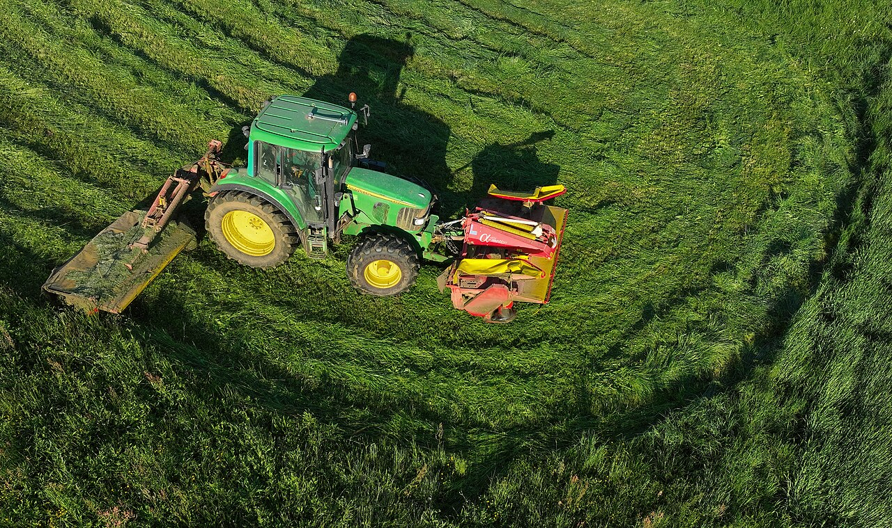
FarmWise wound down + Naïo –40% — the open environment breaks computer vision
Why the CV stack (computer vision) failed
AP2b — the deterministic alternative
FarmWise Titan FT35 · wound down in 2025
Lemken / Kverneland — mechanical cultivator
FarmWise wound down 2025 Naïo €4M → €2.4M (–40%) Computer vision trained under greenhouse conditions: • shadow shift (arXiv 2508.19511) • variable lighting • dust / fog
Mechanical cultivators as the deterministic option: • stem detection by mechanics • inter-row cultivation • works in any weather • cost 3-5× lower than a CV robot
Sources: Farm Progress 2025; arXiv 2508.19511 (shadow bias); Lemken / Kverneland press
Notes:
The second L2 failure, structurally close to Monarch but in a different niche: FarmWise and Naïo Technologies.
FarmWise — a CV weed robot, founded in 2016, having raised more than thirty million dollars — announced a wind-down in 2025. Per reports, customers were left in limbo, machines in the fields without service support. Naïo Technologies — a French company from Toulouse, autonomous weeding robots Oz, Dino, Orio — entered judicial recovery, the French equivalent of Chapter 11, in June 2025. Naïo's financial trajectory: revenue of four million euros in 2021, two point four million in 2024 — a fall of about forty percent.
The structural cause of both failures is one and the same, and it's documented in the academic literature: an arXiv paper from August 2025 «Weed Detection in Challenging Field Conditions: Semi-Supervised Framework for Overcoming Shadow Bias» and a MDPI Agriculture review from 2024. Computer-vision models trained under greenhouse conditions perform poorly in a real field. The concrete degradation mechanisms: dust creates visual occlusion of the cameras. Variable lighting — cloud shadows change the contrast within minutes. Shadow bias — the model learns to classify shadows as vegetation; this is a typical error with an insufficiently diverse dataset. Morphological similarity of crop plants and weeds at early growth stages. Image-quality degradation leads to classification errors — a drop in overall accuracy from the claimed ninety percent in tests to fifty-to-sixty in a real field. This is precisely the figure that pushes the farmer's unit economics into the red.
And here is the critical distinction we'll use in the following sections. AP-two-b — a genuine non-AI alternative. When a CV stack structurally can't withstand open-environment conditions — mechanical weeders give a deterministic robust solution without an AI stack. Lemken Steketee EC-Weeder; Kverneland Onyx — this is less "smart", but deterministically robust to dust, rain, shadows; requires no firmware updates; doesn't depend on cloud connectivity; has no CV failure modes. This is a categorically different class of alternative, distinct from the one we'll examine a slide later — in the case of Cognitive Pilot and ITELMA.
And the key distinction, without which a student will draw the wrong conclusion. AP-two-a and AP-two-b are different things. AP-two-a — an architecture choice within the AI domain: CV versus sensor-fusion AI. AP-two-b — a choice of a non-AI alternative: mechanics instead of AI. Don't confuse them. A student who read only AP-two-a might erroneously conclude that AI always wins if the class is chosen correctly. A student who read only AP-two-b might erroneously conclude that AI is always worse than mechanics. Both conclusions are wrong. The correct conclusion — the choice depends on the nature of the environment and the character of the task, and the engineering skill is to recognize which of the two cases is before us in a concrete situation.

Slide 21
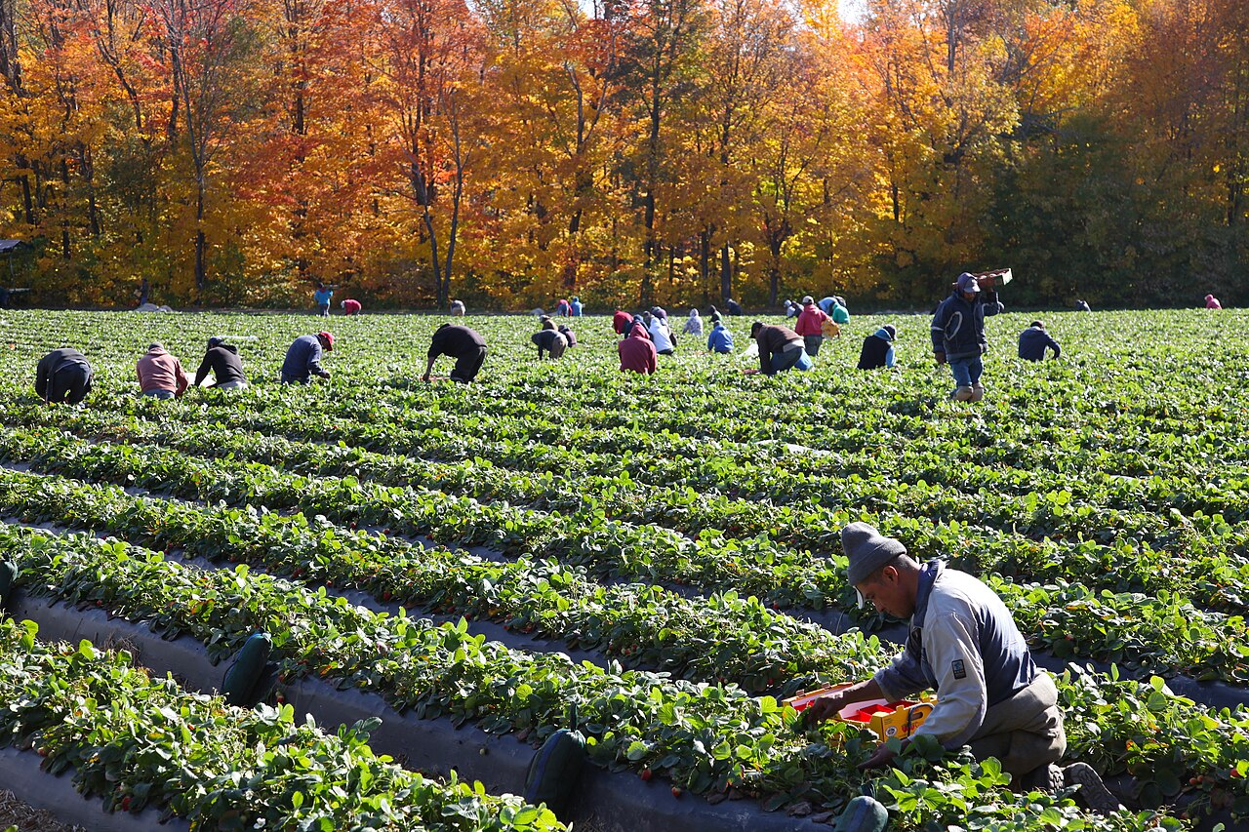
Strawberry-picking robot — 10 years of pilots, not production deployment
$200-350k
capital cost per robot
$68-130k
annualized depreciation per robot
$43k / acre
cost of manual harvesting in California
<5% of market
robots × $50B addressable labor market
Manual strawberry harvesting (Wikimedia Commons, CC-BY-SA)
“Harvesting is the last great unsolved problem”
Sources: Wikimedia Commons; RobotToday market analysis 2024
Notes:
The third second-level failure — more precisely, a drawn-out pilot phase that doesn't turn into production — is the strawberry-picking robot. Dozens of startups in California, the UK, and Japan have been working on this for ten to fifteen years already.
The 2024 economics. One strawberry-picking robot costs from two hundred to three hundred fifty thousand dollars of capex. Annualized capex plus maintenance — from sixty-eight to one hundred thirty thousand dollars per year. The addressable manual-labor market for strawberry picking in the US is about fifty billion dollars. Robots occupy less than five percent of this market. In California, picking-labor costs come to forty-three thousand dollars per acre per year for harvesting alone.
The structural cause of the stall. Strawberry picking is a task in which the human baseline "learns in days". An experienced picker distinguishes ripe from unripe berries, doesn't break the fruit, avoids broken shoots, works at different speeds depending on the density of the crop. The robotics-ML stack doesn't catch up to this baseline over years and tens of millions of dollars of R&D. The quote that has become canonical in the literature: "harvesting is the last great unsolved problem in agricultural robotics".
The alternative: H-2A guest worker programs — agricultural-worker visas in the US — plus ergonomic improvements. Seated harvesters, partially mechanized platforms on which workers sit and pick with one hand — reduce physical strain without trying to fully automate the task. This is still the right path — until robotics catches up.
Tevel Aerobotics from the previous slide is an example of a specialized niche where the task is simpler: apples hang on the tree, they're easier to grasp than low-growing strawberries. This illustrates the same specialization principle: a narrow niche works, generic doesn't.
DailyRobotics announced a commercial launch of a robotic strawberry picker in California for 2026. This is one more promise that needs to be verified. The category pattern — dozens of startups in the pilot phase, a handful with commercial revenue, and for every year of delay more startups are added, promising a "breakthrough in eighteen months". An engineer should treat such promises with the same skepticism as an "AI agronomic advisor in a year".

Slide 22
3
Section 3 — L3 «Animal»
Semi-closed environment + individual-animal measurement. AI works more reliably than at L1-L2.
4 working cases (SenseHub, CattleEye, DeLaval, Birdoo) · 3 anti-hype lessons (Cainthus, tie-stall, Holstein bias)
0. Opening
1. L1 Field
2. L2 Robot
3. L3 Animal
4. L4 Chain
5. Environment
6. L5 Shelf
Notes:
We climb to the third rung — L3, the level of livestock. This is a semi-closed environment: the animals are kept in a barn or on pasture, the environment is partly controlled, but the individual variability of each animal — behavior, health, productivity — is high. At this level AI works more reliably than at the first and second rungs, for two structural reasons.
The first. The economics are concentrated. One cow gives milk worth three to five thousand dollars per year; the loss of one cow due to an undetected disease is a measurable loss. This creates direct and clear economics for AI sensors and analytics.
The second. Measurements at the individual-animal level are possible — via a tag, a camera, a collar. This turns an open-environment farm into an array of semi-closed-loop micro-environments: one animal is one loop. And on each loop AI works on a narrow task with measurable feedback.
In this section we'll examine four working cases of 2026: Allflex SenseHub with two million cows mounted; CattleEye, acquired by GEA in 2024; DeLaval VMS V310 with ninety-nine point eight percent attachment rate; Cargill Birdoo for broiler weight estimation. Then three anti-hype lessons in one block: Cainthus as an example of "partnership announced, no metrics", tie-stall barns as a physical configuration that breaks CV, and Holstein bias as an architectural asymmetry for Russia's local breeds. And at the end — the Russian parallel Connectome.ai plus the sanction uncertainty of the dairy stack.

Slide 23
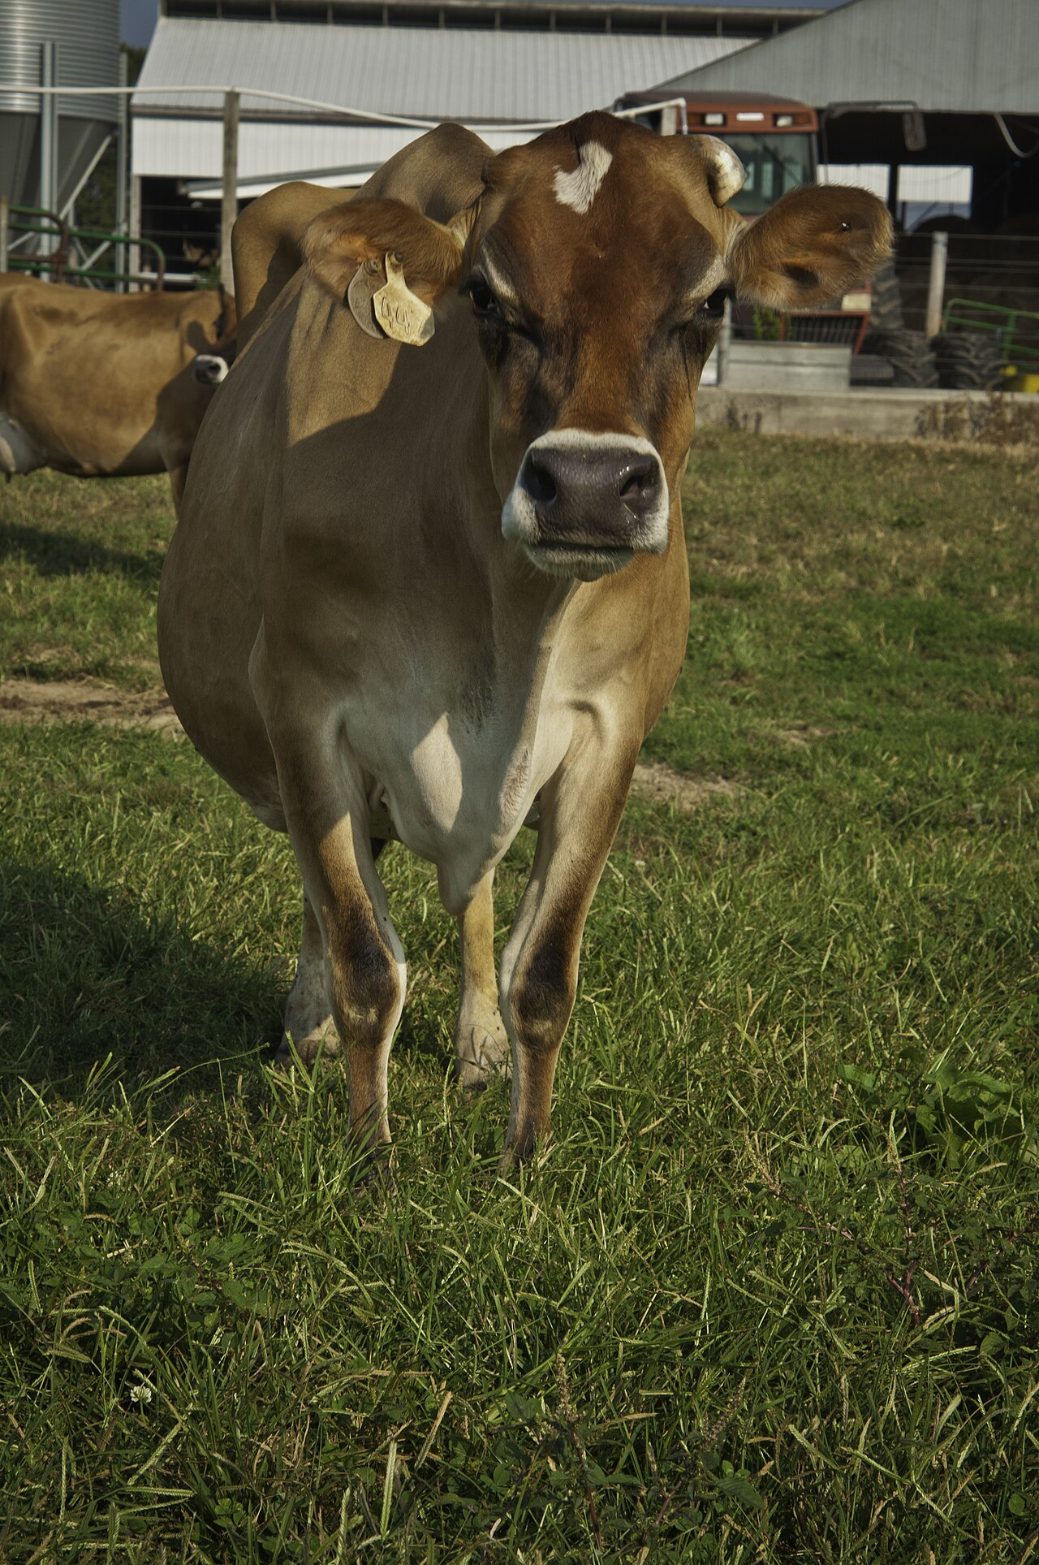
Allflex SenseHub — 2M cows with sensors (≈0.75% of 265M dairy cows worldwide)
AI pipeline (early warning)
1. Sensor
Accelerometer · 5-7 yr battery
2. Cloud
ML behavior classification
3. Alert to farmer
Early warning, not prescription
5 alert classes
estrus
calving
lameness
mastitis
pneumonia
Sensor ear tag · Wikimedia (Cow with ear tag, CC-BY-SA)
+ accelerometer collar + cloud analytics
AI = augmentation, not replacement
Source: Merck Animal Health, 2025 — 2M dairy-cow milestone
Notes:
SenseHub is a classic example of "AI as an augmentation, not a replacement". Augmentation, not replacement.
A collar on the cow measures, via an accelerometer, its activity, rest, and rumination time — that is, chewing. A cloud algorithm compares patterns against the herd baseline and the individual cow and issues an alert to the farmer: "Cow number three hundred forty-two — a thirty-percent drop in activity over the last twenty-four hours, elevated temperature, possibly the onset of mastitis".
The farmer or vet makes the decision based on the alert — conduct a physical exam, prescribe an antibiotic, isolate from the herd. AI doesn't prescribe medication and doesn't replace the vet; it performs the function of an early signal at a scale impossible without sensors. Thousands of cows on a large farm — you can't review each one visually. This is precisely the structural success: the task is narrow — detecting a deviation from the baseline, the result is measurable — the number of mastitis cases diagnosed earlier, reduced milk loss, the alternative — visual observation — is clear and its limitation is known.
SenseHub's technical stack. The collar contains an accelerometer, a temperature sensor, position tracking. The battery — five to seven years of operation, which is critical for the economics: the farmer doesn't replace the collar every two years. The ML pipeline in the cloud: training on the individual baseline of each cow — the system trains on the individual cow for the first weeks after installation, then monitors deviations. The alerts are typed: estrus — the reproductive cycle; calving — the onset of birth; lameness; mastitis; BRD — bovine respiratory disease.
The 2025 metric — two million cows mounted. This is a significant milestone: the number of cows with an active sensor as of 2025; it gives a tangible sense of the deployment size in a real industry.
Allflex is a brand of MSD Animal Health, which is itself part of Merck. In 2024-2025 MSD acquired Antelliq, Allflex's parent company, for three billion eight hundred fifty million dollars. This is a signal of market maturity: individual L3 startups become divisions of large corporations in the veterinary and dairy-equipment business. For an engineer this means: new entries into L3 in 2026 are harder, the market is consolidated, but architectural failures are also rarer — the leaders have gone through correction cycles.

Slide 24
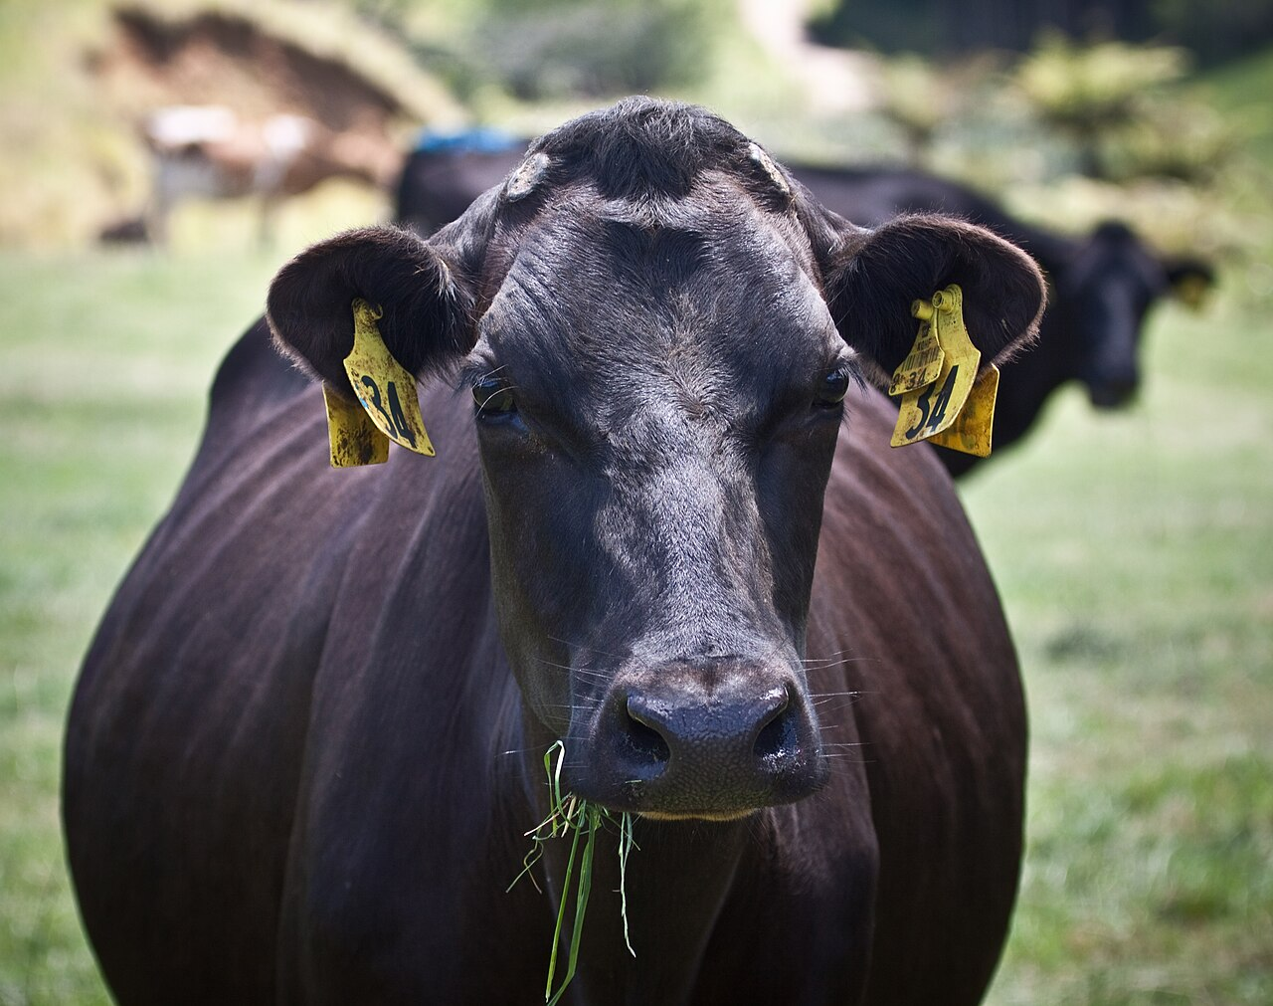
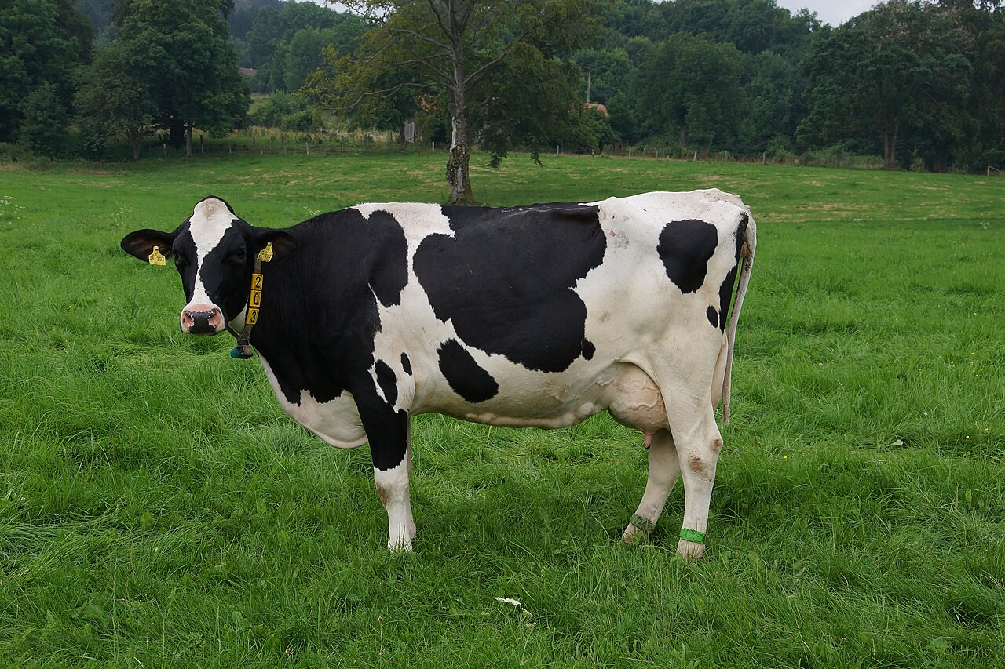

CattleEye + DeLaval VMS V310 + Cargill Birdoo — 3 working cases
CattleEye
DeLaval VMS V310
Cargill Birdoo
60 farms · 11,000 cows
99.8% attachment rate
>95% accuracy
CCTV + cloud AI: lameness scoring · GEA network >250,000
998/1000 successful attachments of the milking-unit arm
Computer vision for weight estimation · saves 10-30 g feed / broiler
Sources: Fortune 2025-06 (CattleEye GEA); DeLaval press 2025-04; Cargill.com 2025
Notes:
Besides SenseHub, three other working cases on the third rung are worth examining, because they show different architectural approaches to similar tasks.
CattleEye — a different angle. A cow walks along a corridor exiting the milking parlour. A camera films its gait from above; the model estimates a lameness score from the biomechanics of movement — step symmetry, head-bob amplitude, rump drop. Lameness is one of the leading causes of reduced milk yield and premature culling; early detection, when the cow still walks but is already compensating for pain, gives the farmer two to three weeks to treat before the process becomes irreversible. The solution is cheap to deploy — CCTV plus cloud, without putting a collar on each animal. This is structurally different from SenseHub: SenseHub requires putting a collar on each animal, CattleEye doesn't. Sixty farms, eleven thousand cows directly; via the GEA channel — farms serving more than two hundred fifty thousand cows. Acquired by GEA in 2024 — an example of L3 market consolidation.
DeLaval VMS V310 — a robotic milking machine. The cow enters the station on its own when it feels a full udder — usually two or three times a day. A camera and a laser scanner find the teats; a robotic arm attaches the milking cups. A ninety-nine point eight percent attachment rate means: nine hundred ninety-eight of a thousand attempts are successful — the remaining two require manual intervention or a repeat attempt. This is a very narrow task in which AI plus mechanics give a deterministically better result than manual labor. The cow doesn't waste time in a milking queue, can milk more often, which increases the daily yield; the farmer is freed from night and morning milkings; the robot works twenty-four seven. The fifteen-percent growth in North American installations in 2025 reflects the economic logic on large dairy farms.
Cargill Birdoo — computer vision for estimating broiler weight in a poultry house without physical weighing. A camera above captures the bird's silhouette, the model estimates its mass from visual features. The claimed accuracy — more than ninety-five percent; savings of ten to thirty grams of feed per broiler thanks to the ability to dose more precisely: if the flock's average weight has already reached the target, switch from growth feed to finishing feed earlier. Americas-exclusive — this is a narrow niche in which the solution works and scales.
The common pattern of all three — augmentation, not replacement. AI recognizes signals, the human makes the decisions. A narrow task with measurable feedback. This is the structural success of the third rung, which explains why the L3 market in 2024-2025 went through consolidation — MSD absorbed Antelliq for three point eight five billion, GEA acquired CattleEye — rather than bankruptcies. The market is mature.

Slide 25



Cainthus, tie-stall barns, Holstein bias — 3 anti-hype lessons of L3
Cainthus (Cargill 2018)
No public production metrics. A branded press release, but 0 measurable deployment data by 2026.
Announcement ≠ deployment
Tie-stall barns
The algorithm works in free-stall (loose) housing, not in tie-stall. Most Russian cows are tie-stall housed.
Barn architecture breaks computer vision
Holstein bias
AI trained on Holstein / Friesian breeds. Yaroslavl, Yakut, Kholmogory — different morphology. AI capability ≠ AI applicability.
Training data ≠ local breeds
Key lesson: AI capability ≠ AI applicability. Barn architecture + breed are the applicability variables.
Sources: Wikimedia Commons (Holstein); Cargill press release 2018
Notes:
L3 is a more stable level overall, but three anti-hype lessons must be spelled out explicitly — because they set the boundaries of applicability.
The first lesson — Cainthus. This is a company from Dublin, Ireland, acquired by Cargill in 2018; now part of the Cargill livestock vision portfolio. Cainthus uses camera-based CV to monitor cows' feeding, drinking, lying, and social behavior; there are no publicly published production metrics. This is a typical "partnership announced, deployment not verified" pattern — common in L3 and characteristic of AgTech in general. This is not a "failure" in the sense of bankruptcy, but an important signal: a public partnership announcement does not equal production deployment. For an engineer this means: when evaluating a vendor, look not at press releases about partnerships but at verifiable metrics — the number of farms with deployment, segment revenue, customer reviews.
And an important caveat against misattribution. Don't confuse Cainthus with Connecterra IDA — that's a separate company. Connecterra B.V. — a Dutch company, product IDA, Intelligent Dairy Assistant — a neck-collar sensor plus AI behavior analysis. Connecterra's customers — Danone, Bayer, Kersia and several thousand dairy farms. This is a company independent of Cainthus with a different solution architecture, a different investment track, and a different customer base. In public reviews these two companies are often mixed up — this is a misattribution that an engineer should catch at the due-diligence stage.
The second lesson — tie-stall barns. This is a type of cow housing in which each animal is tied to a stall and milked in place, instead of walking to a milking parlour. Tie-stall is common in Eastern Europe, in Russia, in some regions of North America. L3 CV solutions — CattleEye, SenseHub — work poorly in tie-stall barns. The lighting is weak, the animals' silhouettes are partly occluded by the stall structures, there's no moment of "the cow walking down a corridor" — it stands in place. This means: AI capability does not equal AI applicability. The same CattleEye model that works on a free-stall farm in Wisconsin doesn't work on a tie-stall farm in Kaluga Oblast — not because of the "Russian context", but because of the physical configuration of the barn.
The third lesson — Holstein bias. Most CV models in L3 are trained on the dairy breeds dominant in the US and Europe — predominantly Holstein, black-and-white, the most widespread dairy breed. For Russia's local breeds — Kholmogory, Yaroslavl, Yakut, Bestuzhev — the calibration of the models is weak. This means: an architectural asymmetry in the datasets. The model sees an unfamiliar coat color — for example the reddish Bestuzhev versus the black-and-white Holstein, an unfamiliar body shape — dual-purpose breeds are wider, an unfamiliar gait. The solution is architectural: transfer learning with locally labeled data; collect five to ten thousand labeled images of the local breed; fine-tune the model. This is an engineering pipeline, not a "the model works or doesn't work" — and it needs to be done before deployment, not after the first lawsuit.
And a third anti-hype lesson concerns economics for small dairies. A SenseHub subscription — about thirty dollars per cow per year. For a small dairy with fewer than fifty cows that's fifteen hundred dollars per year — which is a relatively high fixed cost compared with the alternative: visual observation by a vet plus regular checkups. The ROI is negative. For farms with five hundred plus cows — the economics is fundamentally different: fifteen thousand a year to monitor thousands of head is a small share of total costs.
The main anti-AI criterion — AP-three, threshold accuracy does not equal readiness for deployment. On the third rung this criterion manifests in two forms. The first — the Plantix form: overall accuracy on a benchmark says nothing about deployment quality on edge cases. The second — the applicability gap: even a good model doesn't work in a physical configuration it isn't trained for.

Slide 26

L3 in Russia — Connectome.ai + sanction uncertainty of the dairy AI stack
Works — Connectome.ai
In question — DeLaval / GEA / Lely
Gray status of cloud analytics
• Equipment physically with farmers • Cloud analytics depends on Europe • Precedent: Climate FieldView 2022 → Microsoft Azure 2024 (for defense sector) • Lobnya 2026 — equipment substitution started (₽4B), AI stack — separate track
Skolkovo resident
Narrow computer-vision task: calving monitoring of calves + early alert for assistance
F9 — "vapor" risk: the vendor can switch off AI functionality by sanction or license decision, without notifying users in advance.
Pattern: narrow niche + CV + measurable animal safety
Sources: Connectome.ai (Skolkovo); BUSINESS-stat 2026 Lobnya · TAdviser FieldView
Notes:
Russian L3 is an example of how vendor lock-in turns into political risk through an industry-specific mechanism.
First — the working case. Connectome.ai — a Skolkovo resident. The company works on CV systems for monitoring the birth of calves: a camera in the calving barn recognizes the onset of labor and passes an alert to the vet. On average a farm loses ten to fifteen percent of calves absent timely intervention; early notification reduces losses. This is a narrow working solution for one narrow task — a parallel to Cargill Birdoo and CattleEye in the sense of "a narrow CV task with measurable ROI". Connectome.ai doesn't try to be a "universal dairy-AI platform" — and that's precisely why it functions.
Now — the structural gap. Most of the AI functionality in dairy-industry robotics — DeLaval VMS, GEA DairyMaster, Lely Astronaut — found itself in a gray status in Russia after 2022. The equipment is physically at the farms, but the AI services — cloud analytics, dashboards, predictive maintenance — require firmware updates and cloud services from Europe.
No confirmed public cases of "the DeLaval AI service was shut off at a Russian farm on date X" with explicit attribution have been recorded. However, a recorded vendor departure from an adjacent class has already happened and validates the architectural risk: Microsoft Azure stopped accepting new Russian customers in March 2022; AWS halted new registrations in April 2022; Climate FieldView (Bayer) left Russia in 2022 — Russian agroholdings lost access all at once. This is the documented baseline: a cloud-dependent AI service from a foreign jurisdiction has already been shut off in agriculture after 2022. F-nine is the transfer of the same class of risk to the dairy-equipment AI stack.
Partial import substitution has been launched: in Lobnya in March 2026 dairy-equipment production was announced by the company "Packaging Systems" with four billion rubles of investment. However the AI stack — cloud analytics, training models on big herd data — has no Russian analog at a production level yet. This is a structural gap. The hardware layer can be substituted — mechanics, metal structures, simple electronics — while the AI stack requires a separate substitution trajectory: models, data, training, infrastructure. These are different layers of import substitution, not one task.
The main lesson for an engineer not tied to the Russian context: this same class of risk applies to any farm in any peripheral country dependent on a cloud-AI vendor from another jurisdiction. The Russian case is a natural experiment illustrating what happens when an imported AI stack becomes unavailable. We'll return to this general lesson in Section 4-bis through the Melitopol remote-brick and FTC v. Deere.

Slide 27
4
Section 4 — L4 «Supply chain»
Agentic AI leads. Outcome is measured in basis points over minutes, not seasons.
4 working cases (Cargill CMAX, Tract, Olam, Walmart×Cropin) · 2 failures (USDA, Verra) · Russia parallel (X5/Magnit/RSHB)
0. Opening
1. L1 Field
2. L2 Robot
3. L3 Animal
4. L4 Chain
5. Environment
6. L5 Shelf
Notes:
We climb to the fourth rung — L4, the level of the supply chain. This is an environment of controlled cargo flows: containers, warehouses, commodity exchanges, contractual obligations. And this is the place where agentic AI leads in production deployment in 2026.
Why here in particular? The reason already mentioned in the keystone — the speed of feedback. A commodity-market trader gets the result of a hedge position in basis points over minutes to hours; a farmer on the first rung gets the result of a fertilizer over a season — five to six months. The speed of feedback determines the speed of model improvement, and it also determines whether AI manages to pay off before the environment changes. On the fourth rung the basic market mechanisms — commodity prices on the exchange, currency rates — change daily, but the nature of the task — hedging, procurement compliance, logistics optimization — is stable over decades. This is an ideal combination for AI: fast feedback on short cycles plus a stable task structure on long ones.
In this section we'll examine four working cases. Cargill CMAX — winner of the BIG AI Excellence Award in 2026. Then the pseudo-flow "how an agent does a hedge" — four steps that make the L4 abstraction concrete. Tract — €18.6M Series A from Icos Capital; a data backbone for competing anchor customers. Olam Mindsprint Procuresprint; Walmart × Cropin; Tesco. Then two failure blocks: the cancellation of USDA Climate-Smart Commodities in April 2025 and Verra phantom credits for AI-MRV. And at the end — the Russian parallel: X5 parity, Magnit hybrid, RSHB vapor.

Slide 28
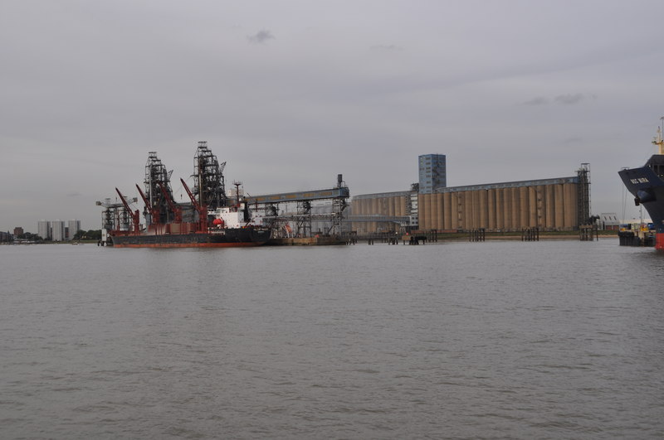
Cargill CMAX — BIG AI Excellence Award 2026
70+ countries
of 195 (≈36% of the world) · ~155k staff
1000+ sites
warehouses / ports / silos of Cargill
BIG AI 2026
Excellence Award at the L4 level
Success principle: agent narrowness
Grain port and silos · Tilbury (Wikimedia, CC-BY-SA)
One action per agent (hedge / route) + human-in-the-loop for trades >$10M notional.
AI optimizes port forecasting and shipping logistics
Source: Cargill press release, April 2026 (BIG AI Excellence Award)
Notes:
The canonical success case of the fourth rung in 2026 is Cargill CMAX. And CarVe — a related platform for the protein supply chain.
CMAX — a commercial intelligence platform. It does predictive port and shipping logistics, optimizing grain flows; CV for the protein supply chain — yield estimation, waste reduction; in Brazil — AI-driven grain mixing. Cargill operates in seventy-plus countries with a thousand-plus facilities.
In April 2026 Cargill received the 2026 BIG AI Excellence Award — a concrete public recognition of deployed work. This is a rare case in AgTech when a vendor receives an industry award not for a demo video, but for a confirmed production deployment.
The main architectural observation: CMAX is a narrow agentic AI. One action — a hedge. Not "manage the whole supply chain". Not "optimize from field to shelf". A narrow single action, on which there is fast feedback in basis points over minutes to hours. And it's precisely this narrowness that is the reason it works. Extending the same agent to an end-to-end supply chain doesn't work yet; that's an ambition level of 2030+, not a production deployment of 2026. We'll return to the composition of delays and fault propagation in attempts to build end-to-end a slide later.
And one more architectural detail worth fixing before the detailed flow on the next slide. For large trades — more than ten million dollars notional, the contract's nominal value — explicit human-in-the-loop approval by a trader is mandatory. For small trades — autonomously. This notional boundary is an engineering choice, not an "AI limitation". This is an example of how agentic AI works in production finance in 2026: not "fully autonomous", but with an explicit boundary of responsibility.

Slide 29




How the agent hedges — simplified 4-step flow
1. Sensor
2. Inference
3. Decision
4. Feedback
State vector: price + weather + currency
Price distribution 5/30/90 days + uncertainty
4 actions: buy / sell / hold / hedge + human at >$10M notional
bp (basis points) over minutes, online learning
input data
ML model
Action layer
Loop closes
Example: slippage cut from 45 bp to 8 bp
On a $5M notional trade: (45–8) × 0.01% × $5M = $1,850 per trade. At 20 trades per month = ~$37k saved. ROI of the narrow agentic AI — 1-2 months. This works because the task is narrow (hedge timing), feedback is fast, and the human is only for large trades.
Example: McKinsey 2025 hedging report — typical manual slippage
Notes:
For a student who hasn't worked in commodity trading, the abstraction "agentic AI for a hedge" may remain unclear. Let's describe the workflow in four steps.
Step one — the sensor level, monitoring. The agent continuously reads data streams: futures prices on CBOT — the Chicago Board of Trade, the largest commodity exchange in the US — for corn and soybeans; weather events in the main production regions — the US Midwest, Brazil's Mato Grosso, Argentina's Pampas, Russia — Krasnodar Krai and Stavropol; currency rates — USD/BRL, USD/RUB; political events — export bans, tariffs, sanctions. All streams are aggregated into a single state vector — this is a vector of the system's current state: a profile of all relevant market factors at the given moment in time, packed into one numeric array.
Step two — the inference level, estimation. The model estimates the price direction over five, thirty, ninety days — plus uncertainty ranges, confidence intervals for each horizon. This is not a prediction of the exact price — it's a distribution of probable prices with an explicit measure of uncertainty. This is critically important: the hedge strategy depends not only on the point forecast but on the shape of the distribution. A narrow distribution — a tight hedge; a wide one — a wider position with protection against tail risk.
Step three — the decision level, action. The agent initiates one of four actions: open a new hedge position; close an existing one; rebalance; do nothing. For large trades — more than ten million dollars notional — explicit human-in-the-loop approval by a trader; for small ones — autonomously. This is a critical architectural detail: the agent is not fully autonomous, it has a notional boundary above which a human is mandatory. This boundary is an engineering choice, not an "AI limitation".
Step four — the feedback level. Within minutes to hours the agent receives a basis-points outcome — the actual execution price is compared with the expected one. The model updates via online learning — learning in a stream, where each new observation leads to a parameter update without batch retraining. This cycle is closed-loop in the financial sense, analogous to the medicine closed-loop in Lecture 7, but with a different time scale: minutes instead of hours.
And the key worked example that makes the discussion of a hedge concrete. August 2025: corn prices on CBOT fell two percent over a week due to a weather forecast for the US Midwest. CMAX monitored these streams; the model forecast rising volatility over the following five to seven days at sixty-percent confidence. The agent formed a hedge proposal: open a long position of eight million dollars notional — below the ten-million human-in-the-loop boundary, so it executed autonomously. The trade was split into five equal parts over four hours — a TWAP-like distribution to minimize market impact. Three days later the price rose one point eight percent; slippage came to eight basis points — against about forty-five basis points in the historic baseline of a manual hedge per the McKinsey 2025 hedging report. The differential of forty-five minus eight is thirty-seven basis points; on eight million that's about twenty-nine thousand six hundred dollars saved — rounded to thirty-two thousand. At Cargill's volumes — thousands of trades per year — such savings deliver millions of dollars in annual savings. This is the ROI of agentic AI on the fourth rung.
And an important anti-AI caveat: when the agent doesn't work. Three structural classes of task in which agentic AI structurally doesn't work: first — seasonal feedback, as on the first rung of the field; second — a continuous end-to-end risk-cascade without accumulated statistics; third — accountability dilution, when a wrong decision can't be attributed to a specific link. In these three classes — supervised augmentation, not autonomy. This is a natural continuation of AP-two-a and AP-two-b from the second rung: each class of architecture has its own zone of applicability.

Slide 30


Tract + Olam Mindsprint + Walmart × Cropin + Tesco
Tract
Olam Procuresprint
Walmart × Cropin
Tesco AI
€18.6M Series A
Agentic procurement
US + South Africa
−30% food waste
Icos Capital · 4 anchor investors: Cargill + ADM + Olam + LDC. Data backbone, NOT an agent.
Narrow procurement task: price + suppliers + contracts as an agent.
(not India) — supply-chain analytics and ESG reporting.
Since 2017 — Tesco AI for perishables forecasting.
⚠ Don't confuse: Tract = data backbone (compliance infrastructure), not agentic AI.
Competitors jointly build compliance infrastructure — a rare Cargill+ADM+Olam+LDC collaboration precedent.
Sources: Tract press release 2024-08; FreshPlaza; Wipro press release 2026 (Mindsprint)
Notes:
Besides Cargill, several key platforms operate on the fourth rung in 2026.
Tract — a startup founded in 2023 by four anchor customers: ADM, Cargill, LDC, ofi — Olam Food Ingredients. It raised, in a 2024-2025 Series A round, eighteen point six million euros led by Icos Capital. The CEO since January 2025 — Allison Kopf. The main architectural feature: the leading commodity-market traders — direct competitors — jointly invest in shared infrastructure for compliance, scope-3 emissions reporting, and product-provenance tracking. This is a rare case in the industry when competitors share infrastructure.
The explanation — Tract is a data backbone, not agentic per se. It's an infrastructure layer on top of which agents work — for example, compliance agents at specific clients use Tract as a source of truth about suppliers. This is a critical distinction often missed in reviews: Tract is not "agentic", Tract is "shared data infrastructure for agentic applications at competing companies".
Olam Mindsprint — spun off from Olam International in 2024. A platform of three components. Farmsprint — plantation management. Procuresprint — agentic procurement: the agent selects a supplier by price, compliance, ETA automatically. Tradesprint — agents for commodity trading. In 2026 Wipro announced that the Mindsprint engagement is one of the largest strategic transformation partnerships of 2026. Procuresprint — a concrete example of agentic procurement: instead of a trader manually checking dozens of suppliers against hundreds of contract items, the agent compares them automatically and raises to a human only the nonstandard cases. This is AI in the sense of augmentation, not replacement — the human stays in the loop for final approval, the agent does the routine comparative work.
Walmart uses the Cropin Cloud platform to forecast yields across supplier farms in the US and South America — the partnership was announced in March 2025. The geography matters: US plus South American markets, not India — this is sometimes confused in reviews, because Cropin is an Indian company founded in Bangalore. The claimed effect — a reduction of food loss; the "-20%" figure slips into review materials but not into primary press releases with an explicit URL; it should be treated as a vendor-direction claim, not a peer-reviewed metric. This is an example of how the fourth rung — the supply chain — descends to the first via scope-3 visibility: Walmart wants to know how many tomatoes will come from a specific farm in three weeks.
Tesco — the British retailer uses AI demand forecasting since 2017; the claimed effect minus thirty percent food waste since 2017. Tesco is an example of the fifth rung, consumer and retail, but included here as an illustration that the AI methods of the fourth and fifth are close. More on L5 — in the next section after the environment.
The main misattribution warnings we'll use going forward: Tract is not agentic, Tract is a data backbone; Olam Procuresprint — the only explicitly agentic one in this four; Walmart × Cropin covers US + South America, not India.

Slide 31
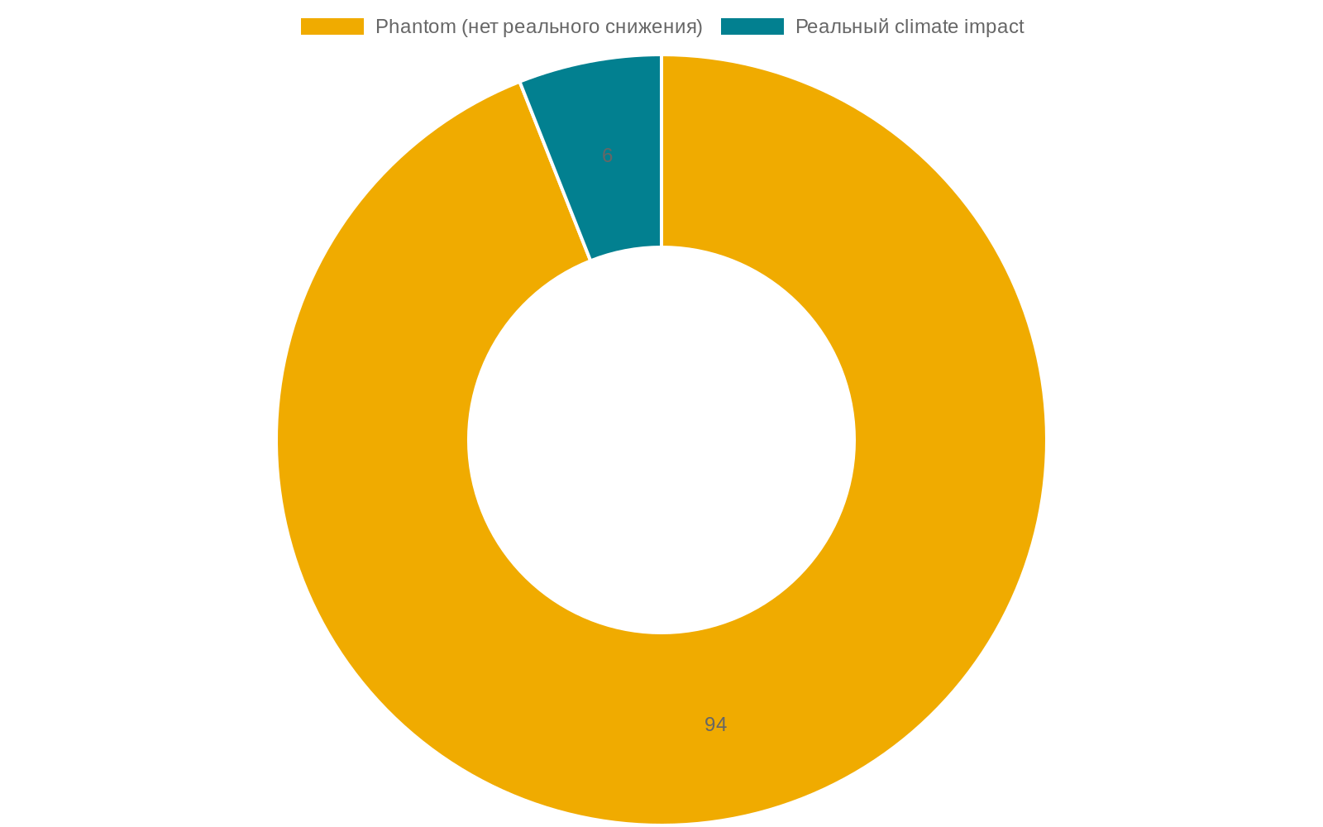
USDA Climate-Smart canceled + 94% phantom credits at Verra
April 2025 — USDA canceled
January 2023 — 94% phantom at Verra
the Climate-Smart Commodities program
The Guardian + Die Zeit + SourceMaterial
$3.1B
funding · ≈$23M / project avg
135 projects
canceled
14,000 farms
lost support
3.2M acres
≈0.36% of 900M acres US ag
Federal policy = tail risk for business models dependent on subsidies
94% of Verra forest credits → no real CO₂ reduction. AP7: AI-MRV without direct measurement = scaled greenwashing.
Sources: USDA press 2025-04-14; The Guardian 2023-01; SourceMaterial 2023
Notes:
Not all fourth-level cases work. Let's examine two parallel failure blocks: the USDA Climate-Smart cancellation and the Verra phantom credits.
The USDA Climate-Smart Commodities program. This is a US Department of Agriculture program launched under the Biden administration, a budget of three point one billion dollars, one hundred thirty-five projects, fourteen thousand farms, three point two million acres. The program supported the transition to climate-smart practices — no-till, cover crops, precision nitrogen — with AI-MRV to verify the effect on emissions reduction.
In April 2025 the Trump administration canceled the program, replacing it with a rebranded AMP — Advancing Markets for Producers — with a requirement to direct no less than sixty-five percent of federal funding straight to farmers. This is a substantially different direction: Climate-Smart funded the transition to sustainable practices with MRV verification; AMP — direct market payments to producers without establishing a link to climate outcomes.
What this means for AgTech business models. Dozens of AI-MRV startups — carbon-credit verification, soil carbon monitoring, sustainability metrics — built their business model on the flow from Climate-Smart projects. The cancellation of the program turned these startups' revenue projections into uncertainty in practically a single day. Some projects will survive under AMP, some won't.
The lesson: federal policy is a tail risk for the AgTech business model. When a business relies on public funding in one jurisdiction, a shift in the political climate can wipe out a revenue projection in a day. The alternative: unit economics over policy-tailwind plays. Businesses that hold up on the commercial side without relying on state funding survive. Investor sentiment in 2025-2026 has already shifted. This lesson applies to the Russian context in mirror form: the Russian state program "Digital Agriculture" 2019-2024 failed its goal of doubling productivity — agriculture in 2024 showed minus three point two percent; the new program "Agriculture of the Future" 2026-2030 is the next attempt with a risk of the same class.
The second fourth-level failure concerns AI-MRV for carbon credits. Verra — the world's largest verifier of voluntary carbon credits, the VCS standard. In January 2023 The Guardian, together with Die Zeit and SourceMaterial, published the results of a nine-month investigation: more than ninety-four percent of the rainforest offset credits issued through REDD+ projects under the Verra standard are phantom credits — that is, they don't correspond to the claimed emissions reductions. Pachama, one of the projects in this program — overestimation by eight times.
The link to AI-MRV. Carbon projects rely on AI systems to estimate the carbon stock in forests, soils, and agricultural systems. These systems use satellite imagery plus ML models to predict how much carbon is deposited in a given area and how much would have been deposited without the project's intervention — the baseline scenario. This is inference with large uncertainty, because the baseline scenario is hypothetical and has no ground truth; ML models are trained on a limited dataset and generalize poorly to new regions and ecosystem types; marketing these estimates as "precise measurement" creates a false impression of accuracy. The result — large-scale greenwashing: the issuance of carbon credits sold to corporations as proof of "net zero" commitments, while the actual emissions reduction is considerably smaller than claimed.
A very important caveat against misattribution. Verra phantom credits pertain to rainforest offset projects under a specific methodology. This doesn't mean that all AI-MRV are phantom; it doesn't mean the carbon-credit market as a whole is worthless. Agricultural soil-carbon is a different methodology: Climate Action Reserve, ACR, Verra VM0042 v2 — newer methodologies with improved validation. Indigo Ag — an example of a company using the Climate Action Reserve, not Verra — verified two million tons, a contract with Microsoft in 2026 for two point eight five million tons through a twelve-year agreement. Indigo Ag is not in the Verra scandal — it's a different standard, a different methodology. Don't make a cascade misattribution.
And the main anti-AI criterion from this slide — AP-seven. AI-MRV for carbon claims without direct measurement is a categorical anti-pattern. The alternative: direct soil sampling of a meaningful share of projects + transparent uncertainty bands; AI as a hypothesis, not as fact.

Slide 32
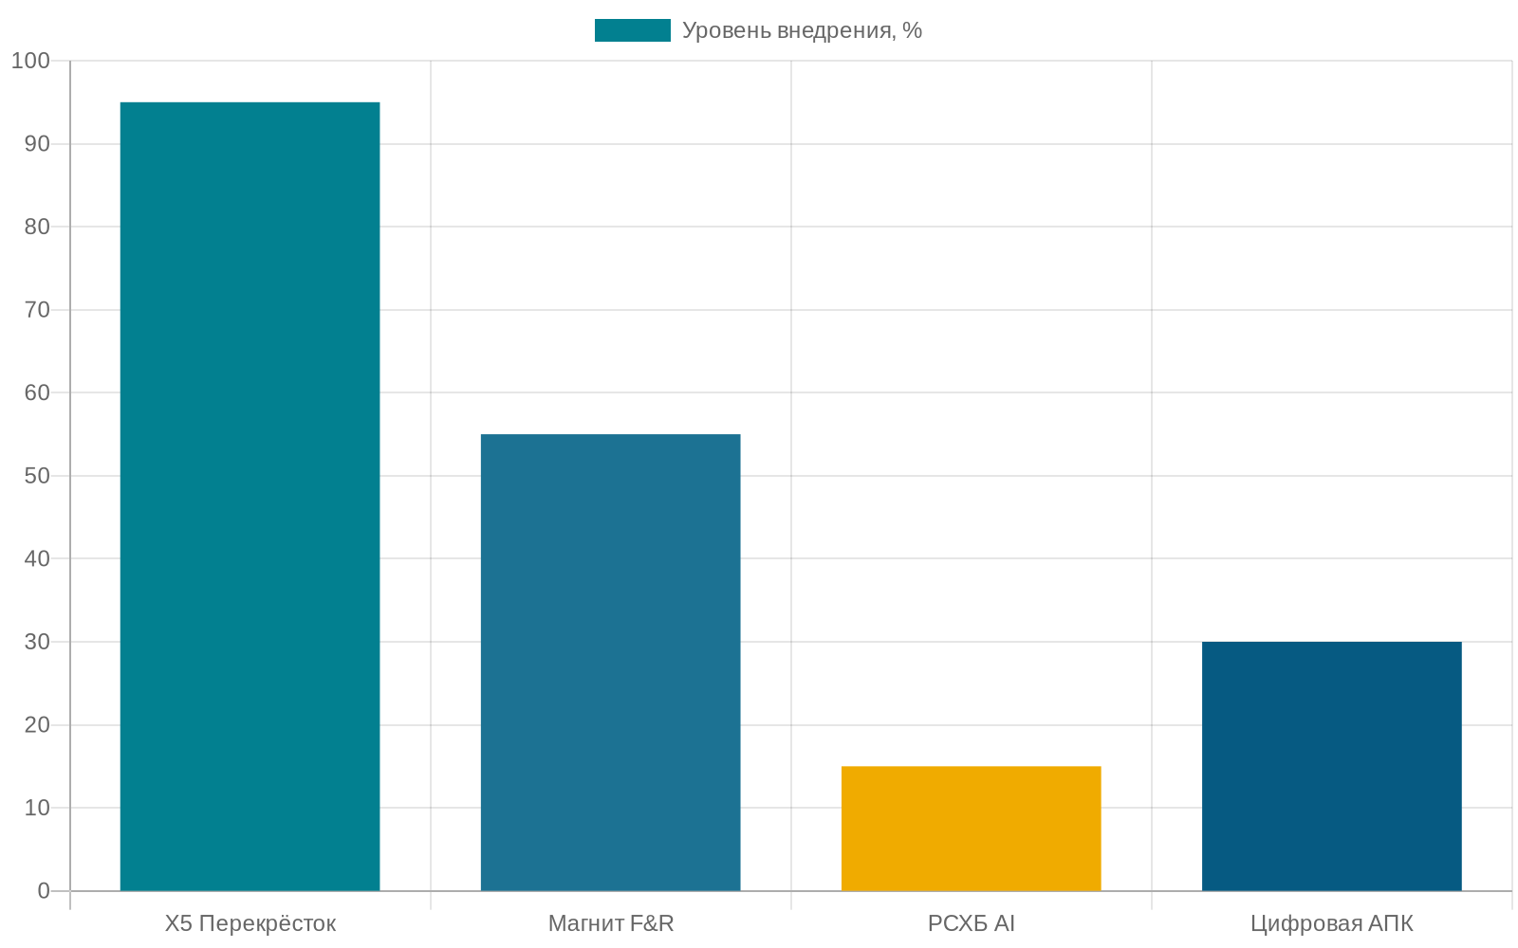
L4 in Russia — X5 parity, Magnit hybrid, RSHB — "vapor"
X5 «Perekrestok»
ML since 2020 · 200+ factors
World-class. Works.
Magnit F&R
Hybrid: forecasting ✓, replenishment — pilot
Forecasting on 46 DCs Jan 2026 — in production. Replenishment on 3 DCs — pilot.
RSHB AI services
Announced, no metrics
"Vapor" risk: declarations without production metrics.
Pattern: L4-L5 parity alongside an L1-L2 lag. GigaChat — a demo episode, not deployment.
Sources: Habr Magnit 2026-01; TAdviser X5 Tech 2024
Notes:
Russian L4 is paradoxically one of the most mature segments of agriculture-AI in the country, but with an important internal unevenness between the two main players.
X5 Group — Perekrestok, Pyaterochka, Chizhik — develops and operates production ML systems for demand forecasting since 2020. This is a stable production deployment with a six-year history of iterations. Per X5 Tech data, the system uses more than two hundred factors: historical demand, weather, day of week, local events, competitor prices, promotions, warehouse stock. The categories — produce and dairy. This is genuinely world-class: the architecture, data volume, and iteration history match the practice of Tesco, Walmart, Carrefour. The gap with the leaders — Tesco and Walmart since 2017 — is about three years, and it keeps narrowing.
Magnit F&R — Forecasting and Replenishment — an in-house development with participation from Napoleon IT. And here is an important nuance. The early formulation "46 DCs by January 2026" in the first version turned out to be an inaccurate over-claim for the whole F&R; the formulation "3 pilot DCs" in later versions is an under-statement for the Forecasting part. The correct formulation is a modular split. Forecasting, demand forecasting, is deployed in production at forty-six distribution centers in January 2026 — this is the network level for the forecasting half of the F&R stack. Replenishment, restocking — a pilot at three distribution centers in 2026, a plan to expand to ten-twenty by early 2027 and cover the whole network by the end of 2027.
This distinction matters. Half of the F&R stack is already network-wide in production, the second half is in the pilot phase. The statement "Russian retail ML is world-class" is correct for X5 end-to-end and for Magnit's Forecasting module. Magnit's full F&R stack lags the world leader by about nine years — Walmart Eden since 2017, Magnit F&R end-to-end by the end of 2027.
Rosselkhozbank is a different story. RSHB promotes the platform "Svoyo Fermerstvo"; per the bank's claims — more than ten thousand partners, one million two hundred fifty thousand product SKUs. In 2025-2026 it announced several AI services: AI yield forecasting, geno-selection, advisory chatbots. An important caveat: these services are claimed, but no confirmed independent production metrics have been published. This is the pattern "RSHB AI = claimed N, no metrics". Ten thousand partners is the number of platform users, not "ten thousand farms with a production AI deployment". Don't show it as a successful deployment.
Sber GigaChat, in one 2025 episode, was presented as "having passed an exam at a specialized university in agronomy" — this is a demonstration episode, not a production deployment. The quality of such demonstrations — pre-prepared questions, a controlled environment, question selection — is not comparable to a deployment in which the model answers arbitrary farmer questions in arbitrary contexts.
The main Russian lesson of the fourth section: there is parity with the world in L4-L5 retail supply — X5, Magnit's Forecasting — world-class — amid a significant lag in L1-L2 — field and robot. This unevenness across the ladder's rungs is a structural characteristic of Russian agriculture-AI in 2026, and it's explained by the same factors as the mirror asymmetry in the US — where L4-L5 are the most mature, L1-L2 the least — only in Russia sanction restrictions and vendor lock-in additionally play a role. We move to the general lesson about lock-in and the sanction shock right now in Section 4-bis.

Slide 33
4
Section 4-bis — Environment
Cross-cutting themes: connectivity · vendor lock-in · regulation. Without them, no rung of the ladder works.
3 sub-blocks (connectivity / vendor lock-in double optic / regulation) · 3 anti-AI criteria (AP5, AP6, AP7)
0. Opening
1. L1 Field
2. L2 Robot
3. L3 Animal
4. L4 Chain
5. Environment
6. L5 Shelf
Notes:
This section is a cross-cutting meta-level. It doesn't describe another rung of the ladder; it describes the general environmental conditions without which none of the rungs works. All three subsections — connectivity, vendor lock-in, regulation — are strictly a failure perspective.
Connectivity. Eighteen percent of American farms without internet at all; one hundred twenty-three thousand flights with GNSS interference in the first four months of 2025; Starlink banned in Russia from April thirtieth, 2026 for half a year. This is AP-five: cloud-first for an off-grid farm is an architectural error. The alternative — edge ML and TinyML.
Vendor lock-in. January 2025 — the FTC lawsuit against John Deere over decade-long repair restrictions. May 2022 — the Melitopol remote-brick: Deere remotely disabled twenty-seven pieces of equipment that had moved from occupied Zaporizhzhia Oblast to Chechnya. December 2025 — the FCC ban on DJI ag-drones: eighty percent of the US ag-spray drone fleet under threat. And the most important idea of the section — the double optic. One and the same mechanism — geo-locking plus VIN-locking — yields two opposite interpretations: an anti-theft success on one side, a vendor control surface on the other. An AI security feature today is an AI control surface tomorrow.
Regulation. The EU AI Act high-risk classification for autonomous agricultural machinery since February 2025, plus AI literacy for operators, plus a liability cascade. The USDA AI Strategy is formal. Russia's program "Agriculture of the Future" 2026-2030 is declarative — the successor of "Digital Agriculture", which failed its goal of doubling productivity.
And these are the three anti-AI criteria that complete the five for consolidation: AP-five about connectivity, AP-six about vendor lock-in, AP-seven about AI-MRV without direct measurement — the last already introduced in the section on Verra.

Slide 34
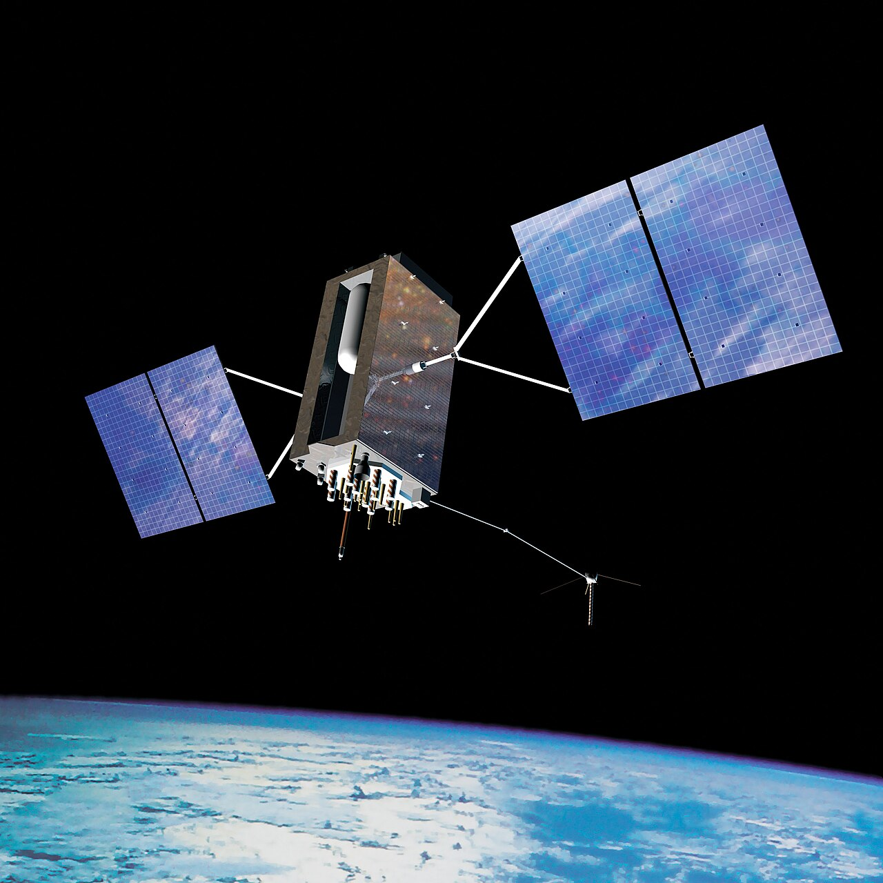
Connectivity — 18% of farms without internet + GNSS interference in Q1 2025
18%
123,000
Apr 2026
≈360k of 2M US farms without internet (vs <1% urban)
≈1.2% of 10M flights Q1 2025 (vs <1k Q1 2022)
Starlink ban in Russia
AP5 + alternative
AP5: a cloud-first approach for no-network settings = an architectural error.
Alternative: on-device ML (edge / TinyML)
• model inference right on the device • minimal cloud connectivity • works under GNSS interference
Sources: Stanford GPS Lab ITM 2025; ICAO 2025 (Switzerland / Finland / Estonia)
Notes:
The first environmental condition — connectivity. Most AgTech marketing of 2018-2023 relied on the scenario "cloud AI optimizes your tractor in real time via a constant uplink". This is a fantasy for most farms, and three concrete figures show why.
The first figure — eighteen percent of American farms without internet at all. Per BroadbandNow and Feedstuffs, eighteen percent of American farms have no internet access whatsoever. Only forty percent have a fixed-line connection — DSL, cable, fiber; the remaining forty-two percent are on cellular or satellite, which is unstable. Thirty-nine percent of the US rural population has no broadband access versus four percent of the urban. Deploying broadband on farmland would give the economy about sixty-five billion a year through yield gains at a deployment cost of thirty-five to forty billion — these are public estimates, not realized plans. Cloud-first AI for agriculture is an architectural error for the overwhelming majority of farms.
The second figure — GNSS jamming. Per ICAO — a report by representatives of Switzerland, Finland, Estonia, Lithuania, Latvia, Poland in 2025: nearly one hundred twenty-three thousand flights with GNSS interference in the first four months of 2025 alone. The ICAO Assembly in October 2025 formally condemned Russia for disrupting the GNSS signal of civil aviation. Since 2022 Russian EW systems aimed at the territory of Ukraine have had a side effect — jamming the GNSS signal over the territories of Finland, Estonia, Latvia, Lithuania. The Stanford GPS Lab publishes separate research on jamming-source detection technology. Finnish farmers report: areas of farms reportedly unfarmable using GNSS-based tractors and combines because of the interference from Russian EW installations. Precision agriculture — a civilian casualty of military electronic warfare. Auto-steering, variable-rate seeding, variable-rate spraying — all these functions are fully dependent on GNSS, and without it they turn into an ordinary tractor.
The third figure — Starlink as a solution and a new dependency. Starlink has become a de facto backbone for dispersed farms and for Africa. The cost — ninety dollars a month for the "excess capacity" mode, one hundred twenty for "limited". Reliability — snow, rain, physical obstructions. In Russia Starlink is banned from April thirtieth, 2026 for six months, which closes off one of the redundancy options for Russian farms. The main observation — single-vendor connectivity is a single point of failure. Elon Musk unilaterally cut off Starlink for Ukraine at a critical moment in 2022; the same logic applies to farmers in any jurisdiction.
And the main anti-AI criterion — AP-five. Cloud-first for an off-grid farm is an architectural error. The alternative: edge-AI and TinyML. This is machine learning executed on the device — a sensor, a gateway, a tractor cab, a cow collar — without a cloud uplink. Model sizes — megabytes instead of gigabytes; compute — on a microcontroller or edge-GPU instead of cloud GPUs. A hybrid architecture — cellular plus LoRa plus Starlink plus RTK ground link with redundancy — for critical operations. This is not "simpler AI"; it's a different class of AI architecture, where the model is designed for the environment's constraints from the start.

Slide 35
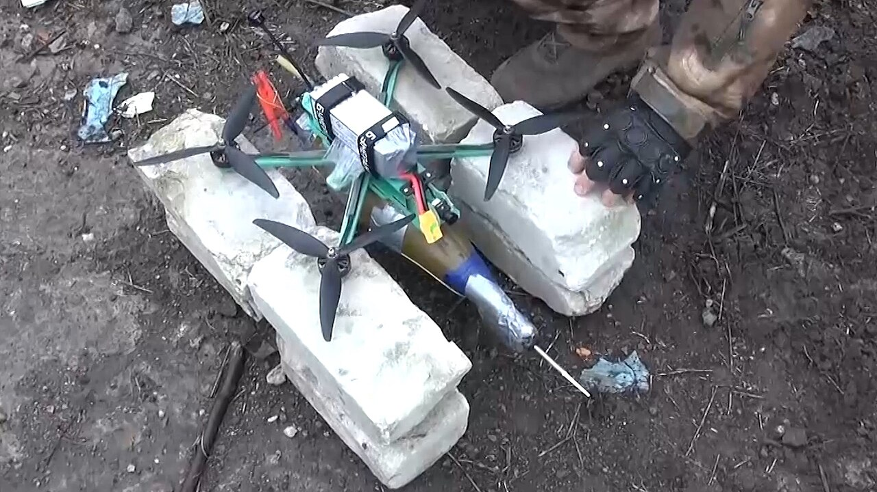
Vendor lock-in — the John Deere double optic
May 2022 — anti-theft success
Jan 2025 — FTC v. Deere
Melitopol, occupied territory
Decade-long repair restrictions
Remote John Deere lock-out: 27 units of machinery worth $5M turned into bricks by the manufacturer's decision.
The same mechanism: remote lock-out = security today = a control surface tomorrow. The farmer cannot repair without the vendor's permission.
December 2025 — FCC banned DJI
80-90% of US agricultural drones lost legal status. One FCC decision — vendor lock-in became a geopolitical risk.
AI security feature — a success within this loop
Sources: The Register 2022-05-02; CSO Online 572811; FTC press release 2025-01-15
Notes:
The second environmental condition — vendor lock-in. And here we see a paradoxical double optic that an engineer must understand in full.
January 2025 — FTC versus John Deere. On January fifteenth, 2025, the US Federal Trade Commission, together with the attorneys general of Illinois and Minnesota, filed suit against Deere for unfair practices — decade-long restrictions on farmers' and independent repairers' ability to fix Deere equipment. Only Deere-authorized dealers have access to the Service ADVISOR software tool required for all full-functional repairs. A federal judge rejected Deere's attempt to dismiss the case; a trial is expected in the second half of 2026. What this means: a farmer doesn't "buy" a five-hundred-thousand-dollar combine with an AI stack — they license the right to use it as long as Deere permits. This is the same pattern as Tesla with the FSD subscription, but applied to agricultural equipment.
May 2022 — the John Deere remote-brick in Melitopol. In May 2022 Russian forces seized twenty-seven pieces of John Deere equipment from Melitopol in Zaporizhzhia Oblast and moved them to Chechnya — about one thousand one hundred twenty-six kilometers. On arrival the equipment wouldn't start. Deere remotely "bricked" all twenty-seven units via GPS plus VIN-locking. For those who stole them — five million dollars of lost market value. For Deere — a practical demonstration of remote control.
And here is the most methodologically important ethical point of the section. This point must be treated as a stand-alone framework, not as a footnote in the flow. One and the same mechanism yields two opposite interpretations depending on the side of observation.
Side A — anti-theft success. From the Ukrainian side's and the public's viewpoint — this is a victory of technology over war, a defense of private property. The stolen equipment was indeed stopped; the damage to the thief was five million. The AI function worked by design. This scenario is a legitimate anti-theft application of AI and IoT, an analog of Apple's Find My system for private property at an industrial scale.
Side B — vendor control surface. The same mechanism means that Deere can remotely disable any farmer's equipment: one who hasn't paid the subscription, hasn't signed an EULA update, ended up under sanctions, fell into a political rift. Russian farmers after February 2022 experienced this scenario in practice — the equipment is physically with them, but the cloud services, firmware updates, and the Service ADVISOR tool are unavailable. Climate FieldView left Russia in 2022 simultaneously with the exit of Bayer Crop Science; Russian agroholdings that had invested in FieldView lost access to the platform. Microsoft and Amazon left in that same 2022.
The engineering lesson. An AI security feature today is an AI control surface tomorrow. The same mechanism thanks to which a stolen combine doesn't work in Chechnya is a cause for concern for every farmer in any jurisdiction that falls into a political rift. Ownership of the equipment becomes fictitious — the farmer licenses the right to use, not owns the equipment with a built-in AI stack. The Russian experience after 2022 is a natural experiment illustrating what happens when an imported AI stack becomes unavailable. This is a universal lesson, not Russia-specific — it applies to any farmer in any peripheral country.
And December 2025 — the FCC ban on DJI and Autel. On December twenty-second, 2025, the FCC added all foreign-made drones plus UAS-critical components to the Covered List, banning new product authorizations. DJI occupies eighty percent of all ag-spray drone flights in the US; Chinese drones overall — about ninety percent of the market. In 2024 spray drones treated ten point three million acres in the US, about two hundred fifteen million in revenue from custom applications. Non-Chinese alternatives — Skydio, Geo-scan — are on average two and a half times more expensive. This same logic — vendor lock-in at the geopolitical level, cutting off the supply chain not because of AI quality but because of politics.
And the main anti-AI criterion — AP-six. AI-driven equipment is a vendor lock-in trap. The alternative: open-source farming hardware — Farm Hack, Open Source Ecology — the right to repair, a multi-vendor strategy with an explicit exit route, mechanical fallback — that is, readiness to operate without AI functions when they're switched off.

Slide 36
Regulation — EU AI Act vs USDA vs "Agriculture of the Future"
EU AI Act
USDA AI Strategy
Russia "Agriculture of the Future"
Regulation 2024/1689
FY2025-26
Decree 31.12.2025
• Ag machinery — high risk • Feb 2025 — operator obligated • AI literacy mandatory • Liability chain: vendor → operator
• Formal declaration • Climate-Smart canceled • No mandatory AI literacy • No high-risk classification
• Declarative program • Previous one (Agriculture 2024) –3.2% • No measurable indicators • No vendor liability
Strict, enforceable
Formal, weak enforcement
Declarative, unverified
Sources: Cambridge EJRR 2024; USDA AI Strategy FY2025-26; Decree of the Government of the Russian Federation 31.12.2025
Notes:
The third environmental condition — regulation. Here 2024-2026 produced three significant documents an engineer should know about.
The EU AI Act — Regulation 2024/1689 — came into force in August 2024. Agricultural machinery with AI safety components is a high-risk classification under this law. This means: manufacturers — XAG, AGCO, Bonsai Robotics, Naïo Technologies, and eventually Cognitive Pilot and ITELMA when exporting to the EU — need compliance teams; a mandatory pre-market conformity assessment; a mandatory technical file and logs; a liability cascade — the tractor manufacturer plus the AI provider plus the farmer in an autonomous collision. Since February 2025 a requirement for AI literacy for operators has been in force — a farmer operating a high-risk AI machine must be trained. This is the most serious regulation of AI in agriculture in the world as of 2026.
The USDA AI Strategy FY 2025-2026 — formally published, but largely declarative. Combined with the cancellation of Climate-Smart Commodities in April 2025, which we discussed on the previous slides, it shows: US agriculture-AI regulation is not as developed as the European. In the US, the main regulation of AgTech goes through the FCC — drones, the FTC — vendor lock-in, the USDA — programs, not through a single AI regulator.
Russia — the program "Agriculture of the Future" 2026-2030, a Government Decree of December thirty-first, 2025. This is a declarative program inheriting the structure of the previous "Digital Agriculture" 2019-2024, whose goal — doubling agricultural productivity — was not achieved. Agriculture in 2024 showed minus three point two percent. This is an important lesson: a declarative program document does not equal a real result. An engineer assessing the Russian agriculture-AI landscape by ministerial press releases systematically overestimates the industry's maturity. The real metrics — the agriculture digitalization index of twenty-seven point two out of one hundred per Yakov & Partners 2024 — a structural gap that is not closed by declarations.
Standards. ISO 17532:2007 plus ISO 19115 for farm data exist, but they're not "hard" like DO-178C in aviation — we examined this in Lecture 9. This is part of the historical regulatory vacuum in agriculture, and it explains why the best L1-L2 success cases are those where the vendors themselves invest in quality — Cargill, John Deere — rather than where a regulator prescribes.
The main practical conclusion of the environment section: connectivity, vendor lock-in, and regulation are the layer on which all the rungs of the ladder stand. Without AP-five, AP-six, and AP-seven — without edge ML, without a multi-vendor exit route, without direct measurement of carbon claims — no rung works sustainably. And these three anti-AI criteria plus the previous two — AP-one thermodynamics, AP-three accuracy threshold, AP-four generic LLM — make up the final five, which we'll move to in the next section.

Slide 37
5
Section 5 — L5 «Shelf» + 5 criteria
Retail AI is mature + five anti-AI criteria + checklist + career landscape + callback to Plenty.
L5 briefly (Walmart, Tesco, X5) + 5 criteria + checklist + careers + closing callback
0. Opening
1. L1 Field
2. L2 Robot
3. L3 Animal
4. L4 Chain
5. Environment
6. L5 Shelf
Notes:
We climb to the fifth — the final — rung of the ladder. L5 — Consumer and retail. This is the highest rung and the most mature layer of agriculture-AI. And it's the only rung on which there are essentially no failure cases.
In this short section we do four things. First — L5 retail in brief: Walmart Eden ML, Tesco AI demand forecast, X5 «Perekrestok», Magnit F&R Forecasting. But at the same time — an important anti-hype caveat: L5 success doesn't prove agriculture readiness, it's the specifics of retail-AI.
Then — the main consolidation of the lecture: the five anti-AI criteria. AP-one thermodynamics, AP-three accuracy threshold, AP-four generic LLM, AP-six vendor lock-in, AP-seven AI-MRV. Plus three inline criteria: AP-two-a architectural choice, AP-two-b non-AI alternative, AP-five cloud-first off-grid. Eight explicit "when not AI or not this class of AI" criteria — the operational tool of LO-five.
Then — the pre-purchase verification checklist. Ten questions in five blocks. A concrete artifact for applying LO-two. And the career landscape — market-based, without advocacy, in generic form.
And in the finale — a closing callback to Plenty Compton from the very start of the lecture. Plenty closed not because of bad AI — but because of LED thermodynamics. And a bridge to Lecture 11 cyber-physical manufacturing.

Slide 38

L5 — Walmart Eden + Tesco AI + X5 «Perekrestok» + Magnit F&R (hybrid)
Walmart Eden
Tesco AI
ML since 2017
−30% food waste
Perishables forecasting + freshness routing across 11,000+ stores
Since 2017 — daily forecasting for ~3,500 UK supermarkets
X5 «Perekrestok»
Magnit F&R (hybrid)
ML since 2020 · 200+ factors
Forecasting ✓ · Replenishment — pilot
Russian L5 flagship. World-class.
Forecasting on 46 DCs January 2026 — in production. Replenishment — pilot on 3 DCs.
⚠ Caveat: L5 is retail AI, not agriculture. Magnit F&R — the "hybrid" nuance: forecasting in production, replenishment a pilot.
Walmart corporate 2025 · Tesco AI annual report · X5 Tech 2024 · Habr Magnit 2026-01
Notes:
L5 is the highest rung of the ladder and the most mature layer of agriculture-AI. This is the level of consumer retail, where a fully digitized environment gives AI models ideal conditions: every product SKU has a digital footprint, every transaction is logged in real time, every decision — procurement, pricing, shelf placement — has direct and measurable feedback in hours to days.
The canonical L5 success cases of 2026. Walmart's Eden ML algorithm — a system for assessing the quality of fresh produce on inbound shipments and predicting shelf life. It's been in production since 2017. This is inference on images of inbound pallets plus an ML forecast of spoilage speed. Per Walmart's claims, using Eden plus Cropin's yield forecast leads to reduced food waste; the exact "minus twenty percent" figure slips into review materials, but this is a vendor self-report, not a peer-reviewed metric.
Tesco AI demand forecast — the British retailer uses ML for demand forecasting since 2017. The claimed effect — minus thirty percent food waste since 2017. This is public reporting in Tesco's annual reports.
X5 «Perekrestok» — the Russian retailer deployed an ML demand-forecasting system since 2020. It uses more than two hundred factors: historical demand, weather, day of week, local events, competitor prices, promotions, warehouse stock. The categories — produce and dairy. A fully in-house ML team. Per X5 Tech data, the forecast accuracy is world-class. This is the very parity with world leaders we discussed in Section 4: X5 in production for six years, Tesco and Walmart for nine years, a gap of about three years that keeps narrowing.
Magnit F&R — the fourth canonical L5 success case, and for it it's important to distinguish two modules. The Forecasting module is deployed in production at 46 distribution centers since January 2026 — this is the network level and de facto parity with world leaders in this narrow task (Habr Magnit 2026). The Replenishment module — a pilot at 3 DCs with a plan to scale to 10-20 by early 2027. This is a hybrid status: half of the F&R stack at world level, the second half in the pilot phase. The correct formulation is a modular split, not a blanket "Magnit at world level" and not "Magnit at pilot".
And this level works reliably for world leaders, for X5, and in Magnit's Forecasting module. It's the only level where "AI everywhere" is not hype but production reality for established players. But — and this is a critical anti-hype caveat — most of this layer is not specific to agriculture, but represents general retail-supply ML. ML demand forecasting in grocery retail is the same ML demand forecasting as in fashion retail or in FMCG non-food. And this is an important observation: L5 successes don't prove "AI readiness of the whole agriculture chain" — they prove the maturity of retail-AI as a separate discipline.
Why is this rung in an agriculture-AI course? Three answers. First — it shows "mature ML": what happens when the environment is fully digitized and feedback arrives in seconds to minutes; it's a contrasting backdrop for understanding why L1-L2 work differently. Second — L5 success doesn't prove agriculture readiness; critical for anti-hype: the "AI revolution in agriculture" usually relies on L5 metrics that pertain to retail-AI, not field tasks. Third — L5 descends into L1 via scope-3 visibility: Walmart Eden plus Cropin plus Walmart-supplier farms form a cross-level pattern where an L5 player penetrates into suppliers' L1 data. This is the place where L4-L5 architectures reach beyond their domain.

Slide 39
Five anti-AI criteria — the key takeaway of the lecture
#
Criterion "when not AI"
Failure example
Alternative
AP1
Thermodynamics > AI
Plenty Compton: $940M in losses
Not AI · open field or different unit economics
AP3
Accuracy ≠ deployment
Plantix 85% × 10M = ~100k errors
Calibrated confidence + abstention
AP4
Generic LLM as advisor
Tzachor: 56-71% wrong
AI with source verification + human-in-the-loop
AP6
AI equipment = vendor lock-in
Deere $5M + FTC + DJI ban
Open standards / multi-vendor
AP7
AI-MRV without direct measurement
Verra: 94% phantom credits
Soil sampling + satellite physics
Also: AP2a (architecture choice within AI) · AP2b (deterministic alternative) · AP5 (cloud-first off-grid)
Notes:
Let's gather into one table the five explicit "AI isn't needed or isn't applicable here" criteria we examined over the whole lecture. This is the final consolidation for LO-five — analyze, formulate at least five explicit criteria for when AI isn't applicable.
The first criterion — AP-one. The law of thermodynamics matters more than ML. When the fundamental economics (energy or capital investment) is an order of magnitude above the market price of the product — ML doesn't close the gap, because it works on the denominator. The example from the lecture — vertical farming for commodity leafy greens: LED delivers about one hundred times more energy than free sunlight; Plenty lost nine hundred forty million, Bowery — thirty-two million of never-used equipment. The alternative — open ground where energy is under ten cents per kilowatt-hour; vertical only for high-value crops.
The second criterion — AP-three. Threshold accuracy does not equal readiness for deployment. Even ninety percent accuracy at scale is hundreds of thousands of wrong high-stakes decisions. Example: Plantix ten-to-fifteen percent misdiagnosis on ten million plus downloads — about one hundred thousand wrong pesticide recommendations per year. The alternative — an uncertainty-aware recommendation with abstention: not sure — ask an expert.
The third criterion — AP-four. A generic LLM in advisor mode for high-stakes decisions is a categorical anti-pattern. Example: ChatGPT and Bard recommendations of the wrong herbicide window in Tzachor et al. in Nature Food 2024. The alternative — RAG-grounded in a local regulator: USDA-EPA, EU-EFSA, Rosselkhoznadzor — plus explicit abstention under low confidence plus a human in the loop.
The fourth criterion — AP-six. AI-driven equipment is a vendor lock-in trap. The more AI and telematics in the equipment, the stronger the vendor control surface. Examples: the FTC versus Deere in 2025, the Melitopol remote-brick in 2022, the Climate FieldView exit from Russia, the FCC ban on DJI ag-drones. The alternative — open-source hardware Farm Hack, the right to repair, a multi-vendor strategy, mechanical fallback.
The fifth criterion — AP-seven. AI-MRV for carbon claims without direct measurement is inference with large uncertainty, marketed as precise measurement — that is, scaled greenwashing. Example: Verra ninety-four percent phantom credits, Pachama overestimation by eight times. The alternative — direct soil sampling of a meaningful share of projects plus transparent uncertainty bands; AI as a hypothesis, not as fact.
Plus three inline criteria we introduced in Sections 2 and 5 and actively use. AP-two-a — architectural choice within the AI domain: when CV doesn't work in the open environment, a different class of AI — sensor-fusion AI — may be more robust; the Cognitive Pilot versus ITELMA example. AP-two-b — a genuine non-AI alternative: when AI as a class isn't applicable, mechanical works; the example of vertical farming → open ground; FarmWise → Lemken Steketee. AP-five — cloud-first for off-grid is an architectural error; the alternative edge ML / TinyML.
The main thing about this matrix — it's a tool. When you're offered an AI solution for an agriculture task, run it through these five criteria plus the three inline. If even one fires — that doesn't mean "impossible", it means "a redesign is needed here". If several fire — it's worth reconsidering the fundamental choice of approach.
This matrix is not dogma. It works in 2026 with the data we have. In five years new criteria may appear, and the old ones may shift emphases. It's a working tool to update with experience.

Slide 40
Pre-purchase verification checklist for an AI solution
Block 1
Block 2
Block 3
Block 4
Block 5
Task classification
Production status
Accountability
Vendor lock-in
Connectivity
1. Narrow or general-purpose?
3. Production metrics vs announcements?
5. Vendor liability chain?
7. Open data standards?
9. On-device fallback when internet is absent?
2. Closed-loop or open environment?
4. Is there independent verification?
6. SLA on AI-functionality failures?
8. Interoperability with other vendors?
10. Alternative to GNSS navigation?
Scoring: 8-10 "yes" = buy/pilot · 5-7 = conditional · ≤4 = reject
Answer — not in the vendor's words, but from external sources: independent audits, FTC press releases, industry reports.
Notes:
Before moving to the consolidation of the five criteria, let's give a concrete applicable artifact — a pre-purchase verification checklist for an AgTech solution. This is an operational application of LO-two: critically evaluating a vendor claim — ten questions grouped into five blocks of two items.
Block one — solution classification. The first question: on which rung of the ladder is the solution located? L1, L2, L3, L4 or L5? If the vendor can't answer unambiguously — that's a sign the product mixes levels. The typical "universal platform for the whole agriculture cycle" pattern almost always means the L1 functions aren't worked out. The second question: exactly what operating mode does the AI component use? Rule-based, classical ML, CV, sensor-fusion, RAG-grounded LLM, agentic AI? Brand is not the same as mode. Having gotten the answer, you can predict which class of failures the solution is more vulnerable to.
Block two — production status. The third question: how many production deployments? Not "sold", not "pilot", not "partner announcement". How many of them are verified independently via customer references? The fourth question: what is the model's accuracy on the edge cases of the specific deployment environment — soil type, climate zone, livestock breed? Cross-check: request a bench-test from an independent agricultural extension service, not from the vendor. Additionally — which failure modes are already documented and how does the vendor address them?
Block three — liability and regulation. The fifth question: if the product is sold as "autonomous", who is liable for a collision or damage? If the answer is "the farmer" — that's vendor maskirovka. The marketing says "autonomous", the contract says "you are liable". The sixth question: the regulatory status in the specific jurisdiction? EU AI Act high-risk classification, FCC compliance, locally required certifications? Cross-check: request the compliance documentation; if the vendor refuses — that's a red flag.
Block four — lock-in and exit route. The seventh question: what is the exit route upon terminating the relationship? Who will have access to the processing history, satellite imagery, herd metrics? Cross-check: the wording in the contract. The eighth question: does the solution require an exclusive tie-in or work in a mixed fleet?
Block five — connectivity and resilience. The ninth question: always cloud, periodic synchronization, or fully offline? What share of the functionality is available when the channel fails? The tenth question: what will happen if the AI function is switched off or becomes unavailable — political factors, subscription expiry, a vendor decision? Is degradation into an "ordinary tractor" possible without losing basic functions?
Scoring rubric: eight-to-ten green — buy / pilot ready, the solution passes due diligence for a commercial deployment. Five-to-seven green — conditional pilot, limited piloting on one or two sites with explicit exit criteria. Four or fewer green — reject or escalate to expert audit.
This is a minimal audit check to which a student — or the CTO of any company evaluating an AgTech investment — should have a direct and measurable answer. Each of the ten items is verified not by the vendor's words but by external sources: independent reports, public registers, customer references, regulatory filings. This is a concrete practical tool for critically evaluating a vendor claim — the skill by which an engineer protects the company from vendor maskirovka.

Slide 41
Career landscape — L1-L5 segments + the Russian market
L1 Field
L2 Robot
L3 Animal
L4 Supply chain
L5 Shelf
International
International
International
International
International
John Deere · Bayer · BASF Climate · Taranis · Granular
Carbon Robotics · Saga · Tevel AGCO · Aigen
DeLaval · GEA · Lely Cargill Birdoo · Allflex
Cargill CMAX · Tract · Olam ADM · Walmart×Cropin
Walmart Eden · Tesco AI WooliesX · Carrefour AI
Russian
Russian
Russian
Russian
Russian
Cognitive Pilot · ITELMA EFKO · Geoscan · ExactFarming
(niche RU startups)
Connectome.ai · Skolkovo
X5 Tech · Magnit digital Rusagro Tech · RSHB.digital
X5 «Perekrestok» (world-class)
Market landscape without advocacy. Generic form — "specialized technical universities"
Notes:
What should an engineering student do who has read the material and wants to work in this field? Below is a market landscape, information about the industry's segmentation, not a prescriptive career recommendation. Career decisions are individual and depend on a specific skill profile, inclinations, and circumstances.
Educational trajectories. Specialized technical universities offer master's programs in agro-IT, agro-engineering, digital agronomy. Specialized agricultural universities — programs in digital farming and animal science with digital technologies. These 2024-2026 programs have begun integrating ML courses into their curricula, which distinguishes them from programs of a decade ago. At the continuing-education level — online courses in satellite analytics, computer vision, ML for time series — a good supplement to a basic engineering education.
The L1-L2 segment in the international context covers large AgTech vendors with precision-farming and autonomy infrastructure. Examples — John Deere in the See & Spray and autonomous direction, Bayer Crop Science Digital, BASF Digital Farming in the xarvio advisory direction. As well as independent startups in specialized niches — Carbon Robotics in robotic weed control, Saga Robotics in UV-C strawberry treatment, Aigen in solar field robots. The skill profile for entry — computer vision, edge ML, sensor fusion, ROS, autonomous navigation.
The L3 segment in the international context includes dairy-equipment manufacturers with an AI stack — DeLaval, GEA, Lely; startups in CV for monitoring animal health and behavior — Cainthus as part of the Cargill portfolio, Connecterra IDA, CattleEye within GEA; companies in poultry CV like Cargill Birdoo. Skills — CV plus classical ML methods for animal biometrics, time-series analysis of sensor data.
The L4-L5 segment in the international context covers large commodity traders with agentic AI stacks — Cargill CMAX and CarVe, ADM, COFCO. The data infrastructure layer — Tract as an example of shared infrastructure for competing companies. Retail-supply ML — Walmart Eden, Tesco AI, Cropin. Skills — LLM and agentic architectures, RAG, finance and commodity trading basics, supply chain economics.
The Russian market has a segmentation distributed across levels. At L2 are Cognitive Pilot, ITELMA and Geoscan — autonomous machinery, UAV. At the R&D level agroholdings operate: EFKO in FoodTech, Rusagro Tech in digital agronomy. At L4-L5 — RSHB.digital, Magnit digital, X5 Tech — supply chain ML, demand forecasting. At L1 SaaS — ExactFarming. At L3 in narrow niches — Connectome.ai, a Skolkovo resident in the field of CV for monitoring calf births. Additional sources — the ecosystems of corporate R&D units of large banks and tech companies.
This is a market landscape, not a prescription. Each of these positions requires a specific skill profile, which an engineer obtains from the course as a whole plus specific industry preparation. Career decisions are individual.

Slide 42
Callback to the start of the lecture (Plenty Compton):
Plenty did not close because of bad AI.
Plenty closed because of LED thermodynamics.
The controller worked. CV recognized. The model trained. LED ≈ 100× sunlight energy — AP1.
For each rung of the ladder — what works and what breaks:
Level
✓ Works
✗ Breaks
L1 Field
See & Spray (5M acres)
Plenty / Bowery (thermodynamics)
L2 Robot
LaserWeeder G2 (narrow laser)
Monarch (demo ≠ deployment)
L3 Animal
SenseHub (2M cows)
Cainthus / tie-stall housing
L4 Supply chain
Cargill CMAX (narrow agent)
USDA Climate-Smart / Verra 94%
L5 Shelf
Walmart Eden / Tesco / X5
GNSS jamming Finland
The engineer holds the whole ladder in mind
Transition to Lecture 11
and picks the right tool for each rung. Knows where AI does not work — and why.
L11 — cyber-physical manufacturing. A closed loop like L4-L5 + physical contact of AI with the product like L2.
Thank you. Next — questions and answers
Notes:
Let's return to the start of the lecture.
A ladder of five levels. AI climbs from field to shelf and works differently on each rung. L-one — an open biological environment; AI works on narrow tasks — See & Spray, xarvio; breaks in attempts at generic advisory and in attempts to build a closed-loop — the collapse of vertical farming. L-two — semi-controlled; specialization beats universality — LaserWeeder, Saga UV-C, Tevel; the universal "autonomous tractor" goes bankrupt — Monarch, FarmWise. The architectural choice within the AI domain — CV versus sensor-fusion AI — is critical. L-three — semi-closed individual-level; AI works more reliably — SenseHub, CattleEye, DeLaval; limitations — physical configuration, Holstein bias, economics. L-four — controlled cargo flows + fast feedback in basis points; agentic AI leads — Cargill CMAX, Tract, Olam. Federal policy — a tail risk; AI-MRV without direct measurement — large-scale greenwashing. L-five — a fully digitized environment; AI works reliably for established players — Walmart, Tesco since 2017, X5 since 2020; a hybrid status at Magnit. L-five successes don't prove the readiness of the whole chain — it's the specifics of retail-AI, not agriculture-AI.
Remember Plenty Unlimited in Compton? The opening in May 2023 with the mayor's delegation, reporters, and the promise of four and a half million pounds of leafy greens per year. The closure in December 2024 — after nineteen months. Raised capital of about nine hundred forty million from SoftBank, Walmart, Bezos Expeditions. The company's valuation: one point nine billion in January 2022 → less than fifteen million in early 2025 — a collapse of about ninety-nine percent. We asked at the very start: what exactly did AI do in this failure — and in what sense did it fail to do it?
Now the answer. Plenty did not close because of bad AI. Plenty closed because of LED thermodynamics. The climate controller worked. Computer vision recognized the growth stages. The ML yield models were trained and updated. What did not work — the arithmetic of energy: LED lighting in California at prices of about twenty-five cents per kilowatt-hour ate the AI optimization. For every five, ten, twenty percent of efficiency saved through ML, there remained a base consumption two orders of magnitude higher than that of an open field with free sun. This is AP-one — the law of thermodynamics matters more than ML: the first of five anti-AI criteria we've arrived at along the full trajectory of the lecture.
And this works not only for Plenty. The same logic can be laid onto every rung of the ladder. Where AI works — See & Spray at L1, LaserWeeder at L2, SenseHub at L3, Cargill CMAX at L4, Walmart Eden at L5. Where it breaks — Plenty at L1, Monarch at L2, Cainthus tie-stall at L3, the USDA Climate-Smart cancellation at L4, GNSS jamming plus Melitopol plus the Starlink ban at the environmental level. The ladder is a map of engineering decisions, not an "AI revolution in agriculture". Each rung has its own working tools and its own failure modes; the engineer's task is to know which tool to apply on which rung, and where AI is structurally unsuitable.
The engineer holds this whole ladder in mind, choosing the right tool for each rung, and knowing where AI doesn't work and why. This is neither "optimism" nor "skepticism" toward AI in agriculture — it's a decision-making apparatus: for a concrete task, name the ladder rung, assess the environmental conditions, apply the corresponding one of the five anti-AI criteria, name the tool or the alternative.
And a bridge to the next lecture. In Lecture 11 we move to L-eleven — cyber-physical manufacturing. This is an environment closer to L4-L5 in level of control — a production line is more closed-loop than a field — and at the same time with physical contact of AI with the product, as in L2 robotics. It's a combination of two environmental characteristics, and it gives a different class of AI applications — predictive maintenance, robotic assembly, quality control — which we'll examine using the same "environment → task → class of AI → failures → alternatives" frame as in this lecture.
Thank you. Next — Q&A.

Slide 43
Questions and answers
Backup questions on VF thermodynamics, agentic AI scope, ITELMA vs Cognitive Pilot, foundation models
Backup questions
Plenty and Bowery
Agentic AI
Cognitive and ITELMA
Why vertical farms specifically in the US? In a closed environment — US vs Japan vs UAE?
Where else does agentic AI work in engineering tasks — besides hedging?
Can a hybrid solution be built CV + sensor fusion, or are these different paradigms?
Notes:
Let's open the Q&A. I have three typical questions in reserve that may come up — in case the room is quiet.
The first — about vertical farming. "Oishii survived and raised a Series C of one hundred fifty million in May 2026. Is this an exception or a turnaround for the category?" The answer is short. Oishii is an exception that proves the rule, not a reversal of the category's collapse. Oishii sells premium strawberries at ten-plus dollars per package in Whole Foods in New York. Their unit economics work precisely because they don't try to compete with the open field on leafy greens. Tortuga AgTech, acquired by Oishii in March 2025, showed technical success — fifty percent reduction in harvest expenses — but within a collapsed category. This is a business-model lesson, not a technical robotics lesson. The premium segment in vertical farming can survive; commodity leafy greens can't, because of LED thermodynamics versus free sunlight.
The second — about Cognitive Pilot and ITELMA. "Is it really a replacement of one by the other or do they solve different tasks?" They solve different tasks. Cognitive Pilot is a CV stack answering the question "what do I see" — recognizing visual features in the field: the uncut edge, obstacles. ITELMA Kvadro is sensor-fusion AI on multi-GNSS, answering the question "where am I" — precise navigation with two-to-five-centimeter accuracy. The correct solution for a modern autonomous combine is a combination of both: GNSS navigation as primary plus CV as secondary for nonstandard situations. The "one is better than the other" comparison is a false simplification. This is an example of AP-two-a — an architectural choice within the AI domain.
The third — about foundation models. "How accessible are TerraMind and Prithvi-EO 2.0 to smallholders by 2030?" The answer depends on three factors. First — compute. Fine-tuning a foundation model requires a significant GPU cluster. For smallholders in Africa or Asia, direct access to H100 / A100 — no. The alternative — fine-tune-as-a-service from large providers. Second — local data. A foundation model for agriculture covers geographies unevenly — the US, EU, Brazil are data-rich; sub-Saharan Africa, Russia outside the southern regions — underrepresented. This means fine-tuning requires local data collection — which is hard for smallholders without an external partner. Third — the interface. A smallholder doesn't work with a Hugging Face API; they need a mobile app in their national language. This means there must be a UX layer between the foundation model and the farmer, which hasn't been built yet. By 2030 I expect: foundation models will become accessible to large AgTech startups serving smallholders via UX layers (like Plantix, but with a RAG-grounded architecture); direct smallholder access to the models — no.
Open to your questions.

