Slide 1
Where the model decides, and where code must
Large-language-model workflows: the second session of the arc.
1
Notes:
Last session we ended with a working chain: a form, field extraction by the model, a lookup check against a reference list, a row written to the table, a results screen. Today we don't touch a single one of those nodes — we're giving the chain new steps it's about to pick up: a notification to the coordinator, a check for a repeat request, a decision on a refund, delivery of an image.
At each of these steps we'll ask the same question: should the model do this part of the work, or should code? The answer isn't always obvious in advance. Sometimes a model step sits where a simple substitution of already-known values would have been enough — and then the model is just extra weight, with its own cost and risk. And sometimes, the other way around, a text rule inside a prompt probabilistically stands in for what should have been a hard condition in code from the very start — and that doesn't surface right away, but in practice, the one time the rule slips exactly where the cost of a mistake is highest.
The session is practical, but built differently from last time. Last time I assembled the nodes live, in front of you. Today — for each case a ready pair of workflows was built and run ahead of time, with the model and without, and we look at what they actually did on the same requests from the same training center. For one of the cases we go even further and break down a whole experiment: dozens of runs with a measured error count, not a guess at how it should have worked.
We stay on the same rung of the ladder as last time — chain. Today we don't climb higher, we make it more thorough. By the end of the session you'll have, not one new node, but a criterion: how to look at any step of your own chain and decide who belongs there — the model or code.

Slide 2
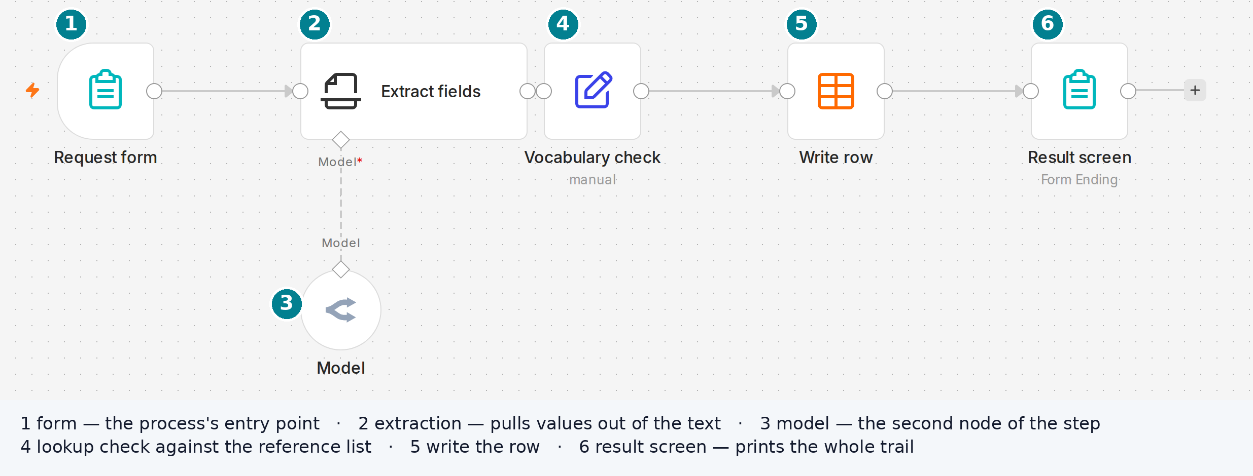
Starting state: the workflow from last session
This is a real n8n canvas, not a diagram. We have a workflow for classifying incoming requests — six nodes, the same order, the same names as at the end of last session.
2
Notes:
We have a workflow for classifying incoming requests — here it is, on screen, a real screenshot of the canvas, not a drawn diagram. The exact same six nodes you saw at the end of last session, in the same order, with the same names. Not one node has been renamed, deleted, or changed — if you opened the workflow file at home, today's rig starts from that same file.
Quick reminder of how it is built, because from here on we will refer to these steps by name. The form takes the request as free text — the person writes however is convenient, no format required. Extraction is a separate model step that pulls the topic, urgency, and contact out of that text, if a contact is mentioned in the text at all. The lookup list is not a model but a deterministic check: a value is either from the given list, or it becomes "other" or "not specified" — there are never empty cells after this step. Write puts the finished row into the table, and the results screen shows the requester every step at once, as a single sheet.
Separately — the failure branch, which you cannot see in this particular shot: if extraction cannot parse the text even after three attempts, the request does not disappear — it goes into the same table with its own marker, and it gets its own screen.
Why look at this again at all. Not because there is anything to pick at here — there are no complaints about these six nodes today. It is because today's four cases are exactly the steps this chain is about to pick up: a notification channel, a check for a repeat request, a decision on the refund amount, delivery of an image. Not one of them has had the question "is this the model's job or code's job" asked of it yet. We are starting from a clean, already-working foundation and building onto it, case by case, with this one question.

Slide 3
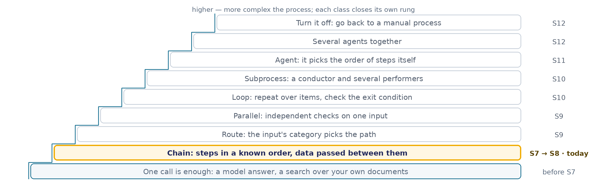
Same rung: chain
The gold bar sits in the same place as last time. Today's four cases are not a climb higher — they are what happens inside one and the same rung when new steps get added to the chain.
3
Notes:
A quick reminder here, not a new introduction — you have already seen this exact ladder in the last session, so I am not going to walk through all nine rungs all over again from scratch.
The short version, for anyone who has forgotten the details in between. Nine rungs, bottom to top, running from simple to complex. At the very bottom sits whatever a single model call, or a search over your own documents, is enough to close by itself — that part was already covered back in the lecture, not here. One rung up from that is chain: several steps in a known, fixed order, with data handed off between them along the way. We spent the entire last session standing on that rung, and we are staying on that same rung for the whole of today as well.
It is worth saying this outright, rather than leaving it implied, because it is an easy, intuitive mistake to think that four brand-new cases and one fairly elaborate experiment in a single session must mean we have climbed somewhere higher up the ladder. We have not climbed anywhere. Route, where the category of the input itself picks which path is taken; independent checks running in parallel; loops and subprocesses; an agent that decides its own order of steps; several agents working together — every one of those is a later session, a different and higher rung entirely. Today the chain stays exactly the same by design: step after step, in a known order, nothing more exotic than that. What changes between last time and today is not the height we are standing at, but the depth of the question — we are learning to put a far more precise question to the very same device, one step at a time.
And here is why this deserves a reminder of its own, not just a passing comment on the way to the first case. Because the rule for moving up this ladder, stated plainly back in the last session, reads exactly like this: never climb without a requirement that the rung below genuinely fails to close. And every one of today's four cases turns out to be exactly that kind of requirement — something the "chain" rung did not close automatically, on its own, just by existing: a notification that does not quietly mix up facts, a check that does not restart the whole thing from zero on every repeat, a refund decision you can actually stand behind in front of someone else, image delivery that does not silently break the run. Not one of the four requires climbing higher. All four close inside that same rung we are already standing on, provided you answer one single question correctly at each step along the way.

Slide 4
The session's axis: where the model decides, where code must
LOOKS RELIABLE
TURNED OUT TO BE
the message reached the coordinator, the chain got shorter and cheaper without an LLM
a repeat request about the same question came in — handled as new
the prompt says "don't refund more than amount X"
the image got assembled and sent to Telegram
The right column won't close all at once at the end — one row at a time, right after the case that closes it. And each time, not by my telling it, but by what we see on screen.
4
Notes:
Here is the axis the whole session stands on: four rows, and every single one of them looks, at first glance, like a perfectly normal, working result. Go ahead and read the left column. The message reached the coordinator. The request got processed without any fuss. The prompt has a rule about the refund amount written straight into it. The image made it all the way to Telegram. Each of these four phrases describes exactly the moment where it looks like the task has been solved and you can simply move on to the next thing.
The right column is empty, and that is not an oversight on our part — it is the actual plan for the session. Each of these four stories is hiding something that only shows up once you look more closely at it: an extra step sitting where none was actually needed, a repeat request that went unrecognized as a repeat, a probabilistic decision standing exactly where a hard condition was required instead, a data format that behaves nothing like ordinary text does. We are not going to name any of it right now — we are going to find it for ourselves and write it into the table as we break down each case in turn.
Four rows — and that is exactly the four cases of today's session: Notifications, Duplicate check, Refund approval, and Card in Telegram. At the end of each individual case there will be a moment where we come back to this very same table and write exactly one row into the right column — never an abstract conclusion handed to you, but a concrete observation drawn from a concrete run we have just watched together with our own eyes, on screen.
None of this means all four stories are broken from the very start. Quite the opposite, actually — every one of them looks completely functional on its surface, and that is the main trap built into this whole exercise: something that works is far too easy to mistake for something you can genuinely stand behind. The difference between those two states is precisely what this table measures, row by row, all the way through to the very end of the session, when we will finally see all four pairs sitting side by side and can compare them in a single glance.
Remember this table carefully — we will come back to it right after the very first case is done.

Slide 5
Case 1. Notifications
"Send me one line in Telegram: who wrote and about what — so I don't have to check the table for every request."
Уведомления
Проверка на повтор
Одобрение возврата
Карточка в Telegram
5
Notes:
Olga is the administrator of the training center, and she has one specific, concrete request for the chain we built in the previous session. When a request touches on more than one topic at once, she wants to receive a message about it in Telegram, rather than having to go and check the results screen every single time a requester happened to mention something beyond the main question.
The request sounds simple enough, and granting it looks easy at first — the chain already knows everything it needs to know: the name, the main topic, the extra topics. All three values have already been extracted by this point and are sitting right there in the table. All that's left, it seems, is to assemble them into one readable message and send it off.
This is exactly where the case begins: how, precisely, to assemble that text out of three already-known values — that is today's question, and it turns out to be less obvious than it looks at first glance. Next comes a live scene from Olga's working day, showing what the first attempt actually did, and a little later, once we look at real runs, what that same attempt actually produced in practice.
Notice carefully what Olga did NOT ask for. She did not ask anyone to "make the notification smart" or to "let the model decide for itself what to write." She described only the result she wants to see on her own phone — one single line that immediately makes clear who wrote in and about what. How exactly the chain arrives at that line is not her concern at all, and that is worth keeping firmly in mind: the whole case from here on is about how different teams of engineers, standing at this very same spot, end up choosing different answers, even though the underlying need is one and the same for everyone, and every bit as concrete.
That need is exactly what we work with for the whole of this case — not some abstract "we need a notification," but this exact phrase, word for word, against which any proposed solution can be checked from here on. Remember its shape well: that is precisely how we will check every option that follows — not by eye, but by feeding it a real request and watching closely whether it produces exactly this line.

Slide 6
The result screen and the multi-topic request
The training center, the same process that went live last session: form → field extraction → write to a table with topic, extra topics, and urgency → result screen. Olga, the administrator, works with this screen — twenty requests a day, and she clears most of them calmly straight off the result screen: the topic and urgency are already there, and who to hand it to is obvious at a glance.
1
Every few requests, the text doesn't come out shorter than usual: the person mentioned something beyond the main question — asked about payment, asked to reschedule a class, asked about the timetable. The "extra topics" field in the table catches this and records it honestly.
2
Olga doesn't open the result screen for every request right away — there are twenty a day, and opening each one the moment it's ready would be exactly the manual work the process was supposed to remove. She checks in batches, several times per shift.
3
If a multi-topic request arrives between checks, it sits in the table with the right fields — and looks no different from an ordinary request until Olga opens the screen herself and reads that exact row.
4
By evening, on a busy day, she admits honestly: she noticed some multi-topic requests not the moment they arrived, but at the next batch check — sometimes hours later.
What the training center pays for the delay. A multi-topic request is almost always more urgent than an ordinary one: the person isn't just asking about the course, they also want to move a paid class to today, or clarify something that has to happen before the end of the day. A batch check every few hours turns exactly that urgency into an ordinary queue.
Olga states her wish with total precision: "Send me one line in Telegram for every request like that — who wrote, on what topic, and what else they mentioned — so I don't have to go check the result screen because of one multi-topic request among twenty ordinary ones."
6
Notes:
This is the same process we ended last session with: form, field extraction, write to the table, result screen. Nothing about how the process works changes — what changes is what Olga now expects from it.
Twenty requests a day, and most are about one topic: sign up for a course, reschedule a class, pay. For those, the result screen gives everything needed at once: the topic and urgency are already filled in, and who to hand it to is obvious at a glance.
But every few requests, the person mentions something beyond the main question — payment on top of signing up, rescheduling on top of a course question. The "extra topics" field in the table records this honestly. The problem isn't that the process missed it — it noticed and recorded it correctly. The problem is who sees it, and when.
Olga doesn't sit in front of the result screen all day. She has twenty requests and the ordinary work of a training center around them — she checks in batches, several times a shift. If a multi-topic request lands in the table between checks, it sits there with the right fields and looks no different from an ordinary one: the only way to notice it is to open the screen and read that specific row.
And a multi-topic request is almost always more urgent than a single-topic one. The person isn't just asking about the course — they also want to move a paid class to today, or clarify something that has to happen before day's end. A batch check every few hours turns exactly that urgency into an ordinary queue, and by evening Olga honestly admits: she didn't catch some of these requests right away.
Hence her request, stated with total precision, not "make the notifications smart": one line in Telegram for every multi-topic request — who wrote, on what topic, what else they mentioned — so she doesn't have to go check the result screen over one request among twenty ordinary ones.
How exactly to assemble that line from three already-known values is the question this case opens with.

Slide 7
How to assemble the notification from three values
How do you assemble the notification text from these three values?
the model writes the whole notification text freely
we fill in a ready-made message form entirely by algorithm — substitution only
whatever the algorithm can close, it closes; whatever requires interpreting the request text, we call the model for that separately
we take the algorithmically assembled text as the base and add one phrase of tone from the model on top
7
Notes:
All three values needed to assemble the notification are already structured: the name, the main topic, the extra topics. The question isn't what to assemble — it's how.
The first card: the model writes the whole notification text freely. This is what Version 1 already does.
The second: we fill in a ready-made message form entirely by algorithm — just substituting values into a template fixed in advance, with no model call at all.
The third: a mixed option — whatever the algorithm can close (the values themselves), it closes; whatever requires interpreting the request text and wasn't extracted structurally in advance, we call the model for that, and only for that.
The fourth: we take the algorithmically assembled text as a solid backbone, and add one short phrase of tone or comment on top, composed by the model.
Don't choose by feel — estimate: which of the four approaches reliably produces text matching what Olga asked for, on any request, not just a lucky one.
Notice that the cards are laid out as a spectrum, not at random: on the left, the option where the model does all the work; on the right, where the algorithm does all the work; and between them, two mixed options, each splitting the work between model and code differently. This is deliberate: the question isn't "model or code," it's "how much of the work in this specific task actually requires interpretation, and how much is just substituting what's already known."
No card here is marked as obviously weak — each of the four has a situation, in principle, where it would be a sound choice. Today's question is tailored to Olga's need specifically, with her concrete text example and with already-structured values on input. For a different need, with a different set of known and unknown values, the answer could be different — worth keeping in mind while picking a card, but we'll break down this one, today's.
Fifteen seconds to decide, then let's see the cards.

Slide 8
What each action actually does
ACTION
HOW IT WORKS
ADVANTAGE
DRAWBACKS
the model writes the whole text
gets three already-extracted values and freely composes the notification text, with no fixed form
the text sounds alive, not like a canned phrase — it can write like a human
the values are already extracted — there's nothing to interpret; the text is re-assembled on every run, with a risk of slipping in a detail that wasn't in the request
the algorithm fills in the whole form
substitutes three already-structured values into a template text fixed once, with no call to the model
the result is deterministic: it matches the given text example on any request, not just a lucky one
no room for variability: if the message form ever needs to change in meaning, not just in values, the expression has to be rewritten by hand
algorithm + model for what requires interpretation
structured values are substituted by the algorithm; whatever stayed unstructured and requires interpreting the request text is passed to the model separately
would work honestly for a genuinely mixed case — where at least one value really requires interpretation, not just is already known
for this specific need, there's nothing to interpret: all three values, including urgency, were already extracted structurally last session — there's simply no work left for the model here
algorithm + model's tone on top
an algorithmic backbone of text is assembled by substitution, and the model adds one short phrase of tone or comment on top
the scope of freedom is smaller than in the first action — the risk and cost of calling the model are correspondingly lower
the same kind of risk as the first action, just smaller in scale: the model still generates text and can slip in a detail that wasn't there
8
Notes:
Let's break down the four actions in order, and I'll say this up front: none of them is foolish — each has a situation where it would be the right choice. The question is which situation we actually have in front of us.
First — the model writes the whole text. It can do that, no question, and the text comes out alive, not like a canned phrase. But look at what it has on input: all three values — name, topic, extra topics — are already extracted, structured, and sitting ready. The model has nothing to interpret, literally nothing to add to what's already known. And since it still generates text freely on every run, it keeps a chance of slipping a detail into the message that wasn't in the request — we'll see this on a real run shortly, not in theory.
Second — the algorithm fills in the whole form. This is exactly the amount of work actually needed: the three values already exist, the message form is always the same, and there's essentially no variability required. The result predictably matches the text example Olga asked for.
Third — the mixed option, algorithm plus model only for what requires interpretation. The idea is sound on its own, and it would work if the request had at least one value that needs to be inferred from the text — the degree of urgency, say, if it hadn't been extracted explicitly as a word. But in our chain, urgency already exists as a separate structured field, from last session. There's literally no work left for the model here — this is a solution for a different need, one we don't have right now.
Fourth — an algorithmic backbone plus a phrase of tone from the model on top. This is a scaled-down version of the first option: the model still composes something, just less of it. The same kind of risk remains, just at a smaller scale.
Which action actually meets our need — next screen.

Slide 9
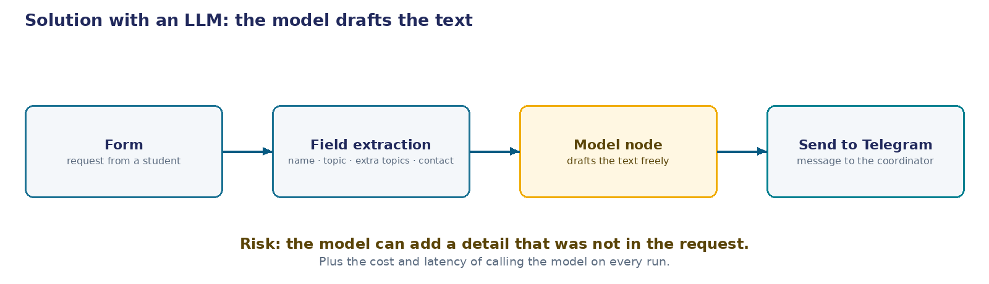
Architecture: the model-step composes the text
Four blocks: form → field extraction → a step that calls the model on every run → Telegram. The decision about the text's form is made anew on every request.
9
Notes:
This diagram is Version 1's architecture in pure form, with not a single specific tool named. If tomorrow someone builds this same chain in a different orchestrator than the one we use, the wording doesn't change by a word: once the request's fields are extracted, a separate step is added that calls the model on every run and gets back finished, freely composed text.
The important property of this architecture isn't that it calls the model — it's when it does so: the decision about the text's form is made anew on every run, not once in advance. That's where the risk grows that we'll break down shortly on real runs: since the text is reassembled on every call, it sounds a little different each time, and sometimes that "different" carries a detail that wasn't in the request at all.
Next comes the second architecture diagram, with not a single change anywhere else in the chain, but a different answer to this exact one node. That's what we'll compare — these two screens, one against the other, not paragraph against paragraph.
Why even bother drawing such a de-personalized diagram first, instead of going straight to the real interface with real field names? Because whether this is the right node for the task doesn't depend on which tool it's built in. If you build a similar chain on a different engine, directly in code, or through any other orchestrator, the question "does this step call the model on every run, or was the decision made in advance" sounds exactly the same, and the answer doesn't change. The specific names of nodes and parameters are a layer below — they come next, on the following screens, and there they're already tied to a real tool, with its real fields and its real prompt text.
What's worth watching here is where the block sits relative to the rest of the chain you already know: it doesn't replace some old node, it sits alongside, as a new branch, after the request has already been written to the table. The other five nodes from last session are untouched by this architecture.

Slide 10
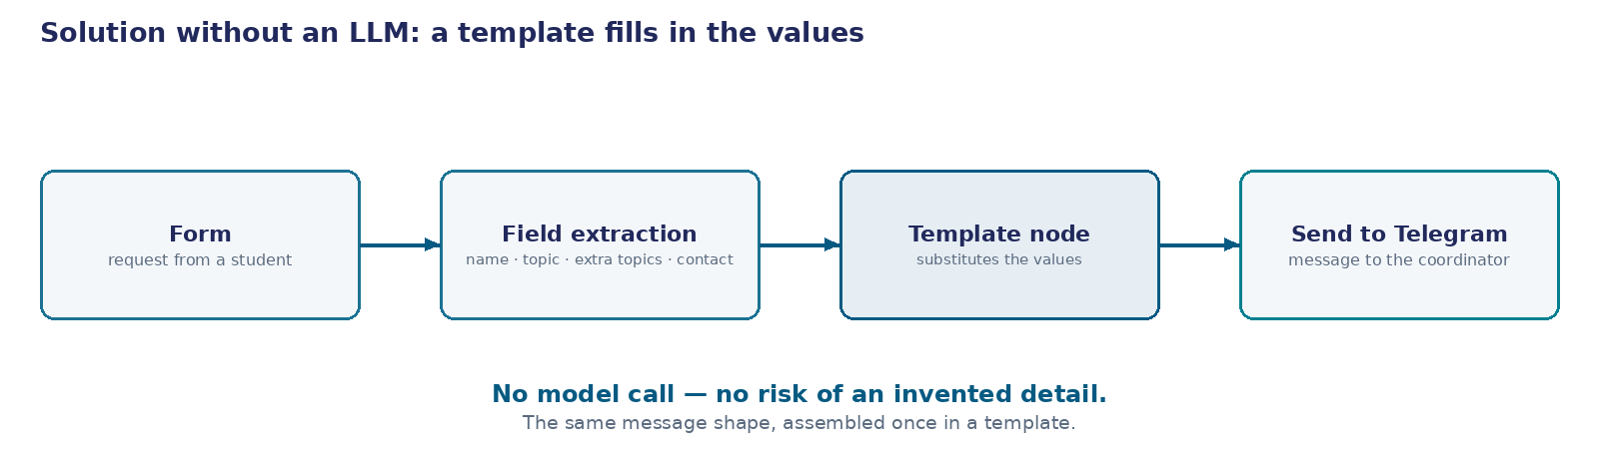
Architecture: the template-step substitutes values
The same chain: form → field extraction → substituting values into a fixed form → Telegram. The decision about the text's form was made once, in advance, not on every run.
10
Notes:
This is the second architecture diagram, and it's worth looking at not on its own but alongside the previous one — the difference between them is exactly one node, and the rest of the chain is untouched, step for step. Where the first diagram had a node that calls the model on every run, here there's a node that substitutes already-known values into a text form fixed once. No model call happens at this step at all.
The real difference isn't the tool — it's the moment the decision gets made. In the model version, the decision about how the text will sound is made anew on every request. In this version, the decision was made once, in advance, when the text form was designed and fixed, and from then on it's simply reproduced without variation.
That has a direct consequence for reliability: this node has no room to compose anything. It cannot insert a detail into the message that wasn't in the request — because it doesn't compose anything at all, it only copies values into pre-marked places. The placeholder finding we'll break down shortly, on real runs of the model version, is structurally impossible in this architecture — not because this version is "smarter," but because there's simply no step here that could create it.
What this looks like inside the actual tool, with the real parameters of both versions — the next screens.
It's worth addressing one objection that naturally comes up: "what if the template turns out less flexible than the model, and misses something important?" That's a fair question, and the answer isn't "a template is always better" — it's "for this specific need, the template has exactly as much flexibility as it needs": three values, one message form, nothing that would require genuinely different text from request to request. If the need were different — say, the requester's tone had to be accounted for, or the text had to vary with urgency — this same argument would cut the other way, and the model version would be the one to prefer.
The order of events here stays exactly as it really happened: the model version was built first, practice found the placeholder problem, and only after that did the team arrive at the architecture you see on this screen. The two diagrams stand side by side now not because they were equally weighted options from the start, but because side by side makes them easier to compare one to one — what exactly changed, and why that change closes the problem found in practice.

Slide 11
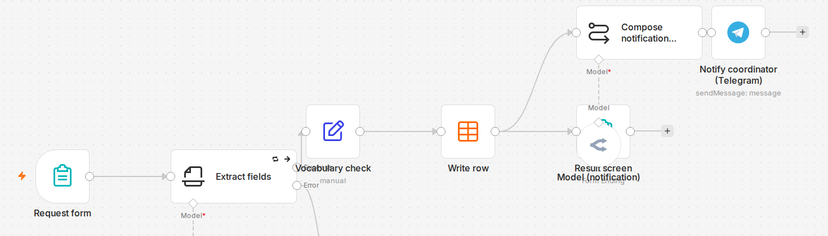
The whole path on the rig: the model version
Request form → field extraction (calls the model) → vocabulary check → write row → "Compose notification…" (calls the model a second time, the caption cut off by an ellipsis — that's how the n8n interface behaves with a narrow card) → send to the coordinator in Telegram.
11
Notes:
This is the real canvas of the live rig — not an illustration and not a simplified diagram, but the same screen you'd see opening the "Case 1 (before)" workflow in n8n. The frame shows the whole path: the request form, field extraction, the vocabulary check, writing the row, the message-composition node, and sending to Telegram.
Look closely at two details right on the frame. First — the "Compose notification…" node's caption is cut off by an ellipsis right in the interface: the card is narrow, and n8n truncates a long name the same way it would truncate any other. The full name, "Compose notification (LLM)," is only visible if you open the node itself — that's an honest interface limitation, not a simplification on our part. Second — the "Model*" marker under this node: the asterisk means the parameter is required — the model call here isn't optional, it's a configuration requirement.
The same marker sits under the field-extraction node, a bit to the left — and that's not news: the model was already doing work there, even in the simpler diagram; without it there's no turning a request's free-form text into structured values. What's new is the second call, at the step that composes the finished message, where all the needed values already exist and there seems to be nothing left to extract. Next to the composition node there's one more block visible — "Result screen Model (notification)"; in the template version we'll see shortly, that block isn't there at all, in the same spot — the difference is visible at the canvas level already, before we open a single settings panel.
What exactly this model gets as input, and what it's asked to do, isn't visible on this frame: the canvas shows node cards, not their open settings. Explaining that in prose next to a frame that doesn't show it would mean asking you to take it on faith. Instead, the next screen is the real settings panel of this same node, with the real prompt text, as it stands on the rig right now.

Slide 12
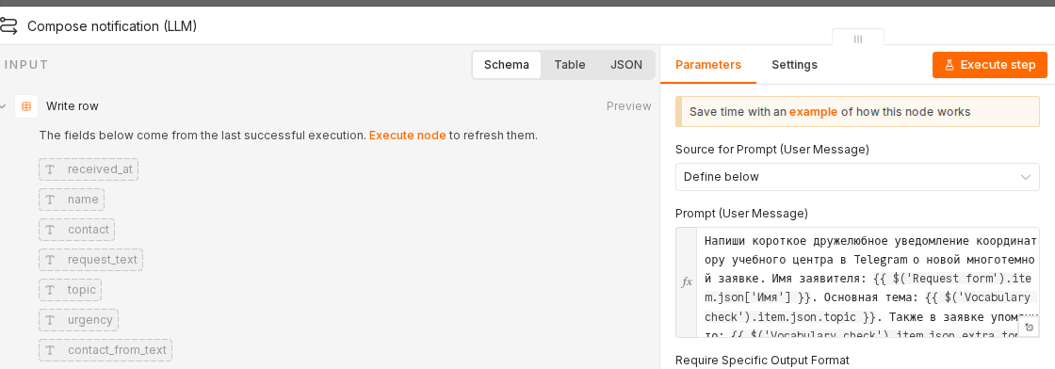
Node settings: the prompt of the model version
Node "Compose notification (LLM)", Parameters tab. The Prompt (User Message) field (real screen, text in Russian — see Assertion above): «Напиши короткое дружелюбное уведомление координатору учебного центра в Telegram о новой многотемной заявке. Имя заявителя: {{ $('Request form').item.json['Имя'] }}. Основная тема: {{ $('Vocabulary check').item.json.topic }}. Также в заявке упомянуто: {{ $('Vocabulary check').item.json.extra_topics }}. Пиши по-человечески, одно-два предложения.» — in English, what this instructs: "Write a short, friendly Telegram notification to the training center's coordinator about a new multi-topic request. Requester's name: {{ … }}. Main topic: {{ … }}. The request also mentioned: {{ … }}. Write it the way a human would, one or two sentences."
The Require Specific Output Format and Enable Fallback Model toggles — both off: no fixed answer structure, no fallback model if the call fails.
12
Notes:
Here's the actual settings panel — what opens if you double-click the "Compose notification (LLM)" node on the canvas from the previous screen. Before anything else: this screen is real, and the prompt is in Russian because the live bot genuinely addresses a Russian-speaking coordinator — we are not re-drawing or re-translating it, because that would misrepresent what's actually configured. The prompt's source is "Define below": the text is set right here, not pulled from a separate system prompt somewhere else.
The model is handed three already-ready values — the requester's name, the main topic, and the extra topics, all extracted earlier, at previous steps of the chain — plus one instruction: write a short, friendly Telegram notification to the coordinator, one or two sentences, the way a human would. No fixed phrase structure, no "answer in exactly this form" — this is exactly the freedom we talked about on the architecture diagram: a meaning-level task with no fixed response structure.
Notice one detail already, before we see the result: there's nothing in the instruction like "address the coordinator by name" or "insert the recipient's name." The model simply was never told the coordinator's name — because the text Olga receives doesn't need it. This detail becomes important two screens from now, when we see the real runs.
The two toggles under the prompt field are also part of the real configuration, not invented for the breakdown. "Require Specific Output Format" is off: the answer isn't constrained in structure at all. "Enable Fallback Model" is off too: if the primary model doesn't respond, there's no fallback here.
The finished text from this node goes straight into the node that sends the message to the coordinator — no check in between; you can already see that on the previous, general frame, from the direct arrow between the two nodes.
The configuration itself looks tidy and gives no hint of a future problem: the prompt is short, clear, with no obvious wording mistakes. Worth keeping in mind going forward — if the next screens turn up a finding, it won't be about the quality of how the prompt was written. It will be that any text a model composes freely from a naturally worded instruction can accidentally drag along a scrap of the very form it was working from — and no format check will catch that, because the resulting text is syntactically fine.

Slide 13
What the message looks like on Olga's phone
Telegram, chat "Training center notifications."
New request from Maria: topic "course," also mentioned: payment.
Exactly what Olga described in the previous scene, word for word: who wrote, on what topic, and what else they mentioned — one line, with no need to open the result screen.
13
Notes:
Before we look at how this gets assembled inside the chain, let's look at what Olga herself actually sees — on her phone, not on the result screen inside n8n.
She doesn't open anything new. She already has a chat with the notifications bot — the same bot the center uses for other alerts too. One message lands in that chat: "New request from Maria: topic 'course,' also mentioned: payment." One bubble, no attachments, no buttons, nothing to click through to understand what it's about.
The message's shape wasn't chosen arbitrarily — it's exactly the three values Olga named as sufficient in the previous scene: who wrote, on what topic, what else they mentioned. Not more, not less. Add one more field to the line — say, payment status or an internal request number — and the notification stops reading at a glance: it turns into text you have to parse, instead of skimming among twenty similar messages a day.
In the interface, this looks ordinary, and that's the whole point of the slide. The new message simply appears in the same chat where the history of all the center's earlier notifications already lives — no separate tab, no new icon, nothing else to navigate to. Olga reads this chat top to bottom exactly the way she read it yesterday and the day before; only the content of one line changes, not the habit she already has.
This is exactly the example Olga named in the previous scene, word for word — who wrote, on what topic, what else they mentioned. Three values, one line. If the message looks like this on every request, the task is fully solved: it's enough for Olga to read the notifications, without opening the result screen over one multi-topic request among twenty ordinary ones.
The question is whether it looks like this every time, on any request, not just this one. The next screen shows real runs of this same node, not a made-up example — and one of them looks different from this.

Slide 14
What two real runs actually produced
REQUEST TEXT
WHAT CAME OUT AND WHY
Maria: "I want to sign up for the analytics course and also ask about payment, please call back today"
Delivered: "New request from Maria: topic 'course,' also mentioned: payment." Free-form text, but it matched the goal in meaning — the model had enough from the instruction and the three values; interpreting was genuinely simple here.
Oleg: "I want to move my class to Friday and ask about course payment"
Delivered: "Hi, [Coordinator's name]! We have a new multi-topic request from Oleg about moving a class and about payment." The model inserted a literal fragment of its own instruction template — words addressed to itself, not to Olga. The node didn't fail, the message was delivered, the status was green: the mismatch is visible only in the content.
A format check doesn't catch this. Both runs are technically successful: both nodes completed, both messages were delivered. The only way to notice the difference is to read the actual text a real person received.
14
Notes:
Here's what actually came out in practice, not just in theory — two separate runs of one and the same node, with one and the same instruction, run against real requests.
The first request — from Maria, about a course and about payment. The model received three values along with the instruction to write a short, friendly notification. The result: "New request from Maria: topic 'course,' also mentioned: payment." It sounds free and quite human — and at the same time it matches, in meaning, exactly what Olga asked for. On this particular request there was genuinely nothing complicated to interpret at all: the three values fall together easily into a single phrase.
The second request — from Oleg, about rescheduling a class and about payment. The very same node, the very same instruction. And here is what it actually wrote this time: "Hi, [Coordinator's name]! We have a new multi-topic request from Oleg about moving a class and about payment." Read that second word carefully. This is not a variable that simply failed to substitute correctly on a technical level — it is a literal fragment of the model's own instruction template, words addressed to the model itself and not to Olga, which the model was supposed to replace with real content and, in this case, did not.
And here is what matters about what happened at the level of the execution log: nothing at all. The node did not fail, did not return an error. The status reads success on both runs. If all you do is look at the log, the second run is completely indistinguishable from the first.
There is only one way to find out that something is actually wrong — you have to read the actual text that a real person received. A check on the message's format is powerless here: the resulting text is syntactically fine in both cases, and the difference between them shows up only in the content.
And there is the answer to the question left from the previous screen: the message sometimes comes out looking exactly the way it needs to, and sometimes it doesn't, and there is no way to predict in advance, just from looking at how the node is configured, which of the two outcomes the very next request will produce. Next comes an architecture that drops this node altogether, along with its real configuration.

Slide 15
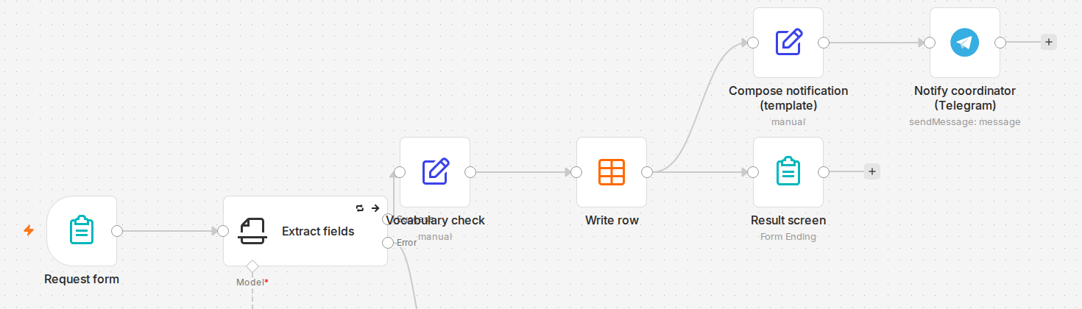
The whole path on the rig: the template version
Request form → field extraction (calls the model) → vocabulary check → write row → "Compose notification (template)" (the caption reads in full, no model call) → send straight to the coordinator in Telegram.
15
Notes:
This is the same canvas of the live rig as the previous screen, with the same crop — deliberately, so the two frames are easy to mentally overlay. The path is recognizable right away: the request form, field extraction, the vocabulary check, writing the row, the composition node, sending to Telegram.
The difference is in exactly one place, and it's visible already, before opening any settings panel. In the previous frame, the "Model*" marker sat under the composition node, along with an extra block, "Result screen Model (notification)." Here, that spot is empty: "Compose notification (template)" is connected by a direct arrow straight to the send node, with not a single intermediate model node. The caption reads in full, with no ellipsis — simply because "(template)" is shorter than "(LLM)"; the card is equally narrow in both versions.
The field-extraction node, a bit to the left, is still marked "Model*" — and it's important not to confuse this: that call is shared by both versions, the model hasn't left the chain entirely, it has only left one specific step. The difference between Version 1 and Version 2 isn't "with a model" versus "no model at all" — it's "the model is called twice" versus "the model is called once, exactly where it's genuinely needed." The vocabulary-check and write-row nodes between them are untouched by this edit at all — they're built the same way in both versions, and there's no need to compare them: the difference lives in exactly one node, it doesn't spread across the chain.
What the "Compose notification (template)" node actually does instead of the model — one expression, written once by hand — isn't visible on this frame either: the canvas shows cards, not their settings. Same as last time, describing that in prose next to a frame that doesn't show it would mean asking you to take it on faith. The next screen is the real settings panel of this node, with the full expression text, as it stands on the rig.

Slide 16
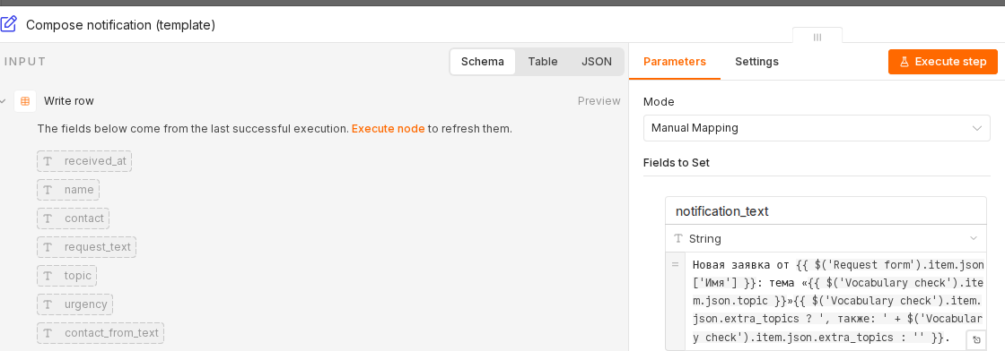
Node settings: the expression of the template version
Node "Compose notification (template)" (Set / Edit Fields), Mode — Manual Mapping. Field notification_text (String), real screen, Russian field names and output text — see Assertion above: «Новая заявка от {{ $('Request form').item.json['Имя'] }}: тема «{{ $('Vocabulary check').item.json.topic }}»{{ $('Vocabulary check').item.json.extra_topics ? ', также: ' + $('Vocabulary check').item.json.extra_topics : '' }}.» — in English, what this produces: "New request from {name}: topic '{topic}'{, also: {extra topics}, if present}."
"Include Other Input Fields" — on, "Input Fields to Include" — All: the rest of the request's fields pass through the chain unchanged.
16
Notes:
Here's the actual settings panel of the "Compose notification (template)" node — and it's worth comparing directly with the model version's panel we saw two screens ago, because the node serves the same purpose but is built in a fundamentally different way.
Mode here is "Manual Mapping": one field, notification_text, type String, and inside it, an expression written once by hand. It substitutes already-known values into pre-set places: the requester's name, the main topic, and, if present, the extra topics — with a condition built into the expression itself that adds the phrase "also: …" only when extra topics exist, and adds nothing if they don't. There's no separate model node anywhere near this one — in this version of the chain, no such node exists at all, which we already saw on the previous, general frame by the absence of the "Model*" marker.
Unlike the model version's panel, this expression is fully visible on screen, with no scrolling — it's shorter and fits the field without being cut off. Compare that with Version 1's prompt: there, the statement text is longer and part of it runs past the edge of the visible field area.
Worth noting separately: the "Include Other Input Fields" toggle is on, and "Input Fields to Include" is set to "All." That means the node doesn't just assemble the notification text into one new field — it also passes every other request field onward unchanged, so later nodes don't lose anything they might need.
The result of this expression is deterministic: given the same input values, the text always comes out exactly the same, with no variation — and, as a result, with no risk of inserting something into the message that wasn't in the request. The cost of that reliability is the flip side: if the message form ever has to change in meaning, not just in values, this expression has to be rewritten by hand, every single time. We ran both versions through the same requests — what follows from that is next.

Slide 17
Not every text output is generation
PRINCIPLE
IF ALL THE NEEDED VALUES ARE ALREADY STRUCTURED AND THE MESSAGE FORM DOESN'T CHANGE IN SUBSTANCE, THIS IS A FORMATTING TASK, NOT A MODEL TASK.
Task class
Assembling a message from already-extracted values in a fixed form.
17
Notes:
Let's pull this case's conclusion into one transferable rule, not an observation that only works for coordinator notifications.
The model node in Version 1 didn't break and wasn't technically wrong — the message was delivered, the response format was correct. It was simply solving a problem that didn't actually exist: all three values were already sitting in structured form, there was nothing to interpret, and the final message's shape didn't change from request to request. In that situation, calling the model isn't a tool for generating new meaning — it's an expensive, not entirely predictable way of rewriting, in its own words, something that's already known.
That gives us a general rule that carries over to any orchestrator, not just the one we use: not every text output in a chain is generation, in the sense of the model creating something new. If all the needed meaning has already been extracted at earlier steps and the result's shape is fixed, what's in front of you is a formatting task, not a model task — and it should be solved by deterministic value substitution, not free-form text generation.
The task class this case closes can be named like this: assembling a message from already-extracted values in a fixed form. You can recognize it in your own chain by one sign — if you can write the template of the final message in advance, without seeing a specific request, and all that's left in it are blanks for substitution, then there's nothing left to compose, and there's no need to call the model for it.
This doesn't mean the model is unnecessary here always and everywhere — this rule has limits, and we move to them on the next screen.
Worth noting separately: both nodes we compared formally solved the same task — the message reached the coordinator in both cases, and the run was green for both. On the surface, by delivery alone, there's no difference between them. The difference only shows up when you stop looking at what the node did once, and start looking at what it might do on the next run you haven't seen yet — and that's exactly the shift in perspective the whole of today's session is built around.

Slide 18
When you need the model, when a template is enough
NUANCE
WHAT IT MEANS
An extra step is a risk, not just a cost
Every model call is a point where a hallucination can appear — even in a trivial formatting task.
A template isn't permanently safe
If the message form ever needs genuine variability (different languages, different levels of detail), the template will have to be rewritten by hand for every new case — a different kind of cost, an engineering one.
Criterion. The model is needed when the content genuinely varies, or when a value requires interpreting text that wasn't interpreted at an earlier step. A template is enough when the message has one form and every value is already structured.
The first line of the axis is closed. The message really did reach the coordinator — and the chain turned out shorter and cheaper without the model node. The LLM here was simply an extra step: the template produced the same result, without its cost or its risk.
18
Notes:
Two nuances before we lock in the criterion, and both are about how neither version is permanently safe on its own.
The first nuance — an extra model step is a risk, not just an extra cost. It's easy to think that because the task is trivial — just assembling already-known words into one phrase — there's nothing to worry about. But we just saw: even on a trivial formatting task, calling the model stays a point where a hallucination can appear — that is, a detail that wasn't on the input. The cost in money and time isn't even the main thing here — the main thing is that what ends up in the text is, in principle, unpredictable.
The second nuance is exactly about the template, and it's there for balance. A template isn't permanently safe just because it's deterministic. If at some point the message form needs genuine variability — say, notifications have to be written in several languages, or with different levels of detail for different recipients — a static expression won't notice that on its own, and it'll have to be rewritten by hand for every new case. That's a different kind of cost, an engineering one, not a hallucination risk, but real all the same.
That gives us a criterion you can take with you and apply to any chain of your own, without remembering a single node name. The model is needed when the content genuinely needs variability, or when a value requires interpreting request text that wasn't interpreted at an earlier step. A template is enough when the message has one form and every needed value is already lying there structured.
And back to the session's axis. The first line: the message really did reach the coordinator, and that observation was true from the start. What it turned out to be: the chain came out shorter and cheaper without the model node at all — the same result, without its cost and without its risk.

Slide 19
Case 2. Duplicate Check
"Isn't this the same question he wrote in two hours ago?"
19
Notes:
We closed the first case: the notification to the coordinator is now assembled by substituting values, not composed by the model on every run. The second case starts from a different need, but one just as ordinary for a training center.
Course requests are handled by an administrator, and many messages from different people pass through her in a day. Sometimes the same person writes about the same question twice: forgot they'd already asked, didn't see the answer, decided to remind in different words. The reason doesn't matter to us. What matters is that the chain we're building shouldn't react to a repeat request every time as if it were seeing it for the first time.
The line on screen isn't from an abstract client — it's from the person reading the requests on the other end: the administrator, who sees the incoming stream all day and has to decide in a second whether this is a new question or one she's already dealt with. The difference from the first case is where the need grows from: there, the discomfort was the client's, getting a dry or uneven notification text; here the discomfort is the administrator's — and, no less, the client's own, who has every right to expect he won't be asked again about something he just explained.
So far it looks like a minor interface detail: so what, the question came in twice. But behind every repeat run stands the whole chain again — logging the request, assembling the notification, the model's work on the earlier steps. If the repeat isn't stopped at the entrance, all of that work gets redone for a question that already has an answer. It's cheaper to stop the repeat at the entrance than to run it through the whole chain and sort it out after the fact.
Today the task isn't whether the check is needed — it obviously is — but what to build it from. And, as we'll see further on, two different tools are in play by price: one almost free, the other noticeably more expensive. The question isn't which one to pick as the only one, but how to order them.

Slide 20
Requests Duplicate
1
Monday morning. Olga, the training center's administrator, opens the requests table and sees a question from a client: "when can I pay for the class?" She answers.
2
Two hours later — a second request from the same contact: "how do I pay for the course". In meaning, it's the same question. Olga doesn't recognize the rephrasing and processes it as new: answers again.
3
The client gets two different answers from the center two hours apart — and it looks as if the first answer got lost.
This isn't rare. By Olga's own estimate, such repeats happen about 10 times a day: someone forgot they'd already asked, someone didn't see the answer and asked again in different words.
The cost of the mistake isn't abstract. Double the administrator's work — plus the client's distrust: "don't they see I already asked?"
20
Notes:
The need is simple, and it's exactly the one this case starts with: Olga, the training center's administrator, keeps track of requests one by one, all day long. On Monday morning she sees a question from a client sitting in the table — "when can I pay for the class?" — processes it and answers. An ordinary morning, an ordinary request, nothing about it that stands out.
Two hours later a second request arrives from the same contact: "how do I pay for the course". In meaning it's the same question, just phrased differently. But Olga sees dozens of requests a day and doesn't keep in her head who asked what two hours ago — she doesn't recognize the rephrasing and processes the request as new: spends the time again, answers again, and nothing in front of her flags that this already happened once.
For the client it looks different. He gets two different answers from the training center two hours apart — and the only explanation that comes to mind is that the first answer got lost or nobody read it. The cost of this mistake isn't abstract: it's double the administrator's work, which could have gone to something else, and the client's distrust — now he's not sure anyone is even reading carefully, and that doubt doesn't go away just because the second answer eventually arrives.
And this isn't a one-off. By Olga's own sense of it, this kind of repeat — the same question in different words, already answered — happens to her about ten times a day. We haven't measured that number with instruments; it comes from a person who reads requests every day, not from a dashboard — but even as an estimate it shows this isn't a quirk of one morning, it's a standing part of the flow, day after day.
Today the task isn't whether the check is needed — it obviously is, since this happens every day — but what to build it from so it catches not only literal repetition but also the rephrasing we've just run into.

Slide 21
How to Build a Duplicate Check
How do you build a duplicate check?
compare the texts literally — exact match after normalization
compare the texts by shared words — the classic vector approach with a threshold
ask a general-purpose model whether it's the same question, just phrased differently
ask a specialized question-comparison service instead of a general-purpose model
check exact match cheaply first, and only pass through what's left
21
Notes:
Here's the very pair exact match stumbled on: "how do I pay for the course" — a question asked two hours after "when can I pay for the class?". By meaning, it's the same question. Letter for letter, two different texts.
The question: how do you build a duplicate check.
Five cards, and this isn't theory — five real approaches that show up in live systems. Compare the texts literally — exact match after normalization, which we already saw on the previous screen. Compare the texts by shared words — the classic vector approach with a threshold, no trained model, but more serious than plain string comparison. Ask a general-purpose model whether it's the same question, just phrased differently. Ask a specialized service tuned specifically for comparing questions, rather than a model that can do practically anything. Or check exact match cheaply first, and only pass through what's left unresolved.
Notice the wording: all five describe an action you can take and implement, not a claim about what some tool can or can't do on its own. "Compare literally" is an action. "Ask the model" and "ask the specialized service" are also actions, not a ready-made conclusion like "the specialized service is more accurate than a general-purpose model". The difference matters: the question isn't which tool is smarter in principle, but which step you'd put first and which second in a chain that processes an entire training center's requests.
Four of the five cards are standalone solutions you can take and implement whole: literal comparison, word-based comparison, calling a general-purpose model, or calling a specialized service. The fifth isn't another separate tool but a way to combine the ones already named: cheap first, and the expensive one only on what the cheap step didn't resolve. If votes split between the first four options and the fifth, that's fine: the first four answer "what to compare with", the fifth answers "in what order".
Choose. There's more than one right answer here — all five are real engineering solutions. We'll break down what each one actually catches on our pair, what it doesn't, and what it costs.
Fifteen seconds, then we lock it in.

Slide 22
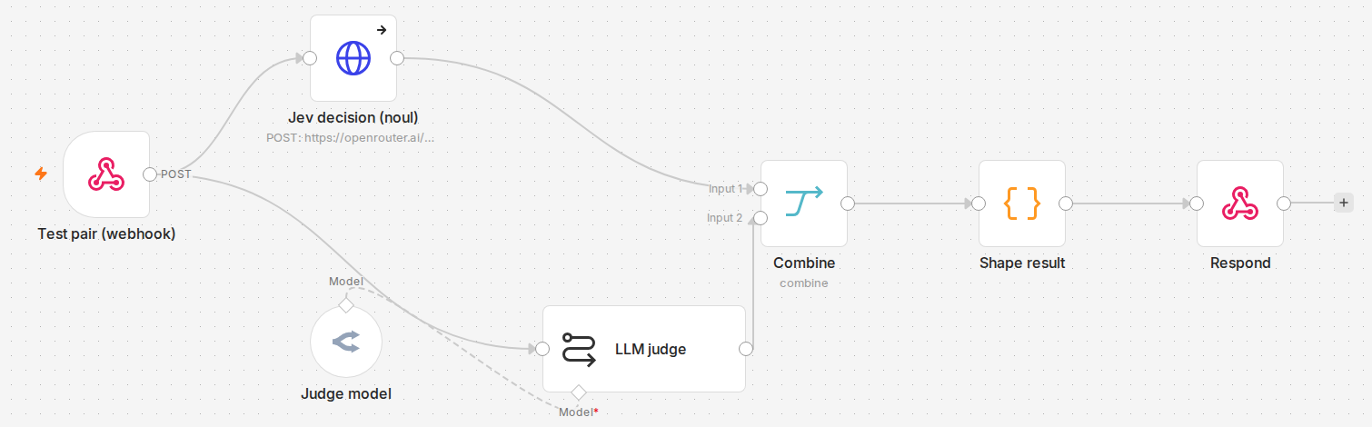
What Each Scheme Caught
SCHEME
CORRECT OUT OF 20
WHAT IT CAUGHT
WHAT IT MISSED / GOT WRONG
COST AND SPEED
Hash (exact match)
15/20
all 5 repeats, all 10 different ones
all 5 rephrasings (0/5)
cheap and instant — no model call
TF-IDF + cosine (threshold 0.3)
13/20 — worse than hash
repeats, some of the different questions
the same 5 rephrasings + 2 false positives on close topics (hash doesn't make this mistake)
cheap and instant — no model call
Judge model (gpt-4o-mini)
17/20
all 10 duplicates
3 false positives, including a pair with no shared words
~$0.15/M in · $0.60/M out — for the case (≈300/mo) ≈$0.006/mo (price-list estimate)
jev service
20/20
all 20, zero errors
clean split, no overlap
$0.042/M in, $0 out — for the case ≈$0.003/mo (price-list estimate)
Honest finding. TF-IDF misses every rephrasing, adds 2 false positives where hash never errs. jev scored best — accurate, cheap — but one 20-pair run can't justify replacing a working architecture. At this case's volume (≈10/day) both paid options cost under a cent a month: accuracy decides.
22
Notes:
We're breaking down the five actions from the previous screen — on a measurement taken before deciding anything.
Exact match, action one, catches 15 out of the 20-pair set: all 5 literal repeats and all 10 deliberately different questions, but none of the 5 rephrasings — zero out of five. Cost and speed aren't counted separately here: it's string comparison, either free and instant or it isn't there at all.
Action two, the classic vector approach — TF-IDF plus cosine similarity, threshold 0.3 — looks more serious: a similarity measure, a tunable threshold, a realistic engineering choice, not a weak alternative for contrast. The result on the same set, the same method — 13 out of 20, worse than hash. The same five rephrasings are missed for the same reason: the Russian words for "payment" and "to pay" are different inflected forms of one verb, and the Russian words for "course" and "class" are different words for one meaning, and a word-based measure is blind to that in principle. But two false positives on a close topic got added — "a Python course" and "a data-analytics course" share almost all their words, and the 0.3 threshold counted them as the same question. Hash never makes that mistake on the same pair — different strings don't match by definition. The more serious tool paid for the old failure with a new category of error, also free — the price isn't in money but in missed and false answers.
Action three, the cheap judge model: a direct question — "is this the same question, just phrased differently?" — model gpt-4o-mini. The result: 17 out of 20, all 10 real duplicates caught. But three of its own false positives, and not all from word overlap: the pair "how long does one class run" and "tell me about the continuing-students group" shares no words at all, and the model still said "yes" — an error of judging meaning, not words. And here, for the first time, a money cost appears: by gpt-4o-mini's price list, at the case's volume (~300 calls a month) — about $0.006 a month, under a cent; a price-list estimate, not a measured fact.
Action four — the specialized external service jev, a narrow Decisions API, measured by the same method. The result: 20 out of 20, zero errors — a clean split between all the duplicates and all the different questions, with the 0.5 threshold clearing it comfortably. The best result of the four schemes — and this is the very service that used to carry the label "not measured": the cause wasn't an access problem but a plain node configuration mistake that was found and fixed. By pricing, it's not just more accurate than the cheap judge model but also cheaper — about $0.003 a month at the same volume; also a price-list estimate, not a measured fact.
The main honest finding: the best result didn't come from the most obvious candidate — the narrow service beat the general-purpose judge model and cost less. But one measurement on 20 pairs of one topic isn't reason enough to immediately rewrite an architecture already demonstrated on the rig: the same discipline that kept us from taking jev on faith earlier keeps us from blindly trusting this number now. And one more thing: both sums here are under a cent a month — price isn't the argument.
Action five, ordering — cheap first, expensive only on what's unresolved — settles both tasks on price: 5 literal repeats get caught for free by hash, and the expensive step is called only on what's left. What this looks like architecturally — on the next screen.

Slide 23
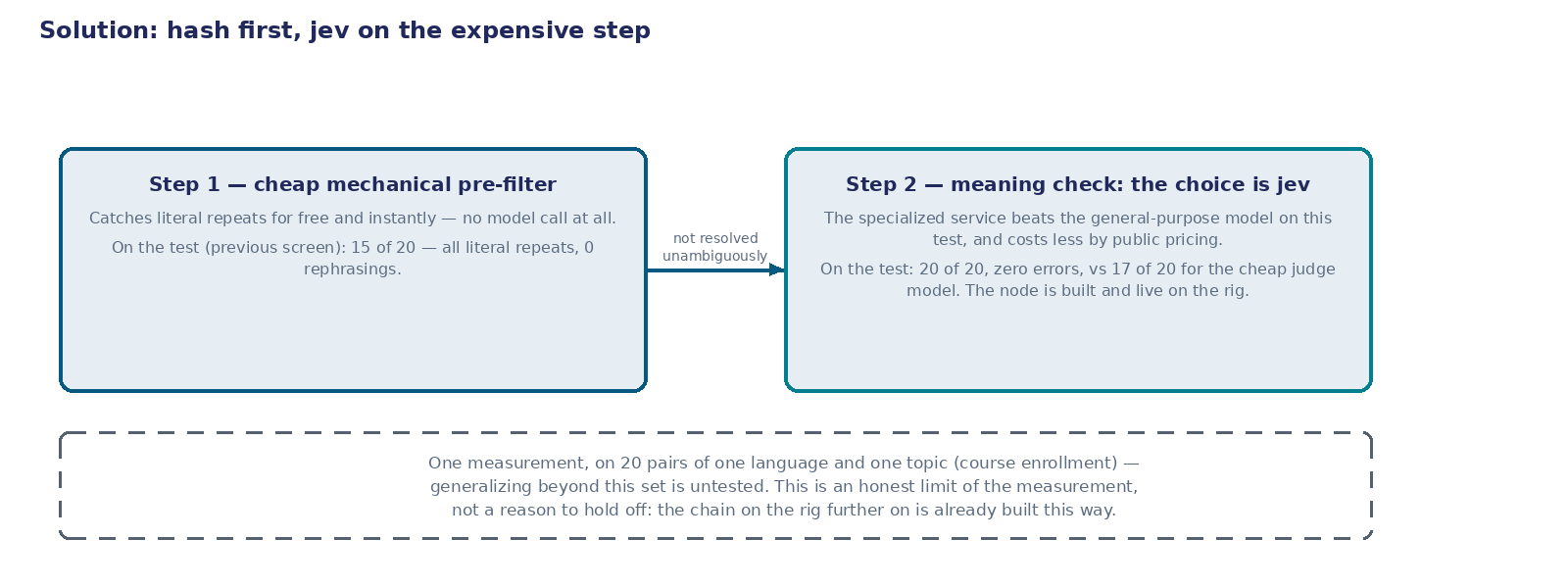
Solution: Hash First, jev on the Expensive Step
Figure: step 1 — the cheap mechanical pre-filter, takes on literal repeats for free. Step 2 — the meaning check, the measurement's choice is the specialized service (jev), more accurate and cheaper than the general-purpose model on this test. The node is built and live on the rig.
Honest caveat — right on the figure. One measurement, on 20 pairs of one language and one topic (course enrollment). Generalizing beyond this set is untested — this is a boundary of the measurement, not a reason not to deploy the solution.
23
Notes:
On the previous screen we measured five actions. From here — an architectural conclusion, and it isn't tied to any one specific tool: this formulation wouldn't change if the chain were built not in n8n but in anything else, and it doesn't name a single node.
The first step is a cheap, mechanical filter. It takes on everything that can be resolved without a model: all literal repeats, and resolves it for free and instantly. The classic vector approach doesn't go into this step — the measurement showed it isn't just a non-improvement over the simplest string comparison, it's measurably worse. That hasn't changed.
What changed is what runs on the second step. It used to be just the judge model — the only measured candidate for the expensive step. The measurement between it and a second candidate came out against the familiar choice: the specialized service jev — 20 out of 20, zero errors, and by public pricing even cheaper than the cheap judge model. By this test's results, the expensive step now runs it, not a general-purpose model — and that's no longer a thought for later, it's a built chain.
And right away, honestly, about the boundaries of this measurement: one test on 20 pairs of one language and one topic is a narrow basis for the conclusion "jev is always better than any judge model, everywhere". Nobody has checked generalizing beyond this specific set — a different language, a different topic, a different volume. The same discipline that kept us from taking jev on faith before keeps us from saying anything broader than the measurement showed now. But that's not a reason to delay deploying it here: on this set, for this task, the gap is clean and comfortable, and the solution is already live on the rig — over the next two screens you'll see the actual configured chain, not a draft diagram.
This is the same general move as in this session's first case: the model isn't removed, it's shifted to where it's actually needed — only here we also saw that even inside the "expensive" step there can be more than one candidate, and choosing between them is its own check, not something self-evident.
Now let's look at what this looks like not as a principle, but as configured nodes in an already-built chain.

Slide 24
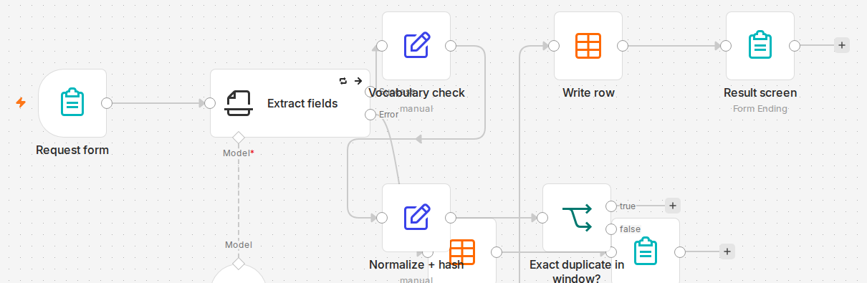
Configuration: Normalization and Exact Match
Node Normalize + hash (Set). Takes the request's text, lowercases it, trims the edges, collapses repeated internal spaces: normalized_hash = text.toLowerCase().trim().replace(/\s+/g, ' '). Alongside — the same calculation for the same contact's recent message.
Node Exact duplicate in window? (IF). Condition: normalized_hash is strictly equal to the recent request's hash — a string comparison, both values already lowercased. Match → a repeat is found, caught for free, no record written. No match → the request moves on down the chain.
24
Notes:
Here's what the first, cheap step actually looks like in the real chain — not a principle, but two real, configured nodes from the rig, on a real screenshot of the canvas.
The first node, Normalize + hash, is a Set — it doesn't call anything, it only computes values. We take the request's text and lowercase it: "When" and "when" become the same string after that. We trim the edges and collapse repeated internal spaces — an extra space shouldn't turn matching text into non-matching text. The same thing gets computed for the same contact's recent message, so there's something to compare against.
The second node, Exact duplicate in window?, is an IF, and it has one condition: the current request's normalized hash is strictly equal to the recent request's normalized hash. The strings match — we have a repeat in front of us, and the chain stops there: the answer already exists, no new record is needed, and the run itself still finishes successfully — worth remembering, we'll come back to this in a couple of screens. The strings don't match — meaning the cheap filter didn't give an unambiguous answer, and the request moves on to the meaning check.
Notice: neither of these two nodes calls a model. String comparison is pure mechanics, cheap and instant, and you can afford it on every single request without exception — this step's cost doesn't grow with how many requests arrive per hour. This is exactly the same cheap step as before today's architectural edit: only what comes after it changes.
One parameter deserves separate attention here, even though it isn't visible on this screen — the time window we search for a recent message from the same contact. Too short a window will miss a repeat if the person didn't write back immediately. Too long a window will start confusing different, genuinely new questions from the same person with a repeat of the same question. This is a parameter that has a cost on both sides, and we'll come back to it in the nuances.
How each of the two nodes is built on the inside — on the next screen: we'll open each one's settings panel and look at the real fields and the condition, not the canvas labels.

Slide 25
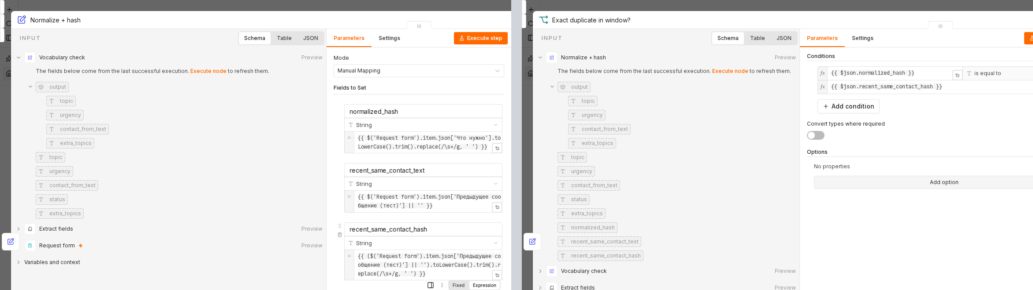
Node Settings: The Parameters Screen
Node Normalize + hash (Set, Manual Mapping mode). Three fields with expressions: normalized_hash — the current request's normalized text ($('Request form').item.json['Что нужно'].toLowerCase().trim().replace(/\s+/g, ' ') — the field name 'Что нужно' is the real, literal name of this field on the live Russian-language intake form, not an artifact of translation); recent_same_contact_text — the same contact's recent message as is, unchanged; recent_same_contact_hash — that same text, normalized by the same formula. "Include Other Input Fields" is on (All) — the rest of the request's fields pass through untouched.
Node Exact duplicate in window? (IF). One condition: {{ $json.normalized_hash }} is equal to {{ $json.recent_same_contact_hash }} — the previous node's third field compared against its first. "Convert types where required" is off: the strings are compared as-is, with no hidden type coercion.
25
Notes:
Here's what these two nodes actually look like if you open each one's settings panel — not a retelling in words, but what you'd see on screen if you opened the live rig yourself.
The left panel — the node Normalize + hash, Manual Mapping mode. It has three fields, not one. The first, normalized_hash, takes the current request's text from the Request form node — by the real, literal name that field carries on the live form (shown on the Visual above; it's in Russian, since the form itself is Russian, not a translation leftover) — and normalizes it: lowercase, trimmed edges, repeated internal spaces collapsed. The second field, recent_same_contact_text, is simply the same contact's recent message, unchanged, in case the text needs to be shown as-is rather than only compared. The third, recent_same_contact_hash, is that same text from the second field, run through the same normalization. The word "hash" in the field name isn't about a cryptographic hash here — it's a normalized string, the same operation as for the current request, just applied to a different text. At the bottom of the panel, the toggle "Include Other Input Fields" is on with the value "All" — the rest of the request's fields, topic, urgency, status, pass through the node intact and aren't lost along the way.
The right panel — the node Exact duplicate in window?, type IF. It has one condition, and it's shown in full: {{ $json.normalized_hash }} is compared with the operator "is equal to" against {{ $json.recent_same_contact_hash }} — that is, exactly against the third field the previous node computed. The toggle "Convert types where required" is off — the strings are compared as-is, with no hidden type coercion that could silently turn different values into "equal" ones. The "Add condition" button below shows the node has exactly one condition — there's no hidden logic off-screen.
Together these two nodes aren't the abstract formula from the previous screen — they're exactly what's configured on the rig: three fields in Set and one condition in IF, both shown in full. Next — the second, expensive node, the one that only sees what this condition didn't resolve.

Slide 26

Configuration: A Structured Request Instead of a Text Prompt
Node Jev decision (reworded?) (httpRequest). POST .../api/alpha/decisions, model typesafe/jev-1.13. The question type is noul: "yes/no" with a probability, not free-form text. The criteria are given explicitly: "yes" — the same question in different words, "no" — a different question, even if the topics or some words look similar.
Result on 20 real pairs. Duplicates — jev_noul 0.70–0.97. Different questions — 0.02–0.08. Threshold ≥ 0.5 → duplicate, a clean gap across 0.08–0.70 — the score is 20 out of 20.
26
Notes:
Here's the second node — the one that only sees what the cheap filter didn't resolve unambiguously. And it's built fundamentally differently from what used to stand in this exact spot.
It used to be a request to a general-purpose model with a free-text prompt: describe the task in words, ask it to answer "yes" or "no". Now it's a structured HTTP request to the specialized service jev. The difference isn't just the tool — it's the very shape of the question: the service doesn't accept arbitrary text, it accepts an explicitly typed question — in this case type noul, a closed "yes or no" question, but not simply binary, with a probability attached. Both texts are passed along, plus an explicit instruction for what counts as "the same question", and two explicit criteria — what counts as a "yes", what counts as a "no". None of this has to be guessed from the tone of the wording, the way it would in a free-form prompt: the criteria are a separate, explicit field of the request.
The result was checked not on two illustrative runs but on all twenty pairs of the test set — the same one hash, TF-IDF, and the judge model were measured on earlier. The split came out clean: on the ten pairs where a duplicate was expected, the service returned a probability between 0.70 and 0.97. On the ten pairs where a different question was expected — between 0.02 and 0.08. Between these two groups there's an honest gap: the maximum among the "different" pairs is noticeably below the minimum among the "duplicate" pairs. The 0.5 threshold holds a wide margin here, and that matters: the result doesn't depend on a luckily chosen threshold — the service split the pairs apart confidently in both directions.
Let's take one pair for concreteness, so we're not left with only ranges. "When can I pay for the class?" and "how do I pay for the course" — different words, the same meaning. jev returned 0.76 — comfortably above the threshold. On this same pair, hash and TF-IDF give zero — not because they erred, but because by construction they have no shared meaningful words to compare: this is exactly the kind of task where mechanical comparison is blind in principle, and the meaning check isn't.
Now, after seeing both nodes of the real chain, — what this means for the architecture as a whole.

Slide 27
What Olga Sees on a Repeat Request — and What She Doesn't
The requests table, that same morning.
Row 1 — "when can I pay for the class?" — an ordinary request.
(Two hours later the same text, word for word — there's no second row. The repeat was stopped before it reached the table.)
Row 2 — "how do I pay for the course" — logged, and looks exactly like an ordinary new request.
For the literal repeat, the scene's problem is solved completely: it simply never reaches Olga. For the very same rephrasing the case started with — it gets logged as-is, as a second row, no different from the first.
27
Notes:
Before wrapping up the case, it's worth honestly looking not at the diagram and not at a node's settings, but at what Olga herself actually ends up seeing in the requests table she opens every morning.
Take the very pair this case started with. The first request — "when can I pay for the class?" — comes in as an ordinary row, like any other. If exactly the same text, word for word, arrives two hours later, no new row appears in the table at all: the cheap mechanical step stops it before it gets there, and the run itself still finishes normally. Olga won't see the repeat, or even a trace that it happened — for her, it simply didn't happen.
But if the same question in different words arrives two hours later — "how do I pay for the course", exactly the request the scene opened with — the picture is different. We just measured the meaning check on this step: it reliably tells this kind of rephrasing apart from a new question. But today that distinction has no connection at all to what ends up in the table: the second row gets logged anyway and looks exactly like the first — with no flag at all that it's probably a repeat. Olga will see two rows from the same contact two hours apart — exactly the picture the case opened with.
This isn't a slip in the accuracy measurement — the meaning check really does tell the two apart well on its own test. It's a boundary of what's actually built and carried through to the result today: reliably telling apart isn't the same as reliably not showing twice. What to do with a detected rephrasing — quietly let it through, log it with a flag, or stop it the same way as a literal repeat — is exactly the product question we already called a nuance: not every detected repeat has to disappear from the table. But today, by default, it doesn't disappear, and that's worth knowing in advance rather than discovering as a surprise when you open the table.
Back to what all of this means for the case's architecture as a whole.

Slide 28
Mechanics and Meaning — Different Tools, Not Versions of Each Other
The systemic takeaway. Exact match stays in the final solution — but as the first cheap filter, saving 5 of 20 model calls for free, not as an alternative to the LLM.
Further in the course. In Seminar 10, this same mechanic — comparing the meaning of requests — scales up into searching for an answer in a knowledge base.
28
Notes:
Let's sum up this case on the measurement we just saw, not on an assumption.
Mechanical checking and meaning-based checking aren't competitors, and neither is a "more advanced version" of the other. Exact match can't catch a rephrasing in principle: it compares strings, not meaning, and it has no other way to work. The classic vector approach looked like a more serious alternative — it has a similarity measure and a threshold — but the measurement on 20 real pairs scored it worse than plain hashing: 13 out of 20 against 15. It fails on the same spots, the same rephrasings, for the same reason — zero shared words despite a complete match in meaning — and on top of that it gives 2 false positives exactly where hash makes no mistake at all. A "more serious" non-language tool doesn't just fail to guarantee an improvement — it can be measurably worse. That's what the measurement showed on its own data, not a general property of the method.
The systemic takeaway worth carrying forward: spend the expensive tool only where the cheap one clearly didn't give an answer. Exact match stays in the final solution — but as the first cheap filter that takes on literal repeats for free and saves 5 of 20 model calls on our set, not as an alternative to the LLM it supposedly competes with. The model is called only on what the first filter didn't resolve unambiguously, and there its cost is justified, because nothing else can replace it: neither hash nor the classic vector approach solves rephrasing in Russian.
This is the same systemic move as in this session's first case, only there it looked different: the model step was removed entirely and replaced with substituting values, because the task turned out to be fully deterministic. Here the task isn't fully deterministic — mechanics can't in general tell whether two different strings of text share one meaning — so the model isn't removed, it's shifted to where it's actually needed.
And separately — where this leads further in the course. In Seminar 10, this same mechanic — comparing the meaning of two requests — grows into a task of a different scale: searching for a ready answer in a knowledge base and merging similar questions into one, instead of comparing a new text against a single recent request from the same person. Today's duplicate check is, in essence, the first, narrowest version of that same task.

Slide 29
Nuances of the Duplicate Check
1
The time window — a parameter with a cost on both sides. Too short a window will miss a repeat spread a day or two apart. Too long a window will start confusing a person's different, consecutive requests with a repeat of one request.
1
The LLM judge has its own error asymmetry, not zero (Wataoka, Takahashi, Ri — NeurIPS 2024 Safe GenAI Workshop, arXiv:2410.21819, self-preference bias): a judge model is systematically non-neutral, even when formally answering "yes" or "no". Our own test confirmed this directly: 3 false positives out of 20, and not all of them come from word overlap in the questions.
1
"What counts as a duplicate" is a product decision, not just a technical one. Sometimes "the same question in different words" is worth treating as a new request — the person is waiting for an answer more urgently the second time. Not every technical repeat has to collapse into one in the interface.
29
Notes:
Three nuances, and not one of them is about which scheme to pick — all three surface only after the choice has already been made and the solution already built.
First — the time window is itself a parameter with a cost. Too short a window and the check will miss a repeat the person sent a day later rather than a couple of minutes later: formally, that's already "not a recent" request. Too long a window and the check will start confusing different, but back-to-back, requests from the same person with a repeat of the same request. This number has to be tuned from reality, not guessed once and left alone.
Second — an LLM similarity check is a specific case of a more general task, where a model acts as a judge evaluating someone else's text. And it has the same error asymmetry as any model acting as an evaluator: this isn't an assumption, it's a documented result — Wataoka, Takahashi, and Ri showed at NeurIPS 2024, at the Safe GenAI workshop, that a judge model is systematically non-neutral, even when formally it's just answering "yes" or "no" to a direct question. And this isn't an abstract reference to someone else's work: we just saw exactly this on our own test — three false positives out of twenty, not zero, and at least one of them isn't explained by word overlap in the questions — the model erred on a pair with not a single word in common. The meaning check isn't perfect; it just errs differently than mechanics does.
The third nuance — what we even count as a duplicate — is a product decision, not just a technical one. Sometimes a person deliberately rephrases their question, because they need an answer more urgently the second time, and collapsing that request into "already answered" would be wrong in substance, even if technically it's the same question. Not every detected repeat has to show up as a single entry in the interface — this is a decision worth discussing with whoever works the requests every day, not guessing at in code.

Slide 30
When Exact Match Is Enough
EXACT MATCH IS ENOUGH
MEANING CHECK IS NEEDED ON TOP
repeats are mostly literal, like Boris's first question
rephrasings are expected, like his second question
you need a free, instant filter on the whole request stream
the cost of a missed duplicate is higher than the cost of one model call on the borderline cases
the classic vector approach isn't worth adding "just in case" — the measurement showed a result WORSE than hash, not the same
the frequency of the model's own errors is a measured cost (3 false positives out of 20 for us), not zero, and it has to be budgeted for too
neither hash nor the classic vector approach solves rephrasing in Russian on their own, in full
the specific meaning-check tool is also a choice: a cheap general-purpose model (17/20 on our test) or the specialized service jev (20/20) — not something to guess by default, it needs its own check
Closes the axis's row. It looked reliable: a request about the same question came in again — handled as new. What it turned out to be: without a duplicate check, every repeat request restarts the chain from scratch; neither hash nor the classic vector approach solves this entirely for live Russian text — a model is needed, with its own, measured price for being wrong.
30
Notes:
A criterion, and it's not about which tool is better in principle — all three work; the question is what kind of repeats you expect and what you're willing to pay for each one's mistakes.
Exact match is enough for literal repeats — on our set that's 75 percent, 15 out of 20, for free and instantly. This is Boris's first question, asked twice in exactly the same words — for a case like that, hash handles it completely, and spending a model call on every single request doesn't pay off.
The classic vector approach isn't worth adding "just in case", counting on the similarity measure and a tunable threshold to deliver an improvement on their own. The measurement on 20 real pairs showed a result WORSE than hash — 13 out of 20 against 15: you can't treat it as a "smarter hash" without checking it on your own data — it can turn out worse than the simplest option.
A meaning check is needed on top exactly where rephrasings are expected — Boris's second question, asked in different words. The model is needed there, and it's important to remember: its own error rate — three false positives out of twenty for us, fifteen percent — is the price you pay for that accuracy, not zero. If the cost of a missed duplicate — the administrator's repeated work, a repeat call, the client's distrust like what Boris got — is higher than the cost of one extra model call on borderline cases, the meaning check earns its keep.
And a separate line in the criterion: which specific model to check meaning with is also a decision, not obvious by default. On our test, the cheap general-purpose model scored 17 out of 20, the specialized service jev scored 20 out of 20 and costs less by pricing. This doesn't mean "always take the specialized service": it means the choice of tool for this step is worth checking the same way we checked whether the step is needed at all — not guessed.
And now let's close the second row of our table. It looked reliable: a request about the same question came in again — formally that's just a new request, handled as new, a green run. What it turned out to be: without a duplicate check, every repeat request restarts the whole chain from scratch, as if the question had never been asked — exactly what happened with Olga and Boris. And this is the thing worth carrying forward: neither exact match nor the classic vector approach solve this task entirely on their own — a real rephrasing needs a meaning check, with its own measured, not imagined, price for being wrong, and that's exactly why in the final solution it stands as the second step, not the only one.
The case is closed: we went from Olga's need and her client's, through two unsuccessful or incomplete cheap approaches, an honest measurement on real texts, and choosing the right order of tools — to a concrete criterion for deciding whether the second, expensive layer is even needed at all, and with exactly which tool to build it. Next is this session's third case, and there the same fork between model and code will show up not in request text, but in a decision that directly controls money.

Slide 31
Case 3. Refund approval
"Automatic refund — up to a set amount. Above the threshold — only through the manager."
Уведомления
Проверка на повтор
Одобрение возврата
Карточка в Telegram
31
Notes:
The third case of the day, and the subject shifts from text to money. In the first case we decided how to assemble a notification from values we already knew. In the second — how to tell a repeat question from a new one. Here the decision rests on a single number: the amount of the refund.
The training center accepts refund requests — a missed class, a course that did not fit, a change of mind. Part of these requests the center must approve on its own, without pulling the manager into every small case: this is routine work, and it needs to be handled fast, without approvals from above. Another part — the large amounts — must go to the manager without exception: there the cost of a mistake is higher, and the decision cannot be left uncontrolled. A threshold splits these two categories: three thousand rubles.
Why it can't simply all go to the manager, or all be handed to automation, needs little explaining. If every case is handled by hand, the manager drowns in small requests and has no time left for what actually needs them. If automation is trusted with absolutely everything, a large amount can go out without a single human glance — and where the count runs into the tens of thousands, that is a risk nobody takes on knowingly. The threshold is the compromise between these two extremes, and how precisely it holds is what decides whether the compromise works in practice or only on paper.
The phrase on the screen is not a technical prompt or an instruction to the model — it is how the business would state this idea before handing it over for implementation: automatic refund — up to a set amount. This is a direct continuation of the process we already built in Seminar 7: there the system read the text of a request and determined its topic; here it goes one step further — once a request is recognized as a refund request, the same system decides whether to approve the amount automatically or pass it to the manager. Not two separate processes, but one process with an extra step added.
Inside this step the rule sounds simple and, at first glance, entirely unambiguous — there is a threshold, there is a comparison, what could possibly go wrong.
It is exactly this seeming unambiguity that will turn out, under testing, to be incomplete. But let's not get ahead of ourselves: first let's see how this rule lives today and who carries it out — next screen.
The case track at the bottom of the screen — third of four; after this the session moves to a business case with a similar story at a different scale, and then to the last, fourth case of this session.

Slide 32
Version 1: a continuation of the classification process
The same request form we've already used in the previous cases: a person describes the situation in their own words — "please refund 2,500 rubles for a missed class."
1
A person writes a request in free text — it contains both the ask and the amount.
2
The process that in Seminar 7 determined the topic of a request now goes one step further here: it reads the text and decides on its own — approve the amount automatically, or pass it to the manager (model qwen/qwen-2.5-7b-instruct).
3
Decision "approve" — the money moves to the client's card automatically, with no human involved.
4
Decision "escalate" — the request goes to the manager, and the manager decides from there.
What today's trust rests on. The version has been running for a month. Nobody has complained that something was approved that should have been escalated, or the other way around. The team considers the rule reliable — on exactly that basis: nothing bad has been noticed.
32
Notes:
Here is how this works today, and it is not a new process built from scratch — it is a continuation of what we already built in Seminar 7. There the system read the text of a request and determined its topic: payment, rescheduling, a question about the course. Here, once a request is recognized as a refund request, one more step is added: the same system reads the amount inside the text and decides on its own whether to approve it automatically or pass it to the manager.
The request arrives through the same form we used in the previous two cases: a person writes in their own words, and the amount is stated inside the text rather than in a separate field. "Please refund 2,500 rubles for a missed class" — an ordinary phrasing, nothing structured.
One step of the chain makes the decision, and makes it in full. Inside that single step, three operations are combined at once: read the amount, compare it with the threshold, and formulate the answer — and the model does all three itself, with no check from outside. It is exactly this capability — adding an automatic refund up to a set threshold within the same form, without sending every small request to the manager — that the team implemented a month ago.
From there the fork is simple, and it brings a detail that wasn't in the previous cases: if the decision is "approve," the money is not just "processed" — it moves to the client's card automatically, with no human touch at all. If the decision is "escalate," the request lands with the manager, who then decides.
And here is what today's trust in this version rests on. It has been running for a month. In that month nobody has come forward to say "this request was approved incorrectly" or "this one was escalated for nothing." The team naturally reads that as confirmation: the rule works, the model handles it.
But it's worth saying out loud exactly what the absence of complaints confirms — and what it doesn't. It confirms that no mistake was noticeable or costly enough for someone to come back and complain. It does not confirm that there were no mistakes at all. The difference between these two claims is exactly the next beat.
Also notice what this version lacks between reading the amount and the final word of the answer. There is no separate step that states out loud, "the amount is this," and separately, "the threshold is that," and separately, "here is the result of comparing them." All of it happens inside a single model call, and the only thing that comes out is the finished word "approve" or "escalate" — with no intermediate trace by which you could check how the model arrived at that word in a given case. It is exactly this opacity of a single call that will need to be unpacked next.

Slide 33
How to make sure the threshold decision never errs
How do you make sure the threshold decision is never made incorrectly?
write the rule more clearly in the prompt
give the model a calculator tool for comparing amounts
put an IF node after the amount is extracted
make the amount an explicit numeric field on the form
33
Notes:
Let's pause here for a second before moving on. The rule has run for a month, no complaints — and this is exactly the point where an engineer has to ask: is silence proof, or simply the absence of a reason to check?
The question worth asking: how do you make sure the threshold decision is genuinely never made incorrectly? Not "how to make things more reliable" in general, but specifically about this one point — comparing the amount with the threshold.
Four cards, and they are four different actions on the process, not four opinions about the model.
The first — write the rule more clearly in the prompt itself: rephrase the text to explicitly separate what happens exactly at the boundary from what happens on either side of it.
The second — give the model a calculator tool: let it not do the comparison in its head, but call a separate function to compare the numbers.
The third — put an IF node after the amount is extracted: let the model still pull out the amount, but let code do the comparison against the threshold.
The fourth — make the amount an explicit numeric field on the form: don't write it inside the free-text request, collect it as digits right at intake, in its own field.
As in the earlier cases: there is no single obviously wrong option here among the rest. All four are real engineering moves, and some of them carry a real limitation that doesn't show up right away. Think not about "what sounds more reliable," but about what removes the very possibility of the mistake, rather than just lowering how often it happens.
And one more hint for later — not about which card is correct, but about how to approach them. Two actions change SOMETHING about how the model makes the decision — a rewording, a tool. Two actions change WHERE the decision is made at all — moving it into code, or removing the need to extract anything in the first place. The difference between "do the same thing better" and "do it differently" will carry the whole breakdown that follows.
Fifteen seconds to choose, then we vote by raising hands — the breakdown is on the next screen.

Slide 34
What each of the four actions delivers
ACTION
HOW IT WORKS
ADVANTAGE
DRAWBACKS
Write the rule more clearly in the prompt
Reword the rule, explicitly separating "≤3,000 → approve" from ">3,000 → escalate"
Measured: version 1 erred 9/101 at the boundary; the clarified wording — 100/100 on the extended set
A fact about this specific set/model, not a structural guarantee — the decision is still made by text, not code; another wording or model could diverge again
Give the model a calculator tool
The model gets a number-comparison function instead of comparing "in its head," and decides itself whether to call it
In theory splits extraction and comparison into two operations
The model still extracts the amount from text first — the same probabilistic step — then probabilistically decides whether to call the tool: the probabilistic part doesn't disappear, it moves earlier. Measured: 56/100 — worst of all options; the calculator can't do comparisons (11/100 refusals), 30/100 answers don't reduce to a clean word, 9/100 errors scattered across the range
Put an IF node after the amount is extracted
The model still pulls out the amount, code compares it with the threshold — a condition, not a text call
Removes the probabilistic part from the decision point. Measured: 0/101 on the extended set, including boundary cases
The model still extracts the amount — an extraction error (not a comparison error) isn't closed by this node, though none turned up on this set
Make the amount an explicit numeric field on the form
Collect the amount as digits in a form field — never extract it from text at all
Removes the uncertainty earlier: there's nothing to extract, so there's no extraction-error risk
Works only if the form can be changed; an email/chat/other channel still requires extraction from text. The metric is applicability, not accuracy — there's no extraction step, so there's no accuracy to measure either
Bridge ahead. One action measurably fixed the specific finding, one measurably failed, one eliminates the risk structurally and is confirmed by measurement, one changes the input before the decision point and needs no accuracy metric at all. Which one is right here isn't decided by argument at the table — it's decided by the measurement you're already seeing in this table; the next beat shows how it was built.
34
Notes:
Let's go through the four actions, and each one now has not just reasoning behind it, but a real run on the live rig.
Write the rule more clearly — explicitly separate what happens on either side of the boundary. We ran it on the extended set of a hundred requests, the same ones where version one erred nine times out of a hundred and one — zero errors. This is a measured fact, but not a structural guarantee: the decision is still made by text comprehension, not code, and another wording or another model could diverge from the rule again, just somewhere else.
Give the model a calculator tool — this one needs a more detailed explanation of why it doesn't solve the problem. Before the calculator can compare anything, the model still has to extract the amount from the text — the same probabilistic step as without the calculator. And after that, the model itself, also probabilistically, decides whether to call the tool and with which arguments. The calculator doesn't remove the probabilistic part — it adds another one where there wasn't one before. We assembled a real agent with a real calculator and ran it on the same hundred requests: fifty-six out of a hundred, the worst of all the options. n8n's built-in calculator can do arithmetic but not comparisons, and on "2,500 is less than 3,000" it honestly answered "I don't know how to do this" (11 out of 100). A third of the answers didn't reduce to a clean word — mixed alphabets, reasoning instead of an answer, one switch into Chinese. Almost a tenth of the errors were scattered across the whole range, not just at the boundary.
Put an IF node after extraction — the model still pulls out the amount, code does the comparison. On a hundred and one requests — zero errors, including every boundary case built into the set. What it fundamentally doesn't close is an extraction error itself; none turned up on this measurement, but architecturally that's not this node's job.
And last — an explicit numeric field on the form. Accuracy was deliberately not measured here: a step that doesn't exist has no accuracy to measure. The applicable metric is applicability: it works only if the form can be changed; otherwise extraction from text is still unavoidable.
Before choosing among the actions, we need to know exactly how bad things currently are, and exactly where version 1 goes wrong on the extended set. That measurement is the next beat.

Slide 35
Testing an idea: the jev service for extracting the amount
The proposed idea. Pull the refund amount out not with a general-purpose model, but with the specialized jev service — the same one that, in Case 2, told a repeat question from a new one — and still leave the threshold comparison to code, the same IF node already chosen by version 2.
What the test showed. The jev service has exactly four response types: yes/no with a probability, a choice from a fixed list of options, a position on a predefined scale, a region on an image. An open-ended number is not among them. The decisive test: amounts of 2,999 and 3,001 rubles — on opposite sides of the real 3,000-ruble threshold — both came back with the same scale bucket, with full confidence. The service did not tell them apart. The only way to tell them apart would have been to build the bucket boundary at exactly 3,000 in advance — that is, to know the threshold at the moment of framing the question to the service, exactly as in the version-1 prompt text.
How this differs from the calculator. With the "give the model a calculator tool" action (previous screen), the model COULD call the tool — the probabilistic part didn't disappear, it just moved one step earlier. With jev in this task, the operation "return an open number" simply does not exist in the API at all — this isn't a job done poorly, it's a job the service structurally does not take on.
The lesson. First verify that a service can actually do what you want from it, and only then design the step around it — not the other way around.
35
Notes:
Before moving on, it's worth telling you about one idea that came up after the table on the previous screen was already finished, and which did not make it in as a fifth row — not because anyone shied away from it, but because testing showed it could not be built the way it was conceived.
The idea sounded reasonable. We already have the specialized jev service — the same one that, in the previous case, told a repeat question from a new one better than a cheap judge model. Why not use it here too — to pull the amount out of the request text, while still letting code compare it with the threshold?
Before assembling the chain, the idea was checked with direct calls on the live rig — you cannot make up a number, you have to measure it. And it turned out: the jev service has only four response types — yes or no with a probability, a choice of one option from a predefined list, a position on a given scale, a region on an image. An open number isn't among them at all, in any form.
The decisive test showed why this isn't a minor point. Two amounts, 2,999 and 3,001 rubles, sit on opposite sides of the real three-thousand-ruble threshold. Both were given the same predefined scale of ranges. The service returned the same range for both, with full confidence each time — it did not tell them apart. Telling them apart would have worked only if the range boundary had been hard-coded at exactly three thousand in advance — that is, if the threshold had to be known at the moment of framing the question to the service, exactly as in the version-1 prompt text, which is the very thing we're trying to get away from.
This is a different story from the calculator we went through a minute ago. With the calculator, the model could call the tool — the probabilistic part simply moved one step earlier and kept living there. With jev, in this particular task, the operation "return a number" simply does not exist in the service's interface — this is not a poorly performed job, it is a job of a different class that the service doesn't take on at all.
The lesson is simple and general, not just about refunds: before designing a step around a third-party service, you first have to verify it can physically do what you want from it — not assume that because it's good at a neighboring task, it will fit here too. "Choose from ready-made options" and "extract an arbitrary number" are different classes of task, and success at one says nothing about the other.
Now — what we actually did with this finding: a solution that replaces exactly the node where the mistake happens. That's the next beat.

Slide 36
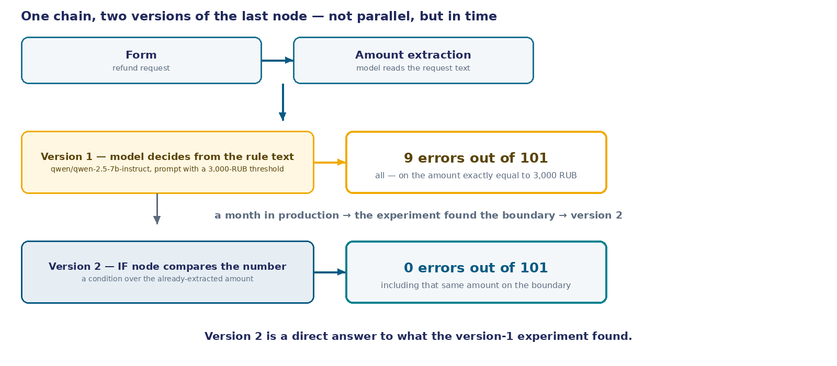
Version 2: the same path, one point changes
Version 1 (was). Free-text form → model extracts the amount → the same model decides from the rule text → result.
Version 2 (became — a direct answer to the experiment's finding). The same form → model extracts the amount → IF node compares the number to the threshold → result.
The chain hasn't been rebuilt. The difference is confined to exactly one node — the very one where the decision used to be made. Everything else — the form, extracting the amount, routing the request further — stayed the same.
36
Notes:
In the action table we just stated the number: version one, the one that's been running for a month, errs nine times out of a hundred and one. And not at some random point in the chain — at exactly one point, where the "approve" or "escalate" decision gets made. Before going further and breaking that number down, it's worth showing what we actually did with this finding. Version two is not a new chain built from scratch — it's version one with exactly that one node replaced.
Look at the diagram. The top band is version one, the one that ran for a month. A free-text form, the model pulls the amount out of it, and the same model — in the same call — decides whether to approve the amount or escalate it, by reading the text of the rule. This last action, deciding from the rule's text, is exactly the point where all nine errors happened.
The bottom band is version two. It doesn't appear alongside version one in parallel, nor does it replace it from the very start — it appears specifically as an answer to what the experiment showed. The form is the same, extracting the amount is the same — the model still has to pull a number out of the free-text request, because we haven't changed the form yet. But further down the chain, where the model used to decide from the rule's text, there is now an IF node: it compares the already-extracted number with the threshold as a condition in code, not as a text call.
Notice that this is not drawn as two equal, parallel processes that we supposedly built at the same time and compared. Version two came after version one, and because of a problem found in it — that is the correct way to tell the story of a decision change, and it matches exactly what actually happened: a month in production, an experiment, a finding, and only then a node replaced.
Next we'll break down how well this actually works — not just the headline number, but exactly how the test on a hundred and one requests was built, and exactly which phrasings tripped up version one again and again. That's the next beat.

Slide 37
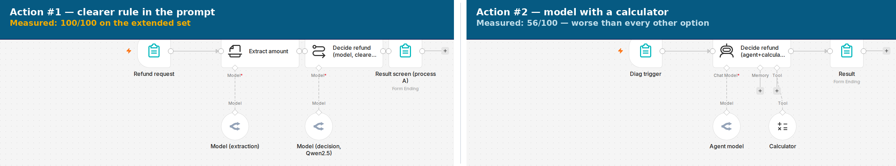
Testing in practice, not on trust
Why measure, rather than wait for a complaint. A complaint only arrives if a mistake is noticeable enough and costly enough for someone to come back. A quiet mistake — a slightly larger amount approved, a slightly smaller one escalated — will never trigger a complaint.
The original 51 (a cluster near the boundary). A fixed seed. 25 amounts near-or-below the threshold (1,000–3,000 RUB, a cluster near the boundary: 2,900…3,000, three times exactly 3,000; e.g. "can I get a refund of 3,000 rubles for one missed class?"). 25 amounts clearly above (3,200–9,000 RUB; e.g. "a refund of 3,200 rubles, or I'll file a complaint"). Plus 1 manual test.
The new 50 (harder than the first). Tight border — 15 amounts within ±20 RUB of the threshold (2,980…3,020; e.g. "please refund 2,999 rubles, the class was cancelled at the last moment"). Two numbers — 20 texts with a distracting number and a target number (e.g. "the course cost 12,000 rubles, I want a refund of 2,400 rubles for one block"). Indirect phrasing — 15 texts where the amount is derived by arithmetic or the word "about," not stated as an explicit number (e.g. "the class cost 1,500 rubles, please refund me for two such classes").
101 requests total. The correctness criterion — the decision read from runData of a real run — is compared against the expectation "approve if the amount is ≤ 3,000 rubles, otherwise escalate" — the very rule stated by the prompt text itself.
37
Notes:
This is a separate beat about the measurement process itself, and it deserves a full screen rather than one summary line — because here the method matters more than the number, and in this round the method became even more important: the original three errors on fifty-one requests sounded under-powered to rely on with confidence, so the set was extended.
Let's start with why measure at all, if there were no complaints. A complaint is a signal that only arrives under one condition: the mistake is noticeable enough and costly enough for a person to come back and point it out. A quiet mistake — a slightly larger amount approved when it should have been escalated, or the other way around — will never trigger a complaint, because most likely nobody will even notice it.
The original set is fifty requests, generated once with a fixed random-number-generator seed, plus one manual test. Inside it are two clusters: twenty-five amounts from one thousand to three thousand rubles, densely grouped right at the boundary, and twenty-five amounts clearly above the threshold, where the correct answer is obvious.
And here is what was added in this round. Three thousand rubles is one specific amount, and the cluster around it in the original set was dense but not exhaustive. Fifteen amounts were added even closer to the boundary — literally within twenty rubles of it on either side. Twenty texts were added where one message contains two different numbers: a distracting amount — what the course or class used to cost — and a target amount, the one actually being asked back. The correct answer is based on the target, and the extractor has to tell one from the other, not just grab the first number in the text. And fifteen phrasings were added where the amount isn't stated as a direct number at all, but derived by arithmetic — "two classes at one thousand five hundred each" — or by the word "about" or "roughly."
In total — a hundred and one requests, and the correctness of each run is not judged by eye: the decision actually recorded in the run data is compared against the expectation that follows from the rule's own text.

Slide 38
Result: 9 errors out of 101, all nine at one point
TEST BLOCK
REQUESTS
ERRORS V.1
ERRORS V.2
EXAMPLE REQUEST
At or below the boundary (1,000–3,000 RUB)
25
3 (= 3,000 RUB)
0
"can I get a refund of 3,000 rubles for one missed class?"
Clearly above (3,200–9,000 RUB)
25
0
0
"a refund of 3,200 rubles, or I'll file a complaint"
Manual test
1
0
0
text not recorded as data
Right at the boundary (±20 RUB from 3,000)
15
0
0
"please refund 2,999 rubles, the class was cancelled at the last moment"
Two numbers in one text
20
0
0
"the course cost 12,000 rubles, I want a refund of 2,400 rubles for one block"
Indirect phrasing (arithmetic/"about")
15
6 (= 3,000 RUB)
0
"the class cost 1,500 rubles, please refund me for two such classes"
Total
101
9
0
What the model decided at the boundary. At an amount of exactly 3,000 rubles — in any phrasing, direct or arithmetic — version 1's model answered "escalate," even though the rule ("don't refund more than 3,000 rubles") implies that the boundary itself is "okay to approve." All 9 errors without exception are on this one amount; not a single error happened at 2,999 rubles, nor at 3,001, nor anywhere else in the range.
38
Notes:
Here is the result of the measurement on the extended set. A hundred and one runs, and version one has nine errors.
The table is broken down by test block not for looks, but because this way you can see right away where the error is and where it isn't. The original boundary cluster — twenty-five requests, three errors. The original amounts clearly above the threshold — twenty-five requests, zero errors. The new block right at the boundary, where amounts sit even closer to three thousand — fifteen requests, and surprisingly zero errors: neither 2,980, nor 2,999, nor 3,001, nor 3,020 threw the model off, because none of them matches the threshold EXACTLY. The block with two numbers in the text — twenty requests, also zero: the model confidently tells the distracting amount apart from the target one. And then the block of indirect phrasings — fifteen requests, with six new errors in it, and all six where the arithmetic inside the text ("half of six thousand," "three classes at a thousand each") comes out to exactly three thousand.
This is the main thing the extended set confirms: the error isn't smeared across the range and doesn't depend on how complicated the phrasing is. It is tied to ONE EXACT AMOUNT — three thousand rubles — regardless of whether that amount arrives as a direct number or as arithmetic from two numbers. The model handles "obviously a lot," "obviously a little," and even amounts within twenty rubles of the boundary — flawlessly, in every case without exception. The miss happens only where the amount literally equals the threshold.
And this is not a random error that occasionally slips through anywhere. It is a systematic error sitting at one specific point — where the rule's text and its formal interpretation diverge. Everywhere else in the range, no matter how close to the boundary, the model is flawless.
The difference between "a random mistake" and "a systematic mistake right at the boundary" is exactly what the solution we already showed on the diagram eliminates structurally: the IF node changes the very point where the decision is made, rather than lowering how often it errs there. Next — what this node looks like in the real setup, next to the version-1 prompt for contrast.

Slide 39
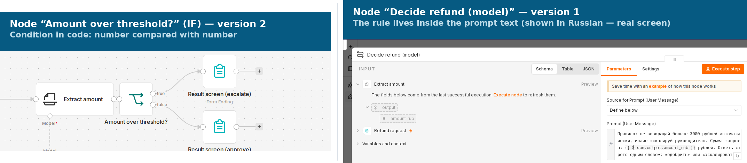
Setup: the IF node versus the rule as text
Left — node IF ("Amount over threshold?") on the canvas, version 2. Condition: the extracted amount (a number) strictly greater than 3,000. Branch "yes" → escalate to the manager. Branch "no" → approve. The comparison is an operation on a number, not text that has to be understood.
Right — the real, open settings panel of node Decide refund (model), version 1. Field Prompt (User Message): the same rule ("no more than 3,000 — otherwise escalate"), but as text the model has to read and interpret, rather than as a condition in code. This is a real screen, not a retelling of one — and because it genuinely is a screenshot of the live rig serving a Russian-speaking training center, the prompt is captured exactly as it stands, in Russian: «Правило: не возвращай больше 3000 рублей автоматически, иначе эскалируй руководителю. Сумма запроса: {{ $json.output.amount_rub }} рублей. Ответь строго одним словом: «одобрить» или «эскалировать».» In English, this reads: "Rule: do not refund more than 3,000 rubles automatically, otherwise escalate to the manager. Request amount: {{ amount }} rubles. Answer with strictly one word: 'approve' or 'escalate.'"
39
Notes:
Here is the real setup of the node that replaced the model's decision in version two — next to the real, open panel of the version-one prompt it replaced. Both screens are genuine, both were captured from the live rig, and it was worth placing them side by side for the contrast.
On the left — the IF node, named "Amount over threshold?" by meaning. There is one condition inside it: the extracted amount, already a number and not text, is compared to three thousand with a strict "greater than." If the condition is true, the request goes down the "escalate" branch. If not, down the "approve" branch. This is a number-comparison operation, and it has no room for interpretation: either one number is bigger than the other, or it isn't.
On the right — the very panel of node Decide refund (model), version one, exactly as it was actually configured. In the open Prompt (User Message) field is the rule's text — quoted on the visual exactly as it appears on screen, genuinely in Russian, because this live rig serves a Russian-speaking training center. On screen this field is cut off in height by n8n's own interface — you don't see the whole line — the visual carries it in full, uncut. Notice that, formally, this text contains the same comparison — "no more than 3,000" — but it exists only as part of the meaning of a sentence that the model has to understand and apply. The model doesn't have a separate step "compare two numbers"; it has one step, "read the rule and the amount together and formulate an answer." And it's exactly inside this one step that, nine times out of a hundred and one, the rule and its interpretation diverged — precisely at the boundary, where the text can be read two ways.
This is exactly the difference between a decision made by code and a decision made by reading comprehension, laid side by side, without a single word about which version is better — it shows in the very shape of the setup. On the left, a number is compared with a number. On the right, a number is hidden inside a phrase that has to be understood as a whole in order to pull the same fact out of it.
The amount that the IF node compares is still extracted by the model from the free-text request at the previous step — version two didn't change that step. What changes is only what happens after extraction: a text-based decision became a condition in code.
Next — two more real settings panels: what the parameters of the amount-extraction node and the condition itself look like from the inside, not just from outside on the canvas.

Slide 40
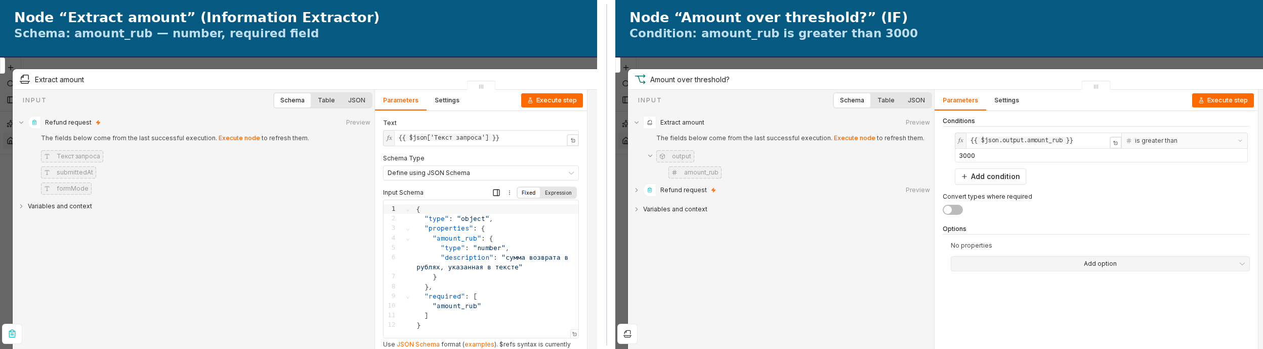
Settings panels: "Extract amount" and "Amount over threshold?"
Node "Extract amount" (Information Extractor). Parameters tab, Schema Type — "Define using JSON Schema." Schema: {"type": "object", "properties": {"amount_rub": {"type": "number", "description": "the refund amount in rubles, as stated in the text"}}, "required": ["amount_rub"]}. One field, strictly of type number, required.
Node "Amount over threshold?" (IF). Parameters tab, the one condition: {{ $json.output.amount_rub }} is greater than 3000. "Convert types where required" is switched off — the comparison expects an already-ready number and converts nothing implicitly.
40
Notes:
On the previous screen the IF node was visible from the outside — a card on the canvas with a name and two branches. Here is the same thing from the inside, exactly what an engineer sees when they double-click the node and open its settings.
On the left — the node that extracts the amount from the request text. It's called "Information Extractor," and its task is set not by a free-form prompt but by a strict JSON schema: one parameter, amount_rub, strictly of type number, and required. The model inside this node is not allowed to return text, a range, or the word "about" — the result either passes this schema, or the node is considered to have failed. This is the same extraction step that version 2 does not remove: the model still pulls out the amount, but the result of this step is now disciplined by format, not just by instruction. A free-form prompt can be read several different ways; a required, strictly typed field cannot — it either comes back as a valid number, or the step fails loudly instead of quietly guessing.
On the right — the node that replaced version 1's text-based decision. It has one condition, and it reads literally: the already-extracted number is compared to three thousand with the "greater than" operator. Not a paragraph of text about a threshold, but one comparison line in the interface, where the operator has no room for interpretation. The type-conversion switch is turned off deliberately: the condition needs a ready-made number, not a string that still has to be turned into one on the fly, risking a silent conversion error.
The difference between these two panels and the version-1 text prompt we saw earlier isn't a matter of word count — it's about where the meaning of the decision actually lives. In the prompt, the rule is dissolved in natural language, and the model has to re-read and interpret it every single time. Here, the rule is a strictly typed field in a settings form, which is either filled in correctly or flagged as an error before the run even happens. The rest of the chain, which we walked through on the diagram, hasn't changed — only what's visible on these two panels has.

Slide 41
What the client sees on automatic approval
Training-center support chat.
Your refund request has been approved. 2,500 rubles have already been sent to the card you used to pay for the class.
The same amount from this case's scene: "please refund 2,500 rubles for a missed class" — an example below the threshold, so version 2 approves it on its own, without the manager, and the client sees the result, not the mechanics of the decision.
41
Notes:
Before returning to comparing the versions, it's worth stepping into the client's shoes for a second and looking at what they see when their request is approved automatically.
Recall the request from the scene: "please refund 2,500 rubles for a missed class." The amount is below the three-thousand-ruble threshold, so both version one and version two would approve it on their own, without the manager. The difference between the versions is in how that decision gets made inside the chain — the client doesn't see it at all.
The client doesn't open any separate result screen, doesn't log into a personal account, and doesn't wait for an email with an attachment. Into the chat where they've already been messaging the training center comes one short message: the request is approved, and the specific amount has already been sent to the card they used to pay for the class. One bubble, no attachments, no buttons — exactly like the first case of this session, where the same kind of short notification arrived in an already-existing chat.
What matters is what this message doesn't contain. No name of the node that made the decision, no word "threshold" or number "three thousand," no internal request or execution id — none of what we just walked through on the diagram and in the node settings. This is the same boundary the course has pointed to from the start: operational details live in our breakdowns and in production documentation, while the screen a real person sees carries only what they need to know to understand: the money is already theirs.
And this isn't a feature specific to version two. If version one, with its text prompt, had also decided to approve this request, the client would have seen exactly the same message — because everything that changes between the versions happens before this screen, inside the chain, not in the interface the client sees. The difference between the versions is a difference in how reliable the decision itself is, not in what the person ultimately receives.
A question worth holding onto: if the request amount happened to land exactly on the three-thousand-ruble threshold — and we just saw exactly where version one kept getting this wrong — would the client get this same message, or a different one, about the request being passed to the manager? The answer is in the comparison we're returning to now.

Slide 42
Breakdown of both versions after testing
VERSION 1 (RULE IN THE PROMPT)
VERSION 2 (IF NODE)
Errors on 101 requests
9 — all on the amount of 3,000 RUB
0
At the boundary (3,000 RUB)
"escalate," even though the rule implies "okay to approve"
"approve" — the condition > 3000 leaves no room for a second reading
Outside the boundary
correct in every case, including amounts 20 RUB from the boundary and texts with two numbers
correct in every case
42
Notes:
Here is the final comparison, and it matters what it's built on: this isn't a new test assembled specifically to make version two look good. It's the very same extended set of a hundred and one requests — the original fifty-one, on which we first found the problem, and the new fifty, harder than the first, added precisely to test the finding against tougher phrasings. Version two was run on exactly the same set.
The first row — the number of errors. Version one — nine out of a hundred and one. Version two — zero. Not "fewer," but zero, on a set that includes a dense cluster of amounts right at the boundary, amounts twenty rubles away from it on both sides, texts with two numbers, and phrasings where the amount comes from arithmetic rather than being stated directly — that is, on a set that gives any error the maximum chance to show up, if there is one.
The second row — the very behavior at the boundary that started all of this. At an amount of exactly three thousand rubles — whether it arrived as a direct number or as arithmetic inside the text — version one answered "escalate," even though the rule, read carefully, implies that this exact amount can still be approved. Version two answers "approve" on the same amount, and the reason isn't that the IF node "understood the rule better." The reason is that the condition "strictly greater than 3,000" mathematically allows no second reading: either one number is bigger than the other, or it isn't.
The third row — outside the boundary both versions are flawless, and the extended set confirmed this separately: neither amounts twenty rubles from the threshold, nor texts with a distracting second number, threw version one off. It was bad at exactly one point — and that is exactly why the diagnosis "a systematic error at the boundary," rather than "an unreliable model," was the correct diagnosis, and the fix was a targeted replacement of one node rather than a rewrite of the whole chain.
This is the form in which this course compares decisions within a case: not two worlds built in parallel to illustrate a thesis, but a version built as a direct answer to a finding, and measured on the very same — now extended — test that produced and confirmed that finding.

Slide 43
Where the decision must be code
The precise wording of the finding. Not "the model sometimes errs probabilistically" — more precisely: the model systematically misses exactly at the boundary of the condition, where the rule's text and its formal interpretation diverge, while being flawless everywhere else in the range.
The class of task. A decision formalizable as a condition over a number is not a decision point for the model. Boundary values are the first thing to check with a real run, before trusting any similar threshold rule.
43
Notes:
Now the generalization — what should stay with you after the numbers of this particular case are forgotten.
The first thing worth dwelling on: the wording of the finding matters exactly, not approximately. It is wrong to say "the model sometimes errs probabilistically" — that's too vague and says nothing about where to look for the problem next time. The precise wording is different: the model systematically misses exactly at the boundary of the condition — where the rule's text and its formal interpretation diverge — while behaving flawlessly across the rest of the range. The difference between "sometimes errs" and "systematically misses at the boundary" is the difference between "you need more checks everywhere" and "you need to check exactly one point."
From this follows the class of task worth taking away. If a decision can be expressed as a condition over an already-structured value — a number greater or smaller than another number, a date earlier or later than another date, a status on a list or not — that decision is not a job for the model at the decision point. The model can stay necessary earlier in the chain, where free text still has to be parsed and a value pulled out of it. But the moment of comparison itself is code, and only code.
And the practical conclusion that works well beyond refunds: boundary values are the first thing to test with a real run, before trusting any similar rule built on a threshold. Not the middle of the range, where things are usually fine, but specifically the boundary — where the rule's wording and its interpretation diverge most often.
This is the same lesson that already came up in the notifications case and in the repeat-request case, only here it's stated more precisely thanks to measurement: not "test the model on edge cases in general," but specifically — at the point where a human phrasing of a rule and a literal condition can fail to match. Every threshold anyone has ever written in words has a point like this.
And one more detail that the measurement added to this generalization. A clearer rewording of the rule — one of the four actions reviewed — in practice removed this exact error entirely: a hundred out of a hundred on the extended set. This doesn't contradict the conclusion "the decision must be code" — it refines it. The improved wording is a measured improvement of a SPECIFIC prompt on a SPECIFIC set, not a structural guarantee: nothing in the architecture rules out that another phrasing, another model, or a future update to it will diverge from the rule again, just somewhere else. The IF node eliminates the whole category of this error: a number-to-number comparison in code doesn't need to be re-verified every time the wording or the model changes.

Slide 44
Three nuances before applying the conclusion
1
A calculator tool for the model is not a guarantee, and in practice is measurably worse. The probabilistic part doesn't disappear, it just moves one step earlier: whether the model calls the calculator at all, and how it passes values into it. Measured for real: 56 out of 100 — worse than every other option, with new failure modes (mixed alphabets in the answer, the tool not supporting comparisons, errors scattered across the whole range).
2
The threshold X is the single source of truth. If it lives in two copies — the prompt text and the IF condition — a mismatch between the two copies is the same class of problem as a broken contract between steps.
3
The extracting model can still make a mistake. The conclusion isn't "the model is never needed" — it's "the model must not be the decision point"; an explicit numeric field on the form removes this part of the risk too — but only if the request form itself can be changed; otherwise extraction remains the model's job.
44
Notes:
Three nuances before carrying the case's conclusion away as an absolute rule.
The first is about the calculator, which we discussed among the question's four cards. Giving the model a tool for comparing numbers isn't the same as putting an IF node after extraction. Last time we only asserted this: the probabilistic part doesn't disappear, it moves one step earlier, to where the model decides whether to call the calculator at all and how to pass values into it. This time the claim was checked with a real run — we assembled an agent with a genuine calculator tool and ran it on the same hundred requests. The result turned out to be not just "no guarantee," but measurably worse than every other option: fifty-six correct answers out of a hundred. And failure modes turned up that nobody had specifically planned for: n8n's built-in calculator can't compare numbers, only do arithmetic, and in one case out of nine it honestly answered "I don't know how to do this"; a third of the agent's answers didn't even reduce to a clean word, "approve" or "escalate"; and almost a tenth of the errors were scattered across the whole range of amounts, rather than sitting neatly at the boundary the way version one's did. A tool given to the model is not a guarantee, it's a relocation of the problem — and now that's not just an argument, it's a number.
The second is about the threshold itself. Three thousand rubles currently live in two places: the version-1 prompt text and the version-2 IF condition. If the threshold ever changes — say, to three thousand five hundred — and someone fixes it in one place while forgetting the other, you get exactly the same problem as the contract between steps we already went through in earlier cases of this arc: two places that are supposed to match, with nothing guaranteeing that they do. The threshold must have exactly one source of truth.
The third, and it answers directly to the question card about an explicit numeric field on the form. A model that extracts an amount from free text can still make a mistake: read the wrong digit, confuse the amount in one sentence with the amount in another. This case's conclusion isn't "the model is needed nowhere in this process" — more precisely: "the model must not be the point where the decision is made." If the request form can be changed, an explicit numeric field removes the risk of incorrect extraction too — the amount arrives already structured, and there's no need to reconstruct it from text at all. But if the source is an email or a chat, rather than a form we control, extraction remains the model's job, and its own accuracy is a separate question that this solution doesn't close.

Slide 45
Criterion: when the decision must be code
The criterion. A decision must be code when it formalizes as a condition over an already-structured value. Better still — eliminate the need for extraction entirely, if the data source can be made structured from the start.
The axis row, closed. A decision left to the model bypassed its own rule in a measured share of runs — nine out of a hundred and one, and exactly at the boundary of the condition. A decision handed to an algorithmic gate — never.
45
Notes:
This is the criterion you can carry out of this particular case and into your own work, without having to remember a single number or a single node's name.
A decision must be written as code whenever it can be stated as a condition over a value that is already structured: a number greater than or smaller than some threshold, a date earlier or later than a given mark, a status that either is or is not on a list known in advance. If the condition can be written down on paper without a single word of ambiguity in it, then it has no business sitting in a piece of text that a model is left to understand and interpret on its own. Its proper place is in code, where a comparison simply has no room left for two different readings.
And there is an even stronger version of that same criterion, one step earlier in the chain: better still, if you can manage it, is to eliminate the very need to extract the value in the first place. If the data source itself can be made structured right from the start — the way this can be done, say, with a request form — the comparison becomes simple not because we somehow taught the code to compare numbers; it already knew perfectly well how to do that. It becomes simple because the very moment at which something has to be pulled out of free text stops existing at all.
Now, let's close out this session's axis as it applies specifically to the third case. The axis keeps asking the same question: where in the chain does the model make the decision, and where must that decision belong to code instead — and what goes quietly unnoticed whenever that boundary is never named out loud, explicitly. Here the answer turns out to be specific and carefully measured, not vague or general: a decision left in the model's hands ended up bypassing its own stated rule in a measured share of the runs — nine out of a hundred and one, on the extended set, and exactly at one single point, right at the boundary of the condition, not scattered randomly across the whole range. A decision handed instead to an algorithmic gate, on that very same test, scored zero out of a hundred and one — that is to say, never. The difference between "measurably rare" and "never" is the entire distance that separates a decision you choose to trust to the model from a decision you choose to trust to code, at least as it applies to threshold-based conditions of this kind.

Slide 46
1
Zillow Offers: algorithmic home buying
"We've determined that the unpredictability in forecasting home prices far exceeds what we expected… the error rate we observed turned out to be far more volatile than we ever thought possible."
— Rich Barton, CEO of Zillow, November 2, 2021, announcing the shutdown of the Zillow Offers business
Zillow is the largest real-estate listings aggregator in the US. Since 2018 the company ran a line of business called Zillow Offers, also known as iBuying: the algorithmic Zestimate model priced a home from public data, the company bought it almost instantly at that price, did minimal repairs, and resold it quickly — earning on the spread between the purchase and the sale.
Inventory write-down — $304.4 million for Q3 2021, $407.9 million for the full year. Workforce cut — ~25%, about 2,000 people. In that same quarter Zillow bought 9,680 homes and managed to sell only 3,032 — the average loss per home sold came to ~$80,000.
Cases
46
Notes:
This quote belongs not to an analyst but to the company's own CEO, announcing the shutdown of an entire line of business himself.
Zillow is the largest real-estate listings aggregator in the US, and since 2018 the company had a separate line of business, Zillow Offers, also called iBuying. It worked simply: the algorithmic Zestimate model priced a home from public data, the company bought the home almost instantly at that price, did minimal repairs, and resold it quickly, earning on the spread between the purchase and the sale. The scheme worked for as long as the housing market behaved the way the model, trained on historical data, assumed it would.
In the fall of 2021, Zillow announced it was shutting the business down entirely. The numbers on screen are not journalists' estimates but direct figures from its SEC filings: the write-down on home inventory came to $304.4 million for a single quarter and $407.9 million for the full year, the workforce was cut by roughly a quarter, about two thousand people. In the third quarter of 2021 alone, the company bought 9,680 homes and managed to sell only 3,032 — the average loss per home sold came to about $80,000.
We take up this case right after "Refund Approval" on purpose. There, the rule about the refund-amount threshold lived in the prompt's text, not in the code's condition, and the model bypassed it in a measured share of runs — right at the edge of that condition. At Zillow the shape of the gap was the same: the risk threshold above which it would have been worth halting the automatic purchase or handing the decision to a person existed not as a mandatory condition in the loop, but as an expectation that the model would manage, because it had managed before. The only difference is scale: there, it's one conversation with a customer; here, it's buying a house with real money, and thousands of such decisions were made in a row.
On the next screen is a diagram of how that loop was actually built: without a mandatory gate and without a short checking interval. And the question we'll ask after it isn't whether the market's volatility could have been predicted in advance. It's about what was missing from the decision loop itself.

Slide 47
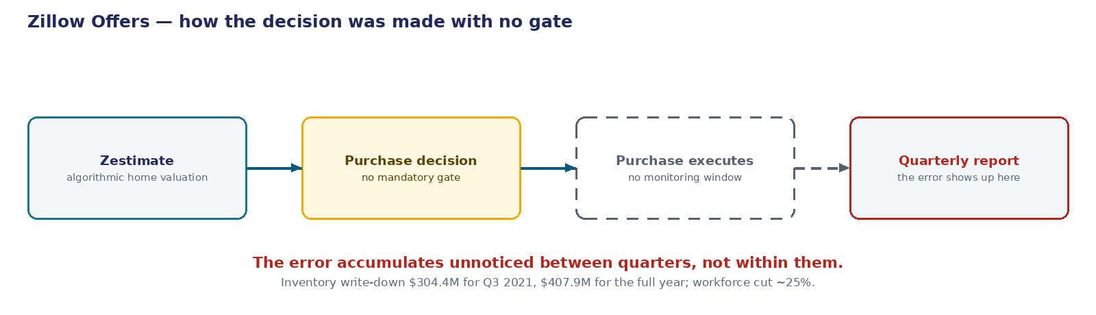
How the buying decision actually worked
Zestimate (algorithmic valuation) → purchase decision with no mandatory gate above the risk threshold → the purchase executes → no short accuracy-monitoring period (hours to days) → the error accumulates unnoticed → visible only in the quarterly SEC filing.
47
Notes:
The diagram on screen is the same device we already used to compare how the decision was built in the "Notifications" case: there, one row showed the chain with an LLM node, the other without it. Here, one row shows how Zillow's actual loop for deciding to buy a home was built.
The first step is the algorithmic Zestimate valuation: the model names a home's price from public data. The second step is the purchase decision, and here is the first gap: the decision was made with no mandatory gate above a given risk threshold. Any valuation, no matter how far it strayed from a reasonable range, moved on through the loop with no mandatory stop.
The third step is the purchase executing: the money goes out, the home becomes a company asset. And here is the second gap, a costlier one: after the purchase there was no short accuracy-monitoring period — hours or days in which one could notice that the actual resale price was systematically diverging from the forecast. No such period existed at all.
Because of this, the error wasn't caught right away — it accumulated unnoticed, purchase after purchase, quarter after quarter. The only point where it became visible was the quarterly SEC filing — that is, a historical archive that confirms what happened, not a control period that could have stopped it.
The difference between an archive and a control period isn't a stylistic nuance. An archive tells the truth only after the cost of the error has already been realized. A control period could have halted buying in a segment while the loss was still small. Zillow had only the archive.
On the next two screens are the question and the breakdown, and after that — a diagram of the same loop, but with the gate that was missing here.
Notice that not one of the five steps on this diagram looks like a mistake on its own. Pricing from public data is standard practice. Buying at the computed price is standard practice. Minimal repairs and a quick resale are standard practice too. The mistake isn't in any single step — it's that between the steps there's no point where the process could stop and ask, "is this valuation actually reliable right now?" That exact missing stopping point is what we'll go looking for in the next breakdown.

Slide 48
What was missing from Zillow's decision loop
What was missing from the decision loop?
calibrate the model more precisely
set up runtime drift monitoring with an automatic stop threshold
tie the purchase decision above a given risk amount to a specific human underwriter
know in advance that the housing market would behave unpredictably
48
Notes:
We just saw the diagram: valuation, purchase with no mandatory gate, the error visible only from the quarterly report. The question is what should have been in that loop and wasn't.
Zillow Offers bought homes by algorithmic valuation and resold them. The model priced the home, the purchase decision was made almost automatically, and this happened thousands of times in a row, for as long as the market behaved as usual. When the housing market in 2021 turned out more volatile than history had assumed, the model's error rate jumped sharply, and the decision loop failed to catch it in time.
The question: what was missing from the decision loop?
Four cards. The first comes back to the accuracy of the algorithm itself — calibrate the model more precisely. The second is about watching the model in real time rather than once a quarter: set up runtime drift monitoring with an automatic stop threshold. The third is about who ultimately answers for a decision with a large stake: tie a purchase above a given risk amount to a specific human underwriter. The fourth is about the market itself, not the decision loop: know in advance that the housing market would behave unpredictably.
Notice that all four cards sound like reasonable engineering steps, and that's deliberate: the point isn't to tell a silly option apart from three serious ones, but to work out which one actually changes the decision loop and which one only rephrases what was already there. Resist guessing from the wording which option is the "odd one out."
Fifteen seconds to choose, then we vote by raising hands.
One more thing to consider before voting. All four options sit on the same diagram we just saw: valuation, purchase, execution, no checking interval, quarterly report. Don't think abstractly about "what sounds reasonable" — think concretely about which of the four options would add a new node or a new stopping point to that diagram, and which would just rephrase what's already drawn on it. A card that only restates a step already on the diagram, in slightly different words, is not the one that closes the gap.

Slide 49
What each option actually does
OPTION
WHAT IT DOES
WHAT IT DOESN'T DO
calibrate the model more precisely
improves accuracy on stable historical data
isn't related to the finding: the model was already calibrated correctly — what failed wasn't the calibration, but a market regime absent from the training history
runtime drift monitoring with an automatic stop threshold
catches a sharp jump in the error rate within hours or days, while the loss is still small
was never put in place on the real buying loop: the only control that remained was the quarterly SEC filing — an archive, not an observation period
tie the decision above the risk threshold to a human underwriter
returns the decision with a large stake to a person right at the point the decision is made
was never built in structurally: the algorithm decided on buying the home by itself, regardless of the risk amount
know in advance that the market would behave unpredictably
—
isn't an engineering solution but a wish: market volatility is an external fact that can't be controlled from the model's side
What's decisive. The model didn't fail — the loop around it did: there was neither a short monitoring period nor a structural tie between large decisions and a person. A decision controlling hundreds of millions of dollars remained probabilistic where it should long since have become gated.
49
Notes:
Let's go through them one at a time, in the order they're listed.
Calibrate the model more precisely — the first thing that comes to mind, and the first thing that turns out not to have been the cause. The Zestimate model was calibrated correctly on historically stable data: before the pandemic, its error over a holding period of a few months fell comfortably within the range the company considered workable for everyday operation. The culprit was not the calibration itself — it was the market's own volatility, a regime of price behavior that simply was not present anywhere in the data the model had been trained on.
Runtime drift monitoring with an automatic stop threshold — that is what was actually missing. A production model controlling hundreds of millions of dollars in real-estate purchases had no short period for watching its own error rate as it happened — hours or days that would catch a sharp jump while the loss was still small and the segment could still be paused. The only control left standing was the quarterly SEC filing — that is, a historical archive, not a period in which anyone could actually stop.
Tie the decision above the risk threshold to a human underwriter — the second half of the same gap. The decision to buy a home above a given risk amount was never structurally tied to any specific person: the algorithm decided on its own, regardless of how large the stake was. This is exactly the same shape of gap we already worked through in "Refund Approval" — there too, a refund-amount threshold existed on paper, but it never became an algorithmic gate.
Knowing in advance that the market would behave unpredictably isn't an engineering solution at all — it's a wish dressed up as a fix. Pandemic-driven volatility was a real external factor, but it was never a point where an engineer, sitting inside the company, could have changed anything.
What's decisive here is that the model itself didn't fail — the loop built around it did: there was neither a short control period nor any structural tie between large-stake decisions and a human being. A decision controlling hundreds of millions of dollars kept being made probabilistically, in a place where it should long since have become gated. On the next screen is a diagram of that same loop, but this time with the gate in it.

Slide 50
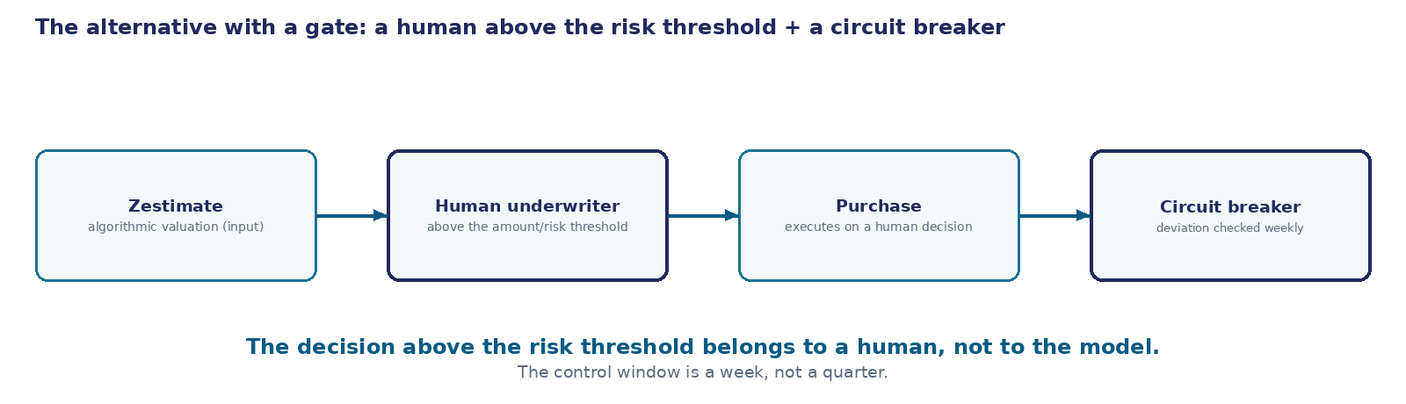
An architectural alternative: an underwriter and a circuit breaker
Zestimate (algorithmic valuation, an input, not the decision) → a human underwriter makes the final purchase decision above the amount/risk threshold → an explicit circuit breaker on the deviation of the actual price from the forecast, checked weekly or more often — not quarterly.
50
Notes:
There won't be a demo here — this isn't our own rig, it's someone else's, halted system. But the architectural solution is stated just as directly as in any of our own cases, and the diagram on screen is the same row we drew without the gate, just with two added nodes.
The architectural alternative has two parts, and both work together, not separately. First: the algorithmic valuation stays an input to the decision, not the decision itself — buying a home above a given risk-amount threshold requires a final decision from a human underwriter, right at the point the decision is made, not after the fact. Second: an explicit circuit breaker that trips when the deviation between the actual sale price and the forecast exceeds a threshold — checked weekly or more often, not quarterly. As soon as the actual deviation exceeds the threshold, automatic buying in that segment stops pending manual review, instead of continuing while waiting for the next report.
This is the same device we already saw in "Refund Approval": the decision is replaced by a deterministic condition wherever it can be expressed as a condition over a structured value — a risk amount, a price deviation. The difference is in the scale of the condition, and in the scale of the cost if the condition isn't put in place. At the training center, the gate was a single refund amount. At Zillow, the gate was every single home purchase, and the cost of the gap wasn't an awkward conversation with a customer, but a realized loss in the hundreds of millions of dollars.
It matters that neither of the two parts works on its own without the other. A human underwriter without a circuit breaker still only learns of a problem from reporting, unless someone has assigned them to check the forecast-versus-actual deviation on a regular basis. A circuit breaker without a person on large-stake decisions will stop the process, but won't explain what to do with purchases already under way. The two parts together give you exactly what the loop was missing: fast detection of the deviation, and a person who takes on the decision once the deviation is confirmed.

Slide 51
When to scale back automation
SCALE BACK AUTOMATED DECISIONS
CAN KEEP SCALING
the cost of a single error is tens or hundreds of thousands of dollars of real capital
the cost of a single error is one unpleasant conversation with a customer, not capital
external conditions show growing volatility relative to the regime the model was trained on
the market and the data are stable, the regime matches what the model saw in training
a decision above the amount or risk threshold isn't tied to any specific person
a decision above the threshold structurally goes through a person, and a working circuit breaker exists
the only quality control is reporting once a quarter
there's a short monitoring period (hours to days) with an automatic stop threshold
The limit. If the cost of a single model error is tens of thousands of dollars of real capital, and external conditions show growing volatility, scale back automated decisions until the model's robustness to the new regime is confirmed — don't keep scaling "until we see the quarterly numbers."
The same idea as in "Refund Approval", at a different scale. There, the gate was the decision on a single refund request, and the cost of the error was an awkward conversation with a customer. At Zillow, the gate became every home purchase, and the cost of the missed threshold was a realized loss of hundreds of millions of dollars and roughly a quarter of the entire workforce. The threshold existed in both cases; it never became an algorithmic gate in either, until someone checked.
51
Notes:
The criterion, in direct form, same as for every one of our cases.
You need to scale back automated decisions when the cost of a single model error is measured in tens or hundreds of thousands of dollars of real capital — not an abstract metric, but money the company literally pays. At Zillow, one error is a house bought at the wrong price, not a point on a chart.
Scale back when external conditions show growing volatility relative to the regime the model was trained on. The pandemic-era housing market of 2020–2021 didn't resemble the market whose history the model was calibrated on, and it was exactly that mismatch of regimes, not the model itself, that became the source of the error.
Scale back when a decision above a given amount or risk threshold isn't structurally tied to any specific person: without that tie, a large stake gets decided by the same probabilistic loop as a small one.
And scale back when the only quality control is reporting once a quarter. A quarter is an archive, not a period in which you can stop before the loss grows.
The flip side is symmetric: if the cost of an error is small, the regime is stable, large decisions go through a person, and working monitoring exists — you can keep scaling automation further.
And last, the reason we placed this filler right here. The idea is the same one we already worked through in "Refund Approval", just at a different scale. There, the gate was the decision on a single refund request, and the cost of the error was an awkward conversation with a customer. At Zillow, the gate became every home purchase, and the cost of the missed threshold was a realized loss of hundreds of millions of dollars and roughly a quarter of the company's entire workforce. The threshold existed in both cases. It never became an algorithmic gate in either — until someone checked, with a test run or with a filing before the SEC.

Slide 52
Card in Telegram
The run log is green, the sending node got a successful response. Nothing arrived at the coordinator's Telegram.
52
Notes:
The fourth case of today's session opens with a contradiction that doesn't settle in your head right away, and it's worth sitting with it for a moment before we start pulling it apart.
The n8n run log is green, from top to bottom. The binary data was assembled without a hitch. The sending node got a positive response from the Telegram API, the same kind of response that closed every run in the first three cases of this session. And the coordinator's Telegram got nothing at all in return — or got something, but cut off partway through, missing the part that actually mattered.
Both statements are true at the same time, and that is exactly the point of this case: nothing broke visibly or loudly. Everything we know how to check, after this session's first three cases, said "success" — and the recipient still has no usable result. The three previous cases taught us to catch a model's outright refusal, a repeated request that silently failed, and an error sitting right at a condition's boundary. None of those three tricks would have caught this one: the node didn't fail, so there's nothing here for a retry to catch; a condition has nothing to do with it either, because the whole path went through formally flawlessly, start to finish, without a single red line in the log.
We'll name the actual marketing need that produced the first version of this chain on the next screen, together with the whole timeline: what was asked for, what got assembled, and exactly where along that path it broke. Here, on this opening screen, one fact is enough on its own — the contradiction the whole breakdown starts from.
For scale: the three previous cases of this session each added something to the training center's scenario — a template instead of a model, a repeat check, a condition instead of a loose text rule — three independent decisions, and every one of them started from a complaint or a measured error that was visible right away, the moment someone looked. The fourth case starts differently. There are no visible signs of failure at all, not one, until someone actually sits down and checks the run log against what really happened at the recipient's end of the chain.
Let's break down what actually happened here, why none of the earlier tricks would have caught it, and what there is to do about it next.

Slide 53
Marketing's need and the first version
The training center already sends the coordinator a text notification about a new request (Case "Notifications"). Marketing asks: instead of plain text — a card, text over a picture, in the same channel.
1
We put a chain together: the notification text is prepared with the same substitution trick as in "Notifications"; the next step fetches the picture by its link; the last step sends the picture to Telegram with that text as the caption.
2
On test pictures the chain works without a hitch: the card gets assembled and sent, the coordinator sees it in Telegram.
3
Marketing sends the first real card for an actual mailing — a high-resolution scan straight from a phone, noticeably bigger than the test pictures.
4
The run finishes successfully: the n8n log is green, the sending node got a positive response from the Telegram API. The coordinator's Telegram has no card — either it never arrived at all, or it arrived cut off.
The cost you don't see in the log. This isn't a node failing and it isn't a call error — we already know how to catch those. This is a quiet loss of the result during a formally successful run, and until now we've had no reason to check binary data by anything other than the bare fact that it got assembled.
What has to be true before a card counts as ready. Two classes of requirement, different in kind:
REQUIREMENT CLASS
WHAT GETS CHECKED
Mechanical
file size, format, resolution — the file has measurable, enumerable properties
Semantic / content-based
the picture actually shows what's needed — not a broken placeholder file, not someone else's image, not an empty frame
53
Notes:
This case's scene doesn't open with a complaint, but with a request — and that's an ordinary story of extending an already-working process.
The training center already sends the coordinator a text notification about a new multi-topic request — the same substitution-into-a-ready-form trick we put together in the "Notifications" case. Marketing looks at that plain message and asks: instead of text, send a card — an image with text over it, in the same channel, in the same notification.
We put a chain together the same way anyone assembles an extension of an already-working process. The text is prepared by the same substitution node as before. The next step fetches the picture by its link and gets it as binary data, not as a text field. The last step sends that picture to Telegram, with the notification text going along as its caption.
On test pictures everything works without a single hitch: the card gets assembled, it's sent, the coordinator sees it in Telegram in exactly the same place where he used to see text. The chain was put into production on that basis — it passed the check we knew how to run.
And then marketing sent the first real card for an actual mailing — not a test image, but a high-resolution scan straight from a phone, noticeably larger than the files the chain was checked on. The run that processed it finished the same way every previous one had: the n8n log is green, the sending node got a positive response from the Telegram API, nobody saw any error at all.
And the coordinator's Telegram had no card — either the message never arrived, or it arrived cut off, missing part of the image.
Here's the real cost of this scene. This isn't a node failing: we've known how to catch failures since last session, with a retry and a branch. This is a quiet loss of the result exactly where everything formal says "success" — because until now we've had no reason to check binary data by anything beyond the bare fact that it got assembled at all.
Which means that before calling this a solution, we need to explicitly name what the card is obligated to meet — not after the fact, looking at a failure, but ahead of time, as a requirement. And there isn't one requirement here, there are two, and they're different in kind. The first is mechanical: a file has a size, a format, a resolution, and these are numbers and enumerable values you can compare against a condition. The second is semantic, or content-based: does the picture actually show what it's supposed to show, rather than a broken placeholder, someone else's image, or an empty frame. The difference isn't a formality — it directly decides which tool is even capable of checking a requirement like that, and that's exactly the question that comes up next.

Slide 54
How to check that the picture matches the requirements
How do you check that a picture matches the requirements?
check the file's size and format before sending — in code
check that the picture opens without errors — in code
check that the picture actually shows what's needed — with a vision model
don't check anything — trust the sending node to handle it
54
Notes:
We just saw the finding: the run is green, and the card never reached the coordinator all the same. All day today we've been asking this chain the exact same question, over and over — does this step belong to the model, or does it belong to code. Let's apply that same question to the picture now.
The question on the screen: how do you check that a picture matches the requirements?
Four cards are on offer, and this is deliberately not the question "what do we do once the file goes over the limit" — it's a question about what check to build ahead of time, before the file goes any further down the chain at all. The first option — check the file's size and format before sending, in code: the same action, in essence, as the IF node in "Refund approval," just applied to a file's properties instead of a money amount. The second — check that the picture opens without errors, also in code: make sure the file is technically sound and not broken somewhere inside. The third — check that the picture actually shows what it's supposed to show, with a vision model: a different kind of task by its very nature, and it needs a fundamentally different tool to answer it. The fourth — don't check anything at all, just trust the sending node to handle it on its own: exactly what quietly happened in our scene.
Notice that the first two cards and the third one are different kinds of action underneath, even though all three are worded alike, as "check." Size, format, whether the file opens cleanly — these are properties you can count and compare directly against a number. Whether the picture's actual content matches what's needed — that question is no longer a number at all, it's meaning, and meaning doesn't compare the same way.
Choose not by whichever option merely sounds more reliable on first read, but by which tool is genuinely capable of running a check like that in practice: can the question be expressed as a plain condition over a number, or does it need someone — a human being or a model — to actually look at the content itself and judge it.
Fifteen seconds to choose a card, and then let's compare what everyone picked.

Slide 55
Which check closes which requirement
CARD
WHICH REQUIREMENT IT CLOSES
CLOSED TODAY?
check the file's size and format before sending
mechanical
yes — in code, deterministically, before sending
check that the picture opens without errors
mechanical (same class)
yes — the same way
check that the picture actually shows what's needed
semantic / content-based
no — there's no step in the chain today that can do this
don't check anything
neither
no — this is exactly what happened in the case scene
A technically sound file (right size, right format) can still show the wrong thing — for example if the node fetching the picture got a hosting error page instead of the actual picture: the format and size would pass the mechanical check, and the content would be wrong.
Next — how the first two points get implemented technically: a tool-agnostic architecture, then the actual configuration in n8n.
55
Notes:
The question's four cards aren't four equal answers — they're a breakdown against the two requirements we just named in the scene: mechanical and semantic.
The first and second cards — check size and format, check that the file opens without errors — both close the mechanical requirement: a file has numeric, enumerable properties, and a program can compare them against a condition just as deterministically as the IF node in "Refund approval" compared an amount against a threshold. This is code, and only code: a model isn't needed here and adds nothing.
The third card — check that the picture actually shows what's needed — closes the semantic requirement, and here the honest answer is different: there's no such step in our chain today. The only tool that's even capable of judging what's in the picture is a vision model, and that level isn't covered at all today.
The fourth card — don't check anything — closes neither requirement, and that's exactly what happened in the case scene: the run is green, the sending node got a positive response, and the result didn't match what the recipient expected.
A separate example, for why these two requirements can't be substituted for each other. A technically sound file — right size, right format — can still show the wrong thing: for instance, if the node fetching the picture by its link got a hosting error page instead of the actual picture. The error page's format and size could easily pass the mechanical check, while the content is nothing like what was required. This is the same lesson we already saw in "Notifications" and in Zillow, carried over to a picture: a mechanical requirement on a file is a job for code; a requirement on content is a job that needs a model, not the absence of a job at all.
The table's first row and second row are one and the same class, closed today. The third row is a class that's named but not closed: next we'll look at what an architecture that at least accounts for it looks like, and then an honestly assembled chain where it isn't there yet.

Slide 56
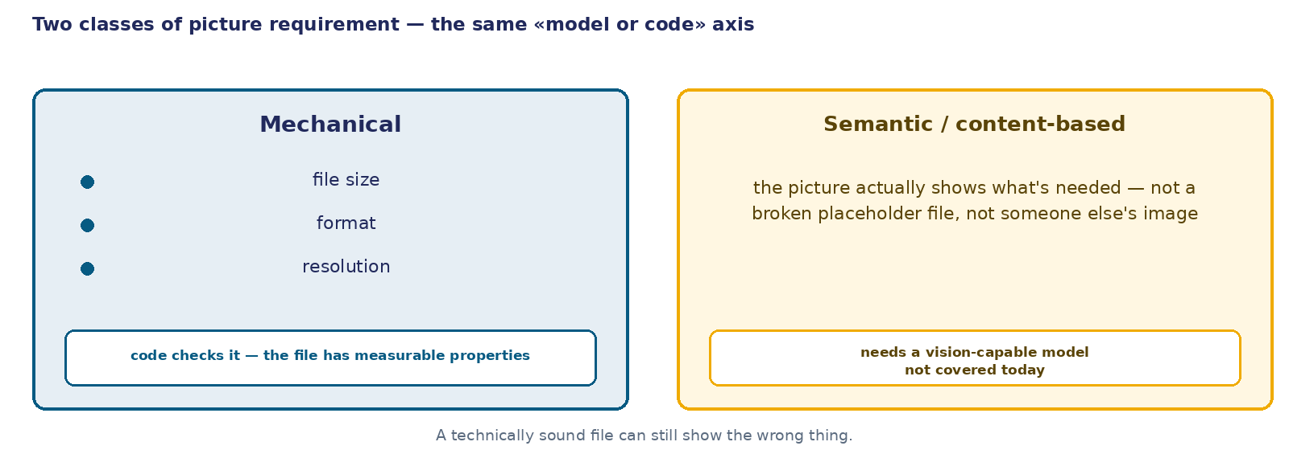
Architecture: two classes of file requirement
File → mechanical requirement (size, format, resolution) → checked by code, deterministically, before sending. File → semantic requirement (does it show what's needed) → checked by a vision model — there's no such step in the chain today.
56
Notes:
The first layer of the solution is architectural, with no tie to n8n or Telegram, and it directly continues the breakdown we just did.
The two requirement classes from the previous screen become two separate arrows on the diagram. On the left — the mechanical requirement: a file has a size, a format, a resolution, and all three properties can be checked programmatically, with the same trick we used in "Refund approval" to compare an amount against a threshold. This is a check before sending, not after: the file either passes the condition, or the chain stops it earlier than it would have reached Telegram.
On the right — the semantic requirement: does the picture actually show what's needed. There's no node on the diagram for this arrow in our chain today — we show that honestly as a gap, not as a fake block. The only tool that's even capable of judging an image's content is a vision model, and it isn't in the chain today.
It matters that these two arrows are drawn separately rather than as one combined "check the file." Code that checks size and format knows nothing about content — it can let a file of the right size and format through even if the wrong picture is inside it. And the other way around: a model capable of judging content is an excessive and expensive tool for the question "is the byte limit exceeded," which a single number comparison solves perfectly well.
This is an architectural rule, not a specific node's setting — we'll see the actual configuration on the next screen, in layer two.
It's worth holding on to the shape of this diagram, because it repeats a shape we've already seen twice today: in "Notifications" we split a step that composes text from a step that substitutes values; in "Refund approval" — a text rule from a condition over a number. Here the same split is applied not to text and not to an amount, but to a file: one side of it (size, format) formalizes and gets checked by code, the other (content) resists formalization and needs a tool that can actually look at an image, not just measure it.

Slide 57
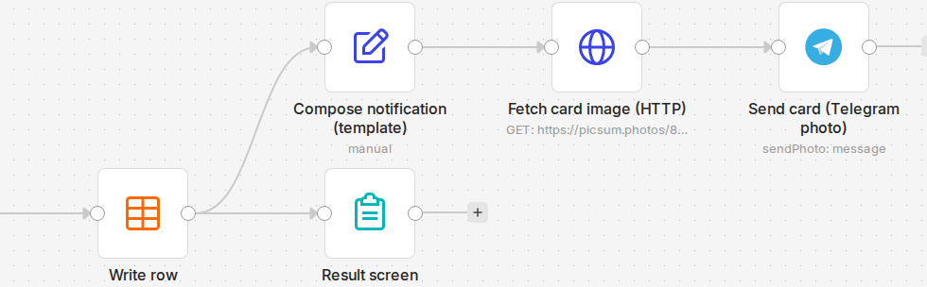
The branch point on the real canvas
Workflow "C8 · Case 4 — photo in Telegram," live rig. Write row → Result screen — the same main request-intake path as in Case 1. From the branch point after Write row, an arrow runs upward, into Compose notification (template) → Fetch card image (HTTP) → Send card (Telegram photo) — the three nodes this case breaks down next.
57
Notes:
Before we open the settings panels, one wider frame — to see where these three nodes even come from on the canvas.
This is the real canvas of the live rig, the same workflow as the next screen, just with a bit more context in frame. On the left — Write row: the node that writes the request to the table, and Result screen — the screen the ordinary form ends on. This is the exact same request-intake path we already saw on Case 1's canvas: the form, the field extraction, the topic-dictionary check, the row write. We don't repeat it here — it's simply visible off to the left, because that part of the process hasn't changed.
What has changed is visible on the arrow itself. From that same point, right after Write row, a second arrow runs off — upward, to the Compose notification (template) node. Before, in Case 1, all the recipient ever saw from that point was a text message. Now a new branch is attached to that same spot in the process: Compose notification (template) → Fetch card image (HTTP) → Send card (Telegram photo) — the three nodes we'll break down one at a time on the next screens. This is the honest answer to "where does Case 4 show up in the real process" — not alongside, not instead of, but as a branch off a point that already existed.
Deliberately left out of frame: further to the right, on the same wiring, there's another branch, for when the model fails to parse the request — also real, also part of this workflow, but it belongs to the intake step, not to assembling and sending the card, and it isn't our focus today. We aren't pretending the canvas ends exactly where this frame ends — it keeps going, just not in this direction of the breakdown, and that choice to cut the frame there is a deliberate one, not an accident of cropping.
Now that it's visible where these three nodes grow from — a closer zoom: the same chain, but with the real size-boundary check that is what brought us into this case in the first place.

Slide 58
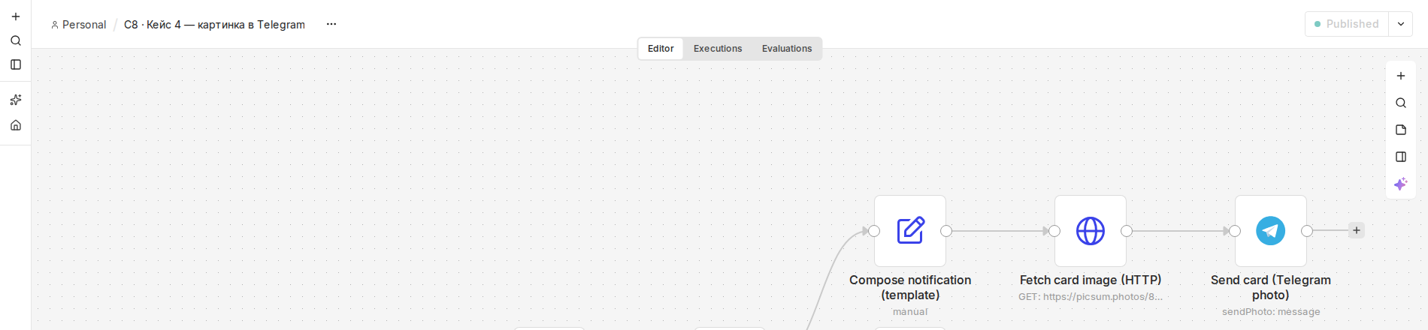
The chain in n8n and the size boundary, checked with a real call
WHAT
BYTES
Checked file
12,812,355 (~12.8 MB)
Telegram's photo limit
10,485,760 (10 MB)
Telegram Bot API's response: "Bad Request: file of size 12812355 bytes is too big for a photo; the maximum size is 10485760 bytes"
58
Notes:
The second layer is the same architecture, assembled in n8n as three specific nodes, plus a real check of the exact boundary layer one talked about.
The first node is the same substitution trick we configured in the "Notifications" case: a single expression that assembles the notification text out of fields the request already carries. The second node fetches the picture by its link; the important setting detail is that the response format is set to file, not text or JSON — from that point on, this node's content is binary data. The third node sends it to Telegram in photo-sending mode, with the picture's binary data as input and a caption — the text from the first node. Notice what's missing from this chain: a model never shows up at any of the three steps, and there's no separate size-or-format check node either — layer one's rule still lives at the architecture level, not inside a specific node, and that's shown honestly, not papered over.
That's why we checked the boundary with a real call instead of an assumption. n8n's own default limit for binary data is 16 MB. Telegram's limit on photos is separate and narrower: 10,485,760 bytes, that is, 10 MB. We deliberately assembled an uncompressed file right between these two thresholds — 12,812,355 bytes, about 12.8 MB: under n8n's limit, but over Telegram's photo limit. We sent it directly through the Telegram Bot API — the same call the sending node inside the chain uses.
The response that came back is real, not invented for the example: a file of a given size is too big for a photo, with the maximum size stated. Telegram directly names the size and directly names the limit — not silence, but an explicit, readable error. And this sharpens what we saw in the case scene: there, the card disappeared quietly — because a problem at n8n's boundary more often looks exactly like that, while Telegram, at its own boundary, answers differently, in plain text. A size check inside the chain can't rely on either side necessarily reporting an error honestly.

Slide 59
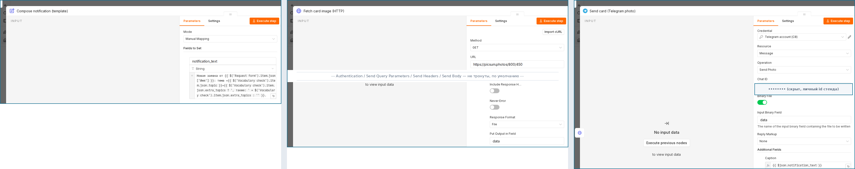
Node settings: the parameters screen
The Compose notification (template) node. Mode: Manual Mapping. The notification_text field: the same expression that was already on this node's panel back in Case 1 — not rewritten, not simplified for the demo.
The Fetch card image (HTTP) node. Method: GET. URL: https://picsum.photos/800/450 — the real source of the test picture, not invented for the example. Below, past a skipped block of unchanged toggles: Response Format = File (from this point on the node's content is binary data, not text or JSON), Put Output in Field = data.
The Send card (Telegram photo) node. Credential: Telegram account (C8). Resource: Message, Operation: Send Photo. Chat ID — the real recipient (masked on the figure, not relevant to the lesson). Binary File is on, Input Binary Field = data — the same field name the previous node set. Caption: {{ $json.notification_text }} — the photo's caption comes from the chain's first node.
59
Notes:
Here's what these three nodes actually look like once you open each one's settings panel on the live rig — not a retelling in words, but what's really on screen.
The left panel is the Compose notification (template) node, the chain's first step. On the previous screen it was said that it assembles the text with the same substitution trick we configured in the "Notifications" case — and here you don't have to take that on faith: here's the panel itself, and the notification_text field holds exactly the same expression that was already on screen back in Case 1. There's no point breaking it down again — that's already been done there — but it was worth showing right here that this is literally the same node, not one rewritten from scratch for a new task.
The middle panel is the Fetch card image (HTTP) node. The request method is GET, and the URL is visible in full: picsum.photos/800/450, a real public test-picture service, not a source invented for the example. Further down the real panel there are four toggles — authentication, query parameters, headers, request body — and all four are off, untouched by anyone; on the figure that part of the panel is replaced with a direct caption naming exactly what's skipped, not silently cleaned away. But the next setting after them matters: the response format is set to File, not text, not JSON. It's exactly this field that turns the node's content into binary data — that's the whole difference between "download a picture" and "download text that happens to contain a link to one." Below it is the name of the field the node will put that binary data into: data.
The right panel is the Send card (Telegram photo) node. At the top — the Telegram account's credentials and the chosen operation: sending a photo, not a text message. Further down — Chat ID, a real numeric recipient; on this screen it's masked, because it's the live rig's test Telegram account's personal id and has nothing to do with the lesson, but the field itself and its role are shown honestly. Below — the Binary File toggle is on, and the input field's name is data, the exact name the previous node put the picture into: these nodes are connected not only by an arrow on the canvas, but by a matching field name. And at the very bottom — Caption, the photo's caption: {{ $json.notification_text }}, the same expression the chain's first node assembled, already broken down back in Case 1.
Notice the INPUT panel on all three screenshots — it says "No input data": the chain's earlier nodes weren't run before this screenshot was taken, this is an open configuration, not the result of a run. That's shown honestly, not dressed up as something bigger, and the only thing actually being measured here is the real parameters panel on each of the three halves, not an empty left-hand side.
Now we have not just a path on the canvas, but what's really configured inside each step of that path — including the first one, already familiar from last case.

Slide 60
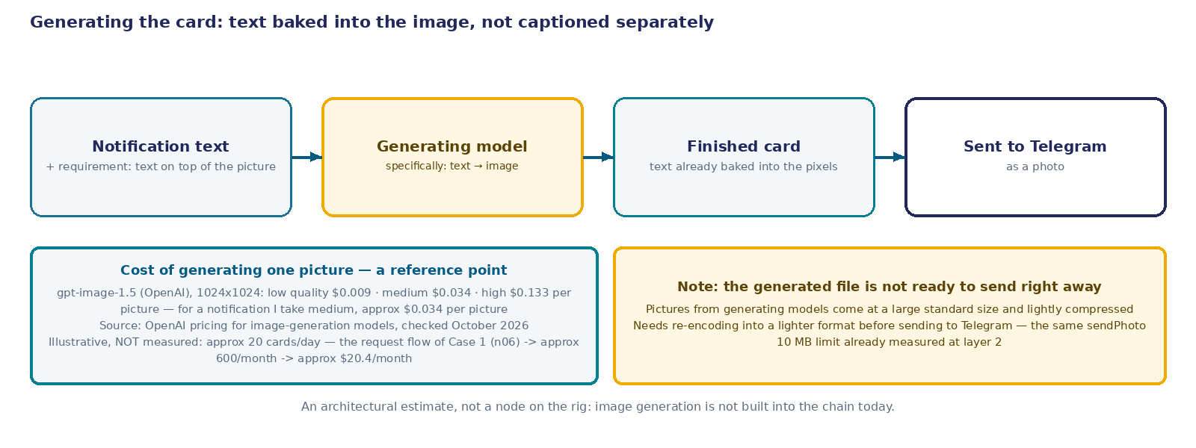
Generating the card: text inside the image
Notification text and the "text on top of the picture" requirement → specialized generating model (text → image) → a finished card, text already baked into the pixels → sent to Telegram as a photo.
Cost of generating one picture — gpt-image-1.5 (OpenAI), 1024×1024: low quality $0.009 · medium $0.034 · high $0.133 per picture. Medium quality fits a notification — ≈$0.034 per card. Illustrative, not a measured volume: the case scene doesn't state the mailing frequency explicitly — if it's ≈20 cards a day, the same request flow as Case 1 (n06), that comes to ≈600 cards a month and ≈$20.4 a month. Note. Pictures out of generating models come at a large standard size, lightly compressed — before sending to Telegram they need re-encoding into a lighter format, the same sendPhoto 10 MB limit we already measured.
60
Notes:
Let's pause for a second on what we actually assembled on the previous screen, and compare it with what marketing asked for at the start of the case.
Marketing asked for a card: text on top of a picture, in one image. The chain we configured does something else — it fetches a ready-made picture by its link and puts the notification text next to it, as a caption, a separate text field of the Telegram message. This works, Telegram really will show the text next to the photo, but the text isn't inside the image — that's not the same thing as "a card with text on top of the picture," and it's worth saying so honestly rather than papering over the difference in silence.
To get a real card — an image with the text physically baked into the pixels — you need a separate step, and the ordinary "fetch a file by link" node won't do it: it knows how to download a ready-made picture, not how to draw on one. You need a specialized generating model: on the input, the notification text and the task "turn this text into a readable image"; on the output, a finished file with the text already inside it.
This step has a cost, and it isn't zero. As a reference point, take the public price of a comparable model — OpenAI's gpt-image-1.5: generating one picture at 1024 by 1024 points runs from under a cent at low quality to thirteen cents at high quality, depending on how much precision and detail you choose. For a short text notification on a card, the highest precision is unlikely to be needed — a reasonable reference point here is about three and a half cents a picture, medium quality. This isn't a measurement on our own rig — there's no such step on the rig — but an honest estimate against someone else's, but current and checkable, pricing.
Three and a half cents for one card doesn't say anything on its own until it's tied to a volume — and this case's scene doesn't state the mailing frequency explicitly. The volume shouldn't be invented out of thin air: the card replaces the very notification sent for every new request, and we know that flow from Case 1 — twenty requests a day. If the whole flow switches to cards, that comes out to about six hundred cards a month and about twenty dollars a month. This is an illustrative example of a calculation, not a measured volume: neither the mailing frequency nor a full switch to cards is explicitly fixed in the scene. But with a base now in place, you can see: for the training center, this isn't a price that argues against the solution, and it isn't zero either, the kind of thing you can skip counting.
And one last thing worth keeping in mind even without building this step: generating models usually hand back a file at a large standard size that isn't compressed very hard. That means the finished card can't be sent to Telegram as-is — it needs re-encoding into a lighter format ahead of time, by the same logic we already saw on the previous screen with the 10,485,760-byte limit on photos. Generation doesn't remove the size check — it adds it again, at a new point in the chain.

Slide 61
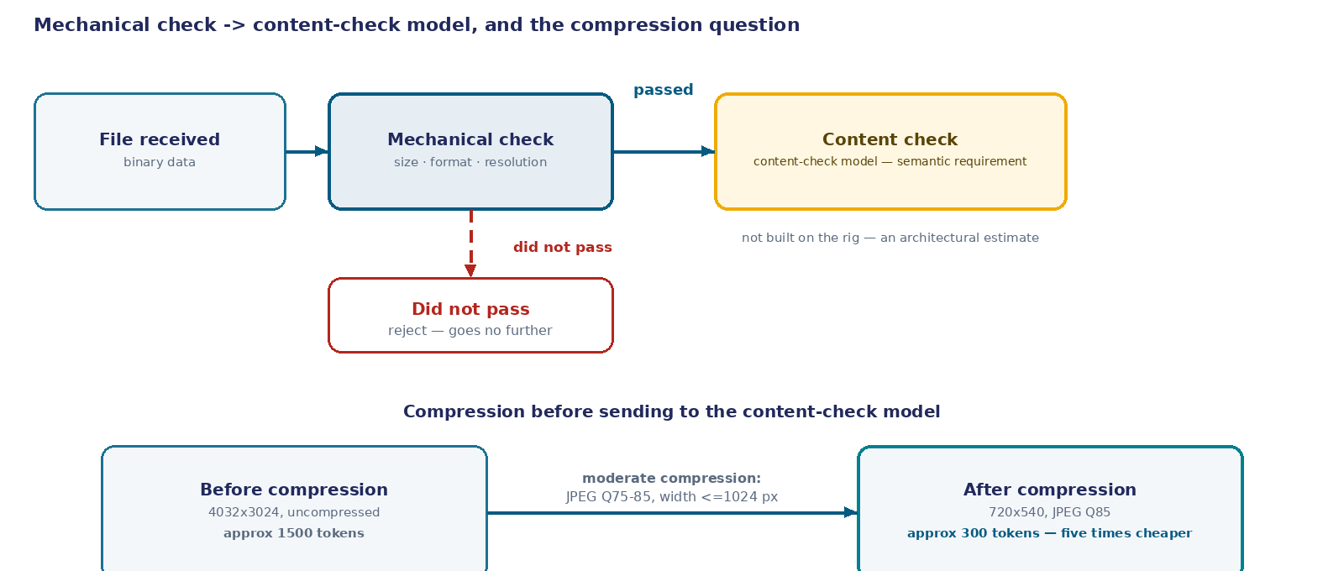
Check order and the compression question
ACTION
HOW IT'S DONE
ADVANTAGE
DRAWBACK
No compression
as-is (4032×3024)
maximum detail
expensive — ≈1500 tokens
Moderate compression
Q75–85, ≤1024 px
≈300 tokens, five times cheaper
clips fine print near the limit
Aggressive compression
low quality, < ~1024 px
even cheaper
text and detail become unreadable
61
Notes:
Before talking about compression, it's worth explicitly naming the order these two steps have to run in — and it isn't an arbitrary choice.
The mechanical check goes first. It's cheap, fast, and deterministic: it compares size, format, and resolution against a condition, and either lets the file through or rejects it right away, before it reaches anything more expensive. The content-check model goes second, and only on what already passed the first check: running an expensive model call on a file that won't pass by format anyway is a waste. This is the same economy we saw in Case 2: a cheap mechanical step absorbs most of the work, and the expensive tool only gets what genuinely needs its judgment.
Now — the question the course owner specifically asked us to research honestly rather than guess at: does it make sense to compress a picture before sending it to the content-check model. The answer, from public sources, not a measurement on our own rig: moderate compression is usually worth it and doesn't noticeably hurt accuracy. An example given in those sources: a 4032-by-3024 image, uncompressed, costs models roughly fifteen hundred tokens of processing; the same image, shrunk to 720 by 540 at JPEG quality 85, costs roughly 300 tokens — five times cheaper — and for most tasks that barely affects accuracy.
But there's an important caveat, and it can't be dropped silently. Tasks where the model has to read text in the image — and our card is exactly that kind, with readable text on it — degrade noticeably more from compression than most. The general recommendation is to compress carefully, not going below roughly 1024 points on the longer side, if the model needs to make out text or numbers on the card. Aggressive compression for a bit of extra savings isn't justified here: the cost of a misread is higher than the cost of a few extra tokens.
In the table this is laid out as three options to choose among, not one correct answer: no compression, moderate compression, and aggressive compression — each has its own cost and its own risk, and the choice depends on whether the model has to actually read text on the card or whether judging the picture as a whole is enough.

Slide 62
What the coordinator sees on a successful send
Telegram, "Training center notifications" chat.
A photo card, captioned with the notification text: "New request from Maria: topic "course", also mentioned: payment."
The same caption as in Case 1 — the notification text here is built by the same substitution formula, only now it arrives as a photo's caption instead of a separate message. This is the successful case: the file fits within the measured boundary, and the card arrives whole.
62
Notes:
Before going back to wrapping up the case, it's worth pausing for a second to look at the exact same thing from the other side — through the coordinator's eyes, as he simply opens Telegram.
When the file fits within the limit — and we've just measured that limit with a real API call — the coordinator sees no run log, no sending node, no byte count. He opens the same notifications chat where he used to get text messages about new requests, back in the "Notifications" case, and sees a photo in it with a caption: "New request from Maria: topic "course", also mentioned: payment."
This caption isn't new text invented specifically for the card. It's the exact same text we already saw in the session's very first case, assembled by the same value-substitution formula from the request's fields. The only difference is that now it doesn't arrive as a separate message — it comes as a caption to the photo attached to the same notification, exactly the extension marketing asked for in this case's scene.
It matters what isn't on this screen. There's no name of the node that assembled the text or fetched the picture by its link. There's no byte count and no word "limit" — the coordinator doesn't need to know exactly where the boundary sits to understand that the request has arrived. There's no run log and no mark that everything is "green." This is the same boundary the course has talked about from the start: service-level details live in our breakdowns and in the production documentation, and on a real person's screen there's only what that person needs to know to understand what's happening.
And this is exactly the flip side of the scene the case opened with. There, the run was green, and the coordinator's chat was empty — or held a cut-off file. Here, the run is also green, but the coordinator sees a whole card, because this time the file fits within the measured boundary. The difference between these two states isn't visible in the n8n log or in the Telegram API's response by itself — it's only visible here, in the recipient's own chat, and by exactly one sign: did the picture arrive whole or not.
This is exactly why it was worth measuring the byte count as precisely as we did on the previous screens: the single reason to measure the size boundary is so the coordinator sees exactly this chat every time, instead of an empty space where a card should be.

Slide 63
The binary-data contract and the boundary of the introductory level
Binary data in n8n is a separate data model, not just another field value. The contract between steps that broke on text in "Notifications" (the node didn't fail, the result was just quietly wrong) breaks here on format and size — for the same reason: a formally successful run says nothing about whether the result reached the recipient.
ENOUGH AT THIS LEVEL
NEXT LEVEL — SEMINAR 10
one file, one known limit, one send
storing and searching among many files
checking size and format before sending
processing a file's content with a model (searching images by meaning)
an explicit condition in the chain at every step touching binary data
a vector store and indexing attachments
63
Notes:
Let's wrap up what we broke down in this case, and name right away where it ends.
Binary data in n8n is a separate data model from text JSON fields, not just another value in a request. A text field has content. A file has content, and it also has a size and a format, and it's exactly these last two properties that decide whether the result reaches the recipient.
The contract between steps that broke in the "Notifications" case on text — the node didn't fail, the result just quietly turned out wrong — breaks here on the format and size of a binary attachment, for the exact same reason: a formally successful run says nothing about whether the result reached the recipient in the shape expected. This is one and the same lesson on two different data types within a single session, and that's not a coincidence — it's one and the same systemic property of any chain: a step's success measures the step itself, not what happens after it.
Now the explicit boundary this case deliberately doesn't cross. We introduced binary data at the level of "one file, one known limit, one send": fetch the file, check its size and format, send it. Storing many files, searching among them, and processing their content with a model — a vector store, searching by image, answering based on picture content — is a next-level task, and it's deliberately untouched here. Seminar 10 completes exactly what's left out of frame today: it doesn't introduce binary data from scratch, it continues from the level we left it at today.
The difference between the two levels isn't about the tool's complexity, it's about the question being asked at all. Today's question was "will this specific file arrive on this specific run" — and the answer is fully known ahead of time, from two numbers: the file's size and the channel's limit. At the next level, the question is different — "which of many files answers the meaning of the request" — and it no longer has an answer you can compute from two numbers before the run.

Slide 64
When binary data needs separate attention
ALWAYS NEEDED
NOT REQUIRED BY THIS SESSION
checking the size and format before sending any file or image in the chain
storing many files
searching among attachments and processing their content with a model
knowing the delivery channel's limit, not just the orchestrator's own limit
The axis's fourth row is closed. Looked reliable: the picture got assembled and sent to Telegram. Turned out to be: as long as it fits the limit — a large file either arrives partially or not at all, and the run stays green regardless.
1
n8n's own default limit — 16 MB on binary data. For a photo with text that's usually enough, but a high-resolution scan or a phone photo — not always.
2
Telegram's limits are a separate, narrower ceiling, and they differ for photos and for documents. Something that got past n8n's limit can still fail to get past the delivery channel's limit — two independent thresholds, not one.
3
A manual run with binary data uses noticeably more memory than an automatic one — the difference is more noticeable than on text fields, and it's worth keeping in mind while debugging a node like this live.
64
Notes:
Three classes of nuance, and then the criterion and the axis's last row.
First. n8n's own default limit on the size of binary data is 16 MB. For a photo with text that's usually enough, but a high-resolution scan or a phone photo straight from the camera — not always: that's exactly what the file in our scene looked like.
Second. Telegram's limits are a separate, narrower ceiling, and they differ for photos and for documents. Something that got past n8n's limit can still fail to get past the delivery channel's limit: these are two independent thresholds, not one, and checking one doesn't excuse you from checking the other.
Third. A manual run with binary data uses noticeably more memory than an automatic one — we already saw this with text data last session, but on a file the difference is more noticeable, and it's worth keeping in mind if you're debugging a node like this live on your own rig.
The criterion. You always need to treat binary data as a separate contract whenever a file or image passes through the chain, not just text fields: checking the size and format before sending, and knowing the delivery channel's limit specifically, rather than only the orchestrator's own default limit, is the baseline, with no exceptions carved out by task type. And what this session doesn't require of you — not in the deck, and not in your own process back home — is anything beyond that baseline: storing many files at once, searching among them, or processing their content with a model is a next-level task, not part of the introductory one, and nothing here asks you to reach for it yet.
Let's close the axis's last row. Looked reliable: the picture got assembled and was sent to Telegram without a single visible complaint anywhere along the way. Turned out to be: as long as it fits the limit — a large file arrives partially, or doesn't arrive at all, and the run still stays green regardless, exactly as it did in the very first scene of this case.

Slide 65
Four rows of the axis: what they turned out to be
LOOKS RELIABLE
TURNED OUT TO BE
the message reached the coordinator, the chain got shorter and cheaper without an LLM
the LLM here was just an extra step — a template did the same job, with no model and no risk of hallucination ("Notifications")
a repeat request about the same question came in — handled as new
without a duplicate check, every repeat request restarts the chain from zero; neither an exact match nor word-level similarity catches this fully — a rephrasing needs a meaning-based check ("Duplicate check")
the prompt says "don't refund more than amount X"
the decision stayed probabilistic: the model worked around the rule in a measured share of runs, right at the edge of the condition; an algorithmic gate — never ("Refund approval", confirmed at company scale — Zillow)
the image got assembled and sent to Telegram
only as long as it fits the limit — a large file either arrives incomplete or doesn't arrive at all, while the run still shows green ("Card in Telegram")
Where in the chain does the model decide, and where must code — and what stays silent when that boundary is never named explicitly?
65
Notes:
Back to the table we started with. The right column isn't empty anymore, and it wasn't my words that filled it — it was the screens we just watched.
First row. The message reached the coordinator, the chain got shorter and cheaper without an LLM — that's how the decision looked after the first case. What it turned out to be: the LLM node for assembling the notification was just an extra step — a template did the same job, with no model, no variability, and no risk that the text would say something the request never contained at all.
Second row. A request about the same question came in again, and it got handled as new — until we put in a duplicate check. What it turned out to be: without that check, every repeat request restarts the whole chain from zero, and neither an exact text match nor similarity by shared words catches a rephrasing in full — we counted it ourselves on real text: zero shared words between two phrasings of the same question. A meaning-based check was needed, and only on whatever the cheap filter didn't already screen out.
Third row, the most expensive one in terms of proof. The prompt said "don't refund more than amount X" — and the decision was considered reliable for a month, because there were no complaints. What it turned out to be: the decision stayed probabilistic, and the model worked around the rule in a measured share of runs — right at the edge of the condition, not by chance. The algorithmic gate — a condition in code — didn't get it wrong once in the same experiment. And after that we saw the same shape of failure at the scale of an entire company: Zillow lost a quarter of its workforce and hundreds of millions of dollars on that same ungated threshold, which cost us one awkward conversation with a client.
Fourth row. The image got assembled and sent to Telegram — it looked like a completed action. What it turned out to be: only as long as the file fits the limit. A large file either arrives incomplete or doesn't arrive at all, while the run still shows green — the same contract that broke on text in the first case, only here it breaks on size and format.
All four rows are about the same thing: where in the chain the model makes the decision, and where code must, and what stays silent when that boundary is never named explicitly. The line between "it works" and "you can stand behind it" today ran not through one node, but through every single step of the chain.

Slide 66
What we're taking from the session
FILE
A CONTINUATION OF STUDENT.JSON, THE ONE YOU FINISHED LAST SESSION WITH
what's new
coordinator notification by template, not by model · duplicate check in two tiers · refund decision by a condition in code, not a rule in text · image delivery with a size check before sending
how to install
same import as last time: workflow menu → Import from File
what you need
your own n8n and a model provider key, same as before, plus a Telegram bot and token for the notification and the image
what to do
run a few requests, including a repeat and an oversized image, and see where any of the four decisions behaves differently from what's on screen
66
Notes:
Let's gather what got added today to the workflow you're already working with at home.
It's the same file, a continuation of student.json, the one you left last session with: the form, field extraction, the lookup list, writing to the table, the results screen, plus retry and the failure branch. Today four decisions got added to it, and each one replaces something that looked like it worked with something you can answer for.
The notification to the coordinator is now assembled by substituting values into a ready-made template, not by a separate model call: the same text, with no risk that the model adds a detail to the message that wasn't in the request. Before the request is written, there's now a two-tier duplicate check: cheap and instant for cutting literal repeats, and a meaning-based question for whatever's left. The refund decision is now made by a condition in code, not a text rule inside a request to the model: the same amount threshold, but without the chance of getting it wrong right at the edge. And delivery of the image to Telegram now checks the file size before sending, instead of trusting that it'll just work out.
Install it the same way as last time: workflow menu — import from file. You need the same things last session needed — your own n8n and a model provider key — plus, additionally, a Telegram bot and token, if you want to check the notification and the image on your own data.
The homework request is the same as last time: run a few requests on your own version, including a repeat request and an image noticeably larger than usual, and see which of the four decisions behaves differently for you than it did here on screen.
And a separate request, because today's session was denser than the last one: don't check all four decisions in one evening. Take one — whichever is closer to your own work — and get it to a state where you can explain to a colleague why it's built exactly that way; the other three can wait until next week.

Slide 67
What's next
Now: any input → one and the same path through the chain
Next: input type A → one path · input type B → another · input that fits no type → its own default path
Seminar 9: condition versus switch · classification as a separate step of the chain · what to do with an input that fits none of the named branches · how branches that look parallel on the canvas actually execute
67
Notes:
What we are ending on today, and what today's session was still missing.
All through today, each step of the chain in turn got handed either to the model or to code — but the path any given request actually traveled was still the same single path for everyone: every request went through the exact same sequence of steps, regardless of what it was actually about. The notification got assembled the same single way for every request. The duplicate check was one and the same check, applied to everyone alike. The refund decision got made by one piece of logic, for any amount at all, with no distinction drawn between them.
But the request's own topic has already been pulled out into its own separate field, ever since last session — and the moment it is pulled out like that, it becomes obvious that a request about payment and a request about rescheduling a class really do need to travel different ways from this point on: one of them should go to the accountant, the other should go to the schedule instead. That particular split simply cannot be done by sending both down the same single road.
The next session is about the fork in that road. Condition versus switch: when a branch point should decide one plain yes-or-no condition, and when it actually needs a choice among several named branches at once instead. Classification as its own separate step of the chain, one whose whole job is deciding which branch a given request goes down next. What to do with an input that does not fit any of the named branches at all — the tool itself has a built-in default answer for exactly that case, and it is not always the answer you would expect it to be. And there is one thing I will say ahead of time, specifically so that none of you talk yourselves into believing the opposite later: branches that look perfectly parallel sitting side by side on the canvas in fact execute one after another, in strict sequence, in the exact order they happen to sit on the screen.
The next session's conceptual change of pace will be either Optum or IRS — one more case where what is actually at stake is not a single conversation with one client, but a classifier's own decision, one that ends up governing how tens of thousands of people are handled all at once, together.

