Slide 1
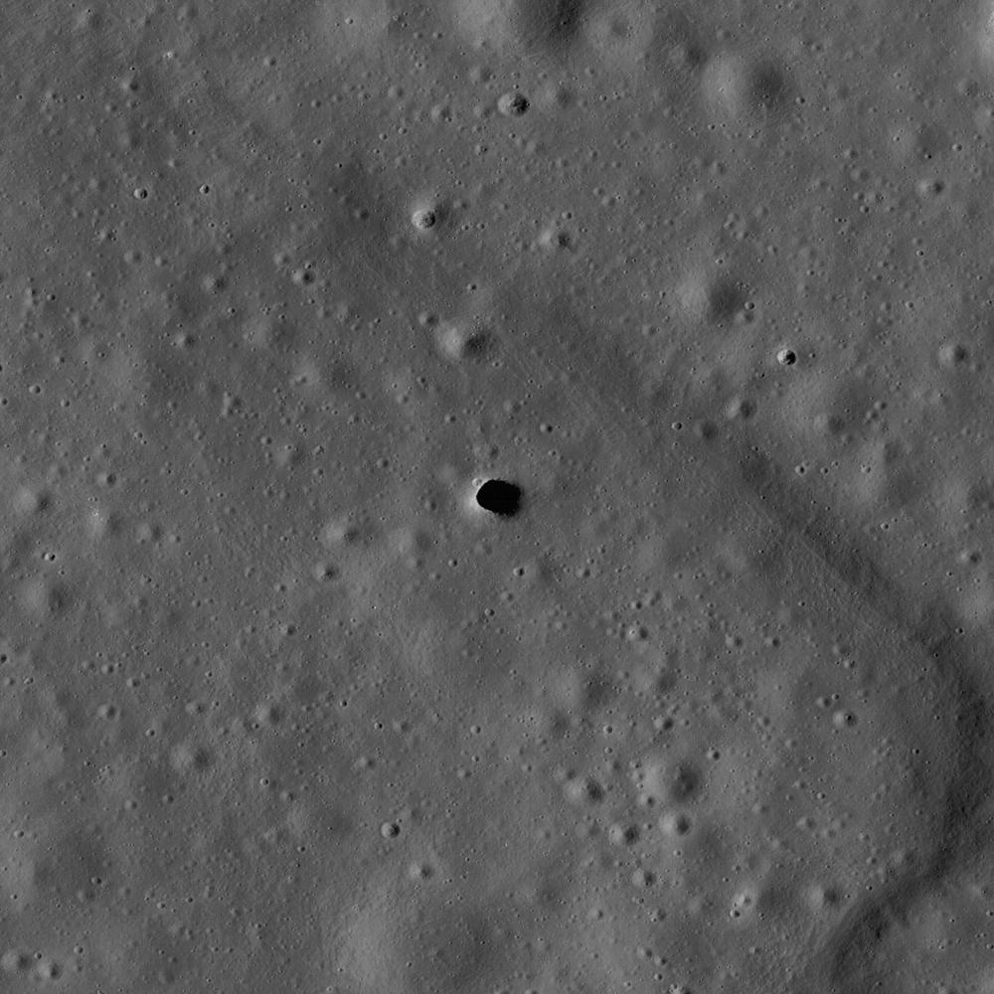
The frontier that becomes its own laboratory
AI in civilian space
Lecture 9
The solutions space forced us to invent — and that did not exist before it.
Notes:
The image on this slide is not mood-setting decoration. It is the entrance to the Marius Hills lunar lava tube, photographed by the orbiting LRO spacecraft: a real opening in the Moon's surface leading into an empty underground space with no GPS, no daylight, and no connection to the surface. This is exactly where, in this very tube, this lecture's reconnaissance team of three robots will arrive — and the exact device that leads them there was born not in space, but at the bottom of an earthly mine, in a DARPA competition for underground reconnaissance. That is the whole lecture's claim, in one frame, before it starts proving it piece by piece: the familiar answer is "engineering solutions come from the lab, and space just applies them" — and today we will test that answer with thirteen concrete case studies.
The lecture is about civilian space: Mars rovers, orbital dockings, weather forecasting, computation in orbit. In an hour and a half we will go through four types of AI contribution — not organized by geography (not "the Moon", not "Mars", not "orbit"), but by what exactly AI does: decides and acts on its own, controls at a distance, designs what didn't exist before, and finally, quite literally, moves into space computationally, because there's more sun there.
The lecture's throughline question is this: which decisions did space force us to invent — and did they exist before it demanded them? The answer will be given right at the end, named case by case for each section, not as one general phrase right now.

Slide 2
The collapse in launch cost — the lecture's foundation
Space Shuttle, 1981–2011
54500
Today's rideshare launch — cargo below rated capacity
6000
Falcon 9, reusable, 2024–2026
2900
0
54500
$ per kilogram of cargo to orbit
An 18–20× drop — not gradual, but a step change: first-stage reusability
There is one named cause: first-stage reusability. 39 Falcon 9 boosters have flown an average of 14.9 times each — the rocket became an asset, not a consumable.
An important caveat for every number that follows. $2,700–3,140/kg is a price list divided by rated payload capacity, not the actual cost of a specific launch. For a satellite on a rideshare launch, the price is closer to $6,000/kg.
Harry W. Jones, «The Recent Large Reduction in Space Launch Cost», NASA NTRS
Notes:
Let's start with the number that anchors everything that follows. The Space Shuttle, from 1981 to 2011, cost on average, across its entire program budget, about $54,500 per kilogram of payload to orbit — that isn't the price of one flight, it's the whole program's economics: development, infrastructure, upkeep between flights, divided by its rated payload capacity of 27,500 kilograms. Against that — today's reusable Falcon 9: its current price list gives about $2,700–3,140 per kilogram. The difference is an 18–20× drop, and that number isn't there for slide polish: it comes from the same peer-reviewed NASA paper (Harry Jones, NASA NTRS) that calculated the Shuttle's number too.
There is one named cause for the drop: first-stage reusability. At the time of the count, SpaceX had 39 boosters in circulation, flying an average of 14.9 times each. A rocket that isn't thrown away after one flight stops being counted as a consumable — it becomes an asset you can use dozens of times over.
And right away — an honest caveat worth keeping in mind for every number later in the lecture: the $2,700–3,140/kg price is a price list divided by rated payload capacity, not the actual cost of a specific launch with a specific payload. If the cargo is below the rated capacity, or flies as part of a rideshare launch, the price per kilogram for it is higher — closer to $6,000, twice the average. This doesn't disprove the 18–20× drop, but it does mean: the number is an order-of-magnitude reference point, not an exact price for any specific cargo. That same habit — asking "is this an average or a specific figure, what's the base it's calculated from, has it been reproduced" — will be useful for every number later in the lecture, including AEGIS's "93% hit rate" and AIFS's "~2.5 minutes per forecast".

Slide 3
Satellites and data grew by an order of magnitude
STARLINK'S SHARE OF ALL ACTIVE SATELLITES
COPERNICUS (SENTINEL) ARCHIVE, 2018 → 2025
~65%
9.7 → ~91 petabytes
~11,100–11,150 satellites in one constellation
a ×9 increase in 7 years; EOSDIS by 2030 — ~600 petabytes
1381
2015
0
20000
16800
2026
active satellites in orbit
A ~12× increase in 10 years — more tasks than operators able to handle them by hand
Algorithms didn't get smarter on their own — the number of tasks grew faster than the number of operators able to handle them by hand.
Union of Concerned Scientists · planet4589.org (J. McDowell) · CelesTrak · BryceTech · NASA EOSDIS · Copernicus/DLR
Notes:
The second explosion is a direct, quantitative consequence of the first: once getting to orbit became several times cheaper, the number of things actually put into orbit jumped sharply. The number of active satellites grew ~12× in ten years — from 1,381 in 2015 to 16,800–17,100 today, according to independent tracking databases from Jonathan McDowell and CelesTrak. Of those, one constellation, Starlink, accounts on its own for about 65% of all active spacecraft in orbit.
The number of orbital launches per year grew from 87 in 2015 to 325 in 2025 — a quarter more year over year, while the number of satellites deployed grew by 54%: a modern launch carries, on average, more spacecraft at once than it did ten years ago. Of those 325 launches in 2025, SpaceX carried out 165 — about half of all launches worldwide.
In parallel, the volume of data coming down from satellites and needing processing is growing too. NASA's EOSDIS archive grew from 116 petabytes at the start of 2024 to a projected ~600 petabytes by 2030; the European Copernicus program's archive grew from 9.7 petabytes in 2018 to ~91 petabytes in 2025 — a ninefold increase in seven years. The German DLR archive grows by 15–30 terabytes a day.
These three numbers aren't three different stories but one: launch cost fell, the number of satellites grew by an order of magnitude, and the volume of data those satellites produce grows at the same pace. There are now more machines and more data in orbit than the old model — "one operator watches one system and reads every image by hand" — can physically service. That's exactly what explains why the issue of autonomy in space has become so acute right now, rather than a decade earlier or later — and why this growth in data comes back directly later in the lecture: it motivates the LeoLabs case study in Section 1 and is named directly as the reason for demand for computation in Section 4.

Slide 4
Who is launching, and how fast
COMPANIES WITH CONFIRMED FIRST-STAGE LANDING
COUNTRY CONCENTRATION, SINCE START OF 2026
4
US 150 of 254 launches
SpaceX, Blue Origin — with reuse; LandSpace, Galactic Energy (China) — landing confirmed, reuse not yet
China 76, Russia 13 — more than half the world's launches in one country
COMMERCIAL SPACE-INDUSTRY REVENUE, 2026
RECORD SINGLE-BOOSTER TURNAROUND
$544.3 billion
9 days
more than 80% of the entire global space economy (~$600 billion); ten years ago the ratio was reversed
landing → next launch (booster B1088); before 2017 this metric had no numerical value at all
10 years ago (2015), not a single company in the world had demonstrated a successful first-stage landing.
flightatlas.org (10.31.2026) · OECD, «The Space Economy at a Glance 2026» (09.2026) · BryceTech
Notes:
The numbers on falling launch cost and the growing number of satellites don't say who is behind this or how much the industry itself has accelerated — and those are two separate questions, easy to lose behind the raw totals.
Reusability is no longer the privilege of one company, though landing and actual reuse are worth separating explicitly. As of the end of October 2026, four companies worldwide have demonstrated their own first-stage landing technology. Two have confirmed landing plus actual reuse: SpaceX (routinely since 2017) and Blue Origin (New Glenn, first landing November 13, 2025, first reuse April 19, 2026). Two more have demonstrated successful landing without confirmed reuse — both from China: LandSpace and Galactic Energy. Ten years ago, in 2015, not a single company in the world had demonstrated a successful landing at all.
At the same time, concentration remains high: according to independent aggregate statistics, since the start of 2026, of 254 orbital launches, 150 went to the US, 76 to China, 13 to Russia. More than half of the world's 2026 launches belong to one country, mostly through SpaceX, and that concentration shouldn't be hidden behind the phrase "14 countries can launch".
The commercial sector has overtaken the government sector by revenue: per an OECD review, commercial space-industry revenue in 2026 is $544.3 billion, more than 80% of the entire global space economy. Ten years ago the ratio was reversed — most of the revenue came from government contracts.
And the pace of iteration has grown not just in launches per year, but in the turnaround between two flights of the same vehicle: the record turnaround for a single booster between landing and its next launch is nine days. Before 2017, this metric couldn't have had a numerical value at all — every stage flew once and was discarded.

Slide 5
The second round of the drop: Starship, plan and fact
STARSHIP TEST FLIGHTS AS OF 10.31.2026
BOOSTER CAUGHT / REUSED
14
3 times / 1 time
the 14th reached orbit for the first time, deployed 26 Starlink satellites
the second stage was never caught — there is no regular cycle yet
MUSK'S TARGET (PLAN, NOT FACT)
AEROSPACE CORPORATION ESTIMATE (REALISTIC RANGE)
<$100 per kg
$100–500 per kg
with full reusability + on-site propellant production — stated 07.29.2026
optimistic scenario — $67/kg after 9 cycles
An honest calendar caveat. Landing people on the Moon (Artemis, HLS based on Starship) has slipped to no earlier than September 2028 — a NASA Inspector General report (March 2026) says "years behind schedule".
The next attempt to catch both stages at once is no earlier than November 8, 2026, and that date may slip further.
SpaceX, quarterly report 10.20.2026 · Aerospace Corporation / Ars Technica · Ark Invest · NASA OIG, report 03.2026
Notes:
The drop in launch cost we've already seen is a fact that has already happened. But right now a second round of the same process is unfolding, and it's important right away to separate what has already happened from what is a stated goal.
As of October 31, 2026, Starship has flown 14 test flights. The fourteenth reached orbit for the first time and deployed 26 Starlink satellites — the first real commercial use, not just a test of the flight itself. The first stage, the booster, has been caught and partly reused three times; the second stage, the ship itself, has never been caught. There is no regular "caught → reused" cycle yet — these are isolated events, not routine. The next attempt to catch both elements at once is scheduled for no earlier than November 8, 2026, and that date itself may slip.
How much cheaper will launch get if this succeeds? Here an honest spread of estimates matters more than one pretty number. The target Musk states is well below $100 per kilogram, on condition of full, immediate reusability of both stages plus on-site propellant production. No mission has confirmed this yet — it's a plan, not an achieved result. Independent analysts are more cautious: Aerospace Corporation names an optimistic scenario of ~$67/kg after nine reuse cycles of one ship, and considers $100–500/kg the realistic range for the industry. Ark Invest gives $115–200/kg by 2029.
Even at the conservative edge of that range, that's a further 15–30× drop from today's Falcon 9, on top of the twenty-fold drop that has already happened. A separate honest caveat: the NASA Inspector General's report and a warning from the Aerospace Safety Advisory Panel (ASAP) agree on one thing — the lunar version of Starship for the Artemis program may fall years behind schedule; landing people on the Moon has slipped to no earlier than September 2028. And importantly: the drop in launch cost in 2026 is no longer the story of one company. Blue Origin has for the first time landed and reused New Glenn; in China, at least two private companies have landed the first stage of their own rockets. This is an industry-wide shift with several independent participants.

Slide 6
A threshold, not a promise
ORBITAL DATA CENTERS TODAY VS GROUND-BASED
2.5–3× more expensive
BCG: $660–750 million/MW against $230–300 million/MW on Earth
200
Google's threshold, by ≤2035
1500
today, from
0
4000
500
Starcloud's threshold, ~2028
2900
today, to
$ per kg of cargo to orbit
Today, several times above Google's threshold — the threshold is named, not invented
This is not "already worth it" — it's "will become worth it at such-and-such threshold". The difference between these two statements is what keeps the whole of Section 4 honest.
The reverse scenario. If cost freezes at the upper end of the range ($500/kg, not $67–100/kg), the drop from today's Falcon 9 will be not 30× but 5–6×, and Google's threshold will move years further out than 2035.
Google (Project Suncatcher) · Starcloud · BCG, report 08.2026
Notes:
This paragraph is the one place in the industry overview where the lecture talks not about what has already happened, but about what could happen under certain conditions. This is exactly where it matters most to keep the difference between a fact and a threshold.
Google — specifically in the context of its own orbital-computing project, Suncatcher, which we'll examine in Section 4 — states directly the number at which placing compute infrastructure in space becomes economically competitive with ground-based data centers: a launch cost no higher than $200 per kilogram. Today, orbital capacity for dedicated missions costs $1,500–2,900 per kilogram — the threshold is far off, but it is named, not invented. Google itself forecasts the threshold is reachable by 2035, on condition that Starship reaches a cadence of 180 launches a year. Starcloud names its own break-even threshold — around $500 per kilogram — and expects it by mid-to-late 2028.
A fair counterweight to these forecasts came from a BCG study published in August 2026: today orbital data centers cost 2.5–3 times more than ground-based ones per megawatt of capacity. That's exactly what keeps the whole of Section 4 honest: Starcloud's and Suncatcher's demonstrators are already working today, regardless of which scenario launch cost follows next — but what's proven is the principle, not economic competitiveness.
And the reverse scenario is worth stating explicitly. If cost freezes not at $100/kg (Musk's target) and not even at $67/kg (Aerospace's optimistic scenario), but at the upper end of the realistic range — $500/kg — then the drop from today's Falcon 9 would be not 30× but a much less impressive 5–6×, and Google's $200/kg threshold would move years further out than the stated 2035. That doesn't make Section 4's material irrelevant — but it's worth keeping in mind that both ends of the range remain equally possible outcomes.

Slide 7
Why right now — three frontiers
Economics not solved
Threshold named, not passed
Barrier removed — routine
Asteroid mining
Space-based power
Lunar bases
AstroForge Odin (02.26.2025) unsuccessful; second mission — Q4 2026, not yet launched
5–10× more expensive than ground power — Overview Energy/Meta: a 1 GW contract, demo in 2028
Firefly Blue Ghost — first successful commercial landing, 03.02.2025
track maturity, 2025–2026
All three share the same starting point — a 1970s idea; the shared trigger is the collapse in launch cost. That alone doesn't solve the track's economics
A shared pattern: the drop in launch cost does not solve the economics of each track on its own — it lowers the threshold for even attempting it.
Overview Energy/Meta (04.27.2026) · Firefly Aerospace, Blue Ghost Mission 1 (03.02.2025) · AstroForge
Notes:
Three tracks — space-based solar power, lunar and Martian bases, resource mining on asteroids — are not new ideas: all three were discussed in engineering literature back in the 1970s. The question worth asking explicitly: what changed right now, turning them from speculative constructs into the subject of real investment decisions?
Space-based solar power rests on the same threshold as all of Section 4: the arrival of reusable launch systems lowered the cost of orbital access by an order of magnitude. At today's commercial launch price, electricity from space-based power, by analysts' estimate, costs 5–10 times more than ground-based alternatives — a threshold, not an achieved state. But interest is already material: on April 27, 2026, Overview Energy and Meta announced an agreement for access to future capacity of up to 1 gigawatt, with a demonstration in 2028 and commercial delivery in 2030.
Lunar bases: a barrier that stopped being a state monopoly. Before 2024, not a single Moon landing had ever been carried out by a commercial organization. On March 2, 2025, Firefly Aerospace's Blue Ghost Mission 1 spacecraft made the first fully successful landing on the Moon by a private organization. This is a structural, not a quantitative, shift: landing on the Moon stopped being the exclusive competence of a handful of national agencies. This doesn't cancel the honest caveat about NASA's unadjusted $100 billion estimate for landing six astronauts on Mars — a commercial landing of a small uncrewed craft and a large crewed base remain tasks of a different order of magnitude.
Resource mining on asteroids is the narrowest frontier of the three: the drop in launch cost lowered the threshold for attempting it, but didn't solve the fundamental economic question. So far, no one has mined and sold material from an asteroid commercially. AstroForge's first mission ("Odin") launched on February 26, 2025 and was declared unsuccessful in early March of the same year; its second, as of October 31, 2026, has not yet launched — it's stated for the fourth quarter of 2026. The shared pattern across all three: the drop in cost lowers the threshold for attempting it, but doesn't solve the track's economics on its own, and the speed of the transition from "speculative idea" to "testable question" differs for each one.

Slide 8
What exactly space pays with for the pressure of being a frontier
What the frontier pays with
Distance
3–22 min to Mars
Data volume
×12 satellites, ×9 archive
Human time
hours of CFD, routing, forecasting
New capability
computation in orbit
Four places where being a frontier demands payment — in distance, data, human time, a new task
Space is a frontier: extreme conditions make off-the-shelf solutions insufficient and force the creation of new ones — invented precisely under this pressure, not borrowed from softer conditions.
The familiar, easier answer: engineering solutions come from the lab, space just applies them. The next slide tests that answer with one concrete case.
Notes:
The three numbers the industry overview gave us — launch cost, number of satellites, data volume — add up to a single claim, and the rest of the lecture will test it with material rather than declare it. The claim is this: space is a frontier, and extreme conditions (distance, lack of ready infrastructure, the cost of error) make off-the-shelf engineering solutions insufficient and force the creation of new ones — not borrowed from softer conditions, but invented precisely under this pressure. A frontier doesn't just require solutions — it generates them.
The familiar, easier-to-settle-into answer runs differently: engineering solutions come from a lab on Earth, and space simply applies them, the way any other hard-to-reach environment applies tools that already exist. The next slide — the case of the mine and the lunar tube — tests that familiar answer with one concrete case, and later, across thirteen case studies: the solution the lecture's material shows was, in a notable share of cases, born not in a lab on Earth specifically "for space", but somewhere the pressure of conditions was comparably harsh — and only afterward turned out to fit conditions harsher still, the real frontier of space.
Payment for this comes due at four addresses, and they don't line up one-to-one with the lecture's four sections — each address runs through several sections at once. Distance — minutes and seconds of communication delay, from Mars (3–22 minutes) to the Moon (1.3 seconds) to low orbit (fractions of a second). Data volume — satellite observations and sensor readings that classical manual calculation can't keep up with. Cost of human time — an operator physically cannot be in the loop for every dig cycle, every repeat shot, every route check. New capability — a task no one did at all before: searching through thousands of engineering variants, computation physically located in orbit. If any of the thirteen case studies ahead doesn't explicitly address at least one of these four points, that's worth noting as a flaw in the case study itself, not a feature of the presentation.

Slide 9
From an earthly mine to a lunar lava tube
DARPA Subterranean
Challenge, 2018–2021
LAMP 2.0 architecture
COROB-X — lunar
lava tube
Mine
LAMP 2.0
Moon
a competition for autonomous reconnaissance of mines and collapsed buildings — GPS and comms don't work underground, same as in space
8+ robots stitch maps together over kilometer-scale distances — measured at the earthly competition
carried over in spirit, not in code; tested on Earth, Lanzarote, 02.2023 — never flown to the Moon
transfer stage of the solution
One architecture, three stages: from a mine competition to a lunar demonstrator
The transfer: the lecturer's own testimony.
What follows is a case from the lecturer's own practice about carrying a solution from one frontier to another; told orally, with no text on screen.
Closing line. The familiar answer: "solutions come from the lab, space applies them". The lecture's question: what happens when the frontier itself becomes the laboratory?
DARPA Subterranean Challenge (2018–2021) · JPL/Caltech/MIT/KAIST/Luleå, the NeBula/CoSTAR family
Notes:
Before the lecture starts proving its claim piece by piece across thirteen case studies, it presents that claim with one measured case — the very case study promised to the room, which is the lecture's claim itself, not an illustration of it.
The NeBula/LAMP architecture was not born in space. It appeared as the winner of the DARPA Subterranean Challenge — a competition for autonomous reconnaissance of mines and collapsed buildings, that is, an earthly frontier where satellite navigation and stable communication also physically do not work: underground, GPS doesn't penetrate rock, and radio is jammed by the same walls. The team built a SLAM system called LAMP — a three-tier architecture: each robot's own local odometry, place-match search between maps at a base station, and joint pose-graph optimization. The LAMP 2.0 version scales to 8 or more heterogeneous robots over kilometer-scale distances — a figure measured at the earthly competition, not in space.
This architecture was then adapted — in the spirit of the approach, not directly by code, and that's an honest caveat worth stating right here — for conditions harsher still than earthly mines: lunar lava tubes, where there is not only no GPS and no stable communication, but no daylight and no connection to the surface at all. The COROB-X demonstrator, which we'll examine in detail in Section 1, uses an architecture from the same family. There is no direct confirmation in public sources that COROB-X literally uses NeBula/LAMP code: the connection is by family of solutions and by the underlying task, not by shared source code. The technology was tested on Earth, in Lanzarote, in February 2023; it has never flown to the Moon.
The second part of this case study is, by the course's own canon, given over to the owner's own testimony about carrying a solution from one frontier to another. The field is left open on purpose: without that testimony it stays a placeholder, not a story invented on the owner's behalf — the owner fills it in themselves.
Closing line: the familiar answer says "engineering solutions come from the lab, space applies them". The question this lecture asks with its material going forward is — what happens when the frontier itself becomes the laboratory?

Slide 10
The lecture's question
Which decisions did space force us to invent —
and did they exist before it demanded them?
The answer — at the end of the lecture, named case by case for each of the four sections.
Notes:
The material we'll gather over the next four sections answers one question, and it will be stated here for the second time — in the Wrap-up, right at the end, where the answer will be given named case by case for each of the four sections, not as one general phrase.
The question is this: which decisions did space force us to invent — and did they exist before it demanded them? This isn't a rhetorical question for mood — it will get a concrete, testable answer, and that answer will turn out to be neither a flat "space always invents" nor "space only applies what's ready", but different section by section: in two of the four sections we'll find a measured case of a solution born specifically by the frontier; in the other two, an honest transfer of a ready-made tool into a new configuration that was previously impossible. This 2:2 split isn't a predetermined target — it's what turned up as a consequence of honestly applying the case-selection rules to the material we gathered.
Keep this question in mind throughout the whole lecture: with every new case study it's worth asking — was this solution invented right here, under this specific pressure, or carried over ready-made from softer conditions? The answer to this question isn't just a nice phrasing — it's an engineering skill that carries over into any industry: the ability to tell a real innovation, forced by the conditions of the task, apart from applying an already-existing tool to a new place.

Slide 11
The map of the evening: four fronts
Section 1 — maximum autonomy: no human in the loop at all. Section 2 — minimum autonomy: a human controls, just at a distance. Section 3 — not about autonomy at all: a model designs and forecasts. Section 4 — a mirror of the whole lecture: it's not space getting smarter, it's AI moving into space.
Next — Wrap-up (registry, answer to the question, the tally) and Closing (the debt carried forward).
No.
Section
Term
What it hinges on
1
Autonomous robots in space
autonomous robotics
the machine decides and acts on the spot with no dispatcher
2
Remote control
teleoperation
a human controls at a distance — where that stops working
3
Design and new capabilities
AI-assisted design and forecasting
a model does work that simply didn't exist before
4
Space for AI
orbital computing
computation moves to where there's more energy
Notes:
Section 1 is this lecture's maximum autonomy: later on we'll show a lesser degree of autonomy (Section 2) or shift sideways to other kinds of task (Sections 3–4). Section 2 is the minimum autonomy: a human still holds control, just at a distance, and it comes right after Section 1 on purpose, so that the boundary of "how far can a human still control this" is visible against the maximum we just showed. Section 3 isn't about autonomy at all, but about a new kind of task: design and forecasting that used to require either a human at a drafting table or a supercomputer. Section 4 is a mirror of the whole lecture: it's not space getting smarter with AI, it's AI starting to physically change where compute infrastructure is placed.
Looking at this sequence not as four separate blocks but as one path, you can see the question itself gradually shift. Section 1 asks: can the machine decide on its own? — and answers "yes, where the task is geometric or admits an easily trainable model". Section 2 asks: where's the boundary past which a human can no longer decide alone? — and answers "where communication delay or the speed of events physically leaves no time". Section 3 doesn't ask about autonomy of action, but about autonomy of thinking: can a model design or forecast something that used to require only a human? — and answers "yes, but the final check stays classical". Section 4 no longer asks about the task itself, but about its physical location: where is it cheaper to compute? — and answers "mostly on Earth for now, but the threshold for a different answer has already been named as a number". Four questions, not one — and that's exactly why the lecture is split into four sections rather than one general case study of "AI in space". After the four sections, the Wrap-up will bring the thirteen case studies together into a single answer to the lecture's question and a shared tally, and the Closing will name the debt carried forward.

Slide 12
How to read this lecture's numbers
A separate rule — the denominator. "93% hit rate" without stating "of what" means nothing. Where the denominator can't be found in open sources, the lecture names that as a gap rather than inventing a figure.
Type of number
Example
How it's presented in the lecture
Fact-number
24%→93% AEGIS; Dragon routine since 2020
always with a source and a date
Threshold-number
$200/kg (Google's threshold); <$100/kg (Starship's target)
explicitly a plan/goal/condition, not achieved
Analyst's-estimate-number
$100–500/kg Aerospace; $115–200 Ark Invest
always a range with a source, never a single figure
Notes:
Before we move on to the case studies, it's worth explicitly naming the rule by which this lecture reads quantitative claims — the same rule the course requires of any measurable claim: a number without a stated base doesn't read as anything, and a threshold is never confused with a fact.
Three types of numbers will come up repeatedly in the lecture, and each has its own reading rule. A fact-number is an event that has already happened and been measured: AEGIS's hit rate going from 24% to 93%, Dragon's routine docking since 2020, the Starcloud-1 launch on November 2, 2025. Such numbers always come with a source and a date. A threshold-number is a condition under which something will become possible, but hasn't yet: $200/kg for orbital computing to be competitive, <$100/kg as Starship's target. Such numbers are always explicitly marked as a plan, a goal, or a condition, not an achieved state — confusing these two types would mean believing that orbital data centers are already cheaper than ground-based ones today, when the honest material says the opposite. An analyst's-estimate-number is a range proposed by an independent observer, not by a participant in the events themselves: $100–500/kg from Aerospace Corporation, $115–200/kg from Ark Invest. Such numbers are always given as a range with a named source, not as one precise figure, because collapsing a range to one number for the sake of a tidy slide would distort the very nature of the estimate.
A separate rule concerns the denominator of any share or percentage. AEGIS's "93% hit rate" without stating "of what" means nothing — the lecture names it: of the total number of selected targets, compared against 24% for the previous mode. Starlink's "~65% of all active satellites" is of the total number of active satellites in orbit, not of the total number of spacecraft ever launched. Where the denominator can't be found in open sources, the lecture states that directly as a gap, rather than inventing a plausible-looking figure. This habit — asking "of exactly what" — will be useful for every one of the thirteen case studies ahead.

Slide 13
The breakdown's form: five steps
Steps 1–3
Cost of both
errors
Both classical
modes (a/b/c)
The model
vs the modes
Steps 4–5
How it works:
input/output/name
What moved over
+ what it gave/cost
The form of the breakdown — applied identically to all 13 cases in the lecture
Step 2's column — applied identically throughout the lecture: (a) both modes are given a number in the same unit · (b) the second mode is named but has no number of its own · (c) a second mode simply doesn't exist for this task, and the reason is stated.
A gain measured from zero (ignoring what the classical mode could already do) is not accepted.
Notes:
Every detailed case study later in this lecture is built on the same form. Let's work through it once on an empty example, so we don't have to explain it again later.
Step 1. The cost of both kinds of error, named before any precision. What does a decision made too slowly cost, and what does a decision made too riskily cost — in hours, in sols, in dollars per kilogram, in human risk. Until this is named, the gain doesn't read as anything.
Step 2. Both classical modes, calculated in the same units. This is where step 2's column applies, used identically throughout the lecture: (a) both modes are given a number in the same unit as the model; (b) the second mode is named but has no number of its own, and that's said on the spot, not disguised; (c) a second mode simply doesn't exist for this task, and the reason for that is stated explicitly, not presented as a gap in the research.
Step 3. The model or the automation against these modes. A comparison in the same units, with a named base. A gain measured from zero isn't accepted in this lecture; what matters is the difference specifically from what worked before.
Step 4. How it's built — input, output, trained or classical, the product's name. Where there's no answer in open sources, that's stated honestly as "sources don't disclose this" — rather than filled in with a similar-looking number from a neighboring case.
Step 5. What moved over. By the name of a form from the course's own dictionary, or an explicit refusal to assign a form, with a reason. Next to it — a "gave — cost" pair: what became possible, with a number and a base, and what it was paid for with, in comparable units. We'll apply this form thirteen times in a row from here — to AEGIS, SPOC, COROB-X, LeoLabs, and so on — and keeping it in mind will save us from having to explain each next case study's structure from scratch.

Slide 14
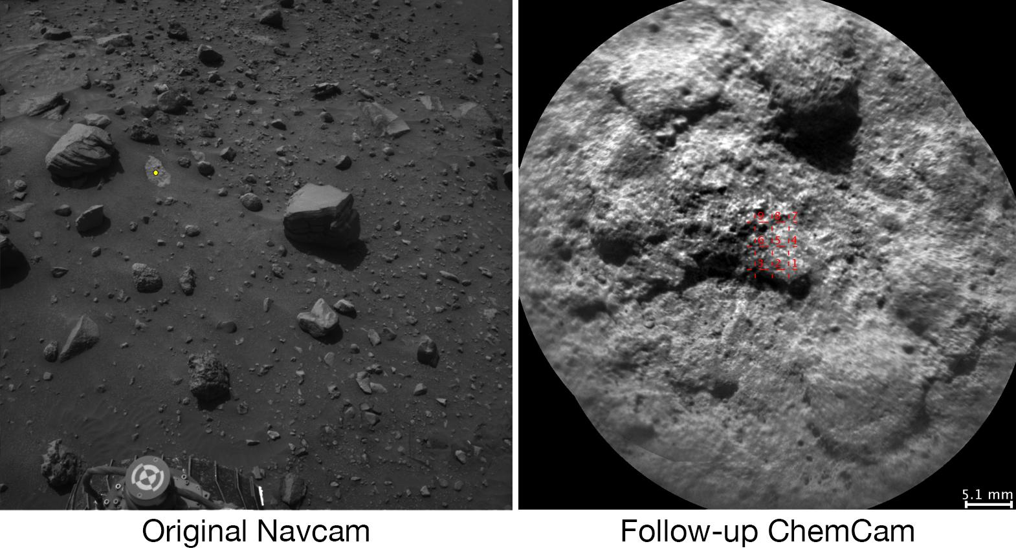
1. Autonomous robots in space
The machine decides and acts on the spot — with no dispatcher at every step.
In order:
AEGIS — autonomous selection of scientific targets on Mars
SPOC — deep learning for labeling Martian soil
COROB-X — three robots in a lava tube
LeoLabs — radar prioritization and collision warnings
Notes:
This section opens the chain of four types of AI contribution promised by the map of the evening, and holds the lecture's maximum autonomy: later on we'll show a lesser degree of autonomy (Section 2) or shift sideways to other kinds of task (Sections 3–4).
Four case studies in order: AEGIS — a rover decides for itself what to photograph, raising target-selection accuracy from 24% to 93%. SPOC — a deep network labels soil type in an image with 98% accuracy, already helping rover drivers today, and potentially the rover itself in the future. COROB-X — three robots build a map of a lunar lava tube on their own, somewhere too dangerous for a human to descend. LeoLabs — a commercial radar network decides on its own which object from a growing catalog of orbital objects to observe next, and issues up to 400% more close-approach warnings.
Before we get to these four cases, the section first names the stage as a whole — what kind of work this is, what data gets captured, how a decision gets made without automation — and separately breaks down where a classical, deterministic algorithm manages on its own, and where a trained model is needed. This is the section where the line between automation and learning is the most visible on the surface of any of the lecture's four sections: geometry goes to the classical approach, recognizing an object against noise goes to the model.

Slide 15
The stage: autonomous robotics
TERM
DATA
autonomous robotics
environment + own state
deciding and acting with no dispatcher at every step of the cycle
soil, terrain / position, charge, remaining range
DECISION
WITHOUT AUTOMATION
a specific physical action
a human on the spot
dig here, drive this route, photograph this object
an astronaut in a suit, an engineer on a tether — limited by risk and the length of the excursion
This section comes first, and not arbitrarily. This is the lecture's point of maximum autonomy, against which the rest of the sections can later be compared.
Three ways of getting data — all onboard the machine itself: cameras (stereo pairs), LIDAR, inertial sensors.
Notes:
The five parts below are the general template by which each of the lecture's four content sections opens; it will recur almost verbatim in the descriptions of teleoperation, design, and orbital computing, and that's a deliberate choice: once we've learned the template once, we spend our attention on the content from then on, not on the structure of the text itself.
What kind of stage this is. The industry term is autonomous robotics: deciding and physically acting with no dispatcher at each individual step of the cycle. What data gets captured and what question it answers. The machine receives two streams: the state of the environment (soil, terrain, the geometry of the space) and its own internal state (position, charge, remaining range). The question is what to do right now, with no waiting for confirmation from Earth. How this data is captured. Three methods, all onboard: cameras (stereo pairs for recovering depth), LIDAR, inertial sensors. What decision gets made. A specific physical action: dig here, drive this route, photograph exactly this object. How this is decided without automation. The classical alternative is a human physically present: an astronaut in a suit, an engineer on a safety tether. It works, but is limited by the length of a spacewalk and, above all, by physical risk where a machine doesn't risk a life.
Why does this section come first, rather than third or fourth? Maximum autonomy sets the scale: by showing what a machine can do when there's no human in the loop at all, we get a reference point against which we can later measure how much autonomy is actually used in Section 2, and why Section 3 is even needed, where autonomy is replaced by a different kind of contribution — design, not action.

Slide 16
Where the classical approach handles it, where a model is needed
The classical approach handles it, no training
Needs a trained model
• Terrain traversability, cave mapping (AutoNav/GESTALT)
• Falcon 9 landing — convex optimization (G-FOLD)
• The physics of soil and optics is known in advance
• Recognizing an artifact against Martian dust
• Features aren't known in advance, statistics from examples
• A lightweight classifier inside an otherwise classical pipeline
The strongest example of this distinction lies outside surface navigation entirely. Falcon 9's first-stage landing (G-FOLD) is convex optimization, not a neural network. It visually looks like a miracle of autonomy — and it is one, but its autonomy is built from math, not from learning.
Notes:
This is the first and most important place in the lecture where we need to honestly separate "automation" from "a trained model": not everything that looks like autonomy is built from a neural network, and a significant share of this section's most impressive results doesn't use learning at all.
Geometric navigation is solved with no training whatsoever. Terrain traversability, building a map of a cave with no GPS — this is a classical algorithmic task: stereo vision, pose-graph optimization, fitting planes to a point cloud. This task was solved by classical methods long before deep learning became an engineer's tool, and moving it onto a neural network today would mean replacing a verifiable, deterministic algorithm with a less predictable one — with no gain that would justify such a swap. This is a direct, engineering-grounded criterion for "a trained model isn't needed here": the task is entirely geometric, and the physics of the soil and optics is known in advance.
The strongest example of this same principle lies outside surface navigation entirely. The Falcon 9 first-stage landing algorithm (G-FOLD, implemented as SCvx, CVXGEN) is a classical convex-optimization task, not a neural network. The decision of how much thrust to give the engines and when is settled by a mathematically provable algorithm, not by a model trained on examples of past landings. This is an important, honest distinction precisely because landing a rocket visually looks like a miracle of autonomy — and genuinely is one — but its autonomy is built from classical math, not from learning.
Recognizing an object against noise — where the classical approach can't manage alone. Spotting a scientifically interesting artifact against a background of uniform Martian dust is a task where features that aren't known in advance need to be extracted from the statistics of examples, rather than from an explicit physical model. This is where a lightweight trained model comes in — a random forest or a convolutional network — but this isn't a full-fledged deep network making an end-to-end decision; it's a narrow classifier embedded inside an otherwise classical pipeline. This boundary, named here in two paragraphs, will be broken down at the level of the mechanism itself on the next slide.

Slide 17
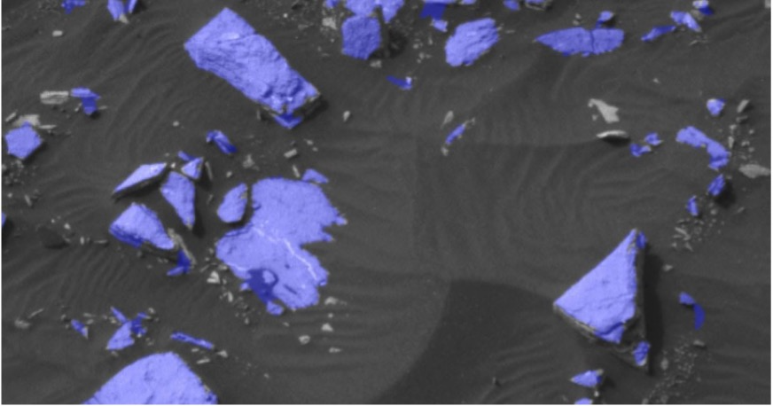
How the methods work: geometry and random forest
STEREO VISION (PARALLAX)
RANDOM FOREST
disparity → range by geometry
dozens to hundreds of decision trees
two cameras on a known baseline, similar triangles, no trained parameters
bagging + a random subset of features at each node
THE KEY PROPERTY OF A RANDOM FOREST
interpretability
a tree can be read all the way through, step by step — not a black box
Why exactly this mechanics matters: it's what holds up AEGIS. Distance to the target (Block 1) is one of the features by which interest is ranked (Block 2). Both blocks are below, before we move on to the case study itself.
Notes:
§1.2 drew the line between the classical approach and learning in two paragraphs — but a named boundary and a mechanically understood boundary aren't the same thing. This slide makes it mechanically clear before we move on to the first three detailed case studies.
Block 1. Stereo vision and parallax — why distance doesn't need to be learned. Two cameras, set apart by a precisely known distance (the baseline), photograph the same point in a scene. If the point is close, it projects onto noticeably different positions in the left and right frames; if far, onto almost the same position. The difference is called disparity. Knowing the baseline, the focal length, and the measured disparity, the distance to the point is computed directly from the formula for similar triangles, with not a single parameter that would need to be fit from the statistics of examples. This is the same principle by which a pair of human eyes judges the depth of a scene. That's exactly why the distance to an object in AEGIS is a classical geometric quantity, not something a classifier guesses from statistics.
Block 2. Random forest — an ensemble of trees you can read all the way through. This isn't one model but many (dozens to hundreds) of independently trained decision trees, voting together. A single tree easily overfits to the noise of specific examples; a random forest fixes this with two tricks: each tree is trained on its own random subsample of examples (bagging), and at each split point the tree chooses its test from a random subset of features. Because of these two sources of randomness, the trees come out different, and their errors cancel each other out when voting.
This design has an engineering consequence: a random forest is not a black box in the sense a deep neural network is often called a black box. A specific tree can be read all the way through, step by step: which feature and which threshold it checked at every node. For a deep network with millions of weights, unpacking a decision the same way is structurally much harder. A random forest doesn't try to solve the task end-to-end from a raw image — it works on a small set of already-extracted features, and for a task of this scale a heavier architecture wouldn't deliver a gain that would justify its computational cost onboard a Mars rover.

Slide 18
How the methods work: a map without GPS and a single-glance detector
CNN DETECTION (THE YOLO FAMILY)
coordinates + class in a single pass
'you only look once' — the whole frame's grid at once, not window by window
input
work
output · bottleneck
Local odometry
Match search between robots
Joint pose-graph optimization
estimating one's own displacement from sensors
without it, the robot has no map of its own
finds places where different robots were at the same spot
even if the robots never met directly
matches become edges of a shared graph
minimizes the total inconsistency across all edges
Three tiers, not two — each one closes a gap the previous one leaves.
A detector ≠ geometry. The detector decides "what this is and where on the frame" (pixels); geometric localization in space is, again, the classical approach, not a neural network.
Notes:
The DARPA mine case study at the start of the lecture already named SLAM and said LAMP's architecture has three tiers — but it didn't explain what each tier means or why there are exactly three. This slide closes that gap before we examine COROB-X in detail.
SLAM — simultaneous localization and mapping: a robot answers two questions at once, "where am I" and "what does the space around me look like", with no ready-made map in advance and no external positioning signal. For a single robot, there's one tier: local odometry, estimating one's own displacement from sensors. When there are several robots, as in COROB-X, one tier isn't enough: without a way to stitch the maps together, three separate maps stay three separate maps. The second tier is match search between robots, the inter-robot version of loop closure: the algorithm looks for moments when two different robots were at the same physical place, even if they never met directly. The third tier is joint pose-graph optimization: the matches found become additional edges of a shared graph, and the task is to find a position for every node such that the total inconsistency across all edges is minimal. This is a classical graph-optimization task, not a trained model.
YOLO-family object detection differs from a classifier (like a random forest) in the kind of task it solves: a classifier answers "what is this", a detector answers two questions at once — "where in the image is the object" (a bounding box) and "what kind of object is it". YOLO does this in a single pass of the network over the entire image — the network splits the frame into a grid of cells and, for each one, simultaneously predicts the probability of an object, its coordinates, and its class. It's trained on labeled examples — a fully trained component. But once the detector has found the artifact and given its pixel coordinates, converting those coordinates into a real distance is, again, classical projective geometry, the same task as the range measurement in AEGIS, not a neural network.

Slide 19
Example: AEGIS — autonomous selection of scientific targets on Mars
COST OF A MISS
CLASSICAL MODE (BEFORE AEGIS)
1 lost sol
24% hit rate
re-choosing a target costs another full communication cycle with Earth
targeting by Earth command based on the previous image
THE MODEL (AEGIS, ROCKSTER + RANDOM FOREST)
HOW IT WORKS
93% hit rate
NavCam stereo-pair input → Rockster → features → random forest → ChemCam
routine on Curiosity since 2016 (first on Opportunity, 2010)
range — by geometry (Block 1), ranking — by random forest (Block 2)
What moved over. Productivity grew almost fourfold — a scientist sets the target profile in advance, once, instead of choosing every target personally.
An honest gap. Sources don't disclose the feedback loop or the composition of the random forest's training set.
Image classification.
Francis et al., Science Robotics 2017 · JPL, AEGIS project page
Notes:
This case study carries the most evidentiary weight in the whole of the lecture's claim, and not by accident: of the thirteen cases, it's the one in continuous use the longest (continuously since 2016) and the most thoroughly confirmed by a peer-reviewed publication.
The cost of both sides: a target chosen from an old image without autonomous selection often turns out to be scientifically uninteresting — the rover spends its limited communication time and resources photographing something that contains no new knowledge. Re-choosing costs another full Martian sol, wasted: time on the ChemCam spectrometer, battery charge, and, most expensive of all, the bandwidth of the link to Earth.
The classical mode (column a — given a number in the same unit as the model): before AEGIS, Curiosity targeted by Earth command, based on the previous image with limited information. The result was a 24% hit rate on scientifically interesting targets.
The model: the Rockster algorithm finds potentially interesting objects by brightness contrast and edges in NavCam stereo images, extracts features — size, shape, intensity, range — filters out unsuitable candidates, and ranks the rest with a random-forest classifier against a pre-set target-of-interest profile. This is an honest architectural detail: not deep learning, but an interpretable classifier, which is enough for a task of this scale onboard with a limited, radiation-hardened processor.
The result: accuracy rose from 24% to 93%, saving one sol per target-selection cycle. Five questions of engineering depth: the processing happens onboard; before AEGIS, a scientist chose every target personally, afterward they set the profile in advance and the choice happens onboard; there's no human in the loop of the choice itself, the arbitration is inside the algorithm; a direct metric was measured (24%→93%), published in Science Robotics; the classifier was trained in advance, and no data on retraining during operation was found — an honest gap. All three case-selection criteria are met exemplarily: remove the random forest, and the rover reverts to 24%; the subject matter is industry-relevant; both sides are measured with a number and an explicit source.

Slide 20
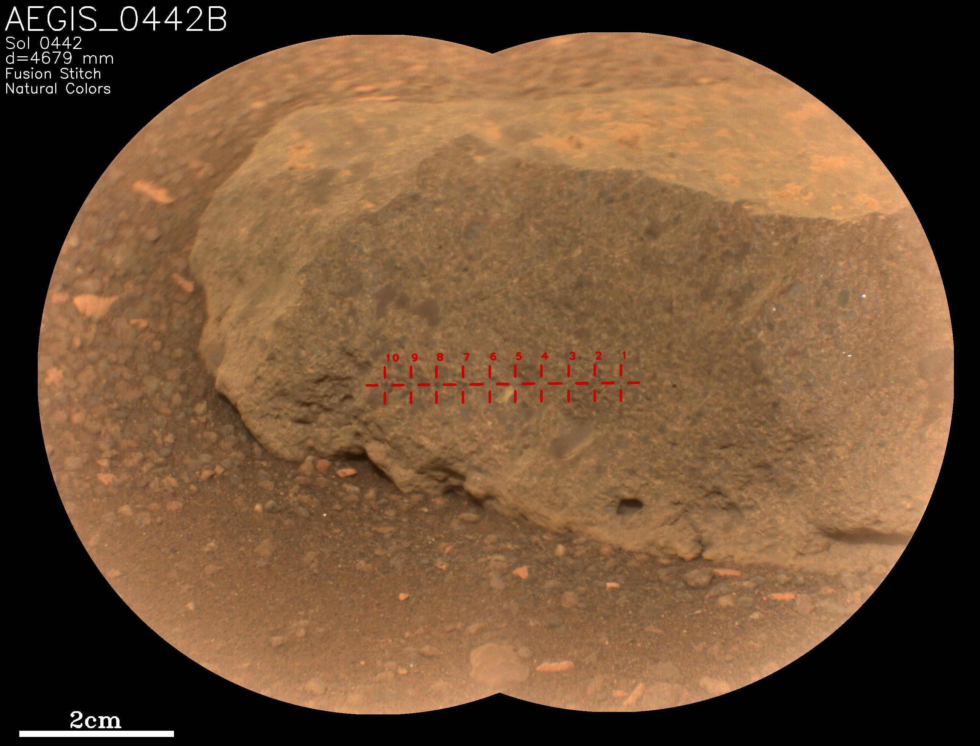
AEGIS on Perseverance
Not a one-off trick on a single rover. AEGIS first fired on the Perseverance rover's SuperCam instrument in May 2022 — the same algorithm, a different rover, a different instrument.
It's the architecture that transfers, not the number. Rockster and the random forest stay the same; the target profile is tuned for the new instrument from scratch.
NASA Science, PIA25289, 05.31.2022 · Photo: NASA/JPL-Caltech/LANL/CNES/IRAP, first use of AEGIS on the Perseverance rover's SuperCam, 05.18.2022
Notes:
The photo marks the shot NASA used to note the first use of AEGIS on the Perseverance rover's SuperCam science instrument, May 18, 2022. Up to this point, the case study on the neighboring slide spoke only about Curiosity and the ChemCam instrument, where AEGIS has run routinely since 2016 and holds 93% accuracy against the previous 24%. This shot shows the story doesn't end with one rover: the same technology carried over to a second rover and a different science instrument.
It's important to understand exactly what carried over and what was retuned from scratch. The architecture — the Rockster algorithm, which searches for candidates by brightness contrast and edges in stereo images, and the random-forest classifier, which ranks them — stayed the same, with no retraining from zero. Only the target-of-interest profile is retuned: what SuperCam's science team considers an interesting object differs from ChemCam's profile on Curiosity.
An honest gap: sources don't publish a separate accuracy figure for AEGIS on Perseverance and SuperCam, comparable to the 24%→93% for Curiosity and ChemCam. What this case shows isn't a new number — it's proven transferability: a system that works once extends to new instrument-and-rover configurations without being rewritten from scratch, just by retuning one parameter — the target profile.

Slide 21
How AEGIS is built into the rover
input
work
output
Input: NavCam stereo pair
Work: random forest ranks them
Output: coordinates for ChemCam / SuperCam
range to the object — by geometry, via parallax, not a neural network
Rockster searches for candidates by brightness contrast and edges
the classifier scores candidates against the target-of-interest profile
the scientist sets the profile in advance, on Earth, once
the shot happens onboard, with no round-trip to Earth for approval
the choice of the specific target in the moment belongs to the algorithm, not a human
Where a human used to stand. Before AEGIS, a scientist chose every target personally, from the previous cycle's image — that is, in the spot held by this diagram's third block.
What the automation did. The third block moved onboard: the target's coordinates go straight to ChemCam or SuperCam, with no waiting for a command from Earth.
Notes:
The AEGIS case study on neighboring slides has already named how it's built, in words — input, Rockster, random forest, ChemCam. This diagram gathers those same three blocks into one picture of the integration: what's at the input, what happens inside, what's at the output — and shows explicitly exactly where in this chain a human used to stand, and where an algorithm now stands.
The input is a stereo pair from the NavCam navigation cameras. Two cameras, set apart by a known distance, give the range to every point in the image by a geometric method, via parallax — a classical, non-trained part. The Rockster algorithm uses this stereo pair to find candidates for interesting objects, using brightness contrast and edges.
The work is a random-forest classifier ranking the candidates found against the target-of-interest profile. This profile isn't a choice the algorithm makes on its own: a scientist on Earth tunes it once, in advance — for example, "look for objects of such-and-such shape and brightness". Once the profile is set, the actual moment of choosing a specific target out of the many candidates happens onboard, with no human involved.
The output is the chosen target's coordinates, passed directly to the ChemCam instrument (on Curiosity) or SuperCam (on Perseverance, see the neighboring illustration) for imaging. This is exactly where the full cycle used to stand: an image to Earth, a scientist's decision, a command back to the rover — a cycle that cost a whole Martian sol for every miss. Now this entire stretch of the chain, except for setting the profile, runs onboard in a single pass.

Slide 22
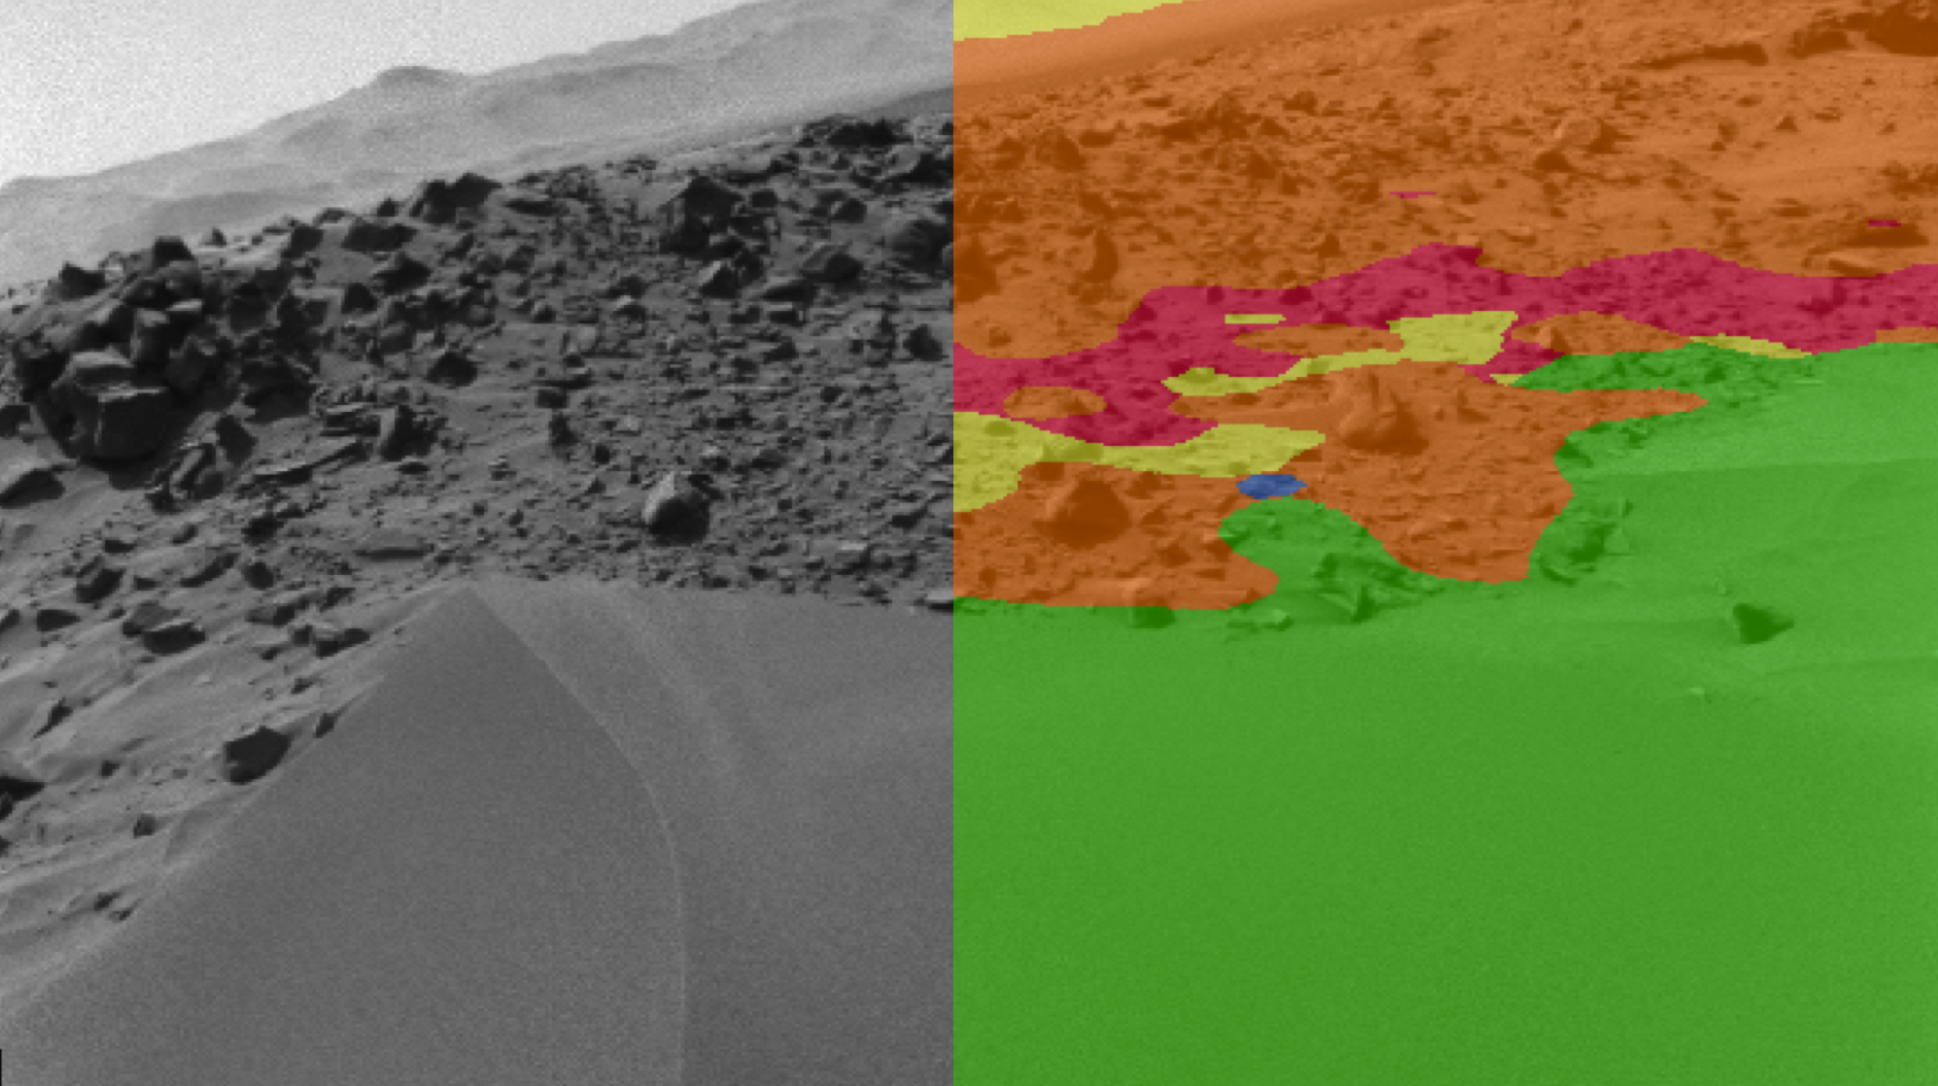
Example: SPOC — labeling Martian soil with a neural network
COST OF ERROR
CLASSICAL MODE
a stuck rover
the driver's visual judgment
loose sand mistaken for firm soil — risk of months of recovery or losing the vehicle
named, but no precise figure exists in open sources
THE MODEL (SPOC-HIRISE / SPOC-NAVCAM)
HOW IT WORKS
98% accuracy
HiRISE/NavCam input → patches → CNN → soil-class map
a deep CNN right on pixels, already used by Curiosity and Perseverance drivers
a ground tool today; forward-looking — SPOC-Lite (CPU) and SPOC-HPSC/SNPE (GPU) for a future onboard version
The feedback loop is explicitly closed — unlike AEGIS and COROB-X: the AI4Mars project (Zooniverse) is recruiting volunteers to label Perseverance images right now.
A forward-looking part. SPOC-Lite and SPOC-HPSC/SNPE are for future missions, not deployed on flying rovers.
Image classification.
NASA JPL, SPOC project page (nasa-jpl.github.io/SPOC) · AI4Mars/Zooniverse
Notes:
The volume of images piling up from the Mars program's orbital and ground cameras is growing faster than people can label them by hand — the same data growth named for the whole industry back in the Introduction. A soil-classification error isn't abstract: a misidentified surface type can lead to a stuck rover, months-long recovery, or the loss of the vehicle.
The classical mode (column b — the second mode is named, but has no number of its own in open sources): before SPOC, a human driver did the labeling, judging terrain danger by hand from their own experience; no precise figure for hours per image was found.
The model: SPOC is NASA JPL's family of deep convolutional neural networks. SPOC-HiRISE works with orbital images, SPOC-NavCam with the rover's own images. Unlike AEGIS's classifier (a random forest) and the classical AutoNav, SPOC is a full-fledged deep network, working right on pixels, with no intermediate manual extraction of geometric features. NASA states 98% accuracy. The model is already used by rover drivers for route planning on Curiosity and Perseverance right now — but it's a ground support tool, not an onboard module.
The training data isn't static: the AI4Mars project on the Zooniverse platform recruits volunteers to label Perseverance images, and those labels keep coming in and get used to improve the model — the feedback loop is set up explicitly, unlike AEGIS and COROB-X, where the composition of the training set isn't disclosed.
The forward-looking part: two variants for future onboard use — SPOC-Lite (a simple model for an ordinary CPU) and SPOC-HPSC/SNPE (a full network for a GPU, which neither Curiosity nor Perseverance has onboard). Neither is deployed today — an explicitly named, not-yet-realized direction. What moved over: labeling moved from the driver's sole visual judgment onto the model's classification layer — a decision aid, not a replacement for the driver.

Slide 23
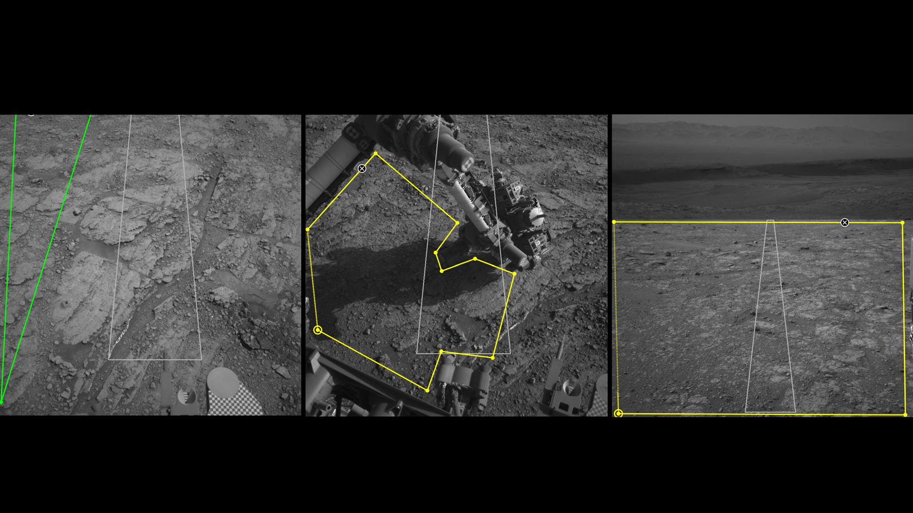
Soil for SPOC
Four surface classes, not an abstraction. Soil, bedrock, sand, and large rock — exactly the types AI4Mars asks volunteers to label.
This data is what holds up the 98% accuracy. Without a steady stream of newly labeled data, SPOC can't learn new Martian terrain.
NASA Science, PIA23897, 06.12.2020 · Photo: NASA/JPL-Caltech, Martian soil types from the AI4Mars project's data
Notes:
The photo shows three frames from Curiosity's navigation and mast cameras, with Martian soil types marked by the AI4Mars project: sand, bedrock, large rock, and ordinary soil. This isn't SPOC's output — it's the raw material: the same set of classes that volunteers on the Zooniverse platform label by hand on rover images, and it's exactly this labeled data that SPOC learns to tell safe surface apart from dangerous surface from.
The neighboring case study has already named the cost of a classification error — a rover getting stuck in loose sand mistaken for firm soil, with the risk of months of recovery or losing the vehicle. This image shows why the 98% accuracy figure isn't fixed forever: the AI4Mars project continuously collects new labels from new Perseverance images, and those labels feed back into training — the feedback loop is set up explicitly, by name, unlike AEGIS and COROB-X, where the composition of the training set isn't disclosed.
Three classes in one frame is a concrete answer to "what exactly does SPOC classify": not a binary "dangerous / not dangerous", but several surface types at once, each carrying its own risk for the rover's movement.

Slide 24
How SPOC is built into route planning
input
work
output · with the driver
Input: rover camera images
Work: CNN soil classification
Output: a traversability map
orbital HiRISE and onboard NavCam — two sources of frames
the image is sliced into patches for pixel-level classification
a deep convolutional network determines surface type right from pixels
no manual feature extraction — unlike AEGIS's random forest
the map feeds into route planning, it doesn't replace the decision
whether to drive a section or not is decided by the rover driver on Earth
The model labels, it doesn't decide. The soil-class map is a recommendation for planning, not a command that goes straight to the hardware.
The final authority is named directly. The decision to drive or not drive a specific section stays with the rover driver on Earth — same as before SPOC.
Notes:
The SPOC case study on neighboring slides has already named the accuracy — 98% — and the fact that it rests on a continuous stream of new AI4Mars labels. This diagram answers a different question: exactly where the model's output is built into the rover's route-planning process, and who decides after it.
The input is images from two sources: the orbital HiRISE camera gives a wide view of the terrain in advance, the rover's own NavCam navigation cameras give a detailed view immediately ahead of it. Both kinds of images are sliced into patches — small sections of the image that get classified separately.
The work is SPOC's deep convolutional network passing over every patch and determining surface type right from the image's pixels: soil, bedrock, sand, large rock. This sets SPOC apart from AEGIS's classifier (a random forest), which needs pre-computed geometric features before classification — SPOC doesn't need that intermediate step.
The output is a traversability map, assembled from the classifications of all the patches. The map is fed into the route-planning process as one of several inputs, alongside other terrain data — but it doesn't execute movement itself. The final authority — to drive a specific section or route around it — stays with the rover driver on Earth, the same person who made this decision before SPOC existed, just now with a more detailed hint on hand.

Slide 25
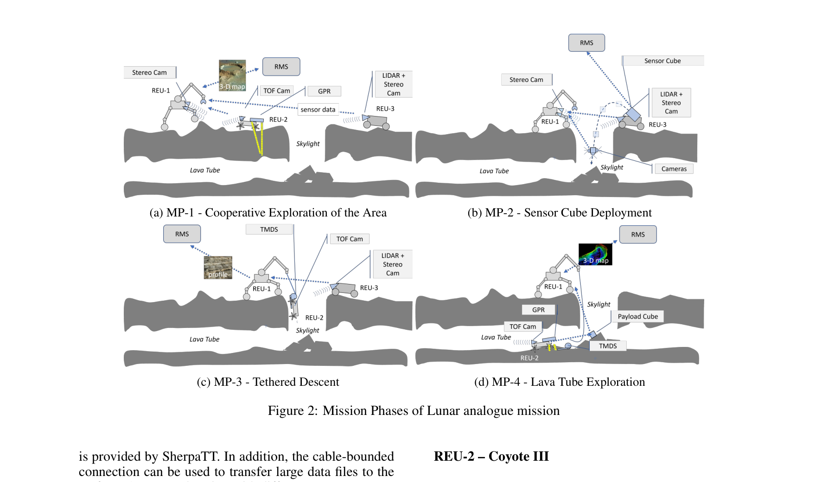
Example: COROB-X — three robots in a lava tube
COST OF RISK
CLASSICAL MODE
a ceiling collapse with no warning
does not exist
a human on a safety tether risks their life; three robots do not
no industry on Earth had solved this task before this demonstrator
AUTOMATION (SHERPATT + COYOTE III + LUVMI-X)
HOW IT WORKS
4 phases: mapping → sensor cube → tethered descent → 3D reconnaissance
visible+thermal spectrum → YOLOv4 → EaRLaP → geometry
a three-tier SLAM in the spirit of the DARPA mine architecture + a YOLOv4 CNN layer
the arbitration is the EaRLaP pipeline, filtering out false detections
What moved over. Safety unambiguously improved — three robots don't put a human life at risk. Complexity grew just as unambiguously: one human with a flashlight → three machines, a tether, a surface base station.
An honest gap. Sources don't give a numerical measure of map quality. The system has never flown to the Moon or Mars.
Image recognition.
DFKI (Germany) together with Space Applications Services · field testing, Lanzarote, 02.2023
Notes:
A human on a safety tether descends into a lava tube slowly and risks their life under an unstable cave ceiling. Three robots exploring the same space in parallel work faster and don't risk a life — but at the cost of a noticeably higher system complexity.
The classical mode (column c — the task is new, no classical earthly equivalent exists in the same units, and the reason for that is stated): no industry on Earth had solved the task of "build a 3D map of a closed underground space with no GPS, no daylight, and no connection to the surface, using several autonomous machines" before this demonstrator.
Three machines of different designs: SherpaTT — a hybrid wheel-legged robot, a surface scout and anchor for the tether. Coyote III — a light rover that descends into the entry shaft and builds an autonomous 3D map. LUVMI-X — maps outside together with SherpaTT. The work runs in four phases: surface mapping → deploying a sensor cube at the entrance → tethered descent inward → autonomous 3D reconnaissance. Under the hood is an architecture in the spirit of LAMP, already broken down using the DARPA mine case at the start of the lecture: three-tier SLAM (local odometry → match search → joint graph optimization). Object detection is a separate CNN layer, including YOLOv4, across the visible and thermal spectrum; geometric localization of a found object is classical projective geometry, not a model.
An explicit arbitration mechanism is named by name — the EaRLaP pipeline, which filters out false and missed detections before they're counted as a confirmed artifact. A human on the surface checks already-aggregated data after the fact — there's no connection to the surface at all during the reconnaissance itself. The link to the NeBula/LAMP architecture is by the spirit of the approach and family of solutions, not shared code. The three selection criteria: remove the CNN detector and the result changes; the subject matter is industry-relevant; but there's no numerical "was X, became Y" outcome here, only a qualitative comparison of risks — an honestly acknowledged boundary of the selection, not a hidden weakness.

Slide 26
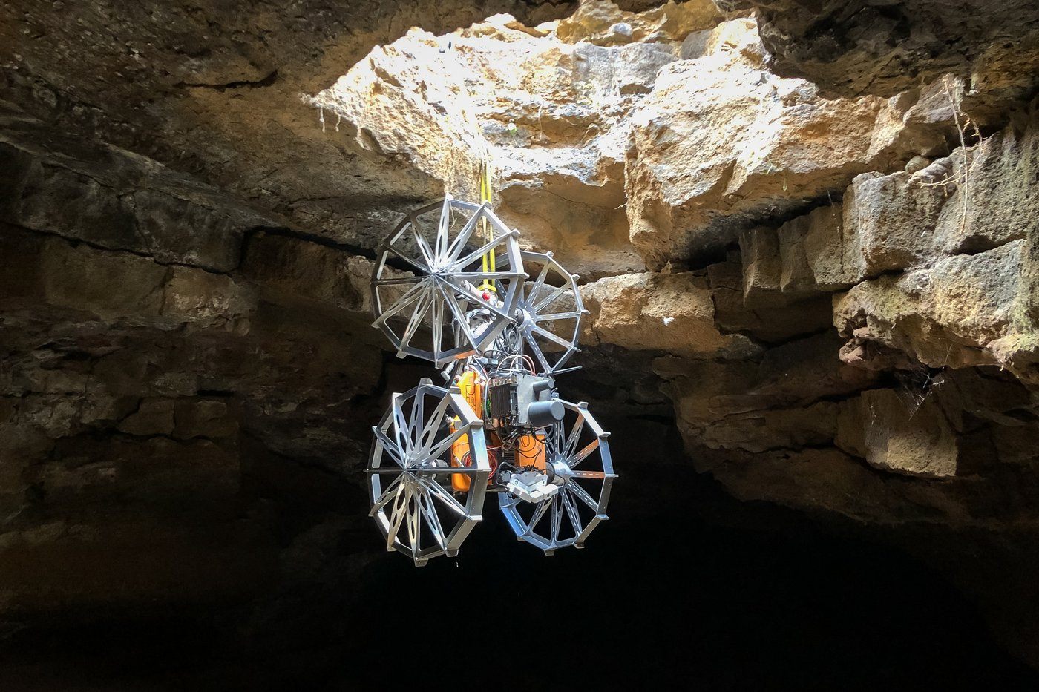
COROB-X's field test
A field test site, not the Moon. Lanzarote, Canary Islands — a lava tube chosen specifically for its geological resemblance to lunar skylights.
In the photo: the Coyote III rover, not a human. The tether holds the machine, not a climber: the same descent that only a roped human used to make.
DFKI, press release 03.08.2023 · Photo: DFKI, Tom Becker
Notes:
The photo shows the third phase of COROB-X's field test, shot in March 2023 in Lanzarote by a team from DFKI (Germany) together with Space Applications Services. The Coyote III rover descends on a tether through a skylight opening into a lava tube — a vertical shaft leading into an underground space with no GPS and no daylight. The tether is fed and held by the SherpaTT system, the same hybrid wheel-legged robot that surveys the surface outside and also serves as the anchor for the descent.
Choosing this particular test site wasn't arbitrary: Lanzarote's lava tubes are geologically similar to skylights found on the Moon and on Mars — openings in the surface leading into underground lava tubes, which are being considered as shelter for a future base from radiation and temperature swings. Testing on Earth, under conditions as close to extraterrestrial as possible, is a standard step before a system ever flies.
The shot shows exactly what the COROB-X case study is about: a descent into a tube like this with a tether and safety line used to be done by a human, at risk under an unstable cave ceiling. In this frame, the tether holds the machine — human safety in this specific operation has unambiguously improved, and along with it the complexity of the whole system has grown too: three robots of different designs, a tether, a surface base station, in place of one person with a flashlight.

Slide 27
How COROB-X's three robots build one map with no GPS
input
work
output · bottleneck
Input: three robots, three different maps
Work: matches between the robots' maps
Output: one map of the tube, with no connection to the surface
SherpaTT and LUVMI-X are outside, Coyote III is inside the tube
each computes its own displacement from sensors — with no GPS
finds places where different robots were at the same point
works even if the robots never met directly
matches become edges of a shared pose graph
the three maps stitch into one during the descent itself
The mechanism is on the neighboring slide, this one is the application. The three SLAM tiers are already broken down on the methods slide; this slide shows exactly how they're built into the COROB-X mission.
Three robots of different designs, one map. SherpaTT and LUVMI-X work outside, Coyote III inside the tube; each with no GPS and no direct link to the others during the descent.
Notes:
The neighboring slide has already named how the three-tier SLAM works, in words — local odometry, match search between robots, joint pose-graph optimization. This slide doesn't repeat that breakdown; it gathers the same three tiers into one picture specifically for COROB-X: what exactly is at the input, what happens inside, what's at the output of this specific mission in the Lanzarote lava tube.
The input: COROB-X has three machines of different designs, and each builds its own local map independently of the others. SherpaTT, a hybrid wheel-legged robot, maps the surface outside and simultaneously serves as the anchor for the tether. LUVMI-X maps outside together with SherpaTT. Coyote III descends on that tether through the skylight opening into the tube itself and builds its own 3D map there — with no GPS, no daylight, no connection to the surface. The first SLAM tier — local odometry — belongs to each robot on its own: without it, none of the three even has a map of its own.
The work: three separate maps aren't enough — without a way to stitch them together, three maps stay three unconnected maps, not one shared space. The second tier is match search between robots: the algorithm looks for moments when two different robots were at the exact same physical spot in the tube or its surroundings, even if they never met there directly.
The output: the third tier, joint pose-graph optimization, turns the matches found into additional edges of a shared graph and looks for a position for every node such that the total inconsistency across all edges is minimal. For COROB-X, this is the exact moment when the three separate maps from SherpaTT, LUVMI-X, and Coyote III become one map of the lava tube — and the stitching happens during the descent itself, while there's no connection to the surface at all yet; a human on the surface only sees the aggregated result after the fact.

Slide 28
Example: LeoLabs — radar prioritization and collision warnings
COST OF A MISS
COST OF A FALSE ALARM
loss of a satellite + a debris cascade
fuel depletion + noise for the operator
Kessler syndrome: threatens every neighboring satellite at the same altitude
unnecessary maneuvers, after which a real warning gets lost
CLASSICAL MODE
THE MODEL (LEOLABS)
government networks, named, no figure found
up to 400% more warnings
11 radars at 7 sites, detection from 2 cm; ~$60 million in annual contracts in 2026
less frequent radar imaging, a coarser detection threshold
An honest caveat. Sources don't state how many maneuvers satellites actually performed in response to these warnings in 2026 — a warning issued ≠ a maneuver performed.
For contrast. With Starlink, the automation both warns and maneuvers itself — there's no third party at all.
Classification (prioritization) on structured data.
LeoLabs (eoportal.org, leolabs.space/conjunction-alerts, SpaceNews)
Notes:
This case study is the fourth in the section, added as an explicit exception to the "up to three case studies per section" rule: it answers a question the industry overview left open — satellites grew ~12× in ten years, so what happens with that growth next, when you have to decide which two objects might collide?
The cost of a missed close approach is losing a satellite, and worse, a debris cascade threatening every neighboring satellite at the same altitude. The cost of the opposite error is too-frequent, low-quality warnings: fuel wasted on unnecessary maneuvers and operator overload, after which a real warning risks getting lost in the noise.
The classical mode (column b): before dense commercial radar networks, the catalog was maintained by government networks with less frequent imaging and a coarser detection threshold; what share of close approaches that network missed, no figure is named.
The model: LeoLabs is a commercial radar network for low Earth orbit, with 11 operating radars at 7 sites as of 2026; the company entered 2026 with annual contracts worth ~$60 million (including a SpaceWERX STRATFI grant for a new UHF radar in the Indo-Pacific, announced in March 2026), plus a NASA Space Act agreement. It detects objects from 2 cm. Its own model doesn't predict a collision directly — it prioritizes which object is most worth the radar observing next given limited time, predicting the probability of getting a good-quality measurement. There are 3–5 close approaches of large objects a week, and accounting for small debris the risk is estimated at 20 times higher; warnings prioritized by the model come out up to 400% more often.
The arbitration: the decision to maneuver stays entirely with the specific satellite's operator; LeoLabs only warns. What moved over: the decision of "what to observe next" moved from a pre-set rule onto the model; the decision of "whether to maneuver or not" didn't move anywhere.

Slide 29
How LeoLabs is built into the warning system
input
work
output · an honest boundary
Input: a growing catalog of objects
Work: a prioritization model
Output: a close-approach warning
ranks which object is most worth the radar observing next
predicts the probability of getting a good-quality measurement
11 radars at 7 sites, detection of objects from 2 cm
the orbital-debris catalog grows with every pass
up to 400% more warnings than the previous mode
whether to maneuver or not is decided by the satellite's operator, not LeoLabs
The model doesn't predict a collision directly. It solves a different task — where to point the radar next, given limited observation time.
The boundary is stated directly, with no guesswork. LeoLabs issues the warning; the decision to maneuver belongs to the specific satellite's operator, not to LeoLabs.
Notes:
The LeoLabs case study on the neighboring slide has already named the numbers — up to 400% more warnings, 11 radars at 7 sites. This diagram shows exactly how the chain is built inside: what's at the input, what the model does, and where the boundary of its responsibility ends.
The input is a growing catalog of low-Earth-orbit objects, gathered by LeoLabs's 11 operating radars at 7 sites, with detection from 2 centimeters. The catalog grows with every radar pass: new debris, new satellites, new measurements of existing objects.
The work: LeoLabs's own model doesn't predict a collision directly. It solves a different task: given limited radar observation time, which of the many objects in the catalog is most worth observing next, in order to get a good-quality measurement exactly where the risk of a close approach is higher. This is a prioritization task, not a trajectory-prediction task.
The output is a close-approach warning, issued up to 400% more often than the classical mode, with its less frequent imaging and coarser detection threshold. The boundary here isn't an accidental oversight but something stated explicitly on the neighboring case study too: LeoLabs only warns. The decision to maneuver — and whether it's even worth spending fuel on a maneuver at all — stays entirely with the specific satellite's operator. What share of the warnings issued led to an actual maneuver is something sources don't publish — the same honest gap named on the neighboring slide.

Slide 30
Section 1 mentions
• AutoNav/GESTALT — the classical approach, not a neural network: drives Perseverance for 90% of its route (against 6% for Curiosity)
• NASA IPEx — an autonomous lunar excavator, with not a single trained model: up to 10,000 kg of regolith per lunar day, TRL5 (technology readiness level 5 of 9 — tested under real conditions, not just in the lab)
• ICON Project Olympus — laser sintering of regolith; the claimed AI quality-control layer is not publicly disclosed
• Starlink — ~300,000 autonomous maneuvers a year on its own, with no third party: it warns and executes within one organization
• JPL GIMLI / Moon Diver — proposed missions into lava tubes, early selection stage, not flying vehicles
• ISRU autonomy — oxygen extraction TRL6, water extraction (LADI) TRL4
NASA JPL · NASA NTRS (IPEx) · ICON · Starlink
Notes:
This section's mentions aren't chosen as a list of "a few more interesting facts" — they're chosen by the same principle that holds up the whole course: each carries one numerical observation that none of the four detailed case studies carries — a different kind of task, a different readiness status, or a direct consequence of constellation scale.
AutoNav/GESTALT — a stereo pair builds a point cloud, a classical algorithm fits planes and builds a traversability map, over which a heuristic planner lays out a route. This is the classical approach, not a neural network, and it's exactly this system that drives Perseverance autonomously for 90% of its route — against 6% for the older Curiosity with a weaker onboard computer.
NASA IPEx — an autonomous excavator on the Moon. Its working tool is rotating bucket drums, not a classical bucket. The Auto-dig digging algorithms are classical heuristics, with not a single trained model: the physics of the soil and the drum's geometry are known to engineers in advance. Autonomy is supervised at the campaign level; up to 10,000 kg of regolith per lunar day, TRL5, hasn't flown to the Moon yet. This is the section's cleanest case where there's no trained model at all, at any level.
ICON Project Olympus — laser and microwave sintering of regolith in layers, right at the construction site; vacuum testing has been passed, delivery to the Moon is planned for 2026–2027. The architecture of the AI print-quality-control layer isn't publicly disclosed — the level is product announcements, not an engineering spec.
Starlink performs on the order of 300,000 autonomous maneuvers a year, with no waiting for operator approval at a critical moment; at that scale, maintaining a team to confirm every decision by hand would be physically impossible. This is a different point on the same spectrum of task as LeoLabs: there, a third-party network prioritizes observation and warns; here, the operator itself both observes and executes the maneuver.

Slide 31
What it gave and what it required — Section 1
Gave
Required
• Scientific productivity ×4 (AEGIS)
• Soil labeling at 98% accuracy (SPOC)
• Reconnaissance of unreachable places (COROB-X)
• Up to 400% more warnings (LeoLabs)
• Pre-certified thresholds (geometry)
• More complexity: 3 robots instead of 1 human
• $60 million/year of radar infrastructure
• The decision to respond stays with the operator
Grid cell
Case study
Classification × image
AEGIS, SPOC (at different depths)
Recognition × image
COROB-X
Classification × structured data
LeoLabs
In sum: the gain is measurable and large where the task is already solved and confirmed by working operation (AEGIS since 2016, SPOC as a ground tool already today, LeoLabs as a commercial service). Where the technology hasn't been tested on the real Moon or Mars, that's stated directly.
Notes:
What it gave: scientific productivity that grew almost fourfold (AEGIS); soil and hazard labeling at 98% accuracy, sparing drivers from having to build an assessment of every image from scratch (SPOC); reconnaissance of places physically unreachable safely for a human (COROB-X); close-approach warnings coming out up to 400% more often at detection from 2 cm (LeoLabs).
What it required: pre-calculated and certified safety thresholds where the decision stays geometric and classical — such a decision isn't delegated to learning precisely because its correctness has to be proven mathematically, not statistically; added system complexity where the task is entirely new — three robots and a physical tether instead of one human with a flashlight; growing commercial radar infrastructure and a satellite operator's own willingness to decide whether to respond to someone else's warning — a growing number and accuracy of warnings alone doesn't guarantee anyone actually responds to them.
The section's first three detailed case studies sit on one axis: in all three, a trained model is brought in exactly where a classical calculation would be insufficient (recognizing an object against statistical noise) or unreachable in reasonable time. AEGIS's classifier is lightweight — a random forest on top of geometric features. SPOC's model is heavier and works right on pixels. COROB-X's CNN detector finds the artifact, while geometric localization stays classical. The section's only case with no trained model at all is NASA IPEx (a mention). LeoLabs sits apart on this axis: the task isn't recognizing an undefined object against noise, but prioritizing a limited observation resource among a growing, already-cataloged number of candidates — a second, separate axis of the "classical approach alone / a model is needed" boundary.
The stage's cumulative map: after Section 1, three cells of the course's grid are filled — "classification × image" (AEGIS and SPOC), "recognition × image" (COROB-X), "classification × structured data" (LeoLabs). The cell NASA IPEx could have filled stays honestly empty.

Slide 32
Section 1 conclusion
AEGIS
SPOC
productivity grew almost 4×
98% soil-labeling accuracy
range geometry + a lightweight classifier on top of it, routine since 2016
a deep network on pixels — currently a support tool on the ground, not an onboard module
COROB-X
LEOLABS
cave reconnaissance with no human inside
up to 400% more close-approach warnings
three robots and a tether instead of one human with a flashlight — a task with no classical equivalent
at detection of objects from 2 cm — the satellite operator still decides whether to respond
Geometry is solved with no training — by classical calculation. Recognizing an object against noise is solved by a lightweight model inside a classical pipeline, not replacing it. A wholly new task — cave reconnaissance with no GPS or communication — has no classical equivalent at all.
Next — Section 2: the same task, a different degree of autonomy.
Notes:
Geometry in this section is solved with no training at all — a direct, engineering-grounded criterion for where a trained model isn't needed and isn't even useful: it would add unpredictability exactly where a decision can be proven mathematically rather than guessed from the statistics of examples. Recognizing an object against statistical noise is solved by a lightweight trained model built into a classical pipeline, not replacing it. A wholly new task — exploring a cave with several robots, with no GPS and no communication — has no classical equivalent at all, and here we honestly call this novelty, not a gap in the research.
For AEGIS, geometry (range measurement from a stereo camera pair) and a lightweight random-forest classifier together raise target-selection accuracy from 24% to 93% — the rover's scientific productivity grew almost fourfold, routinely, since 2016. For SPOC, a deep network works right on the pixels of an image and labels soil type and hazards at 98% accuracy — but for now this is a support tool for the rover driver on the ground, not an onboard module of the rover itself. For COROB-X, a CNN detector finds the cave artifact in a frame, and geometry — as with AEGIS — localizes the already-found object in space; the price of this autonomy is three different machines and a physical tether between them instead of one human with a flashlight. For LeoLabs, the model neither classifies nor detects, but predicts which observation will deliver more value: close-approach warnings became up to 400% more frequent at detection of objects from 2 cm, but the satellite operator still decides on their own whether to respond to the warning.
Later in the lecture — Section 2 shows a different point on the same spectrum: a system where a human still holds control, just at a distance, and shows this with a deliberate break in form — not a stage definition, but a specific scene.

Slide 33
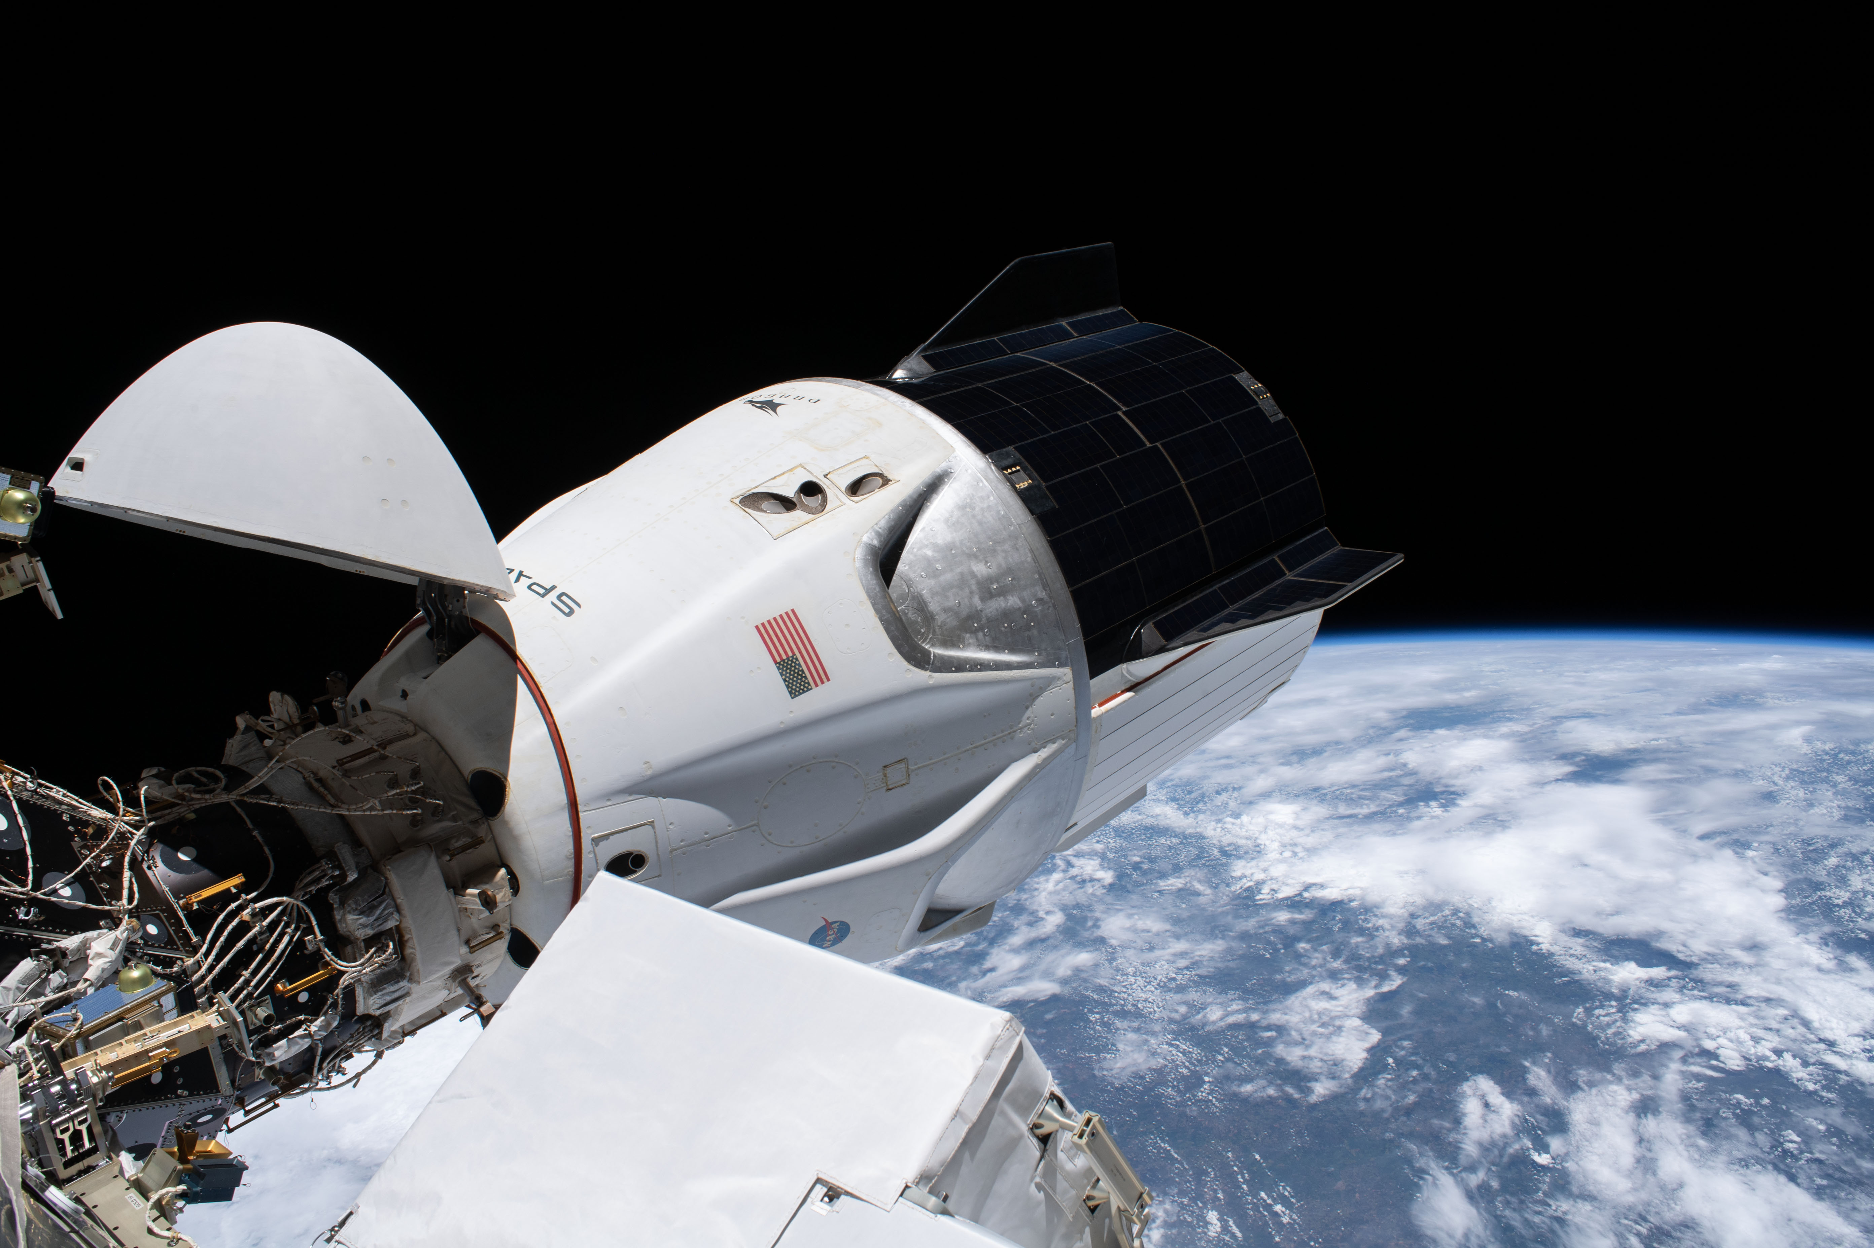
2. Teleoperation
A human is in control — but from a distance. Where does this stop working?
In order:
Dragon — autonomous docking to the ISS
Predictive latency compensation — a trained model instead of a classical filter
Astrobee — ML-assisted piloting
Notes:
This section is the second step of the chain: the degree of autonomy shown in Section 1 drops here, and we show where a human still holds control — just from a distance — before Section 3 moves away from autonomy itself to a different type of task altogether.
Three breakdowns in order: Dragon's autonomous docking to the ISS — automation gets a whole, explicitly carved-out piece of the task (the final 220 meters of approach), the human controls the rest himself. Predictive latency compensation — the trained model is not a supporting draft and not manual intervention, but the active mechanism itself, continuously predicting the scene's future state and compensating for the operator's perception of the delay. Astrobee — automation is built into every single control cycle, proposing a draft solution that a classical controller refines before trusting it.
The section opens not with a definition but with a scene — a deliberate break in form: the lecture's first substantive section was built on the form "term, general description, then breakdowns," and after that opening the form starts to become predictable. Here we deliberately break it.

Slide 34
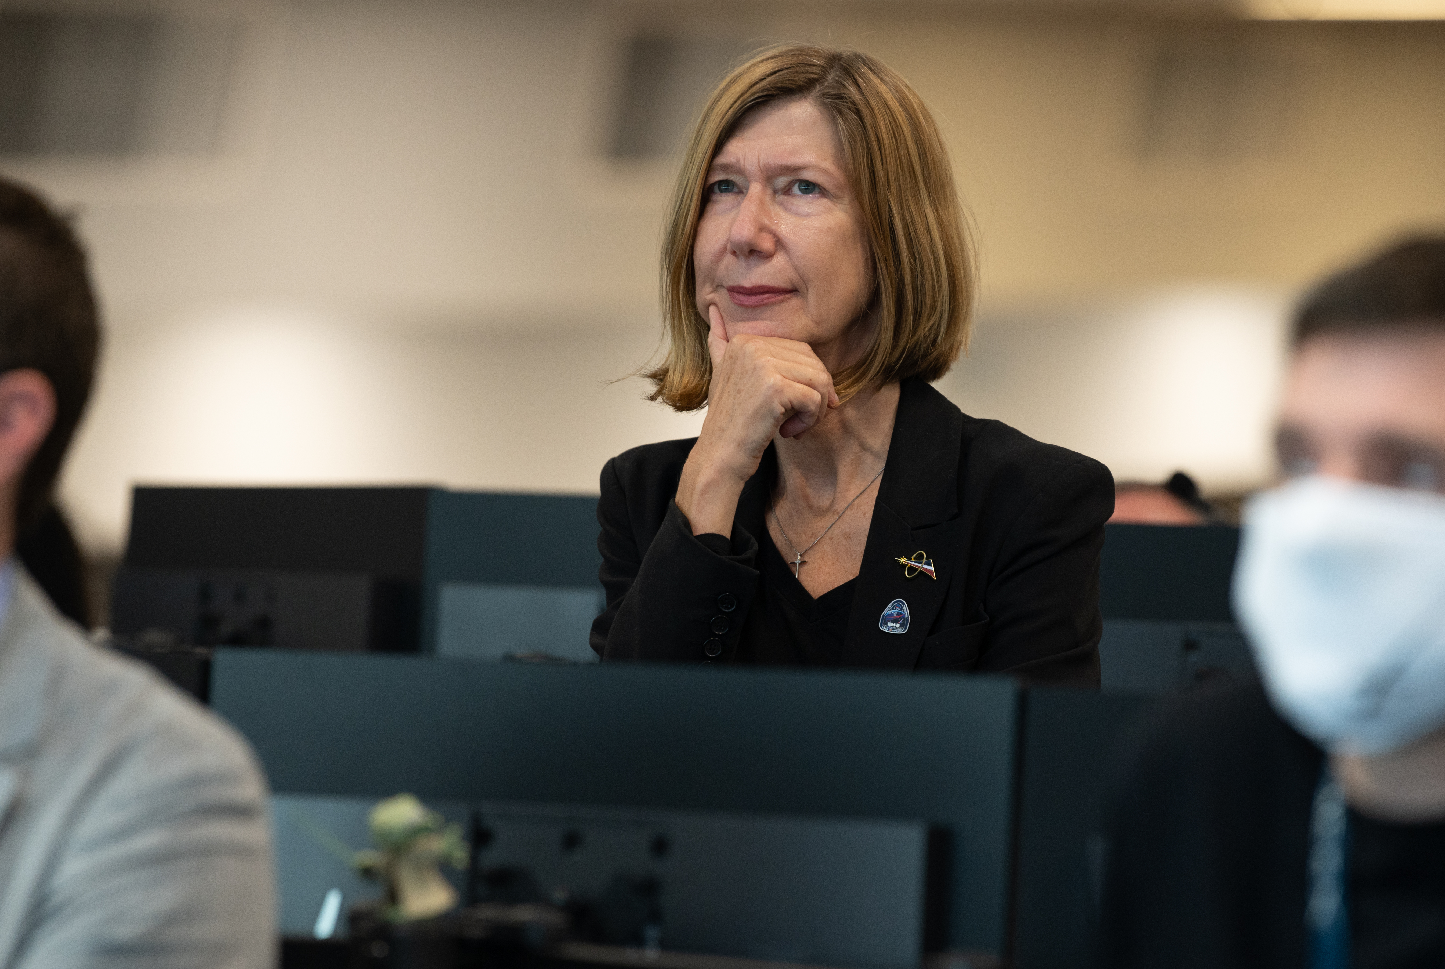
Scene: the crew watches the ship park itself
Four astronauts in the Dragon capsule, 200 meters from the ISS. The commander keeps his hands on the screen — not to fly the ship, but to be ready to take control.
The ship docks itself to the docking port without a single command from the screen: rangefinders measure distance dozens of times per second, and automation calculates the thrust. A few minutes later — the soft click of the latches.
A routine operation since 2020 — not a test, not a demo.
SpaceX/NASA, Demo-2 mission (2020)
Notes:
Four astronauts sit in the Dragon capsule two hundred meters from the International Space Station. The commander keeps his hands on the touchscreen — not to fly the ship, but to be ready to take control if something goes wrong. The ship docks itself to the docking port without a single command from the screen: laser rangefinders measure the distance dozens of times per second, automation calculates and issues commands to the attitude-control thrusters, and a few minutes later the latches click softly shut. This is not a test and not a demonstration — a routine operation that has repeated since 2020. The crew watches something happen that, until recently, required a pilot's painstaking manual work.
This scene opens the section neither by accident nor for decoration: the lecture's first substantive section was built on one and the same form — first the term and a general description of the stage, then the breakdowns. After that opening, the form starts to become predictable, and here we deliberately break it. The term and the general description of teleoperation will follow further on, only after the scene has shown what this looks like in practice.
This break in form is not decoration but a substantive device: the scene shows exactly the tension around which the whole section is built — automation acts, the human watches and stays ready to intervene — before that tension gets broken down into terms and definitions. By the time we reach the formal description of teleoperation on the next slide, you have already seen it in action and can check the definition against the example you have already seen.

Slide 35
Stage: teleoperation
TERM
DATA
teleoperation
real-time video feed + telemetry
controlling a system from a distance, the decision stays with the human
the question: how long a human can stay in the loop at a given delay
DECISION
WITHOUT TELEOPERATION
confirm or cancel an action
a human physically on site
as far as the communication delay allows
safer in terms of control, requires presence and risk
This section follows Section 1 for a reason: it shows where the boundary of autonomy has not yet been crossed — a human holds it deliberately, not by default.
Notes:
The five parts below continue the general schema opened for Section 1: term, data and question, how the data is obtained, the decision made, the alternative. Here the schema follows an unusual order of presentation — after the scene, not before it.
What kind of stage this is. The industry term is teleoperation: controlling a system from a distance, where the decision stays with the human. What data is obtained and what question it answers. The human receives a real-time video feed and telemetry. The question is how long a human can stay in the decision-making loop given the communication delay and the speed at which events unfold. How this data is obtained. A direct telemetry channel — radio or laser link — and an operator console with video and a joystick or touch interface. What decision gets made. The human confirms or cancels the system's action in real time, as far as the delay allows. This section comes after Section 1 in the lecture for a reason: it shows where the boundary of autonomy has not yet been crossed — a human holds it deliberately, not by default, not because no one bothered to build a more autonomous system. How this decision is made without teleoperation. The classical alternative is fully manual execution of the task by a human physically present on site: an astronaut personally pilots the ship or performs the operation. Safer from the standpoint of direct control, but requires physical presence and the risk that comes with it.

Slide 36
Where a human is needed, where the boundary has already shifted
TO THE ISS
TO THE MOON
a fraction of a second
1.3 seconds
the same order as the Starlink delay in telesurgery — covered later in this section (~130 ms)
plus the controller's own operational delays
TO MARS
3–22 minutes
depending on the relative position of the orbits — 2–3 orders of magnitude more than the lunar delay
This is a physical, not an organizational, reason why Section 1 and Section 2 need to be two separate sections at all — a property of the geometry of distance that no communication channel can outrun faster than the speed of light.
Where an event unfolds faster than a human can react — control is handed to automation in advance, with the right to intervene, not after the fact of an accident.
Notes:
Teleoperation works as long as the communication delay and the speed at which events unfold leave the human real time to react. At low orbit that's seconds — enough for the operator to assess the picture and respond. At Martian minutes of delay, that is physically impossible — a direct bridge to why Section 1 is an engineering necessity on Mars, not a convenience.
The communication delay between two points in space is set by distance and the speed of light — a quantity that no engineering solution can get around, unlike channel bandwidth. The delay to the ISS is a fraction of a second, the same order as the Starlink delay in telesurgery — a case that comes up later in this section (~130 ms). The delay to the Moon is 1.3 seconds plus the controller's own operational delays. The delay to Mars is 3 to 22 minutes, depending on the relative position of the orbits; even the lower bound is two orders of magnitude greater than the lunar delay, and the upper bound is nearly three. This is a physical, not an organizational, reason why Section 1 and Section 2 need to be two separate sections: the boundary between them is not an engineer's choice but a property of the geometry of distance.
Where the event itself unfolds faster than human reaction — an emergency maneuver, the final fraction of a second of docking — control is handed to automation in advance, before the event happens, with the human's right to intervene, not the obligation to perform the action himself. This is a key distinction: the decision of "who acts at this moment" is made not after the human turns out unable to react, but in advance, by engineering, at the design stage.
All three detailed breakdowns in the section belong to different organizations and countries with no connection to each other, and each in its own way shows automation or a model inside the loop — not coordination, but a parallel, independent emergence of automation wherever that one physical constraint demands it.

Slide 37
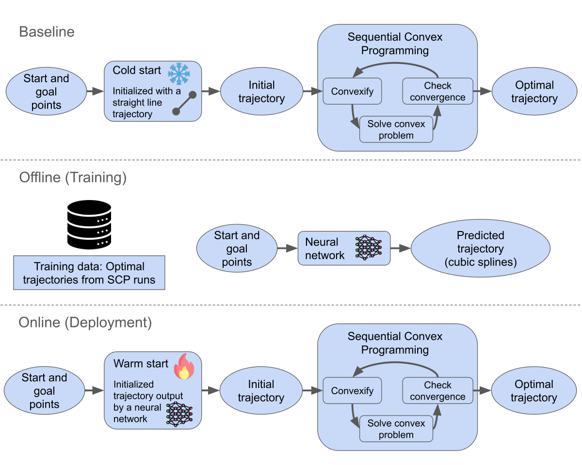
How the methods are built: the classical controller and the warm start
base
acceleration
separate mechanism
Controller (feedback)
Warm start
Predictive latency compensation
measures → compares → computes a command, dozens of times a second
stability guarantees — strictly within the given conditions
the model suggests a starting point for the trajectory search
the final guarantee does not change — the controller checks the solution
the model predicts the scene across the interval of the communication delay
changes what the operator sees, not what they decide
The controller's key property. Provable mathematical stability guarantees — but strictly within the conditions it was designed for in advance.
A warm start in the worst case — does not make the final decision any less safe, only spends more iterations refining it.
Notes:
Behind the phrase "a boundary of responsibility set in advance, manual intervention, or a classical controller as the last line of defense" stand two specific mechanisms, different in nature.
The controller is an algorithm that performs the same sequence of three steps on every cycle: measures the current state, compares it with the desired one, and computes a control action. This cycle is feedback: the controller does not predict the entire future motion in advance, but continuously, dozens of times a second, corrects the course based on the observed deviation. No single correction has to be perfect — stability is provided by the cycle's own frequency. The key property is provable mathematical stability guarantees — but strictly within the conditions the controller was designed for in advance.
When the controller's task is not just "hold the course" but find a whole trajectory around obstacles (Astrobee's task), the controller solves the optimization problem iteratively: it starts from an initial guess and gradually improves it. A warm start is when that initial guess is not arbitrary but suggested: a model trained on the statistics of past trajectories offers a starting point already close to a good solution. Critically, the warm start does not change the final safety guarantee — it is simply a better starting point for the same classical mechanism, which still checks the final solution either way. In the worst case, if the warm start is unlucky, the controller simply spends more iterations — no worse off than without it.
The third, separate mechanism is predictive latency compensation. Neither the controller nor the warm start solves the control task here: the trained model directly predicts how the scene will change over an interval equal to the communication delay and overlays the prediction on the operator's video feed — it changes what they see, not what they decide.

Slide 38
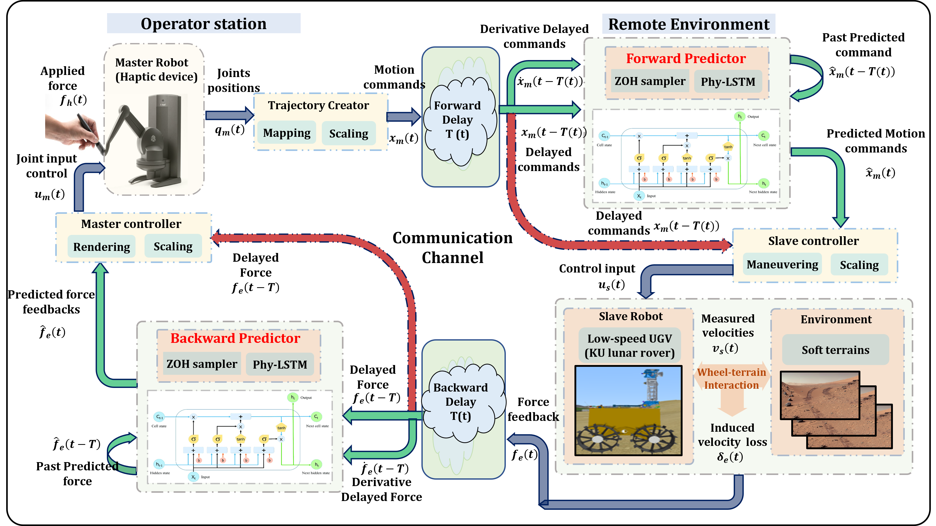
How predictive latency compensation is built
input
work
output · honest gap
Input: delayed stream
LSTM or temporal convolutional network
Output: frame for the operator
video and recent history of the scene's motion from the remote site
the frame is already stale by the amount of the communication delay
the predicted, corrected frame replaces the raw video on the screen
the sources name no formal threshold for checking the prediction
the LSTM steps through frames one at a time and keeps a memory
the TCN looks at a window of past frames at once, without memory
trained on recorded past sessions of scene motion
Changes what the operator sees, not what they decide. Neither the controller nor the warm start is involved here — all movement commands stay with the human.
An honest gap. The sources name no formal threshold for checking the prediction before it is shown.
Notes:
The breakdown of the controller and the warm start named predictive latency compensation as a third, separate mechanism — but did not explain how it is built inside. This slide closes exactly that gap, mechanically, before moving on to assessing its effect and its honest status in a separate case study.
The input is a video feed and the recent history of the scene's or object's motion from the remote site; by the time this stream reaches the operator, the communication delay has already passed, and the frame shown lags reality by that amount. Two variants of the trained model solve the same task — predicting how the scene will change going forward in time — but read the history differently. The recurrent LSTM network processes frames in order, one after another, and at each step updates an internal memory that carries information from the distant past into the current moment. The temporal convolutional network (TCN) is built differently: it does not keep a step-by-step memory, but applies a convolution at once over a whole window of recent frames — the same way an ordinary convolution over an image looks at once at a pixel's neighborhood, except here the neighborhood is stretched in time rather than in space. Both architectures are trained on recorded past sessions of scene motion — not specifically on lunar data; the sources do not detail the makeup of the training set for the lunar analog separately.
The output is the predicted frame, corrected for the delay, which the operator sees on their console instead of the raw, delayed video. This is where this mechanism's honest gap stands: the sources name no formal threshold or check at which the model's prediction would be confirmed or rejected before being shown — the operator simply sees the corrected picture and trusts it directly.
The key difference from the other two mechanisms in the same section is not that a trained model replaces the classical approach, but WHAT exactly it changes. The controller and the warm start change the movement command — what the system or operator ultimately does. Predictive latency compensation does not touch the command at all: the operator still decides where to move and still issues every command — only the image in front of their eyes changes, the material on which they base their decision.

Slide 39
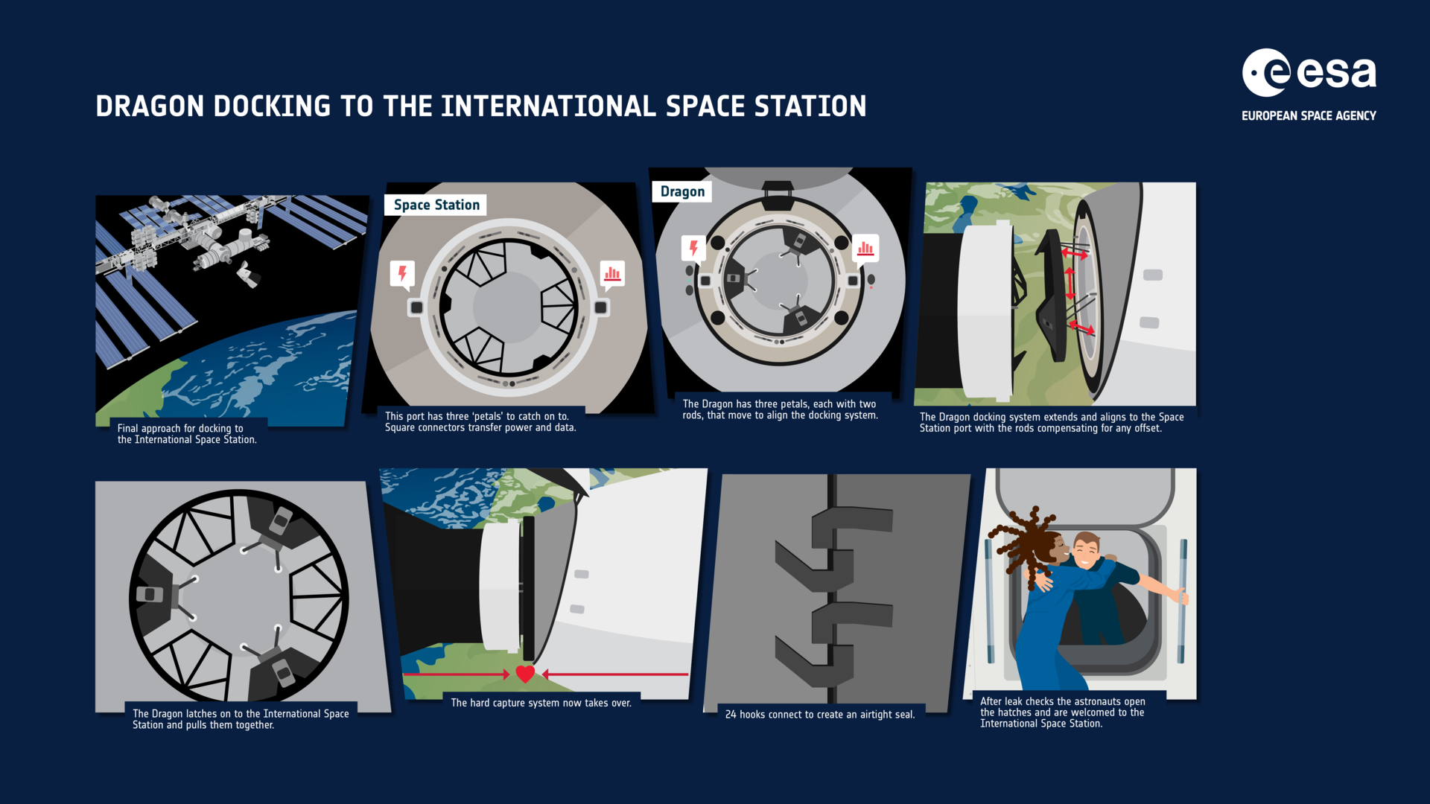
Example: Dragon's autonomous docking to the ISS
COST OF MANUAL ERROR
COST OF FULL AUTOMATION WITH NO MANUAL INTERVENTION
millisecond precision at the edge of motor control
an unforeseen scenario
speed, angle, and position must coincide with hard-to-achieve precision
any system designed for a finite set of scenarios risks running into a new one
CLASSICAL MODE
AUTOMATION (NASA DOCKING SYSTEM)
manual docking, Shuttle / Soyuz
autonomous from 220 meters
named, but the hours of preparation and attempt statistics are not published
routine since 2020; manual intervention available at any moment
220 meters is not a physiological limit of reaction time, but an engineering decision: where automation is reliably more precise than a human.
What moved over. Precision of the final approach — to automation; responsibility — stays with the human: he monitors and can intervene, though he almost never does.
NASA/SpaceX, Demo-2 mission (2020)
Notes:
Manual piloting on the final meters of docking requires millisecond precision with minimal margin for error — a task at the edge of human motor capability. Full automation with no ability to intervene is a risk in an off-nominal situation the algorithm did not anticipate.
Classical mode (column b): manual docking, performed by the crews of the Space Shuttle and Soyuz — a named but uncounted baseline: the procedure takes hours of pilot preparation, but the exact number and the statistics of successful attempts are not published — just as the success rate of Dragon's autonomous phase is not published either.
Model/automation: the NASA Docking System — on the Demo-2 mission in 2020, the commander manually piloted the ship to a distance of 220 meters, after which the ship autonomously performed soft docking. The crew monitors the process, and manual control is available to return at any moment. Input — laser rangefinders and video feed; output — attitude-control thruster commands. Why exactly 220 meters: a balance between how far out automation already has sufficiently precise rangefinder data, and the range within which human motor control still performs no worse than automation — the sources do not detail the exact methodology behind choosing this boundary.
Five questions of engineering depth: manual piloting has not disappeared, but is preserved for the stretch within 220 meters; the threshold is set in advance, arbitration is manual intervention; the sources characterize the operation as "routine since 2020" without publishing attempt statistics; the control system's architecture is not publicly disclosed by SpaceX — honestly unknown whether it is trained statistically or computed classically, like G-FOLD. Three selection conditions: the architecture is undisclosed, but the exception "AI enabled something that was impossible without it" applies; the subject is unconditionally industrial; column b — hours of preparation are named without a number.

Slide 40
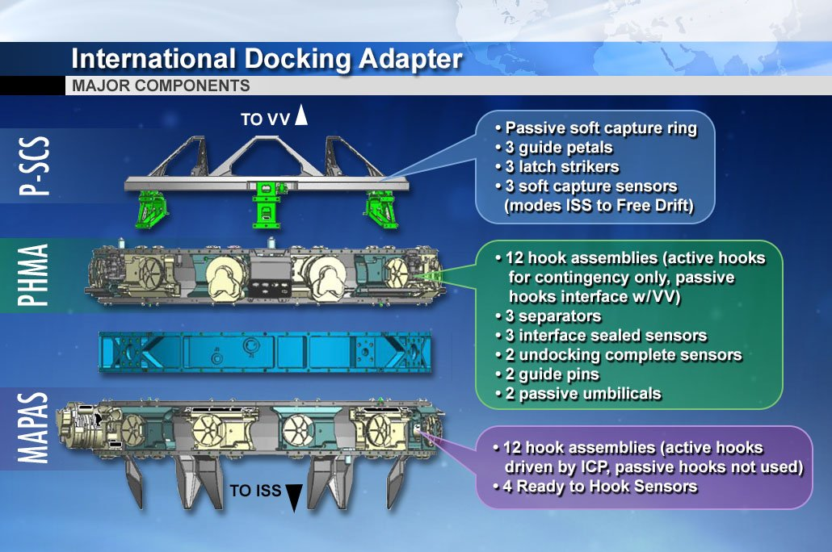
Dragon's docking port
Real hardware, not a diagram. The ring, alignment sensors, soft capture latches — this is exactly what physically receives Dragon on the final meters of approach.
This is exactly where the precision named on the neighboring slide arrives. Millimeter tolerance in angle and position is not an abstraction, but a requirement of this specific mechanism.
Wikimedia Commons, NASA, 08/19/2016 · Photo: NASA, main components of the docking mechanism, public domain
Notes:
The photo shows the main components of the International Docking Adapter, the same NASA Docking System design that Dragon autonomously approaches over the final 220 meters. The photo was taken in 2016, before Crew Dragon's crewed flights began, and shows the mechanism on the ground, without a ship nearby — exactly the hardware the automation is aiming for.
The elements visible in the photo — the docking ring, alignment sensors, and soft capture latches — work as the final mechanical check on the automation's calculation: even a perfectly calculated approach trajectory must coincide with this specific physical ring within the given tolerance, or soft docking will not happen.
The neighboring breakdown already named the price of manual error — millisecond precision at the edge of human motor control. This photo makes that price literal: you must coincide not with an abstract point in space, but with a real mechanical component of a specific size, visible in the photo. It is to this mechanical precision, not to an arbitrarily chosen number, that the automation of the NASA Docking System, operating on Dragon since 2020, is calibrated.

Slide 41
How Dragon's docking automation is built
input
work · honest gap
output
Input: laser rangefinders and video
Work: internal control logic
Output: autonomous docking from 220 meters
the NASA Docking System's architecture is not publicly disclosed by SpaceX
trained statistically or computed classically, like G-FOLD — unknown
per public data — LIDAR and cameras on approach to the station
range and approach angle are measured in real time
routine since 2020, precision at the edge of human motor control
the crew can take manual control at any moment
An honest gap — not a research shortfall, but a fact about Dragon. SpaceX does not publish what happens inside the middle block of this diagram, and the chapter states this directly instead of guessing.
The outer blocks are known precisely. Input — sensors per public data; output — routine autonomous docking since 2020, with manual intervention standing ready.
Notes:
This diagram is built differently than its neighbors: the middle block — "work" — is not described in detail here, not because the breakdown was too lazy to find a source, but because the company itself has not publicly disclosed this part. That deserves to be shown honestly, not filled in with a plausible guess.
Input — per public data, Dragon's approach to the International Space Station uses laser rangefinders and a video feed that measure distance, angle, and relative velocity to the docking port in real time (see the neighboring illustration of its actual components). This is the only part of the diagram confirmed openly by technical descriptions.
Work — but exactly what happens between the measurement and the command to the thrusters, SpaceX does not publicly disclose. It is unknown even at the level of principle: whether the control logic is computed classically, like, for example, the G-FOLD algorithm for stage landings, or whether part of the solution is statistically trained on data from past dockings. Calling it a "neural network" or a "classical controller" without a source would mean guessing a fact that is not publicly available — so the lecture's breakdown openly leaves this block as an honest gap.
Output — nonetheless known precisely: starting with the Demo-2 mission in 2020, the automation routinely performs autonomous docking from a distance of 220 meters, with precision at the edge of human motor control. The crew is not taken out of the loop, though: manual control is available to return at any moment, although it is almost never used. This case shows that an "honest gap" is not a sign of a weak breakdown: sometimes the most precise thing you can say about a system's internal design is to call it undisclosed, rather than invent a plausible design in its place.

Slide 42
Example: predictive latency compensation
COST OF OVER-CAUTION
COST OF RISK
slow, often-stalling work
acting on a stale picture
the operator waits to make sure the picture has 'caught up' with reality
correcting an already-made move in jerky steps
CLASSICAL MODE
MODEL (LSTM / TCN)
extrapolation at constant speed
reduces task time by up to 26%
works while motion is uniform; errs on sharp changes
lunar analog facilities — a research stage, not routine practice
Honest status: a research stage, not deployed practice. Tests are at lunar analog facilities, not on a real mission; the lunar analog is confirmed by a single journal source, not a series of independent repetitions.
Prediction on video — the first appearance of the "video" modality in the lecture's grid.
Frontiers in Space Technologies 10.3389/frspt.2026.1920649 · ScienceDirect S1526149226000639
Notes:
At high communication delay, the operator either over-compensates — moving slowly, stopping often to make sure the visible picture has caught up with reality — or takes the risk of acting on an already-stale picture. Both strategies pay in task time.
Classical mode (column b): simple extrapolation at constant speed — the system assumes the object will keep moving the same way and completes the picture by the amount of the delay. Works as long as motion is actually uniform, and errs the more sharply the scene changes.
Model: a research direction from 2026, several independent publications, including tests at lunar analog facilities. The trained model — a recurrent LSTM network or a temporal convolutional network (TCN) — predicts the scene's future state forward in time by the amount of the delay and overlays the prediction on the operator's video feed in real time. The measured effect in one publication is a reduction in task completion time of up to 26% at high delay compared with ordinary video.
It's worth stating the status honestly: this is a research stage, not deployed practice. Most publications on this technique are general robotics and telemedicine, not specifically lunar testing; the lunar analog is confirmed by one specific journal source. The sources describe no formal threshold or arbitration mechanism: the operator remains the one who makes all the decisions, the model only affects what they see. What moved over: the burden on the operator's own perception moved to the model, which performs the compensation computationally. Three selection conditions: remove the model and the operator reverts to raw video or linear extrapolation, so the change is directly caused by the model; the subject is industrial; column b — the effect is named with a number, but it is one publication, not statistics across many trials: the confirmation here is weaker than for Dragon or Astrobee, where the effect is verified by routine operation.

Slide 43
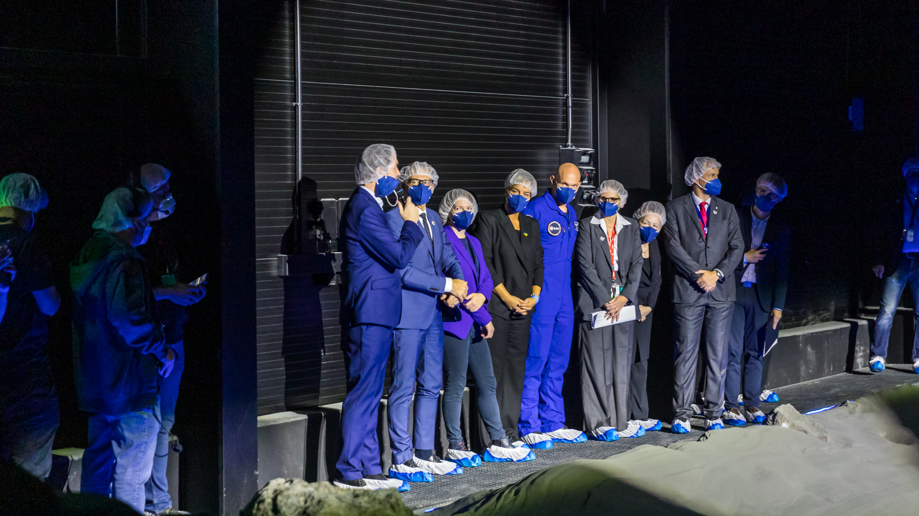
The LUNA analog facility, Earth
Honestly: this is Earth, not the Moon. The LUNA facility (Germany, ESA/DLR) is covered with lunar regolith simulant — a test at a site resembling the target, not the target itself.
This is exactly where what was broken down nearby is tested. Predictive latency compensation — a research stage, not deployed practice on a real mission.
Wikimedia Commons, Raimond Spekking, 09/25/2024, CC BY-SA 4.0 · Photo: Raimond Spekking, Wikimedia Commons, CC BY-SA 4.0 — a demonstration by astronauts at the LUNA facility (Earth)
Notes:
The photo shows a demonstration involving two astronauts at the LUNA facility, an analog complex of the European Space Agency and the German Aerospace Center (DLR) in Cologne. This needs to be said honestly and right away: despite the name, the photo shows Earth — a facility covered in lunar regolith simulant, built precisely to test hardware and procedures under lunar-like conditions before they ever actually fly.
The neighboring breakdown has already named the status of predictive latency compensation directly: a research stage, not deployed practice, confirmed at lunar analog facilities, not on a real mission. This photo is a literal illustration of that caveat: a lunar-like setting, real people in real spacesuits or simulation suits, but under Earth's sky and Earth's gravity.
The difference between the facility and the actual Moon is not a formality. The facility has no real multi-second communication delay produced by the distance to the Moon — it has to be artificially simulated, along with the rest of the conditions of a lunar operation. That is why the confirmation here is weaker than for Dragon or Astrobee, which routinely operate under real conditions: the confirmed effect (reducing task time by up to 26%) was measured under lunar-approximating conditions, not on the Moon itself.

Slide 44
Example: Astrobee — ML-assisted piloting
COST WITHOUT AN ASSISTANT
COST OF FULL AUTONOMY WITHOUT A CHECK
delay and load on the operator
collision risk
multiple small course corrections from Earth
the station's cramped interior space
CLASSICAL MODE
MODEL (WARM START)
manual remote piloting
TRL5, tested aboard the ISS
named, the number of interventions per maneuver is not published
Stanford + NASA, 12/2025; the robot was handed to Arkisys in summer 2025
Arbitration is not human, but machine. The classical controller automatically refines or rejects the model's proposal on every cycle, before it becomes a thrust command.
The only breakdown in the section where the sources name the developing organization (Stanford) separately from the operating organization (NASA).
Stanford + NASA, demonstration 12/2025
Notes:
Fully manual remote control of a free-flying robot creates delay and load on the operator with every small course correction. Full autonomy with no human check is a risk of collision with the station's equipment in its cramped interior space.
Classical mode (column b): manual remote piloting — the number of operator interventions per maneuver without the assistant is not given as an exact number; the reduction in load with the model is also not expressed as a percentage.
Model: a joint Stanford and NASA demonstration, December 2025 — the first demonstration of ML control on the "warm start" principle: the model proposes an initial approximation of the trajectory, which is refined by a classical controller before execution. TRL5, tested in a real operational environment aboard the ISS, not in a lab. Input — current position and target point; output — the proposed trajectory for the controller to check. The robot has flown on the ISS since 2019; in summer 2025 it was handed to the commercial company Arkisys — the warm-start demonstration took place after that handover.
Why a warm start is needed if the controller can solve the task on its own: a controller that has to find a trajectory from scratch either has to search through more options for longer, or accept a coarser solution; the model proposes a starting point significantly closer to a good solution, and the controller is left not to search but to refine — at the same final safety guarantee. Arbitration here is not human but machine: the classical controller automatically refines or rejects the model's proposal. What moved over: the load from small corrections dropped, but the warm start is not full autonomy — the model's proposal still passes through the classical controller. Three selection conditions are met without caveats on the first two, column b on the third.

Slide 45
Astrobee on the ISS
A cube-shaped body with no tether and no legs. Astrobee holds itself in the air with fans that push air out through side nozzles — not magnets, not wheels, not grabbing the walls.
This exact free flight is what the warm start refines. The model proposes a flight path through the station's module, and the classical controller checks it before every maneuver.
NASA Johnson Space Center, Wikimedia Commons, 05/01/2024 · Photo: NASA Johnson Space Center, public domain
Notes:
The photo shows Astrobee in free flight inside the Japanese "Kibo" module of the International Space Station, taken by NASA Johnson Space Center. The body is a cube roughly 32 centimeters on a side, with no tether and no mechanical attachment to the station: internal fans keep it aloft and move it by pushing air out through controllable nozzles on the sides of the body, generating thrust in the needed direction. This is fundamentally different from the station's earlier robots, which held onto handrails or moved along guide rails — Astrobee moves through the module's entire free volume on its own.
It is exactly this kind of movement — finding a path through a cramped space full of equipment, with a risk of collision on every maneuver — that is the task refined by the "warm start" covered on the neighboring slide: a model trained on the statistics of past trajectories proposes a draft route, and a classical feedback controller checks and refines it before execution, without changing the final safety guarantee.
The robot has flown on the ISS since 2019, in several units — the photo shows one of them, with no human visibly present nearby: it is exactly the absence of constant manual control that allows the trajectory statistics to accumulate, on which the warm-start model is later trained.

Slide 46
How the warm start is built into Astrobee
input
work
output · bottleneck
Input: free flight inside the station's module
Work: the model proposes, the controller refines
Output: thrust command to the fans
current position and target point, fans instead of a tether
the space is cramped — risk of collision on a maneuver
the model, on statistics of past trajectories, suggests a start
the feedback controller refines it before the maneuver
the controller carries the final safety guarantee
an unlucky start only costs more iterations, no worse off
The warm start's design is on the neighboring slide; here — what it is built into. This mechanism suggests the starting point of the trajectory specifically for Astrobee's free flight inside the station's cramped module.
The final decision is not the model's. The controller checks and refines the proposed trajectory before every command to the fans.
Notes:
The neighboring slide already broke down the warm start's design as a general technique: a feedback controller measures, compares, and corrects dozens of times a second, while the model only suggests a good starting point for the trajectory search. This slide does not repeat that breakdown — it shows exactly which device and exactly which task it is built into for Astrobee.
Input — Astrobee is a cube-shaped body roughly 32 centimeters on a side, with no tether and no mechanical attachment to the station; internal fans that push air out through controllable nozzles on the sides of the body keep it aloft and move it. The task's input is the robot's current position and a target point inside the "Kibo" module, a cramped space full of equipment, where the risk of collision exists on every maneuver.
Work — here the controller needs not just to hold a course, but to find an entire trajectory through this cramped space around obstacles. A model trained on the statistics of Astrobee's past trajectories (the robot has flown on the ISS since 2019, without constant manual control, which is what allowed this statistics to accumulate) proposes an initial approximation of the route — already close to a good solution, not an arbitrary point. The classical feedback controller accepts this approximation as the starting point for its own iterative search and gradually refines it.
Output — a corrected thrust command to the fans, which the controller executes only after its own check. The final safety guarantee of the maneuver does not change because the start was suggested by the model: if the suggestion turns out unlucky, the controller simply spends more iterations refining it — the result will be no worse than if there had been no warm start at all.

Slide 47
Mentions from Section 2
• Exosuit with "artificial muscles" (Bristol) — tested only in Earth analog missions, never flew in space
• ESA exosuit — force feedback: the operator feels the tool's resistance physically, not just visually
• Earth–ISS delay — a fraction of a second, the lower bound of the range that Section 1 stretches out to 22 minutes
• Telesurgery over Starlink — delay ~130 ms; lung resection on an animal model, performed remotely; there is no trained model in the decision loop at all
University of Bristol · ESA · PMC (telesurgery)
Notes:
These four mentions hold up the side of the section not covered by the three detailed breakdowns: two show teleoperation through a physical, wearable shell, the third brings the delay scale back to Section 1's numbers, and the fourth is an honestly kept compact case where the decisive leap was made not by a model but by communication infrastructure.
An exosuit with "artificial muscles" (University of Bristol) for teleoperating a manipulator robot outside the station — tested only in Earth analog missions, reduces operator muscle fatigue; never flew in space. The ESA exosuit is a different design for the same purpose: a teleoperator on the station controls an external robot through force feedback, feeling the tool's resistance physically.
The Earth–ISS communication delay is a fraction of a second, the lower bound of the same range that Section 1 stretches out to twenty or more minutes at Martian distances.
Telesurgery over Starlink — the decisive leap was made by communication infrastructure, not by a model. Starlink provides a delay on the order of ~130 milliseconds, which proved sufficient to perform a lung resection on an animal model remotely: the surgeon controls the instrument through a console directly, and there is no trained model in the decision loop at all — automation here is limited to transmitting the signal. There is no classical Earth-based analog for "telesurgery over a low-orbit satellite" (column c): terrestrial telesurgery over fiber-optic cable is a different delay and different infrastructure. This case stands not as a weak fourth breakdown, but as an explicit example of where the boundary of AI's application passes right by the task altogether: the decisive leap belongs to communication infrastructure, and calling this an application of artificial intelligence would be a substantive error.

Slide 48
What it gave and what it required — Section 2
Gave: access to operations without physical presence at the event — the surgeon stays on Earth, the operator at the console, the crew a witness at the moment of docking.
Required: being willing to accept that not everything is routine practice (latency compensation is only an analog); deciding in advance exactly when automation acts without confirmation.
Grid cell
Breakdown
Forecasting × video
Predictive latency compensation — the first appearance of the 'video' modality
Planning × structured data
Astrobee
— (architecture not disclosed)
Dragon
— (no trained model at all)
Telesurgery over Starlink (mention)
Notes:
In sum, teleoperation expands where a task can physically be performed, but does not remove the dependence on the communication link — it only changes what exactly depends on that link: not the human's presence, but the channel's stability and delay.
The section's three detailed breakdowns fall into a clear order by the role automation plays within them. With Dragon, automation performs the final, most precise part of the task entirely, but on a pre-defined segment outside of which the human controls. With predictive latency compensation, the trained model compensates for the perception of the delay itself throughout the whole task, without making decisions for the operator — a research stage, not routine practice. With Astrobee, automation is built into every control cycle, proposing a draft that a classical controller refines before it becomes a command. Next to these three — compactly, but honestly — stands the extreme, fourth case of the spectrum: with telesurgery over Starlink, there is no automation in the decision at all, only communication infrastructure carrying the human's decision. From "no automation at all" through "automation compensates perception" and "automation on a pre-defined segment" to "automation on every cycle, but not the final word" — this is a gradual escalation that directly foreshadows the transition to Section 3, where the model's role grows further still.
Cumulative stage map: to the three cells filled after Section 1, Section 2 adds two new ones. For Dragon, the architecture is undisclosed (the cell is conditionally empty). For predictive latency compensation, the "forecasting × video" cell is filled — the first appearance of the "video" modality in the entire grid. For Astrobee, the "planning × structured data" cell is filled. After two sections, five cells are filled, and it is clear that maximum autonomy and the teleoperation spectrum together cover noticeably more task types than Section 1 alone.

Slide 49
Conclusion of Section 2
DRAGON
PREDICTIVE COMPENSATION
partially
column b
via the exception 'enabled what was impossible without it'
the effect is one publication, not statistics
ASTROBEE
STARLINK TELESURGERY
column b
does not pass
without caveats on the first two conditions
there is no trained model at all — a breakdown of a false match
Where delay and speed do not allow it — control is handed to automation in advance with the human's right to intervene, not replaced by it entirely and not taken away from the human after the fact of an accident.
Bridge to Section 1: at a 22-minute delay at the far end of the range, no human on Earth can be "in the loop" in the sense the Dragon commander was at a distance of 200 meters.
Notes:
A human stays in the decision loop for as long as communication delay and the speed of events actually allow it. Where they do not allow it, control is handed to automation in advance with the human's right to intervene — not replaced by it entirely, and not taken away from the human after the fact of an accident, but handed over by an engineering decision made before the event happened.
Further along the cycle — the same communication constraint, stretched to an interplanetary scale, where teleoperation stops being an option at all. This is the bridge to why Section 1 is necessary on Mars, not merely convenient: at a delay of several minutes, let alone 22 minutes at the far end of the range, no human on Earth can be "in the loop" in the sense the Dragon commander was in the loop at a distance of two hundred meters from the station.
For Dragon, the first selection condition passes partially, via the exception "AI enabled something that was impossible without it"; the second is unconditionally industrial; the third is column b, with the hours of manual preparation named without an exact number. For predictive latency compensation, the first condition is met directly; the second is unconditionally industrial; the third is column b, with an honest caveat: the effect is named as a number from one publication, not statistics across many trials. For Astrobee, the first and second are met without caveats; the third is column b, with neither side having an exact number. For Starlink telesurgery, the first condition fails literally — there is no trained model at all; this is exactly the case the course deliberately provides a separate genre for: a breakdown of a false match, where the content is the failure of the selection condition itself, not a win over it.
Further on, Section 3 moves away from autonomy of action itself to a different type of task — design and forecasting.

Slide 50
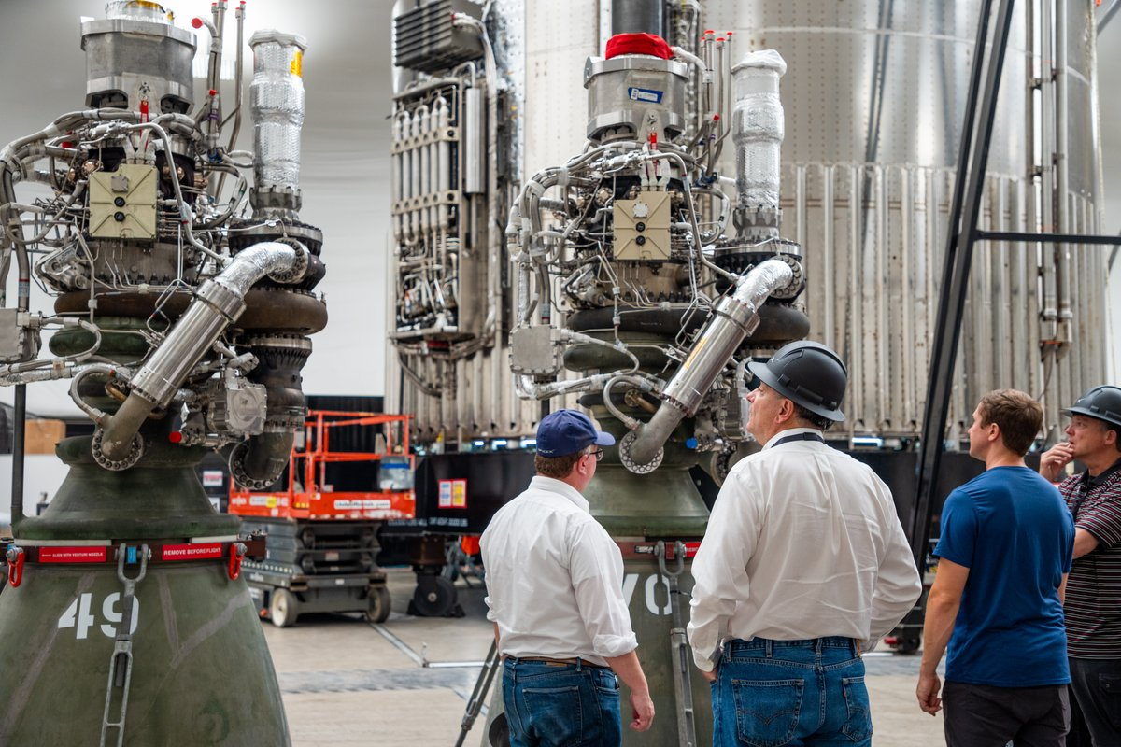
3. Design and new capabilities
Not autonomy of action — thinking at the drafting table, which did not exist before at all.
In order:
Surrogate models — in Raptor engine design
Claude/Anthropic — rover route planning
AIFS and AIGEFS — AI weather forecast models
Generative design — NASA Goddard structures
Notes:
This section closes the second half of the lecture by type of AI contribution — from action (Section 1) and remote control (Section 2) to thinking at the drafting table, which previously required only a human or a supercomputer.
Four breakdowns in order, of varying scale of impact: the Raptor surrogate model solves a task inside one engineering department of one company. Rover route planning by the Claude model is the task of one operational team (JPL), but the result is publicly checkable by the final distance traveled. AIFS and AIGEFS weather forecasting is a task whose result touches not one company, but entire weather services and, through them, millions of people. NASA Goddard's generative design of structures is a task already applied today to several real mission concepts of the agency, including a future flagship telescope.
In all four, the model does not replace the process — it changes how many options can be considered in the same amount of time. At the same time, not one of the four models does the entire job on its own, start to finish: the final check in every case is a separate, non-AI step. This is the third of the lecture's main honest boundaries, and it runs through the whole section the same way: the model expands the search space, it does not replace the check.

Slide 51
Stage: AI-assisted design and forecasting
TERM
DATA (4 AREAS)
AI-assisted design and forecasting
engine configurations, imagery + terrain, atmosphere, geometry space
tasks that make possible what did not exist at all
thousands of variants / route / forecast / structure
WITHOUT A MODEL
manual calculation, hours per variant
CFD (computational fluid dynamics — computing flow and combustion) for one configuration, manual planning, a supercomputer, CAD iteration by iteration
Why this section comes third, not first. Design seems like the most "obvious" niche for AI. Putting it first would hide what the section actually shows: even where distance is not a constraint, the model still does not fully replace the classical check.
Notes:
Five parts — the third application of the lecture's general schema, already familiar from Sections 1 and 2. In this section, the schema unfolds three or four different subject areas at once rather than one — and that is justified because all of them represent one type of AI contribution.
What kind of stage this is. The industry term is AI-assisted design and forecasting: tasks that do not speed up an already-existing process, but make possible something that did not exist at all. What data is obtained. Four different types for four breakdowns: thousands of combustion configuration variants, orbital imagery and terrain, the global state of the atmosphere, the space of possible structural geometries. There is one common question: can you search through, plan, compute, or generate something that previously physically did not fit within an engineer's available time or a computational window. How this data is obtained without a model. Manual engineering calculation and simulation one variant at a time; manual route planning by an engineer from imagery; numerical physical computation on a supercomputer, taking hours across thousands of processors; manual design of a part's geometry in CAD, step by step.
Why does this section come third, after autonomy of action and teleoperation, rather than first? Because intuitively, design and forecasting seem like the most "obvious" niche for artificial intelligence — a task that does not require physical presence anywhere at all. Putting it first would mean starting with the case most intuitively simple and hiding what the section actually shows: even where physical distance does not matter, the model still does not fully replace the classical check. Having gone through Sections 1 and 2, you have already seen this pattern on material where distance was a constraint; here the same pattern is confirmed on material where distance is not a constraint at all — and that is a stronger claim.

Slide 52
Where the model gives a new capability, where its role is invisible
The model's scale of impact grows by orders of magnitude between breakdowns — from one engineering department to several real NASA mission concepts. The engineering principle does not change — except for one explicit exception.
In the first three breakdowns, the model predicts a number or a plan over an already-given structure. In generative design, it produces the geometry itself, which no one specified in advance.
Notes:
In all four breakdowns of this section, the model does not replace the process — it changes how many options can be considered in the same amount of time: thousands of engineering configurations instead of dozens, a whole route instead of one segment at a time, a forecast in minutes instead of hours. At the same time, not one of the four models does the entire job on its own, start to finish: the final check in every case is a separate, non-AI step. This is the third of the lecture's main honest boundaries: the model expands the search space, it does not replace the check.
It's worth saying separately why this section is methodologically harder than the previous two. In Section 1, the boundary was mostly visible: geometry is classical, recognition is the model. In Section 2, the boundary is also fairly clear: either the model proposes the solution, or there isn't one at all, or the architecture is undisclosed. In Section 3, the boundary blurs differently: here the model genuinely performs substantive intellectual work, but that work is always embedded in a larger process, with classical steps standing before and after it.
The four breakdowns are chosen to show different scales of task and different types of model contribution. The Raptor surrogate model solves a task inside one engineering department. Rover route planning is the task of one operational team, publicly checkable by the final distance traveled. Weather forecasting is a task whose result touches entire weather services and millions of people. Generative design is already applied today to several real mission concepts, including a future flagship telescope. The scale of impact grows by orders of magnitude, the engineering principle does not change — except for one explicit exception: in the first three breakdowns, the model predicts a number or a plan over an already-given structure; in generative design, the model itself produces the geometry that no one specified in advance — a qualitatively different type of contribution.

Slide 53
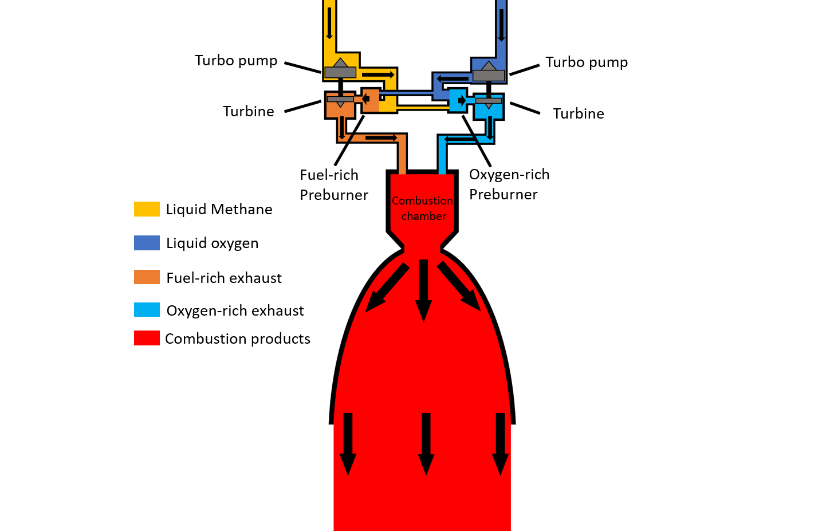
How the methods are built: the surrogate model and generative search
COST OF THE SURROGATE'S LIMITATION
FROM SURROGATE TO GENERATIVE DESIGN
guaranteed only within the trained range
evaluation → production
a surrogate answers 'how good is this configuration'; generative design asks 'what geometry can even exist here'
outside it — the prediction may be inaccurate, and there's no way to know without a full check
Steps
CFD simulations
(expensive, hours)
Pairs of "parameters → result"
as training examples
The surrogate predicts
in seconds
Surrogate model: the expensive stage happens once, after that — almost free
The expensive stage does not disappear — it moves to a different point in time. It still takes computing enough examples in advance, once, for the network to learn the pattern — and those examples are exactly the same "hours of computation per variant."
Notes:
This section's general principle is that the model expands the space of searchable options, it does not replace the final check. But the mechanism itself, by which the model performs its part of the work, is worth breaking down separately: the surrogate regression model that holds up Raptor and, in a modified form, generative design.
A surrogate model, in an engineering context, is a trained neural network that replaces an expensive physical simulation with an approximate but fast prediction. Engineers first run a full physical CFD simulation for a set of configurations covering a reasonable range of parameters — this is the expensive stage, hours of computation per variant. Pairs of "configuration parameters → simulation result" become training examples, and on them the network learns to predict the result directly from the parameters. After training, the network predicts almost instantly — not because it "computes physics faster," but because it does not compute physics at all: it statistically reproduces the relationship between input and output.
This acceleration has exactly one cost: the surrogate's accuracy is guaranteed only within the range of parameters seen during training. For a configuration far from anything the model has seen, the prediction may be inaccurate — and there is no way to find that out in advance without a full physical check. It follows directly that a final CFD check of selected candidates is mandatory not because engineers distrust the model on general principle, but because it is the only way to find out whether a specific chosen configuration has stepped outside what the model has ever seen.
Generative design of structures uses structurally the same fast-evaluation technique — but not to rank already-enumerated variants, but as an internal step of an iterative search algorithm that itself proposes and modifies a part's geometry. The Raptor surrogate answers "how good is this particular configuration"; generative design answers "what geometry can even exist here" — the object the model acts on is different: a number versus a geometry.

Slide 54
How the methods are built: attention on the weather grid
LECTURE 2: ATTENTION OVER TOKENS
AIFS/AIGEFS: ATTENTION OVER THE ATMOSPHERE'S GRID
Q/K/V, neighbor = a position in text
Q/K/V, neighbor = physical adjacency of points
'a flashlight in a dark room' — the beam is pointed at the relevant tokens
a point's query is compared against the keys of physically close points
input
work
output
Query of a point
Keys of the neighbors
Values of the neighbors
'what information do I need from my neighbors'
computed for every grid point
compared against the query — which neighbors are relevant
neighbor = physical adjacency on the grid, not a position in text
the physical quantities of neighboring points
a weighted sum by the match between the query and the keys
Why the architectures are 16-layer — not a coincidental number, but a trade-off between how far one point's influence needs to spread in a single pass and how much that costs computationally.
Notes:
Lecture 2 already broke down the attention mechanism in a language model: for every token, three projections are computed — query, key, and value — and the model decides how strongly each token should attend to every other token, weighting the values by the match between the query and the keys. The working metaphor is a flashlight in a dark room: the beam is pointed at the relevant tokens.
This same idea — not similar, but structurally the same — works inside the AIFS and AIGEFS processor. The difference between the two applications is not in the weighting math itself, but in what counts as a "neighbor." For a language model, a neighbor is a position in the sequence of words. For a weather model, a neighbor is the physical adjacency of points on the globe's grid: a grid point computes a query and compares it against the keys of physically close points, not against an arbitrary other point on the planet directly.
Take a grid point over the ocean, near which a low-pressure area is forming. Its query is, roughly speaking, "what information from my neighbors do I need to predict my own pressure six hours from now." The keys of neighboring points are what each one can offer: a point with falling pressure carries a key different from its calm neighbors. The values are the physical quantities of those points themselves, summed with weights according to the degree of match.
This does not mean the influence of distant points is unreachable — the architecture is multi-layered. AIFS is built as a 16-layer transformer with a sliding attention window: at each layer, a point sees only the neighbors within the window, but across several layers the influence spreads further. AIGEFS is a message-passing graph network: at each layer, a node collects messages from directly connected nodes. Message-passing and attention are close relatives in idea, but not literally one mechanism in formula detail: AIFS is literal Q/K/V attention, AIGEFS is a related but formally different aggregation method, tracing back to the GraphCast architecture.

Slide 55
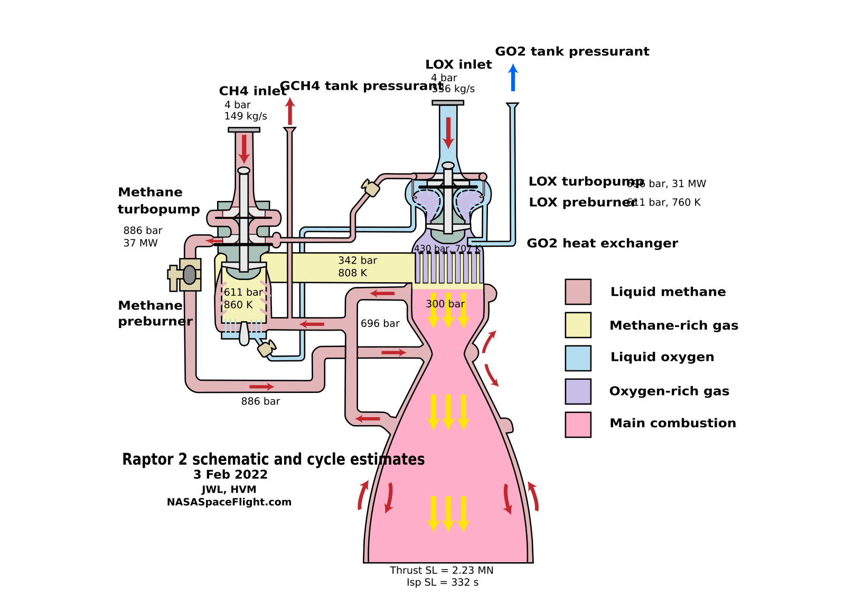
Example: surrogate models in Raptor engine design
COST OF A FULL CFD SIMULATION
COST OF THE SURROGATE
hours of computation per variant
accurate only within the trained range
limits the search to dozens of variants per cycle
outside it — the prediction is inaccurate, and there's no way to find out without a full check
CLASSICAL MODE
MODEL (SPACEX SURROGATE)
full CFD computation, dozens of variants per cycle
thousands of variants in the same cycle
a counted baseline
prediction in seconds, calibrated against a subset of real CFD cases
What moved over. The engineer now sorts thousands of variants, not dozens — the stand still decides. The model widens the search, not the check.
Honest gap. SpaceX names no exact numbers for the surrogate-to-stand funnel.
Forecasting on structured data.
Job postings and publications of SpaceX's "AI for Vehicle Engineering" team
Notes:
A full physical CFD simulation of one combustion configuration takes hours of computation. The surrogate model gives a prediction in seconds, but it is trained on a limited set of already-computed examples — and its accuracy is exactly as good as that set allows.
Classical mode (column a): a full CFD computation, hours per variant; the number of variants an engineer manages to consider in one design cycle is limited to dozens.
Model: a surrogate neural network, trained on an array of combustion and aerodynamics CFD simulation data, predicts a configuration's behavior orders of magnitude faster than the full physical simulation. The existence of a standing "AI for Vehicle Engineering" team inside SpaceX is confirmed by open job postings and publications — a working engineering tool, not a marketing claim. Input — engine configuration parameters; output — predicted combustion characteristics. Accuracy is calibrated against a subset of actually computed CFD cases — the surrogate is periodically checked against "real" physics.
Why combustion and aerodynamics specifically are especially well suited to surrogate modeling: a full CFD simulation solves a system of nonlinear differential equations anew for every new geometry — hence hours of computation. The surrogate does not solve these equations at all: it statistically approximates the relationship between input and output, having learned it once.
The classical process has not disappeared, but split into two stages: first the surrogate, as a wide filter, selects the most promising variants out of thousands, then the narrow selected set goes through a full CFD simulation and a bench test. SpaceX does not disclose exact public metrics — an honest gap. Three selection conditions are met, although the confirmation here is weaker than in many other breakdowns: the company does not publish exact numbers on either side.

Slide 56
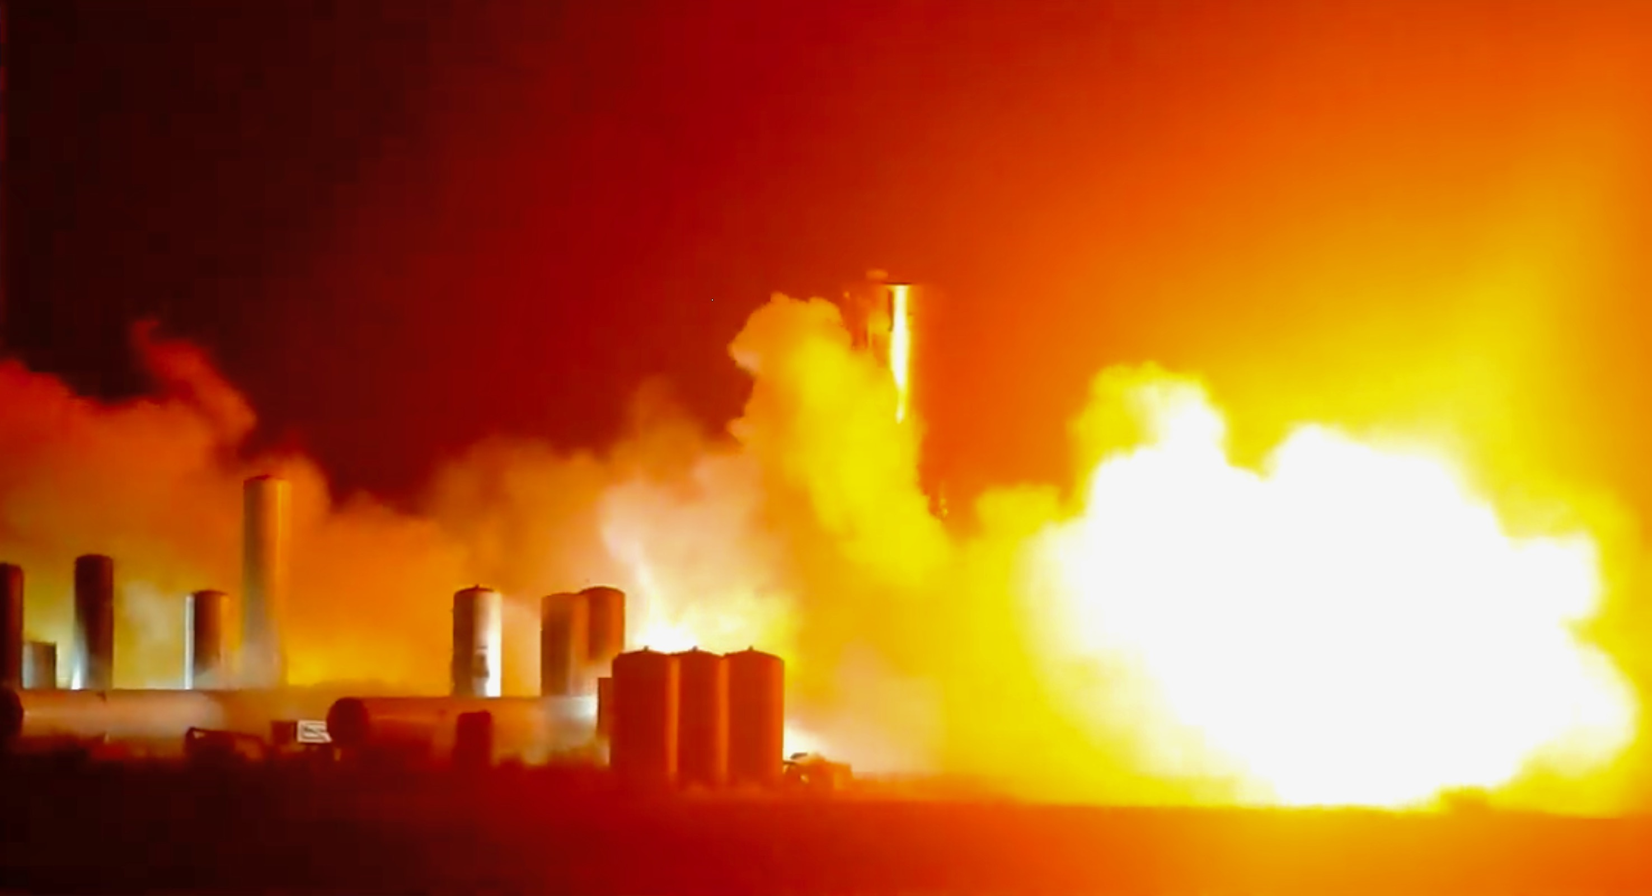
Raptor's test fire
This is exactly the final check named on the neighboring slide. The surrogate filters thousands of variants in seconds — but only a selected candidate that has passed the full CFD simulation ever reaches this kind of fire.
The fire is not an illustration of power, but a measuring instrument. This is exactly where the surrogate model's accuracy is calibrated against real combustion physics.
Wikimedia Commons, photo by Steve Jurvetson, 05/05/2020, CC BY 2.0 · Photo: Steve Jurvetson, Wikimedia Commons, CC BY 2.0 — Raptor static fire test on Starship SN4, Boca Chica
Notes:
The photo shows a static fire test of the Raptor engine on the Starship SN4 prototype at SpaceX's Boca Chica site, May 2020. This is a real, not staged, frame: a real flame under a real stage prototype, the very final stage that the whole process broken down on the neighboring slide leads to.
The neighboring breakdown already named the design: a surrogate neural network, trained on an array of combustion CFD simulations, predicts an engine configuration's behavior in seconds instead of hours of full physical computation, and the engineer sorts through thousands of variants instead of dozens. But the surrogate's prediction is not the final decision. It is exactly the static fire test shown in this slide — the step that confirms or rejects the prediction against real physics, not against a statistical approximation.
This is a direct illustration of the surrogate model's boundary, named nearby: the surrogate's accuracy is guaranteed only within the range it saw during training, and there is no way to find out that a specific configuration has stepped outside that range without a full check. The test stand visible in the photo is exactly that full check: expensive, slow, but the only one that truly confirms whether the engine will withstand the load in reality, not just in the network's prediction.

Slide 57
How the surrogate model is built into the Raptor engine
input
work
output · bottleneck
Input: Raptor configuration parameters
Work: the surrogate predicts in seconds
Output: selection moves on to CFD check and the stand
combustion chamber geometry, fuel-feed parameters
the range of accuracy is set by the CFD training set
trained on SpaceX engineers' own combustion CFD computations
predicts characteristics instead of hours of computation
selected configurations go through full computation and fire
accuracy is not guaranteed outside the trained range
The surrogate's design is on the neighboring slide; here — exactly what it integrates into. This same fast-evaluation technique works here for a specific Raptor engine, not an abstract example.
The network does not decide the final outcome. Selected configurations go through a full CFD computation and a static fire test — the same thing visible in the neighboring photo.
Notes:
The neighboring slide already broke down the surrogate model's design as a general technique: engineers compute expensive CFD simulations in advance, pairs of "parameters → result" become training examples, and the trained network afterward predicts the result almost instantly — but only within the range it saw during training. This slide does not repeat that breakdown; it shows exactly which configuration of which engine this technique is built into at SpaceX.
Input — the parameters of a specific Raptor engine configuration: combustion chamber geometry, fuel-feed parameters. The range of parameters within which the surrogate's prediction can be trusted is set not by the physics of the engine itself, but by which configurations the engineers managed to compute in advance with a full CFD simulation and include in the training set.
Work — the surrogate neural network, maintained by the standing "AI for Vehicle Engineering" team inside SpaceX (the team's existence is confirmed by open job postings and publications, not a marketing claim), is trained on an array of combustion and aerodynamics CFD computations specifically for Raptor. After training, the network predicts combustion characteristics from configuration parameters in seconds — not because it computes physics faster, but because it does not compute physics at all: it statistically reproduces the relationship between input and output, learned from already-computed examples.
Output — this integration's bottleneck is named directly: the surrogate's prediction for Raptor is not the final decision. The wide set of promising variants selected by the surrogate goes on to a full CFD simulation, and then to a static fire test on the stand, the same one shown in the neighboring Starship SN4 photo. It is exactly this test that calibrates the surrogate's accuracy against real combustion physics and screens out configurations the surrogate misjudged by stepping outside what it saw during training.

Slide 58
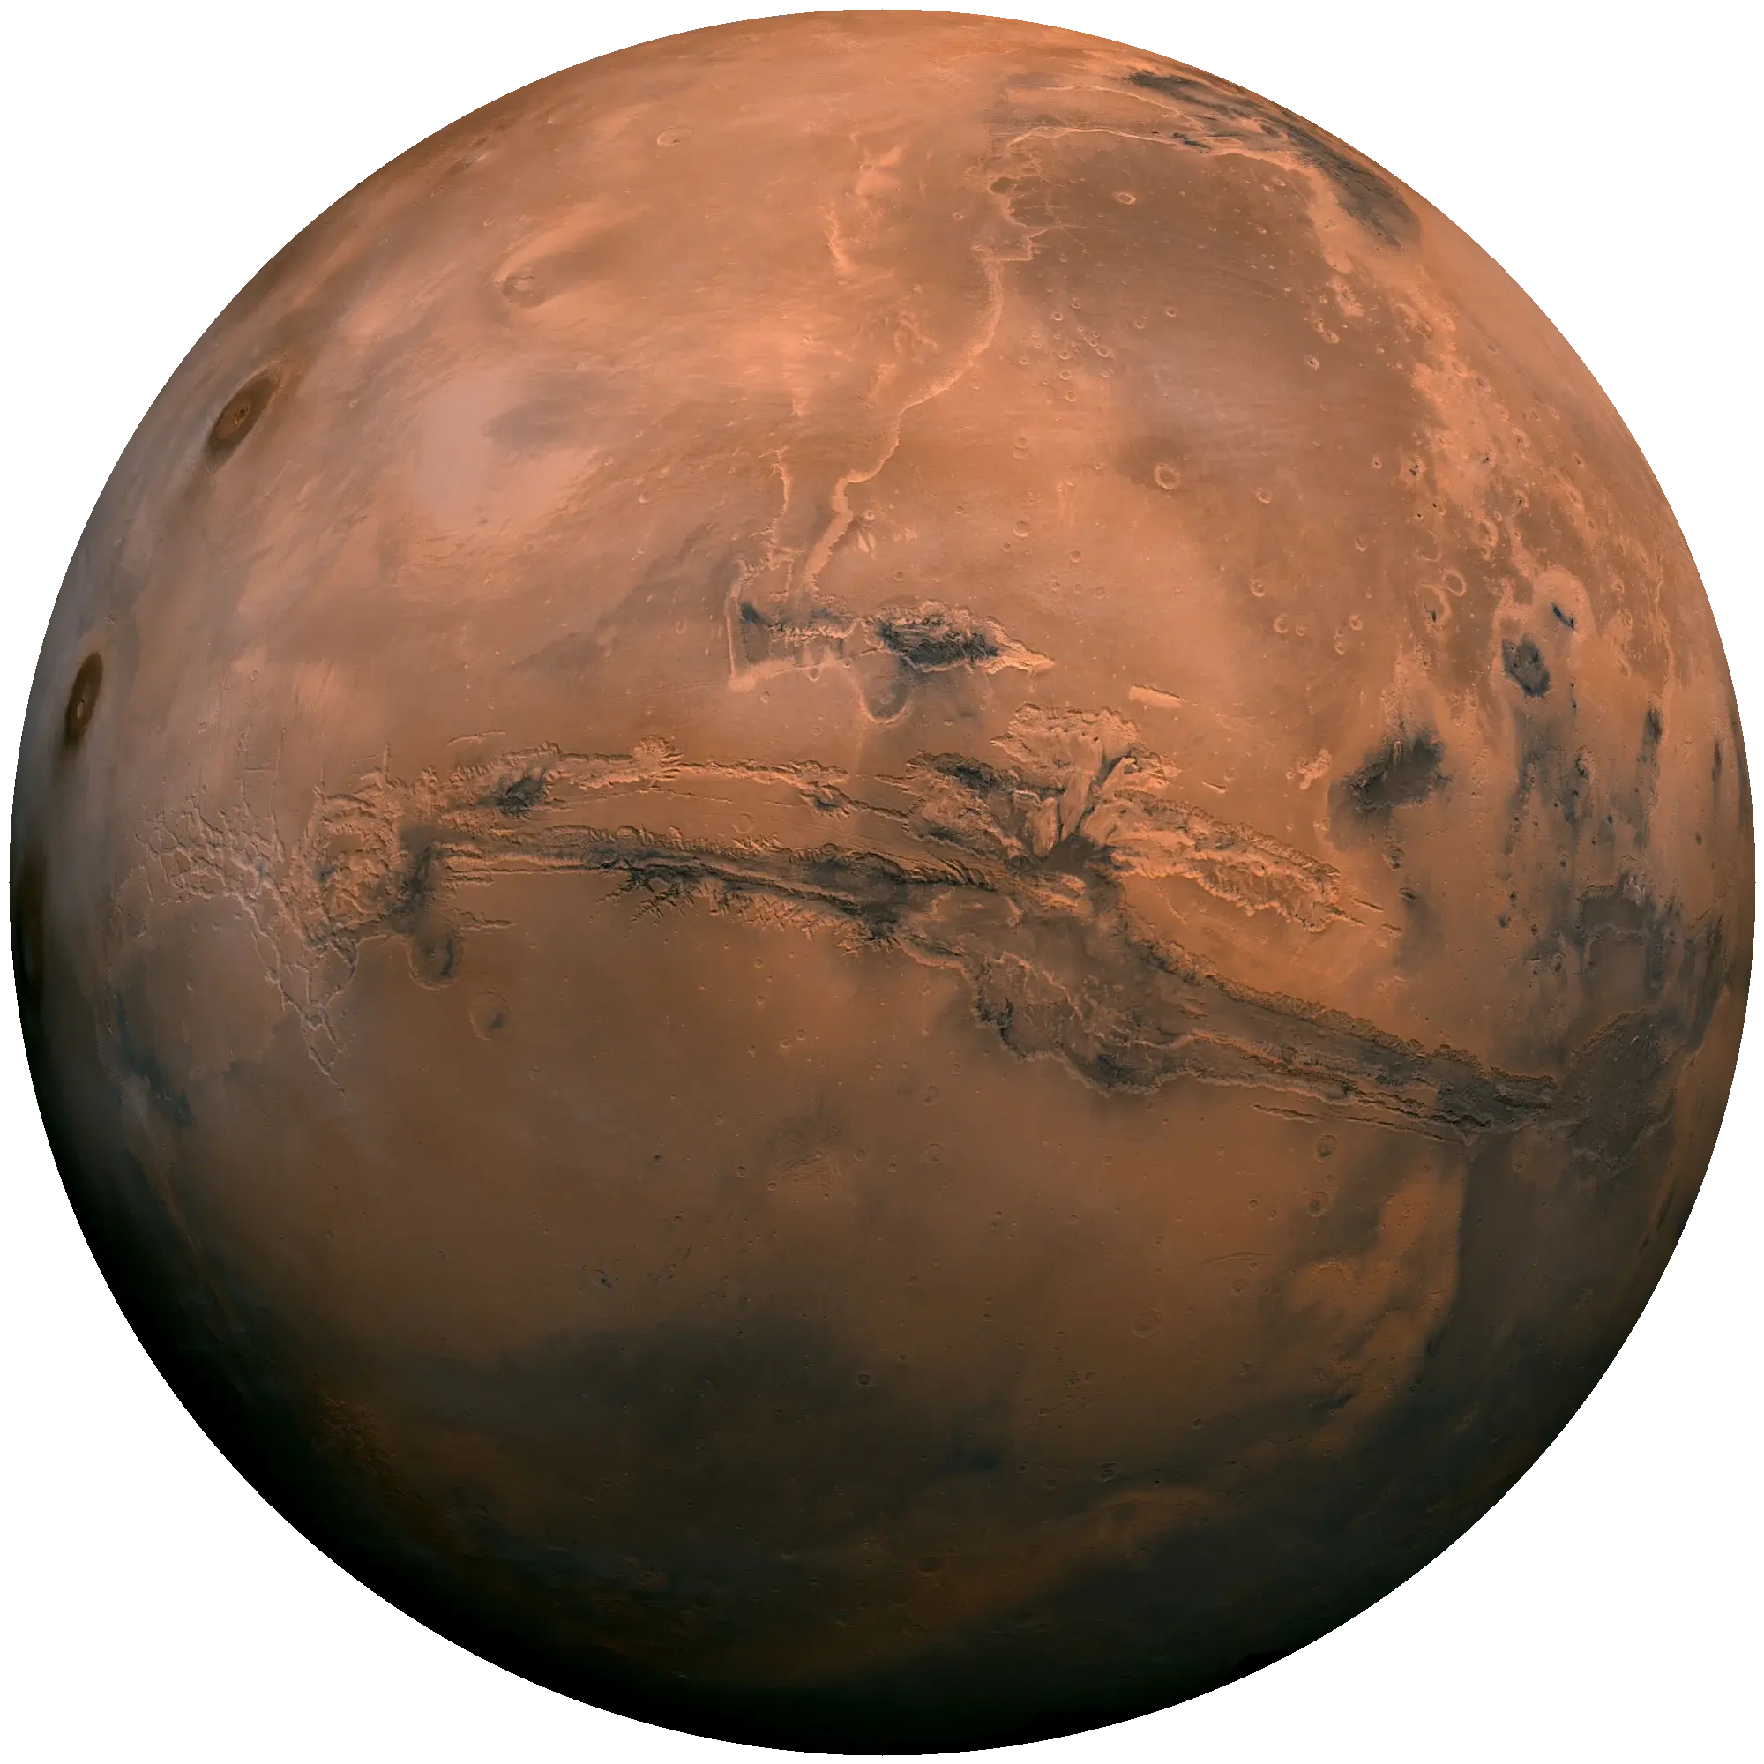
Example: Claude/Anthropic plans a rover route
COST OF MANUAL PLANNING
COST OF INSUFFICIENT CHECKING
hours of work, proportional to route length
an unchecked dangerous stretch
risk of sending the rover onto unverified terrain
segment by segment from HiRISE imagery
CLASSICAL MODE
MODEL (CLAUDE, GENERAL-PURPOSE)
'roughly twice as fast' — engineers' own estimate
456 meters over 2 sols
sum of two drives (210 m + 246 m; one source rounds to ~400 m) in RML format — the same format humans use
no exact hour count for a route of the same length is in the sources
The final check is a separate, non-AI step. JPL's digital twin ran the plan through more than 500,000 variables for compatibility with the flight software.
The most recent breakdown in the lecture — December 2025.
Planning on multimodal data.
Anthropic + NASA/JPL, Jezero crater, December 8 and 10, 2025
Notes:
This is the most recent breakdown in the lecture: December 8 and 10, 2025, Jezero crater on Mars.
Manual route planning by JPL engineers from HiRISE camera imagery and digital terrain models takes hours of work, proportional to route length. A plan without careful checking carries the risk of sending the rover onto a dangerous stretch.
Classical mode (column b): manual planning is named and described, but the exact number of hours is not given in public sources; engineers estimate the gain as "roughly twice as fast" — named as an estimate, not an invented exact number.
Model: Claude Code analyzed HiRISE orbital imagery and digital terrain models, stitched a route out of segments roughly 10 meters long, placed waypoints, checked and edited them for safety itself, and then converted the final plan into Rover Markup Language — the same command format used by live human operators. The model is general-purpose, not specially trained on Martian data. By outputting the plan in RML, the system plugs into the existing production process without reworking downstream systems — and that is what makes it usable in a real operation, not just a paper demonstration.
The final check is a separate, non-AI step, and that needs to be said explicitly. JPL's digital twin ran the final plan through more than 500,000 telemetry variables for compatibility with the flight software — classical engineering constraint verification, not re-modeling the terrain's physics. The result — a 456-meter route (the exact sum of two drives, 210 m and 246 m; one source rounds it to ~400 m), covered over two sols. Claude is a general-purpose model, not specially trained for this task: the question "what was it trained on" does not apply here, the same as for the classical IPEx automation, but for a different reason. Three selection conditions: the first is met literally, the second unconditionally, the third is column b with an honest caveat.

Slide 59
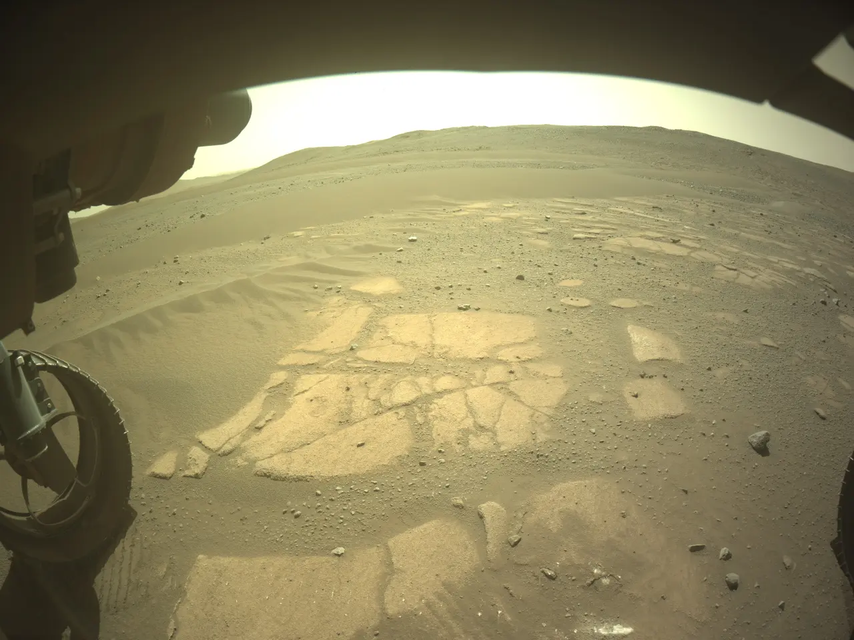
The Sol 1707 image
Not an illustration, but the task's own material. It was from frames like this one from the front camera that Claude stitched together a route out of 10-meter segments and placed waypoints.
The date is not an arbitrary number. Sol 1707, December 8, 2025 — the day of the first of two drives that together covered 456 meters.
Anthropic, Claude on Mars · Photo: Anthropic / NASA JPL — front camera of the Perseverance rover, sol 1707, December 8, 2025
Notes:
The photo shows a frame from the front hazard camera of the Perseverance rover, taken on the 1707th Martian sol, December 8, 2025. This is not a stock illustration of the Jezero crater terrain "in general," but a specific photo from a specific day on which, according to Anthropic and NASA JPL, Claude analyzed HiRISE orbital imagery and terrain data and planned a route across exactly this stretch of surface.
The neighboring breakdown already named the result: a 456-meter route, covered over two sols (the 8th and 10th of December), and the fact that the final check of the plan was performed not by Claude, but by JPL's digital twin, which ran the plan through more than 500,000 telemetry variables for compatibility with the flight software. This photo is the material Claude actually worked with: rocks, terrain, shadows, all of which had to be accounted for when stitching together a safe route out of short segments.
It's worth saying explicitly why this exact frame is more valuable for the breakdown than a generic illustration of the Martian surface could be: this is the only case in the entire lecture where an image is available from literally the day and event named in the breakdown, not just a thematically similar photo of the same place or instrument.

Slide 60
How Claude is built into route planning
input
work
output · threshold
Input: HiRISE imagery and terrain models
Work: Claude plans and checks
Output: the digital twin, then the rover
stitches a route out of ~10 m segments, places waypoints
checks the plan for safety itself, converts it to RML format
orbital imagery and digital terrain models of Jezero crater
the final check is not Claude's: >500,000 compatibility variables
classical verification, not re-modeling the terrain
The threshold sits where it doesn't appear to. Claude checks its own plan for safety — but that is not the final check; the final one belongs to the digital twin, a separate non-AI step.
RML is not a demo simplification. It's the same command format real human operators use — the plan plugs into the existing process with no rework needed.
Notes:
The neighboring breakdown already named the outcome — a 456-meter route over two sols. This diagram breaks the process itself into three parts and separately shows exactly where the final-check threshold sits, because it sits somewhere other than where one might assume by default.
Input — orbital imagery from the HiRISE camera and digital terrain models of Jezero crater, the same material JPL engineers use for manual planning, and the same type of data visible in the neighboring front-camera photo of the rover.
Work — Claude Code analyzes this imagery and these models, stitches a route out of segments roughly 10 meters long, places waypoints, and checks and edits the result itself for safety. After that, it converts the final plan into Rover Markup Language (RML) — the same command format used by live human operators. It is exactly this output in RML, rather than some proprietary format, that makes the plan suitable for plugging into the existing production process without reworking downstream systems.
Output — this is where the honest threshold stands, and it needs to be stated directly: Claude's own safety check is not the final authority. The final check is performed by a separate digital twin at JPL, unconnected to Claude, which runs the plan through more than 500,000 telemetry variables for compatibility with the rover's flight software. This is classical engineering constraint verification, not re-modeling the terrain's physics — and only after it does the plan actually go to the rover for execution.

Slide 61
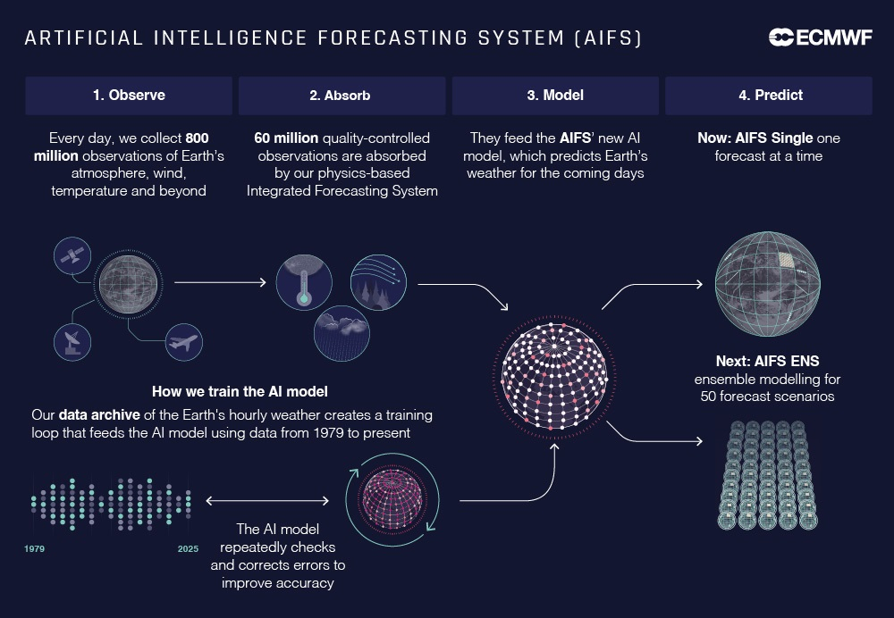
Example: the AIFS and AIGEFS AI weather-forecast models
CLASSICAL MODE (IFS / GEFSV12)
MODEL (AIFS, ECMWF)
hours on a supercomputer
~2.5 minutes on one A100
more than a thousand processors, a 10-16 day forecast
AIFS-SUBS (46 days) — ~920x faster, ~200x less energy
MODEL (AIGEFS, NOAA, BASED ON GRAPHCAST)
HONEST BOUNDARY
<4 minutes on one A100
they do not do their own data assimilation
~0.3% of operational GFS compute cost
without classical 4D-Var/GDAS, which folds observations into a picture of the atmosphere, the models simply have no input
What moved over. NOAA doesn't choose between the models — it combines them: 31 runs of AIGEFS + 31 of GEFSv12 = the hybrid HGEFS ensemble, 62 members.
An honest ceiling nearby. Pangu-Weather is good "on average," weaker at the extremes — exactly where a forecast matters most.
ECMWF (arXiv 2406.01465, GMD Copernicus 2026) · NOAA (NWS SCN 25-89)
Notes:
Classical physical computation — the IFS model (ECMWF) and GEFSv12 (NOAA) — is precise, but requires more than a thousand supercomputer processors and several hours for a single forecast.
Both models' architecture is encoder–processor–decoder: the "encoder" translates the raw data grid into a compact representation, the "processor" is the main part, where the attention mechanism or message-passing does the work (the design is broken down on the previous slide), the "decoder" translates the representation back into a forecast. AIFS (ECMWF) is a graph transformer, with a 16-layer transformer processor using a sliding attention window; trained on 38 years of ERA5 reanalysis data plus 8 years of operational analyses. AIGEFS (NOAA, based on DeepMind's GraphCast) is a message-passing graph network, a 16-layer processor, around 36.7 million parameters.
An important honest detail, shared by both models: neither AIFS nor AIGEFS does its own data assimilation — both take an already-prepared analysis of the atmosphere from a classical system (4D-Var for AIFS, GDAS for AIGEFS). Without classical assimilation, neither forecast model exists. Result: AIFS delivers a 10-day forecast in ~2.5 minutes on a single processor against hours on a supercomputer; AIGEFS, under four minutes, ~0.3% of GFS's compute cost. Both have been operational since 2025 at different weather services.
What moved over: the freed-up compute budget turned out to be so large that NOAA does not choose between the old and the new model, but combines them in the hybrid HGEFS ensemble — 31 runs of AIGEFS plus 31 runs of the classical GEFSv12, 62 members. An honest ceiling nearby: China's Pangu-Weather is good "on average," but weaker exactly where an accurate forecast matters most — at the extremes. Three selection conditions are met with the strongest evidentiary grade in the section.

Slide 62
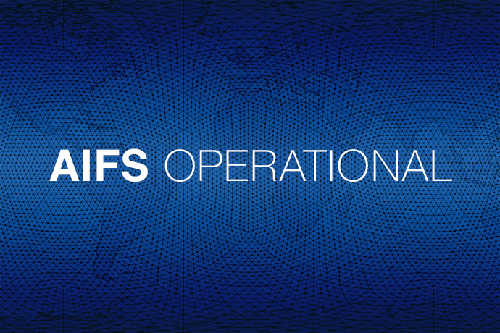
Status: AIFS operational
Not a photo of an office, but an official status. "AIFS operational" is an ECMWF announcement: the model has left the research stage and now counts as a forecast on par with the classical approach.
The grid in the background is not decoration. The pattern repeats the same thing: points on the atmosphere's grid, linked to each other — the design broken down on the neighboring attention slide.
ECMWF · Graphic: ECMWF — official announcement of AIFS operational status
Notes:
This graphic is an official ECMWF material, by which the center marked the AIFS model's move from research development to operational status in 2025. It's worth saying honestly: this is not a photo of a room full of monitors, but a designed announcement — and the word "operational" here is not a marketing epithet but a technical boundary: from this exact moment, AIFS is not a demonstration prototype but part of the daily working weather-forecast service, on par with the classical physical IFS model it supplements.
The pattern in the background — a grid of crossing lines covering the image — visually echoes the design of the model itself: the neighboring breakdown already showed that AIFS treats the atmosphere as a grid of points, where each point "looks at" physically close neighbors through the attention mechanism. The coincidence is not accidental: this kind of graphic is typical of materials where a company illustrates a graph- or grid-based model architecture with an abstract pattern of connections.
The neighboring breakdown already named the numbers behind this status: AIFS computes a 10-day forecast in about 2.5 minutes on a single A100 processor, while the classical physical IFS computation takes hours on a supercomputer with more than a thousand processors. The freed-up compute budget is not wasted — ECMWF and NOAA put it toward the hybrid HGEFS ensemble, broken down nearby.
The honest boundary of "operational" status is also worth naming: neither AIFS nor its relative, AIGEFS, performs its own data assimilation — both receive an already-prepared analysis of the atmosphere from a classical system. Operational status applies to the forecast itself, not to the full data-processing cycle from observation to result.

Slide 63
Where AIFS and AIGEFS stand in the forecast pipeline
input · not AI
work
output
Input: classical data assimilation
Work: transformer / graph network
Output: a weather forecast to weather services
4D-Var (ECMWF) or GDAS (NOAA) fold observations into an atmospheric analysis
without this step the model simply has no input
AIFS — a 16-layer transformer with an attention mechanism
AIGEFS — a message-passing graph network on the GraphCast architecture
AIFS — ~2.5 minutes, AIGEFS — under 4 minutes, on one A100
NOAA combines AIGEFS with the classical model into an ensemble, it does not replace it
This is a different question than on the attention slide. There — how the attention mechanism works inside the model. Here — where the model itself stands among the steps AI does not perform at all.
The honest boundary is at the input, not the output. The model does not assemble the picture of the atmosphere itself: without classical data assimilation, there simply is no input for it to use.
Notes:
The neighboring slide already broke down how the attention mechanism inside AIFS is built — the same principle as a language model, except here the neighbors are not tokens but points on the atmosphere's grid. This slide asks a different question: where does the forecast model itself stand among all the steps needed for the forecast to exist at all, and which of those steps AI does not perform.
Input — this is where the honest boundary stands, and it needs to be stated directly rather than quietly skipped: neither AIFS nor AIGEFS performs its own data assimilation. Both models receive an already-prepared analysis of the atmosphere from a classical system — 4D-Var at ECMWF, GDAS at NOAA — which folds heterogeneous observations (from satellites, weather stations, radiosondes) into a consistent picture of the atmosphere's current state. Without this classical step, the forecast model simply has no data to start computing from.
Work — AIFS's architecture is a 16-layer transformer with a sliding attention window, trained on 38 years of ERA5 reanalysis data; AIGEFS is a message-passing graph network based on the GraphCast architecture, around 36.7 million parameters. Both architectures are encoder–processor–decoder, where the processor performs the main computational work of the forecast.
Output — AIFS computes a 10-day forecast in about 2.5 minutes on a single A100 processor, AIGEFS in under 4 minutes. But even at the output, the model's place is not final: NOAA does not replace the classical GEFSv12 with the new model, but combines 31 runs of AIGEFS with 31 runs of the classical model into a single hybrid HGEFS ensemble of 62 members — the model takes its place in the pipeline, it does not retire the rest.

Slide 64
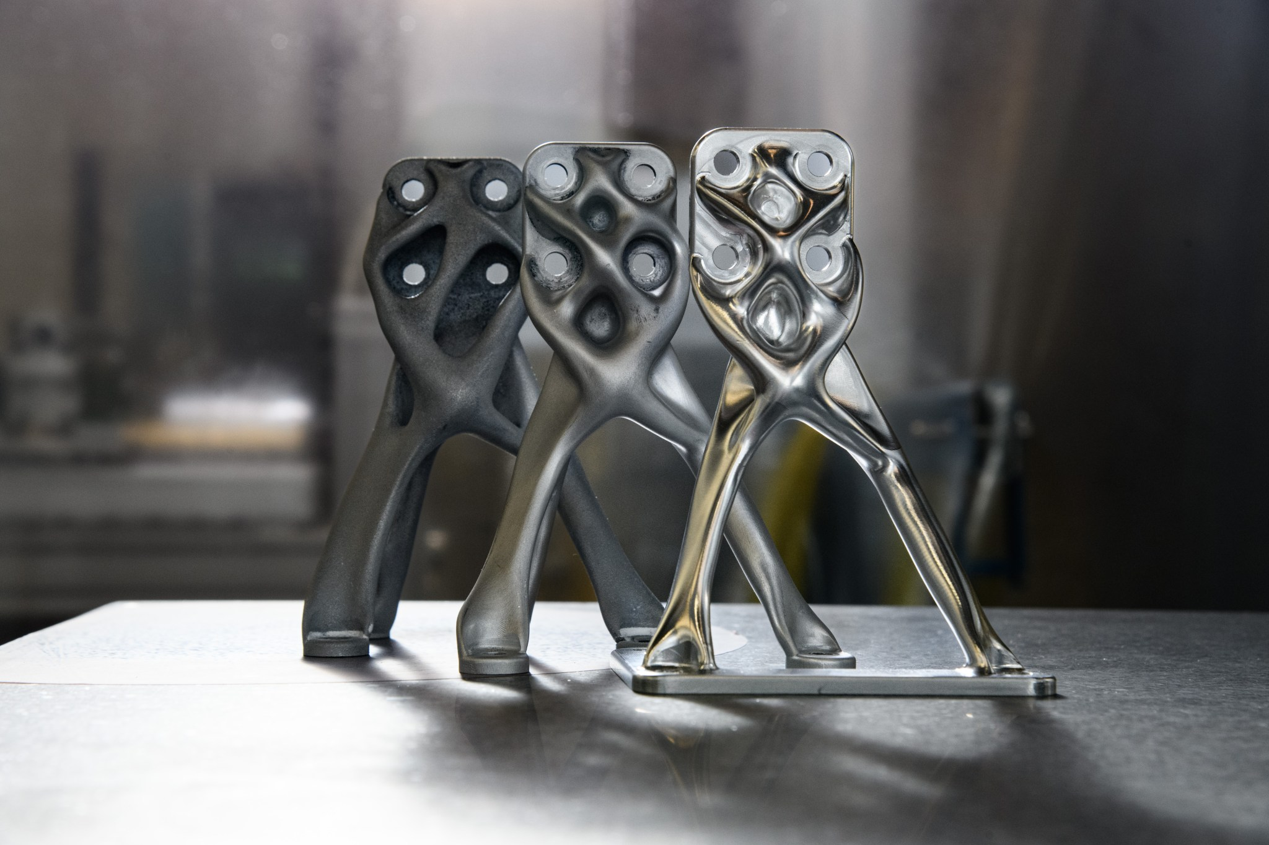
Example: NASA Goddard generative design of structures
COST OF MANUAL CAD DESIGN
COST OF UNFAMILIAR GEOMETRY
iteration after iteration by hand
harder to check before flight
four goals at once (mass, stiffness, heat, manufacturability) — hard for intuition
an organic shape needs more engineering time to analyze
CLASSICAL MODE
MODEL (GENERATIVE DESIGN, NASA GODDARD)
manual CAD, widely practiced
a claimed 10x reduction
no independently published number of its own — hours or cost per part
the method author's own internal estimate, NOT an independently confirmed fact — applied on the Habitable Worlds Observatory
The section's fourth breakdown — the exception to the 'up to three' rule. A qualitatively new contribution: the model does not predict a number for an already-given configuration — it produces the geometry itself.
Generation on structured data — the first time the 'generation × structured data' cell in the lecture's grid is filled.
NASA NTRS (citations/20230013955, Ryan McClelland) · Fast Company
Notes:
This breakdown is the fourth in the section, present by an explicit, named exception to the "up to three detailed breakdowns per section" rule: it carries a qualitatively different type of model contribution than the section's previous three breakdowns.
Manual structural design in CAD — an engineer fits a part's geometry by hand, iteration after iteration, holding mass, stiffness, thermal characteristics, and manufacturability all at once. Holding four goals at once by hand is a hard task for intuition: an overly conservative geometry saves time but pays with extra mass, and on the frontier every extra kilogram costs a separate slot in the cargo bay. The flip side of the cost: the geometry proposed by automated search is often unfamiliar to an engineer's eye and may be harder to manufacture or test.
Classical mode (column b): manual design is well known, but it has no independently published number of its own comparable to the model's claimed effect.
Model: Generative Design, a NASA Goddard program, method authored by Ryan McClelland. Unlike the Raptor surrogate, which predicts the characteristics of an already-given configuration, generative design produces the geometry itself: the algorithm explores the space of possible shapes, simultaneously optimizing mass, stiffness, thermal characteristics, and manufacturability, and delivers the engineer a finished shape that was not designed by hand step by step. It is applied right now to several real NASA mission concepts, including the Habitable Worlds Observatory — a future flagship telescope whose mission has not yet launched.
The claimed effect — a tenfold reduction in development time and cost — is the method author's own internal estimate, not an independently confirmed fact, and that honest caveat needs to be stated explicitly. Final engineering qualification and testing remain a separate classical step before flight — the same principle as with Raptor. Three selection conditions: the first is in the strongest form among the section's four breakdowns (without the model, the geometry would not have arisen the way it arose); the second is unconditional; the third is column b, with the caveat about an internal estimate.

Slide 65
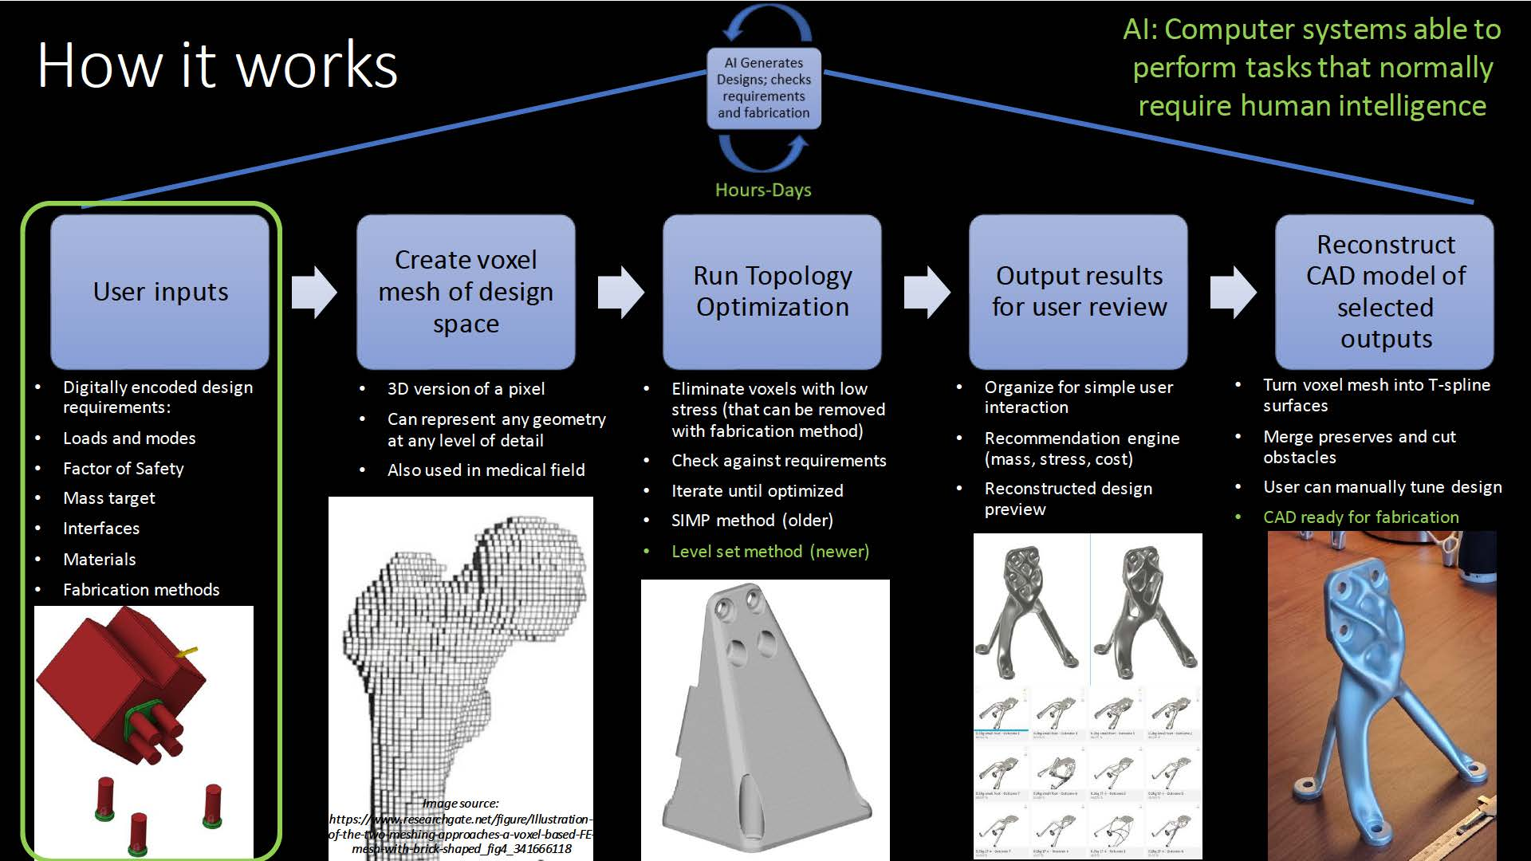
The five steps of the search
Five steps, not one leap from task to answer. From loads and constraints at the input to a finished shape at the output.
The engineer sets the goal, not the lines. The algorithm finds the shape within the given boundaries.
1. Loads and constraints → 2. Spatial mesh → 3. Topology optimization → 4. Checking the result → 5. CAD model
NASA NTRS (citations/20230013955, Ryan McClelland) · Slide 10 of the NASA Goddard presentation: input mesh → topology optimization → finished geometry
Notes:
The slide shows the official generative-design workflow diagram from NASA Goddard's presentation, authored by Ryan McClelland. It breaks down exactly what has already been named: here the model does not predict a number for an already-given configuration, the way the rocket engine surrogate does — it produces the geometry itself.
The process runs in five steps. First, the engineer sets the initial data: the loads the part must withstand, the mounting points that must not be touched, and the constraints on mass and manufacturability. Second, the space where the part's material can be located is divided into a fine spatial mesh, inside which the algorithm will search for a shape. Third, topology optimization is launched: the algorithm iteratively decides in which cells of the mesh material is needed and in which it can be removed, all while holding every goal set in the first step. Fourth, the intermediate result is checked against the original requirements. Fifth, the found shape is reconstructed into an ordinary CAD model, which can then be handed off to manufacturing.
This is the mechanical difference between a surrogate model and generative design, named on the neighboring slide as "number versus geometry": a surrogate answers the question "how good is this specific configuration," while generative search, shown here step by step, answers a different question — "what geometry can even exist here" — searching through options within the boundaries the engineer set, rather than evaluating one proposed option.
The organic shape, unfamiliar to the eye, that results from the fifth step is not a side effect of the algorithm, but a direct consequence of the fact that it is not bound by the straight edges and symmetry familiar to an engineer: it searches for a shape that satisfies all the goals at once, regardless of what the familiar part of the same purpose usually looks like.

Slide 66
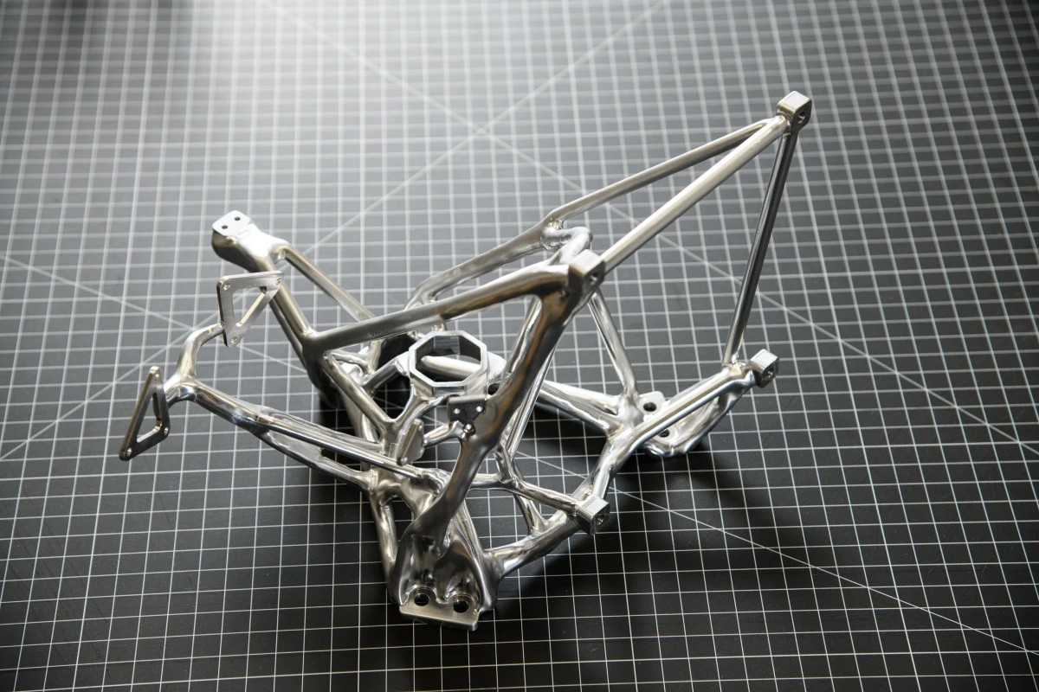
The organic part
A close-up of the very geometry the algorithm found. Branching, uneven ribs instead of a flat panel and a straight stiffening edge.
Not one straight edge where an engineer would normally draw a straight line. Material is removed exactly where it's not needed for the load — not wherever is convenient for a cutting tool or mill.
NASA NTRS (citations/20230013955, Ryan McClelland) · Close-up of the geometry found by the algorithm, NASA Goddard
Notes:
The photo is a close-up of a part whose geometry was found by NASA Goddard's generative search — the same method and the same organization as on the neighboring slide with the five process steps, except here it's not the process but its result shown up close.
The difference from an ordinary engineered part is visible immediately, without explanation: where an engineer, designing a bracket by hand, would normally leave straight edges, flat panels, and symmetric stiffening ribs — because that's convenient to draw and easy to calculate load on by hand — this part has almost no straight lines at all. The ribs branch and taper unevenly, following not drafting logic but the shape the load actually travels through. Material is removed exactly at the points that carry no load, and left exactly where the load actually passes, and altogether this gives a shape that visually reads as "grown," not drafted with a ruler.
This is not an aesthetic choice by the algorithm — it is a direct consequence of how it searches for a solution. Classical design moves from familiar ready-made shapes (a beam, a panel, a rib) toward fitting them to the load; generative search moves in the opposite direction — from the load and constraints themselves toward any shape that satisfies them, regardless of whether it's recognizable to an engineer's eye or not. It is precisely for this unfamiliarity that the developers of the method pay a separate cost, named on the neighboring slide: organic geometry requires more engineering time to check before a part is cleared for flight.

Slide 67
Mentions from Section 3
• NVIDIA FourCastNet3 — commercial wind-energy forecasting: Eni, Southwest Power Pool, Hitachi
• Satellite + AI in agricultural insurance — speeds up crop-loss assessment by up to 50%
• Planetary defense — Sentry-II and ATLAS, already-operating systems. Sentry-II assesses impact risk 100 years ahead; ATLAS reduces the false-positive rate. Honest calendar caveat: NEO Surveyor is delayed, launch no earlier than September 2027 — not to be confused with the already-operating Sentry-II/ATLAS
• Short mentions (1-2 lines, the topic of other lectures in the course): satellite imagery analysis of Earth · ML exoplanet search (TESS/RAVEN) · onboard anomaly diagnostics (Artemis II, OPS-SAT)
NVIDIA · EarthDaily Agriculture · NASA (Sentry-II, ATLAS) · science.nasa.gov (NEO Surveyor)
Notes:
The section's six mentions hold three different roles. The first two show that forecast models, trained on the same general principle as AIFS and AIGEFS, have already moved beyond a single research organization and work as a commercial product in various niches. The third — planetary defense — is a heavier mention with its own numbers: the same task that holds up the whole section, but on asteroid material rather than weather. The last three are short; they name adjacent directions this lecture deliberately does not break down in detail — not because they're unimportant, but because each one's engineering depth belongs to a different lecture in the course.
NVIDIA FourCastNet3 — the commercial use of weather-forecast models by the companies Eni, Southwest Power Pool, and Hitachi for wind-energy forecasting. Satellite + AI in agricultural insurance — operationally in use at commercial platforms in 2025–2026, speeding up crop-loss assessment from satellite data by up to 50%.
Planetary defense — NASA's Sentry-II and ATLAS, already-operating systems, not future plans. Sentry-II continuously scans the catalog of known asteroids and assesses impact probability on a horizon of 100 years ahead. ATLAS is a global network of inexpensive autonomous telescopes, where machine learning reduces the false-positive rate and speeds up the dispatch of warnings — the same type of task that holds up the LeoLabs breakdown: prioritizing and filtering signal out of noise. Honest calendar caveat: NEO Surveyor is delayed, launch no earlier than September 2027 — not to be confused with the already-operating Sentry-II and ATLAS.
Satellite imagery analysis of Earth, ML exoplanet search, and onboard anomaly diagnostics — three short mentions; the engineering depth of each belongs to the topic of a different lecture in the course.

Slide 68
What it gave and what it required — Section 3
Gave: orders of magnitude more variants, routes, forecasts, or geometries in the same engineer-time.
Required: training data from already-computed classical cases — the surrogate does not exist without them — and a separate, non-AI checking step before trusting the result.
Breakdown
Risk of a model error
Raptor surrogate
a few hours lost — filtered out by the stand
Claude/rover route
a lost planning cycle — filtered out by the digital twin
AIFS/AIGEFS
the highest cost — a real decision affecting many people
Generative design
intermediate — an unfamiliar shape is costlier to check
Notes:
In sum, the gain is measurable and large in all four breakdowns, but not one of them removes the classical checking step — the model frees up time precisely so that step can be performed more thoroughly, not so it can be skipped.
All four of the section's breakdowns fall at different levels of risk when the model errs. An error in the Raptor surrogate costs the engineer a few wasted hours of a full simulation on an unsuccessful configuration — a noticeable but not catastrophic cost, because the final bench test will filter it out regardless. An error in the model planning the rover's route would, in the worst case, lead to sending a plan that fails the digital-twin check — that is, a lost planning cycle, not a real accident. An error in the weather-forecast model carries the highest cost: an incorrect forecast used for a real decision can affect the actions of many people with no direct connection to the model itself. An error in generative design sits in between: an unsuccessful geometry is filtered out by the final engineering qualification, but the cost of that check itself is higher — an unfamiliar shape takes more time to analyze.
SpaceX's surrogate model is narrowly specialized, predicting a number for an already-given configuration. Claude is a general-purpose model, planning a route over an already-given map. AIFS and AIGEFS are trained specifically for forecasting, but on years of historical data, and forecast the evolution of an already-given state. Generative design is a qualitatively different point: it produces a structure itself that no one specified in advance.
Cumulative stage map: Section 3 adds three new cells — "forecasting × structured data" (Raptor, AIFS/AIGEFS), "planning × multimodal combinations" (rover route), "generation × structured data" (generative design). After three sections, eight cells of the course's grid are filled.

Slide 69
Conclusion of Section 3
RAPTOR SURROGATE
CLAUDE/ROUTE
column a
column b
all three conditions, but without SpaceX's own numbers
second unconditional, a caveat on the third
AIFS/AIGEFS
GENERATIVE DESIGN
column a
column a
the most solid confirmation in the section
the first condition in its strongest form
A general- or special-purpose model expands how many options can be considered per unit of time — or, for generative design, expands the space of possible options itself. It does not replace the final check in any of the four cases.
Bridge to Section 4: if a model can work from anywhere, with no physical tie to a location — where is it physically most advantageous to place it?
Notes:
A general- or special-purpose model expands how many options can be considered per unit of time, or — in the case of generative design — expands the space of possible options itself, without replacing the final engineering check in any of the four breakdowns. This is the common conclusion for all four breakdowns in the section, and it directly contradicts the simplified reading "the model now does the engineering work instead of the human": the model does part of the work, the final word stays with the classical computation, simulation, or test.
For the Raptor surrogate model, all three selection conditions are met, although the confirmation here is weaker than in many other breakdowns: SpaceX does not publish exact numbers on either side. For Claude/Anthropic, the first condition is met literally, the second unconditionally, the third is column b with an honest caveat. For AIFS/AIGEFS, all three conditions are met with the most solid confirmation in the section: remove the model and you're back to hours of computation on a supercomputer, directly confirmed by official publications. For generative design, the first condition is met in its strongest form among the four breakdowns — without the search algorithm over the space of shapes, the engineer would not have considered the variants the algorithm considered; this is not "the same thing, faster," but "a differently structured process."
Further along the cycle — the reverse question: if a model can perform this work from anywhere, with no physical tie to any specific place on Earth, then where is it physically most advantageous to place it? Section 4 answers this question literally.

Slide 70
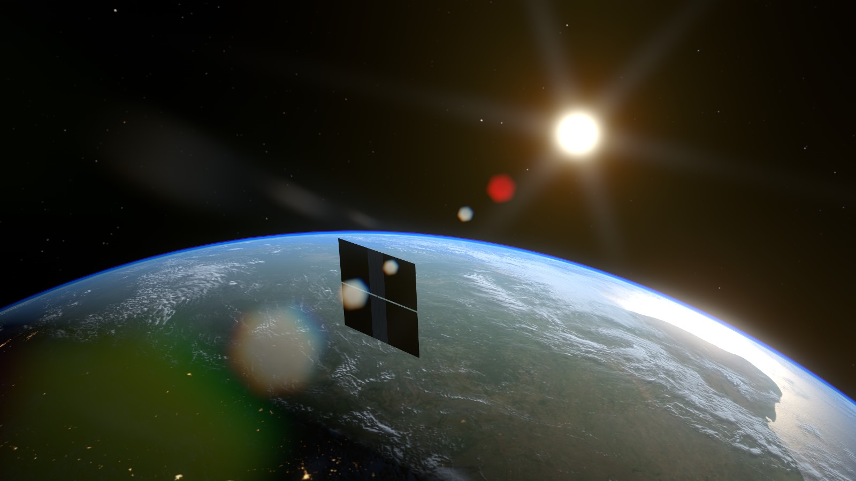
4. Space for AI
A mirror of the whole lecture: it isn't that space is making AI smarter — AI is physically moving into space.
In order:
Starcloud — the first data-center-class GPU in space
Google Project Suncatcher — a satellite with tensor processing units
Notes:
This section closes out the four types of AI contribution: from autonomy of action, through remote control and thinking at the drafting board, to the question of where the computing infrastructure itself physically sits — a mirror of Section 1, where the machine moved into space to act where a human cannot be.
Two breakdowns in order: Starcloud-1 — the first data-center-class GPU, an Nvidia H100, in space, already serving real requests to the open Gemma model. Google Project Suncatcher — a refrigerator-sized satellite equipped with four tensor processing units, with a plan to grow the constellation to 81 spacecraft in a single laser-linked cluster.
Why does this section come last, closing the lecture, rather than somewhere in the middle? It depends logically on the material of all three previous sections at once: the demand for computing that this section serves is created by the growth in data and the growth in the number of systems broken down in the previous sections — rovers and excavators generate telemetry, teleoperated systems stream video, surrogate models and forecasts themselves require computing power. This section is the answer to the question "where is it physically cheaper to do all this computing work," which can only be asked once it has been shown how much of this work has appeared at all.

Slide 71
Stage: orbital computing
TERM
DATA
orbital computing
a data center's power and cooling budget
placing AI computing infrastructure physically in space, not on Earth
not observation of the outside world — an internal budget of the infrastructure itself
WITHOUT ORBITAL PLACEMENT
a ground-based data center
limited by the power grid's throughput and the region's climate
A reversal of the whole lecture's logic. In Sections 1–3, the question was "what part of a human's work can a model do next to the action itself." Here the question is different: not what the model can do, but where it's physically cheaper to put it.
Notes:
Five parts repeat the same general scheme that already opened Section 1, Section 2, and Section 3: term, data and question, ways of doing it without automation, the decision being made, the alternative. This is the scheme's last use in the lecture, and the material it organizes here is the least like the previous three — not about action, not about remote control, not about design, but about the physical location of the computing infrastructure itself.
What this stage is. The industry term is orbital computing: placing AI computing infrastructure physically in space rather than on Earth. What data is collected and what question it answers. The data here isn't observation of the outside world — it's the internal power and cooling budget of the data center itself. The question is where it's physically cheaper to compute, if demand for AI computing is growing faster than ground-based power generation can keep up with it. How this is done on Earth without it. A ground-based data center is built next to a source of electricity and cooling — a river, a power grid, a suitable climate. What decision gets made. Put the computing in orbit, where the sun shines almost continuously and there's no competition for land or water for cooling. How this is handled without orbital placement. A ground-based data center, limited by the power grid's throughput and the climate of a particular region.
Why does this section come last, rather than somewhere in the middle? Because it depends logically on the material of all three previous sections at once. This section is the answer to the question "where is it physically cheaper to do all this computing work," which can only be asked once it has been shown how much of this work has already appeared, and keeps appearing.

Slide 72
Why it's inference, not training, that moves to space
Training — why it stays on Earth
Inference — why we move it to orbit
• Thousands of accelerators compute one model and synchronize at every step
• Every step changes the model's weights in their entirety, and the copies cannot be allowed to diverge
• Power and networking are sized for the whole cluster at once, not for a single chip
• One pass of the finished network from input to answer, nobody touches the weights
• A neighboring accelerator for step-by-step synchronization isn't needed at all
• Starcloud-1 — a single H100 chip answers requests to the Gemma model
The difference isn't in what's being computed, but in how many accelerators have to talk to each other at every step. Training needs thousands; inference needs one or a few, with no constant cross-checking between them.
On Starcloud-1, the Gemma model's weights don't change by a single step. The chip runs a finished network — it doesn't train a new one.
Notes:
The previous slide called orbital computing a reversal of the whole lecture's logic — but it didn't explain why it's specifically language-model inference that can physically be moved to a satellite, and not training the same model. The difference is an engineering one, not a quantitative one: it isn't that training is "harder" in the sense of more computation for the same question — it's that the two processes are built differently.
Training a neural network is a repeating process: every pass of data through the network ends with computing an error and adjusting the weights, and that adjustment has to be applied consistently, all at once, to every copy of the model computing in parallel across different accelerators. For thousands of accelerators to train the same model, they have to exchange results literally at every training step — otherwise their copies of the model diverge and end up training, in effect, different networks. This constant cross-checking between accelerators is exactly what requires a cluster — not just a lot of chips, but chips physically connected by a high-bandwidth network to each other, the way the internal network of servers inside one Earth-based data center works. That's exactly the kind of cluster that holds the training of this same chapter's weather-forecasting models — separate nodes, each with several H100 processors, wired to each other, not scattered apart.
Inference is a fundamentally different kind of task in form. The network is already trained, its weights are fixed, and the only thing that happens is a single pass of the input data through the finished network, from start to end, with no error computed and no weight adjustment afterward. Inference doesn't need a neighboring accelerator to cross-check with at every step at all: a single chip, handed a request, can carry it through to an answer on its own. That's exactly why the inference task isn't tied to any particular point in space — it doesn't need a data center's internal network; it only needs power, cooling, and a communication channel for the request and the answer themselves.
Starcloud-1 is this difference in its purest form: a single Nvidia H100 chip in orbit runs inference on the already-finished open Gemma model, answering real requests, and not a single weight of that model changes on board. Training that same Gemma — with a cluster of accelerators exchanging data at every step — stays on Earth; the orbital satellite doesn't take on that work and doesn't demonstrate it.

Slide 73
What already works, and what is still demonstrator-sized
This is the start of a new infrastructure category, not a replacement for the existing one — and the breakdowns that follow say exactly that, without overstating it.
In space right now: 5 chips — 1×H100 (Starcloud-1) + 4×TPU (Suncatcher) — s52/s53
In a single ground-based AI data center: tens of thousands of GPUs — typical size of a modern training cluster
The bars are not to linear scale — the difference is orders of magnitude, not percentage points.
Notes:
The hardware really is flying and really is answering real requests — this isn't a concept on paper or a render of a future product. At the same time, the scale is honestly tiny: a handful of chips against tens of thousands of GPUs in ground-based data centers. This is the start of a new infrastructure category, not a replacement for the existing one, and the breakdowns that follow say exactly that, without overstating it.
This section flips the logic the whole previous lecture ran on, and that reversal is worth naming explicitly. In Sections 1–3, the question was "what part of a human's or a classical method's work can a model do, physically present where the action happens." In Section 4, the question is different: not what the model can do, but where it's physically cheaper to put it, if the task itself (language-model inference) isn't tied to any particular point in space at all. A task performed by a language model can, in principle, run anywhere there's electricity and cooling — which is exactly why the question of placement becomes a purely engineering question of power and cooling economics, not a question about the model's own capabilities.
This is an honest reversal worth keeping in mind through both of the next breakdowns: Starcloud and Suncatcher prove the principle — the hardware physically works in space — not economic competitiveness. The difference between "it works" and "it pays off" is the same honesty the whole industry overview held onto with the $200/kg threshold number: the threshold is far off, but it's named, not invented.

Slide 74
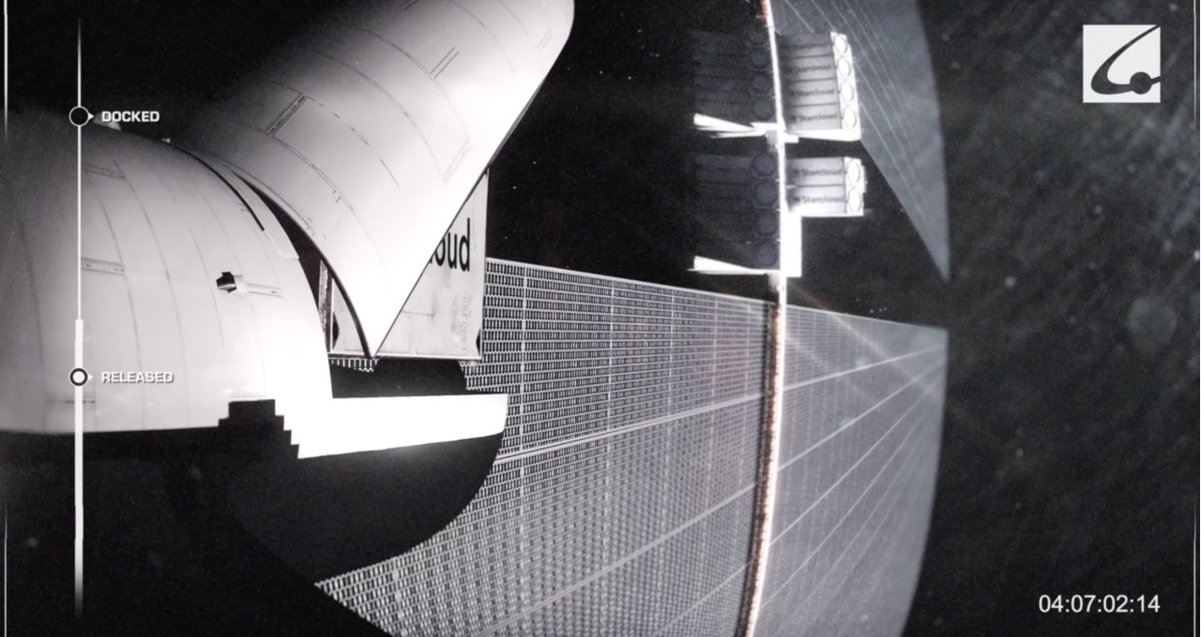
Example: Starcloud — the first data-center-class GPU in space
COST OF A GROUND-BASED DATA CENTER
COST OF AN ORBITAL DATA CENTER
cheap to build
launch and upkeep cost orders of magnitude more
limited by the power grid's throughput and climate
near-continuous sunlight is the main resource gained in return
CLASSICAL MODE
MODEL/AUTOMATION (STARCLOUD-1, 60 KG)
does not exist
launched 02.11.2025
'a data center in space' is a new category, not a faster version of the old one
first data-center-class H100 in space; serving requests to the Gemma model
An FCC (the US telecom regulator) filing for 88,000 satellites is the company's plan, not a fact. Series A round of $170 million (03.2026) + $250 million at a $2.3 billion valuation (08.2026).
What moved over. The question "where is land and electricity cheaper" moved into the question "where is the sun more continuous."
Text generation.
CNBC, 02.11.2025
Notes:
The company's name states the direction of its work plainly: Starcloud — literally "a cloud in the sky." The earlier name, Lumen Orbit, is also worth knowing — it shows up in earlier sources.
A ground-based data center is cheap to build but limited by the power grid's throughput and the climate. An orbital data center gets near-continuous sunlight, but launch and upkeep cost orders of magnitude more than a ground-based one.
Classical mode (column c — a task that's genuinely new, with no classical earthly equivalent at all): for "a data center in space," no classical Earth-based equivalent exists — this is a new infrastructure category, not a faster version of the old one.
Model: Starcloud-1 (60 kg, launched November 2, 2025) — the first data-center-class Nvidia H100 GPU in space; already serving real requests to the open Gemma model. Input is an inference task, delivered over the satellite link; output is the computation result — the process itself doesn't differ from Earth's; the difference is in the physical location and power source. Why specifically the open Gemma model: the demonstrator's job is to prove that standard hardware physically withstands orbital conditions and keeps doing the same computing work, without mixing two different questions into one experiment.
The company filed with the FCC for a future constellation of 88,000 satellites — this is a stated plan, not a fact of today. Funding: a Series A round of $170 million (March 2026) and an additional $250 million at a $2.3 billion valuation (August 2026). An honest gap: the sources confirm the fact that requests are being served, but they don't publish latency, bandwidth, or per-request cost statistics. The three selection conditions: the first applies in its purest form — without hardware in orbit, the fact of "computation in space" wouldn't exist at all; the second holds unconditionally; the third is the weakest point of the breakdown — the numerical takeaway is limited to the fact that "the device works."

Slide 75
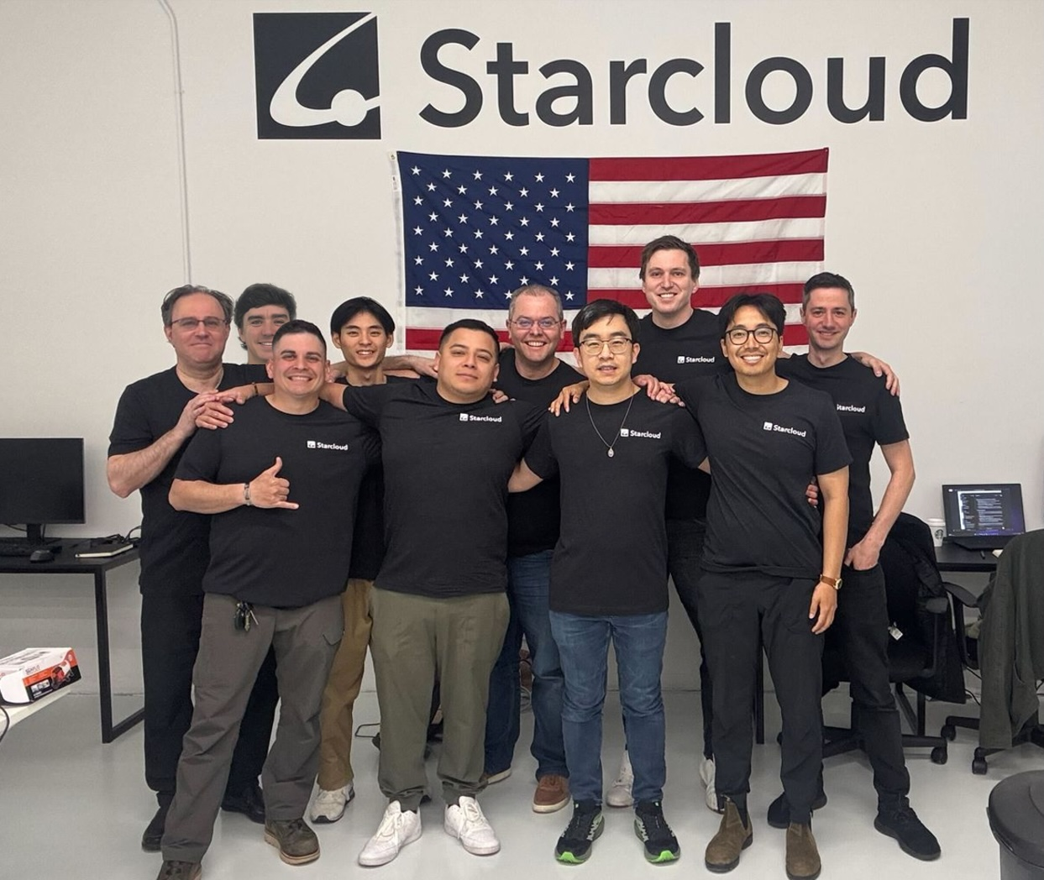
The Starcloud team
Real people stand behind the satellite, not just an engineering render. This exact team took the demonstrator from idea to a working H100 in orbit.
NVIDIA's Inception program isn't a marketing detail. As a participant in this startup program, Starcloud gets access to NVIDIA's hardware and expertise.
NVIDIA blog, Starcloud · Photo: NVIDIA — the Starcloud team
Notes:
The photo shows the Starcloud company team, featured in an NVIDIA blog piece about its partnership with Inception-program startups. A photo of people, not an engineering render or a visualization of a future satellite constellation — it's worth showing it alongside the breakdown for exactly that reason: behind every number ("the first data-center-class H100 in space," "an 88,000-satellite filing with the FCC") stands a specific team of engineers, not an abstract corporation.
The adjacent breakdown has already named the gist of the case: Starcloud-1, 60 kilograms, launched November 2, 2025, carries a data-center-class Nvidia H100 GPU and is already serving real requests to the open Gemma model. NVIDIA, the maker of the chip itself, has a direct stake in the demonstrator's success — hence the piece on its own blog, which names the team and describes its work.
This is one of the rare moments in the lecture where you can clearly see, behind the technical breakdown, not a single chip in a vacuum but the result of a whole engineering team's work — solving problems of radiation hardening, heat rejection without convection, and servicing hardware with no human access — problems that simply don't exist when designing a ground-based data center.

Slide 76
How a request's path through Starcloud is built
Path up
User's
request
Ground
station
Satellite
link
H100 onboard:
Gemma inference
Path down
Computation
result
Same
satellite link
Ground
station
Answer to
the user
The request's path up and the answer's path down — the computation inside the chip doesn't differ from Earth's
What's new is only at the input and output. The satellite link up and down — that's the entire difference from an ordinary ground-based data center.
Inside the chip — nothing new. Inference on the Gemma model aboard the H100 runs exactly as it would on Earth: the difference is in the location and the power source, not in the computation.
Notes:
The adjacent Starcloud breakdowns have already named the fact and its cost: the first data-center-class GPU in space, the first AI model answer from such a chip in orbit. This diagram lays out the path of a single request step by step — from the user to the answer and back — to show exactly where something genuinely new appears in this chain, and where everything is built exactly the way it is on Earth.
The path up: the user's request is carried by a ground station over a satellite link to the satellite, where the H100 processor is physically installed. It's on this very spacecraft that inference on the open Gemma model runs — the same computing operation any ground-based data center performs, just physically moved out to orbit.
The path down: the computation result is sent back over the same satellite link, through the same ground station, and reaches the user as an ordinary answer. The only difference between this chain and an equivalent request at a ground-based data center is the presence of a satellite link at the input and output; the computing process itself, inside the chip, is identical to Earth's.
An honest gap, also named in the adjacent breakdowns: the sources confirm the fact that requests to Gemma are being served, but they don't publish latency or bandwidth statistics for this link compared to a ground-based equivalent — without those numbers, there's no way to judge when orbital compute becomes not just working, but competitive on response speed, rather than only on access to solar power.

Slide 77
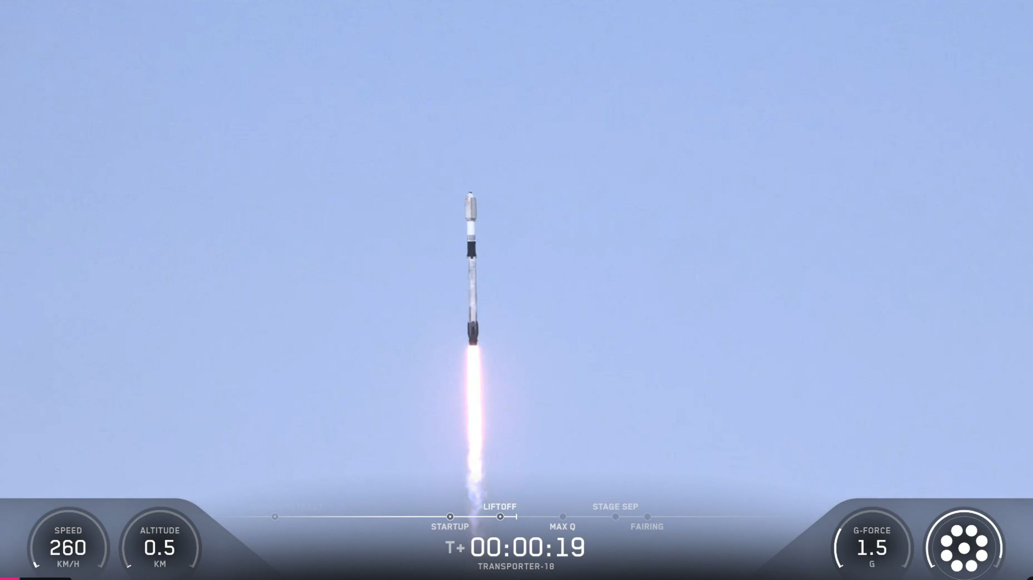
Example: Google Project Suncatcher
COST
CLASSICAL MODE
the same logic as Starcloud
does not exist
a different company, a different chip
the same gap, for the same reason
MODEL/AUTOMATION (SATELLITE + 4 TPUS)
COMPANY'S PLAN
launched 01.10.2026
81 satellites in a cluster ~1 km in radius
first AI model response from a data-center-class TPU in orbit
laser inter-satellite links; partnership with Planet Labs — 2 satellites by early 2027
The engineering sense of the name: "sun catcher" — not cooling, not radiation shielding, but the continuity of sunlight as the main resource.
The company openly admits: some engineering decisions can only be verified in real orbital conditions, not on Earth.
General-purpose generation/inference — an infrastructure demonstrator, not tied to a single task.
CNN, 01.10.2026
Notes:
The project's name states the engineering essence of Google's choice plainly: "suncatcher," and the name itself honestly lays out the priority — not cooling, not radiation shielding, but the continuity of sunlight as the main resource that gives the whole design its point.
The cost on both sides and the classical mode (column c) are the same logic as Starcloud, carried out by a different company with a different chip: the same gap in a classical equivalent, for the same reason.
Model/automation: a refrigerator-sized satellite equipped with four tensor processing units, launched on a Falcon 9 rocket on October 1, 2026 — the first recorded AI model response from a data-center-class TPU in orbit. The company's plan is to grow the constellation to 81 satellites, joined into a cluster about one kilometer in radius via laser inter-satellite links; a partnership with Planet Labs calls for launching two satellites by early 2027.
Why specifically laser inter-satellite links: they carry significantly more data per unit of time at the same distances than a radio-frequency channel — a cluster running distributed computation needs exactly that kind of high bandwidth between its own nodes. The company openly admits to technical difficulties: some engineering decisions can only be verified in real orbital conditions, not on Earth — an honest admission of the limit of what can be simulated in advance.
What moved over: competition for where to put the computing moved from the Earth-based electricity market to the orbital sunlight market — the same shift in criterion as Starcloud's, confirmed independently by a second major technology company. The three selection conditions are the same as Starcloud's: the first applies in its purest form, the second holds unconditionally, the third is the weakest point — the numerical takeaway is limited to the fact that it works.

Slide 78
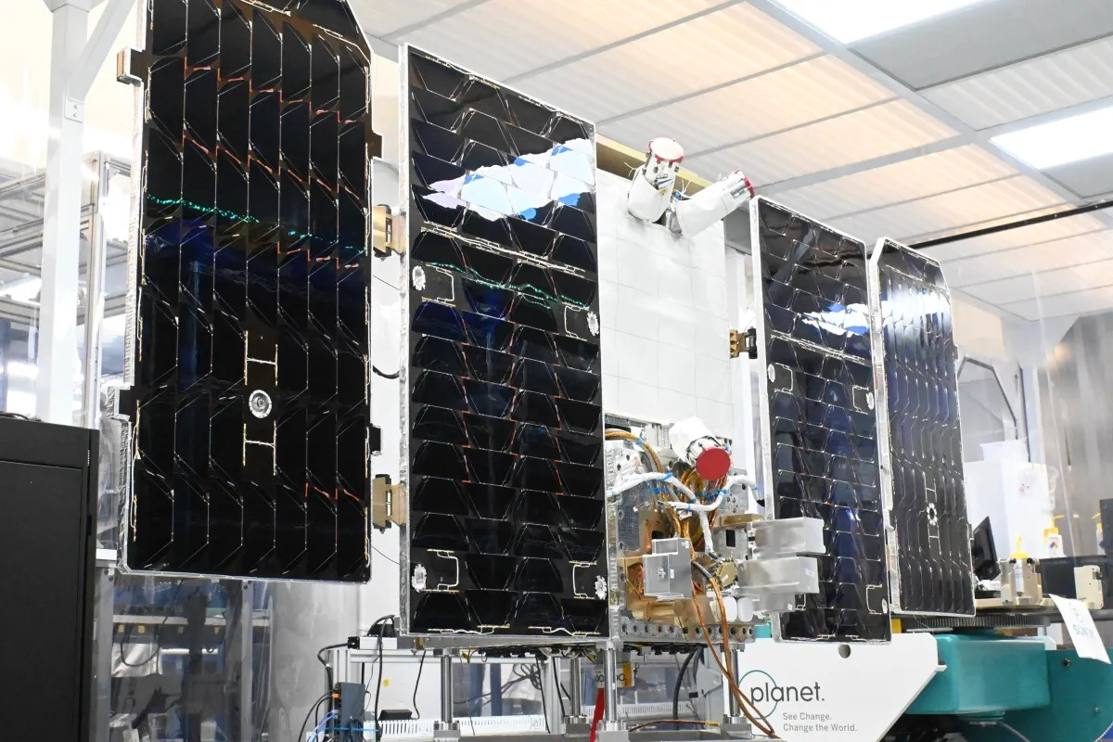
Suncatcher during assembly
Real hardware, not concept art. The deployed solar panels and the satellite body are what physically flew, assembled in the assembly facility before launch.
Inside are four tensor processing units. The same physical unit that has already delivered the first AI model response in orbit.
TechCrunch, 30.10.2026 · Photo: the assembled Suncatcher satellite in the assembly facility
Notes:
The photo shows the assembled Suncatcher satellite in the assembly facility before launch: deployed solar panels, a refrigerator-sized body, ground support equipment nearby. This is a photo of the real spacecraft, not a render of a future constellation and not an artist's illustration — the distinction is worth naming explicitly, because some of the publicly available material about the project is, in fact, renders.
Inside this body are four tensor processing units, Google's own design for machine learning. This exact spacecraft, launched on a Falcon 9 rocket on October 1, 2026, delivered the first recorded AI model response from a data-center-class TPU in orbit — the fact the whole case breakdown is built around.
The solar panels in the photo aren't a decorative element — they're the exact key constraint that gives the whole design its point: the continuity of sunlight in orbit, with no day-night cycle, which every ground-based power source is subject to. The company's plan is to grow the constellation of such spacecraft to 81 satellites, linked to each other by laser communication lines into a single cluster; what's visible in this photo is the first physical unit of that plan, not a mockup of it.

Slide 79
Suncatcher's second AI case: the model holds formation
input · not AI
work
output
Input: the formation's orbital dynamics
Work: differentiable optimization of the formation
Output: a maneuver command for every satellite
position and velocity of every satellite in the formation, in real time
numerical integration of the equations of motion — classical mechanics
objective function — the formation's geometry: a cluster ~1 km across with no collisions
gradient — adjoint-state methods
reverse-mode automatic differentiation (AD) in JAX — into the model
a corrected maneuver command for every satellite in the formation
keeps the cluster at a radius of about 1 km with no collisions
Suncatcher's second AI case isn't inference — it's formation control. The tighter the formation, the higher the bandwidth of the laser links between satellites.
The mechanism is differentiable optimization, not prediction from examples. The gradient runs backward through the motion's integration — into the model's parameters, the same way neural networks are trained.
Google, Project Suncatcher preprint — Supplementary Information, Orbital dynamics modeling
Notes:
Unlike Starcloud, Suncatcher has a second AI use case, separate by nature. It's broken down on this slide on its own, not dissolved into the general formula "the same thing as Starcloud": this isn't a variation on the inference task already covered — it's a task of a different type altogether, not computing an answer to a ready-made request, but controlling the physical position of many moving bodies in real time.
Input: to hold formation, the system needs to know the position and velocity of each satellite in the formation at every moment — this is computed by numerically integrating the equations of motion, classical celestial mechanics with no AI in it at all.
Work: according to the preprint's supplementary materials (Supplementary Information, section "Orbital dynamics modeling"), the approach is described as differentiable optimization, not prediction from pre-labeled examples. An objective function is set, whose minimum describes the desired formation geometry — a cluster about 1 km in radius in which the satellites won't collide. This function's gradient is propagated backward through the motion integration itself using adjoint-state methods, and then reverse-mode automatic differentiation (AD) — the same mechanism neural networks are trained by, and whose implementation, per the preprint's text, is substantially simplified by the JAX tool — carries the gradient into the parameters of the flight-control model itself, which is being trained.
Output: a corrected maneuver command for every satellite in the formation. The official preprint describes the result in these words: "An ML-based flight control model enables the satellites to maintain close flight proximity while avoiding collisions" — a flight-control model keeps the satellites in a tight formation while simultaneously preventing them from colliding with each other.
The difference from Starcloud here is fundamental, not a matter of degree — and it's worth naming directly: there, the model is someone else's finished network, answering a single user request via inference, one pass from input to answer, and not a single one of its weights changes on board. Here, a trainable model itself, in real time, controls the physical position of dozens of moving objects — this isn't a variation on the inference task, it's a separate task of control and optimization by nature.

Slide 80
Mentions from Section 4
• Starcloud's FCC filing for 88,000 satellites — the company's plan, not a fact of today
• A reminder from Section 0: the ~12x growth in satellites over 10 years and the multi-fold growth in data are the direct source of the computing demand this section describes
Notes:
Two short mentions don't add a third detailed breakdown to this section — at the time the lecture was prepared, open sources turned up exactly two cases of data-center-class infrastructure in space meeting the three selection conditions — instead, they bring the scale of plans stated for the future back to the numbers already named at the start of the lecture.
Starcloud's FCC filing for 88,000 satellites — the company's plan, not a fact of today; already named in the Starcloud breakdown, repeated here as a general characteristic of the scale of plans stated for the future across this whole stage.
A reminder from the industry overview: the roughly 12x growth in the number of satellites over ten years, and the multi-fold growth in the volume of data over the same years, is the direct source of the computing demand that Section 4 describes: the more satellites there are, and the more data they produce, the more computing is needed to process it, and part of that demand is now physically moving out to orbit itself. This is the loop that closes the industry overview the lecture opened with: the growth in the number of satellites and the growth in the volume of data were named as the reason the question of autonomy in space became urgent right now — Sections 1–3 showed how that reason shows up in robot control, teleoperation, and design. This section shows the same reason from the other side: demand for computing is growing faster than ground-based power generation, and part of that demand is starting to physically move out to the very place the data itself is born.

Slide 81
What it gave and what it required — Section 4
Gave: proof that AI hardware physically works and answers real requests in space.
Required: solving problems that don't exist on Earth — radiation hardening, heat rejection in vacuum with no convection, servicing with no human access — and a willingness to test some of the solutions only in actual flight.
Section
Cells occupied (cumulative)
After Section 1
3
After Section 2
5
After Section 3
8
After Section 4
9 (of the 6 task types, 5 are occupied — retrieval never came up)
Notes:
Gave: proof that AI hardware physically works and answers real requests in space, not just in theoretical calculations. Before Starcloud-1's launch in November 2025, the claim "a data-center-class GPU can work and serve real requests in open space" hadn't been confirmed by a single flown system.
Required: solving problems that simply don't exist on Earth — radiation hardening of the electronics, heat rejection in vacuum with no air convection, servicing hardware with no human access — and an industry-wide acknowledged need to test some of these solutions only in real orbital conditions.
In sum: the start works — the hardware flies and answers requests — but the scale at which this becomes a competitive alternative to ground-based data centers remains a question of many years ahead, and that's honestly named through the specific launch-cost threshold from Section 0.
For Starcloud and Suncatcher, the first selection condition holds in its purest form — without hardware in orbit, the very fact of "computation in space" wouldn't exist at all. The second condition holds unconditionally — both cases are industry cases. The third is the weakest point of both breakdowns: there's no classical mode to compare against, and the numerical takeaway is limited to the fact that "the device works and answers requests." Both cases were brought into the lecture not despite this weakness, but with it explicitly named.
The final cumulative map of the stage across all four sections: Section 4 adds a ninth occupied position — "generation × text" (Starcloud) — and honestly leaves the Suncatcher demonstrator without a task type. Of the six task types in the course's grid, five are occupied in this lecture; retrieval never came up once across the material of the thirteen breakdowns.

Slide 82
Conclusion of Section 4
SECTION 1
SECTION 4
machine → space
computation → space
to act where a human cannot be
to be where there is more energy
A mirror process relative to Section 1. There, the machine moved into space to act where a human cannot be. Here, computation moves into space to be where there's more energy.
Next — Assembly brings all four fronts of the lecture together into a single answer.
Notes:
Computing for AI is starting to physically compete for space not only on Earth. This is a mirror process relative to Section 1: there, the machine moved into space to act where a human cannot be; here, computation moves into space to be where there's more energy.
It's worth saying explicitly what Starcloud and Suncatcher have in common, beyond the bare fact that "this is a computer in space." Both breakdowns share the same type of engineering problem and the same honestly acknowledged limit of applicability: both cases are demonstrators of a new infrastructure category, not a replacement for existing ground-based data centers at scale; both explicitly tie their economic justification to the same launch-cost threshold named in the industry overview; neither has a classical Earth-based equivalent of the task; and both companies openly admit that some engineering decisions can only be verified in actual flight. This isn't a coincidence between two unrelated cases — it's a sign that all of Section 4 describes one and the same new infrastructure category, seen twice, from two different players in the market.
Next — Assembly brings all four fronts of the lecture together into a single answer to the question asked at the start: what solutions did space force us to invent — and did they exist before it demanded them?

Slide 83
Section 5. Assembly
The four substantive sections are done. Assembly brings the material already shown together in three different ways:
• Registry — the denominator and the exceptions
• Answer to the lecture's question — section by section, by name
• Final summary — the count of thirteen breakdowns, the honest gaps, and where AI is flatly not needed
Notes:
The four substantive sections of the lecture are done; this section doesn't add new material — it organizes what's already been shown across thirteen breakdowns so that the answer to the lecture's question becomes explicit rather than implied.
Assembly doesn't repeat the content of the four sections — it brings it together in three different ways: by the denominator and the exceptions, by the answer to the lecture's question section by section, and it closes with a running count of thirteen breakdowns, a summary of honest gaps, and a summary criterion for where AI is flatly not needed.
Before moving on to the numbers, it's worth keeping in mind: the course's rule requires naming the count of breakdowns explicitly, before the numbers, not after them. The denominator is a judgment call, not an arbitrary number, and the next slide will show exactly how it was arrived at and which exceptions went into it, each with a named reason.

Slide 84
13 + 18 = 31
Registry of breakdowns: the denominator and the exceptions
13 detailed breakdowns + 18 short mentions = 31 AI-in-space cases. This is the stated denominator: before trusting any percentage or conclusion later in the lecture, it's clear how many cases it's based on.
Checkability: each of the 13 breakdowns names a source on its slide — it can be opened and checked against what the lecture says.
Section
Detailed breakdowns
Short mentions
Distinguishing feature
1
4
6
LeoLabs — a separate breakdown: answers the question left open at the start of the lecture
2
3
4
—
3
4
6
Generative design — a qualitatively new type of model contribution
4
2
2
—
Notes:
Before summing up the content, it's worth explicitly naming the base: the lecture's material isn't "a few vivid examples" — it's 13 detailed breakdowns plus 18 more briefly mentioned cases, 31 positions in total, unevenly distributed across the four sections (4, 3, 4, and 2 detailed breakdowns).
Three cases didn't make it into the count of detailed breakdowns, each with an explicitly named reason: the ESA exoskeleton (never flew to space), the DARPA Subterranean Challenge (the lineage of the NeBula/LAMP architecture, not a separate space case in its own right), Pangu-Weather (folded into the AIFS/AIGEFS breakdown as a technical ceiling). Two cases that were detailed breakdowns in an earlier version of the lecture are now reduced to short mentions: NASA IPEx (the only case in the section with no trained model at all) and telesurgery over Starlink (no trained model in the loop). SPOC and predictive latency compensation took their place — both carry a trained model at the very center of the breakdown.
Section 1 holds four detailed breakdowns, not three: LeoLabs answers a direct question left open at the start of the lecture, and carries a task type (prioritization) that none of the section's other three breakdowns show. Section 3 is four, not three, for the same kind of reason: NASA Goddard's generative design carries a qualitatively new type of contribution — the model doesn't predict a number, it produces the geometry itself.

Slide 85
Answer to the lecture's question — Sections 1 and 2
Section 1. Geometric navigation — carried over ready-made. The SLAM architecture for subsurface exploration (NeBula/LAMP) — wasn't born in space: invented for an Earth-based mine, then adapted for a lunar tube.
Section 2. Teleoperation as a principle — carried over ready-made. Telesurgery over Starlink — space created a new engineering configuration that didn't exist before: not through a model, but through communication infrastructure.
Notes:
The four answers are deliberately not folded into one general thesis: collapsing them into a single phrase would lose exactly the distinction that is the content of this part — that different sections give different, non-interchangeable answers to the same question.
Section 1 — Autonomous robots in space. Geometric navigation existed before space — classical robotics, carried over to a new environment with no fundamental change to the architecture. But the SLAM architecture for exploring a closed, GPS-less, lightless, connection-less underground space wasn't born in space: it was invented for an Earth-based DARPA mine-exploration competition, and then adapted — in the spirit of the approach, not directly in code — for the conditions of a lunar lava tube, which turned out to be even harsher. This is exactly the measured example of "invented under the pressure of one frontier, then carried over to a harsher one," which is the very axis the whole lecture rests on. LeoLabs is a third, more modest example of the same question: the prioritization task itself is a general technique from scheduling theory, not invented for space — but the density and scale of the catalog create a specific, quantitatively different task from any ground-based application of that same general technique.
Section 2 — Remote control. Teleoperation as a principle existed before space. Predictive latency compensation also isn't a space-industry invention. But the specific combination — this technique, tested specifically in lunar analog trials — didn't exist before interest in lunar teleoperation specifically. Telesurgery over Starlink shows the same pattern even more sharply: the task "a surgical operation over a satellite link with ~130 ms of latency" had no Earth-based classical equivalent at all — space created a new engineering configuration, though the decisive leap belongs to the communication infrastructure, not to a trained model.

Slide 86
2 : 2
Answer to the lecture's question — Sections 3 and 4
Section 3. Surrogate models and generative search — general ML techniques, not an invention of space. But the specific application (Claude on Mars, geometry for the flagship telescope) — was physically impossible before powerful general-purpose models appeared.
Section 4. The idea of putting computing next to the power source isn't new. But the engineering of an orbital data center — didn't exist before this specific project.
Overall count: 2:2 — not a target set in advance, but an honest outcome of selecting the material.
Notes:
Section 3 — Design and new capabilities. Surrogate ML models and generative structural design aren't a space-industry invention: they're general engineering machine-learning techniques, used in the auto industry too. But the specific application — route planning for a rover by a general-purpose model with a subsequent digital-twin check, and designing real structures for the future flagship telescope via generative search — was physically impossible before sufficiently powerful general-purpose models appeared, and before there was willingness to trust them with a draft version. This is carrying a ready-made tool into a new role, not inventing an algorithm from scratch.
Section 4 — Space for AI. The idea of putting computing where there's more energy isn't new in itself — that's how data centers end up next to dams on Earth. But the engineering of an orbital data center — radiation hardening, heat rejection in vacuum, servicing with no human access — didn't exist before this specific project: these problems hadn't come up in any Earth-based data center configuration.
Overall count: of the four sections, two (Section 1 and Section 4) have a measured case of a solution born specifically from the frontier's pressure; in the other two (Section 2 and Section 3), space mostly carries a ready-made tool into a new, previously impossible configuration. This is the honest answer to the lecture's question: not "space always invents" and not "space only applies" — it depends. This 2:2 split wasn't a target set in advance when the material was prepared — it turned up as a consequence of honestly applying the three selection conditions to the material the research turned up. It would have been tempting to build the lecture so that all four sections demonstrated the same thesis — material could have been found for that, if we'd wanted to select only the cases that fit. We deliberately don't do that.

Slide 87
13 of 13
The count: thirteen breakdowns, one boundary, never crossed
FINAL CHECK OR THE RIGHT TO INTERVENE
MODEL DOES SUBSTANTIVE WORK
rests with a classical, non-AI step
in 12 of 13
in all thirteen cases without exception
the exception is Dragon, whose architecture isn't publicly disclosed
AEGIS — a target profile set in advance · SPOC — the human driver, the final authority · COROB-X — the EaRLaP pipeline + after-the-fact review · LeoLabs — the operator decides the maneuver, not the model · Dragon — manual intervention · Predictive latency compensation — the operator decides for himself · Astrobee — a classical controller refines it · Raptor surrogate — the test stand and CFD · Claude/route planning — a digital twin, 500,000 variables · AIFS/AIGEFS — classical data assimilation · Generative design — engineering qualification before flight · Starcloud/Suncatcher — the decisions made by people at the design stage.
Notes:
This paragraph holds the main conclusion of the whole lecture, and it's worth reading as an answer to a practical engineering question: when designing any new autonomous system for a frontier, it's useful to ask in advance which part of the decision cycle will go to the model, and which part is reserved for a mandatory classical check.
The thread running through the lecture: a decision that used to require a human present on site, or hours of their own calculation, is now made locally by a model or by automation. The recurring number grows from section to section: a multiple-fold payoff in Section 1, routine autonomy in Section 2, an order-of-magnitude payoff in Section 3, a recorded fact in Section 4.
The lecture's main count is a different one, and it matters more than any single number: thirteen cases were broken down in the lecture, and in all thirteen, the final check or the right to intervene stays with a classical, non-AI step, while in twelve of the thirteen the trained model does substantive work rather than just confirming it isn't needed. Let's name all thirteen, so the claim is checkable: AEGIS has a target profile set in advance; SPOC has the human driver as the final authority; COROB-X has the EaRLaP pipeline and an after-the-fact check; LeoLabs leaves the decision to maneuver with the operator; Dragon has manual intervention; predictive latency compensation leaves the decision to the operator; Astrobee has a classical controller that refines it; the Raptor surrogate has the test stand and CFD; the rover's route has a digital twin with 500,000 variables; AIFS/AIGEFS has classical data assimilation; generative design has engineering qualification before flight; Starcloud and Suncatcher have the decisions made by people at the design stage. In not one of the thirteen was a trained model trusted with the whole cycle.

Slide 88
Summary of honest gaps
• Operating budget and decision-revision protocol — the number of ChemCam measurements per cycle, IPEx's behavior in an off-nominal situation, manual intervention in Dragon at the last moment
• Feedback loop between outcomes and system updates — whether AEGIS's profile gets revised, whether COROB-X's quality cycle closes
• Composition and volume of training data — not disclosed for AEGIS, COROB-X's CNN, Astrobee, LeoLabs; contrast with AIFS/AIGEFS and SPOC, which disclose it in detail
• System architecture, not disclosed by the vendor — the NASA Docking System (Dragon), ICON's quality-control layer
• Economics at the level of a single operation — Starcloud/Suncatcher don't publish per-request cost; generative design's 10x is an internal estimate
• The step after a warning, outside the organization's control — LeoLabs has no data on operators' actual maneuvers
Notes:
Gathering the gaps already named earlier into one place matters for a substantive reason, not just for completeness: scattered across thirteen different breakdowns, they read easily as random details; brought together, they show a systemic boundary of what the industry discloses publicly today about its own AI systems in space.
Operating budget and decision-revision protocol: the exact number of measurements AEGIS is allowed per cycle; IPEx's behavior in an off-nominal situation; Dragon's behavior if manual intervention is attempted at the last moment — none of these thresholds is disclosed quantitatively. Feedback loop: whether AEGIS's target profile gets revised based on failed selections; whether COROB-X's map quality cycle closes; whether Astrobee's warm-start model gets updated after the handover to Arkisys — none of these questions has a published answer. Composition and volume of training data: not disclosed for AEGIS, COROB-X's CNN, Astrobee, or LeoLabs's own model; the contrast with AIFS/AIGEFS and SPOC is telling — there, these details are disclosed in noticeably more depth, which means the absence of this detail for most of the others is a specific developer's choice, not an industry-wide rule.
System architecture not disclosed by the vendor: the NASA Docking System for Dragon, ICON's qualification system. Economics at the level of a single request: Starcloud and Suncatcher confirm the fact that they work but don't publish the cost of a single request; generative design's 10x savings is an internal estimate, not an independently confirmed fact. The step after a warning, outside the control of the organization being discussed: LeoLabs publishes the frequency and accuracy of its warnings but not statistics on operators' actual maneuvers — an honest gap of a different kind, the absence of data on a third party's action.

Slide 89
Where AI is flatly not needed
Point 5 — honestly not found in this lecture's material. That doesn't mean such a case doesn't exist in the industry at all — it means it didn't come up within the thirteen cases selected.
Criterion
Example from the lecture
The task is fully described by known physics
AutoNav/GESTALT, G-FOLD, Terrain-Relative Navigation, NASA IPEx
The decisive leap is in the infrastructure, not the algorithm
telesurgery over Starlink
The task is new — classical methods simply have nothing to build an alternative from
COROB-X, telesurgery, orbital data centers
The final check stays classical regardless of the model
all of Section 3 is 'not enough alone', not 'not needed'
The model creates dependency with no proportionate payoff
didn't come up in the 13 breakdowns — named honestly
Notes:
The course's rule requires explicitly naming where applying a trained model isn't needed or isn't justified, not just showing the successful cases. This lecture's material offers not one general slogan for this, but five concrete, engineering-grounded situations.
The task is fully described by known physics: a rover's geometric navigation, a rocket's landing, descent navigation, and regolith excavation — in all four cases the task has a precise mathematical solution, known to engineers in advance, and a trained model would add unpredictability with no compensating payoff. The decisive technological leap is in the infrastructure, not the algorithm: telesurgery over Starlink is a case with no trained model in the decision loop at all — what changes is the quality of the communication link, not the way decisions get made. The task is new, and classical methods simply have nothing to build an alternative from: COROB-X, telesurgery over satellite, and orbital data centers fall into column c — no classical solution exists for comparison at all, and that by itself is neither an argument for nor against using a model, just an honest statement of novelty.
The final check stays classical no matter how good the model is: this isn't a "AI isn't needed" situation, it's a "AI isn't enough alone" situation — a bench test, a digital twin, classical weather-data assimilation. The model creates dependency that didn't exist before, with no proportionate payoff: this situation simply didn't come up across the thirteen breakdowns — and it's worth saying honestly that the lecture didn't find a clear-cut case of overvalued model adoption in the civilian-space material it covered. That doesn't mean such a case doesn't exist in the industry at all — it means that within the thirteen cases broken down in this lecture, it didn't come up, and that's named honestly rather than glossed over for the sake of symmetry.

Slide 90
A debt carried forward: certifying autonomous systems
BREAKDOWNS UNDER FORMAL CERTIFICATION OF AUTONOMOUS BEHAVIOR SPECIFICALLY
0 of 13
the component gets certified, the campaign gets tested — not the autonomous decision itself
Every organization has its own strict internal approval procedure. But a common, cross-agency, international standard specifically for autonomous behavior — unlike the certification standards for the aircraft or spacecraft itself — doesn't exist.
This isn't specific to space — it's a general feature of every technology that develops faster than the institutional structure meant to regulate it.
Notes:
This lecture, like most of the course's industry lectures, has a named gap that isn't closed by this lecture's material and carries forward through the course: certifying autonomous systems for real industrial deployment. Not one of the thirteen breakdowns flies or operates in a mode where a regulator has formally and in advance certified the system's autonomous behavior as such — the component gets certified, the campaign gets tested, the demonstrator gets approved, but a formal body of requirements for autonomous AI decisions inside space systems, comparable in rigor to the requirements for the rocket itself, doesn't exist in any of the jurisdictions discussed here.
Dragon's manual intervention is an engineering decision by the company itself, built into the design, not a requirement from an outside regulator. NASA IPEx's campaign-level supervised autonomy is an architectural decision by its developers. AIFS and AIGEFS went into operation through ECMWF's and NOAA's own procedures respectively — an internal process of a specific agency, not a general international standard. The difference between "the developer has its own strict procedure" and "a common regulatory standard exists for the whole technology category" is exactly the gap that automotive or aviation certification standards close in other industries, and this one doesn't, not yet.
This doesn't mean the industry operates with no oversight at all — every system discussed here has its own, often quite strict, engineering approval procedure within its own organization. This is a general feature of every technology that develops faster than the institutional structure regulating it can keep up — space is no exception here, it's one example of a general rule.

Slide 91
An earned claim
The familiar answer: solutions come from the lab, space just applies them.
The earned claim: the frontier itself forced the invention of something that didn't exist, and showed that it works.
The course moves on, to agriculture: who to trust with the decision — the model, classical methods, or the human who signs off on the result.
Notes:
This last page of the lecture isn't a reason to lower the bar for yourself: the same question this paragraph opened with is worth continuing to ask of every new AI use case you come across beyond this lecture — what was carried over ready-made, and what was born specifically under the pressure of the task's particular conditions.
The familiar answer, the one the lecture started its breakdown of the mine and the lunar tube with, went like this: engineering solutions come from the lab, and space just applies them. The material of the thirteen breakdowns showed a more complicated picture: part of the solutions really were carried over ready-made (surrogate ML models, the principle of teleoperation, the idea of placing computing next to the power source), and part — the SLAM architecture for underground and sublunar exploration, the specific configuration of satellite telesurgery, the cooling and radiation-shielding engineering of an orbital data center — were born specifically from the pressure of the frontier's conditions and wouldn't exist in this form if that pressure hadn't been there.
The three reasons — distance, the volume of data, the cost of a human's time — named at the start of the lecture, ran through all four sections without staying a stated slogan: each of the thirteen breakdowns addresses at least one of them with a concrete engineering solution, counted in comparable units. This lecture's earned claim isn't "space breeds innovation" in some general sense — it's what happened thirteen times in a row, on concrete, checkable material: the frontier didn't just accept a ready-made solution — in a notable share of cases, it forced the invention of a solution that didn't exist, and showed that it works.
The course moves on with the same general question into the material of other industries, and space here isn't an endpoint but one of the frontiers where this question stands out especially clearly because of the cost of getting it wrong. The course's next industry lecture moves from space to agriculture — an industry with a completely different scale of distances and a different economics of error, but with the same engineering question inside it.

Slide 92
Questions
Notes:
A separate slide for questions from the room, not merged with the closing (per the course's pattern — Q&A stands as its own slide, not merged into the previous one).
Backup material for answering questions is gathered in the chapter ("Q&A backup," part 3) and doesn't appear on the slide — it's reference material for the instructor, covering intersections between sections and questions about the lecture's own methodology: for example, why the random forest in AEGIS still counts as AI; why a lecture about AI pays so much attention to what classical methods do on their own, with no training at all; why the NeBula/LAMP architecture is carried as the anchor example at the start of the lecture rather than framed as a fourteenth detailed breakdown; and an exercise applying the criterion "invented under the frontier's pressure, or carried over ready-made" to a new case — an autonomous inspector for underwater pipelines.
If the room stays silent, one question is prepared in advance in the chapter's backup material: about the sign an engineer uses to tell "invented under the frontier's pressure" apart from "carried over ready-made from softer conditions" — the same criterion the lecture applied thirteen times in a row.

