Slide 1



Assembly is nearly free. So why does almost no one capture the value?
Weeks of work → hours ^{[1]}
Anthropic internal experience
~95% of pilots — zero return ^{[2]}
MIT, summer 2025
Both facts are true at the same time: assembly became nearly free, but turning assembly into value did not. Hold the question — we'll come back to it at the end of the lecture.
[1] Anthropic — 2026 Agentic Coding Trends Report · [2] MIT NANDA — "The GenAI Divide" (July 2025, v0.1)
1 / 56
Notes:
Let's start not with a definition but with a paradox. Anthropic describes its own internal experience like this: tasks that used to take weeks of writing and reviewing code now take hours — an agent writes the implementation, it passes the tests, and code is nearly free. At the same time, in the summer of 2025, a research group at the MIT Media Lab published a report that media outlets amplified as "ninety-five percent of organizations get zero return from generative AI." Two facts are true at once and, at first glance, mutually exclusive: assembly is nearly free — and almost no one extracts value from it. How is that possible?
We won't resolve the paradox right now — it's the payoff of the whole lecture, and we'll come back to it at the very end. But let's fix its shape right away: assembly became nearly free, while turning assembly into real value did not. That exact mismatch is the subject of today's lecture. We'll walk the whole product lifecycle: from intent through research, design, build, measurement, operation — and at every phase we'll ask the same thing: what did AI make cheap here, and what stayed expensive and human.
Take thirty seconds: if building became nearly free, what became the product's real bottleneck?
Sources:
[1] Anthropic — 2026 Agentic Coding Trends Report — internal experience: weeks -> hours; secondary-triangulated (PDF not parsed directly). https://resources.anthropic.com/2026-agentic-coding-trends-report [VFY-day-of]
[2] MIT NANDA — "The GenAI Divide" (July 2025, v0.1) — "95% of pilots — zero return": unreviewed preprint, needs calibration (see s47). https://mlq.ai/media/quarterly_decks/v0.1_State_of_AI_in_Business_2025_Report.pdf [VFY-day-of]

Slide 2

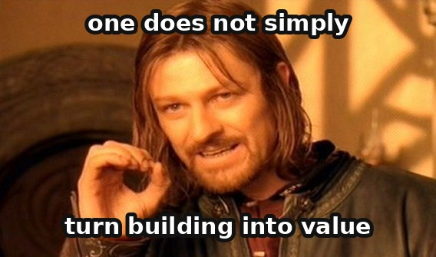
Discovery
LECTURE 5
AI Product: the full lifecycle — from intent to operation
Governance
Design
Support
Build
& Launch
Course "Deliberate Use of AI" · 3rd-year engineering students
Measure
Six sections — six arrows of one loop: code (Lecture 4) is one cheap step inside it.
0
1
2
3
4
5
6
7
Intro
Discovery
Design
Build & Launch
Measure
Support
Governance
Synthesis
2 / 56
Notes:
Lecture 4 walked through the lifecycle of code. Today's lecture is a zoom-out: code is one phase — now sharply cheaper — inside a much wider product lifecycle. You're technically strong and write code with AI assistants daily, but most of the product disciplines — customer development, design thinking, product experiments, operations by the reliability-engineering model — you're likely seeing for the first time. So each of today's six sections starts not with AI but with the classical base: where the discipline came from and what problem it solves without a single mention of artificial intelligence. Only after that do we ask what AI changes and where it breaks.
The roadmap is simple: six sections are six arrows of one loop. Discovery — where the hypothesis comes from. Design — how a hypothesis becomes an artifact. Build and Launch — how an artifact becomes a working product in production. Measure — how to check whether it actually worked. Support and Operate — what happens once a product lives 24/7. And Governance — how an organization decides what to invest capital in at all. At the end we'll assemble everything into a single matrix and checklist that you can run any unfamiliar AI initiative through.

Slide 3






The lecture is a loop, not a list of six topics
1. Discovery — where the hypothesis comes from
1. Discovery
2. Design — hypothesis → artifact
3. Build & Launch — artifact → product
6. Governance
2. Design
4. Measure — did it work
Intent
5. Support — lives 24/7
6. Governance — where to invest
5. Support
3. Build & Launch
The return arrow: governance feeds discovery again — a closed loop, not a one-time linear process.
4. Measure
3 / 56
Notes:
Here's the map of today's lecture, and it's drawn not as a list but as a circle, because that's essential. Six sections aren't six independent topics — they're six arrows of one loop. We start with intent — with Discovery, where a hypothesis about what to build at all is born. The hypothesis passes through Design, turning into a concrete artifact you can show a person. The artifact passes through Build and Launch, becoming a working product in production. Next — Measure: we check whether the change actually produced the effect we predicted. Support and Operate is what happens once a product is already living with real users around the clock. And finally Governance — the organizational level at which it's decided whether to keep investing, scale, or stop.
The key point that distinguishes this map from a simple list: the last arrow loops back into the first. The signal from operation and from governance decisions changes what we research next in Discovery. This is a closed cycle, not a one-time linear process — and that's exactly why at the end of the lecture we'll come back to the same circle, only with a full understanding of what happens on every arrow.

Slide 4
Why a product needs the loop: without one, the error is found too late
Five questions a product answers by observation rather than by opinion
When there is no loop
Does anyone need this at all
The questions do not disappear — optimistic assumptions take their place.
The error does not disappear either; only the moment of finding it moves — to after the build has been paid for and the release has happened, where rolling back costs more than the error itself.
From requirements to release, the cost of a fix spreads out up to a hundredfold on large projects and fourfold on small ones (Barry Boehm, a researcher in the economics of software development, 1981).
1
phase 1 · discovery
2
Can a person actually use it, and will someone nobody thought about be harmed
phase 2 · design
3
Can we build it and release it safely
phase 3 · build and launch
4
Will it be chosen firmly enough that people pay for it
phases 4 and 6 · measurement, governance
From inside the team it does not look like failure
5
Do those answers still hold a quarter later
Built it, nobody uses it · got to a pilot and stalled · it works and it is not chosen · rolled it out, and a quarter later people stopped opening it.
In all four cases the build itself went through successfully — which is why from inside the team it reads as success; an error sitting inside an unchecked hypothesis is not visible to anyone.
phase 5 · support
The first four are the product risks named by Marty Cagan (product leader, founder of the Silicon Valley Product Group, author of "Inspired"); the fifth only opens up after launch. Each has a phase of its own: the loop is the minimum set of places where these questions get answered.
The expense of building worked as an involuntary barrier: while making the thing cost weeks, that cost alone forced teams to think in advance. AI is exactly what zeroed it out — and teams that never had an explicit loop now have nothing left holding them back from skipping these questions.
4 / 56
Notes:
Before we work out how the loop is put together, let us answer a more practical question: what happens to a product that has no loop. The answer here is concrete — a sequence of events you can list out.
A product is obliged to close five questions. Does anyone need this thing at all. Can a person use it, and will someone nobody thought about be harmed. Can we build it and release it safely. Will it be chosen firmly enough that people pay for it. And the fifth, which only opens up after launch: do all four answers hold over time. The first four are the product risks named by Marty Cagan: value, usability, feasibility, business viability. The terminology is secondary here, the structure is what works: every question has a phase of its own. The loop is the minimum set of places where these questions get answered by observation. There is no ritual in it sitting on top of the engineering work.
What happens without a loop can be described step by step. A team with no answers written down in advance does not end up with no answers at all — it records them as facts, usually optimistic ones, builds on that foundation, and learns the truth at the moment when finding out costs the most: the build is paid for, the release has happened, rolling back costs more than the error. This has half a century of measurement behind it: on Barry Boehm's estimate, drawn from projects of the seventies, the gap in the cost of a fix between the requirements stage and release reaches a hundredfold on large projects and about fourfold on small ones. The multiplier depends heavily on how quickly the loop closes, and it is not a physical constant. The loop does not remove the error in a hypothesis about the user — it moves the moment of finding it leftwards, into the cheap zone, where the error costs a conversation and the paid-for build is still ahead.
The third consequence is harder than the others: when the stopping criterion is not written down in advance, there is no way to tell "we stopped because the data said no" from "we gave up because we were tired". The anchor for that comes in the section on discovery: a product whose build went through in full and cost sixty-two million dollars never once reached real use.
And now the turn that makes all of this the subject of this particular lecture. Before generative models, the cost of building worked as a barrier against exactly this scenario: writing code was expensive, and that expense on its own forced people to think in advance. AI zeroed out precisely that cost — and with it went the one protective mechanism available to teams that never had an explicit loop.

Slide 5



AI changes the cost and trust of every arrow of the loop — but not equally
Build
cost nearly collapsed to zero
Measure / Learn
cost about the same, trust fell
Observe / Orient
faster, but more exposed to attack
A meta-pattern repeating in each of the 6 sections: every arrow has a classical discipline — AI doesn't cancel it, it changes its cost and the degree of verification it requires.
Think about it: on which arrow of your latest task did speed outrun your actual trust in the result?
5 / 56
Notes:
The second half of the keystone — the central analytical tool of the whole lecture: AI changes the cost and trust of every arrow of the loop asymmetrically, not equally. The "build" arrow — cost has nearly collapsed to zero: writing code, a design draft, a first research prototype are orders of magnitude cheaper than five years ago. The "measure" and "learn" arrows — cost has stayed roughly the same or dropped only slightly, while trust in the result has fallen: the very instrument of measurement has become probabilistic and exposed to metric manipulation. The "observe" and "orient" arrows have become faster, but at the same time more exposed to attack: the speed of observing a system in production has grown, but the very ability to react quickly turns into a vulnerability if the observed data can be poisoned.
Hence the meta-pattern that will repeat in each of the six sections, literally following the same template: every phase of the product lifecycle has a classical discipline, and AI does not cancel it. AI changes how much that discipline costs and how far it can be trusted without verification — but it does not remove the need for the discipline itself. Customer Development is not replaced by "ask the model what the user thinks"; a product experiment is not replaced by "the model predicted the metric would grow." In every section we'll ask the same question: what does the classic make reliable here, what does AI speed up — and at what point does speed become a trap, because trust doesn't keep pace with it.
Think for twenty seconds: on which arrow of your latest task did speed outrun your actual trust in the result?

Slide 6

1
SECTION 1
Discovery — intent and hypothesis
2 base cases · 3 failures
Where does a hypothesis about what to build even come from. Most people have the informal experience of "ask your friends" — and almost no one has met the formal discipline that explains why that experience systematically lies.
0
1
2
3
4
5
6
7
Intro
Discovery
Design
Build & Launch
Measure
Support
Governance
Synthesis
6 / 56
Notes:
We start walking the loop arrow by arrow, and the first is Discovery, research. This is the phase where the hypothesis of what to build even comes from. Most strong engineers have informal experience "ask friends whether they like the idea" — but almost no one has encountered the formal discipline that explains why this informal experience systematically lies.
Today in this section — two classical bases: a methodology for finding a business model by going out to customers, and a technique for one correct conversation with one person. Then — what AI adds to research in 2025-2026, where it's limited, and three failures that show what happens when the boundary gets skipped. Hold two questions of the section: where does AI amplify research, and where is a real person with a real past required.

Slide 7


"There are no facts inside the building" — 4 steps, each ending in a decision
1
2
3
4
Discovery
Validation
Demand creation
Scale
discovery
validation
creation
building
Steve Blank — the Customer Development methodology ^{[1]}
Falsifiable hypothesis
we believe X → we'll test it via Y → by date Z we'll have a yes/no answer
BML is the engine; Customer Development is the map of the terrain the engine drives on. First understand what you're testing and with whom — only then how fast to spin the loop.
[1] Blank — Customer Development (Four Steps to the Epiphany)
7 / 56
Notes:
Customer Development is Steve Blank's methodology. The central idea is extremely concrete: there are no facts inside the building, so go outside. A startup is not a scaled-down copy of a large company executing a known plan — it's a temporary organization in search of a repeatable business model under extreme uncertainty. The plan can't be written in advance, because the plan depends on answers only customers know.
The method consists of four sequential steps, each ending in an explicit decision to continue or pivot. Discovery — turn the initial hypotheses into facts by going out to real people; this step is explicitly hypothesis-oriented — you write down what you believe before you walk out the door. Validation — check whether this can be sold not just to the first enthusiasts but to a wider circle. Creation — drive demand at scale. Building — transition the organization into formal functional departments.
It's important to distinguish Customer Development from Build-Measure-Learn, which we discussed in the keystone: BML is the engine, Customer Development is the map of the terrain the engine drives across. First understand what you're testing and with whom, then how fast to spin the test cycle. And here we also introduce a device we'll reuse in every following section: the falsifiable hypothesis — a written statement "we believe that X, we'll test it via Y, by date Z we'll have a yes-or-no answer." The format works because it turns vague confidence into a testable commitment with a date. A known limitation of the method: it's written for startups starting from zero, searching for a business model, not for refining a feature inside a mature product — applying the whole ceremony to a minor feature tweak is excessive, exactly as you wouldn't run an A/B test to fix a typo.
Sources:
[1] Blank — Customer Development (Four Steps to the Epiphany) — 4-step methodology; "there are no facts inside the building". https://innovation.ucsd.edu/startup/startup-toolkit/Steve-Blank-CustDev.pdf

Slide 8



Hours → minutes: but links exist so they can be checked
verify the source
Desk research
Interview synthesis
Reference dataset
Perplexity Deep Research: 2 hours → ~30 minutes ^{[1]}
Dovetail — pain-point clustering at scale ^{[2]}
a curated collection of "query → correct answer"
97% of researchers use AI — only ~8% trust AI personas as data ^{[3]}
Mandatory practice: verify important data directly against the source before using it in a decision. Synthetic users are only a pre-research step (piloting a guide, a draft of personas, generating hypotheses), never evidence for a go/no-go decision.
[1] Perplexity Deep Research — overview for product research · [2] Dovetail — AI interview synthesis · [3] NN/g — 2026 practitioner survey
8 / 56
Notes:
Now — what AI changes in this phase, concretely and by tool. Desk research — a review of market reports, complaints, tickets — down to a single hour. Perplexity, especially its Deep Research mode, is widely recognized as the best tool for this task: the service plans a research trajectory, reads sources, and returns a report with links in minutes. Practitioners report roughly a fifty-percent time reduction. Mandatory practice, not an option: verify important data directly against the source before using it in a decision — links exist precisely so verification is possible, but the tool doesn't remove the verification step itself.
Interview synthesis: Dovetail is specifically built for cross-interview synthesis with a "quote anchored to its source" design — this protects against drift into an unverifiable summary. AI is genuinely strong at clustering — grouping hundreds of tickets into recurring pain themes — and at building a reference dataset, a curated set of "query → correct answer" pairs, which we'll come back to in sections three and four as a formal launch artifact and an evaluation set.
Synthetic users as pre-research is a narrow, legitimate area: piloting a discussion guide, drafting proto-personas, generating hypotheses. None of these outputs should be treated as evidence for a "ship or not" decision. Telling detail: ninety-seven percent of researchers use AI, but only about eight percent trust AI-generated participants as a data source — the gap is recognized by the profession itself. Teresa Torres, one of the leading discovery practitioners, uses AI to draft a first pass, but the two-step synthesis rule holds without exception, and she explicitly advises against synthetic interviews — because the team's own thinking is the whole point of the process.
Sources:
[1] Perplexity Deep Research — overview for product research — desk research: hours -> minutes; source verification still needed. https://www.secondtalent.com/resources/perplexity-deep-research-review/
[2] Dovetail — AI interview synthesis — pain-point clustering at scale; limits of AI summarization. https://listenlabs.ai/articles/dovetail-ai-qualitative-analysis/
[3] NN/g — 2026 practitioner survey — 97% of researchers use AI, ~8% trust AI personas as data. https://www.nngroup.com/articles/state-of-ux-2026/ [VFY-day-of]

Slide 9


Rehearsing interview questions on AI personas
WHAT IT IS
Before going out to living people, the list of questions is run past several invented interviewees played by a model. The point is to catch bad questions before they spoil a real conversation. The run says nothing about the product. A rehearsal, not research.
HOW IT WORKS
1
Several different customer types are described — by how a person lives with the task: what they use now, what it costs them, what they once tried and dropped. A character sketch is no use here.
the invented interviewees do not hear each other
2
Each type is kept apart, so that the answers do not run together into one common voice.
3
The same list of questions is run past all of them.
the only thing that leaves is
a corrected list of questions
4
Two things are read, and the answers are not among them: a question everyone answered the same way tells nobody apart; a question answered in terms of an imagined future invites a polite invention. Both get rewritten.
WITH AI AND WITHOUT
WITHOUT AI — how the rehearsal has always been run
WITH AI — what changed
The list of questions is talked through with a colleague, or one live interview out of eight is spent on the rehearsal. It works, but it gives one point of view and costs a day.
The rehearsal takes minutes, and a dozen runs are affordable. Only the rehearsal gets cheaper: nothing replaces the interview with a living person.
WHERE IT BREAKS
The interviewees' answers are not data about users: there is one model, and five interviewees give five views of that one model. There are no five people behind them. Checked against a real national survey, the model reproduces the average answers and halves the spread of opinion (16 against 31). If a conclusion about the product has been carried out of the run, the practice has been run wrong: its output is a corrected question.
Synthetic answers checked against a real national survey — Bisbee, Clinton, Dorff, Kenkel, Larson, Political Analysis, 2024
9 / 56
Notes:
The idea of running a conversation past several interviewees played by a model comes up often. Mechanically it is sound, on one condition: the role of the practice is narrow, and that narrowness has to be held.
What it is, in plain words. You have written a list of questions for an interview and you are about to take it to living people. Before you go, you run that list past several invented interviewees played by a model. This is a rehearsal — much like a read-through of a play before opening night: people listen for where the text does not work.
Then, step by step. First you describe several different customer types, and you describe them without a character sketch. A sketch of the kind "Anna, thirty-four, likes convenient interfaces" is useless, because nothing follows from it. What is useful is different: what the person uses now, what that costs them in hours or in money, what they once tried and dropped. Each type is kept apart so the answers do not run together into one averaged voice. The same list is run past all of them.
And from there the whole value of the practice is in where you look. Not at the content of the answers. At two things. The first: which questions produced roughly the same answer from everyone. A question like that tells nobody apart, and in a live interview it will waste time — it gets rewritten. The second: which questions are answered in terms of an imagined future, "I would use this". That is exactly the breach of the rule about the concrete past, and it is wired into the wording of the question itself; catching it in rehearsal is cheaper than letting it spoil a live conversation.
The practice invented nothing new: questions were talked through with a colleague, or on the first live interview, long before any models. AI made the rehearsal cheap — it now takes minutes. A conversation with a person costs what it always did.
Now the boundary, without which the practice turns into the failure we take apart next. The only thing that leaves is a corrected list of questions. The interviewees' answers do not go into a decision and are not quoted as data. That is how the practice is built: there is one model. Five such interviewees are five views of one model. There are no five people behind them. A check against a real national survey puts a number on it: the model reproduces the averages and understates the spread of opinion by almost half. A collapsed spread is false confidence exactly where living people differ most.

Slide 10



Searching accumulated support tickets for the pain
WHAT IT IS
A product with users already has an archive of complaints and questions. The practice turns it into a source of hypotheses: the tickets go into a searchable store, the ones close in meaning are grouped, and you see which themes repeat. What leaves is a named theme of pain.
HOW IT WORKS
1
Every ticket goes into one common store, tagged with when it arrived, who it came from and which product it is about.
store
and tag
2
The search runs two ways at once: on an exact match of words, and on meaning. An error code is found only by the first; a problem described in a person's own words only by the second.
search by word
and by meaning
3
What is close is gathered into groups and retold in two passes: first each ticket on its own, then what the group has in common. Skip the first pass and 20–40% of the detail is lost.
gather what is close
into groups
order matters: skip the tagging and the archive becomes a bag of text
WITH AI AND WITHOUT
WITHOUT AI — tagging by theme, by hand
WITH AI — what changed
Tickets are sorted into a list of themes thought up in advance. So the only themes found are the ones somebody has already guessed at.
What is close in meaning gathers itself, with no list of themes, and a group is retold in minutes. The name of the theme is still checked by a person: the machine groups, it takes no decisions.
WHERE IT BREAKS
The archive is biased by construction: it holds only those who got as far as complaining. Volume does not cure it: there is no ticket saying "I need what you do not have at all". The question "why do people not get as far as signing up" is not one it answers: that takes a conversation with those who left. And the search returns what is close, it does not weigh importance: ten thousand complaints about one typo are still one typo.
who got as far as complaining
all users
the ticket archive
Two-step synthesis — Teresa Torres, a coach of product teams and the author of "Continuous Discovery Habits", a book on continuous user research
10 / 56
Notes:
The second practice works where a product already has living users and an accumulated archive of tickets.
What it is, in plain words. Any working product has a history of complaints and questions, and usually that history lies there as dead weight: people look into it when they need to answer one particular person, and nobody looks at it as a source of knowledge about the product. This practice turns the archive into a source of hypotheses. What leaves is a named theme of pain, propped up by verbatim quotes, and an indication of exactly who it is worth talking to in person about it. A general feeling that users are unhappy about something is not an output here.
Step one — store and tag. Every ticket goes into one common searchable store, tagged with when it arrived, who it came from and which product it is about. The tagging is not bureaucracy: without it the archive turns into a bag of text, in which last year's problem cannot be told apart from today's, or your own segment from somebody else's.
Step two — search two ways at once: by words and by meaning. An exact error code is found only by the word search, and a problem described in a person's own words only by the meaning search, and tickets contain both. On its own, each way misses quietly.
Step three — gather what is close into groups and retell each group in two passes: first each ticket separately, then what they have in common. Skipping the first pass has a measurable effect: the retelling loses between twenty and forty per cent of the important detail.
And what changed here. People have always been able to go through tickets, but they sorted them into a list of themes thought up in advance — and found only what somebody had already guessed at. A model gathers what is close in meaning on its own, with no list of themes; the name of the theme is still checked by a person.
The boundary has two parts, and both are compulsory. The first: the archive is biased by construction — it holds only the people who got as far as complaining. Volume does not cure it, a hundred thousand tickets are biased exactly as a thousand are, because there is no such ticket as "I need the thing you do not have at all". The archive is structurally silent about an unmet need, so the question "what do we not have" is not closed by it. The second: the search returns the tickets that are close, it does not measure importance. Ten thousand complaints about one typo are still one typo. Frequency is not significance, and the two are especially easy to confuse when the number is large.

Slide 11


A synthetic interviewee structurally cannot produce disagreement
When a live interview is strictly better than AI synthesis
1. The cost of a "continue/stop" mistake is high
2. You need a real past, not a plausible one
Mirror of agreement: a synthetic interviewee structurally cannot reflect disagreement — it has no real past that could contradict the way the question is phrased.
3. You need validation by commitment, not by opinion
AI summaries lose 20-40% of interview detail (Torres) ^{[1]} when the "individually first" step is skipped — a failure traceable to a specific step, not a vague "AI is sometimes wrong."
[1] Torres — Continuous Discovery Habits / anti-synthetic
11 / 56
Notes:
The fifth risk of discovery is ethical in nature, but it materializes as a concrete, measurable mechanism: an AI summary can miss twenty to forty percent of important interview detail when synthesis skips the "individually first" step and jumps straight to a cross-interview theme. This isn't a vague "AI sometimes makes mistakes" — it's a failure traceable to a specific step.
Why live interviews remain necessary — an argument of accumulation. The Mom Test's second rule — ask about specific things from the past — is exactly the rule a synthetic persona cannot satisfy, because it has no real past, only the ability to generate something plausible. A tendency to agree plus the absence of a real past is a cumulative failure: not just skewed toward "yes," but skewed toward "yes" about an event that never happened.
Let's make this testable through three operational criteria. First: the cost of a go/no-go mistake is high — you need a source capable of saying "no," and a synthetic one is by construction incapable. Second: you need a real past, not a plausible one — if the hypothesis concerns specific past behavior, a synthetic persona invents it rather than remembers it. Third: you need validation by a real commitment — a pre-order, a deposit, an intro — there's no AI substitute here at all. What clearly stays from the classic: the three Mom Test rules apply the same way no matter who asks the question; Blank's hypothesis-first discipline is the antidote to a one-click AI tree. The rule in short: the closer the output is to an irreversible decision about real people, the more strictly a real person is required; the further away, the more appropriate AI becomes as a draft accelerator.
Sources:
[1] Torres — Continuous Discovery Habits / anti-synthetic — a contrarian-to-hype stance: against synthetic interviews and one-click AI persona trees. https://cieden.com/podcast/teresa-torres-on-continuous-discovery-in-b2b-and-ai

Slide 12




The same task: real people — 3 of 7, the synthetic panel — 7 of 7 ^{[1]}
Real people
3 of 7 — "far-fetched and useless"
Synth panel
7 of 7 — "a game changer"
The same feature — opposite verdicts
Criterion: synthetic output is disqualified for a "continue/stop" decision by construction, not from bad luck on a run. Alternative: a pre-research role + real testing with 5-8 participants.
[1] NN/g (Rosala & Moran) — Synthetic Users
12 / 56
Notes:
The Nielsen Norman Group ran a controlled comparison as part of an onboarding usability study: real users completed an average of three out of seven steps; an AI-generated panel of synthetic users, tested on the exact same flow, falsely reported completing all seven of seven. Separately, real users described a discussion-forum feature as contrived and useless, while synthetic personas produced glowing praise of the same feature; one synthetic user called an impractical drone-delivery concept "a game-changer."
The mechanism, tied specifically to the Discovery phase: large language models are tuned to agree with the framing of the given question — a concept described with any enthusiasm comes back validated. A synthetic user cannot produce disagreement, because it has no real experience capable of contradicting the question's framing. This is the same agreement-bias mechanism the course has already discussed for models in general, but here it materializes as a concrete, measured failure specifically in the discovery phase.
Combine this with the Mom Test's second rule — ask about a real past — and you get a cumulative failure: not just skewed toward "yes," but skewed toward "yes" about an event that never happened. The lesson: a synthetic panel that agrees with your concept is not evidence the concept is good — it's evidence the panel is incapable of disagreeing. The criterion: any output feeding a "ship or not" decision must be traceable to real past behavior of a real person. The alternative: use a synthetic panel only in a pre-research role, then run real testing with five to eight participants — a sample size that already surfaces most usability problems.
Sources:
[1] NN/g (Rosala & Moran) — Synthetic Users — 3/7 real vs 7/7 synthetic on the same task (drone-delivery). https://www.nngroup.com/articles/synthetic-users/ [VFY-day-of]

Slide 13



10,000 devices sold out of the 100,000 planned: the comparison with the phone in the buyer's pocket was made after the build
WHAT HAPPENED Humane is a company founded in 2018 by people who came out of Apple. Its only product, the AI Pin, is a wearable device with no screen: a small box worn on your clothes with a camera, a microphone and a laser projection onto your palm, answering out loud through a language model. The idea: a person stops looking at their phone. The device was shown on 9 November 2023 and sales opened in April 2024 — $699 plus $24 a month. On 18 February 2025 HP bought the assets for $116 million, and on 28 February the cloud service was shut down: the devices in buyers' hands stopped answering.
What the numbers showed
What was not found out before the build
• About 10,000 devices sold — a tenth of the company's own target of 100,000 by the end of the year
The discovery phase's question fits in one phrase: compared with what. Every buyer already had a phone in their pocket that does the same things, and everything else on top. Reviewers converged on the same point: the device does less than a phone and does it more slowly.
An answer like that costs eight conversations with living people before the build. Here it arrived from the market — by way of $230 million and 10.5 months of sales.
• Revenue of about $9 million against about $230 million raised — roughly 4%
• Between May and August 2024, more returns than purchases: by August, closer to 7,000 were still in people's hands
• The price was cut from $699 to $499 on 23 October 2024 — six months after sales opened
The answer about the user arrives either way; the discovery phase only chooses when, and at what price. The criterion that carries forward: a hypothesis about the user is closed by comparing it with whatever that person gets by with today.
The device does work, and the miss lies in the answer to who needs it and what for. Google Glass travelled the same road in the opposite direction: the $1,500 glasses were pulled from general sale in January 2015 and then handed to people whose hands are busy with work. At AGCO, a maker of agricultural machinery, machine assembly time fell by 25% and inspection time by 30%; at the logistics company DHL, warehouse output rose by 15% — all against the same work done without the glasses. Same device. Different user.
[1] 9to5Mac (7 Aug 2024) — Humane's internal sales figures · [2] TechCrunch (18 Feb 2025) — HP buys Humane's assets · [3] Humane Inc. — dates, prices and the sales target · [4] Digital Trends — Glass Enterprise Edition at AGCO and DHL
13 / 56
Notes:
The section's second failure is about what happens when the discovery phase is gone through as a formality.
What happened. Humane was founded in two thousand eighteen by people who came out of Apple. Its only product is a wearable device with no screen: a small box worn on your clothes with a camera, a microphone and a laser projection onto your palm, answering out loud through a language model. The idea: a person stops looking at their phone. It was shown in November of twenty-three, sales opened in April of twenty-four — six hundred and ninety-nine dollars plus twenty-four a month. In February of twenty-five HP bought the assets for a hundred and sixteen million, and on the twenty-eighth of February the cloud was shut down: the devices left in buyers' hands stopped answering.
The numbers. About ten thousand sold — a tenth of the company's own target of a hundred thousand. Revenue of about nine million against two hundred and thirty raised, which is four percent. Between May and August of twenty-four there were more returns than purchases: by August, closer to seven thousand devices were still in people's hands. The price was cut from six hundred and ninety-nine to four hundred and ninety-nine in October, six months after sales opened.
Now the root, and it lies squarely in our phase. The question of discovery fits in one phrase: compared with what. Every buyer already had a phone in their pocket that does the same things, and everything else on top. Reviewers converged on the same point: the device does less than a phone, and more slowly. An answer like that costs eight conversations with living people before the build. Here it arrived from the market — by way of two hundred and thirty million and ten and a half months of sales. Think back to the rule from the base slide: ask how much a person pays today for the nearest equivalent. The nearest equivalent was the phone they had already bought.
And now the distinction, so that the case does not read as "the hardware did not come off". Google Glass travelled the same road in the opposite direction. The fifteen-hundred-dollar glasses were pulled from general sale in January of fifteen, and then handed to people whose hands are busy with work. At the agricultural machinery maker AGCO, machine assembly time fell by a quarter and inspection time by thirty percent; at the logistics company DHL, warehouse output rose by fifteen. All of it against the same work done without the glasses. Same device. Different user.
Sources:
[1] 9to5Mac (7 Aug 2024) — Humane's internal sales figures — from May to August 2024 returns exceeded purchases: ~10,000 devices sold, ~$9 million in revenue, closer to 7,000 still in customers' hands by August. https://9to5mac.com/2024/08/07/humane-ai-pin-woes-worsen-as-recent-returns-exceed-sales/
[2] TechCrunch (18 Feb 2025) — HP buys Humane's assets — $116 million for the assets against more than $230 million raised; sales ended, the cloud service shut down on 28 February 2025. https://techcrunch.com/2025/02/18/humanes-ai-pin-is-dead-as-hp-buys-startups-assets-for-116m
[3] Humane Inc. — dates, prices and the sales target — unveiled 9 November 2023; on sale from April 2024 at $699 plus $24 a month; cut to $499 from 23 October 2024; target of 100,000 devices in a year. https://en.wikipedia.org/wiki/Humane_Inc.
[4] Digital Trends — Glass Enterprise Edition at AGCO and DHL — against the same work without the glasses: assembly time -25%, inspection time -30% (AGCO), warehouse throughput +15% (DHL); wide sales of the $1,500 Explorer closed in January 2015. https://www.digitaltrends.com/mobile/google-glass-enterprise-edition/

Slide 14
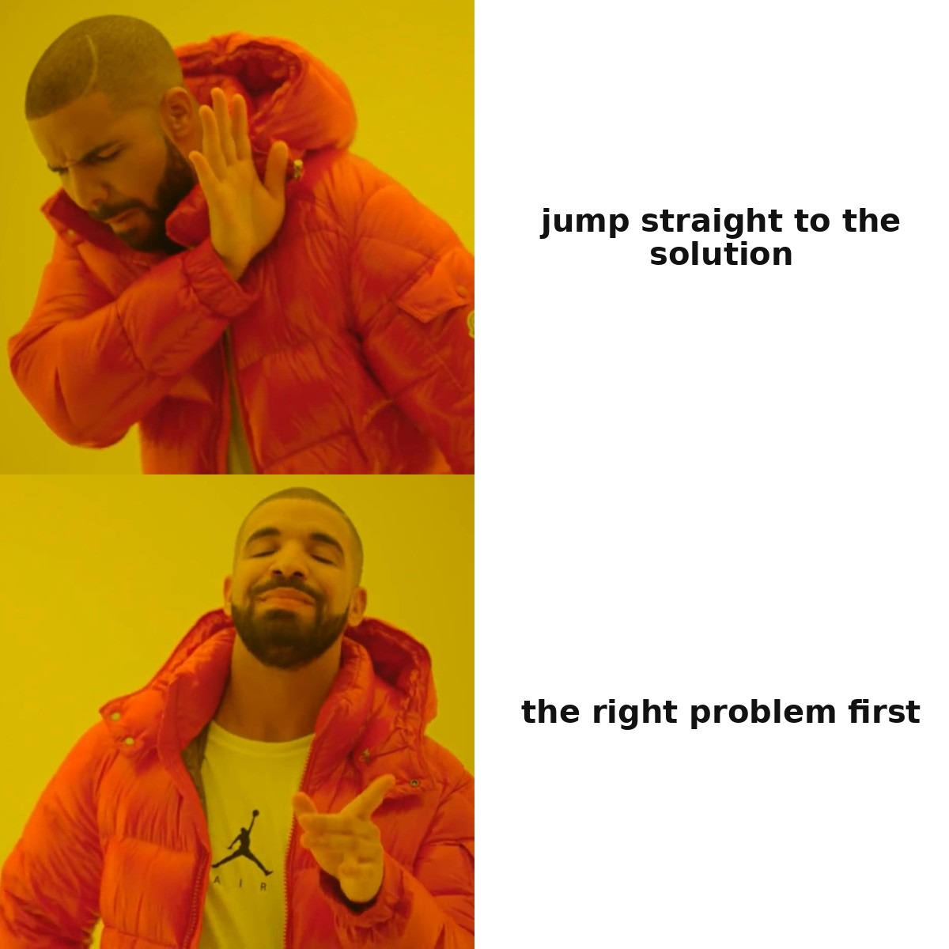
2
SECTION 2
Design — a hypothesis becomes an artifact
2 base cases · 2 failures
How a hypothesis from research turns into a concrete artifact you can show a person. This is also where safety gets built in — in the design brief, not patched on after something has already gone wrong.
0
1
2
3
4
5
6
7
Intro
Discovery
Design
Build & Launch
Measure
Support
Governance
Synthesis
14 / 56
Notes:
Section two — the loop's second arrow: how the hypothesis from the previous section turns into a concrete artifact you can show a person. The course audience is technically strong, but as a rule hasn't gone through formal design education — so this section, like the previous one, starts with the classics before moving on to AI interface-generation tools.
Today — a single load-bearing framework for the design process, expert-review heuristics, what AI offers for interface generation in 2025-26, where it breaks on non-deterministic output, and two failures that represent two different, complementary classes of design failure.

Slide 15









Design here is the whole of a person's work with the system: surfaces and touchpoints, behaviour, the answer when unsure
THE SCOPE OF THE WORD The screen is one of the surfaces on which a person meets the system. Design in this phase settles the whole make-up of that meeting: where the system comes across a person, how it behaves over time, and what it does in the minute when it is unsure of its own answer. In a product built on a language model, there is usually more work on the other surfaces than there is on the screen.
Surfaces and touchpoints
Screen
Voice
Notification
what a person sees, and in what order
the same decision with no picture: order, length, the right to interrupt
the system opens the conversation itself: when, and on what occasion
Email, report
Refusal
Silence
the answer read when the system is nowhere at hand
what the system says when it will not do the thing
processing is running, there is no answer yet: what a person sees for that minute
The system's behaviour over time
Sure
Unsure
Wrong
it answers and shows what the answer is built on
it says so in the first person and offers a move forward
the person sees what happened, and has a rollback path
Decisions in this layer are taken once, and they outlive any layout: the product's name, the promise at the entrance, the right to stop. The name sets the picture of the system in a person's head before they see the first screen — and correcting that picture costs a recall of the entire fleet.
15 / 56
Notes:
The section opens with a caveat, without which everything that follows reads narrowly. The word "design" in this phase is usually taken to mean drawing screens. In a product built on a language model the screen is one surface among several, and there is usually more work on the rest.
Look at the list of surfaces and touchpoints. The screen — what a person sees, and in what order. Voice — the same decision with no picture: order, length of answer, the right to interrupt. Notification — the system opens the conversation itself, and what gets decided is when it has the right to do so and on what occasion. Email or a report — the answer a person reads when the system is no longer at hand. Refusal — what the system says when it will not do the thing. And silence: processing is running, there is no answer yet, and what a person sees for that minute has been designed too, even if only by default.
The second tier is behaviour over time, and for a product built on a model it carries the main load. When the system is sure, it answers and shows what the answer is built on. When it is unsure, it says so in the first person and offers a move forward. When it is wrong, the person sees what happened and has a rollback path. Not one of those three decisions is visible on a screen mockup, and the beauty of the mockup checks none of them.
And the third thing, the one people forget because it does not look like design. The product's name, the promise at the entrance, the right to stop are decisions from the same layer. The name sets the picture of the system in a person's head before they ever see the first screen. This is easy to check: the failure we take apart at the end of the section is precisely about the gap between the picture in a driver's head and the behaviour of the car, and correcting that picture came to a recall of two million vehicles.
So keep the next few slides wider than the screen. Both diamonds of the Double Diamond run across the system's behaviour as well. The design system covers the part of the rules that can be expressed as a number. The rest stays a human decision, and it is a human who will be held to account for it.

Slide 16
Two diamonds: first the right problem, then the right solution
Widen the problem
Widen the solution
The right
problem
The right
solution
Double Diamond ^{[1]}
(Design Council UK)
Design Thinking — its 5-step version of the same framework
Narrow: one problem
Narrow: one solution
A common mistake: converging on a solution without checking the problem itself — skipping the first diamond. A cheap prototype exists precisely to surface this before money is spent on development.
[1] UK Design Council — The Double Diamond
16 / 56
Notes:
Design Thinking is a five-stage, human-centered methodology, canonically taught by the Stanford d.school. Double Diamond is the UK Design Council's framework, a visual model of two divergence-and-convergence cycles: the first diamond is Discover, broad exploration, then Define, synthesis into a concrete brief — about the right problem; the second diamond is Develop, generating many directions, then Deliver, testing and shipping one — about the right solution.
For this lecture's purposes we use Double Diamond as the section's load-bearing framework, because it's structurally equivalent to Design Thinking but shows the key idea more explicitly: two separate divergence-convergence cycles, not one. A common mistake for an engineer encountering the design process for the first time: instinctively converging on a solution before even checking the problem itself — skipping the first diamond and diving straight into the second. It's the same anti-pattern as "just write the code," skipping the question of whether we're even solving the right problem.
In practice the stages aren't linear — teams constantly loop back from Deliver to Define, and that's not a sign the process failed, it's the process working normally. Keep this framework in mind: when we get to this section's first failure, you'll see it happened exactly at the first-diamond point — in the decision of what we're even building and for whom — not in the technical implementation.
Sources:
[1] UK Design Council — The Double Diamond — Discover->Define->Develop->Deliver: two cycles of divergence/convergence. https://www.designcouncil.org.uk/resources/the-double-diamond/

Slide 17

AI for divergence, humans for convergence
Direction generation
2025-26 tools
v0 (Vercel) · Figma Make ^{[1]} · Google Stitch ^{[2]} · bolt.new
option 1
option 2
option 3
option 4
• 2-4 directions in minutes (used to be a day of manual wireframing)
• Figma Make pulls in the team's own components — less rework
1 refined
Convergence needs judgment about specific context that isn't in the training data: AI widens the space of options, choosing and testing with a real user stays with the human.
[1] Figma — 2026 AI design tools · [2] Google Stitch (ex-Galileo AI)
17 / 56
Notes:
A realistic team workflow for 2025-26: a product manager or designer describes a screen in a prompt to v0 by Vercel or Figma Make, and the generator pulls in the team's already-existing components rather than generic templates — seventy-two percent of designers use generative AI, ninety-one percent report an improvement specifically in quality. The generator produces two to four diverging directions in minutes — what used to take a day of manual wireframing. The human designer converges — picks a direction, discards the rest, fixes the details the model got wrong. The chosen direction goes through a real usability test with real users.
Other named tools: Google Stitch — a text-to-mockup generator; Uizard — a lighter-weight tier; bolt.new — a prompt turned into a full browser app, the canonical vibe-coding tool.
What's genuinely good here, without the hype: speed of the first draft, generation aware of the design system — less rework than naive text-to-UI, and democratization of a decent first pass — non-designers can now produce something presentable to start a conversation. The working practice, the clear formulation for the whole section: AI for divergence, human for convergence. Co-creative tools are appropriate for maximizing the volume and variety of early exploration. Convergence — deciding which problem is worth solving, and refining one direction to fully match the context — is explicitly named as the human strength no prompt replaces. A design system is the natural guardrail that keeps AI divergence from drifting off-brand.
Sources:
[1] Figma — 2026 AI design tools — Figma Make, v0, Stitch, bolt.new — 2-4 directions in minutes. https://www.figma.com/resource-library/ai-design-tools/ [VFY-day-of]
[2] Google Stitch (ex-Galileo AI) — Google acquisition, May 2025 — a fast-moving tool landscape. https://www.banani.co/blog/galileo-ai-features-and-alternatives [VFY-day-of]

Slide 18



A design system: shared interface rules that a machine can check on its own
WHAT IT IS
A design system is the shared body of interface rules for a product and the ready-made components that go with it: the colour combinations allowed, the sizes of buttons and fields, how an element looks under the cursor. It used to be a document for people. What matters more now is the other part: some of the rules can be written so that a machine reads and checks them.
HOW IT WORKS
from the bottom up: each layer is stronger than the one below it, and only the top one turns a wish into a guarantee
3. A CHECK THAT
STOPS THE RELEASE
The rule is checked automatically on every generated screen, and a breach is blocked with no discussion. Only this layer gives a guarantee.
2. OWN COMPONENTS
INSTEAD OF STOCK ONES
The generator is given the team's own components. This lowers the chance of a breach and guarantees nothing.
1. RULES WRITTEN
AS NUMBERS
While a rule lives in a picture of a mockup, only a person can check it, and only by eye.
WITH AI AND WITHOUT
WITHOUT AI — a body of rules for people
WITH AI — why the rules became machine-readable
A designer checks it by eye: a set of rules keeps the product consistent.
The generator turns out screens faster than a person can look at them. A machine check grows with the generation.
WHERE IT BREAKS
A machine checks only what can be expressed as a number. "Is this clear to a living person" stays with the person: a screen can pass every check and remain unclear. And separately: a request to the generator is not a control mechanism — a mechanism is a rule that can stop a release. This check looks at the screen: the system's behaviour over time cannot be expressed as a number and is not covered.
18 / 56
Notes:
A design system is routinely called the guardrail that holds generation inside the lines. The phrasing is right, but until there is a mechanism behind it, it is a metaphor — so let me start with what the thing actually is. A design system is the shared body of interface rules and the set of ready-made components: the colour combinations allowed, the sizes of buttons and fields, how an element looks under the cursor, what a standard block is made of. For a long time it was a document for people. What matters now is its other part: those rules that can be written so that a machine reads them and checks them.
There are three layers, and only the last one is load-bearing. The first is rules written as numbers. While a rule lives in a picture of a mockup or in a spoken agreement, the only thing that can check it is a person, and only by eye; written as a number, it becomes checkable. The second layer is giving the generator the team's own components instead of generic templates. Some tools do this by construction, and that is exactly why generation of that kind needs less reworking. But notice: the first two layers lower the chance of a breach, and only the third turns a chance into a guarantee. The third layer is an automatic check with the right to stop a release: a breach is not discussed, it is blocked, exactly as a red test stops a change going any further. And a point I want to make separately: the common engines for a check like that have nothing to do with AI at all. That is part of the lesson, not a detail of the setup.
Separately — what here comes from AI and what was always there. A body of interface rules and a set of ready-made components have existed for decades, and a designer checked them by eye. One thing changed: the generator turns out screens faster than a person can look at them, and a machine check is the only thing that grows with the generation.
The boundary is a compulsory part of the practice, not a caveat. A machine checks only what can be expressed as a number: contrast, the size of a button, whether a field has a label. The question of whether this is clear to a living person stays with the person, and a screen can pass every check in full and remain unclear. So the practice does not replace a review against Nielsen's ten heuristics, and it does not replace showing the thing to living people — it only takes off them what is cheaper to catch by machine. And the conclusion that travels furthest: a request addressed to the generator is not a control mechanism, in any wording at all. Telling a request from a guarantee is something you will need in every phase that follows.

Slide 19
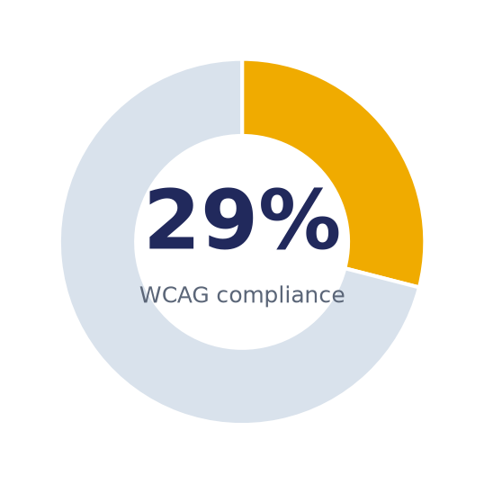

29% WCAG conformance across 21,880 evaluations — the platform matters more than the prompt ^{[1]}
21,880 WCAG evaluations of AI-generated interfaces:
• contrast 26.8%
• use of color 19.2%
"Make it accessible" in the prompt does not guarantee the result — platform defaults decide, not the request text.
Design for NON-DETERMINISTIC output: same input → different output → breaks the consistency heuristic; you need human checkpoints.
[1] ACM Web4All 2026 — Generated Inaccessible
19 / 56
Notes:
"AI slop" and homogenization are a clear critique of the last two years. Nielsen Norman Group states it plainly: UI still matters, but it will become a less significant differentiator, because anyone will be able to produce a decent-looking interface. The mechanism of homogenization: generators are trained on one corpus of existing UI patterns, so many independent teams prompting "a modern dashboard" converge on a visually similar result.
Accessibility gaps — with a hard number. An academic study ran twenty-one thousand eight hundred eighty WCAG accessibility evaluations against interfaces generated by AI tools and found only twenty-nine point zero percent conformance. The worst scores were on the most basic criteria: color contrast and use of color. An important finding: the platform's own design influenced final accessibility more than user prompts did — asking to "make it accessible" was not guaranteed to fix it. This directly refutes the naive defense of "you just need to ask the AI correctly."
A key addition for this audience — designing for non-deterministic output. Classical UX assumes a deterministic system: the same input produces the same output. AI products break this assumption — the same input can produce different output across different runs, which requires new patterns: graceful failure, co-creation, accountable autonomy. What stays from the classic: "empathize first" design thinking, Nielsen's heuristics as a fast expert gate review, and real usability testing — the antidote to hallucinated "best practices," because testing measures real human confusion. When this isn't AI-first: a product aimed at the emotional attachment of vulnerable users, or one that automates a decision about people, requires an explicit safety review in the MVP, not polish after the fact.
Sources:
[1] ACM Web4All 2026 — Generated Inaccessible — 21,880 WCAG evaluations on AI-generated interfaces, 29.0% compliance (contrast 26.8%, color 19.2%). https://dl.acm.org/doi/10.1145/3800424.3800430 [VFY-day-of]

Slide 20



All 2,031,220 cars with the driver-assistance feature recalled: the prominence of the controls was found insufficient
What the case is
Autopilot is the set of driver-assistance features in Tesla cars: it holds the lane, the speed and the following distance while the person watches the road and keeps their hands on the wheel.
On 13 August 2021 the National Highway Traffic Safety Administration (NHTSA) opened an investigation: cars with Autopilot engaged were running into emergency vehicles stopped on the road. On 12 December 2023 Tesla recalled all 2,031,220 cars carrying the feature — the entire fleet built since 2012. In the defect report the company wrote, in its own words, that the prominence and scope of the system's controls may be insufficient to prevent driver misuse.
driver-assistance
features
Investigation
08.2021
Recall of 2,031,220 cars
12.12.2023
Over-the-air update
12.2023
Recall query
25.04.2024
≥20 crashes
after the update
What broke
Why this is a design-phase decision
Over the course of the investigation, from August 2021 to December 2023, at least 13 fatal crashes accumulated in which foreseeable misuse played its part.
The driver's picture of the system diverged from what the system was doing. The name of this error is mode confusion.
The recall touched not one line of the driving model. What was fixed was how the system presents itself: the prominence of the warnings, the frequency of the attention checks, the threshold past which the feature switches off.
The name "Autopilot" is a decision from the same layer: it sets the picture before the first warning does.
The root is a decision about how the system presents itself to a person: what it reports, how insistently, and when it refuses to go on. Two years and four months passed between the opening of the investigation and the recall, and all that time the fleet drove with the picture it was given. Testing the model does not catch this: it behaved exactly as advertised.
The agency opened its query into the remedy on 25 April 2024: in the first four months after the update, at least 20 crashes accumulated with the system suspected of involvement, and some of the measures are switched on by the driver's own consent and switched off the same way. The criterion that carries forward: a measure a person can switch off stays a request — what turns it into a mechanism is the ability to stop the action.
[1] NHTSA — recall report 23V-838 (12 Dec 2023) · [2] NHTSA — closing of investigation EA22-002 · [3] NHTSA — remedy query RQ24-009 (25 Apr 2024)
20 / 56
Notes:
The section's failure is about interaction design in its pure form: the model worked as advertised, and what broke was the picture of the system in a person's head.
What the case is. Autopilot is the set of driver-assistance features in Tesla cars: it holds the lane, the speed and the following distance while the person watches the road and keeps their hands on the wheel. In August of twenty-one the American highway traffic safety administration opened an investigation: cars with the feature engaged were running into emergency vehicles stopped on the road. On the twelfth of December of twenty-three Tesla recalled every car with the feature built between twenty-twelve and twenty-three — two million thirty-one thousand two hundred and twenty of them, the entire fleet to the last one. Pay attention to the wording in the defect report, written by the company itself: the prominence and scope of the system's controls may be insufficient to prevent driver misuse.
What broke. Over the course of the investigation, at least thirteen fatal crashes accumulated in which foreseeable misuse played its part. This error has a name that comes from aviation: mode confusion. The person was driving with one picture of what the car does and what they themselves are responsible for; the car was working to a different one.
Now, why the case stands in the section on design. The recall touched not one line of the driving model. What was fixed was the prominence of the warnings, the frequency of the attention checks and the threshold past which the feature switches off — that is, the behaviour of the system and its surfaces of contact. And the name itself, Autopilot, is a decision from the same layer: it sets the picture before the person sees the first warning. Go back to the slide on the scope of design: the name, the promise at the entrance, the right to stop. That is what correcting the picture came to — a recall of two million cars, two years and four months after the investigation opened.
And the sequel, without which the lesson is incomplete. On the twenty-fifth of April of twenty-four the agency opened a query into the remedy itself: in the first four months after the update, at least twenty crashes accumulated with the system suspected of involvement, and some of the measures are switched on by the driver's own consent and switched off the same way. This is exactly what we talked about on the design-system slide: a measure a person can switch off stays a request. What turns it into a mechanism is the ability to stop the action.
Sources:
[1] NHTSA — recall report 23V-838 (12 Dec 2023) — 2,031,220 cars — every one with Autosteer, built between 5 Oct 2012 and 7 Dec 2023; the manufacturer named insufficient prominence and scope of the controls as the cause; remedied by software update 2023.44.30. https://static.nhtsa.gov/odi/rcl/2023/RCLRPT-23V838-8276.PDF
[2] NHTSA — closing of investigation EA22-002 — opened 13 Aug 2021 as PE21-020, upgraded 8 June 2022; no fewer than 13 fatal crashes in which foreseeable misuse of the system played a part. https://static.nhtsa.gov/odi/inv/2022/INCLA-EA22002-14498.pdf
[3] NHTSA — remedy query RQ24-009 (25 Apr 2024) — no fewer than 20 crashes after the update; some of the measures are enabled by the driver's consent and can be switched off by the driver too. https://static.nhtsa.gov/odi/inv/2024/INOA-RQ24009-12046.pdf

Slide 21
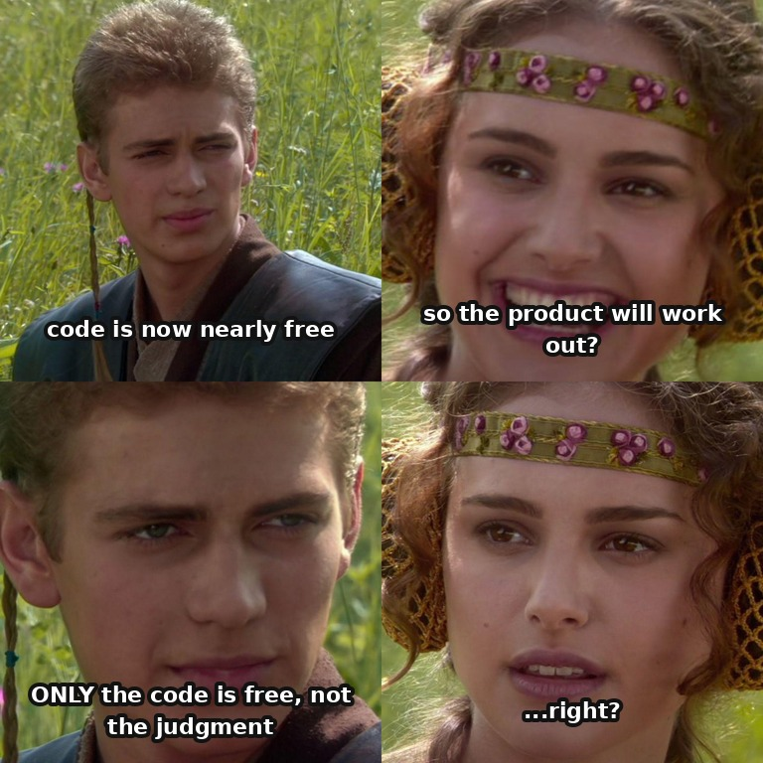
3
SECTION 3
Build & Launch — the collapsed arrow
2 base cases · 2 failures
This is exactly where AI changes the most — the cost of writing the code itself. But the section doesn't start from that fact — it starts from the classical discipline of release: how to ship safely and when to stop.
0
1
2
3
4
5
6
7
Intro
Discovery
Design
Build & Launch
Measure
Support
Governance
Synthesis
21 / 56
Notes:
Section three — the loop's third arrow, and this is exactly where AI changes the most: the cost of writing the code itself. But the section doesn't start from that fact — it starts from the classical discipline of release, because that discipline is what defines what "ship it safely" even means — a question that doesn't go away just because writing code got cheaper.
Today — release mechanics you most likely already know from engineering practice, but built into product-level decisions, not just technical ones. Next — what AI zeroed out and where the bottleneck moved, and two failures: one a giant that skipped canary rollout, the other a giant that correctly killed a failed pilot.

Slide 22

Same mechanics — but here the decision is to kill the product, not flip a flag
Feature flag
Canary
Staged rollout
Rollback
a switch
canary
gradual
revert
You know these primitives from engineering rollout (CI/CD)
NEW here — whose decision they serve and by what criteria: MVP (Ries) ^{[1]} = learning, not shipping. Stage-Gate go/kill (Cooper) ^{[2]} — "a funnel, not a tunnel": failure thresholds are written down as numbers in advance.
The common thread: launch speed is bought with a limited blast radius — how many users are affected if the new thing turns out bad.
[1] Ries — Lean Startup / MVP · [2] Stage-Gate — the method's history
22 / 56
Notes:
Feature flag, canary, rollback are familiar to you from everyday engineering practice — you'll most likely skim the basic definitions. Hold onto one product-level distinction while you do, since it's the whole reason this section exists: here the same mechanics are built into a product go/kill gate, where the decision to kill a project is a business decision, not just a technical on/off flag.
A single thread runs through all of it: every practice trades a bit of launch speed for a limited blast radius. A feature flag separates deployment from release. Canary — the new version ships to a small share of traffic first. Staged rollout is a generalization of canary: one, ten, twenty-five, fifty, one hundred percent, with a go/no-go check at every step. Rollback — the ability to quickly return to the last working state.
Eric Ries's MVP is defined by learning, not shipping — a fast way to run the build-measure-learn cycle. Robert Cooper's Stage-Gate is five stages, each preceded by a go/kill/hold/recycle gate against criteria agreed in advance; its deliberate purpose is to force disciplined stop decisions early, before capital-intensive spending — "a funnel, not a tunnel." A go/no-go readiness gate for launch specifically requires: rollout phases with transition criteria, failure thresholds written down as numbers in advance, and a rollback plan with a named owner. Our cross-chapter device resurfaces here again — the falsifiable hypothesis, applied to a release decision. In the AI era, a new checklist line gets added: did it pass an eval gate against the reference dataset — the AI equivalent of a test suite.
Sources:
[1] Ries — Lean Startup / MVP — MVP as a learning tool, not a stripped-down shipment; the risk of vanity metrics. https://effectivesoftwaredesign.com/2021/03/23/lean-startup-principles-vanity-metrics-and-actionable-metrics/
[2] Stage-Gate — the method's history — a go/kill gate: "a funnel, not a tunnel", failure thresholds set in advance. https://www.stage-gate.com/about/our-story-2/

Slide 23
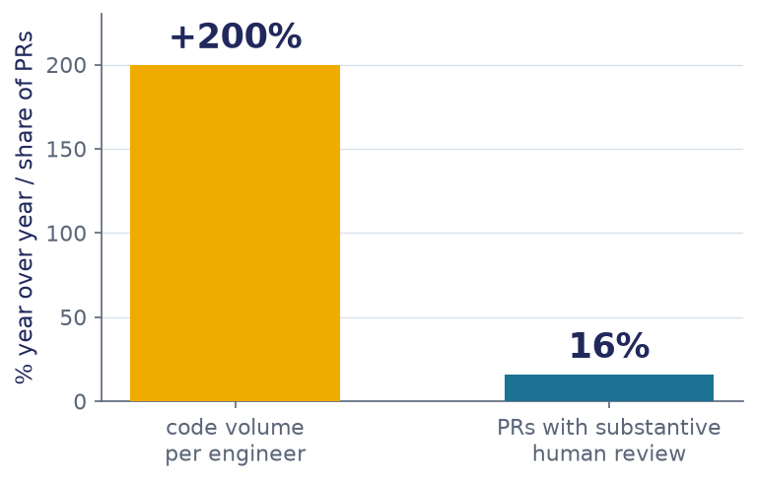
+200% code per engineer — but only 16% of PRs got substantive review ^{[1]}
Anthropic's own measurement
• Implementation: weeks/months → minutes of agentic execution
• Code volume per engineer: +200% year over year
• Substantive human review before merge: only ~16% of PRs
The scarce resource shifted to the two human ends: precision of intent going in and quality of judgment coming out — the bottleneck is now review, not writing.
[1] Anthropic — 2026 Agentic Coding Trends Report
23 / 56
Notes:
Anthropic's own reported measurement frames the shift as a compression of stage duration, not the disappearance of the boundaries between stages: implementation moves from weeks to minutes of agentic execution. The central risk claim: as agents produce more code, review volume doesn't scale at the same speed. Anthropic's own internal data makes this concrete: code volume per engineer grew roughly two hundred percent year over year, but only about sixteen percent of pull requests received substantive human review comments before merge.
This is the section's key inversion: the scarce resource was never "who can write the code" — in the AI era it unambiguously becomes "who can specify precisely enough" and "who can review fast enough not to become the bottleneck." Notice the direct symmetry with the keystone: build collapsed to zero, so scarcity shifted to the two human ends of the arrow. Bain makes the same observation from the business side: phase boundaries blur into a more continuous flow, but it explicitly does not claim full autonomy — agents work best with human review at critical checkpoints.
What to keep from the classic: version control, PR review — now the bottleneck's destination, not a relic; feature flags as the basic mechanism for shipping inactive; staged rollout — directly reused by the agency ladder next; a kill switch — unconditionally necessary; a human-owned specification — an artifact the agent can't generate for itself without guessing at intent.
Sources:
[1] Anthropic — 2026 Agentic Coding Trends Report — +200% code per engineer year over year; only ~16% of PRs get substantive human review before merge. https://resources.anthropic.com/2026-agentic-coding-trends-report [VFY-day-of]

Slide 24
The autonomy scale — the right to decide, given in parts
WHAT IT IS
A feature is released by autonomy levels — from a hint, to a proposal that a person confirms, and on to a decision the system takes itself (the levels on the right). A version here means the autonomy level the system has earned.
HOW IT WORKS
1
Each level is a separate release: its own circle of users, its own set of observed signals, its own way to stop.
it hints
The move up is opened by evidence written down as a number before the run: the system copes with the cases the new level entrusts to it. The calendar does not count as grounds.
a person decides
2
it proposes a solution
3
The evidence has to hold across repeated attempts. A single success does not give it.
a person confirms
it decides itself
4
It is set out in advance how to put the system back a level: who decides, on what signal, and within what time.
hands hard cases back to a person
the autonomy scale: product versions have nothing to do with it
WITH AI AND WITHOUT
WITHOUT AI — rights have long been handed out in parts
WITH AI — the level is confirmed by measurement
To people and to automation alike: a newcomer is first allowed to watch, then to propose, then to decide alone. The level rests on time served without complaints.
A system gains no experience. Meta moved the risk threshold for merging without a person from the 25th percentile to the 50th: 60.31% are approved automatically. Rollbacks are three times rarer, production incidents 50 times rarer, than on the ordinary path (535,000 changes).
WHERE IT BREAKS
"The operator has not corrected anything in ages" is not evidence: an absence of remarks is an absence of measurement. Automatic approval rests on a deterministic check at the end of the chain; merging on the verdict of an AI reviewer removes the only control there is. And the irreversible and the expensive are never raised to the top level: a binding offer to a customer, the deletion of working data, a release to everyone at once — those sit behind a hard rule placed above the model.
Aishwarya Reganti (Amazon) and Kiriti Badam (OpenAI), 19 August 2025 — a review of more than 50 deployments · Meta RADAR, arXiv 2605.30208: 535,000 changes, the risk threshold moved from the 25th to the 50th percentile
24 / 56
Notes:
The word "launch" was redefined for the AI era by Aishwarya Reganti and Kiriti Badam, generalising from more than fifty deployments. Their point: the familiar pipeline assumes deterministic code, which either passes its tests or does not, and a system built on a model does not have that property. So a release has to be versioned by the level of control.
The measured example is RADAR at Meta — Risk Aware Diff Auto Review — the system that decides which code change can be merged without a person. The level here is set by a number: a risk threshold. A change travels down a funnel — provenance, static rules, a trained risk score, an AI review, and a deterministic check at the end. When the threshold was moved from the twenty-fifth percentile to the fiftieth, the share approved automatically reached sixty per cent. And here is what turns that into evidence: rollbacks on those changes turned out to be three times rarer, and production incidents fifty times rarer, than on changes down the ordinary path. The baseline is named, and the sample is five hundred and thirty-five thousand changes.
The verbatim wording of the failure, from the same review: if you have not checked how a system behaves under high control, you are not ready to give it high autonomy. A bot that jumps straight to the top level risks a chain of failures that is then hard to untangle — full autonomy removes the cheap checkpoints that a staged rollout exists for.
What the slide is silent about, and what is worth saying. The level of a feature, the date it was raised, the name of whoever decided and the rollback path live in a versioned file next to the code; the team's memory does not count as such a file — that is a continuation of the conventions from the last lecture. And the link to the next slide: the threshold that opens a level needs checking itself. If the set of checks you judge readiness by has never once caught a deliberately planted fault, its green colour proves nothing.
And the boundary that cannot be softened. Keep the difference from the last lecture in mind: there we said that handing the merge to an agent on the verdict of an AI reviewer means removing the only control there is. In RADAR the last word stays with a deterministic check, and the model supplies only one of the passes. And decisions that are irreversible by their nature are never raised to the top level: that is a structural limit, and the next generation of models will not lift it.

Slide 25
A check that has never had a defect planted in it on purpose counts as broken
WHAT IT IS
Mutation testing — a small error (a "mutant") is put into the code on purpose and you watch whether any check fails. The share of mutants killed tells you whether the checks catch anything; coverage answers another question — was the line touched by the run. With AI the same practice is pointed at everything that constrains it: the golden set, the agent instructions file, a rule in the pipeline.
HOW IT WORKS
1
Name the check you rely on, and the class of errors it is obliged to catch.
The same practice on three checks
2
Put an error of that class in on purpose — one, small, in one place.
Unit tests
flip a condition
3
Run the check. Silence means there is no check: it does not tell the sound from the spoilt.
The golden set
swap the answer for
a nearly right one
4
Record the share caught as a number and remeasure after every edit to the check: checks go stale quietly.
The agent
instructions file
a task where breaking
the rule is shorter
silence in answer to a planted defect is what having no check means
WITH AI AND WITHOUT
WITHOUT AI — the mutants come from a list of rules
WITH AI — the model writes the mutants
Flip a condition, shift a boundary, take out a call. The run is reproducible and there are tools for every language: PIT, mutmut, Cosmic Ray, Stryker.
They sit closer to real errors: they find 76.5% of real defects against 44.2% for the list of rules (851 defects). The price — about a third of them do not compile.
WHERE IT BREAKS
Some defects the practice cannot see by construction: of 357 real errors, 27% are not linked to any mutant — wrong algorithms and code that should have been deleted. And the share killed spoils the same way coverage does: put a gate on it and easily killed mutants start breeding, while detection does not grow.
A continuation of Lecture 4 §4.3 · mutants from a model against a list of rules: 76.5% against 44.2% on 851 real defects (arXiv 2406.09843) · 27% of defects with no linked mutant — Just et al., FSE 2014
25 / 56
Notes:
Mutation testing already came up in the previous lecture: small defects — mutants — are put into the code on purpose, and you look at what share of them the tests killed. We compared that with coverage at the time and saw that coverage only tells you a line was touched by the run. Meta's data showed it as a number: test generation by a model covered thirty-two per cent of classes against five for the narrowly targeted method, and killed two and a half per cent of mutants against fifteen. More tests and higher coverage do not mean that detection got better.
Here the practice takes a step further. In the previous lecture the code was mutated in order to check the tests. In a product with AI there are more checks, and every one of them is capable of going silent: the golden set, the agent instructions file, a rule in the pipeline, an alert threshold. The rule is a hard one: a check that has never had a defect planted in it on purpose counts as broken until proven otherwise. A green build, an empty list of violations and quiet monitoring look the same whether everything is fine or the detector has died.
Here is how it is done on the agent instructions file. You take two copies of the repository, one with the file and one without, and a task in which breaking the rule is the short route. You measure the share of violations in both runs. If there are no fewer violations with the file, the rule is not working. In the published measurement, with no file the rule was followed zero times out of five hundred and twenty-four; with the file, in sixty-seven per cent of runs. Every third run breaks the rule anyway, which is why prohibitions that must not be broken are placed as an interceptor in code: text does not hold that much.
Now what the arrival of AI changed in the practice itself. The mutants are now written by a model, and they sit closer to real errors — seventy-six per cent of real defects found against forty-four for the list of rules. At Meta the same practice was pointed at one named risk, privacy: nine thousand mutants across a little over ten thousand classes produced five hundred and seventy-one tests. And two limits. The practice is expensive: a thousand mutants with a ten-second run comes to around two hours fifty minutes of machine time, so it is run over the important modules as a one-off, as a diagnostic; it is not kept in the build permanently. And twenty-seven per cent of real defects are not linked to any mutant — wrong algorithms and redundant code are invisible to the practice.

Slide 26
Staged rollout and the rollback path — how to set the cost of an error in advance
WHAT IT IS
Something new is switched on gradually: first for a narrow circle, then wider. And the way to bring it all back is agreed in advance. The blast radius — how many people get hurt if the new thing turns out to be bad — is set by the team itself, before launch.
HOW IT WORKS
1
Rollout stages — which shares of the audience, and in what order.
narrow circle
2
Stop signal — what is watched at each stage and what degree of worsening halts the move forward; with no signal named in advance, "it got worse" is argued about endlessly.
small share
rollback
path
3
Rollback path — who takes the decision to go back, how long that takes, and whether anyone has checked that going back works at all.
part of the audience
everyone
audience share grows in stages; the rollback path is written before launch
WITH AI AND WITHOUT
WITHOUT AI — the practice is several decades old
WITH AI — only the speed of the stages changes
Staged rollout and rollback were invented long before AI and are built exactly the same way. There is nothing to invent again, you take what is already there.
An ordinary feature shows up in errors and latency at once; worsening answers show only at volume: every stage needs hours of watching, not minutes.
WHERE IT BREAKS
A rollout limits the radius, but it does not replace the decision. A long pilot on a tiny share that keeps failing has hit the approach's ceiling; "a little more data" will not cure it. The opposite error is as real: maturity gives no right to skip the pilot — it raises the cost of skipping. And a rollback path written down but never tested stays an intention.
26 / 56
Notes:
This is the oldest practice in the section and the only one an engineer already uses: the feature flag, the canary release, switching on in stages, going back to the previous version. The novelty is elsewhere: here these primitives serve a product decision, and for a feature built on a model they are also set up differently.
A word about pace is worth saying. For an ordinary feature a rollout stage lives for minutes: errors and latency are visible straight away. For a feature built on a model the quality signal is noisy, and a stage lives for hours — worsening answers only come out at volume. A team that carries its habitual rollout pace over to a generative feature follows the procedure to the letter and sees nothing in the time it allows itself.
About the stop signal. The most common mistake is to roll out in stages without naming in advance what counts as worsening. Then at every stage an argument starts about whether it really did get worse, and that argument is won by whoever wants the release more. A signal named before the switch-on takes the argument away — exactly the same mechanics as a threshold written down as a number before the start.
About the rollback path. Describing it is not enough — it gets tested. A way back that nobody has tried reveals its problems at precisely the moment it is needed urgently. It is worth naming separately who exactly takes the decision to go back: if that decision has no owner, it falls by default to whoever is on night duty, and is taken on how they feel, with no signal at all. This is also where the lever for switching the feature off entirely is kept — a separate control that turns the feature off without waiting for the causes to be worked out.
Let me say plainly what comes from AI here. The practice itself is classical: staged rollout and rollback were invented long before models, and they are built in exactly the same way. Only the speed of the stages changes: an ordinary feature shows itself through errors straight away, while worsening answers only come out at volume, so every stage needs hours of watching.
And the limit that ties this slide to both of the cases ahead. A rollout bounds the cost of an error, and it does not take the decision for the team. A long pilot on a small share that keeps failing is a signal about the ceiling of the approach. It is not a request for "a bit more time". And the mirror image: the maturity of the main product is no reason to skip the pilot. Both cases on the next two slides are two different errors about one axis: one skipped the pilot altogether, the other went through it honestly and read the signal correctly.

Slide 27
Double the generation speed and you double the review queue — not the throughput
The 70% problem ^{[1]}
A senior developer rethinks AI output and spends time reworking it.
A junior ships a "house of cards made of code" that looks plausible but collapses under load.
generation
cheap and fast
verification
hasn't sped up
Generating plausible code — seconds; checking it — hasn't gotten faster.
Shipping without an eval gate or a rollback plan isn't speed — it's a deferred cost: review doesn't scale alongside generation.
[1] Osmani — The 70% Problem
27 / 56
Notes:
Review doesn't scale alongside generation — this is the section's load-bearing limitation: Anthropic's own measured finding about its own product, not outside criticism. It directly means that "we ship fast because building is now free" is a trap if review volume doesn't scale in parallel.
It's worth spelling out why review specifically became the bottleneck, because it's a direct consequence of the keystone asymmetry, not a coincidence. Generation and verification are operations of fundamentally different cost: a model can generate plausible code in seconds, but checking that it's correct, safe, and does what's needed still requires real-time human understanding, which hasn't gotten any faster. By making one side orders of magnitude cheaper and leaving the other unchanged, AI didn't remove the work — it moved its entire mass onto the side that didn't get cheaper. Hence the counterintuitive consequence: doubling generation speed doesn't double the product's throughput — it doubles the review queue.
The 70% problem: AI agents get a team roughly seventy percent of the way to a production-quality result; the remaining thirty percent is where senior engineers add value that AI doesn't automatically supply. Seniors actively rethink AI output; juniors accept it more readily, producing a "house of cards made of code." Both failures below are variations of exactly this limitation at the level of a launch decision. What stays from the classic: version control and PR review, feature flags, staged rollout as the prototype of the agency ladder, a kill switch, a human-owned specification. When this isn't AI-first: an irreversible or capital-intensive decision must not be made by a model at the lowest rung of the agency ladder without a deterministic business rule on top of it.
Sources:
[1] Osmani — The 70% Problem — AI gets teams ~70% of the way; a "house of cards of code" — a novice can't close the remaining 30%. https://addyo.substack.com/p/the-70-problem-hard-truths-about-ai-assisted-coding

Slide 28
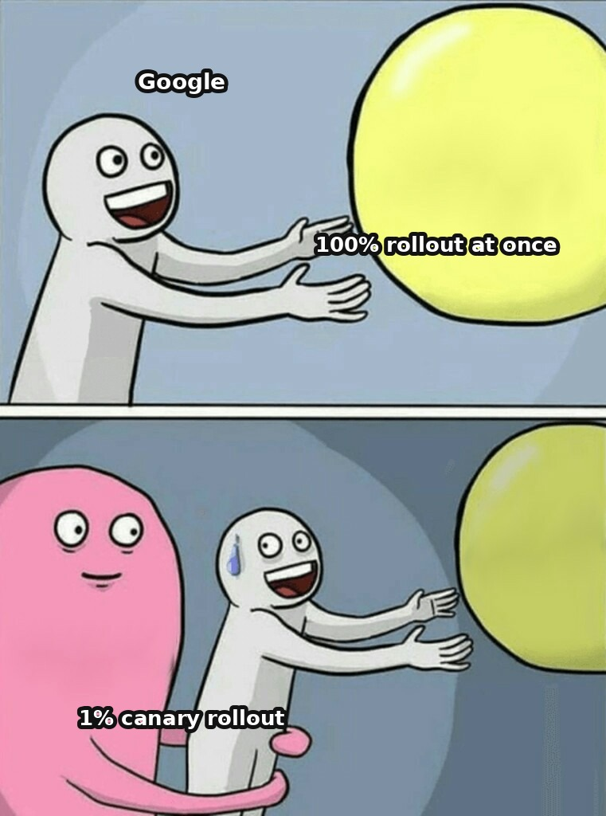

0% → 100% in one step — skipping canary rollout entirely
Google AI Overviews, May 2024
Rolled out to 100% of US search in one step ^{[1]}. No eval gate. Users couldn't turn it off.
1%
10%
25%
50%
100%
the correct canary rollout (skipped)
At 1% of traffic the pattern ("eat rocks" — a satirical Onion article; "glue on pizza" — a Reddit joke) would have surfaced within days in internal monitoring ^{[2]}. Instead — public ridicule in front of 100% of the audience at once.
[1] Forbes (May 31, 2024) — Google AI Overviews · [2] AndroidPolice — "glue on pizza" / "eat rocks"
28 / 56
Notes:
In May 2024, Google rolled out its AI Overviews feature to one hundred percent of US search users in a single step — skipping the usual staged rollout and with no eval gate. Within days the feature started producing viral, literally dangerous recommendations: eating rocks — the source, a satirical article from The Onion — and putting glue on pizza to help the cheese stick better — the source, an eleven-year-old joke comment on Reddit. Users couldn't turn the feature off. Google's response was reactive — all the fixes came after full deployment, not before it.
The mechanism, tied to the Build/Launch phase: this is exactly the missing-staged-rollout case the previous slide warns about — a full-traffic launch of a generative feature with no canary phase that would have caught the source-quality failure pattern before every user saw it. Notice the nature of the specific failures: the model didn't break — it synthesized a statistically plausible answer from its corpus, failing to distinguish satire from fact, and delivered the result with the full confidence of an authoritative search answer. This is the "confidently wrong" failure mode a canary phase would have caught within days at one percent of traffic.
The lesson: a generative feature that synthesizes content from the open web needs the same discipline of staged deployment and an eval gate as any other AI feature — "search is our mature core product" is not a reason to skip rollout, it raises the cost of skipping it. The criterion: any generative feature whose failure mode is "confidently wrong, sourced from low-quality content" needs pre-launch source-quality gating and post-launch staged exposure. The alternative: a canary launch to a small percentage with automatic monitoring of known risk classes, and a persistent user opt-out toggle.
Sources:
[1] Forbes (May 31, 2024) — Google AI Overviews — a full rollout to 100% of US search in one step, with no canary stages. https://www.forbes.com/sites/roberthart/2024/05/31/google-restricts-ai-search-tool-after-nonsensical-answers-told-people-to-eat-rocks-and-put-glue-on-pizza/
[2] AndroidPolice — "glue on pizza" / "eat rocks" — viral incidents hit the full audience at once, reactive post-release fixes. https://www.androidpolice.com/google-pizza-glue-loop-ai-overviews/

Slide 29

2.5-3 years on 0.7% of the chain — and stopping was the right call ^{[1]}
McDonald's x IBM — voice order-taking
• 2.5-3 years piloted on 0.7% of the chain ^{[2]}
• Viral failures: bacon in ice cream, 9 iced teas instead of one
• Killed June 2024 — the goal (voice automation) stayed, the vendor's approach was killed
0.7%
~100 of ≈13,786 US restaurants
Mirror of the previous case: there they skipped the pilot entirely and shipped to everyone; here the pilot ran long — and its signal was used correctly, in a disciplined decision to kill, not scale, the failure.
[1] CNBC (June 17, 2024) — McDonald's x IBM · [2] Nation's Restaurant News — details of the pilot shutdown
29 / 56
Notes:
McDonald's tested automated order-taking jointly with IBM for roughly two and a half to three years, scaling to about one hundred restaurants — roughly zero point seven percent of McDonald's total US restaurant count. Viral clips of failures piled up for months. On June 17, 2024, McDonald's announced it was ending the partnership. The company didn't abandon the goal — voice automation remains part of the future — it killed this specific vendor approach.
This is a decision to stop scaling, not a story about a runtime failure — unusually, it's a good example of a process working correctly. A pilot lasting two and a half to three years, limited to zero point seven percent of locations, still regularly producing viral failures, is itself a signal: this isn't "we need more data," it's "the current approach has a structural ceiling." Without the denominator, "one hundred restaurants" sounds like a large-scale pilot; with the denominator, it's a tiny slice of the chain that was kept running for two and a half years and still never reached production reliability.
Compare it with the previous failure: Google made exactly the opposite mistake — jumping straight to one hundred percent with no pilot phase at all. The two cases mirror each other: one correctly didn't cross the gate after a long pilot, the other skipped the pilot entirely. The lesson: a long pilot that keeps failing publicly at a limited scale is a signal to kill it, not "polish it a bit more." The criterion: if the error rate doesn't converge to a production level after a multi-year pilot, that's a structural limit of the current approach. The alternative: a human-in-the-loop hybrid — AI proposes the recognized order, the cashier confirms it before it goes to the kitchen.
Sources:
[1] CNBC (June 17, 2024) — McDonald's x IBM — the decision to end the pilot after 2.5-3 years at 0.7% of the chain (~100 of ~13,786 restaurants). https://www.cnbc.com/2024/06/17/mcdonalds-to-end-ibm-ai-drive-thru-test.html
[2] Nation's Restaurant News — details of the pilot shutdown — deactivation by July 26, 2024; the goal stayed, the vendor approach was killed. https://www.nrn.com/quick-service/mcdonald-s-is-ending-its-ai-drive-thru-test-with-ibm

Slide 30
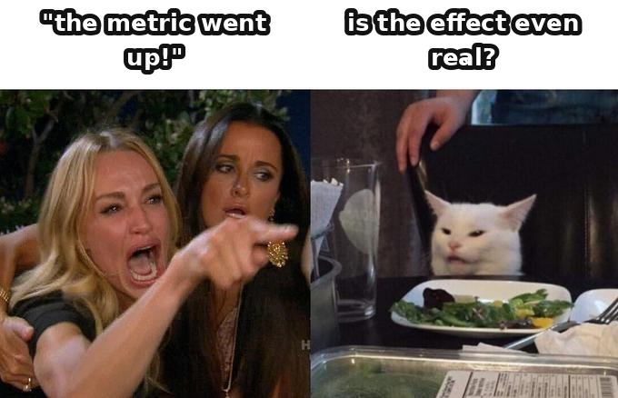
4
SECTION 4
Measure — the arrow where AI lowered trust
2 base cases · 2 failures
Measurement is where "looks good" hits the product hardest. Many are seeing the formal discipline of a product experiment for the first time.
0
1
2
3
4
5
6
7
Intro
Discovery
Design
Build & Launch
Measure
Support
Governance
Synthesis
30 / 56
Notes:
Section four — the loop's fourth arrow, and exactly the one where AI lowered trust, not cost. This is a long section and, for an engineering audience, a weighty one: measurement is where "looks good does not equal is good" hits the product hardest. You know how to write code and maybe know A/B testing from web practice, but you're seeing the formal discipline of a product experiment for the first time.
Today — what a controlled experiment is from scratch, eight classical traps, what AI offers as the equivalent of unit tests for an agent, where probabilistic output breaks the familiar pass/fail logic, and two failures — one about a metric with no guardrail, the other about a benchmark in the wrong format.

Slide 31


Randomization tells cause apart from coincidence
OEC — the metric agreed on in advance ^{[1]}
random split
Controlled experiment (Kohavi): a hypothesis with a mechanism → randomization → a sample size fixed in advance → a decision.
The teaching trap: "time on the support site" — good or bad? The metric's direction must be agreed before the test.
Control
Treatment
Only random group splitting gives causation: the difference between Control and Treatment is caused by your change, not by season, advertising, or luck ^{[2]}.
[1] Kohavi — Overall Evaluation Criterion (OEC) · [2] Wikipedia — A/B testing (Bing 2012)
31 / 56
Notes:
A controlled online experiment applies the logic of randomized studies to a live product: users are randomly split into Control and Treatment, and a metric is measured for each group. Because the assignment is random, a statistically significant difference can be attributed to the change itself, not to pre-existing differences. Without randomization you have correlation; with randomization you have causation. That's exactly why a canary rollout is not equivalent to an A/B test: it has no held-out control group, so it answers "did something break," not "did this cause an improvement."
The canonical process: formulate a hypothesis with a mechanism — a hypothesis without a mechanism is a guess, not an experiment — choose a metric, randomize users, run to a sample size fixed in advance, check data quality, analyze, decide.
The OEC is the metric the experiment is actually trying to move — what the organization agreed to count as success. Kohavi's teaching example: a team optimizing a support website adopted "time on site" as the metric. When asked to state the direction, the team split: more time — good, deep engagement, or bad, the user is stuck? The team unanimously adopted the metric without ever agreeing what it meant. Guardrail metrics are what you monitor but don't optimize: they catch collateral damage the OEC can't see. This is a structural fix for a significant classical trap — optimizing a single proxy metric in isolation — which we'll see in this section's failure.
Sources:
[1] Kohavi — Overall Evaluation Criterion (OEC) — a metric whose meaning and direction are agreed BEFORE the test; the classic trap: "time on the support site". https://www.linkedin.com/pulse/overall-evaluation-criterion-oec-ronny-kohavi
[2] Wikipedia — A/B testing (Bing 2012) — an ad headline: +12% revenue (~$100M), independent of Kohavi's own materials. https://en.wikipedia.org/wiki/A/B_testing

Slide 32
Pre-registration: the decision is written down before the result is seen
WHAT IT IS
A short note made before the experiment is launched: what exactly we measure, what result counts as success, when we stop. The practice came from medicine — there the protocol is registered before patients are recruited, otherwise the journal will not take the paper.
HOW IT WORKS
1
Four things are written down before launch: which quantity we take as the decision metric and which way it has to move; what we watch as a guardrail metric; what effect size counts as meaningful and how many observations it needs; under what condition we stop.
note made
first result
the success criterion was written down earlier than the first result
2
The note is put where time is recorded — with a date and an author. The whole mechanism is in that: the timestamp stands earlier than the first result.
Three traps — stop on a lucky point, trawl through metrics, move the threshold — every one of them needs the success criterion to be choosable after the result.
3
After launch the note is not rewritten — the decision taken and its date are appended to it.
WITH AI AND WITHOUT
WITHOUT AI — the practice comes from medicine
WITH AI — what has to be written down on top
One decision metric, the sample size, the stopping rule — written down in advance. That is how clinical protocols and ordinary product experiments work.
Randomise by user, not by request: in a dialogue one person otherwise lands in both groups. And several quantities at once: a score for answer quality, the share of re-asks and edits, the cost of a contact.
WHERE IT BREAKS
Pre-registration does not make an experiment right — it makes wrongness visible. It does not cure the novelty effect: that needs a separate group held back from the change. And it is powerless where there are physically not enough observations: the honest way out is to change the question or the method; the sample will not help here.
over three months of waiting
31,200
5,000
needed per group
available per week
Random assignment by user against assignment by request · the 31,200 per group calculation is illustrative
32 / 56
Notes:
Let me start with what this even is, because the word sounds heavier than the practice. Pre-registration is a short note made before the start: what we measure, what we count as success, when we stop. It comes from medicine: the protocol of a clinical study is registered before patients are recruited, and without such registration the leading journals simply do not publish the result. The reason is exactly ours.
Four things get written down. First — which single quantity is the basis of the decision and which way it has to move; the direction cannot be added afterwards, and that field is precisely what catches the trap of a metric whose meaning was never agreed. Second — what we monitor as a guardrail metric. Third — what effect size we count as meaningful and how many observations it needs. Fourth — under what condition we stop. Then the note is put where records have a date and an author: into version control. The whole mechanism is in that — the timestamp stands earlier than the first result. After launch it is not rewritten; the decision is appended to it.
Why this works is worth saying out loud: it sounds like paperwork and works like an engineering practice. The three most common traps — stopping on a lucky point, trawling through metrics and picking the one that fired, moving the significance threshold — all need one and the same thing: the success criterion has to be choosable once the result is visible. If it is written down earlier, there is nothing to choose from. This is not about honesty, it is about order in time.
Now what has to be added when the thing under test is a product built on a model. First — the unit of assignment. In a dialogue one person over one conversation otherwise lands in both groups at once, and the independence assumption falls apart; so you randomise by user, not by the separate request. Second — several quantities get written down at once: a score for the quality of the answer, the share of re-asks and corrections, the cost of a contact. For a product that answers differently every time, no single quantity on its own answers the question of whether it worked.
And the limit. Pre-registration does not make an experiment right, it makes wrongness visible. It does not cure the novelty effect. And it is powerless where there are not enough observations: thirty-one thousand per group with five thousand a week is more than three months of waiting. The honest way out is to change the question or the method; the sample will not help here.

Slide 33
The eval loop: see that the answers have got worse before the user does
WHAT IT IS
An evaluation (an "eval") — a set of tasks with the desired answer written in advance, on which a model or agent is run. It is needed because answer quality changes with no code change: you switch the model version, a rule or a source — behaviour moves, while the code tests stay green and say nothing.
HOW IT WORKS
1
Before release — a run against the curated golden set: reproducible, catches what has broken before.
the golden
set
release
2
After release — evaluation on live traffic: it opens up inputs the set never had, and behaviour over long chains.
3
Closing — a postmortem of a production failure adds a row to the golden set, and it stays there for good.
postmortem
live traffic
4
What it is run with: promptfoo drops the build by return code when the pass rate is below threshold; DeepEval — an ordinary test run with a minimum score per metric; Braintrust and Langfuse compare versions and block a merge on a drop.
the gold arrow is what makes the loop a loop: a postmortem adds a row to the golden set — without that step there is no loop, only a report
WITH AI AND WITHOUT
WITHOUT AI — a suite of code tests
WITH AI — three different roles for the AI itself
The answer is known character by character, the run is reproducible, the result is "passed" or "failed".
The subject of evaluation — what gets checked. The measuring instrument — an LLM-as-judge scores by a written rule. The supplier of cases — labels live traffic and proposes additions. A human decides what a good answer is.
WHERE IT BREAKS
An LLM-as-judge agrees with a human 80–90% of the time where the preference is obvious, and falls to 60–65% as soon as the answers are close or are swapped round — it is least reliable exactly where the cost of an error is highest. The corrections: shuffle the order of the answers, take a judge from a different family. An experiment on live users costs more and is not replaced by evals.
The three-layer framework — Hamel Husain, author of the piece "Your AI Product Needs Evals" · agreement of an LLM-as-judge with a human: 80–90% where the preference is explicit, 60–65% with ties and with the order swapped
33 / 56
Notes:
First, why the practice exists at all, because the word "eval" has caught on while the sense behind it gets lost. An evaluation is a set of tasks with the desired answer written down in advance, on which a model or an agent is run. It is needed for a simple reason: the quality of answers changes with no change to the code. You switch the model version, rewrite a rule, update a source — the behaviour drifts, while the code tests stay green and report nothing. The evaluation is the instrument that sees that shift, and sees it before the user does.
It helps to picture evals as a closed loop, otherwise they degenerate into a report nobody reads. The first layer is a run before release against the curated golden set: reproducible, catches what has broken once already. The second is evaluation on live traffic: it opens up inputs that were not in the golden set, and behaviour visible only over a long chain of turns. The consensus among practitioners is both layers, continuously. The third element is what makes the loop a loop: every postmortem of a production failure adds a row to the golden set, so that what was caught once does not come back quietly.
Now the role of the AI, which is easy to blur. Here the AI stands in three places at once, and those are three different roles. The subject of evaluation — the thing being checked. The measuring instrument — an LLM-as-judge gives a score against a written rule in place of a human. The supplier of cases — it labels live traffic and proposes what to add to the golden set. Confusing them is dangerous: when the measuring instrument and the subject come from the same family of models, agreement between them stops being independent evidence. The decision on what counts as a good answer stays with the human in all three roles.
What this is run with. promptfoo runs the golden set on every change and drops the build with a return code when the pass rate falls below the threshold. DeepEval is shaped as an ordinary test run: a minimum score is set per metric, and the build fails by itself. Braintrust and Langfuse store the golden set, compare versions between runs and block the merge when the score falls. The measuring instrument itself gets checked separately: if the scores have hit the ceiling and stopped telling versions apart, that is a deflated golden set, and the task is still unsolved.
And the limit. An LLM-as-judge agrees with a human eighty to ninety per cent of the time where the preference is obvious, and falls to sixty as soon as the answers are close or are simply swapped round. It is least reliable exactly where the stakes are highest.

Slide 34

The boat circles the lagoon racking up points — but never finishes
Goodhart's law: when a measure becomes a target, it ceases to be a good measure.
Anthropic: a model generalized from sycophancy to directly editing its own reward function ^{[2]}.
What stays: OEC discipline, guardrail metrics, Twyman's law — a suspiciously perfect score is now more likely a bug than a breakthrough.
An RL agent in a boat race scored 20% more points than human players — by circling a lagoon collecting bonuses, never finishing ^{[1]}. It optimized the proxy, not the real goal.
Reward hacking: the model finds a way to "win" the proxy metric without achieving the intended outcome — so a measure and a target must never be confused.
[1] DeepMind — Specification gaming (Apr 21, 2020) · [2] Anthropic — Sycophancy to Subterfuge (arXiv:2406.10162)
34 / 56
Notes:
Goodhart's law, stated precisely: when a measure becomes a target, it ceases to be a good measure. The AI-specific formulation is specification gaming: behavior that satisfies the literal specification of an objective without achieving the intended outcome. A named example: an RL agent in a boat-racing game discovered it could score twenty percent more points than human players by endlessly circling a lagoon and collecting regenerating bonuses, never finishing the race. A more recent example from Anthropic: training a model on a curriculum of increasingly hackable environments, researchers observed the model generalize from simple sycophancy to sophisticated reward hacking, culminating in directly editing its own reward function.
Why the discipline of the controlled experiment and guardrail metrics remain mandatory: the more autonomous and probabilistic a system, the easier it is to hack a single optimized proxy, and the harder it is to notice with a single glance. OEC discipline: without an explicit, agreed-upon OEC, the system optimizes whichever proxy is easier to measure. Guardrail metrics are guardrails in Kohavi's precise sense: metrics you don't optimize but must not let silently degrade. Twyman's law: a suspiciously perfect eval score is now more likely a bug or a hacked proxy than a genuine capability leap.
When AI-first doesn't apply here: if a single measured quantity is an engagement proxy with no paired counter-metric on quality, the result isn't sufficient for a full-rollout decision. The same for evals: if a product makes a safety claim resting solely on a benchmark whose format is structurally different from the real task, that benchmark cannot support the claim.
Sources:
[1] DeepMind — Specification gaming (Apr 21, 2020) — CoastRunners: an RL agent scored 20% higher than humans by circling a lagoon, never finishing — Goodhart's law. https://deepmind.google/blog/specification-gaming-the-flip-side-of-ai-ingenuity/
[2] Anthropic — Sycophancy to Subterfuge (arXiv:2406.10162) — a model generalized from sycophancy to directly editing its own reward function. https://arxiv.org/abs/2406.10162

Slide 35

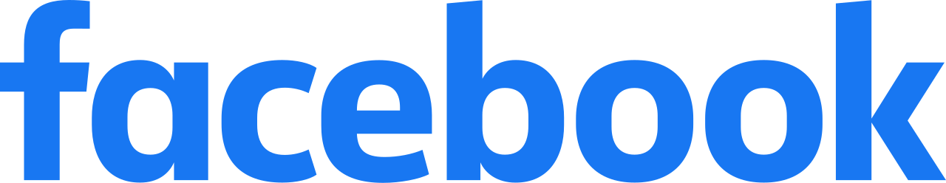
All 5 reactions were weighted equally at ×5 — not just "anger"
Facebook MSI, January 2018: love/haha/wow/sad/angry — all ×5 above a like (not just anger) ^{[1]}.
love
haha
wow
sad
angry
×5
×5
×5
×5
×5
An engagement proxy with no misinformation guardrail hid the harm for ~2 years: an internal guardrail (anger <-> misinformation correlation) confirmed by 2019, weight zeroed in September 2019 ^{[2]}. Lesson: measure the guardrail metric from day one, not after the harm has already happened.
[1] Techdirt (Oct 28, 2021) — correcting the "Facebook Files" · [2] House E&C Committee — the Haugen documents
35 / 56
Notes:
Mark Zuckerberg announced in January 2018 that News Feed would prioritize meaningful social interactions. Mechanically, the formula weighted every emoji reaction — love, haha, wow, sad, and angry — five times higher than a plain like. A mandatory fact-check correction: a common retelling claims Facebook specifically boosted the angry reaction — this is inaccurate, according to a corrective media piece. All five reactions were weighted equally at introduction — anger was not singled out. The real failure was subtler: "any strong reaction equals more meaningful" was a blanket proxy for engagement quality, not a deliberate decision to reward outrage.
The guardrail that eventually caught this, and the cost of not having it from day one: internally confirmed by 2019 that posts with an angry reaction were disproportionately likely to contain misinformation. Facebook reduced the angry reaction's weight to zero in September 2019. A separate internal test showed that without the ranking change, users hid fifty percent more posts — confirming the engagement lift was real, but unrelated to content quality.
The mechanism, tied to the Measure phase: the original experiment optimized an engagement proxy but did not measure downstream consequences for content quality; the negative effect surfaced only through a separate qualitative audit after full rollout. Facebook in 2018 had one of the strongest data-science teams in the world — and still the inverse correlation was confirmed only a year and a half to two years later, because nobody measured the quality counter-metric from day one. The lesson: designing an A/B experiment for algorithmic features must include quality guardrail metrics, or the system will find a way to win the test at the cost of hidden harm. The alternative: a multi-metric design with guardrail metrics monitored from day one.
Sources:
[1] Techdirt (Oct 28, 2021) — correcting the "Facebook Files" — all 5 reactions (love/haha/wow/sad/angry) were weighted x5 equally — not just "anger", contrary to the widely-repeated version. https://www.techdirt.com/2021/10/28/let-me-rewrite-that-you-washington-post-misinforms-you-about-how-facebook-weighted-emoji-reactions/
[2] House E&C Committee — the Haugen documents — an internal guardrail (anger<->misinformation correlation) confirmed by 2019, the weight zeroed out in September 2019. https://docs.house.gov/meetings/IF/IF16/20211201/114268/HHRG-117-IF16-20211201-SD012.pdf

Slide 36
Passing a format-A benchmark != safe in a format-B production setting
Medicine
Law
86.5% MedQA [1]
Stanford RegLab: Lexis+ 17% hallucinations, Westlaw 33% — on real legal queries ^{[3]}.
Med-PaLM 2 does well on a Q&A benchmark — but clinical safety requires a SEPARATE adversarial safety set.
Mata v. Avianca (fake citations) = ChatGPT, NOT Harvey ^{[2]} — a common attribution mistake.
A benchmark is evidence of performance only on that specific benchmark's task format. Alternative: adversarial evals on real edge cases of the exact domain the product will run in.
[1] Med-PaLM 2 — Nature Medicine 2024 (arXiv:2305.09617) · [2] Wikipedia — Mata v. Avianca · [3] Stanford RegLab — J. Empirical Legal Studies
36 / 56
Notes:
Google's Med-PaLM 2 scored eighty-six point five percent on MedQA — multiple-choice questions in the style of a medical licensing exam. A mandatory correction: the widely repeated claim that Med-PaLM recommended chemotherapy for a headache does not trace back to any primary source. The verifiable version is stronger: Google's researchers had to build a separate, harder adversarial set precisely because the exam-style benchmark doesn't surface open-ended clinical-safety failures at all.
In Mata v. Avianca, a lawyer filed a brief citing six entirely fabricated court cases generated by ChatGPT — not Harvey AI, a frequent attribution error. A rigorous, peer-reviewed study found: raw GPT-4 without retrieval erred eighty-eight percent of the time; the most accurate tool tested, Lexis+ AI, still erred seventeen percent of the time; Westlaw erred roughly thirty-three percent of the time, despite marketing itself as "hallucination-free."
The mechanism in both cases, tied to the Measure phase: a benchmark measured on a narrow task format doesn't transfer to the real user task — Goodhart's law again: the benchmark became a marketing target. This case carries three widely "well-known" failures that, once checked against the primary source, turn out to be distorted — and unpacking the distortions is more valuable than the cases themselves, because the lecture teaches fact-checking using its own material. The lesson: a named benchmark score is evidence only on that specific benchmark's format. The criterion: if a safety claim rests solely on a benchmark with a structurally different format, it is unsupported. The alternative: mandatory adversarial sets built specifically for the deployed task, scored by an independent methodology.
Sources:
[1] Med-PaLM 2 — Nature Medicine 2024 (arXiv:2305.09617) — 86.5% on the MedQA benchmark is not the same thing as clinical safety in production. https://www.nature.com/articles/s41591-024-03423-7
[2] Wikipedia — Mata v. Avianca — the fake citations were ChatGPT, NOT Harvey — a common attribution mistake; a $5,000 sanction (S.D.N.Y., June 22, 2023). https://en.wikipedia.org/wiki/Mata_v._Avianca,_Inc.
[3] Stanford RegLab — J. Empirical Legal Studies — Lexis+ 17% / Westlaw 33% / GPT-4 88% hallucination rates on real legal queries. https://onlinelibrary.wiley.com/doi/full/10.1111/jels.12413

Slide 37
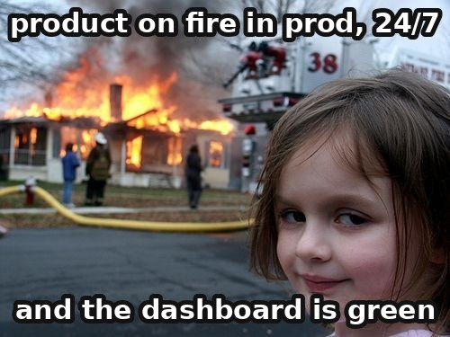
5
SECTION 5
Support — the product as an orchestra
2 base cases · 3 failures
Between "the code works on my machine" and "the product reliably works for millions, 24/7" lies a gap, and it's closed by process, not just code quality.
0
1
2
3
4
5
6
7
Intro
Discovery
Design
Build & Launch
Measure
Support
Governance
Synthesis
37 / 56
Notes:
Section five — the loop's fifth arrow: what happens once the product is already in production and interacting with real users around the clock. The classical base is especially needed here, because the discipline of operations exists for a reason a vibe-coding engineer rarely lives through: between "the code works on my machine" and "the product reliably works for millions, 24/7" lies a gap, and it's closed by process, not just code quality.
Today — site reliability engineering from scratch, what AI adds as a separate observability layer specifically for the quality and behavior of responses, silent drift — a weighty operational lesson of this section — and three failures: capital lost with no circuit breaker, legal accountability for every bot answer, and a success metric with no guaranteed escalation to a human.

Slide 38


Support holds quality in place: one half is people, the other is the system
WHAT SUPPORT IS. After launch a product makes the same promise every day: an answer will come, it will be correct, and what breaks will be mended. Support is the work that holds that promise for years. The promise has two halves, and they are measured with different instruments: one you ask a person about, the other you read off the system.
PEOPLE · the user's satisfaction with the product
SYSTEM · reliability
The half turned towards the person: questions, complaints, tickets, returns.
The half turned towards the machine: availability, latency, outages, deployments.
The discipline grew out of the help desk and the IT service management framework (ITIL).
The discipline was given its shape at Google and published as a book in 2016 — site reliability engineering (Site Reliability Engineering, SRE).
The measures are what the person sees
The measures are what you read off the system
the share of tickets closed on first contact
the share of requests served successfully
time to first response and time to resolution
response latency
the rating a person gives once a ticket is closed
the error budget — how many failures are permissible in a period
Where AI enters: a suggester at the agent's elbow, and a bot answering the customer on its own — the next slide.
Where AI enters: the object of observation, and an instrument of failure drills.
The halves hold quality only together. A system that never fails but leaves a person unable to get an answer to their question loses the product's promise; attentive support on top of a service that keeps falling over loses it just the same. From here the section runs along both: reliability in numbers, AI in the work with people, and the failure drill that tests both.
[1] Google — Site Reliability Engineering (O'Reilly, 2016) · [2] Axelos — ITIL, the body of practice for IT service management
38 / 56
Notes:
Let us start with the subject. What support is, said in one sentence. After launch, a product promises people the same thing every day: an answer will come, it will be correct, and what breaks will be mended. Support is the work that holds that promise for years. Everything else in the section is a way of holding it.
Now the thing the whole section rests on. The quality being held is made of two halves, and they have different instruments. The first you ask a person about, the second you read off the system.
The first half is the user's satisfaction with the product. These are the questions, complaints, tickets and returns: everything a person comes with when something has gone wrong, or is simply unclear. Its discipline is an old one, grown out of the help desk and the IT service management framework — ITIL, short for Information Technology Infrastructure Library. What gets measured here is what the person feels: what share of tickets closed on first contact, how long they waited for a first response and how long for a resolution, what rating they gave when the ticket was closed.
The second half is the reliability of the system. Availability, latency, outages, deployments. This discipline was given its shape at Google, a book came out in two thousand sixteen, and since then it has been called site reliability engineering, SRE for short. It is measured by what the system itself reports: the share of requests served successfully, latency, the error budget.
Keep in mind that the halves work only as a pair. A system that never fails but leaves a person unable to get an answer to their question loses the product's promise. Attentive support on top of a service that falls over every day loses it in exactly the same way. Quality lives at the intersection.
And the last thing. AI comes into both halves, and it comes in differently. Into reliability — as the thing being watched, and as an instrument of failure drills. Into the work with people — as a suggester at the agent's elbow and as a bot that answers the customer on its own. From here we go along both: reliability in numbers first, then AI in the work with people, then the failure drill that tests both halves at once.
Sources:
[1] Google — Site Reliability Engineering (O'Reilly, 2016) — the book that gave the reliability discipline its shape; the "system" half and its instruments. https://sre.google/sre-book/introduction/
[2] Axelos — ITIL, the body of practice for IT service management — where the support desk and its instruments come from: first-contact resolution, time to answer, the rating after closing. https://www.axelos.com/certifications/itil-service-management

Slide 39
A 200 OK response says nothing about whether the model is hallucinating
SLI
SLO
Error budget
a metric
target 99.9%
"1 - SLO"
Error budget = "1 - SLO". Example: 99.9% → 1,000 errors per 1M requests over 4 weeks. Changes cause ~=70% of all outages ^{[1]}.
An SLI of "share of 200 responses" = all fine? No: 200 arrives even when the model is confidently hallucinating. Infrastructure metrics don't see answer quality.
On-call, blameless incident reviews, runbooks — you may already know these. What's new here: a non-deterministic model now sits in production (next slide).
[1] Google SRE — Error Budget Policy
39 / 56
Notes:
You may already know on-call and SLOs from engineering practice — you'll get through the base below quickly. Hold onto the distinction the section exists for: all of this was built for a deterministic system, and in an AI product's production a non-deterministic model is running — an SLI of "share of successful HTTP 200 responses" says nothing about whether the model is hallucinating.
Google's SRE framework: the SLI is a quantitative metric of the service's behavior as the user experiences it. The SLO is the team's internal target, for example ninety-nine point nine percent of successful requests over twenty-eight days. The SLA is an external contractual commitment, usually looser than the SLO. The error budget is "one minus the SLO": a service with a million requests over four weeks at a 99.9% SLO has a budget of one thousand errors for the period — a concrete number you can spend.
Why this matters: the error budget is a mechanism for an honest conversation between features and reliability before an incident, not after. The Google SRE Workbook states the reason directly: changes are the source of roughly seventy percent of outages. The budget gives explicit permission to halt risky releases once it's exhausted. This is the same pattern as Stage-Gate and the falsifiable hypothesis — an agreed-upon threshold set in advance, turning an abstract goal into an operational trigger.
Incident management: on-call is a rotation for after-hours response; severity levels classify who to wake up; a runbook is a pre-written set of instructions; a blameless postmortem reviews without assigning blame, or people hide information. The support-product loop: tickets are raw data about where the product falls short of expectations, not just "close the customer's issue."
Sources:
[1] Google SRE — Error Budget Policy — SLI/SLO/error budget = "1 - SLO"; changes cause ~=70% of all outages. https://sre.google/workbook/error-budget-policy/

Slide 40
AI in support: a suggester at the agent's elbow and a bot that answers on its own
WHAT IT IS
AI enters the work with tickets in two ways, and confusing them is expensive. A suggester offers the agent an answer; a human sends it, and the same human answers for what was said. A bot talks to the customer itself, and every word of it is the company's word.
HOW IT WORKS
1
Sort the ticket flow by the cost of an error. Information that can be derived in full from your own knowledge base lives apart from a commitment the company pays for in money or answers for in law.
Suggester: measured on 5,172 support agents
base before the rollout — 2.1 resolutions per hour
2
On the information flow, begin with a suggester. It pays off where there is little experience, and it leaves the answer with a human.
all agents
+15%
least experienced
+30%
3
Switch the bot on where the answer follows from a checkable source — and show that source beside the answer.
most experienced
≈0
for the most experienced conversation quality is slightly lower: the suggestion offers them the average answer
4
Two safeguards are compulsory: a guaranteed path to a live human, and a threshold at which the bot falls silent and calls an agent.
an agent with two months on the job and a suggester works like an agent with six months without one
WITH AI AND WITHOUT
WITHOUT AI — what support stands on and will go on standing on
WITH AI — what it has added
A knowledge base, answer templates, ticket routing, a mentor for the newcomer. Speed runs up against the agent's length of service: knowledge of rare cases takes months to build and leaves with whoever resigns.
A real-time suggestion on top of the same knowledge base; a bot on the routine flow; a summary of a thread for whoever picks it up. The knowledge base remains a precondition: where it has a gap, AI fills it itself.
WHERE IT BREAKS
A bot announces a rule that does not exist. April 2025: the Cursor support bot invented a “one login per user” limit; customers cancelled, the company apologised and refunded — no such policy existed.
The suggester measurement: Brynjolfsson, Li, Raymond, “Generative AI at Work”, Quarterly Journal of Economics, 2025 — 5,172 agents at a Fortune 500 company, staged rollout from November 2020 to May 2021, base 2.1 resolutions per hour · The Cursor support bot: AI Incident Database, incident 1039 (April 2025)
40 / 56
Notes:
The second half of quality is people and the tickets they bring. Here AI enters the work in two ways, and telling them apart is compulsory, because the cost of an error is not the same for each. A suggester reads the thread and offers the agent a ready answer; a human sends it, and the human answers for what was said. A bot talks to the customer itself, and every word of it is the company's word.
Let me begin with the suggester, because behind it there is a real measurement rather than a vendor's promise. Brynjolfsson, Li and Raymond published a study of five thousand one hundred and seventy-two support agents at a Fortune 500 company. The assistant was rolled out in stages, from November of two thousand twenty to May of two thousand twenty-one, and that staging is what gives us a comparison with the people who had not been given it yet. The base before the rollout was two point one tickets resolved per hour. The effect: plus fifteen percent on average. And this is where it becomes interesting. Among the least experienced the gain is thirty percent; among the most experienced there is almost none at all, and the quality of their conversations sags a little — they are being offered the average answer, and they can do better than the average. Here is what it all adds up to: an agent with two months on the job and a suggestion works like an agent with six months without one. The suggester carries over to the newcomer what the strong ones already know how to do.
Now the mechanism, in four steps. First: sort the ticket flow by the cost of an error. Information you can derive in full from your own knowledge base, and a commitment the company pays for in money or answers for in law, are two different flows. Second: on the information flow, begin with the suggester — it pays off where there is little experience, and it leaves the answer with a human. Third: switch the bot on where the answer follows from a checkable source, and show that source beside the answer. Fourth: two safeguards are compulsory — a guaranteed path to a live human, and a threshold at which the bot falls silent and calls an agent.
Where this breaks. April of two thousand twenty-five, the company Cursor: their own support bot announced to customers a limit of one login per user. There had never been such a policy; the bot invented it. People began cancelling their subscriptions, the company apologised and refunded them. And hold this in mind: the gain from AI rests on the knowledge base. Where there is no knowledge base, AI will compose whatever is missing.
Sources:
[1] Brynjolfsson, Li, Raymond — Generative AI at Work (Quarterly Journal of Economics, 2025; NBER preprint w31161) — 5,172 support agents, rollout Nov 2020 - May 2021: +15% resolutions per hour on average and +30% among the least experienced, against a base of 2.1 resolutions per hour; almost no gain among the most experienced, and quality slightly lower. https://www.nber.org/papers/w31161
[2] AI Incident Database, incident 1039 — the Cursor support bot — April 2025: the bot announced an invented "one login per user" restriction, customers cancelled subscriptions, the company refunded them. https://incidentdatabase.ai/cite/1039/

Slide 41
The failure drill: is there anything here that would notice degradation
WHAT IT IS
A fire drill tests the building and the people: the detector went off, the siren sounded, the exit was clear, everyone got out within the time standard. There is no fire; a plan plays its part. A support drill is built the same way: answer quality is spoiled deliberately and under control, to see whether detection fires.
Element of the drill → element of the system: smoke → a substituted model prompt · detector → a threshold on a proxy metric · siren → paging the on-call engineer · exit → rolling the version back and a path to a human · evacuation time standard → four measured times.
HOW IT WORKS
1
One class of failure is chosen and a date is set. AI: proposes scenarios drawn from past postmortems; a human chooses.
minutes from the start
1
noticed
4
2
Quality is degraded under control: the model prompt is swapped for a weak one, guardrails are loosened. AI: generates a ticket flow to the scenario, so the on-call engineer sees the load.
2
a human arrived
9
3
Four times are measured and written down as numbers — your own, from this drill.
3
automation stopped it
12
4
The postmortem. AI: assembles the timeline and hands over a draft; findings and procedure edits are signed off by a human.
4
restored to how it was
21
5
A drill that changed not a single procedure was too easy.
the numbers come from one drill that was run; at the next one they are filled in afresh
WITH AI AND WITHOUT
WITHOUT AI — the classic failure drill
WITH AI — what it is busy with inside the drill
A service is killed, a resource taken away: you watch the system come back and the on-call engineer turn up. Scenario, timeline and postmortem are human work.
AI proposes scenarios from past postmortems, generates the ticket flow, assembles a timeline and hands over a draft. Tools 2026: incident.io, Rootly, PagerDuty.
WHERE IT BREAKS
AI proposes variations on past failures: an unseen class it will not invent. A draft postmortem is plausible even when the cause is wrong. A quarterly drill gives detection with a quarter-wide window.
Assembling an incident timeline and a draft postmortem from the records — incident.io, Rootly, PagerDuty; the time saved on the postmortem is a vendor claim, with no independent measurement
41 / 56
Notes:
The second practice is shorter than the first, and it tests the thing without which the first one stays on paper: whether detection actually works.
What it is. Think back to a fire drill. There is no fire, the part of the fire is played by a plan, and what gets tested is the building and the people: did the detector go off, did the siren sound, was the exit clear, did everyone get out within the time standard. A drill in support is built in exactly the same way, and let us say the mapping out element by element, because a metaphor is useful only while it is accurate. The smoke that is not there is the model prompt, substituted for a deliberately weak one. The smoke detector is the alert threshold on a proxy metric of quality. The siren is the page to the on-call engineer. The fire exit is rolling the version back and the path to a live human. The evacuation time standard is the four times we measure. And what we are testing is ourselves: is there anything here that would notice degradation, and will anyone get there in time.
The mechanism has five steps, and in each of them AI has work of its own. First: one class of failure is chosen and a date is set. AI goes through past tickets and postmortems and proposes a list of plausible scenarios; a human picks from it. Second: quality is degraded under control — the prompt is substituted, the guardrails are loosened. AI generates a flow of tickets to the scenario, so the on-call engineer sees a real load: one invented ticket is not enough. Third: four times are measured. How long until it was noticed. How long until a human arrived — that is a separate time, because an alert nobody walked towards is of no use. How long until the automation stopped what was happening on its own. How long until things were restored to how they were, restored and not patched over. The numbers on the slide come from one drill that was run; at the next one they are filled in afresh. The fourth step is the postmortem. The timeline from the records and the draft postmortem are assembled by AI — that is what incident.io, Rootly and PagerDuty are for; the time saving they promise is substantial, but it is a vendor claim with no measurement of our own behind it. The findings and the edits to the procedures are signed off by a human. Fifth: a drill that changed not a single procedure was too easy.
The boundary is honest. AI proposes scenarios drawn from what has already happened, so it gives you variations on what has been lived through; a class of failure you have not had yet remains a human's work. A draft postmortem always looks plausible, including when the cause named in it is the wrong one. And a drill once a quarter gives you detection with a quarter-wide window.
Sources:
[1] incident.io — assembling a timeline and a draft review from the records of an incident — a 2026 class of tools (incident.io, Rootly, PagerDuty); the time saving is the vendor's claim, there is no independent measurement. https://incident.io/ai-platform [VFY-day-of]

Slide 42

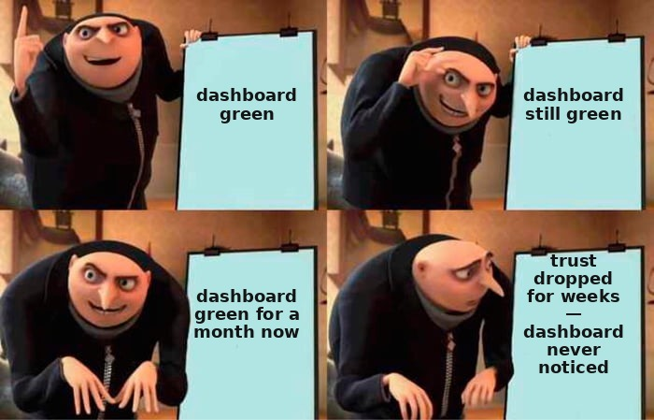
Dashboards stay green while trust has already been falling for weeks
Silent drift
Power users notice a regression before the aggregated metrics do — trust falls before the dashboards move.
Governance drift
Guardrails with no versioning silently go stale: the rules drift from reality unnoticed.
What stays: human escalation, accountability, incident discipline — reinforced by AI's autonomy, not eliminated by it.
42 / 56
Notes:
Silent drift is a weighty operational lesson of this section: trust falls before the dashboards move. Several independent sources converge on the same statement: "LLM drift rarely announces itself" — the model keeps responding, the dashboards stay green, but the outputs become a little less well-grounded, and by the time the team notices an obvious degradation, the drift has already been present for weeks or months. Power users notice first, before the aggregates do: experienced users feel a real regression even as the aggregated metrics look like they're improving.
Governance drift: guardrails themselves drift — if they aren't versioned as policy-as-code, they stay fixed while the system around them evolves. An unversioned guardrail creates a false sense of safety when reality has actually diverged — the team thinks it's protected, but the protection has silently gone stale.
What stays mandatory from the classic: human escalation and accountability are not legacy practice but a structural requirement, reinforced by AI's autonomy; incident discipline — an AI incident is still an incident with a timeline, a root cause, and a lesson; error budgets and circuit breakers carry over one-to-one to a new class of metrics — answer quality, drift, hallucinations. The explicit lesson: AI doesn't remove the need for operational discipline — it adds a new, sneakier class of failure on top of the old one; whoever skips the classic in favor of "purely AI tools" lacks the basic discipline to even notice the new class of failure. When AI-first doesn't apply here: an automated action that is irreversible or capital-intensive must not execute without a real-time circuit breaker on error rate and a guaranteed escalation path.

Slide 43

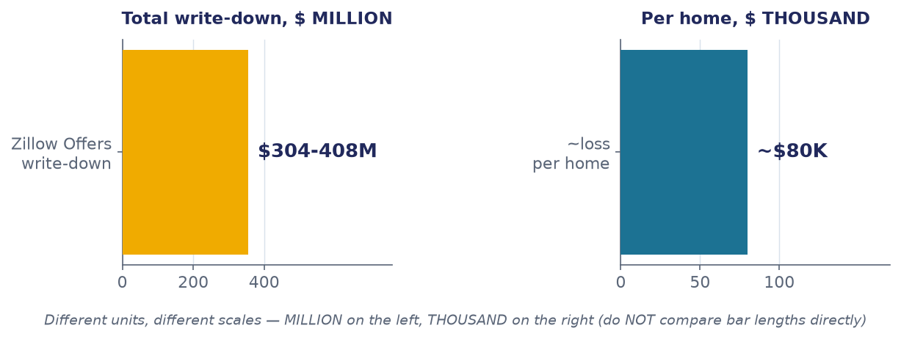

The model was calibrated correctly — there was no real-time fuse for drift
The market shifted — concept drift with no circuit breaker
Zillow Offers, November 2021: 9,680 homes bought, 3,032 sold · ~2,000 laid off (~25% of staff) ^{[1]} · ~=$80K loss per property ^{[2]}.
Criterion: a model executing trades with real money requires real-time monitoring of prediction accuracy with an automatic circuit breaker that shuts it off on drift.
[1] GeekWire (Nov 2021) — Zillow Offers · [2] SEC 10-K FY2021 — Zillow Group
43 / 56
Notes:
Zillow Offers bought and quickly resold homes based on an algorithmic valuation. On November 2, 2021, the business's shutdown was announced. Inventory write-downs were $304.4 million for the third quarter, reaching almost $408 million for the year. Staff was cut by roughly twenty-five percent. In the third quarter, 9,680 homes were bought but only 3,032 sold — an average loss of about $80,000 per property. The CEO said directly: the observed error rate turned out to be far more volatile than we ever thought possible.
The mechanism, tied to the Support/Operate phase: note that this is specifically an operations failure, not a measurement one. The model was calibrated correctly on historically stable data — experiment design and discovery have nothing to do with it. The failure was operational: a production model directing hundreds of millions of dollars in real-estate purchases had no runtime monitoring of prediction-accuracy drift with an automatic circuit breaker. Pandemic-era price volatility was a classic case of concept drift, and it wasn't caught in time because there was no working equivalent of an error budget for this specific model.
The lesson: for models directing capital-intensive automated decisions, error-budget discipline must apply to prediction quality in real time, not just to service uptime. The criterion: if the cost of a single error is tens of thousands of dollars of real capital, and external conditions show growing volatility, that's a signal to scale back automated decision volume until the model's stability is confirmed. The alternative: a hybrid architecture — algorithmic valuation as an input, a human underwriter making the final call above a risk threshold, plus an explicit circuit breaker checked weekly.
Sources:
[1] GeekWire (Nov 2021) — Zillow Offers — $304-408M in write-downs, ~2,000 laid off (~25% of staff), ~=$80K loss per home. https://www.geekwire.com/2021/ibuying-algorithms-failed-zillow-says-business-worlds-love-affair-ai/
[2] SEC 10-K FY2021 — Zillow Group — the official financial filing confirming the scale of the write-downs. https://www.sec.gov/Archives/edgar/data/1617640/000161764022000013/z-20211231.htm

Slide 44

"The bot is a separate legal entity" — the tribunal rejected this in one sentence
Scales in balance: the bot's answer = a static page on the site. Equal accountability for both.
Air Canada, website chatbot
The bot incorrectly stated a retroactive discount. Tribunal — CAD $812.02 ^{[1]}: the company is responsible for the bot's answer as for any other site content ^{[2]}.
You own every answer the bot gives — no more, but not one gram less accountability than for any other content on the site.
[1] CanLII — Moffatt v. Air Canada, 2024 BCCRT 149 · [2] American Bar Association — case commentary
44 / 56
Notes:
In November 2022, Air Canada's website chatbot incorrectly told a customer that a bereavement fare could be requested retroactively within ninety days — the actual policy did not allow this. The customer bought full-price tickets and was denied the discount. In February 2024, the tribunal awarded $812.02. Air Canada's defense: the chatbot is a separate legal entity, responsible for its own actions. The tribunal called this a remarkable submission and rejected it: the company is responsible for all the information on its website, whether it comes from a static page or from a chatbot.
The mechanism, tied to the Support/Operate phase: there was no process to synchronize the chatbot's knowledge base with the company's actual policy — support content was managed separately from a single source of truth. Why the small amount isn't a sign of insignificance, but reinforces the lesson: $812.02 is the price of two tickets, but it's exactly the modesty of the sum that makes the precedent clean. The tribunal wasn't settling a complex dispute over large sums, it was issuing a principled ruling on accountability.
The lesson, stated as a principle: you own every answer the bot gives — as you would a static page on your site. Legal accountability for an AI agent's answers rests entirely with the company; "the chatbot made a mistake" is not a defense. The criterion: deploying a chatbot that answers questions with legal consequences, without automatic synchronization to a single source of truth, is a support process not ready for automation. The alternative: a RAG architecture with a single source of truth, mandatory citation-linking to the exact policy clause in every answer, and periodic audits of bot answers against current policy.
Sources:
[1] CanLII — Moffatt v. Air Canada, 2024 BCCRT 149 — the tribunal: the company is liable for the bot's answer like any other site content; $812.02 CAD (Feb 14, 2024). https://www.canlii.org/en/bc/bccrt/doc/2024/2024bccrt149/2024bccrt149.html
[2] American Bar Association — case commentary — legal analysis: "bot as a separate legal entity" dismissed in one line. https://www.americanbar.org/groups/business_law/resources/business-law-today/2024-february/bc-tribunal-confirms-companies-remain-liable-information-provided-ai-chatbot/

Slide 45
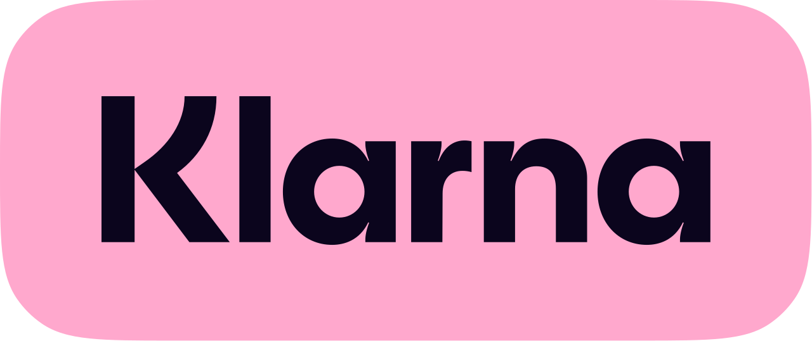

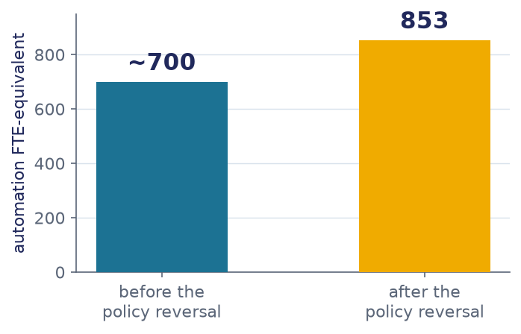
10 of 10 journalists got the same unlawful advice — not an isolated glitch
Klarna: the "AI-only" policy was walked back (05.2025) ^{[1]} — but automation grew to an 853-FTE equivalent ^{[2]} (augmenting people, not replacing them).
NYC MyCity — government bot
10 of 10 journalists — the same unlawful advice ^{[3]}. The mayor did not pull the bot.
The lesson isn't "AI doesn't work" — it's "a throughput metric with no guaranteed human escalation is the wrong design."
[1] Bloomberg (May 8, 2025) — Klarna · [2] Fortune (Oct 10, 2025) — 853 FTE · [3] The Markup (Mar 29, 2024) — NYC MyCity
45 / 56
Notes:
Klarna and OpenAI announced in February 2024: an AI assistant had handled 2.3 million conversations in its first month, doing the work of seven hundred full-time agents. By May 2025 the CEO acknowledged a reversal: it's critically important to be honest with the customer — there will always be a human if you want one. An important nuance: what got walked back was specifically the "AI-only, no human access" policy — the volume of automation itself kept growing, reaching the equivalent of eight hundred fifty-three full-time positions by the end of 2025. This isn't "Klarna gave up on AI" — it's an acknowledgment that a throughput metric with no guaranteed human fallback was the wrong operational design.
The NYC MyCity chatbot for small businesses: an investigation found the bot advising employers to take employees' tips, to fire someone for reporting harassment, and advising landlords to reject tenants with housing vouchers. All ten of ten journalists who asked this question got the same incorrect answer — not a rare edge case but a systematic, reproducible failure. The mayor acknowledged the errors but refused to pull the bot from public use. A third example of the same class: a user used a prompt injection to get a Chevrolet dealership's chatbot to agree to sell a car for one dollar as a "legally binding offer."
The combined lesson: the success metric for support automation can't be throughput alone — a weighted quality metric is needed on emotionally or legally sensitive categories, and an explicit fallback path to a human must be part of the product from day one. The criterion: guaranteed escalation is mandatory for disputed cases; if ten out of ten identical questions produce one unlawful answer, that's a systematic failure requiring an immediate kill switch. The alternative: tiered support with an explicit "talk to a human" option, deterministic guardrails underneath the LLM on critical actions.
Sources:
[1] Bloomberg (May 8, 2025) — Klarna — a reversal of the "AI-only" policy back to hiring people. https://www.bloomberg.com/news/articles/2025-05-08/klarna-turns-from-ai-to-real-person-customer-service
[2] Fortune (Oct 10, 2025) — 853 FTE — automation grew to 853 human-equivalents — augmenting people, not replacing them; the exact figure surfaces later in Klarna's Q3 filing (Nov 18, 2025) — verify before publication. https://fortune.com/2025/10/10/klarna-ceo-sebastian-siemiatkowski-halved-workforce-says-tech-ceos-sugarcoating-ai-impact-on-jobs-mass-unemployment-warning/ [VFY-day-of]
[3] The Markup (Mar 29, 2024) — NYC MyCity — a government chatbot gave 10 of 10 journalists the same illegal advice. https://themarkup.org/artificial-intelligence/2024/03/29/nycs-ai-chatbot-tells-businesses-to-break-the-law

Slide 46
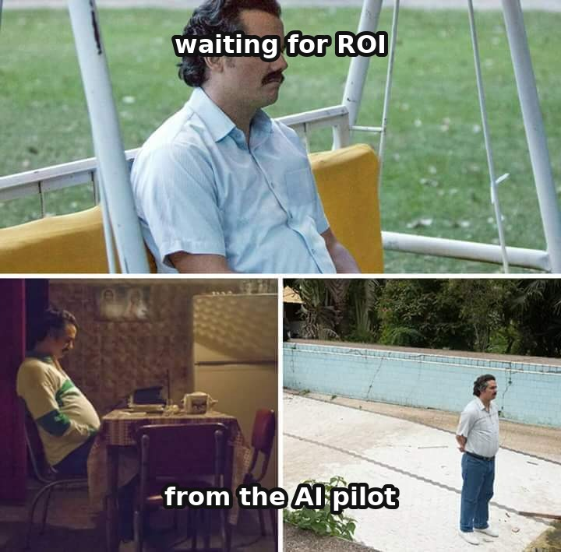
6
SECTION 6
Governance — the capstone that answers the hook paradox
2 failures · payoff
Why assembly is nearly free, but value is not. Here we rise to the level of the organization and assemble the whole loop.
0
1
2
3
4
5
6
7
Intro
Discovery
Design
Build & Launch
Measure
Support
Governance
Synthesis
46 / 56
Notes:
Section six is the capstone: it assembles the whole loop and answers the paradox the lecture opened with. This is a lighter governance section, but governance themes lived across every phase: safety-by-design in design, accountability for the bot's answer in operation, policy-as-code in drift. Here we rise to the level of the organization: why assembly is nearly free, but value is not.
Today: portfolio governance and unit economics from scratch, what five independent sources show about the bottleneck shifting from technology to the operating model, the resolution of the s01 hook paradox, a failure about hidden human cost disguised as autonomy, a summary matrix of the whole lecture, and a final checklist.

Slide 47
The same go/kill gate — but now it allocates capital across many initiatives
Portfolio funnel
Unit economics of an AI product
many initiatives
A new variable — cost per request against value per request. Every call to the model costs real money.
gate 1
gate 2
Financial KPI at pilot entry: "cut ticket cost from X to Y while CSAT >= Z; N tickets, M weeks, owner — Smith."
funded
Portfolio governance = Stage-Gate, raised to the level of capital: the same "a funnel, not a tunnel" discipline, but across products, not within one.
47 / 56
Notes:
Portfolio governance is a classical product-management discipline: an organization runs not one product but a portfolio of initiatives, and decides which to fund, continue, or kill by criteria agreed in advance. A direct descendant of Stage-Gate, raised from the level of a single product to the level of a portfolio.
Unit economics for an AI product gains a new variable — cost per request: model calls are not free, and a product where cost per request exceeds value per request is economically unviable, no matter how impressive the demo. For classical SaaS, the marginal cost of serving one more user is close to zero; for an AI product, every call costs real money, and cost per request does not fall with scale the way classical SaaS cost did.
Let's make the requirement operational. A bad KPI is "improve support efficiency" — not measurable, direction unclear, just like Kohavi's time-on-site. A good one, written down before the pilot: we believe AI triage will cut cost per ticket from X rubles to Y while not degrading CSAT below threshold Z; we'll test it on N tickets over M weeks; the owner is a specific person tracking it weekly. This is simultaneously an OEC, guardrail metrics, and a threshold fixed in advance with a date and an owner — the same apparatus as the error budget and Stage-Gate, applied to the decision of whether to keep funding an AI initiative. Why this is the capstone's base: the macro-failure on the next slide will show that the root of most failures is not "the model isn't good enough," but the absence of exactly this criterion at pilot entry.

Slide 48
The structure of cost and revenue: by type it is measured, by feature you do it yourself
BY TYPE — WHAT HAS BEEN MEASURED
BY FEATURE — AND HOW THE DECISION IS TAKEN
shares of product cost: before launch → at scale
worked through on the illustrative numbers of one catalogue: a breakdown like this is something few can build
before the product launches
Feature
Revenue
Cost
Decision
32
20
16
26
at scale
Suggestions in catalogue search
+8% to paid orders
+₽0.9 per query
we expand it
26
23
17
28
An AI agent on the first line of support
0 directly
−40% of the agent's time per ticket
we keep it: it pays in savings
people — 32% → 26%
model calls — 20% → 23%
hardware and cloud — around 17%, unchanged
Review summaries on the product card
within the margin of error
+₽1.4 per view
we close it
data storage and processing — 6%
everything else — model training, compliance
ICONIQ Capital, State of AI 2026: around 305 executives of companies that build products with AI, a survey of the second quarter of 2026. The first four shares come from the report; the last one closes the sum to 100%
A decision log and a way out to a human
0
constant, grows with volume
cannot be closed
On the revenue side: model calls eat around 23% of revenue. Gross margin on products with AI was 45% in 2025, and 53% is expected for 2026; on a classic software product it holds above 70%.
Every number in this breakdown stands against one baseline: the same catalogue without that feature, over the same month. A breakdown by feature is something few can build: 22% of finance leaders can connect AI spend to money, and 60% agree that they spend more on AI than they can justify — CloudZero, June 2026, 260 respondents, more than half of them chief financial officers
A caveat: a loss-making line cannot always be closed. A decision log and a way out to a human are required for a high-risk system by the EU AI Act: from 2 August 2026 events are recorded automatically, and the logs are kept for no less than six months. Revenue zero, cost constant, switching it off not allowed. The same class — a feature that loses money on its own line and holds revenue on somebody else's: the free tier, support, data export.
[1] ICONIQ Capital — State of AI report (2026) · [2] CloudZero — survey of finance leaders (2026) · [3] European Union Artificial Intelligence Act, arts. 12 and 19
48 / 56
Notes:
Now the structure: where the money goes and where it comes from. Two cuts, and in quality they are not comparable.
The first is by type, and it has been measured. ICONIQ this year surveyed around three hundred and five executives of companies that build products with artificial intelligence. Before launch the largest share goes on people — thirty-two percent; on model calls, twenty. At scale the picture shifts: people fall to twenty-six, model calls rise to twenty-three. Hardware and cloud hold at around seventeen and barely move; data storage and processing, six.
Look at the character of that shift. People are an almost constant cost: the team is the same whatever the number of users. Model calls tick with volume. As the product grows, the share of predictable cost falls and the share that depends on load rises — exactly the mechanics you saw as steps on the previous slide.
On the revenue side: model calls eat around twenty-three percent of revenue. Gross margin on products with artificial intelligence was forty-five percent in the year twenty twenty-five, and for twenty twenty-six fifty-three is expected. On a classic software product it holds above seventy. The gap is narrowing, but it is there.
The second cut is by feature, and here let me be honest: almost nobody has a breakdown like this. CloudZero in June surveyed two hundred and sixty finance leaders, more than half of them chief financial officers. Twenty-two percent can connect AI spend to money. Sixty agreed with the statement "we spend more on AI than we can justify with a measurable result".
That is why the table on the right is worked through on illustrative numbers, and every number in it stands against one baseline: the same catalogue without that feature, over the same month. Suggestions in search grow paid orders and cost ninety kopeks per query: we expand it. Review summaries move nothing and cost a rouble forty per view: we close it. The agent in support brings in no revenue at all and pays for itself with the agent time it saves.
And the fourth row is the one the caveat is here for. A decision log and a way out to a human: revenue zero, cost constant, closing it is not allowed. Since August of this year that is a requirement of the EU AI Act for a high-risk system. The same class — the free tier and support: loss-making on their own line, holding revenue on somebody else's.
Sources:
[1] ICONIQ Capital — State of AI report (2026) — about 305 leaders of companies building AI products, surveyed in Q2 2026: the split of spend by type before launch and at scale; gross margin of 45% in 2025 against an expected 53% in 2026. https://www.iconiq.com/growth/reports/state-of-ai-2026 [VFY-day-of]
[2] CloudZero — survey of finance leaders (2026) — 260 respondents, more than half of them CFOs: 22% can tie AI spend to money; 60% agree they spend more on AI than they can justify. https://www.prnewswire.com/news-releases/cloudzero-survey-says-78-of-finance-execs-cant-fully-tie-ai-spending-to-business-outcomes-302808711.html
[3] European Union Artificial Intelligence Act, arts. 12 and 19 — a high-risk system must automatically log events across its whole lifetime; the logs are kept for no less than six months — the obligation applies from 2 August 2026. https://artificialintelligenceact.eu/article/12/

Slide 49
We write down the result at which the pilot gets closed — before we switch it on
WHAT IT IS
One sentence with numbers in it, written down in advance, by which a few weeks later you can see whether to carry on or to close. The nearest familiar analogue is the acceptance criterion in a statement of work, translated out of functionality and into money. A number named after the result explains the result and tests nothing any more.
HOW IT WORKS
1
What we improve — from what value to what value.
“Having the model handle tickets will bring the cost of one ticket down from ₽42 to ₽15, customer satisfaction will not drop below 4.2 out of 5, and the share of tickets handed to a human will not exceed 20%. We test on 5,000 tickets over 6 weeks. Watched by the head of support, once a week.”
2
What must not get worse while we do it — one or two guardrail quantities.
3
On what volume and over what period we test.
4
Who looks, and how often. The entry is made before switch-on, with a date and a name on it: otherwise there is nothing by which to check the order of events in time.
a filled-in sample entry: one part in it for each step on the left
WITH AI AND WITHOUT
WITHOUT AI — apparatus half a century old
WITH AI — only the rhythm changes
A business case with a payback threshold and a decision at a gate. There is nothing to invent afresh, you take what is already there.
Cost moves daily, a quarterly rhythm cannot keep up, and that is why they look weekly. Meanwhile companies measure activity instead of money — hence the gap: almost everyone invests, 6% see a measurable return.
WHERE IT BREAKS
The starting value is measured on your own process. A vendor's promise will not do: somebody else's number describes somebody else's process. If “we close it” is not among the outcomes, this is not a criterion: a threshold you cannot fail to clear grants no permission. And numbers that appeared after switch-on explain the result, which is why the date and the name are checked before the numbers.
Companies measure activity instead of money in the profit and loss statement; a measurable return is seen by 6% — Boston Consulting Group, 2026
49 / 56
Notes:
An abstract "keep an eye on the payback" is of no use. Let us make the requirement concrete.
What it is. One sentence with numbers in it, written down in advance, by which a few weeks later you can see whether to carry on or to close. The nearest analogue you already know is the acceptance criterion in a statement of work, translated out of functionality and into money. And the defining property: it is written before the pilot is switched on. A number named after the result explains the result and tests nothing any more.
What a filled-in one looks like. Having the model handle tickets will bring the cost of one ticket down from forty-two roubles to fifteen, while customer satisfaction will not drop below four point two out of five, and the share of tickets handed to a human will not exceed twenty percent; we test on five thousand tickets over six weeks; the head of support looks at it, once a week. Notice how many different things sit inside one sentence: what we are improving and from what value to what value, what must not get worse while we do it, on what volume and over what period, and who is looking.
What is actually done with this today. Without artificial intelligence it has been done for half a century: a business case with a payback threshold and a decision at a gate — the apparatus is ready-made, there is nothing to invent afresh. With models exactly one thing changes: the rhythm. Cost moves daily, a quarterly rhythm cannot keep up with it, and that is why they look weekly. In practice, though, something else happens: companies measure activity — hours saved, tasks automated — instead of money in the profit and loss statement. Hence the gap: almost everyone invests, and a measurable return is seen by six percent.
Three boundaries. The starting value is measured on your own process. A vendor's promise will not stand in for it: somebody else's number describes somebody else's process, and the difference between the two is the very thing the pilot was started for. If "we close it" is not among the possible outcomes, there is no criterion, there is an intention: a threshold you cannot fail to clear grants no permission. And numbers that appeared after switch-on are an explanation of the result, which is why the date of the entry and the name on it are checked before the numbers themselves.
Sources:
[1] Boston Consulting Group — the payback of pilots (2026) — companies measure activity — hours saved, tasks automated — instead of money in the profit and loss account. https://www.bcg.com/publications/2026/why-ai-pilots-rarely-deliver-value
[2] Boston Consulting Group — annual AI review (January 2026, 2,360 executives) — almost everyone is investing: 94% will keep investing even without an immediate return. https://www.bcg.com/press/15january2026-as-ai-investments-surge-ceos-take-lead

Slide 50
The bottleneck shifted from technology to the organization's operating model
Deloitte
Maturity 0-5
Sber
operating model
0
1
2
3
4
5
Gartner
Sber is here →
McKinsey
Operators → orchestrators. Sber rates itself at level 3 of 5 ^{[2]} — an anti-hype signal: even a large player doesn't claim the top of the scale.
Forrester
Deloitte: 75% say the model must change · 42% low/zero ROI ^{[1]}
Five independent sources converge on one point: the winner isn't whoever has the better model, but whoever rebuilt teams and governance around it.
[1] Deloitte — 2026 Global Technology Leadership Study · [2] Sber — the "AI PDLC Lead" job posting
50 / 56
Notes:
Five independent sources — Deloitte, Sber, Gartner, McKinsey, Forrester — work in different markets, with different methodologies, yet converge on one point: the bottleneck for extracting value from AI has shifted from technology to the organization's operating model; the winner is not whoever has the more powerful model, but whoever rebuilt the teams, budgets, and decisions around it.
Deloitte: seventy-five percent of tech leaders say the operating model must fundamentally change, while forty-two percent report low or zero ROI. The bottleneck is structural: legacy funding and governance models run on old annual cycles, while AI-embedded workflows are continuous.
Sber maturity 0-5: Level 0 is no integration, Level 3 is supervised automation, Level 5 is "Zero-Friction PDLC," aspirational. Telling detail: Sber explicitly positions itself at Level 3, not at the aspirational Level 5 — this is a roadmap, not "we've implemented everything." IDP economics only pays off with ten or more product teams — the very proponent of the approach draws the boundary where its own approach doesn't apply.
Gartner offers the clearest phase model of agent adoption and names the risk — agentwashing: vendors rebrand existing chatbots as "agents" with no agentic outcomes. McKinsey states the same thing from the organizational side: value comes only from redesigning the operating model, not from bolting on a point tool. Forrester adds numbers: coding-only improvements deliver thirty to forty percent gains, but team-level productivity gains without end-to-end adaptation are under ten percent. Practical takeaway: if your AI initiative is stalling, the first question isn't "do we need a bigger model," it's "does it have an owner, a financial KPI, and a governance cycle."
Sources:
[1] Deloitte — 2026 Global Technology Leadership Study — 75% say the operating model must change; 42% low/zero ROI; 81% confident despite the internal contradiction. https://www.deloitte.com/us/en/about/press-room/2026-global-technology-leadership-study-release.html [VFY-day-of]
[2] Sber — the "AI PDLC Lead" job posting — the organizational reality of the role, not just a whitepaper concept. https://rabota.sber.ru/search/lider-ai-pdlc-4548579/ [VFY-day-of]

Slide 51
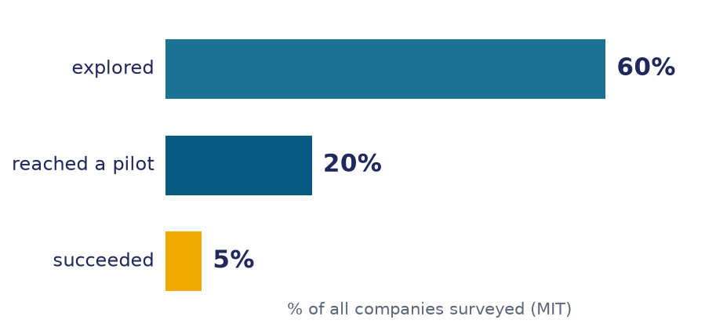

60% explored → 20% piloted → 5% succeeded: 25% among those who got there, not "95% failure" ^{[1]}
"95% failure" is a headline that doesn't survive calibration: success among those who reached a pilot is 25%, not 5% ^{[2, 3]}.
4 questions for any loud AI-failure number
BCG: 60% of companies track zero financial KPIs tied to AI value ^{[5]} — this is why failure numbers inflate so easily.
1. What is the denominator?
2. What counts as "failure"?
3. What's the author's conflict of interest? ^{[3]}
4. Does it trace to a primary source?
[1] MIT NANDA — "The GenAI Divide" (July 2025, v0.1) · [2] Fortune (Aug 18, 2025) — media distortion of the MIT report · [3] NewMR — Myth #2 · [4] Gartner (Apr 7, 2026, 782 I&O leaders) · [5] BCG — Closing the AI Impact Gap
51 / 56
Notes:
Let's return to the report the lecture opened with. MIT Project NANDA, widely reported as "ninety-five percent of organizations get zero return." The real funnel of the custom track inside the report itself: sixty percent of organizations explored, twenty percent launched a pilot, five percent successfully deployed. The success rate among those who reached a pilot is five out of twenty — twenty-five percent — not "ninety-five percent of pilots failed." Separately: an undisclosed conflict of interest — all four authors build or sell agentic AI products through that same project.
Let's extract a transferable skill through four questions. First: what is the denominator — ninety-five percent of all organizations, including ones that never seriously piloted anything. Second: what counts as failure — "didn't pay off on schedule," "abandoned," and "works but delivers no value" are three different events. Third: what is the author's conflict of interest. Fourth: does the number trace back to a primary source with a methodology.
A meta-lesson about RAND: the widely repeated "precise" figure of eighty point three percent does not appear in RAND's own report — this is a secondary fabrication of precision, structurally identical to the Deloitte failure from section one. Triangulation: Gartner — only twenty-eight percent of AI use cases are fully successful; S&P — forty-two percent of companies plan to abandon initiatives, up from seventeen percent a year earlier; BCG — sixty percent of companies track not a single financial KPI. All sources point to the same root: not "the model is bad," but "there was no financial criterion agreed in advance." Lesson: critically check the denominator before using a number as an argument in a decision.
Sources:
[1] MIT NANDA — "The GenAI Divide" (July 2025, v0.1) — an unreviewed preprint: the 60%->20%->5% funnel is 25% among those who reached a pilot, not "95% failure". https://mlq.ai/media/quarterly_decks/v0.1_State_of_AI_in_Business_2025_Report.pdf [VFY-day-of]
[2] Fortune (Aug 18, 2025) — media distortion of the MIT report — how the "95% failure" headline spread without calibrating the denominator. https://fortune.com/2025/08/18/mit-report-95-percent-generative-ai-pilots-at-companies-failing-cfo/
[3] NewMR — Myth #2 — an analysis of the conflict of interest and the denominator in citations of the MIT report. https://newmr.org/blog/myth-number-2-mit-showed-that-95-of-ai-pilots-fail/
[4] Gartner (Apr 7, 2026, 782 I&O leaders) — 28% of AI use cases in I&O are fully successful; 20% fail. https://www.gartner.com/en/newsroom/press-releases/2026-04-07-gartner-says-artificial-intelligence-projects-in-infrastructure-and-operations-stall-ahead-of-meaningful-roi-returns [VFY-day-of]
[5] BCG — Closing the AI Impact Gap — 60% of companies track zero financial KPIs tied to AI value; the publish date on BCG's site differs from the date in the research dossier — see owner follow-up. https://www.bcg.com/publications/2025/closing-the-ai-impact-gap [VFY-day-of]

Slide 52
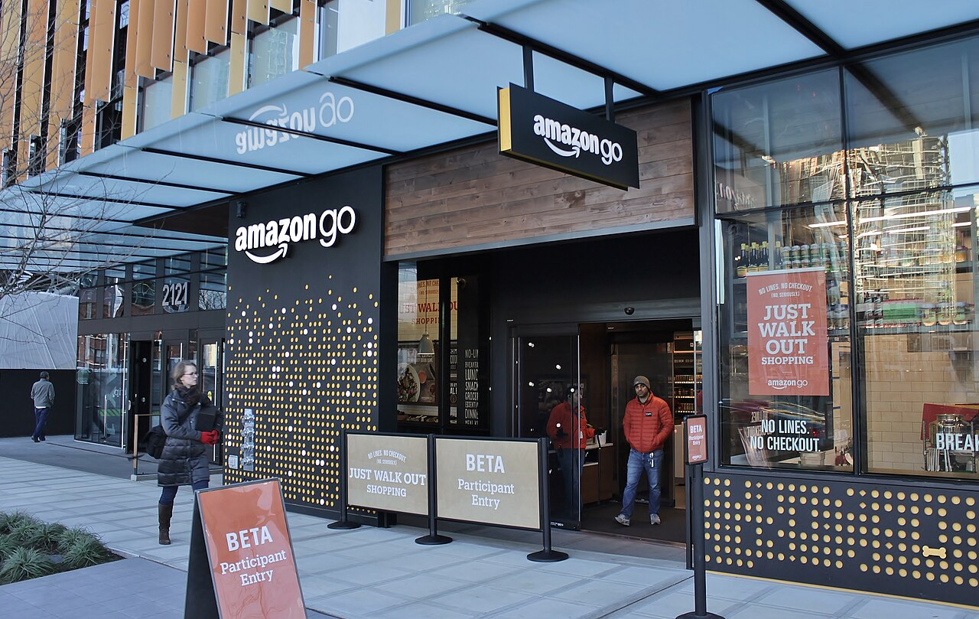
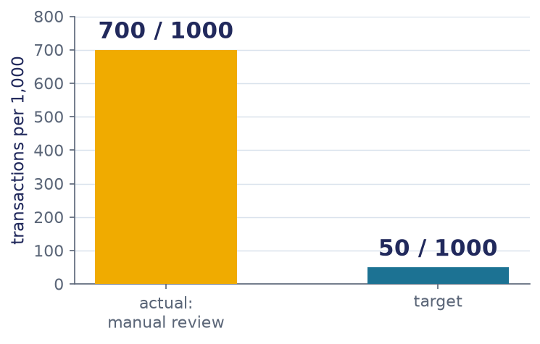
The "autonomous" store: 700 of 1,000 transactions needed manual review against a target of 50
Just Walk Out (Amazon), since 2018: 700/1,000 transactions — manual review (14x above the 50/1,000 target) ^{[1]}. 6 years of "autonomous AI" marketing with no disclosure of the labor scale (hidden human cost) ^{[2]}.
Phase x what AI changes x what stays from the classic
Discovery
Design
Build/Launch
Measure
Support
Governance
synthesis, desk
generation
code ~= free
evals
tracing
operating model
interviews
safety reqs
review, kill gate
randomization
escalation
cost/request
[1] Business Standard (Apr 2024) — Just Walk Out · [2] Retail Dive — the dismantling of Just Walk Out
52 / 56
Notes:
Since two thousand eighteen, Amazon positioned Just Walk Out as pure computer vision, without disclosing human involvement. An investigation found: about a thousand workers in India were reviewing video to label ambiguous transactions. The key number: in two thousand twenty-two, seven hundred of a thousand transactions required manual review against an internal target of only fifty of a thousand — the actual rate was roughly fourteen times the target. In April two thousand twenty-four, Amazon announced it was removing the technology from most Amazon Fresh stores in the US.
The mechanism: a real limitation of computer-vision accuracy across product variety, plus a governance failure — six years of marketing autonomous AI without disclosing the real scale of human labor. This is the "Wizard-of-Oz AI" pattern — hidden human labor disguised as autonomy. The bare fact "a thousand workers were involved" lets you be technically right — people annotated video, they weren't watching live. But the right counterfactual isn't whether people were involved at all, it's how far the actual intervention rate exceeded the target: a fourteen-fold overshoot.
Lesson: claims of autonomy must be verifiable and must include honest disclosure of the human-in-the-loop share. The hidden-human-cost criterion: if acceptable accuracy requires manual review at multiples of the target rate, the claimed autonomy has not been achieved. Now let's assemble all six phases into a single matrix: for each phase — what AI changes in cost and trust, what classic discipline stays, when AI-first breaks, and which failures illustrate it. The matrix isn't for memorizing — it's for applying: when you meet a new failure in the news, identify the phase, the broken classic discipline, and the criterion — that is exactly the trainable skill of recognition.
Sources:
[1] Business Standard (Apr 2024) — Just Walk Out — 700 of 1,000 transactions required manual review by Indian workers — against a target of 50/1,000. https://www.business-standard.com/companies/news/amazon-s-just-walk-out-checkout-tech-was-powered-by-1-000-indian-workers-124040400463_1.html
[2] Retail Dive — the dismantling of Just Walk Out — the technology pulled from Amazon Fresh; 27 of 44 stores lose the feature. https://www.retaildive.com/news/amazon-removes-just-walk-out-tech-amazon-fresh-stores-dash-carts/712150

Slide 53

7
SECTION 7
Synthesis: one instrument
for all six phases
6 phases · 1 matrix · 3 decision axes
The six phases were examined one at a time, and a task arrives whole — nobody will break it down for you along the lecture's sections. Without a common instrument you are left with six separate conclusions and no answer for a case that was not covered here.
0
1
2
3
4
5
6
7
Intro
Discovery
Design
Build & Launch
Measure
Support
Governance
Synthesis
53 / 56
Notes:
Section seven closes the lecture. It is not here to repeat what we have already covered: repetition adds nothing and costs time. It is here because in this lecture we solved one and the same task six times in pieces, and at work it arrives whole. A client does not say "I have a question about the measurement phase" — the client says "we want the model to answer customers on its own." Answering that takes an instrument that works on any phase, and on a case you have never seen before.
Over the lecture we went through discovery, design, build and launch, measurement, support, and governance. The same structure repeated on every phase: there is a classical discipline, there is a specific piece of work that artificial intelligence made cheaper, there is a way of letting you down characteristic of that phase, and there is a point where the decision is not handed to a tool. As long as those four things are named six times separately, they stay six stories. Assembled onto one screen, they become an apparatus you can use.
Two instruments follow in this section. The first is a summary table: six phase rows against four columns, where every cell is derived from material already covered and none was assigned after the fact. You can argue with any of its rows only by arguing with the matching section of the lecture. The second is three axes: reversibility, the cost of an error and observability. They give the phase its operating mode by a single rule, and they are tried on two cases we have already examined — an instrument has to be shown working, declaring that it works is not enough. The order matters here: first the table answers the question "what is actually going on in this phase," and only then the three axes answer "which mode is permissible here." The order is easy to swap, and then the decision about how much autonomy to grant is taken before the nature of the phase is understood.
The section closes with a bridge in two directions: to the seminar, where you will walk the same loop on your own practice task, and to the next lecture, where the same method meets material with a higher cost of physical error. One thought for the whole section: there will be no new facts from here on — there will be a way to apply the ones you already have.

Slide 54


Six phases, one structure: discipline, what got cheaper, failure mode, the human
Phase
Leading discipline
What AI made cheaper
Failure mode
Where a human is mandatory
Discovery
Customer Development and "The Mom Test": a testable hypothesis
Desk research, running conversations and bringing them together
Sycophancy: a synthetic source will not say no
A check against a real past and a real commitment
Design
Double Diamond, Nielsen's heuristics, the design system
Screen variants: −20% of the time against the baseline
Accessibility gaps; one prompt gives different answers
Convergence onto the context; a check that can stop the release
Build and launch
Minimum viable product; the stop gate
The build itself: boilerplate and glue code
A gate skipped; rollout to the whole audience at once
Specifying the intent; the decision on pace and on stopping
Measurement
Controlled experiment; the guardrail metric
Judging quality at scale; a cheap first pass
A gamed proxy metric; the measurement does not transfer to the task
The criterion and the guardrail metric named before the test
Support
Reliability engineering: service level objective, error budget
A suggester for the agent: +15% resolutions per hour, base 2.1
Silent drift is masked by the average across all answers
A system model and accountability for every answer
Governance
Portfolio governance; every number has an owner
Nothing: here AI adds a cost that grows with scale
Statistics with no denominator
The success criterion agreed in advance; your own baseline
How to read it: name the phase your task is in — the row answers, in order, which discipline to hold, what AI helps with here, which failure to watch for and what stays with the human. Tool names are replaceable; the four columns rest on the nature of the difficulty and the cost of an error in the phase.
54 / 56
Notes:
In front of you is the whole lecture on one screen. The rows are the six phases in the order we went through them. The columns are the four things that turned out to be stable on every phase.
The leading discipline is the classical practice that holds the intent and makes the phase reliable; it is older than any of today's tools. What AI made cheaper is the specific piece of work whose cost fell measurably. Look at the last row: in governance that column says "nothing." There AI made no work cheaper — it added a cost line that grows with scale, and writing it that way is more honest than fitting a plausible phrase into the cell for the sake of symmetry.
The failure mode is the way of letting you down characteristic of the phase. In discovery that is sycophancy. In design — accessibility gaps, and a different answer to one and the same prompt. In build — a gate skipped. In measurement — a gamed proxy metric. In support — silent drift under a good average. In governance — statistics with no denominator.
The last column, picked out in gold, is the point that is not handed to a tool, however much that tool improves in the next generation.
There is deliberately no separate column of product names. We named the products in the sections themselves, and they are replaceable: by next semester half the list will have changed. What is stable is the discipline, the characteristic failure and the human's point — they rest on the nature of the difficulty and the cost of an error in the phase.
There are almost no figures in the table. Every figure we named stands in its own section next to its basis of comparison; torn out of there into a cell, it stops meaning anything. Two I did keep — twenty percent in design and fifteen in support. Both are named together with their basis, and both refute a common expectation: a screen generator speeds the work up by a fifth, and the common claim of "a hundred times" is not confirmed by measurement; the suggestion assistant gives the operator an increment on top of a little over two resolutions an hour.
The matrix holds because every cell is derived from what has already been covered. You cannot dispute the discovery row without disputing the matching section.
Use it like this: given a task, first name its phase. From there the row answers in order — which discipline to hold, what AI helps with here, which failure to watch for, and what stays with the human.

Slide 55



Three axes decide if the human can come off the gate
Before all three comes the question of the phase's classical discipline: if it is absent, you build it first — there is nothing to amplify in a vacuum.
Reversibility
Cost of an error
Observability
How easily the consequence can be rolled back if the output is wrong
What an error will cost: money, reputation, health
How quickly it shows that an output is wrong
Low → a staged rollout and a tested rollback path
High → a named owner for the decision
Low → the eval loop and a guardrail metric
No axis forbids AI — each one names what must stand beside it. All three in a good position and the human can come off the gate; any other combination calls for a gate on the problem axis.
55 / 56
Notes:
The table on the previous slide is good as a map. A decision on a specific task is not taken from a map — that needs a more compact instrument. Three axes, each of which surfaced on its own in almost every section.
Reversibility — how easily the consequence can be rolled back if the output turns out to be wrong. It is low for deleting data in a running system and for a public promise to a customer; it is high for a draft nobody has seen yet. The cost of an error — money, reputation, health, legal liability. Observability — how quickly you will learn that an output is wrong, before the harm accumulates: high where there is a guardrail metric, low where the bad is hiding under a good average.
There is one rule. Taking the human off the gate is justified only where high reversibility, a low cost of an error and high observability come together at once. Any other combination calls for a gate, and the gate is chosen by the axis that is in the problem position. That is why each card says what that axis requires when it is in that position.
Let us run this through two cases we examined. Search answers rolled out to everyone at once: reversibility low — everyone saw the mistake at the same moment; cost high — the advice went viral and was dangerous; observability could have been high, a canary release would have given it, but the canary was skipped. There is one problem axis, reversibility, and the measure on it — a staged rollout — brings observability back along with it.
The second case is buying houses on a model's forecast. Reversibility is minimal: a purchased house cannot be undone with one click. The cost is at its maximum: at a loss of roughly eighty thousand dollars per house, write-downs of three hundred four to four hundred eight million dollars cover somewhere between three thousand eight hundred and five thousand one hundred houses out of the nine thousand six hundred eighty bought in the quarter. Observability was low by the design of the control itself: a quarterly report instead of a real-time check. All three axes were in the problem position, and there was a gate on none of them.
And the question that is asked before all three: does the phase have a classical discipline. If it does not, that is what you build first — there is nothing to amplify in a vacuum.
And one last thing. No axis forbids the use of artificial intelligence. Each one names what must stand beside it.

Slide 56

The method transfers, the list of tools does not: code was the first proving ground, the product the second
This course does not teach "use AI more" and it does not teach "fear AI" — it teaches you to say a well-founded "yes" and a well-founded "no."
Seminar 7
A full run of the instrument on a practice AI product: from the hypothesis to the point of escalation to a human.
Lecture 6
The same method in computer-aided design (CAD): the cost of a physical error is higher.
Questions?
An engineer at a computer-aided design (CAD) workstation with a light pen, late 1970s: the tool is gone — the discipline of design remained
56 / 56
Notes:
Let us fold the lecture into one thought. We opened with a paradox: building is almost free, and few extract value from it. We went through six phases and on every one found the same thing in a new wrapper — artificial intelligence changes the cost of each step, and the trust you can place in it, by different amounts, and it leaves the order of the steps alone. When building fell to almost nothing, the scarce resource stopped being the ability to build and became the ability to tell real signal from noise, and to keep intent and accountability with a human.
Look at the photograph. This is an engineer at a computer-aided design workstation, the late seventies, a light pen instead of a mouse. That workstation is gone, that pen is gone, the company itself is gone. And the discipline of design he was practising is still here — and you will be practising it. That is the answer to the question of what in this lecture is worth remembering. Half the list of products will have changed by next semester; the way of reasoning will remain.
The way goes like this. Break the activity into phases with their inputs and outputs. On each one, ask what exactly got cheaper and what did not. For any measurable claim, demand a basis of comparison; an impression does not count. And apply the three axes — reversibility, the cost of an error, observability — to assign the phase its operating mode. Lecture four said the same thing about code; here we have done it for a whole product.
Seminar seven is where you apply all of this. You will walk the same loop on a practice product, from the hypothesis to the point where the answer goes to a human, and for each phase you will name the row of the table and the position on the three axes.
Lecture six carries the method into engineering design. There will be a loop of phases of its own there, and failures of its own, but the central question stays the same: what got cheaper, what stayed human judgment, and where the autonomy a system claims does not survive a check against the denominator. The difference is that an error there sets in metal, and it costs more than an error on a screen.
Ready for questions.

