Slide 1
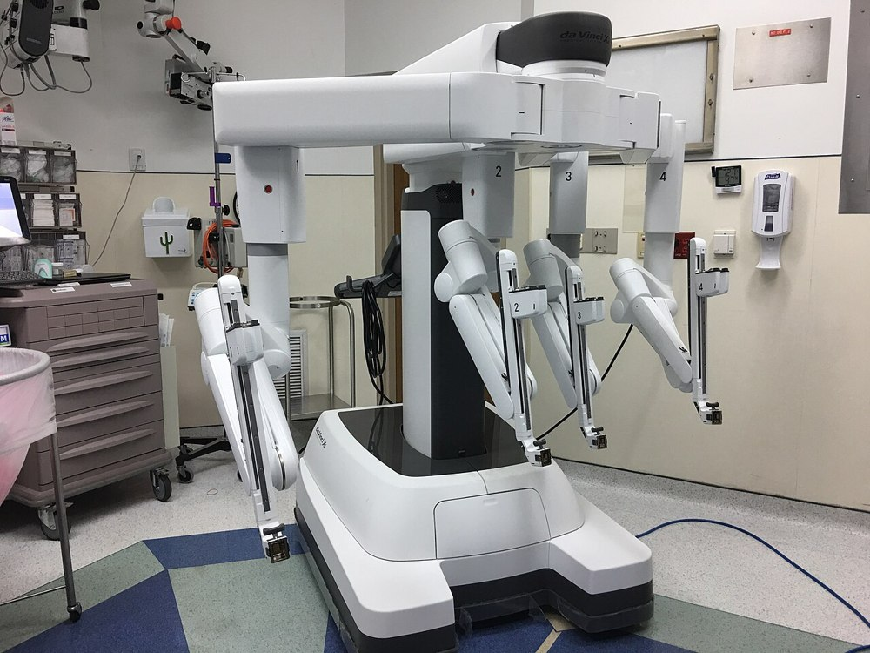

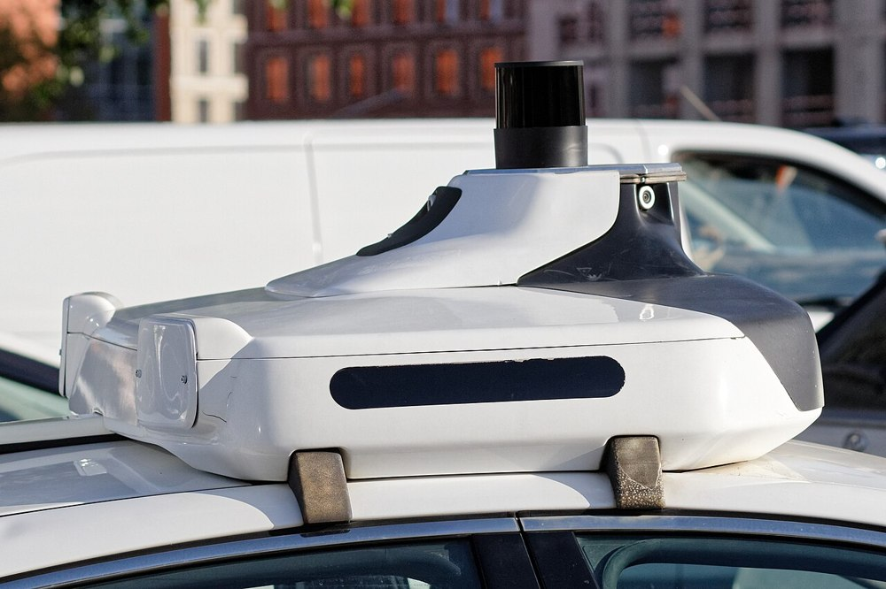


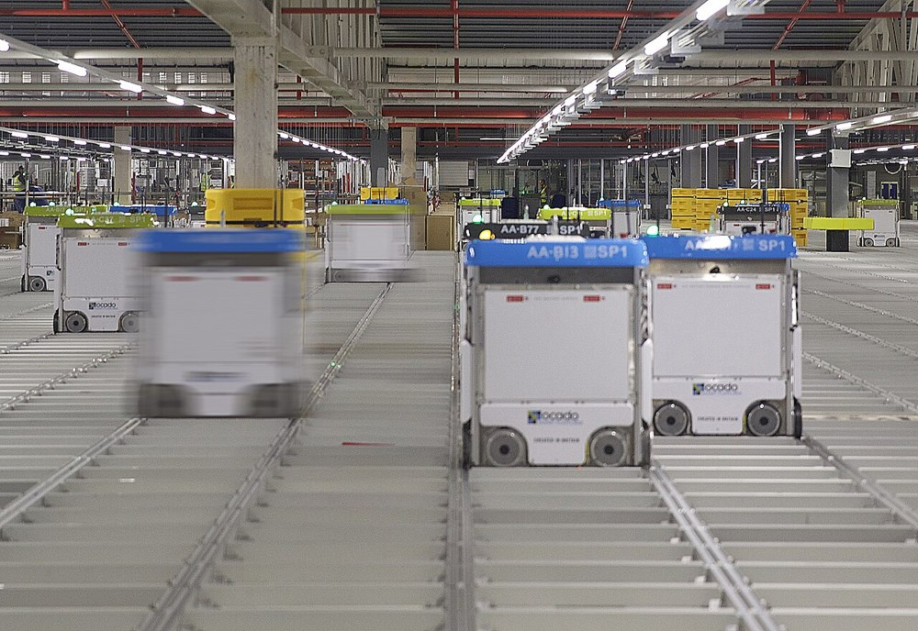


Seminar 1 Getting to know you
Medicine
Finance
Transport
Industry Applications of Artificial Intelligence Systems
Manufacturing
Development / IT
Logistics
Bauman Moscow State Technical University
Science
Cybersecurity
Wikimedia Commons · CC / public domain
Notes:
Welcome to the course “Industry Applications of Artificial Intelligence Systems.” This is the first session — and you're here before you've heard a single lecture in the course. That's deliberate: before we start systematically covering where and how AI is applied in software development, finance, medicine, manufacturing, and other industries, it's useful to honestly record where you stand with AI right now.
Today is about getting acquainted. We'll meet each other and the course format, hear the whole group's stories out loud about where AI genuinely helped and where it let them down, and each of you will honestly record your current experience with AI — no judgment of “right” or “wrong.” Some of you have months of daily work with neural networks behind you; others have made a couple of random queries. Either is a normal starting point.
By the end of the course, you'll come back to today's experience and compare what's changed in how you use AI and how much you trust it.

Slide 2








AI enthusiast and researcher • Builder of AI-based systems
I build innovative solutions, automate processes, and deploy leading-edge AI technologies to solve real business and user problems.
Clarifian clarifian.io
AI-based automatic diagram drawing. Turn text descriptions and ideas into structured, clear visual diagrams and charts in one click.
AI Mentor mentor.tellian.ru
AI-based testing and mentoring. Personalized learning, skills assessment, and intelligent support along your development path.
Maxim Nikolaevich
Levko
Telegram
@Maxim_Levko
w4check.io
workain.ai
Blog · tellian.io
Reliability checks for crypto counterparties.
AI automation of workflows and tasks.
Original writing on technology, AI, and software development.
Email
Levko.maxim@gmail.com
Notes:
Let me start by introducing myself — here you'll hear about my entrepreneurial side, and in the lecture, about my industry experience.

Slide 3





17 lectures × 3 modules — from fundamentals to AI by industry
Today
Module 1
Module 2
Module 3
Fundamentals and familiar industries
High-tech manufacturing
ICT, science, extraction, synthesis
Lectures 1–6
Lectures 7–12
Lectures 13–17
MT1 · S6
MT2 · S12
MT3 · S17
Cross-cutting themes — in every lecture and seminar
Choosing a tool
Common mistakes
Human / AI accountability
Info security
not every AI fits every task
and how to avoid them
who's responsible for the result
what can and can't be shared with AI
Notes:
The course consists of seventeen lectures and seventeen seminars, split into three modules. Today's seminar comes before the first lecture — so on the semester map there's no “you are here” marker on a specific lecture, just a “today” marker before the start.
Module one — fundamentals and familiar industries, lectures one through eight: the theoretical foundation and a look at the industries you encounter most often in practice — software development, finance and retail, engineering design, medicine, creative industries. Midterm one — at the seminar in week eight.
Module two — high-tech industries in physical manufacturing, lectures nine through twelve: aerospace and defense, agriculture, manufacturing, automation and digital twins. Midterm two — at the seminar in week twelve.
Module three — infocommunications, science, extraction, synthesis, lectures thirteen through seventeen: logistics, telecom and cybersecurity, scientific research, oil and gas, and the final synthesis. Midterm three, the final one, at the seminar in week seventeen.
Separate from the structure — four cross-cutting themes that will come up in every lecture and every seminar regardless of industry: choosing the right tool for the task, common mistakes, dividing accountability between human and AI, and information security when working with AI (what can and can't be shared with a model). This isn't a one-off topic for a single session, but a thread that runs through the entire course — which is why it's drawn as a separate tier on the map, not as part of the lecture structure itself.

Slide 4


Midterms — test at home, review in the seminar
At home
In the seminar
A test on an AI testing platform
Review of results and open questions — not test-taking
Midterm · Seminar 6
Midterm · Seminar 12
Midterm · Seminar 17
Midterm seminar: not test-taking — reviewing what raised questions
Notes:
Midterm mechanics differ from the usual “test during class” format. The test is taken independently, at home, on an AI-based testing system — we'll name the platform separately, details are still being finalized.
The seminar time itself, on midterm days — eighth, twelfth, and seventeenth — isn't spent taking the test; it's dedicated to reviewing results and the questions that came up for you. If the test showed that some topic remained unclear, that's exactly the seminar where there's time to go over it separately, with the instructor and with the group.
This differs from the classic format, where the checkpoint is a stress test during class with a time limit. Here, the stress moves to independent homework, and the in-person time is used for what it does best — live discussion and questions.

Slide 5




MAX course chat — everything important in one place
Group chat: “Industrial Use of AI 2026”
Announcements
Schedule, changes, and important course news — all in one place.
Lecture and seminar materials
Slides and materials appear in the chat as sessions happen.
Scan with your phone's camera
Questions between sessions
max.ru/join/sHoHlhI4jvW_swcq5ZLowvz6G94m0IMhAwngxuxsEpI
You can ask a course question and get an answer without waiting for class.
Notes:
All course communication happens in the MAX messenger chat. Scan the QR code with your phone's camera or follow the link max.ru/join/sHoHlhI4jvW_swcq5ZLowvz6G94m0IMhAwngxuxsEpI and join the chat before the first lecture.
What you'll find there. First, announcements: schedule, any changes, important news — all posted in the chat, so you won't need to wait for a separate email. Second, materials: I post the lecture and seminar slides there as sessions happen, so everything's collected in one place. Third, questions: if something's unclear between classes, ask in the chat — you don't have to save it up for the seminar.
Please join today — that way you definitely won't miss the first announcement.

Slide 6






Warm-up: how do you use AI?
We answer out loud and discuss — no camera, no counting. We'll compare your answers with outside statistics in the next block.
Which AI tool do you use most often?
How often do you use AI?
ChatGPT · GigaChat/YandexGPT · Copilot/Claude/DeepSeek · none
every day → weekly → monthly → less often → never
How much do you trust AI's accuracy?
Has AI ever clearly let you down?
a scale from 1 to 5
yes · no · not sure
Notes:
A short warm-up before the statistics — getting a sense of how the group works with AI. Simple format: I ask a question, you answer out loud, and raise a hand if you'd like — this isn't a vote with a camera and a count, it's a live conversation, to get a picture of the group.
Four questions. First — which AI tool you use most often: ChatGPT, GigaChat or YandexGPT, GitHub Copilot / Claude / DeepSeek, or none at all. Second — how often: every day, several times a week, less often, never. Third — how much you trust AI's accuracy, on a scale from one to five. Fourth — whether there's been a case where AI clearly let you down.
We'll need these answers in the next block — we'll compare your group with outside research: whether you're higher or lower on trust, whether you use AI more or less often.

Slide 7
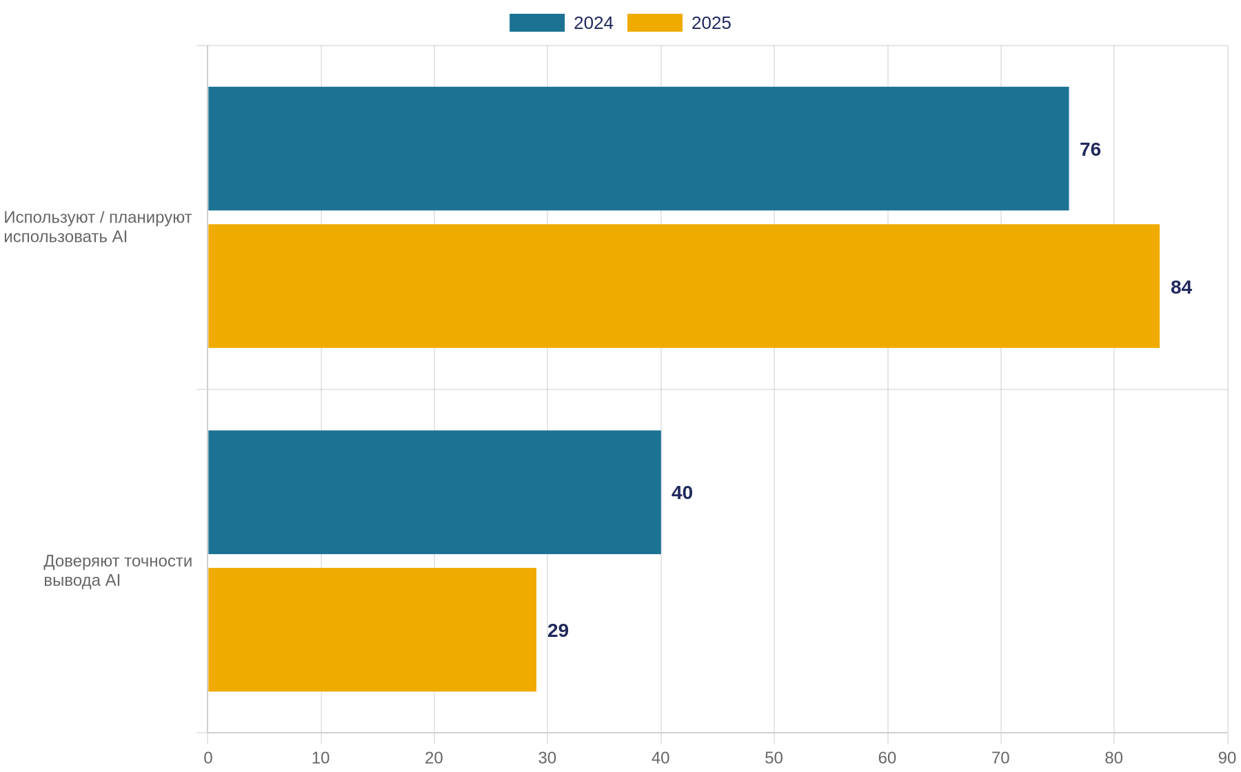
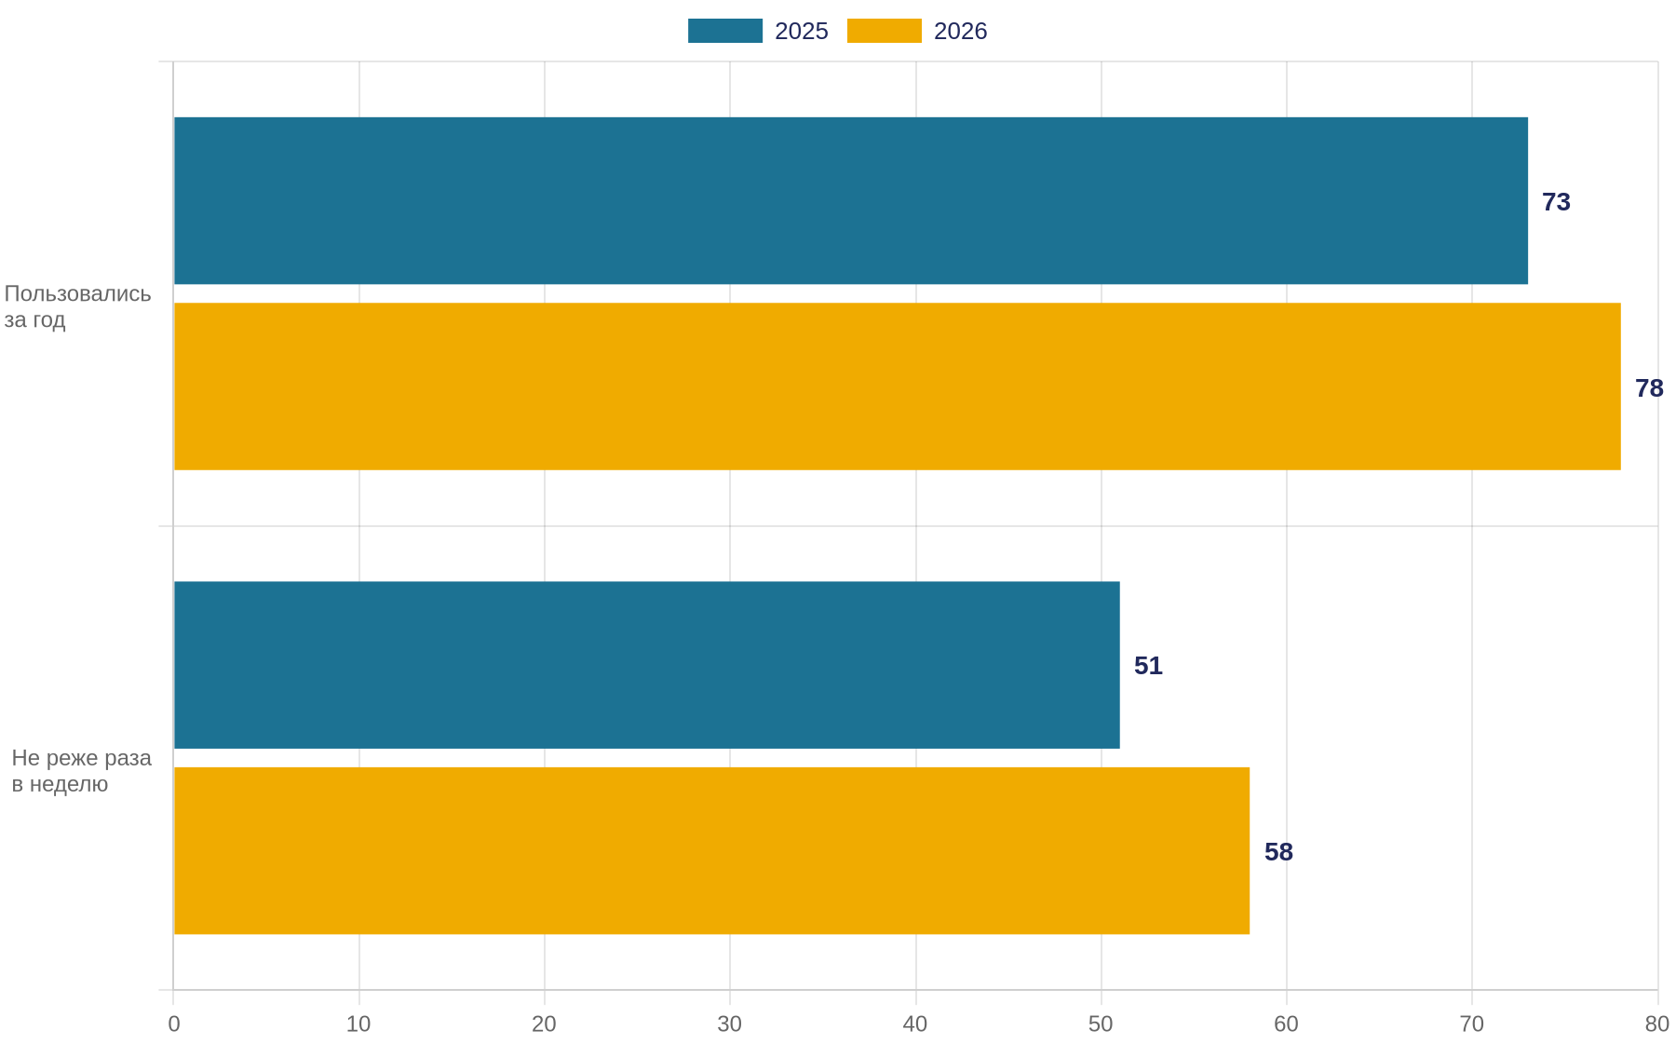
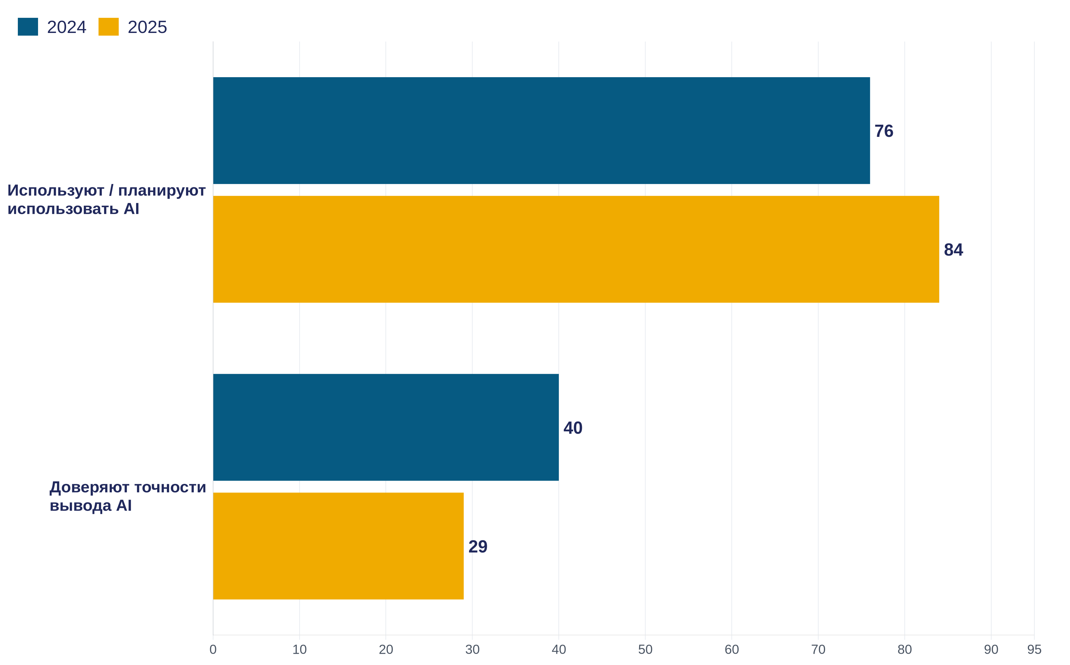
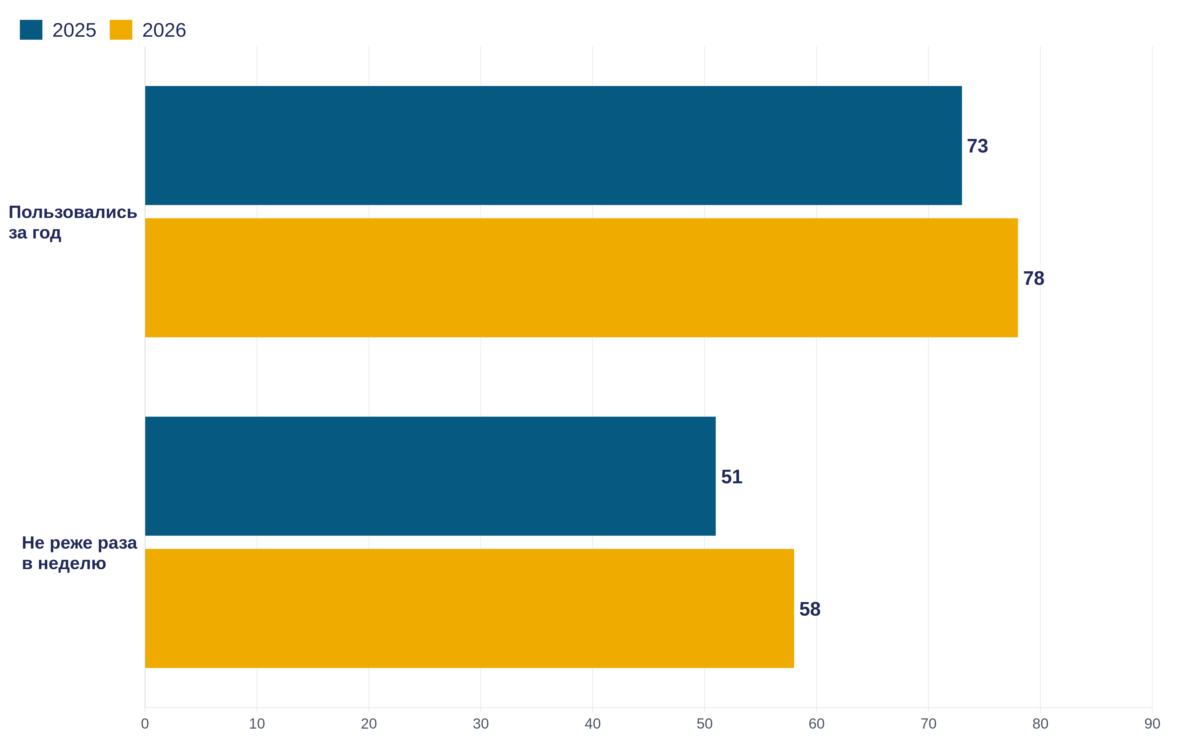
Used more, trusted less — and that's not a paradox
USAGE
WHAT THEY USE MOST
TRUST
84%
ChatGPT
82%
29%
GitHub Copilot
68%
use or plan to use AI tools
Gemini
47%
trust the accuracy of what AI produces
Claude
41%
was 40% in 2024 (−11 pp)
46% explicitly don't trust it · only 3% trust it fully
2024 → 2025: 76% → 84% (+8 pp)
% among those who use AI
Russia · VCIOM, 2026
78% used neural networks over the past year (was 73%) · 58% — at least once a week (was 51%)
64% believe AI is beneficial, 67% of them — only in certain areas · N=3209, 18+, 25–27.06.2026, ≤±1.7%
Sources: Stack Overflow Developer Survey 2025 (N=49 009, May–June 2025; self-selected online sample) · VCIOM “Neural Networks in Our Lives”
Notes:
The first source — the Stack Overflow Developer Survey 2025. Eighty-four percent of developers use or plan to use AI tools in development — up from seventy-six percent in 2024. At the same time, only twenty-nine percent trust the accuracy of what AI produces — down from forty percent a year earlier.
How is that possible — using a tool more, but trusting it less? It's not a paradox: the tool is used as a draft that always gets checked — a sign of mature use. An important methodological detail: this is a self-selected online survey — the respondents are people who came to the Stack Overflow site themselves, so the audience skews toward English-speaking developers.
The second source — VCIOM, “Neural Networks in Our Lives.” In 2025, seventy-three percent of Russians had used neural networks over the past year, and fifty-one percent at least once a week; the 2026 figures grew to seventy-eight and fifty-eight percent. VCIOM surveys Russians in general, not just an engineering student audience.
Compare that with your own answers from the warm-up: where does your group stand — higher or lower on trust, using it more or less often?

Slide 8






Who has a story — did it help or let you down?
A task solved only
on the surface — looks right,
dig in — it's not
Hallucinated fact
Outdated data
Answer doesn't
fit your situation
Lost context in a conversation
Mismatched tone
Notes:
Now — an open exchange of experience in front of the whole audience. In turn, whether by volunteering or by my calling on you, you'll tell one story out loud where AI genuinely helped, and one where AI let you down or made a mistake. Together, on the board, we'll find common patterns in the stories we collect.
Whoever has a story where AI genuinely helped — raise a hand. If no one volunteers right away, that's fine, I can call on someone directly. We'll alternate: one success story, then a failure, then a success again — that way we keep the balance and don't let the conversation slide into one tone.
Six categories of AI failure that come up most often: a hallucinated fact — AI confidently makes up a fact or source that doesn't exist; outdated data — AI answers with information that was correct at training time but is now stale; a task solved only on the surface — the result looks like the right answer, but on inspection the substance isn't actually solved (this is broader than just code: the same pattern shows up in text and in calculations too); losing context in a long conversation, where AI forgets the conditions set at the start; a mismatched tone or style in the response; and too-generic advice — AI gives an answer that's correct in general but nonspecific, and it doesn't account for your particular situation. When you tell a failure story, try to guess for yourself which category it belongs to — we'll pin it down together. Failure stories in particular are valuable today: they help reveal AI's real limits, not just its impressive examples. This same term — hallucination — will come back with a precise definition later, in the quickfire quiz.
— Instructor's personal stories (to tell in this block, one per category) —
1. Hallucinated fact. Last year, while I was writing an article for a conference, a model gave me several citations to research papers that don't exist — and some of the citations pointed to real papers, but on a completely different topic than claimed. It looked confident and plausible, so every citation had to be checked by hand.
2. Outdated data. This is especially noticeable in development: a model pulls in outdated library versions and, worse, outdated approaches. For example, you ask for a React component — and it writes it as a class with componentWillMount instead of hooks; or it suggests moment.js, which hasn't been actively developed in years, instead of date-fns or the built-in Temporal. The code is formally working, but the approach is from the day before yesterday.
3. A task solved only on the surface. This happens with almost every product I build: the first AI prototype looks a lot like what's needed — screen, buttons, responses — but dig in, and often it either doesn't work or fakes working (data is hardcoded, error handling is drawn but not wired up). A finished product on the outside, a stage set on the inside.
4. Lost context. In a long refactoring conversation, after a couple dozen messages, the model forgets what we agreed on at the start: say, I explicitly said “no pulling in external dependencies” and we renamed a module — and twenty replies later it's suggesting a third-party library and the old name again, as if the conversation never happened. The context has drifted out of the window, and the conditions have to be restated.
5. Mismatched tone. The example is right in front of you — these lectures. I prepare them with heavy AI involvement, and there are still odd turns of phrase and tone on the slides and in the notes that I haven't cleaned up. This is an honest example that a model's tone has to be edited by hand.
6. An answer that doesn't fit your situation. The same story keeps coming up for me — a model's paranoid “information security” on dev and test environments: it resists saving or showing the logins and passwords for test users because “that's not secure,” even though we're talking about deliberately fake test accounts on a local environment, which is exactly where that's needed. The advice is correct in general — just not for my particular situation.

Slide 9
Who wrote it — fiction: AI or human?
Text A
Text B
“How strange — he died, and we live on… Except I suspect that every time we go to sleep, we die in exactly the same way. And the sun goes away forever, and the whole of history ends. And then non-being gets bored with itself, and we wake up. And the world arises again.”
“Sleep is a rehearsal for oblivion that we go through every night without noticing the exam. We turn off the light and, for a few hours, stop existing for ourselves, and in the morning we agree that it was an intermission, not a cancellation. Maybe the only difference between sleep and death is that after sleep, someone is waiting for us again.”
Notes:
The first category in the calibration game — fiction. Two short fragments on the theme of sleep and reality, unlabeled. Let's vote: which one was written by a human, which by AI.
Both texts are deliberately similar in theme and tone — the point isn't to find an obvious difference in subject matter, but to hear a difference in style, if one is even noticeable in such a short fragment.
After the vote — ask one or two students what tipped them off: the rhythm of the sentence, characteristic turns of phrase, a recognizable voice? For fiction, there's no objective, measurable criterion for “which is better” — this category is about style and recognition, not about productivity.

Slide 10



Text A — Pelevin, “Generation P”. Text B — AI
Victor Pelevin, “Generation P” (1999)
Generated by AI, prompted for a similar style
“How strange — he died, and we live on… Except I suspect that every time we go to sleep, we die in exactly the same way. And the sun goes away forever, and the whole of history ends…”
“Sleep is a rehearsal for oblivion that we go through every night without noticing the exam. We turn off the light and, for a few hours, stop existing for ourselves…”
Style can be copied, but a short fragment doesn't always reveal the author
A long work: plot, composition, the development of an idea — harder to imitate
Short fragment: AI imitates sentence rhythm and tone more convincingly
Notes:
Text A is a real quote from Victor Pelevin's novel “Generation P,” 1999. Text B was generated by AI, prompted to approximate a similar philosophical-reflective style on the theme of sleep and reality.
On such short fragments, modern models really can do a decent job imitating a recognizable manner of writing — the rhythm of the sentence, characteristic constructions. That doesn't mean AI “writes like Pelevin” in any broad sense — reproducing style over two or three sentences and writing a whole work with an original idea are tasks of very different difficulty. The lesson of this round: a short stylized fragment is an unreliable test for determining authorship, especially in fiction.

Slide 11
Who wrote it — technical text: AI or human?
Text A
Text B
“The while construct in Python runs the loop body for as long as the condition stays true — unlike for, there's no built-in iteration over a sequence here: the interpreter simply checks the condition before every iteration. This is useful when the number of repetitions isn't known in advance and depends on the outcome of computations inside the loop itself.”
“The for statement is used to iterate over the items of a sequence — for example, a string, tuple, or list — or another iterable object. The list of expressions is evaluated once and must return an iterable object; the resulting set of statements is then executed once for each item, in the order returned by the iterator.”
Notes:
The second category — technical text, documentation. Two fragments explaining the behavior of a language construct. Let's vote: which was written by a human, which by AI.
Beyond the question of “who's the author,” let's discuss another one: in what way, and how measurably, does the AI version differ in practical usefulness from official documentation? Not just “who wrote it,” but also “what it means for someone looking for an answer right now.”
After the vote, ask: what tipped you off — the precision of the wording, a characteristic structure that explains through comparison with other languages?

Slide 12



Text A — AI, in seconds. Text B — official Python documentation
AI, prompted to explain while in a similar style
Python 3 documentation translations (digitology.tech)
“The while construct runs the loop body for as long as the condition stays true — unlike for, there's no built-in iteration over a sequence here.”
“The for statement is used to iterate over the items of a sequence — for example, a string, tuple, or list — or another iterable object. The list of expressions is evaluated once and must return an iterable object; the resulting set of statements is then executed once for each item, in the order returned by the iterator.”
AI version
Official documentation
Faster and often just as accurate for standard language constructs · saves search time
Written and maintained by a team · stable for years
for technical documentation, what matters isn't style or who wrote it, but the accuracy and speed of the answer — AI is especially strong here on typical questions
Notes:
Text A was generated by AI, prompted to explain while in documentation style. Text B is an exact quote from the official Russian translation of the Python 3 documentation (“Python 3 Documentation Translations,” digitology.tech), section “8.3. The for Statement.”
What matters here isn't just the question of authorship, but an honest comparison: official documentation is written and maintained by a team, goes through review, and is stable for years. But for standard language constructs like for and while, the AI version is often just as accurate — and you get it in seconds, without having to search for and read through the whole documentation.
Lesson: for technical documentation, what comes to the fore isn't who wrote it, but the accuracy and speed of getting an answer. On typical, well-documented questions — language syntax, standard constructs — AI is especially strong precisely because that information is described, repeatedly and consistently, in its training data.

Slide 13
Who wrote it — code: AI or human?
Code A
Code B
def prepare_method(self, method):
"""Prepares the given HTTP method."""
self.method = method
if self.method is not None:
self.method = to_native_string(
self.method.upper())
def normalize_header_name(name):
"""Normalize an HTTP header name."""
if not name:
return name
return '-'.join(
part.capitalize() for part in name.split('-'))
Notes:
The third category — code. Two small functions, roughly the same scale. Let's vote: which was written by a human, which by AI.
Here too, it's not just about authorship: what's the measurable difference in productivity between “get a function from AI” and “use a proven library”? We'll discuss this in the reveal.
After the vote, ask: what tipped you off — the variable-naming style, the docstring, the structure of the conditional check?

Slide 14
Code A — the requests library, 10+ years in production. Code B — AI, 10-20 seconds
requests, github.com/psf/requests, MIT license
AI, prompted to write a similar function
def prepare_method(self, method):
"""Prepares the given HTTP method."""
self.method = method
if self.method is not None:
self.method = to_native_string(
self.method.upper())
def normalize_header_name(name):
"""Normalize an HTTP header name."""
if not name:
return name
return '-'.join(
part.capitalize() for part in name.split('-'))
requests
AI version
Used in millions of projects · battle-tested under real load for 10+ years
A great fit for typical helper functions in seconds
typical tasks — AI; complex and unique solutions that the system's stability depends on — a human
Notes:
Code A is a real function from the requests library, one of the most-used Python libraries, open source on GitHub, MIT licensed. Code B was generated by AI on a similar prompt — write a small function of similar scope.
An honest comparison, without putting down either side: requests is code that's been running in thousands and millions of real projects for over ten years — every hidden bug has most likely been found and fixed by the community by now, the result of years of testing under complex, high-load infrastructure. You get the AI version in 10–20 seconds — a great option precisely for typical helper functions like this, boilerplate code, one-off scripts.
This round's lesson isn't “AI is worse” — it's a split by task type: typical, helper tasks — AI, it's faster and reliable enough. Complex and unique solutions, architectural, high-stakes ones that a system's stability depends on — a human, with their experience and accountability for the decision.

Slide 15


Who made it — a painting: AI or human?
Image A
Image B
Notes:
The fourth category — an image. One of the two cards is a real painting, the other shows a stylized example of what AI might generate on a similar prompt.
This category is about style and perception, not measurable productivity: modern image-generation models really can imitate recognizable artistic styles in seconds, but the question isn't “which is faster,” it's “what are you actually looking at, and how do you tell the difference.”
After the vote, discuss: what visual cues give away the human hand — light, composition, small imperfections? Modern generative models are getting more and more convincing precisely at stylizing to match specific artists.

Slide 16

Image B — José María Velasco, 1875. AI would generate something similar in seconds
José María Velasco,
“Valley of Mexico from the Santa Isabel Mountain,” 1875
public domain · Wikimedia Commons
Notes:
The real painting is “Valley of Mexico from the Santa Isabel Mountain,” 1875, by José María Velasco — a 19th-century Mexican landscape painter, and one of the most famous panoramas of the Valley of Mexico in the history of Latin American painting, now in the public domain.
On a similar text prompt — “a valley panorama, distant mountains, volcanoes on the horizon, warm evening light, 19th-century landscape painting style” — a modern image-generation model would produce a composition similar in spirit within a few seconds. We're not showing an actual generated file here — we're being upfront that this is a hypothetical example, not passing off our own description as a real result.
The lesson of this round: AI can imitate a recognizable style quickly and convincingly, but behind that speed there's no creation history, no artistic intent, no authenticity of the moment — the commercial or artistic value of the original isn't built on visual resemblance alone. Unlike technical text or code, the question here isn't about reliability, but about ethics and the authenticity of authorship.

Slide 17
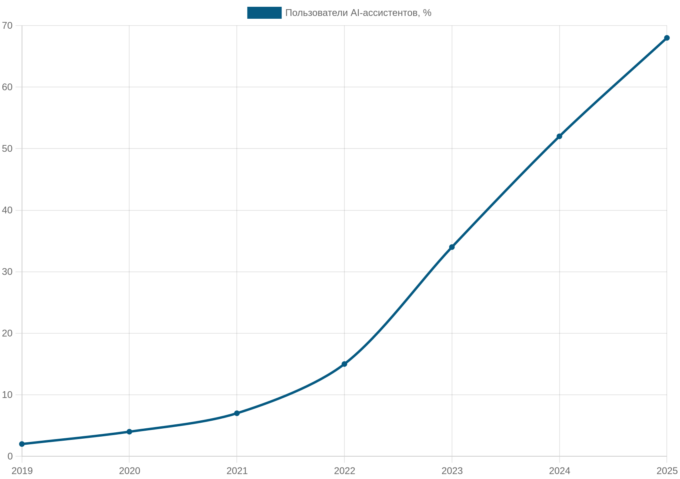
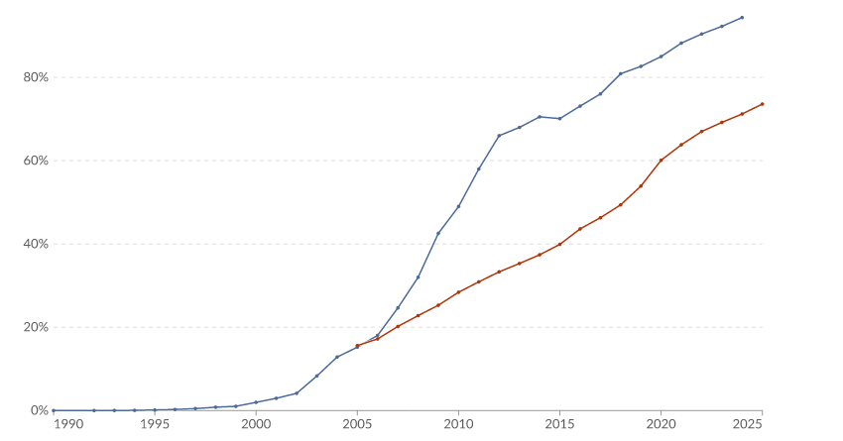
Who made it — a data visualization: AI or human?
Chart A
Chart B
Notes:
The fifth category — data visualization. Two charts of a similar format — a line showing a metric's growth over the years. Let's vote: which is based on real research, which is generated from fabricated data.
Here again the focus is on the measurable payoff: not just “which chart looks nicer,” but “which of the two can you trust, and why.” On the surface, two neat line charts are almost indistinguishable — that's deliberate: the indistinguishability itself is the lesson.
After the vote, ask: what could actually tell apart a chart built on real data from a plausibly drawn one — the data source, a methodology note, or nothing at all, if the presentation is equally polished?

Slide 18

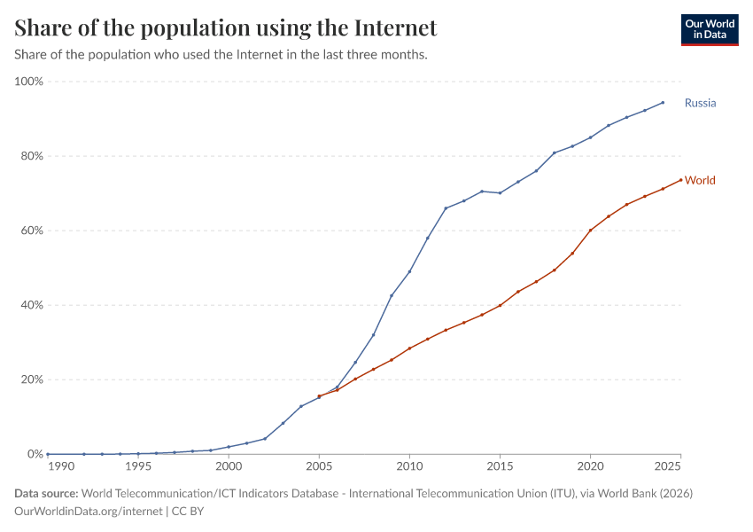
Chart A — AI, seconds. Chart B — Our World in Data, weeks of verification
Generated via an AI tool on fabricated data
Our World in Data · ITU / World Bank data · CC-BY
AI chart
Our World in Data
Solves the visualization task in seconds · no question of authorship or ethics here, unlike with the painting
A research team collects and verifies sources over weeks
Notes:
Chart A was generated by us via an AI tool on plausible but fabricated numbers — specifically for this game. Chart B is real Our World in Data data on the share of the population using the internet, Russia and the world, sourced from the International Telecommunication Union via the World Bank, CC-BY licensed.
An honest comparison: an AI tool solves the data-visualization task in seconds and does it well — unlike the “painting” category, there's no question of authenticity or artistic intent here; visualization is a purely technical task. The only question that matters is where the data came from and how reliable it is. Our World in Data is built by a research team that spends weeks collecting, cross-checking, and re-verifying data sources before publishing a chart.
This is the main lesson of the whole game: the neater the visual presentation, the less it says on its own about the reliability of the data inside it. Form and content are separate questions: AI solves the question of form excellently and quickly, but the question of content — where the data comes from and how real it is — is still a human's responsibility.

Slide 19






True or false? Let's check your intuition about AI
1
AI counts the letters in a word directly, the way a human does
true
false
2
AI always knows what happened in the world today
true
false
3
AI can confidently state something false without meaning to deceive
true
false
4
An AI chat can see your personal email and files by default
true
false
5
AI always gives an answer consistent with the data it was fed
true
false
6
All AI models give the same answer to the same question
true
false
vote before the explanation
Notes:
Quickfire quiz: I read out a statement, you vote by raising a hand — true or false — before I give the answer. There are no answers yet on this slide; next, the correct answers are revealed one at a time, each with a short explanation and a lesson.

Slide 20
True or false? Let's check your intuition about AI
1
AI counts the letters in a word directly, the way a human does
true
✓ false
2
AI always knows what happened in the world today
true
false
3
AI can confidently state something false without meaning to deceive
true
false
4
An AI chat can see your personal email and files by default
true
false
5
AI always gives an answer consistent with the data it was fed
true
false
6
All AI models give the same answer to the same question
true
false
correct answers reveal one at a time — question 1 of 6
Notes:
Question 1: “AI counts the letters in a word directly, the way a human does” — FALSE.
The model doesn't see individual letters. Before processing, text is split into tokens — chunks of several characters (sometimes a whole word, sometimes part of a word or a couple of letters). From then on, the model works with these tokens, not letters. That's why the classic failure example is “how many letter r's are in the word 'characteristic'”: the model can get it wrong because it doesn't literally “count letters,” it estimates the answer statistically. The same root cause shows up in errors counting characters, reversing words, and anagram tasks.
Lesson: wherever an exact character-by-character result matters (counting, masks, formats), don't just trust the model's word for it — verify it, or hand it off to regular code instead of an LLM.

Slide 21
True or false? Let's check your intuition about AI
1
AI counts the letters in a word directly, the way a human does
true
✓ false
2
AI always knows what happened in the world today
true
✓ false
3
AI can confidently state something false without meaning to deceive
true
false
4
An AI chat can see your personal email and files by default
true
false
5
AI always gives an answer consistent with the data it was fed
true
false
6
All AI models give the same answer to the same question
true
false
correct answers reveal one at a time — question 2 of 6
Notes:
Question 2: “AI always knows what happened in the world today” — FALSE.
The model has a training cutoff date: it knows the world roughly up to that point and, by default, has no idea what happened after — a fresh release, a news story, an exchange rate, yesterday's match. The chat itself doesn't browse the internet. For an answer to reflect current data, it needs an explicit tool: web search, a database connection, or a freshly uploaded document (this is called RAG). Without one, a confident answer about “today” is, at best, extrapolation — at worst, a fabrication.
Lesson: for anything that depends on recency (prices, versions, events), either turn on search or check the date — “confident” doesn't mean “current.”

Slide 22
True or false? Let's check your intuition about AI
1
AI counts the letters in a word directly, the way a human does
true
✓ false
2
AI always knows what happened in the world today
true
✓ false
3
AI can confidently state something false without meaning to deceive
✓ true
false
4
An AI chat can see your personal email and files by default
true
false
5
AI always gives an answer consistent with the data it was fed
true
false
6
All AI models give the same answer to the same question
true
false
correct answers reveal one at a time — question 3 of 6
Notes:
Question 3: “AI sometimes confidently says something untrue without intending to deceive” — TRUE.
This is hallucination — we already named it in the block on failures. The model doesn't “lie” in the human sense: it has no intention to deceive, it simply constructs the most plausible continuation and delivers both fact and fiction with the same confident tone. Hence the nonexistent links, invented quotes, and plausible-but-false details. The key trap is exactly the tone: how confident a statement sounds has nothing to do with whether it's correct.
Lesson: tone isn't an indicator of truth. Check any verifiable fact (a link, a figure, a quote, an API) against the original source, especially when the answer sounds smooth and confident.

Slide 23
True or false? Let's check your intuition about AI
1
AI counts the letters in a word directly, the way a human does
true
✓ false
2
AI always knows what happened in the world today
true
✓ false
3
AI can confidently state something false without meaning to deceive
✓ true
false
4
An AI chat can see your personal email and files by default
true
✓ false
5
AI always gives an answer consistent with the data it was fed
true
false
6
All AI models give the same answer to the same question
true
false
correct answers reveal one at a time — question 4 of 6
Notes:
Question 4: “An AI chat can see your personal email and files by default” — FALSE.
A regular chat only sees what you've sent it yourself in the conversation. It doesn't read your email, drive, or files on your computer unless you explicitly connect such an integration or upload a document. Access only exists where you've consciously granted it — and that's exactly what's worth thinking about: what you put into a prompt and which integrations you turn on, especially with work data.
Lesson: no need to panic that “it sees everything,” but don't make a habit of pasting secrets or personal data into the chat either — you control the access, so you're responsible for what you grant.

Slide 24
True or false? Let's check your intuition about AI
1
AI counts the letters in a word directly, the way a human does
true
✓ false
2
AI always knows what happened in the world today
true
✓ false
3
AI can confidently state something false without meaning to deceive
✓ true
false
4
An AI chat can see your personal email and files by default
true
✓ false
5
AI always gives an answer consistent with the data it was fed
true
✓ false
6
All AI models give the same answer to the same question
true
false
correct answers reveal one at a time — question 5 of 6
Notes:
Question 5: “AI always gives an answer consistent with the data it was fed” — FALSE.
Training data shapes the model's “character” and its systematic biases, but the answer isn't derived from it rigidly and unambiguously. First, the model doesn't look up a ready-made chunk of text in the training set — it generates a continuation based on learned statistical patterns, which is why both generalization to new cases and hallucinations are possible. Second, because of the randomness of sampling (temperature), the same question can get different answers on different runs. Third, behavior is heavily adjusted after pretraining — through fine-tuning and dialogue tuning (RLHF) — so the final answer reflects more than just the “raw” training data.
Lesson: don't think of the model as a database search engine. It's a probabilistic generator — hence the flexibility, the non-reproducibility, and the need to verify it.

Slide 25
True or false? Let's check your intuition about AI
1
AI counts the letters in a word directly, the way a human does
true
✓ false
2
AI always knows what happened in the world today
true
✓ false
3
AI can confidently state something false without meaning to deceive
✓ true
false
4
An AI chat can see your personal email and files by default
true
✓ false
5
AI always gives an answer consistent with the data it was fed
true
✓ false
6
All AI models give the same answer to the same question
true
✓ false
correct answers reveal one at a time — question 6 of 6
Notes:
Question 6: “All AI models give the same answer to the same question” — FALSE.
Different models are trained differently and answer differently; moreover, even the same model can give answers that differ in substance on repeated runs (see the previous point on the randomness of generation). This isn't a bug, it's a property of the technology. The practical upside: if you ask two or three different models an important question and the answers agree, that's a weak but useful signal; if they disagree, that's a reason to dig deeper and go to the original source.
Lesson: for significant decisions, cross-check with several sources and, where possible, several models — a single answer from a single model isn't the final word.

Slide 26
The “AI reality-check” memo — 5 points to carry into the next week
A confident tone in an AI's answer doesn't mean the answer is factually correct
1
AI doesn't know about events after its training cutoff date without web search
2
An AI's answer isn't derived unambiguously from its training data — because generation is random, the same question can get different answers
3
AI sees text as tokens, not letters — which is why it sometimes trips up on letter-by-letter tasks like counting letters in a word
4
Different AI models can give different answers — cross-checking with several sources is sensible
5
Notes:
Here's the “AI reality-check” memo — five points that will come in handy this very week, drawn from today's quiz.
First: a confident tone in an AI's answer doesn't mean the answer is factually correct. Second: AI doesn't know about events after its training cutoff date without access to web search. Third: an AI's answer isn't derived unambiguously from its training data — the model doesn't “look up” a ready-made chunk of text in the training set, it generates a continuation based on statistical patterns, and because sampling is random, the same question can get different answers. Fourth: AI sees text not as letters, but as tokens — chunks of several characters — so on tasks that require counting letter by letter (say, how many “r”s are in a word), the model can make mistakes, even though overall it works with language extremely well. Fifth: different AI models can give different answers to the same question — cross-checking with several sources is sensible for important decisions.
Take this sheet with you. These five points will be useful not only in this course, but in any work with AI tools.

Slide 27
THANK YOU
From today's snapshot to a systematic look at AI by industry
Medicine
Finance
Transport
Manufacturing
Development / IT
Logistics
Science
Cybersecurity
Wikimedia Commons · CC / public domain
Notes:
Thank you for today's session. Today you honestly recorded your experience with AI: what worked, what didn't, and what you're bringing into this course.
Next up — Lecture 1 and the whole course, where we'll systematically break down, industry by industry, how AI is actually applied in development, finance, medicine, manufacturing, creative industries, and other fields: which tools work, where the limits of applicability are, and how to choose the right tool for the task. Everything you shared today — success stories and failures alike — isn't a set of one-off cases, but recognizable patterns we'll keep coming back to throughout the course.
If you still have questions — now's the time to ask, before the systematic part of the course begins. Contacts — the course Telegram channel and the instructor's Telegram — will appear here separately. See you at the next session.

