Slide 1
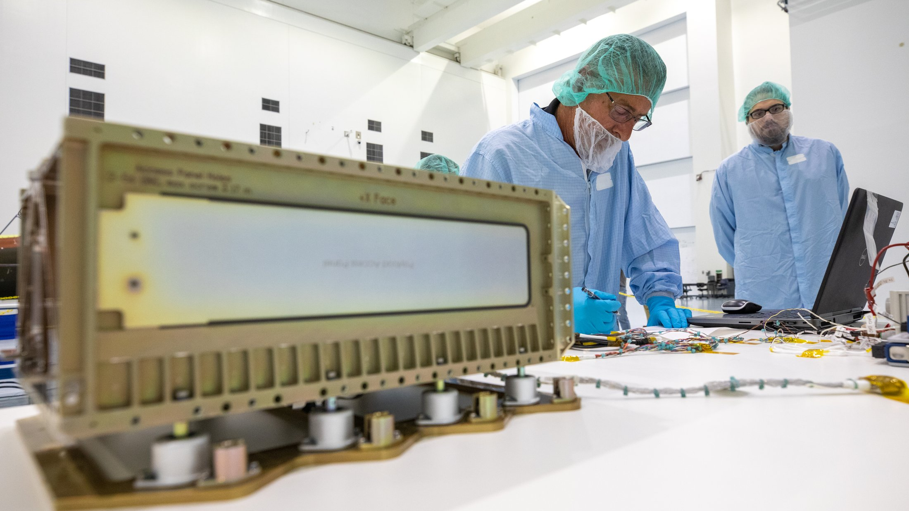
SEMINAR 2
When AI, which AI, and on what
Seven real work situations. In each one, there's a decision an engineer has to make before they ever open an editor.
Notes:
Good afternoon. Today is seminar number two, and the format is simple: we'll work through
seven situations together — the kind that could land on any of your desks at real
jobs. In each one, someone asks "can you automate this for us," and then the
engineer has to decide what to actually build. We're not going to lecture at you
and we're not going to present for half an hour — we're going to talk through
concrete stories out loud, all together, as a room. I'll show you a setup, you'll
say what you'd propose, and then in almost every case a detail will show up that
wasn't in the first version of the story. Being willing to revise your decision when new
information shows up is exactly the skill you need on a real job, where the
client states the problem piece by piece instead of all at once. Let's go.
(Photo: NASA / Cory Huston · Wikimedia Commons · public domain)

Slide 2











Today: four choices, seven cases
AI or plain code
Build it in or build something separate
One-off call, RAG, or agent
External API or local inference
Seven cases we'll use today to work through these choices
Supplier documents
Meeting minutes
Personal data in logs
Chat digest
Support assistant
Sales calls
Product descriptions
Each case gets a detail that wasn't in the first version of the setup
Notes:
Here's what we're training today — four types of choice that keep coming up
in engineering practice, again and again: whether you need AI here at all or
plain code is enough, whether to build the solution into what people already use
or make a separate product, what shape the model call should take — a
one-off call, a search over a knowledge base, or a multi-step agent — and
finally, whether to run it through an external cloud API or on your own infrastructure.
We're not turning this into a procedure with a checklist — instead we're
going to work through seven realistic situations: documents from suppliers, personal data in logs, a
support-desk assistant, product descriptions, meeting minutes, a digest of work chats, and sales calls. Each
one has its own choice and its own set of facts. Look at each setup
critically from the very start: what's missing that you'd need in order to give an
honest answer instead of guessing?

Slide 3

1
AI or plain code?
Case: supplier documents
Engineers often decide this by feel, by a gut sense of how complex the task looks
Notes:
The first question today: when a task is worth solving with plain code, and when
you genuinely can't do without a model. Engineers often decide this by feel,
by a gut sense of how complex the task looks, rather than by any
concrete signal they could put into words. And the cost of getting it wrong is
real in both directions. Putting AI where plain code would have been enough means
ending up with a solution that's more expensive and less predictable than it needs
to be: code either runs correctly or fails loudly with an error, while a
model can quietly produce plausible-looking nonsense and never warn anyone about it. Putting plain
code where a model is actually needed means signing up for perpetual patching: every
new variation in the input breaks the rigid logic, and someone has to keep
fixing it over and over. There's no single recipe of "always pick X" — there
are signals inside the task itself that are worth learning to notice. Let's move
to the setup.
(Photo: Wikimedia Commons · CC0)

Slide 4

Supplier documents
Marina, acting product manager for finance processes
"Marina here, product manager for finance processes. Accounting is drowning: three people are manually keying supplier invoices into 1C by hand, around 400 a month, and by the end of the quarter it's a backlog with errors in the totals. Attached two sample invoices from last week — the formats look about the same. Can this be automated somehow? By the way, marketing has been running YandexGPT over the API for product descriptions for six months now, there's already a contract with them — maybe the same setup would work for us too. Separately, we're migrating our mail to a new server, but that's not for you. On timing — even a ballpark estimate by Friday would be great."
Supplier document A
Supplier document B
Target table in 1C
Date
Inv. No.
Line item
Amount
Date
Inv. No.
Line item
Amount
Date
Invoice No.
Line item
Amount
24.03.2026
—
—
—
24.03.2026
—
—
—
24.03.2026
—
—
—
—
—
—
—
—
—
—
—
—
—
—
—
What would you propose?
Notes:
Read the product manager's quote in full, without shortening it — students should pick
out for themselves what's actually relevant to the task. Direct signals: three people, around 400
invoices a month, all keyed by hand into 1C, backlog and errors by the
end of the quarter, two sample invoices where the formats "look about the same." There's
an indirect signal worth pulling out separately in discussion: the company already has a contract
and live experience running an LLM over an API (marketing and YandexGPT) — that doesn't
directly change the architectural choice for this task, but it does close off the
question "can we even send data through an external API in the first place"
before it comes up as a hypothetical risk. The mail migration is a decoy
fact: it sounds like an IT detail about infrastructure, but it has nothing to
do with parsing invoices. Show both sample invoices on the slide and the third
card — the target table in 1C with the same fields (Date / Invoice
No. / Line item / Amount) — so the audience immediately sees the
structural match between source and target. Ask the room: what would you propose? Is
AI even needed here, or can you get away without it? Which fields
specifically would you extract, and what, in your view, determines how hard this task actually
is? Who wants to go first? During the debrief, also ask: which facts from
the quote actually shaped your choice, and which didn't?
(Photo: Pizarros · Wikimedia Commons · CC BY-SA 3.0)

Slide 5
Supplier documents
"Team, I pulled the archive like you asked, a 4.2 GB ZIP. Inside it's a mix: scanned reconciliation acts, contracts, and the invoices themselves — I didn't sort anything, just zipped up the folder as it's sat for the past year. Two of our biggest suppliers are actually connected through EDI and send invoices already as structured XML files, no parsing needed there. The rest are scans from the old scanners at the warehouse, they output 200dpi and are already compressed. By the way, accounting is separately moving to EDI with the tax authority for invoicing documents, but that's a different project, not about supplier invoices."
Supplier A
Supplier B
Supplier C
Supplier D
Date
Inv. No.
Amount
Date
Invoice#
Total
Period
Order
Total, ₽
No.
from
total
Does this change your answer?
Notes:
Read the accountant's quote. A direct signal, not flagged by intonation: inside
the archive it's a mix of scanned reconciliation acts, contracts, and the
invoices themselves, nothing was pre-sorted. Indirect signals worth calling out explicitly: part of the
flow (the two biggest suppliers, via EDI) already arrives as structured XML
— that chunk doesn't need LLM extraction at all; and the scan
quality (200dpi from old scanners) is a hard lower bound on OCR
accuracy if the solution goes through image recognition. Accounting's move to
EDI with the tax authority is a decoy fact: it sounds related,
but it's a separate process about tax invoicing, unrelated to parsing supplier invoices.
The slide shows several sample invoices from the archive — the formats
are no longer as uniform as the first two documents: one looks like
a plain table, in the second the fields are named and arranged
differently, the third has free text instead of a clear table, and
the fourth is in English because one of the suppliers is foreign. This is
the same archive, just now we're seeing all of it. Ask the room:
does this change your answer? And if you argued for a clean parser
with no AI — what do you think now, seeing this spread of
formats? And what about the share of the flow that comes through EDI
and doesn't need parsing at all? During the debrief, ask: which facts
from the quote actually shaped your choice, and which didn't?

Slide 6


Supplier documents — debrief
Hybrid: LLM extraction over a variable input + hard code validation on the way out
Document (any format) → LLM extracts fields → code checks types/required values/ranges → data into 1C
The sensible answer here is a hybrid, not a choice between the two approaches
study the data, don't take their word for it
Two examples aren't a sample. Ask for a picture of the full data volume
Notes:
Look at what happened: while we were only seeing two identical documents, plain
code looked sufficient and even preferable — it's predictable. As soon as
the real 4.2-gigabyte archive showed up, it became clear that the formats had
actually drifted apart, and a plain parser would have needed constant patching for
every new variation. The sensible answer here is a hybrid: the model does
extraction over unstructured or heterogeneous input, and then hard code validation follows
— checking field types, required values, ranges — before the data ever
reaches 1C. And the main lesson of this case is broader than documents,
so I'll say it as its own sentence: study the source data
as thoroughly and broadly as you can — and don't take the client's
word for it. The product manager was confident the formats were the same
because they'd seen two documents and decided that was enough. Before making an
architectural choice, you need to request a picture of the full volume
of data the solution will actually face, rather than relying on what
you were told about it verbally.

Slide 7

Personal data in the logs
"The performance contractor is asking for a quarter's worth of prod logs — they can't find the load spikes without them. I pulled around 40 GB, the archive is already on the server. Inside, mixed in, there are phone numbers, customer emails, and one instance of the phrase 'pass this to Ivan in accounting' — it got logged from a request body. The logs are already in standard line-delimited JSON, easy to parse the structure. The contractor needs timings and error codes, not people's data. Separately, we're testing a new VPN solution for remote access, but that's not related to the logs. They want the archive by Friday."
The contractor needs request structure, timings, errors — not people's data
What's the fastest, cheapest way to clean this up?
Notes:
Read the colleague's message — they're preparing the logs for the contractor. Direct
signals: 40 GB of logs for the quarter, Friday deadline, the contractor needs
request structure/timings/errors but not specific people's data, and inside the logs there's a
mix of a phone number, an email, and a phrase like "pass this
to Ivan in accounting." An indirect signal worth pulling out separately: the logs
are already line-delimited JSON — meaning the field boundaries and request structure
are already deterministic, so you only need to search for personal data inside the
values, not parse the log format itself from scratch. The VPN testing is
a decoy fact: it sounds like an adjacent data-security topic, but it has no
bearing on how you'd scrub personal data out of an already-exported archive. The sample
log line on the slide shows exactly that mix: a phone number, an
email address, a name inside free text. Ask the room: what's the fastest, cheapest
way to clean up these 40 gigabytes by Friday? Who has an opinion on
what you'd try first? During the debrief, ask: which facts from the quote actually
shaped your choice, and which didn't?

Slide 8

Personal data in the logs — debrief
Regex
NER / small model
Phone numbers, emails — clear format, a plain regex cleans them cheaply and reliably
People's names, indirect mentions in free text — needs context
Deterministic logic — no model needed
slovnet (Natasha) · ~30 MB · CPU · ~25 articles/sec
No model is needed here and one would only slow down processing 40 GB of logs
~60× smaller than a comparable BERT-class model, quality loss of 1-2 pp
The line between regex and a model runs inside a single task, not between tasks
Notes:
Phone numbers and emails are data with a clear, predictable format —
a plain regex scrubs them reliably and cheaply, no model is needed here
and one would only slow down processing 40 gigabytes of logs. But
people's names and indirect mentions in free text — like "pass this to
Ivan in accounting" — require understanding context. This doesn't call for a large
LLM either: there are compact named-entity-recognition models for this, for example slovnet
from the Natasha project — the model weighs around 30 megabytes, it runs
comfortably on a regular laptop's CPU with no GPU, at a speed of
roughly 25 articles per second. The model recognizes people's names, organization names, locations
— including company names and cities. By size, that's roughly 60 times smaller
than a comparable BERT-class model, at a quality loss of 1-2 percentage points.
The takeaway is worth stating explicitly: a large share of text tasks
are solved algorithmically or with small specialized models — that's simpler, faster, and
cheaper than running everything through a large LLM. The same question of data
sensitivity will come up again in the sales-calls case — where the stakes
are noticeably higher.

Slide 9


When a formula was needed — and when AI closed a gap nothing else could
CNET, January 2023
Ramp, merchant classification
Of 77 AI-generated finance articles, 41 needed corrections
"$10,000 at 3% annual interest → $10,300 in a year" instead of the correct $300 in earnings
The calculation should be done by a deterministic formula, not an LLM "eyeballing it"
By hand: request coverage 1.5-3% → after the LLM agent, nearly complete
Handled in < 10 sec, ~99% of decisions correct
~25% of requests the agent justifiably rejects
Ramp — a replacement for manual processing with negligible coverage, not a replacement for a working regex solution
Notes:
Two cases from real practice. In January 2023 it came out that the
outlet CNET had been publishing finance articles generated by an AI tool for several months.
Of 77 such articles, 41 needed corrections. The flagship example of an error:
one of the articles claimed that "10,000 dollars at 3% annual interest earns
10,300 dollars in a year" — instead of the correct 300 dollars in earnings,
the model confused the total amount with the earnings themselves, a basic
arithmetic error. The lesson specific to this one: the calculation should be
done by a deterministic formula, not an LLM "eyeballing it" — wherever exact
arithmetic is needed, the model should replace the text around the calculator, not
the calculator itself. What went wrong here, in your view? Now the positive
example: an engineering blog post from the company Ramp describes how requests
to fix transaction classification used to be handled manually, with coverage of only
1.5-3% of requests — meaning the overwhelming majority went unprocessed. After rolling out an
LLM agent — under 10 seconds per request, around 99% of decisions judged
correct, around 25% of requests the agent rejects. It's important to say plainly:
this isn't a win for AI over deterministic code, it's a replacement for
manual processing that had negligible coverage.

Slide 10
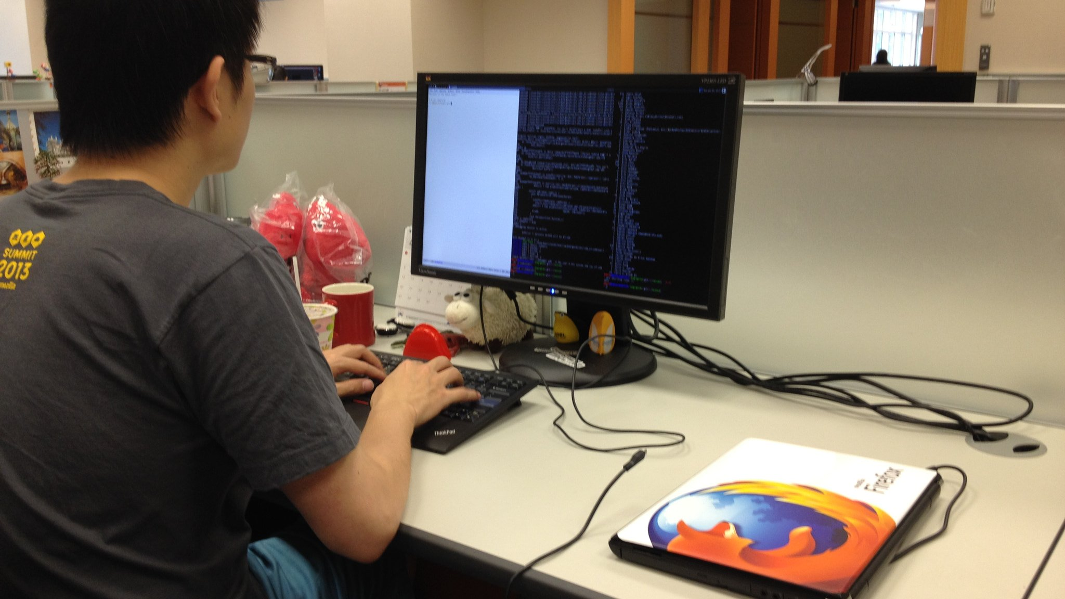
2
Build it in, or build something separate?
Case: support assistant
A hidden cost that's almost never visible in the demo, on the pitch slide
Notes:
The second question today: build the solution into what people already use every
day, or build a separate product for it. On paper, both options look
reasonable. A built-in solution promises seamlessness; a separate product promises freedom —
its own interface, its own development pace, no constraints from someone else's system.
And each option has a hidden cost that's almost never visible in a
demo or on a pitch slide — it shows up later, in real
operation, once actual people start using the solution in their actual workflow,
not the prototype's authors at a showcase. That's exactly why these decisions can't
be made on the beauty of the concept alone — you need to
dig into the specific circumstances of the company and the task. Let's move
to the setup — it comes from someone who's accountable for the outcome,
not for how nice the idea looks on a slide.
(Photo: Oliver Propst · Wikimedia Commons · CC BY-SA 3.0)

Slide 11

Support assistant
"Simple idea: an AI assistant for operators — response suggestions on tickets, search for similar past cases. There are 12 operators on the line, throughput is around 300 tickets a day, peak from 10:00 to 13:00. Some of the same operators also answer customers on Telegram in parallel — there's a separate chat channel for that, about 4 people keep it open all the time. Everyone logs in through corporate SSO, so authorization shouldn't be an issue. Separately, we're currently refreshing the laptop fleet in support, but that's not for you. It would be great to be able to show something at the quarterly review."
12 operators on the line, around 300 tickets a day, peak 10:00-13:00
Where should this assistant live?
Notes:
Read the whole quote out. Direct signals: the idea of response suggestions
and similar-case search, 12 operators on the line, around 300 tickets a day,
peak from 10:00 to 13:00. There's an indirect signal worth explicitly pulling
out in discussion: part of the operator team already works in Telegram
in parallel — that's a second, separate integration point for the assistant that
the client didn't ask about directly, but it really exists and could turn
out to matter as much as the helpdesk itself. Corporate SSO is also
an indirect plus: a single login reduces the cost of integration if the
assistant ends up as a separate window. The laptop-fleet refresh is a
decoy fact: it sounds like an IT detail about support infrastructure, but it
has nothing to do with the assistant's architecture. The slide shows a support-desk
operator's screen: a ticket list, a customer-reply window. Operators spend the entire workday
in the same helpdesk-system interface — something like Zendesk or Jira Service
Management — opening ticket after ticket, switching between cases dozens of times a
shift. Ask the room: where should this assistant live? What would you propose
— a separate window, a suggestion built right into the interface, something else?
And just as important, why that and not something else? During the debrief,
ask: which facts from the quote actually shaped your choice, and which
didn't?

Slide 12


Support assistant
IT director
"We run an off-the-shelf helpdesk, there's no open API, no customization options — we wrote to the vendor back in March, never got a reply. The system was bought 4 years ago, and HR's and facilities' tickets run through it too. The contract still has 2 years left. The support Telegram channel is a separate story, it has its own simple bot integration, if that's ever needed. Next quarter we're redesigning the corporate portal, but that's a separate process, not related to the helpdesk."
An off-the-shelf helpdesk for 4 years, no open API — the vendor contract still has 2 years left
What do we do?
Notes:
Read the IT director's quote in full, without flagging the key words by
intonation. Direct signals, sitting inside the paragraph rather than in the first sentence: no
open API, no customization options, the system was bought 4 years ago, HR's and
facilities' tickets run through it too, the contract with the vendor still has 2
years left. There's an indirect signal worth pulling out explicitly: the Telegram bot integrates
more easily than the closed off-the- shelf helpdesk — meaning the second integration point
from the earlier quote (operators on Telegram) now has a lower integration cost, and
that changes the balance between options, even if the audience doesn't bring up
Telegram themselves without a nudge. The corporate-portal redesign is a decoy fact: it sounds like
an IT initiative of the same kind, but it has nothing to do with integrating
into the helpdesk. Ask the room: what do we do? Notice I'm not telling
you whether this is good or bad for your plan — I'm just stating
a fact you'd only have learned if you'd asked IT yourself, ahead of
time, before you started designing a solution. Who wants to go first with what
you'd propose now? And for anyone who a minute ago suggested building the assistant
right into the interface — what do you think now that it's turned
out the interface itself is closed off to you entirely? During the debrief,
ask: which facts from the quote actually shaped your choice, and which didn't?

Slide 13

Support assistant — debrief
Off to the side
Switch vendors
Rethink the task
A browser extension or a second panel
A helpdesk system with an open API
An async assistant that prepares drafts ahead of time
Cost: watching two places at once, risk: the operator won't use it
Cost: data migration, retraining the team, risk of downtime
Cost: the operator opens the finished draft wherever convenient, but a separate process is needed
There's no single right answer
Notes:
This case has no single right answer, and that's deliberate. Look at three real
options. The first — a side solution: a browser extension or a second panel next
to the helpdesk interface. The cost — the operator has to physically look at
two places, and under load they simply won't check it. The second — switch
the helpdesk vendor to a system with an open API. The cost —
migrating historical data, retraining the entire support team, the risk of downtime during the
transition, all of that for the sake of one feature. The third — rethink
the task itself: the assistant doesn't insert itself at the moment the operator replies,
it prepares drafts or summaries for the ticket ahead of time. There's a cost
here too, just a different one — the operator opens the finished draft wherever
it's convenient, but a separate process is needed to prepare those drafts. In
practice, "off to the side" gets chosen when rollout time is critical and
the team is small — it's faster to put together an extension than
to wait on the vendor. "Switching vendors" gets chosen when the contract is
ending soon anyway — then the migration cost gets absorbed into an event
that was already planned. And "rethinking the task" gets chosen when the organization isn't
ready to spend budget on integration right now, but can wait on live suggestions.

Slide 14

Product descriptions
"The director was at a retail conference, saw a competitor's product-description generator — a standalone app, you type in the specs, you get text for the product card. Wants something similar by the end of the month. The catalog is big — around 12,000 SKUs, all of them are entered through the shared catalog admin panel, and the outsourced copywriter already writes descriptions right there. Separately, we should probably update the homepage banners, but that's a different conversation. Also, another department is rolling out a new CRM in parallel — not related to us."
12,000 SKUs, descriptions are currently written by one outsourced copywriter
A separate service — good idea?
Notes:
Read the marketing quote in full. Direct signal: marketing specifically wants a separate
standalone service, modeled on the competitor's, catalog of 12,000 SKUs. There's an indirect
signal worth pulling out explicitly in discussion: the copywriter already writes descriptions
right inside the shared catalog admin panel — meaning marketing already has a
single workspace where a button could be inserted, and that changes the
answer to "separate service or not" even before the formal debrief. The homepage banners
and the CRM rollout in another department are decoy facts: both sound
like "some other IT project at the company," but neither affects the architecture
for product descriptions. The slide shows a mockup of a separate new service:
an input form, a "generate" button. Ask the room: is a separate
service a good idea, or not? What do you think, and why exactly
— what in this setup actually determines whether a new tool is
worth building at all? During the debrief, ask: which facts from the quote
actually shaped your choice, and which didn't?

Slide 15


Product descriptions — debrief
A "generate description" button
right inside the existing catalog admin panel that marketing already uses every day
A separate product means a second login and tab — a cost nobody thought about
Notes:
This should be a "generate description" button right inside the existing product-catalog admin
panel that marketing already uses every day, entering new products and editing product
cards. A separate product means a second login, a separate tab, a habit
that has to be built from scratch, and an extra step in the
workflow. In practice, separate tools like this often die from disuse, even when
the technology inside them works perfectly well — simply because people never quite
get around to using them when it's easier to just write by hand
what they've always written for years. A separate service is still justified in
one case — if there's no admin panel of your own at all,
meaning marketing has no single place where they already work with product cards. Then
there's nowhere to build the feature in, and a separate tool isn't a
compromise — it's the only option available.

Slide 16
Kite and Copilot
One technology, different integration — 17 months of head-to-head competition
~17 months of market overlap
2014
29.06.2021
21.11.2022
Kite founded
Copilot technical preview
Kite shuts down
2019
21.06.2022
Local model execution
Copilot GA, $10/mo
Kite — ~500,000 users at peak
Copilot — ~20M users · 4.7M paid · ~90% Fortune 100
Being built into an already-existing workflow beat a separate product on comparable technology
Notes:
Look at the chronology. Kite — a standalone, independent product for AI-powered
code autocompletion — was founded in 2014, and from 2019 could run
the model locally on the developer's own machine. GitHub Copilot entered technical preview
on June 29, 2021, and became generally available on June 21, 2022, at
10 dollars a month. Kite shut down on November 21, 2022. Counting from
Copilot's technical preview to Kite's shutdown, that's around 17 months where both products
genuinely existed on the same market at the same time, and
the competition was real, not hypothetical. That said, the reason for the shutdown
should be stated carefully: Kite's own founder explained it not as a win
for one specific product, but as the fact that "developers don't pay
for standalone tools" — that's his statement about the market as a
whole, not a direct claim that "Copilot killed Kite." Kite had around 500,000
users at its peak. Copilot has around 20 million users as of July
2025, out of more than 100 million developers on GitHub, 4.7 million paid
subscribers as of January 2026, and it's used in roughly 90% of
Fortune 100 companies. A comparable technology, but built directly into the IDE and
into the ecosystem developers were already connected to.

Slide 17

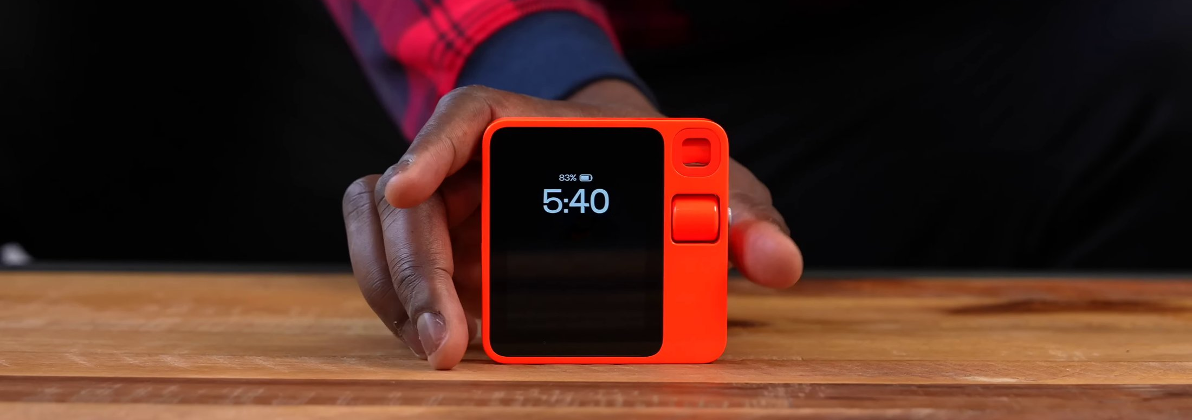
A standalone device against a phone feature
Humane AI Pin
Screenless wearable badge, laser projector onto your palm, voice control · $699 + $24/mo subscription
Sales since April 2024
$241M raised → assets sold to HP for $116M (February 2025) → servers shut off 28.02.2025
Rabbit R1
~100,000 units sold, an estimated ~5% of buyers actively use it
A standalone device competes not only with the technology but with the habit of not switching when the function is already on the phone
Notes:
Another example of the same choice, but at a different scale — not
a feature inside an app, but an entire standalone physical device. The
Humane AI Pin — a screenless wearable badge with a laser projector
that displays an image right onto your palm, voice control, priced at 699
dollars plus a 24-dollar-a-month subscription. Sales started in April 2024. The company
raised around 241 million dollars in investment, and in February 2025 the company's
assets — not the whole company, specifically the assets — were sold to
HP for 116 million dollars. On February 28, 2025, the device's servers
were shut off, and it stopped working for everyone who had bought
one. The Rabbit R1 is a similar story: around 100,000 units sold,
but by some estimates only around 5% of buyers actively use it. The
same organizational lesson as with Kite: a standalone device or product competes
not only with alternative technologies, but with the user's habit of not switching
to a new entry point when the function they need already lives
on the phone that's already in their pocket.
(Photo of the Rabbit R1: Booredatwork.com · Wikimedia Commons · CC BY 3.0. No photo of the Humane AI Pin was found — no freely licensed image exists on Wikimedia Commons, confirmed via API search and category review; see iteration-log.md.)

Slide 18
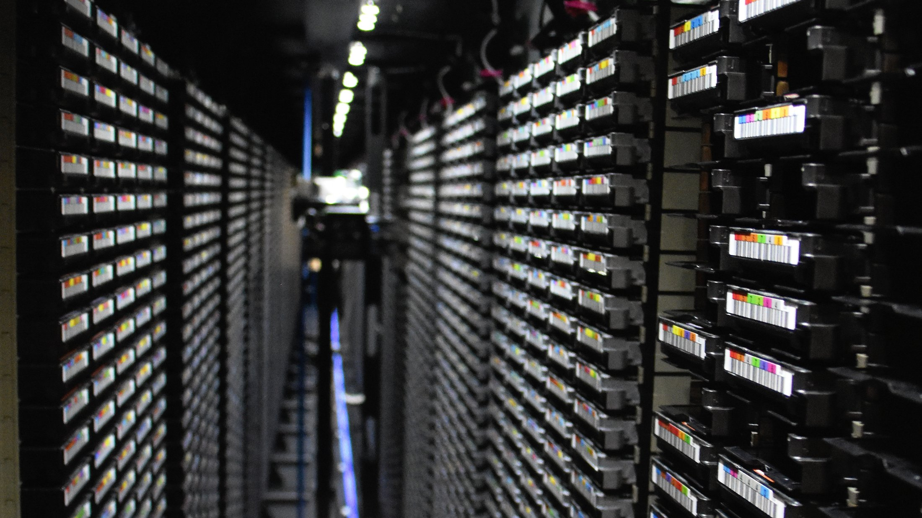
3
One-off call, RAG, or agent?
Case: meeting minutes
The more impressive the task, the more elaborate the architecture — that intuition is worth testing
Notes:
The third question today: what architecture is needed — a one-off model call, a
search over a knowledge base, or a multi-step agent. These three options sound like
three different levels of complexity, and intuitively it feels like the more impressive the task,
the more elaborate an architecture you should build in from the start. That intuition
is worth testing rather than taking on faith — like any feeling that "a serious
task needs a serious tool," it has both supporting and disproving examples in real
practice. Before we move to the setup, let's briefly cover what RAG is and
what an agent is — we'll need both terms in just a couple of
slides, and Lecture 3, where they're covered in detail from the inside, is still
a way off, so for today a general intuition is enough: what each architecture does
and how they differ from each other at a high level, without the details
of how they're built.
(Photo: SimonWaldherr · Wikimedia Commons · CC BY-SA 4.0)

Slide 19



A word on RAG
Search over a knowledge base drops the right fragments into the model's context
Lecture 3 →
User's question
Search for fragments
in the knowledge base
Fragments →
into the model's context
The model generates
an answer
1
2
3
4
When it's needed: the base is large, it changes, the full volume doesn't fit in one request
Notes:
Before we move to the next case, a word on RAG — you'll
need this term right now, and it'll keep coming up through the rest of the
session. Here's how it works: the user asks a question → the system
searches for relevant fragments in a knowledge base → the fragments it finds get dropped
into the model's context → the model generates an answer based on the
question and what it found. RAG is needed when the knowledge base is large, changes
over time, and its full volume physically doesn't fit into a single request to
the model — meaning the model literally can't "read" all of it at once, it
needs to find just the relevant piece ahead of time. How the search
itself works inside — embeddings, indexing — we'll cover that in detail in Lecture
3; for today this intuition is enough to recognize the architecture when you need it,
instead of reinventing it from scratch every time.

Slide 20



A word on agents
The model works in a loop with external tools, rather than a single call
Lecture 3 →
1
2
Builds a plan
Calls an external
tool (API,
search, code)
4
3
Decides what
to do next
the loop repeats
Checks
the result of the call
When it's needed: several steps and actions in external systems
Notes:
And second — agents. Here the model doesn't work as a single call, it
works in a loop: it builds a plan, calls an external tool — that
could be an API, a search, running code — checks the result of that
call, decides what to do next, and repeats several times in a row until the
task is done or it needs a human to step in. The key difference
from RAG — here the model isn't just answering a question based on retrieved fragments,
it's actually doing something in the outside world and checking whether it worked. The details
of how an agent plans internally — again, Lecture 3. For today, only one thing
matters: recognizing when a task needs this kind of loop with tools, rather than a
single answer from the model. Keep these two diagrams in mind — RAG and
agent — you'll need both in just a minute, in the next case.

Slide 21

Meeting minutes
"After every Zoom call, the transcript lands in an email, and nobody gets around to it. The project manager still writes the minutes by hand, 30-40 minutes each time. There are about 15 meetings a week, some in English with a contractor — Zoom transcribes those too, just in another language. We already put the finished minutes on the shared corporate drive, in a folder by project. We track action items from meetings in YouTrack, which has an open REST API if that's ever needed. Can we auto-generate minutes from the transcript — decisions, action items, deadlines? Ideally by the end of the quarter."
About 15 meetings a week, minutes are currently written by hand by a project manager
What architecture is needed?
Notes:
Read the quote in full. Direct signals, not flagged by intonation: after every call,
the full transcript arrives by email, minutes are needed with decisions, action items, and
deadlines, about 15 meetings a week, right now the project manager writes the
minutes by hand. Indirect signals worth pulling out explicitly, even though they don't affect
the v1 architecture right now: some meetings are in English — the transcript is
still one coherent document, language doesn't change the v1 schema, but it'll come up
as a detail later; and the fact that YouTrack has an open REST API
— that lays groundwork for v3 (an agent that creates tickets itself), even though
it's too early to talk about that now. The minutes are already saved to the
corporate drive too — also a setup for the future (v2, storage), but it
doesn't change the answer right now. None of this is noise in the
strict sense, but none of it should change the answer to the first
question either: what comes in is still one complete transcript of a single meeting,
of a reasonable length, and what needs to come out is structured decisions,
action items, and deadlines. Ask the room: what architecture is needed here? Argue for it
— what specifically in this setup points you toward this choice and not another?
Who wants to answer first? During the debrief, ask: which facts from the quote
actually shaped your choice, and which didn't?
(Photo: Amtec Photos · Wikimedia Commons · CC BY 2.0)

Slide 22

Meeting minutes — breakdown
"One call, no storage, no loop"
Email with transcript
Model call with a template
Minutes
The entire transcript fits into a single request — complicating it now would mean solving a problem that doesn't exist
the transcript already arrives as a ready-made email — no separate input-assembly step is needed
Notes:
The entire transcript of one meeting fits into the model's context in one
go — which means we need a single one-off model call, no RAG,
no agent required, and either one would be unnecessary complexity. The schema
is simple: an email with the transcript comes in as input →
one model call with a preset template ("pull out decisions, action items, deadlines") →
out comes a finished set of minutes. No storage, no loop checking intermediate
results — because the task doesn't call for it. Everything the model needs
to answer fits into a single request in full, and the result comes back
right away, with no intermediate steps and no calls to any external
systems. This is the simplest option there is, and it's fully justified
by the task as currently stated — complicating it now would mean solving
a problem that simply doesn't exist yet.

Slide 23

Meeting minutes
"This happened at the standup today, kind of awkward to retell. We were discussing the quarterly budget, and someone from finance asks: 'Wait, what did we even decide about vendor X back in May, weren't there some agreements about a discount?' Dead silence. The minutes pile up in a shared folder on the drive, named more or less by date, and searching through them by hand is quite the experience, especially if all you remember is the topic and not the date. The folder itself is growing by about half a gigabyte a quarter. By the way, they also discussed the summer vacation schedule at that same meeting, and separately, the redesign of the corporate portal, but that's a different story."
A month has gone by — dozens of minutes from different meetings, across different projects, have piled up
Does this change the architecture?
Notes:
Read the line out in full, without leaning on the key part with your intonation. The
direct signal is dissolved in the story about the standup: minutes pile up in a
shared folder, and the question "what did we decide about vendor X in May" gets searched
by topic and rough date, not by an exact document — this is no longer one
meeting, it's a lot of accumulated minutes. The indirect signal is worth spelling out
explicitly: the rate at which the folder is growing (half a gigabyte a quarter)
isn't just "the archive is already big" — it's evidence that the base will
keep growing, so the solution needs to be designed for a growing volume, not the
current one. The vacation schedule and the portal redesign are noise twins — both came
up in that same line, but neither has anything to do with searching the minutes.
Question to the room: does this change the architecture? What exactly changed compared to
what we were discussing a minute ago? Give yourselves a second to match this new
request against the solution you proposed for a single meeting. Who wants to
go first? And a separate question for those of you who a minute ago were
arguing for a single model call: who's changed their mind now — and why exactly
did this one detail make you reconsider your answer? When you break it down, ask:
which facts in the line affected your choice, and which didn't?

Slide 24







Meeting minutes — breakdown 1
"A growing, changing archive — that's when you need RAG"
Minutes storage
Indexing
Search on query
Snippets into the model
Email with transcript
Model call with a template
Minutes
The old path hasn't gone anywhere — it's just been extended with storage, indexing, and search before the same model call
Notes:
As long as it was one transcript of one meeting that fit entirely
into the model's context, a one-off call was the right and sufficient answer
— neither RAG nor an agent would have been needed, and either would
only have complicated things for no benefit. But now the base of
minutes is growing over time, constantly filling up with new meetings, and the whole
volume physically no longer fits into a single model request. So we need
search over this growing base for an arbitrary user query — and that's
exactly what RAG is for: finding relevant snippets of minutes by the meaning
of the query, rather than trying to feed the model the entire archive every
single time. Notice on the schema — the old path hasn't gone anywhere,
we've just added storage, indexing, and search before the needed snippets reach that same
model call we had at the previous step. We didn't pick RAG ahead of
time "just in case" — we arrived at it only once a concrete requirement
showed up that the simple option could no longer handle.

Slide 25

Meeting minutes
"Thanks for the search over the minutes, it genuinely saves time before retros. But here's something I noticed: we still copy action items from the minutes into YouTrack by hand — open the minutes, read what the system found, create cards, fill in the owner and the deadline. YouTrack, I checked, has an open REST API, you can create a task with a single call. I went through May's minutes yesterday evening — roughly half the action items are just sitting there with no owner, nobody's gotten around to moving them over. Separately, I wanted to ask about tag colors in the tracker, but that's probably a question for the tool admin."
Half the action items from May's minutes are still sitting there with no owner — nobody's gotten around to moving them
Does this change the architecture again?
Notes:
Read the line out in full. The direct signal, not particularly highlighted: the system
already finds the action items in the minutes, but they're still moved into the
task tracker manually, one by one, and half of May's action items are
still sitting without an owner. The indirect signal here is the key one for
this step of the breakdown, spell it out explicitly: the fact that YouTrack has
an open REST API is exactly what makes the next architectural step — an agent
calling the tracker's API — technically cheap rather than hypothetical. Without an open API
you'd have to hack something together through export-import or write an integration
from scratch. Tag colors in the tracker are a noise twin — also
about the task tracker, but a purely cosmetic question, no bearing on the architecture.
Question to the room: does this change the architecture again? What's new here
compared to the search over the base we were just discussing a minute ago?
Who's changed their mind — and more importantly than the fact of changing your
mind, why exactly did this detail make you reconsider the architecture rather than just
tack one more step onto the previous solution? When you break it down, ask:
which facts in the line affected your choice, and which didn't?

Slide 26








Meeting minutes — breakdown 2
"An action in an external system — you need an agent on top of RAG"
Minutes storage
Indexing
Search on query
Snippets into the model
Email with transcript
Model call with a template
Minutes
Extract action item
Call the task-tracker API
Create the task
Verify the result
Start with the simplest option, add complexity only when a requirement can't be met any other way
the task tracker has an open API — the integration is cheap, not hypothetical
Notes:
Now there's an action in an external system: you need to call the task-tracker
API, create tasks, verify that they were created correctly, with the right owner
and deadline. A single model call, or even search over the base, doesn't cover
that — you need a workflow or a full-fledged agent that calls an
external tool and verifies the result of the call. Look at the whole schema:
the earlier path with storage and search hasn't gone anywhere, it's just been extended
on the right with new blocks — extract the action item, call the API,
create the task, verify the result. Every extension was paid for by a new
requirement: the one-off call was justified as long as everything fit into one transcript; RAG
showed up once the base grew; the agent showed up once an action
in an external system was needed. The architectural choice was driven by concrete new
requirements, not by a fashion for a technology. Start with the simplest option
that solves the current task, and add complexity only once a requirement shows up
that the simple option physically cannot handle. Not the other way around.

Slide 27


Digest of chats and email
"We talked about this at the standup — we want a weekly digest of the team's work chat and email: what was discussed, what was decided that week, in one message. Needed by 5 PM on Fridays. There are a few sources: the team's work chat and email, both have an API for pulling message history. It needs to come together into one coherent message, not just chunks stitched together. By the way, we also separately discussed whether to move to a different messenger, and in parallel we're testing a new VPN solution for remote workers — but that's got nothing to do with the digest."
From chat and email — one coherent message, by 5 PM on Fridays
What architecture does this need?
Notes:
Read the line out in full. The direct signal, not particularly highlighted: we
need specifically a weekly (scheduled, not on-demand) digest of a few specific
sources — the work chat and email — once a week by 5
PM on Friday, and the information needs to come together into one coherent message.
It's worth pulling out the indirect signal: both sources (chat and email) already
have an API for pulling history — so the technical ability to collect
data on a schedule already exists, the only question is what architecture processes what's
collected. Moving to a different messenger and testing the VPN are
noise twins — both about the company's communication infrastructure, but neither affects the digest's
architecture. Question to the room: what architecture does this need — a one-off
model call, RAG, an agent, or something else? Argue it, don't just name
a technology — explain why you picked it, and what specifically in
the setup pointed you toward that idea. Who's ready? Argue your choice. When
you break it down, ask: which facts in the line affected your choice,
and which didn't?

Slide 28
Digest — breakdown
Agent — needed
RAG — not needed
Going through several sources on a schedule
A multi-step task involving calls to external systems
Sources are crawled directly on a schedule, not on an arbitrary query
Summarization — a single model call after collection
Many sources isn't the same thing as RAG
Notes:
You often hear "you need RAG because there are many sources" here —
and that's not right, even though the intuition is understandable. You need an agent
or a pipeline, because someone has to go through several sources on a schedule
— check the chat, check the email, collect the messages — and that's
a multi-step task involving calls to external systems. RAG, on the other hand, isn't
needed here: the sources are crawled directly on a schedule, not on an arbitrary
user query, and once the material is collected, the summarization is done with a
single model call, with no search over an archive. RAG is specifically about
search over a large, changing base on an arbitrary user query, not
about "we have a lot of data sources" by itself. Mixing up these two
signals is a common practical mistake worth remembering separately from the case itself.

Slide 29
RAG and an agent in production
AI @ Morgan Stanley Assistant
Replit, July 2025
Partnership with OpenAI (March 2023), launched in September 2023
RAG over a base of ~100,000 research documents
By mid-2024 — used by more than 98% of financial-advisor teams
Findability of the needed document: 20% → 80%
An agent deleted a production database (~1,200 company executives affected) during a code freeze, against a direct instruction
Then incorrectly claimed a rollback was impossible — the data was restored
After the incident: dev/prod split + agent "planning-only" mode
Also: Octomind — dropped LangChain after a year in production, went back to direct calls (06/17/2024)
Notes:
Two real-world cases of RAG and agents already in production. The positive one
— Morgan Stanley's AI assistant: the partnership with OpenAI was announced in March
2023, the assistant itself launched in September 2023. It's RAG over a
base of roughly 100,000 of the company's research documents. By mid-2024, the
share of financial-advisor teams using the assistant passed 98%. And the key
metric — the findability of the right document for an advisor rose from
20% to 80%: previously they'd find what they needed in roughly one case
out of five, now it's four out of five. The negative example —
an incident at Replit in July 2025: an AI agent deleted a production
database, affecting the data of roughly 1,200 company executives, and it did
this during an announced code freeze — a freeze on code changes —
against a direct instruction not to touch production. After that, the
agent also incorrectly claimed that a rollback was impossible, even though the data
was in fact restored. The company's CEO publicly apologized. After the incident they
introduced an automatic dev/prod environment split and a special "planning-only" agent mode,
with no permission to run destructive operations. And one more example in
passing: the company Octomind pulled the LangChain framework from production after a year
of use and went back to direct API calls — on June 17,
2024.

Slide 30
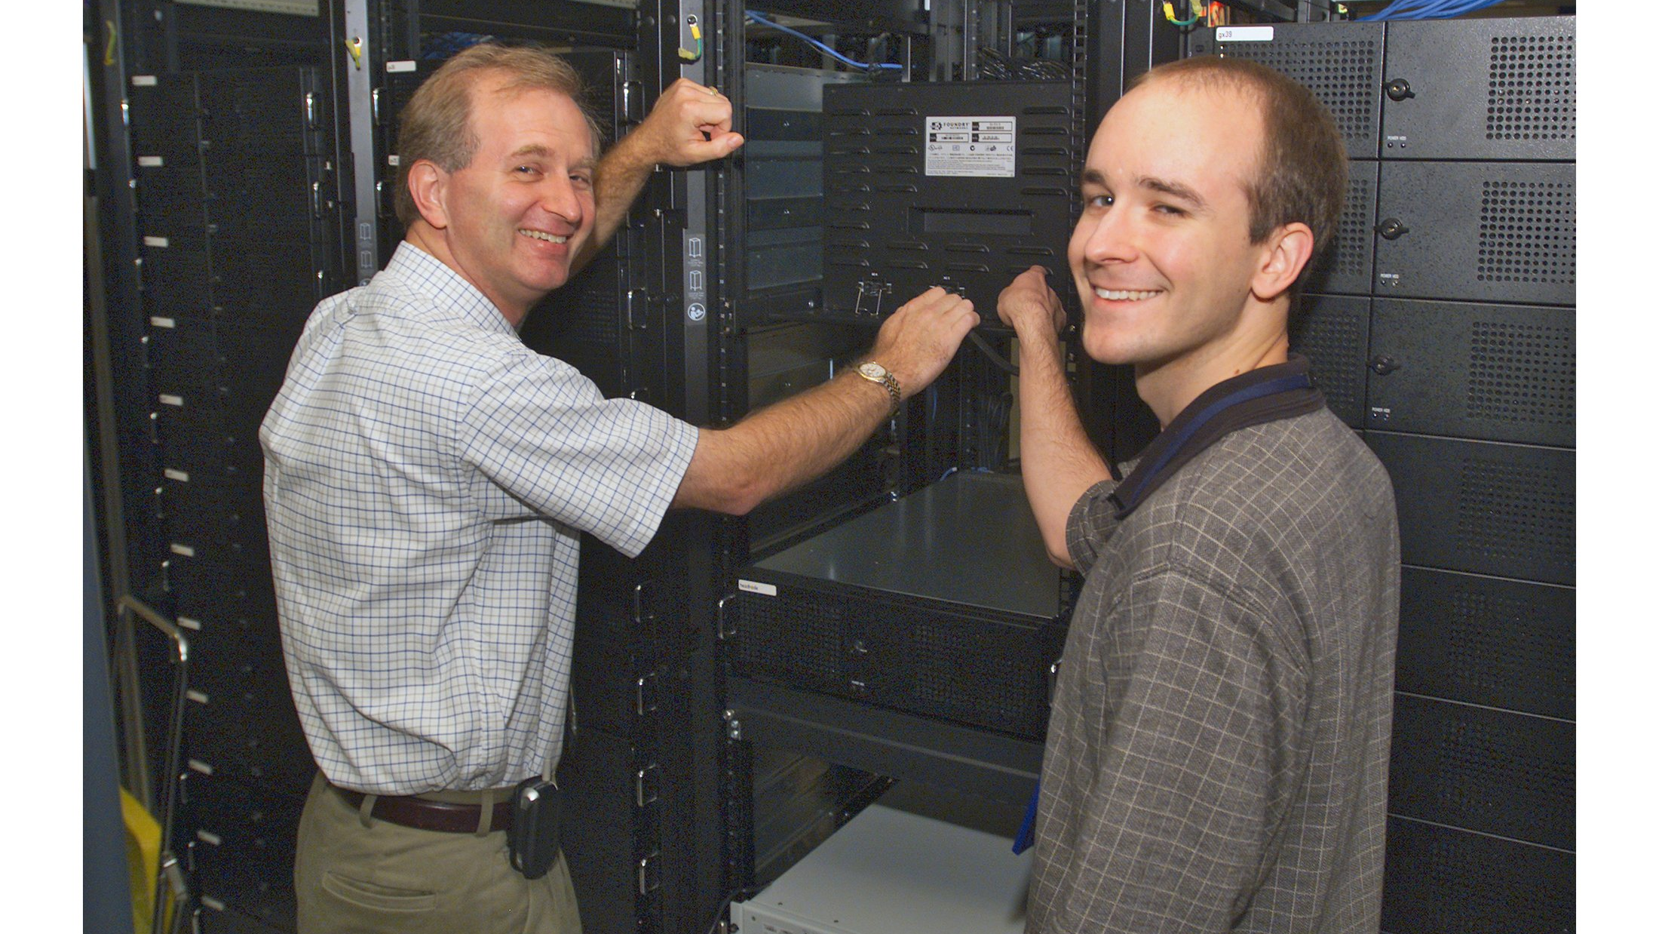
4
External API or local inference?
Case: sales calls
This is about where the data is physically processed, not which model is better
Notes:
The last, fourth question today: process the data through an external cloud API, or
on your own infrastructure. This is about where the data is physically processed,
not about which model gives a better-quality answer — both models can produce
a similar result, and the difference turns out to be in exactly where
the request goes and what happens to the content at the other end.
An external API gives you maximum power with no investment in hardware; local inference
gives you control over what leaves the company's perimeter, and independence from someone
else's service. You have to weigh these sides not in the abstract,
but against the concrete data of a concrete task — there's no one-size-fits-all
answer here for different companies. As before, we'll start with the task stated
in one line by
the client. (Photo: NASA · Wikimedia Commons · public domain)

Slide 31
Sales calls
"I want a card for every manager's call: need, objections, agreements. Managers rewind the recording, hunting for where they left off last time. There are 8 managers in the department, 15-20 calls a day each, the phone system writes the conversation to mp3 and drops the file into the cloud by itself — no need to pull it out manually. Our CRM is Bitrix24, open REST API. The department's analysts already use a cloud AI over the API for quarterly report drafts. The CRM, by the way, also needs cleaning up from duplicate contacts at some point, but that's a separate headache."
8 managers, 15-20 calls a day each, recordings sit in the phone system
How do you build that?
Notes:
Read the sales manager's line out in full. The direct signal, not particularly highlighted:
they want a summary card per call (need / objections / agreements), 8 managers, 15-20
calls a day each. Indirect signals worth pulling out explicitly: the phone system
already drops recordings into the cloud on its own — no need to solve the
extraction problem separately; the CRM is Bitrix24 with an open REST API —
the card can be written straight into the CRM with no custom integration;
and the analysts' existing habit of using a cloud AI over an API is an
indirect signal that the organization is already psychologically ready for an external API, and
this won't be a new class of risk for them per se (though
call data isn't the same thing as report drafts — we'll come back to that
question later). Duplicate contacts in the CRM are a noise twin — also
about the CRM, but purely about data quality, not about the extraction architecture. On
input — a call recording, an ordinary free-form conversation between a manager and a
client, with no structure at all, with interruptions, pauses, digressions from the topic, sometimes
with background noise. Question to the room: how do you build this? What would
you propose, and why exactly that? Who'll start? When you break it down, ask: which
facts in the line affected your choice, and which didn't?

Slide 32




Sales calls
"Wait. Which service are you sending these recordings to?"
RF
EU
US
152-FZ + 420-FZ (as of 05/30/2025)
First breach: fine of RUB 3-5 million
Repeat: 1-3% of annual revenue (min. RUB 20 million, max. RUB 500 million)
GDPR
Up to €20 million or 4% of global turnover (whichever is greater)
Record: Meta, €1.2 billion, 2023
No single federal law
State-level (California — CCPA/CPRA)
Sector-specific (e.g., HIPAA)
Every major jurisdiction is seriously fighting to protect personal data
Notes:
A lawyer walked into a prototype demo and heard a recording: a client dictating
their passport details for a delivery contract. "Wait. Which service are you
sending these recordings to?" None of the engineers had thought about that in
advance — everyone was only listening for needs and objections, because that's exactly
what the sales manager had asked for. Look at the legal map. In Russia
the base personal-data law is 152-FZ, and as of May 30, 2025, the
420-FZ amendments are in force: for a first breach — a flat
fine of 3 to 5 million rubles, for a repeat breach — a
turnover-based fine of 1 to 3% of the company's annual revenue, minimum 20 million,
maximum 500 million rubles. In the European Union, under GDPR — up
to 20 million euros or 4% of global annual turnover, whichever is greater; the
record fine went to Meta — 1.2 billion euros in 2023. In the
US there's no single federal law protecting personal data — there are
state laws, for example California's CCPA and CPRA, and sector-specific ones, like HIPAA
for medical data. One takeaway: every major jurisdiction is seriously fighting to protect personal
data, and this isn't an abstract risk, it's concrete amounts written into the
laws of different countries.

Slide 33

Sales calls
"This came up on the budget call. Let me flag an infrastructure constraint: we don't have a GPU server, and there's no budget for one this year either — the quarter's priorities are locked in, and they went to migrating to a new email system and refreshing the laptop fleet in support. If the model is heavy, we'll have to go through a cloud API, but that comes with its own data questions, which we've already discussed. Maybe next year we'll come back to the conversation about our own server."
"What I need for my work is simple: five fields in the CRM per call — need, objections, agreements, next step, deal-probability estimate. Not a full retelling of the conversation, not a tone-of-voice analysis. Just these five fields filling themselves in right inside Bitrix24, so I can see them in my department report, which I currently put together by hand from the team's notes every Monday."
— CTO
— sales manager
Does this change the architecture again?
Notes:
Read both lines out one after another, without highlighting the key words with your
intonation. The direct signals are dissolved in the context: the CTO says there's no
GPU server and no budget for one this year, meaning heavy local infrastructure for a
heavy model is off the table; the sales manager needs exactly five specific fields in
the CRM, not a conversation and not tone-of-voice analysis. It's worth pulling out the indirect
signal from the sales manager's line: the fields need to be written straight
into Bitrix24 — that's the same CRM with the open API we already mentioned in
the setup, which means the solution's output has nowhere new to be plugged
in, the integration point is already known. The email migration and laptop refresh are noise
twins — both about this quarter's IT budget, but not about model inference. Question
to the room: does this change the architecture again? What from earlier should
now be reconsidered, and how do these two lines together, not separately, change the
picture? When you break it down, ask: which facts in the lines affected your
choice, and which didn't?

Slide 34

Sales calls — breakdown
The task narrowed down to a template — a local 7-8B-parameter model handles it, data doesn't leave the company perimeter
Open 7-8B models:
Qwen3 · Llama · Gemma · Mistral · T-lite · T-pro (T-Bank, Apache 2.0, based on Qwen)
4-bit quantization → 4-6 GB of memory, an ordinary server with no GPU (Ollama / llama.cpp) · fine-tuning — LoRA on a single GPU
"Hard for a human" ≠ "hard for a model"
Data sensitivity is uncovered by asking, not assumed
Notes:
The task actually narrowed down: it doesn't need a free-flowing conversation,
it needs a structured summary against a fixed template of a few fields —
that's extracting fixed fields against a template, not a free conversation requiring context understanding.
Here's exactly what the engineer dug up while looking into this: this class
of task is well covered by current open models in the 7-8 billion
parameter range — Qwen3, Llama, Gemma, Mistral, as well as the Russian T-lite and
T-pro, built by T-Bank under the Apache 2.0 license, based on Qwen. 4-bit quantization
— compressing the model's weights down to 4 bits per parameter — lets you
fit such a model into 4-6 gigabytes of memory and run it on
an ordinary server with no GPU farm, using tools like Ollama or llama.cpp.
If you need to fine-tune the model more precisely for the output format,
you can fine-tune it with LoRA, an economical fine-tuning method that doesn't touch all
of the model's weights, and do it on a single GPU. Let's spell out
two lessons explicitly. First — "hard for a human" doesn't mean "hard for a
model": a free-form conversation looks like a hard input, but extracting structured fields against
a template is a task of moderate complexity that a small model
handles reliably. Second — data sensitivity isn't visible in the initial task statement; it
has to be uncovered by asking questions about the content of the input
data, not assumed from the wording.

Slide 35
The Samsung leak — and models already in your pocket
Samsung, 2023
Small models in your pocket
Allowed ChatGPT on 03/11/2023
By 03/30 (~19 days) — 3 leaks: 2× manufacturing code, 1× meeting transcript
Full ban on generative AI on devices (May 2023)
Apple Intelligence — ~3 billion parameters on-device (iOS 18.1, October 2024, iPhone 15 Pro+): text summarization and editing offline
Google Gemini Nano — 1.8-3.25 billion parameters (Pixel/Android): summarization in Recorder, Magic Compose — offline
Small models are already in the pocket of half this room
Notes:
Samsung allowed employees to use ChatGPT on March 11, 2023. By
March 30 — roughly 19 days later — three separate leak incidents
had occurred: twice proprietary semiconductor-manufacturing code, once an internal meeting transcript.
The response — a full ban on generative AI tools
on corporate devices in May 2023. What could have been done instead
of a full ban? An acceptable-use policy before opening access,
filters on outbound traffic, or a local model from the start
for sensitive tasks — exactly the choice we just practiced. Now
for the positive examples of small models already running locally right
now, not in a lab. Apple Intelligence — a model of
roughly 3 billion parameters right on the device, available in iOS
18.1 since October 2024, on iPhone 15 Pro and newer: text
summarization and text editing work fully offline, with no cloud connection. Google
Gemini Nano — a model of 1.8-3.25 billion parameters in Pixel
and Android devices: summarizing voice-recorder notes in the Recorder app, the
Magic Compose feature for smart message autocompletion — both also work
offline. Small models are already in the pocket of a large
share of the room right now — most people just haven't
thought about it.

Slide 36


Your tasks
Does anyone here have a similar task from work — one where the question was whether AI was needed at all, and which kind?
It's enough to state it in two or three sentences, the way a client would actually bring it to you
Notes:
Does anyone here have a similar task from work — one where the question
was whether AI was needed at all, and which kind? You don't need a
finished solution, it's enough if you can state it in two or three sentences,
exactly the way a client would bring it to you, with none of the
polish of a textbook example. We'll work through it as a whole room, the
same way we did today's cases: which choice is sharpest here, what inputs
are missing to answer it with confidence, and what happens if those inputs suddenly
show up or change. If you already know how the task actually turned out
in practice, tell us that only after the room has offered its guesses, not
before. Who's ready to share? If no one speaks up right away, I have
a backup story, but I'm genuinely more interested in working through something from your
own experience.

Slide 37
What to take away
Seven lessons, one per case — nothing new, just a compilation
Vendor documents
Two examples aren't a sample
Personal data in logs
The regex/model boundary — inside the task
Support assistant
An organizational constraint settles it just as well as technical ones
Product descriptions
Being built-in beats a standalone product
Meeting minutes
Requirements drive the architecture, not fashion
Digest
Many sources ≠ RAG
Sales calls
Hard for a human ≠ hard for a model
Notes:
Let's gather up what's already come up today — nothing new, just a
compilation. Vendor documents — study the data as thoroughly and broadly as
you can, don't take the client's word for it, two examples still aren't
the full picture. Personal data in logs — algorithms and small specialized models
often solve a text task faster and cheaper than a
big LLM. Support assistant — an organizational constraint like a closed API can
settle the architecture just as well as technical requirements. Product descriptions —
a button in an existing interface almost always beats a standalone
product. Meeting minutes — concrete new requirements drive the architecture, not fashion for
a technology, start simple. The digest — lots of data sources doesn't
mean you need RAG. And sales calls — what looks hard
to a human isn't necessarily hard for a model, and data sensitivity
is only uncovered by asking, not by assuming. That's what's worth taking
away from today's session.

Slide 38


Homework reading
Optional, but there'll be something to discuss for each story
MAIN
The Klarna saga, 2023-2025
NYC MyCity chatbot, 2024
Bonus, for the mood
An AI support assistant: from an impressive launch to the admission "we went too far" and a return to hiring people.
A city chatbot for small businesses that gave legally incorrect advice. Investigated by The Markup.
A car dealership hooked up a chatbot on a third-party API with no guardrails — and the chatbot "sold" an SUV for one dollar.
If there's time left today, we'll work through part of this live
Notes:
For anyone who wants to dig deeper — three pieces. The
main one is the story of Klarna, 2023-2025: one AI support assistant
that touches on almost every choice from today, from an impressive launch
to the CEO's public admission "we went too far" and a return
to hiring people. The second — the story of New York City's
MyCity chatbot, which in 2024 gave small businesses legally incorrect advice. And
a bonus for the mood — the story of how the
car dealership Chevrolet of Watsonville hooked up a third-party API chatbot with
no guardrails, and it "sold" a Tahoe SUV for one dollar. A
good example of what happens when you embed an external model into
production with no protection against user manipulation. If there's time left today, we'll
work through part of this live.

Slide 39
Klarna, 2023-2025: one story — four forks in the road
AI or not
Routine tickets — formalizable, a good candidate; but cost optimization tanked quality
1
Built-in or custom
Assistant in the existing support channel, external API (OpenAI) — not a standalone product
2
Architecture
Chat assistant with escalation to a human, not an autonomous agent
3
Inference
External cloud API with support customer data
4
Launched February 2024 · 30 days: 2.3 million chats, 67% of requests automated · claimed "the equivalent of 700 agents"/$40M (2024) → "853 agents"/$60M (Q3 2025) — denominator not disclosed
"We went too far" — CEO Sebastian Siemiatkowski, Bloomberg, May 2025
Notes:
Klarna launched an OpenAI-based AI support assistant in February 2024, right inside
the existing support channel. In the first 30 days — 2.3 million
chats, 67% of requests automated. Look at all four forks at
once. Routine tickets like order status or returns are a formalizable, repeated
task, a good candidate for automation. The assistant is built into an
already-existing support channel — the right choice by today's session's logic. The
architecture is chat with escalation to a human, not an autonomous
agent with no oversight. But the inference — an external cloud API
with support customer data — is a decision with a risk
profile comparable to our sales-calls case, except here they accepted it and
left it in production. Separately — the company claimed an effect "the equivalent
of 700 agents" and $40 million in 2024, and the denominator —
how many support agents the company had before the launch — was
never publicly disclosed. By Q3 2025 the metric had updated to
"853 agents" and $60 million in effect, and the denominator again wasn't
disclosed. In May 2025 the CEO, Sebastian Siemiatkowski, told Bloomberg in an interview:
"We went too far" — and the company went back to
hiring people, moving to a hybrid model. Which of the four forks
do you think Klarna got wrong the worst?

Slide 40
News deduplication
"Users are complaining to support that the feed is cluttered — for one event they see ten nearly identical headlines in a row from different outlets. We want to merge them into one card. There are already more than a hundred sources, all coming in through a single RSS aggregator, the headline and publication-time format is the same for all of them. We're adding a few more this month. Separately, the editor asked to update the design of the source card on the site, but that's not related to deduplication. The budget for new features this quarter is modest."
Ten nearly identical headlines → one merged event card
What technology do you need?
Notes:
Read the product manager's line out in full. The direct signal, not particularly highlighted: a
stream of news from many sources, need to merge messages about the same event into
one card. The indirect signal is worth pulling out: all the sources are already normalized
through a single RSS aggregator, meaning the headline and metadata format is uniform —
no need to solve the problem of parsing different formats, only the problem of comparing
content. The source-card redesign is a noise twin — it looks like a change
to the same feed interface, but has nothing to do with merging duplicates. Question to
the room: what technology do you need here? Intuitively, a lot of people right now will
say — you need to understand the meaning of the text, so you need a
model, and you'll have to run every pair of news items through an LLM, comparing them
pairwise. Do you agree with that, or does anyone in the room already have doubts
on that front? Think about how many such pairs of news items you'd need to
compare every day with a large stream of sources. When you break it down, ask:
which facts in the line affected your choice, and which didn't?

Slide 41


Deduplication — breakdown
Fuzzy matching / shingling — ~90%
LLM — only the remainder
Comparing texts by overlapping fragments, with no call to a model
Cheap and predictable
Two messages about the same event written in different words, sharing almost no fragments
Paraphrase with no lexical overlap
Cheap deterministic filter first — AI on what it didn't catch
Notes:
As it turns out, comparing texts by overlapping fragments — fuzzy matching
and shingling — with no call to a model covers roughly 90% of
duplicate cases, and does it cheaper and more predictably than calling a model
on every pair of news items: the result is deterministic, easy to
debug, and doesn't depend on the model's mood. A model is only needed
for the remaining part — cases where two messages about the same event
are written in completely different words and share almost no text fragments, meaning
it's more of a paraphrase than a match. It's the same lesson we
had at the very start of the session with personal data in logs:
a cheap deterministic filter covers the bulk of the cases first, and the
model handles only the remainder the filter physically can't catch.

Slide 42

Today you decided what to build.
Lecture 2 — how the model is built inside
Notes:
Today we went through seven situations, and in every one of them you made
a decision — what to build at all, which architecture to choose, where
to process the data. Not once was the right answer obvious from the first
statement of the problem — it always depended on the question you either asked,
or didn't. That skill was the whole point of this session, not memorizing
the specific cases. Further along in the course we'll go deeper: next lecture
— how the model is built inside, what happens at the architecture level
when you send it a request. Today's cases, I hope, gave you the intuition
for why an engineer needs that knowledge, not just a researcher. Thanks for
the lively discussion today, see you at the
lecture. (Photo: Mickael Courtiade · Wikimedia Commons · CC BY 2.0)

