Slide 1
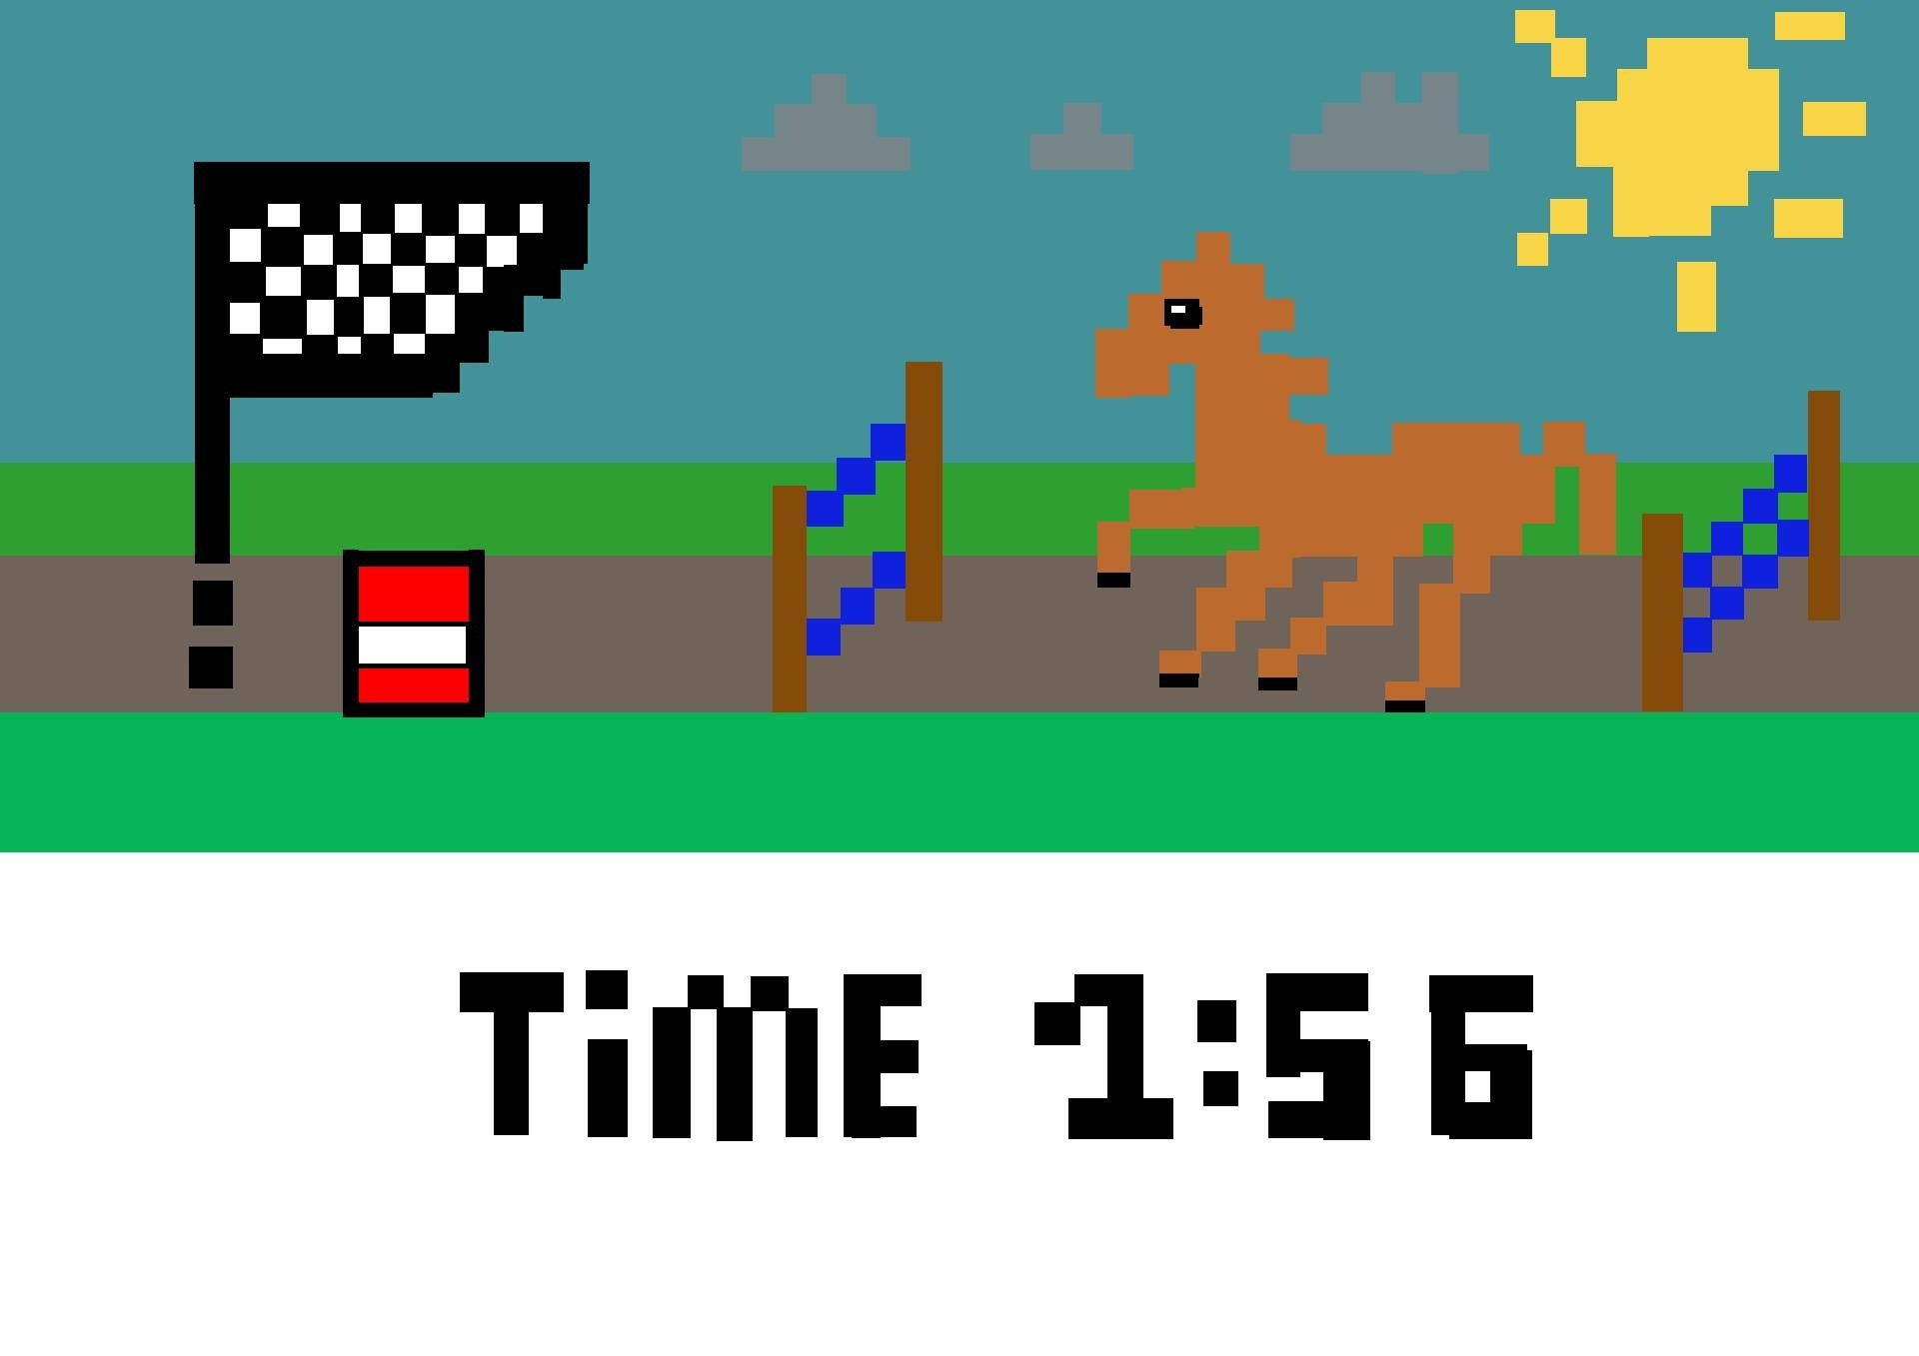
2D Side Scroller

Slide 2
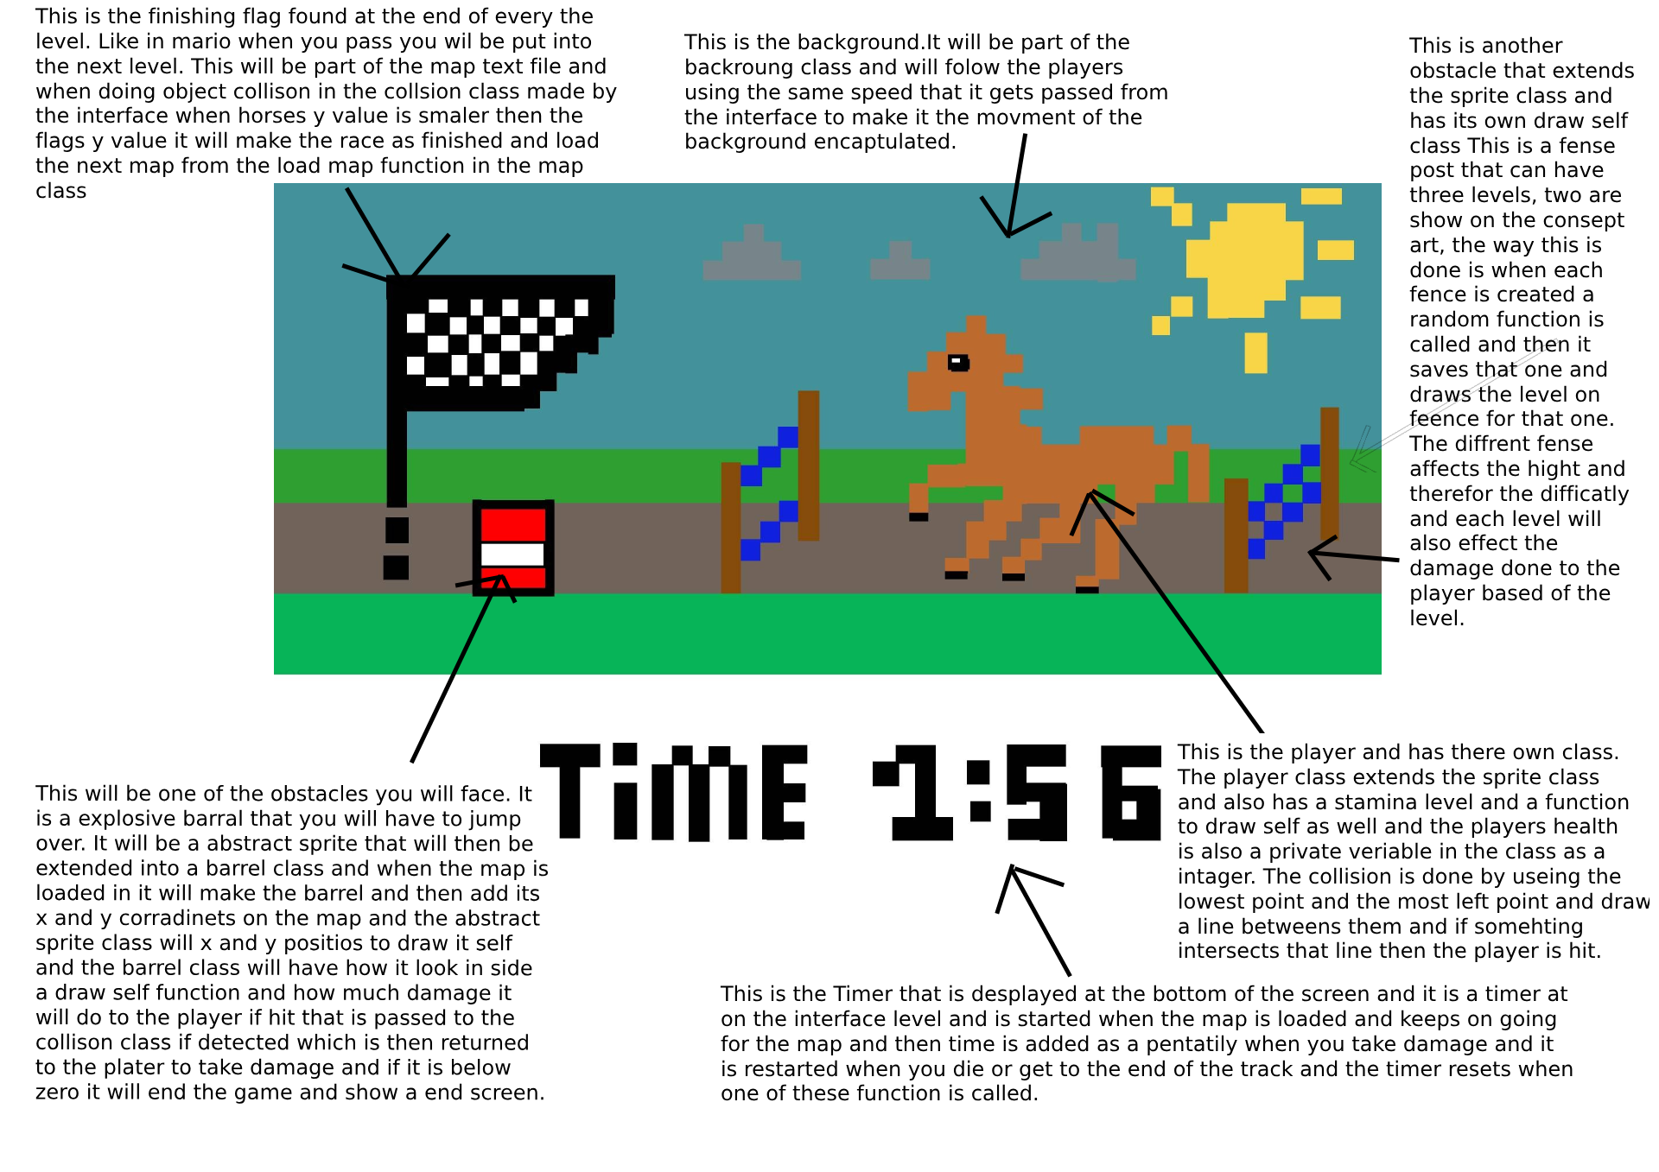

Slide 3
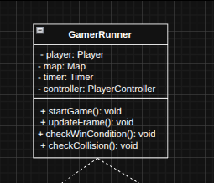
GameRunner
I use the GameInterface so that the Map can interact with the display or movement system without knowing exactly how it's implemented. That means you could switch from a text-based game to a graphical one without changing your map logic.
GameRunner owns the game objects like Player, Map, Timer, and Controller.
GameRunner: Central controller for orchestration. Manages player, map, timer, and input logic. Shows composition.

Slide 4
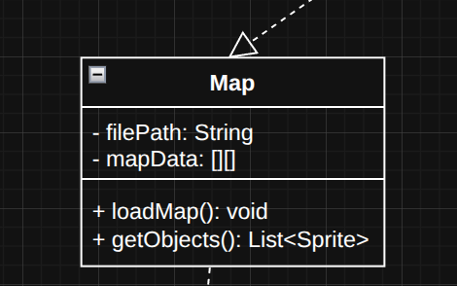
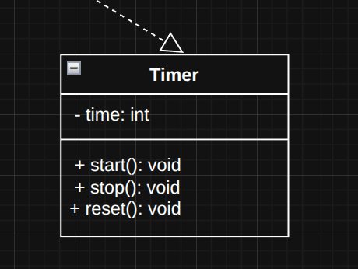
Map and Timer
The Map class uses a GameInterface to pass rendering/movement control to appropriate objects.
The Map loads from a text file, allowing level design to be external and modifiable.

Slide 5
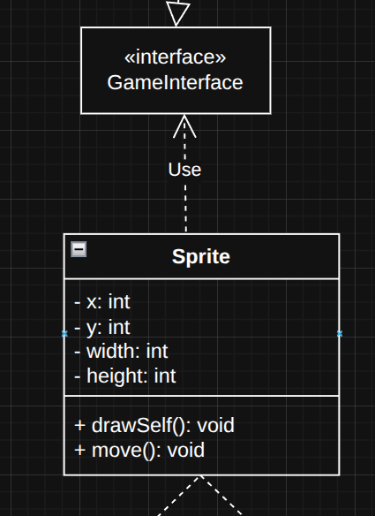
GameInterface
Interface GameInterface: Used by Map to pass graphical elements and movement info without tying to implementation.

Slide 6
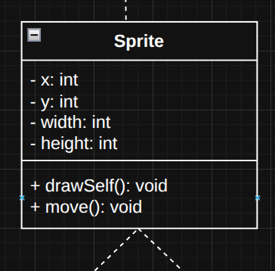
Abstract Class: Sprite
Why abstract? All objects in the game (player, enemies, obstacles) share basic properties like x, y, width, height, and behaviors like drawSelf() and move().
By abstracting Sprite, you ensure common code reuse while allowing specific objects to override or add extra behavior (e.g., EnemySprite.animate() or Player.jump()).
We made Sprite abstract because it defines what all game objects must have (position, size, drawing, movement), but doesn't implement specific behaviour — that depends on whether it's a player, enemy, or static object.
Sprite (abstract): All screen objects inherit movement/drawing logic here. Allows reuse and polymorphism.

Slide 7
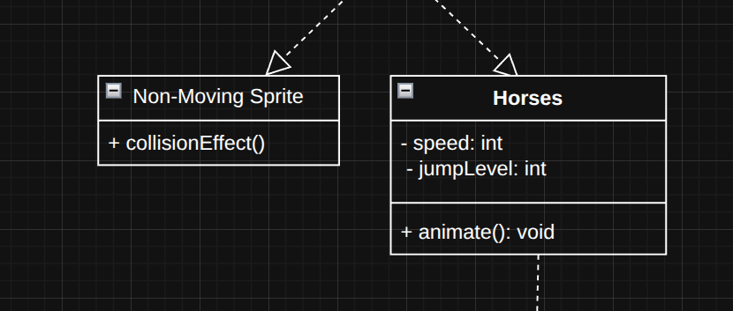
Non-Moving Sprite and Horse
NonMovingSprite, and Horse inherit from Sprite, using polymorphism for rendering and movement.
This reduces duplicated logic and centralizes collision handling via the Sprite base class.

Slide 8
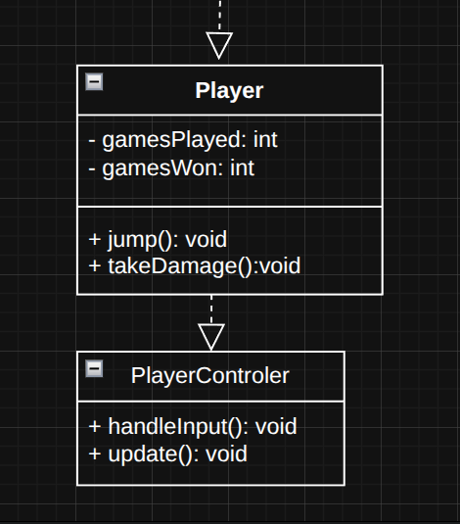
Player and PlayerControler
Each class hides its internal data (like health, position) and only exposes it through methods like jump(), takeDamage() or update(). That way, data can’t be changed directly from outside the object.
PlayerController is composed into the Player class, handling user input and game logic.
Encapsulation: All attributes are private; interaction is only through methods (e.g., jump(), takeDamage()).

Slide 9
Game Brief
This game will be a 2D scroller going right to left. You will be playing as a horse trying to jump over obstacles like exploding barrels and horse jumps of 3 diffrent types that are selcected randomly for each jump when the map is drawn. You will finish the game when you reach the flag at the far left and the timer at the bottom will stop and have your end time displated for that level for a but then you will be send to the next level by loading a new map from another text file and the timer will be reset. I based the movment and the jumping off the dino game from google and the map loading and flag from mario bros. If you hit an obstacle your healf will go down depending on what obstacle it is and i fit is falls below zero a death screen will show.There is also a stamina setting that is not shown on the display that will go down on by a bit on every jump the player did. This prevents the player from jumping forever and make the game require some skill to beat as you need to perfictly time your jumps else you will run out of stamina and die. This stamina can only be regenerated at the end of a level when you get a flag and any left over stamina is not tranferd over.

