Slide 1
Java
By Tesniem Izzat El-Merie

Slide 2
What is it?
Java is a general-purpose programming language – meaning it can be used to develop software for most platforms.
It is as Object Oriented language allowing code reuse.

Slide 3
Setup – JDK and IntelliJ
Install the Java Development Kit (JDK) witch also includes the Java Runtime Environment (JRE):
https://www.oracle.com/java/technologies/downloads/#jdk21-windows
IntelliJ IDEA Community Edition is an IDE for developing in Java, you can install it by downloading the Jetbrains Toolbox and then installing IntelliJ through it (recommended):
https://www.jetbrains.com/lp/toolbox/
Or downloading it directly:
https://www.jetbrains.com/idea/download/?section=windows
The Community Edition is free, the Ultimate version is subscription based. If you download it directly through the link above, scroll down to get the Community Edition.

Slide 4
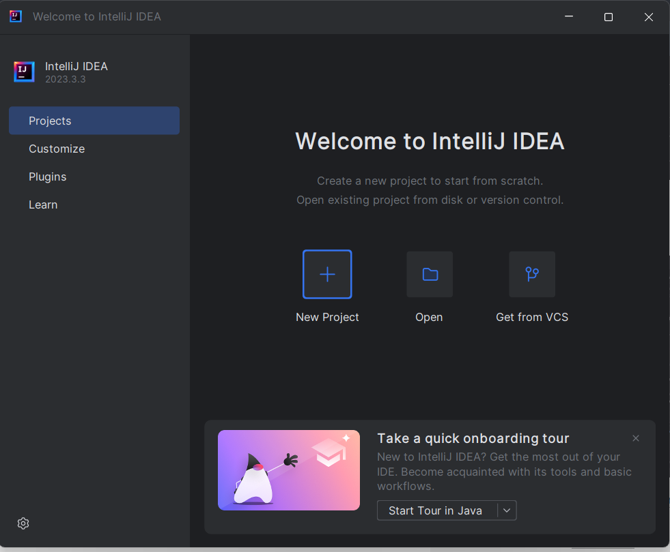
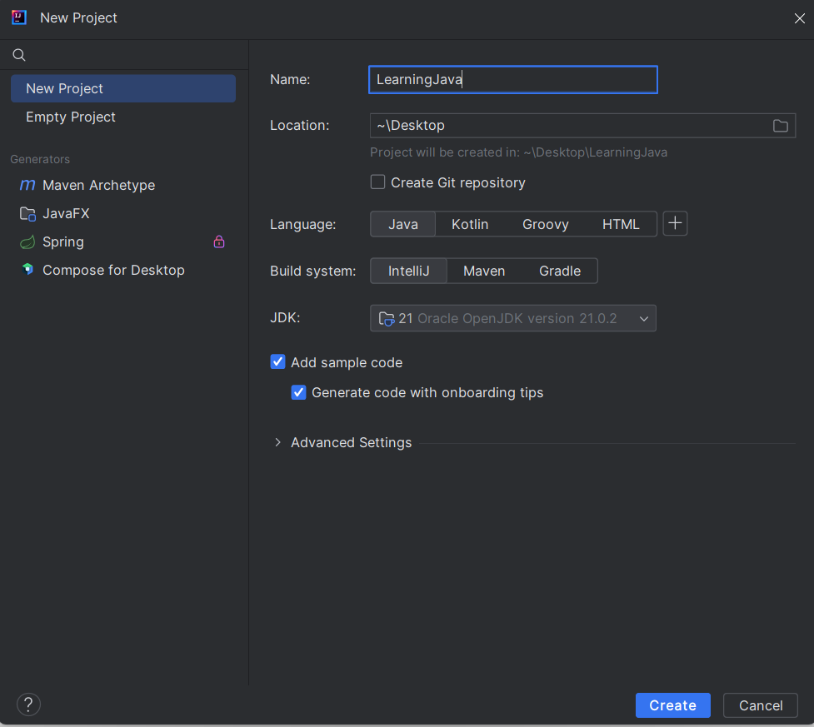
Creating a project
Click on ‘New Project’
Enter the needed properties
Name is the project name
Location is where you want the project saved
Language is the programming language which will be used in the project.
Build system is what will be used to build the project – just use IntelliJ for now
Click ‘Create’

Slide 5
Shortcuts - IntelliJ
Action | Windows | Linux | Mac
Run project | Ctrl + F5 | Ctrl + F5 | Cmd + F5
Systestem.Out.Println() | “sout” + tab | “sout” + tab | “sout” + tab

Slide 6
Naming Conventions
Type | Casing | Example
Packages | Lower case with separating ‘.’ | package.name
Classes | Pascal case | ClassName
Interfaces | Pascal case | ClassName
Methods | Camel case | methodName()
Variables | Camel case | variableName
Constant | Upper snake case | CONSTANT_NAME

Slide 7
Basic Programming

Slide 8
Syntax
Every statement is finished by a semicolon ‘;’
Executable code has to be written in a class
It is case sensitive
classes must have the same name as the file
Files have the extension ‘.java’
Curly brackets ‘{}’ are used to define code blocks
One line comments are defined by ‘//’
Multiple line comments are started by ‘/*’ and ends with ‘*/’

Slide 9
Datatypes - Primitive
Data Type | Size | Description
byte | 1 byte | Stores whole numbers from -128 to 127
short | 2 bytes | Stores whole numbers from -32,768 to 32,767
int | 4 bytes | Stores whole numbers from -2,147,483,648 to 2,147,483,647
long | 8 bytes | Stores whole numbers from -9,223,372,036,854,775,808 to 9,223,372,036,854,775,807
float | 4 bytes | Stores fractional numbers. Sufficient for storing 6 to 7 decimal digits
double | 8 bytes | Stores fractional numbers. Sufficient for storing 15 decimal digits
boolean | 1 bit | Stores true or false values
char | 2 bytes | Stores a single character/letter or ASCII values in single quotation marks ‘’
https://www.w3schools.com/java/java_data_types.asp

Slide 10
Datatypes – Non-Primitive
Data Type | Description
String | Stores text in double quotation marks “”

Slide 11
Variables
A variable is a container used to store values of a specific datatype.
Sets value
Datatype
Ends statement
int i = 5;
Variable name
Value

Slide 12
Variables
Datatype defines which type of values the variable can store.
Variable name is what will be used to reference the variable.
‘=‘ is used to set the variables value.
Value is the values of the variable.
‘;’ defines the end of a statemen, this is a must for the project to run.

Slide 13
Variables – declare & instantiate
A variable is declared by a name and datatype, it is instantiated when it has a value.
//i is declared int i; //i is instantiated i = 5; //f is declared and instantiated float f = 5.5F; //m is declared and instantiated while n is only declared int m = 6, n;

Slide 14
Modifiers

Slide 15
Access Modifiers
Access Modifiers are used to define the scope of classes, variables and methods, ect.
Public | All classes can be accesses it
private | Can only be accessed within the classes itself
protected | Can be accessed in the classes and subclasses
default | Cab be accessed in the same package

Slide 16
Non-Access Modifiers Classes
Non-Access Modifiers are used to define the behavior classes.
final | Class cannot be inherited by other classes
abstract | Class cannot be used to instantiate objects

Slide 17
Non-Access Modifiers
Non-Access Modifiers are used to define the behaviors of methods and attributes.
final | Cannot be overridden
static | Belongs to the class, meaning that if it changes in one instantiation it changes for all.
abstract | For methods in abstract classes, so they cannot have a body
transient | Attributes are skipped when serialized (ignore for now)
synchronized | Methods can only be assessed by one thread at a time
volatile | Always read from the main memeory

Slide 18
Classes

Slide 19
Classes
Classes are defined by:
Modifiers
The ‘class’ keyword
A class name
Brackets defining its scope
Executable code has to be written in a class
public class Main {
private static String name = "Main class"; public static void main(String[] args) { String message = "Hello, velcome to class constructions"; System.out.println(message + "The name of this class is: " + getName()); } private static String getName(){ return name; }
}

Slide 20
Attributes
Attributes are variables within the class scope but outside of methods.
Meaning that they belong to the class itself
public class Main {
private static String name = "Main class"; public static void main(String[] args) { String message = "Hello, velcome to class constructions"; System.out.println(message + "The name of this class is: " + getName()); } private static String getName(){ return name; }
}

Slide 21
Variables
Variables are defined within methods
public class Main {
private static String name = "Main class"; public static void main(String[] args) {
String message = "Hello, velcome to class constructions"; System.out.println(message + "The name of this class is: " + getName()); } private static String getName(){ return name; }
}

Slide 22
Methods
Methods are blocks of code that can be called for code reuse.
A java needs one, and only one, main menu which decides the flow of the project execution.
Only code within this method will be executed.
The main method can only make a direct call to other methods and attributes if they are static as well.
public class Main {
private static String name = "Main class"; public static void main(String[] args) { String message = "Hello, velcome to class constructions"; System.out.println(message + "The name of this class is: " + getName()); } private static String getName(){ return name; }
}

Slide 23
Methods
public class Main {
private static String name = "Main class"; private String getName(){
return name;
} private void setName(String name){
this.name = name;
} public static void main(String[] args){ } }
A methods consists of modifiers a return type, a variable name, parameters and brackets.
Modifiers sets the behavior and access for a method.
The return type defines what datatype the method return. Should the method not return a datatype, it will be defined as a ‘void’ method instead.

Slide 24
Methods
public class Main {
private static String name = "Main class"; private String getName(){
return name;
} private void setName(String name){
this.name = name;
} public static void main(String[] args){ } }
If a method has a return type besides ‘void’ it need to also return a value of that return type.
This is done by using the ‘return’ keyword followed by the value to be returned.
There has to be a return statement for every scenario within its code block.

Slide 25
Methods
public class Main {
private static String name = "Main class"; private String getName(){
return name;
} private void setName(String name){
this.name = name;
} public static void main(String[] args){ } }
The method name is used to call the method.
A method can have the same name as a class or a variable, but not another method unless it has a different parameter list.

Slide 26
Methods
public class Main {
private static String name = "Main class"; private String getName(){
return name;
} private void setName(String name){
this.name = name;
} public static void main(String[] args){ } }
Parameters are the values needed when calling a method and are defined by a pair of brackets ‘()’.
A method without parameters will have a set of empty brackets while.
There is no size limit on a parameter list, however, when the method is called, the parameters passed to it has to be in the same order as they are defined in the parameter list.

Slide 27
Methods
Parameters are defined by their datatype and parameter name, each separated by a comma ‘,’.
The parameter name is used to reference its value within the method scope.
public class Main { private static void setName(String firstName, String lastName){ System.out.println(firstName + lastName); } public static void main(String[] args){ setName("Jane", "Doe"); } }

Slide 28
Resources
http://www.docjava.dk/
https://www.w3schools.com/java/java_intro.asp

Slide 29
To add
Ide – ide tips
How run a project
Syntax
Variables
Datatypes
OOP
Exercises

Slide 30
New material
Programming languages in general
What are IDE’s
Github/Gitkraken
Git Projects

