Slide 1
P.O. Pro
Wireless Reflectance Pulse Oximeter
Team # 3
James Hart
Sofia Iddir
Rob Mahar
Naomi Thonakkaraparayil

Slide 2
Outline
Definition of Pulse Oximetry
Biological Aspects
Available Products
P.O. Pro
Specifications
Design Constraints
Design Overview
Budget
Conclusion

Slide 3
What is a Pulse Oximeter?
A pulse oximeter measures and displays the pulse rate and the saturation of hemoglobin in arterial blood.
This saturation of hemoglobin is a measure of the average amount of oxygen bound to each hemoglobin molecule.
Pulse oximetry is a non-invasive process

Slide 4
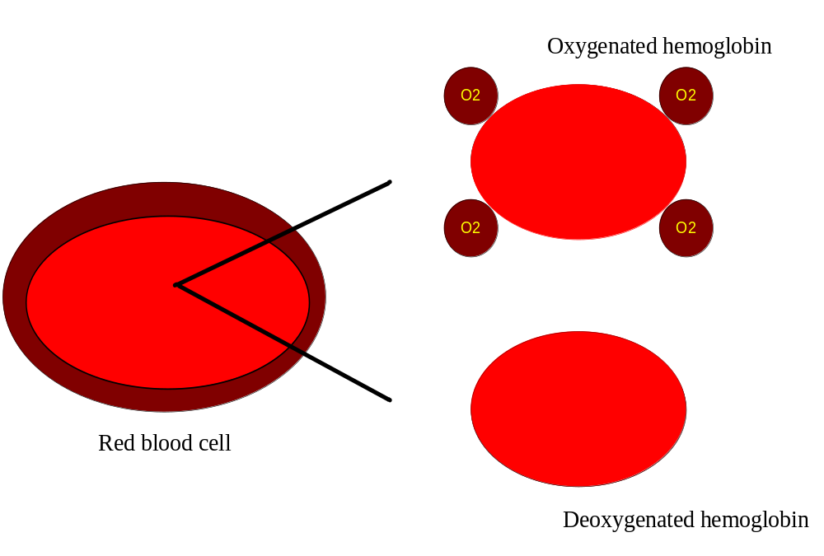
Biological Stand Point
The compound hemoglobin provides a binding mechanism that allows oxygen to be transported through the blood
Hemoglobin changes color when oxygenated. An oxygenated hemoglobin molecule is bright red, while deoxygenated hemoglobin molecule is dark red
This color difference is used in the application of pulse oximetry

Slide 5
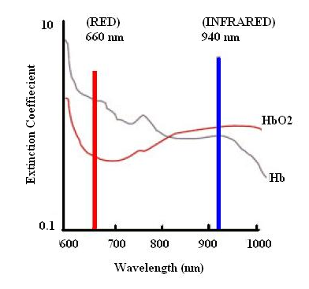
Light Absorbance
shows the extinction coefficient of the oxyhemoglobin and deoxyhemoglobin at wavelengths in the range of interest in pulse oximetry.
The absorbance of light in the red region of the spectrum is much higher for deoxyhemoglobin than for oxyhemoglobin.
The deoxyhemoglobin is more transparent to light from the infrared region than the oxyhemoglobin.

Slide 6
Competitive Products/Patent
The Avant® 4000 System with Bluetooth® Wireless Technology
  Lightweight wrist-worn patient module
  Wireless
SPO Medical Wireless PulseOx 6500 system
  Wireless
  Has an alarm unit
The PedOMetrix is the trademark for SPO-USA's Wellness Baby Monitor (WBM)
  Most similar to P.O. Pro
  Currently under construction
Issued patents are more generic patents that would not influence the design of P.O. Pro.

Slide 7
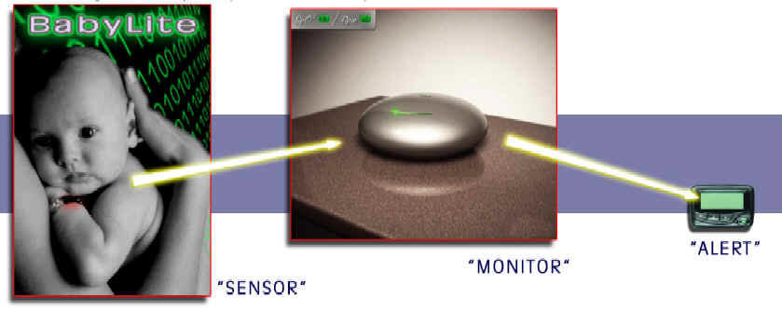
The P.O. Pro

Slide 8
What is the P.O. Pro?
The P.O. Pro will monitor the blood oxygen content of infants and small children
Data sent using wireless transmitter integrated circuit device to a bedside monitor
The monitor displays the blood oxygen content and pulse rate of the child on a digital display
Information is then sent to a portable beeper device
Accessible to the general public through a drug store

Slide 9
Specifications
Sensor:
  Reflectance, not transmittance
  Placed on ankle
  Has a rechargeable battery
  Battery lasts though the night for three years
  Function on all skin pigments
  Hypoallergenic and does not impede circulation
  Can withstand normal movements
Monitor:
  Plugs into wall outlet
  Displays BPM/SpO₂ levels
Alarm:
  May vibrate for hearing impaired
  Has a rechargeable battery
  Displays BPM/SpO₂ levels
  Will notify when abnormal BPM/SpO₂ levels are reached
  Will notify any malfunctions in the device

Slide 10
Design Constraints
Economic constraints :
  cost of building the device
  economic standing of the target market
Manufacturability:
  In order to keep the costs down, it should be as easy to manufacture as possible
Environmental constraints:
  Durability -subjects involved are toddlers or infants.
  The material used
Health and safety constraints:
  A low power Bluetooth transmitter will be used to send data from the sensor to the monitor
  Skin irritations and/or discomfort

Slide 11
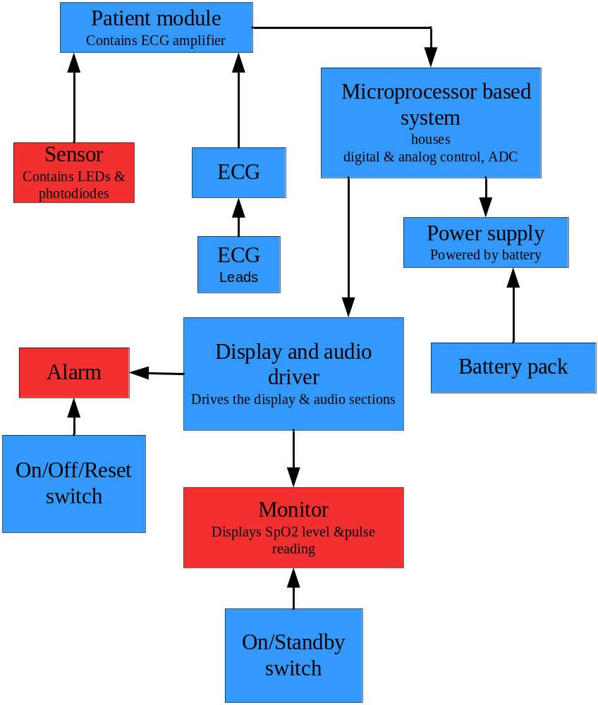
Device Overview

Slide 12
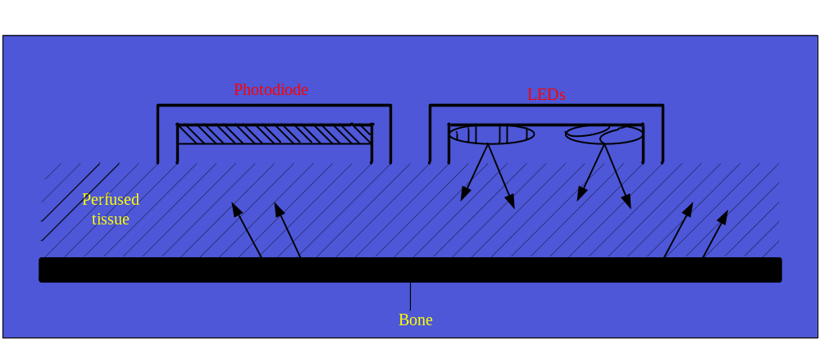
Sensor
Sensor contains:
  two low-voltage high-intensity LEDs as light sources
  one photodiode as a light receiver
One LED emits red light (approximately 660 nm)
The second emits infrared light (approximately 940 nm)
Absorbance is measured directly from backscattered light
The LEDs are alternately illuminated using a four-state clock

Slide 13
Monitor
Displays data sent from sensor
  SpO₂ %concentration
  Pulse rate
Consists of ON/Off/RESET switch
Can be placed in a different room from sensor
Distance between sensor and monitor should not exceed 30 ft.

Slide 14
Alarm
Portable device similar to beeper
Displays data sent from monitor
Consists of ON/Off/RESET switch
Distance between alarm and monitor should not exceed 100 ft

Slide 15
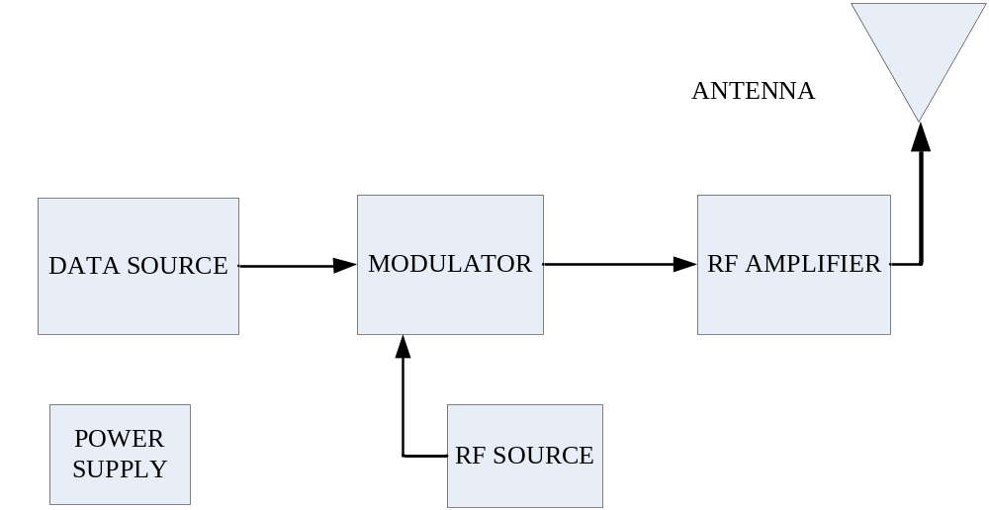
Wireless Communication
→
→
Two different Options:
Rf wireless devices
Bluetooth Wireless

Slide 16
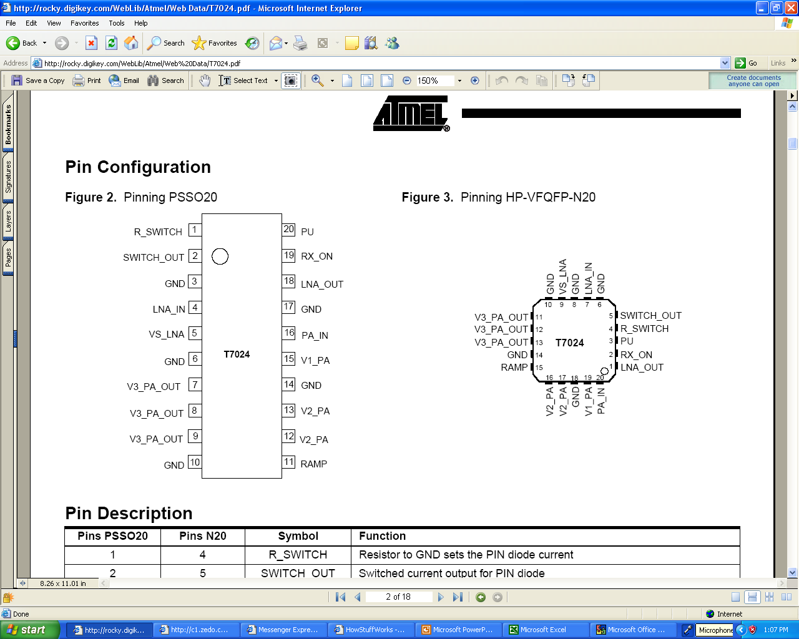
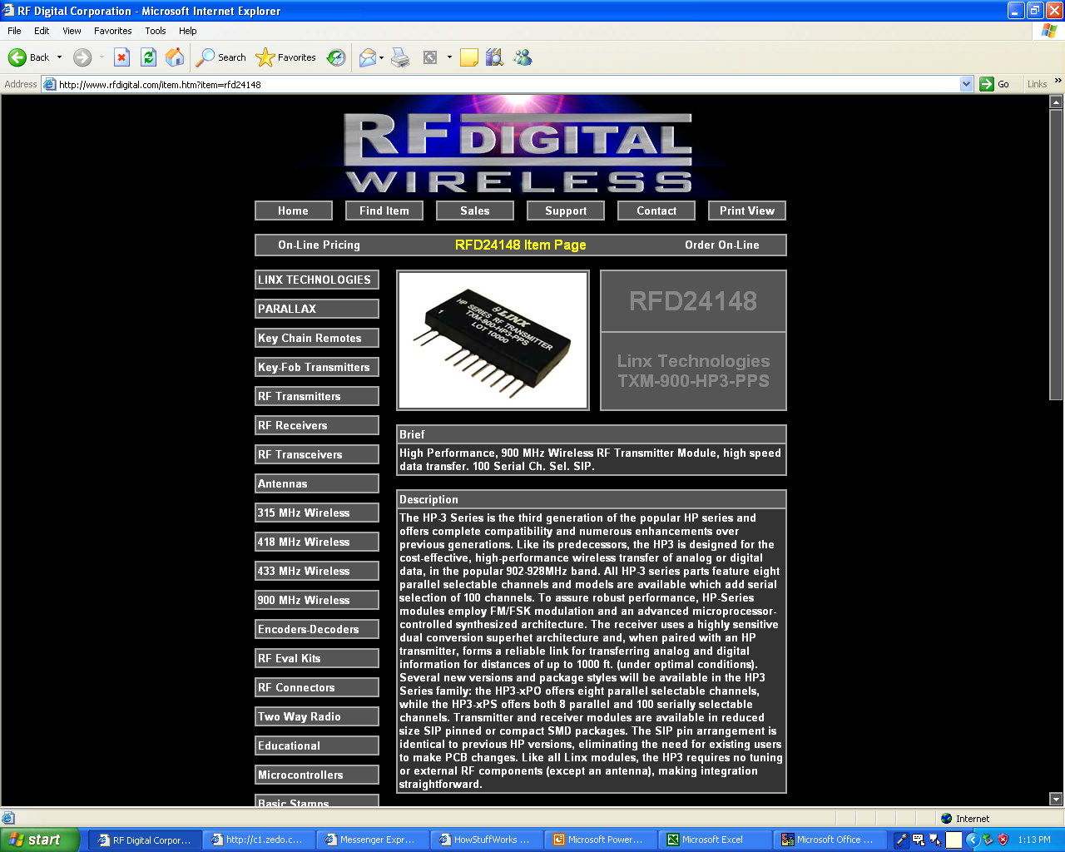
Wireless Options
Here are a few of the potential transmitter/receiver devises we are considering
Design 1 Bluetooth Design 2 Linx

Slide 17
Budget
Ankle Unit
Battery 3.6V Lithium Battery $ 5.00
Box $ 5.00
Strap $ 2.00
Transmitter $ 3.60
Photodiode ?
Bedside Monitor
AC adapter $ 1.50
Box $ 7.00
Microprocessor and other ic's $ 25.00
Receiver $ 3.60
Transmitter $ 3.60
Beeper Device
Battery 3.6V Lithium Battery $ 5.00
Box $ 6.00
IC's $ 15.00
total $ 82.30

Slide 18
Conclusion
The P.O. Pro is a wireless solution to every household
The product is portable, reliable, and easy to use
The P.O. Pro will be readily available to the general public at retail stores while being competitively priced
Final product will consist of a sensor, a monitor and an alarm
  Sensor → Monitor → Alarm
  A watch shaped sensor module which will be placed on the infant’s ankle will transmit data to the monitor
  Monitor will transmit data to the beeper like alarm
  The alarm will sound if an abnormal level of oxygen or pulse rate is detected or if the battery is low
  Product should be designed in such a way that it could be modified to further target a broader population such as athletes

Slide 19
Questions??

