Slide 1

Business Information Systems (CIS 210)
Dr. Thomas Lombardi

Slide 2
Agenda
Good day!
Syllabus
Course Mechanics
Student Survey

Slide 3
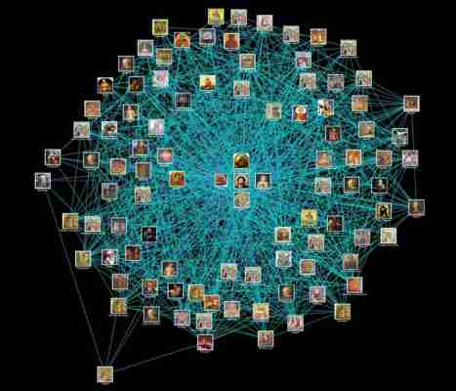
Partner Introductions
Find partner
Learn your partner’s name, major and interest in technology.
Introduce your partner including her or his name, major and technology interests.

Slide 4
“A good syllabus creates shared understanding between students and teacher.”
~ Dr. Lombardi

Slide 5
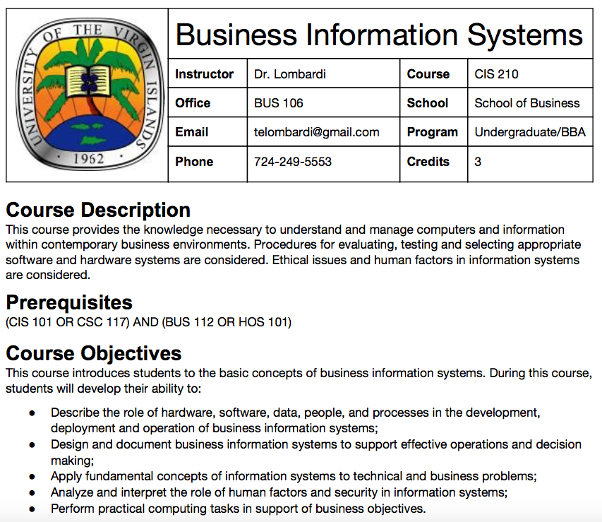

Student/Teacher relationships depend on interaction!
Posted office hours + appointments
UVI Email is preferred if face-to-face is not practical.
Phone is for emergencies only.

Slide 6
Syllabus
Preparation and Participation
First lab: make sure you can log into the lab computer!
Quizzes: Always be ready
Exams: Midterm and Final are comprehensive.
Assignments and Projects
First assignment: send me an introductory email by 1/11.
Notes:
Preparation and Participation
Every class will have some balance of lecture, exercises and lab.
I expect every student to be ready to engage in the activities for the day.
Check your UVI email at least once per day.
Quizzes: Always be ready
Unannounced and at any time in class.
Exams
Midterm and final are comprehensive.
Assignments and Projects
Your first assignment: send me an introductory email by 1/11.
Due by the start of class on the due date unless otherwise stated.

Slide 7
Course Website:
http://telombardi.github.io/bis

