Slide 1


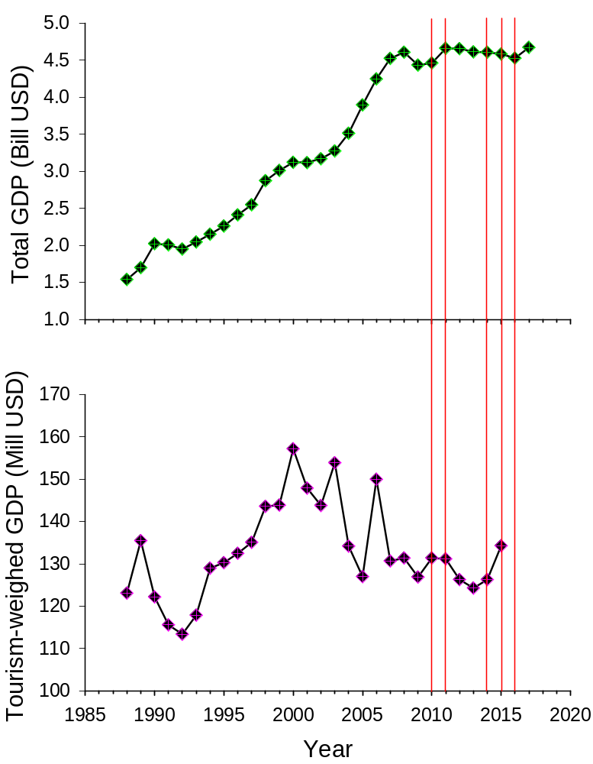
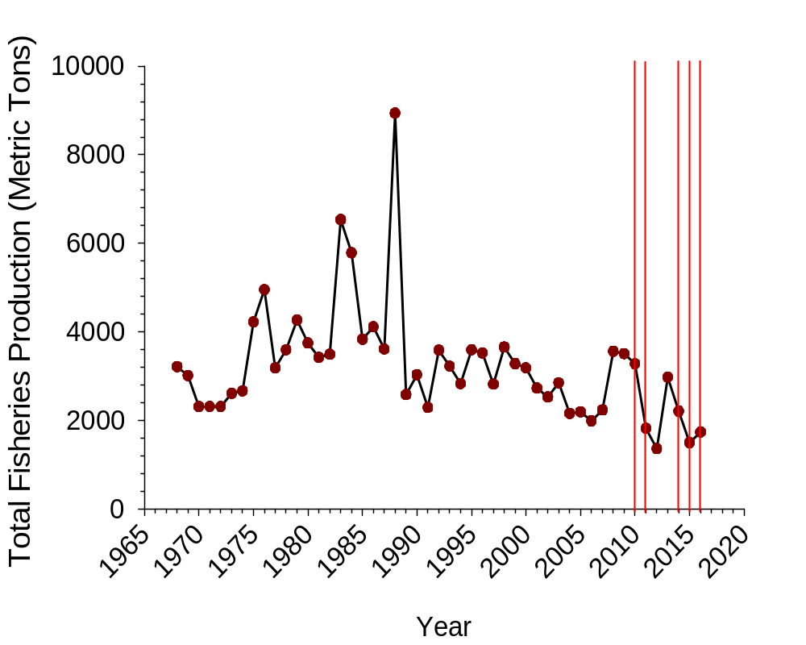
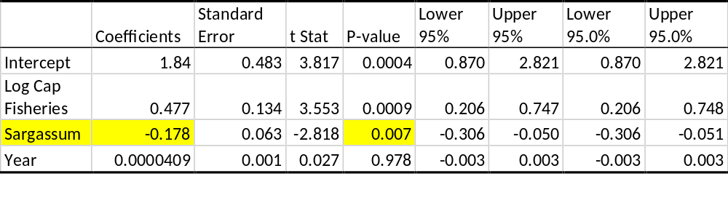
Paradise Lost? Comparing Perceived Risks against Measurable Economic Impacts of Golden Tides in Barbados
Kayla Hallidayª, Edwin Cruz-Riveraª, Tuan Le^{b} and Thomas Lombardi^{c}
ªDepartment of Biological Sciences, University of the Virgin Islands, St. Thomas, USVI
^{b}Thomas H. Albinson II School of Business, West Virginia Wesleyan College, Buckhannon WV
^{c}Department of Management Information Systems, University of the Virgin Islands, St. Thomas, USVI
Introduction
Since 2011, many Caribbean islands have been affected by golden tides- large accumulations of floating algae from the genus Sargassum. A single golden tide can push over 1,800 tons of algal wet mass onto a single beach, affecting hundreds of kilometers, and prompting some nations to declare states of emergency and activate natural disaster plans. Negative effects suggested to accompany these events include die-offs of marine life, blocking of waterways affecting transportation and fishing, health risks related to gases released from seaweed decomposition, and strong decreases in beach tourism^{1,2}. Because small Caribbean islands tend to rely relatively more on tourism and fishing, the potential economic effects of these natural events can be catastrophic, but no economic impact assessments have been performed to quantify such impacts. This study uses a bioeconomic approach to understand the effects of Sargassum accumulations by correlating oscillations in various key indicators to golden tide presence over several decades for the island of Barbados. The focus is on fisheries (calculated as total landings for all fished species reported) and tourism (assessed as numbers of tourists arriving yearly and as tourism-weighed GDP).
Neither total GDP nor tourism-weighed GDP were measurably affected by golden tides. In fact, average tourism increased following golden tide events in some years.
Methods
The impact of golden tides on fish landings, total GDP and tourism-driven GDP were modelled using correlation model that accounted for time-delayed effects for up to two years. The effects of hurricanes and other extraneous variables were weighed against the presence of recorded golden tides using records extending back to 1968 (for fisheries) and 1986 (for tourism). Data were obtained from public databases by the World Bank³ and Barbados Statistical Service⁴. We focused on the Caribbean island of Barbados because this nation has been discussed in many news articles as one of the most impacted by Sargassum accumulations.
Figure 5. Historical Trends in total GDP (top) and tourism-based GDP (bottom) for Barbados since 1986. Currency provided in USD. Red vertical lines indicate years at which golden tides occurred.
Conclusions
We detected a decrease of almost 20% in Barbadian total fisheries following years that experienced golden tides (Fig. 1; Table 1). This strong effect demonstrates a high impact of these natural phenomena on particular economic sectors and island livelihoods, despite the negligible effect of these decreases on total GDP (Fig. 2, top). This reinforces the need to assess sector-specific economic indicators when applying bioeconomic approaches. Interestingly and contrary to public perception, no measurable correlation was found between golden tides and tourism-weighed GDP. Tourism revenues actually increased following some years with golden tides, but oscillations were similar to historical trends when the term “golden tide” was not yet born. Other data confirm that tourist arrivals have not been affected by Sargassum either. Our findings emphasize the need to evaluate perceived risks against quantifiable actual risks of natural phenomena that could affect sustainability and are poised to intensify due to climate change5. The approach used here can inform resource management decisions for other Caribbean islands.
Results
Fisheries data showed a significant negative correlation between golden tides and total fish landings, with model results indicating a decrease of 17.8% in fisheries yields for years following golden tide years (Fig. 1; Table 1).
Acknowledgments
This research was partially funded by a Labor Investing For Tomorrow (LIFT) internship, provided by the USVI Department of Labor. We gratefully acknowledge Shaniqua R. Hodge, LIFT Coordinator and Lizette Llanos, Territorial Project Coordinator.
References
Cruz-Rivera, E., Flores-Díaz, M., & Hawkins, A. (2015). A fish kill coincident with dense Sargassum accumulation in a tropical bay.Bulletin of Marine Science, 91(4), 455-456.
Louime, C., Fortune, J., & Gervais, G. (2017). Sargassum invasion of coastal environments: A growing concern. American Journal of Environmental Sciences 13(1), 58.64
World Bank national accounts data, and OECD National Accounts data files. https://data.worldbank.org/indicator/NY.GDP.MKTP.CD
Barbados Division of Economic Affairs, http://www.economicaffairs.gov.bb/archive.php?cid=10
Maréchal, J. P., Hellio, C., & Hu, C. (2017). A simple, fast, and reliable method to predict Sargassum washing ashore in the Lesser Antilles. Remote Sensing Applications: Society and Environment, 5, 54-63.
Figure 1. Historical Total fisheries production for the island of Barbados since 1968. Red vertical lines indicate years at which golden tides occurred.
Table 1. Results from the correlation model indicating a significant effect of golden tides on total fisheries (P=0.007). The correlation coefficient indicates a decrease of 17.8% in fisheries a year after a golden tide event.

