Slide 1


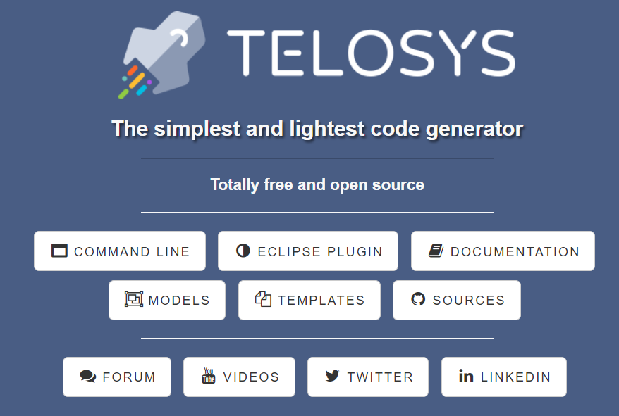
Telosys-CLI
A lightweight and pragmatic code generator
TELOSYS-CLI MODELS TEMPLATES
DOCUMENTATION SOURCES ECLIPSE PLUGIN

Slide 2



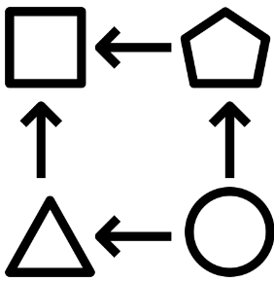
Image : 140 %
Easy and simple
Telosys aims to offer code generation for all. It's a pragmatic tool, light, flexible and easy to use. No UML model required. Telosys only uses text files for models, templates, configuration, etc.
No lock in. You are not captive to the tool. You can you use it temporarily (only for bootstrapping) or keep it for all your project lifecycle, it's up to you.
KEEP IT SIMPLE
NO UML
NO LOCK-IN
LIGHTWEIGHT
ADAPTABLE

Slide 3







Quick start
You can use Telosys with any operating system, only Java is needed.
Download Telosys, unzip and you’re ready to start.
You can install models and templates examples from GitHub to discover how to generate your first pieces of code
www.telosys.org
git
Any Operating System
models templates

Slide 4





Get your project “on rails”
Apply your standards and conventions in Telosys templates.
Guarantee compliance with your best practices.
Reduce overall cost and development time.

Slide 5












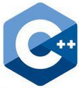





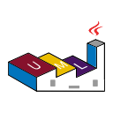







Multi-targets
Telosys lets you generate code for any type of language, framework, database, tool, …

Slide 6
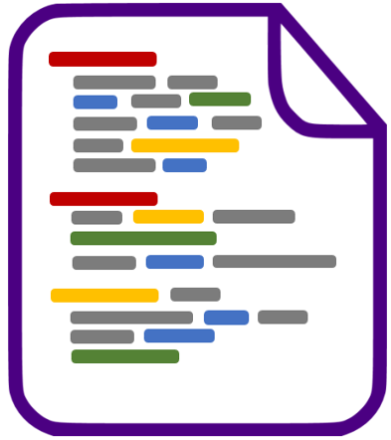


Get the code you want!
Thanks to its great flexibility, you can get exactly the code you want. You decide, Telosys adapts!
model
the code you want
templates
customization

Slide 7


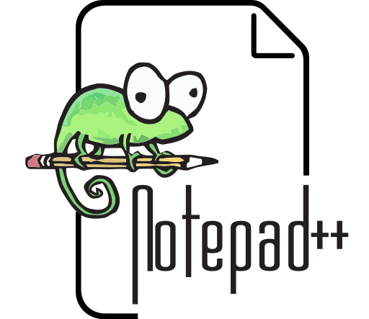








Image : 130 %
IDE independent
As everything is based on text files, you can use Telosys with any IDE or text editor.
models
templates

Slide 8

Model from database
Telosys is able to create a model from database tables.
So if you have a relational database, you can convert it to a Telosys model.
Relational database
Telosys model

Slide 9
Telosys MODELS

Slide 10

What’s a Telosys model?
A model is simply a directory containing a set of “.entity” files plus a “model.yaml” file.
All files are "text files" editable with any text editor or IDE.
A model consists of entities, attributes, and relationships between entities in a functional domain.
Attribute
Attribute
Entity
Attribute
Entity
to One
Link
Entity
Link
to Many
Entity
Entity

Slide 11
Model creation
There are two ways to create a model :
- create a new model from scratch (an empty model which will be enriched manually)
- create a new model from a relational database (an entity is created for each table with the relationships between entities)

Slide 12
Entity
// Employee entity definition
@DbTable(T_EMPLOYEES)
#StrongEntity
Employee {
// Id/PK attribute
id : int { @Id @NotNull @AutoIncremented } ;
// Other attributes
firstName : string { @MaxLen(26) } ;
lastName : string { @MinLen(1) @MaxLen(26) @NotNull } ;
birthDate : date { @Past } ;
status : short { @NotNull @DefaultValue(0) #RuleId(123) };
comment : string { @Size(120) } ;
countryId : int { @FK(Country.id) } ; // Foreign Key
// Links
country : Country ; // to One
projects : Project[] ; // to Many
}
Entity definition
An entity is composed of attributes and links defined with a simple syntax (a basic DSL).
Each attribute is strongly typed.
A link can reference an entity or a list of entities.
“Annotations” and “tags” provide additional data in order to obtain an accurate definition of each entity.
Attributes ( 1..N )
Links ( 0..N )

Slide 13
Neutral types
As Telosys was designed to generate any type of language, its model uses “neutral types”.
Each "neutral type" will be converted to the target language type during the generation phase.
Annotations and tags
The model syntax provides many “annotations”. An annotation is a predefined word starting with "@" that can be used to add more precision to an entity, attribute, or link.
The annotations are intended to deal with the most frequent needs.
For specific needs it is possible to use "tags".
A tag is any word starting with "#" that can be used in a template during the code generation.
Composite Primary Keys (and FK)
The Telosys model was designed from its first version to support composite primary keys (and therefore composite foreign keys).
A composite primary key is simply defined by using multiple "@Id" annotations.

Slide 14
One type of model to do everything
It's now possible to do everything with the DSL model, so the old "database model" (in XML) is no longer supported since Telosys 4.0
Model documentation
For more information see the documentation : https://doc.telosys.org/dsl-model
Model examples
If you want to use existing models instead of creating a model by yourself models examples are available for download.
See https://github.com/telosys-models These models can be used to try code generation very quickly.

Slide 15
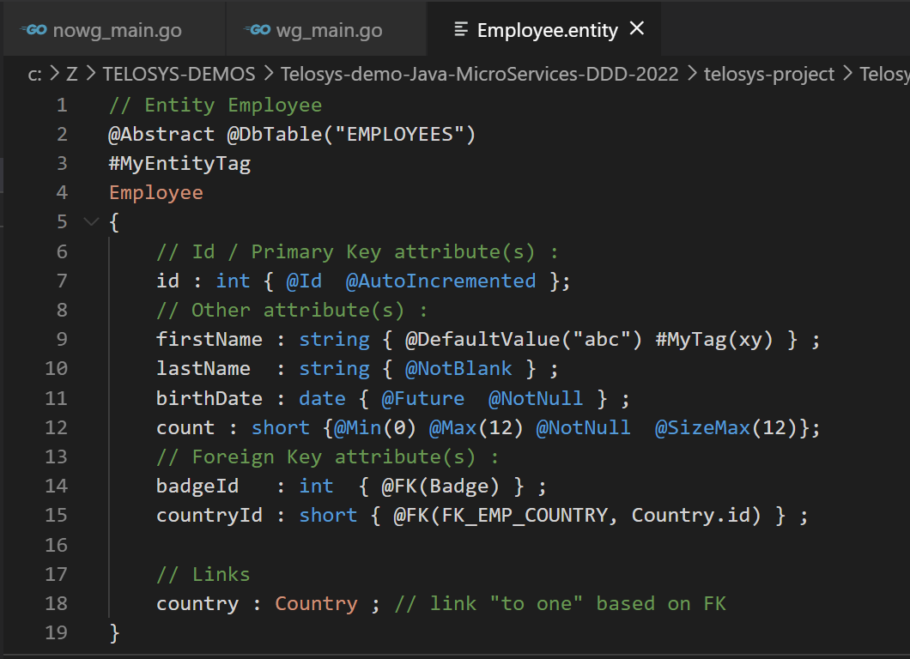

Slide 16


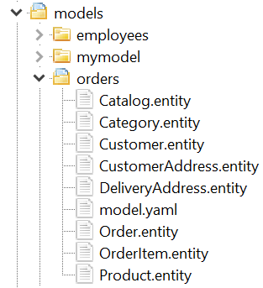
Simple & easy
What’s a Telosys model?
A model is simply a directory containing a set of “.entity” files and a “model.yaml” file.
All files are "text files" editable with any text editor or IDE.
1 model = 1 directory
1 entity = 1 text file ( « .entity » )
DSL

Slide 17
Simple & easy
1 model = 1 directory
1 entity = 1 text file ( « .entity » )
DSL
An entity is described using a DSL (Domain-Specific Language) Very simple grammar , extendable with "tags"
#tag

Slide 18
// "Order" entity definition
@AggregateRoot @DbTable(T_ORDER)
#MyEntityTag
Order {
// Attributes
num : int { @Id @NotNull @Label("order number") } ;
orderDate : date { @NotNull @Label("order date")} ;
status : short { @NotNull @DefaultValue(0) #MyTag(123) };
comment : string { @Size(120) } ;
// FK referencing Customer
customerId : int { @FK(Customer) } ;
// Links
items : OrderItem[] ; // to Many
deliveryAddress : DeliveryAddress ; // to One
}
Annotation (pre-defined)
Neutral type (language-independent)
Entity
Attributes
Tag
(user-defined)
Links

Slide 20

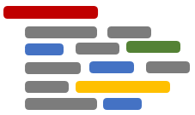
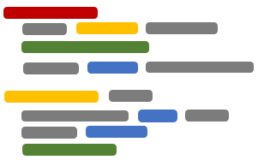

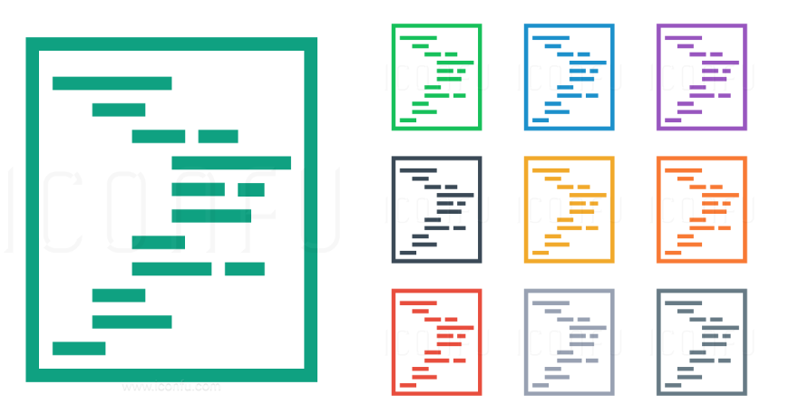

Slide 21








Customize color : https://www.iconsdb.com/royal-blue-icons/text-file-5-icon.html
Xx {
int a;
bool b;
yzbc(p) {
xx = f(a);
o++ ;
}
}

Slide 22









From https://www.iconsdb.com/royal-blue-icons/blank-file-6-icon.html https://www.iconsdb.com/caribbean-blue-icons/caribbean-blue-chart-icons.html
From https://www.iconsdb.com/guacamole-green-icons/database-5-icon.html

Slide 23








Slide 24




NO UML
NO UML
NO LOCK-IN

Slide 25

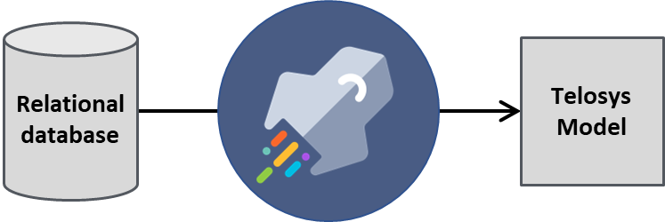
Get the code you want!
Thanks to its great flexibility, you can get exactly the code you want. You decide, Telosys adapts!
Templates
Project conf
customization
Model
the code you want
model

