Slide 1
Templates images

Slide 2



Templates
PROJECT
VELOCITY CONTEXT
VELOCITY
TEMPLATE
DB-MODEL
GENERIC
MODEL
DSL-MODEL
file.vm
GENERATED FILE
VELOCITY
ENGINE
Project
VARIABLES
Project
VARIABLES

Slide 3
Bundle of templates
BUNDLE
set of
".vm" files
"templates.cfg"
"README.md"

Slide 4
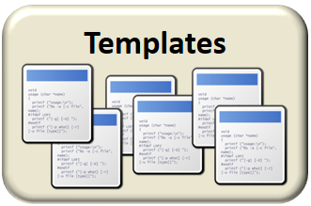








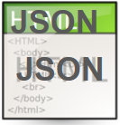

Bundle of templates
Generator
Postman
( test scripts )
Web / Rest
Entities
& services
Persistence

Slide 5
Templates images
final format

Slide 6
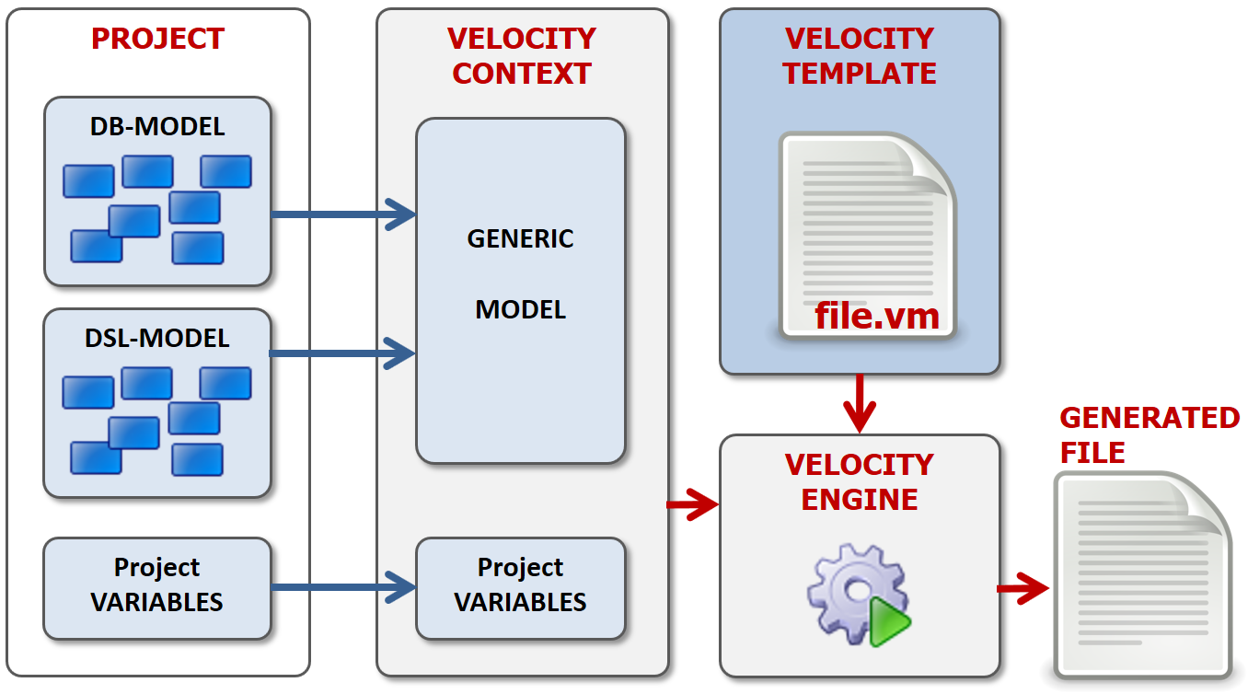
Image size 50 %

Slide 7
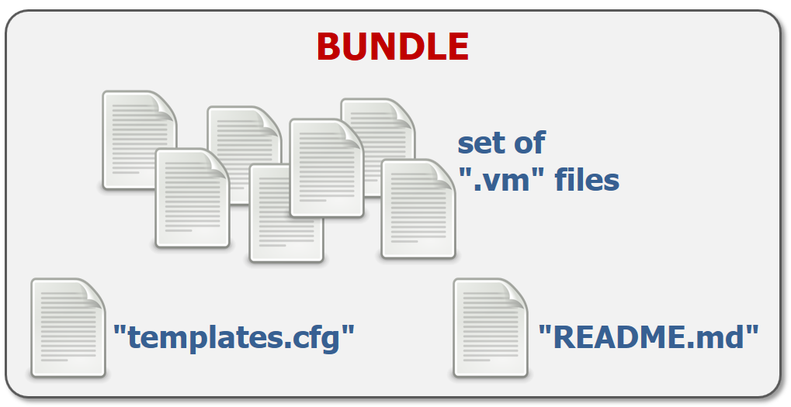
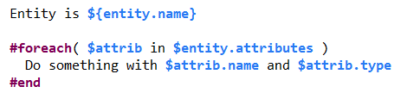
Image size 35 %

