Slide 1





Database model
Relational
Database
DB-MODEL
Telosys
JDBC
New db-model
Update db-model
Database
configuration
JDBC driver
( .jar file )

Slide 2
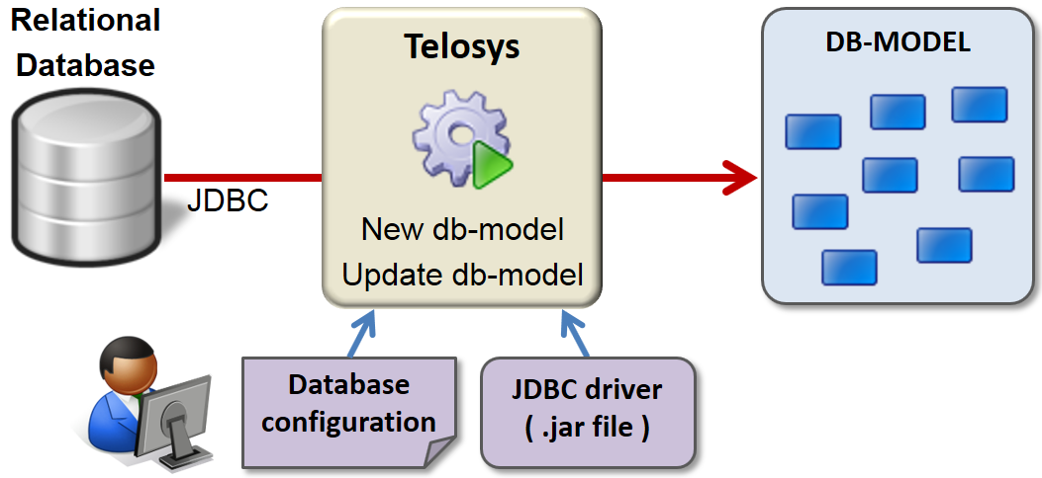
Database model Image - Size 50%

Slide 3


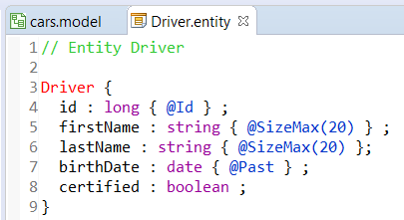
DSL model
Telosys
DSL-MODEL
New model
.entity
create
.entity
.entity
update
.entity
.entity

Slide 4
DSL model

Slide 5
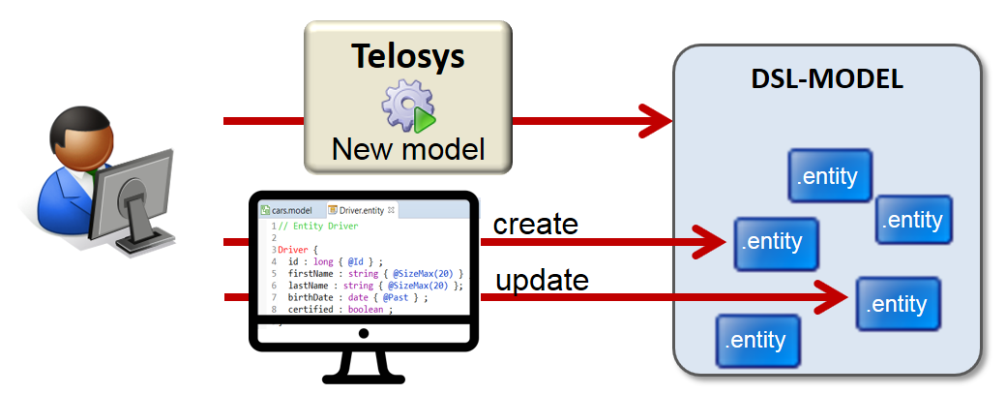
DSL model Image - Size 50%

Slide 6

Templates
PROJECT
VELOCITY CONTEXT
VELOCITY
TEMPLATE
DB-MODEL
GENERIC
MODEL
DSL-MODEL
file.vm
GENERATED FILE
VELOCITY
ENGINE
Project
VARIABLES
Project
VARIABLES

Slide 7
Bundle of templates
BUNDLE OF TEMPLATES
set of
".vm"
files
1 file "templates.cfg"

Slide 8
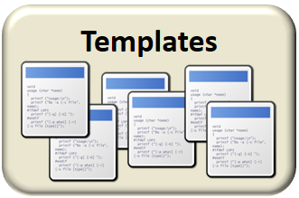






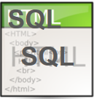
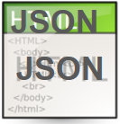

Bundle of templates
Generator
Postman
( test scripts )
Web / Rest
Entities
& services
Persistence

