Slide 1
Models images

Slide 2





Database model
Relational
Database
DB-MODEL
Telosys
JDBC
New db-model
Update db-model
Database
configuration
JDBC driver
( .jar file )

Slide 3


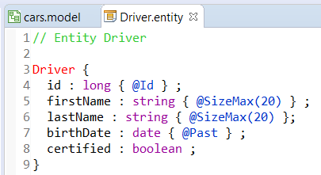
DSL model
Telosys
DSL-MODEL
New model
.entity
create
.entity
.entity
update
.entity
.entity

Slide 4
DSL model

Slide 5
Models images
( final )

Slide 6
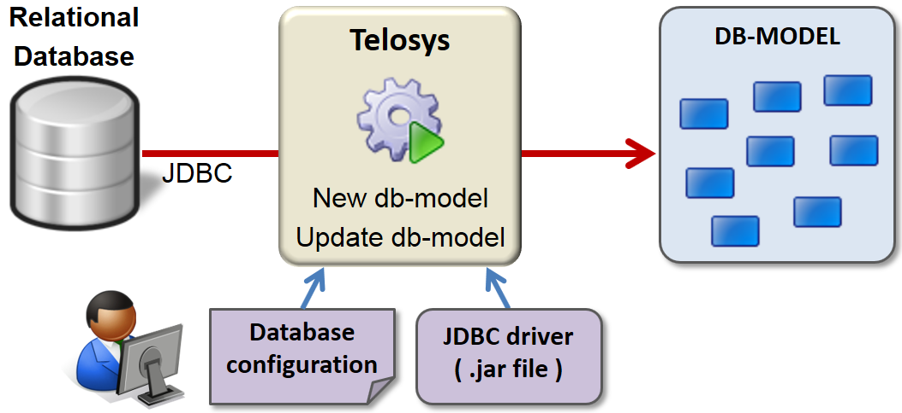
Database model Image - Image Size 50%

Slide 7
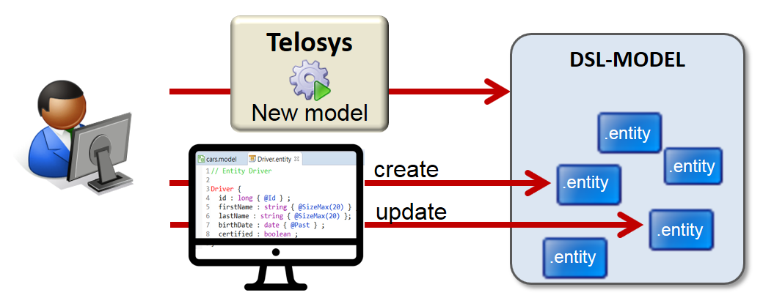
DSL model Image - Image Size 50%

