Slide 1

An Intelligent Traffic Signal Control System Using Q-Learning and Deep Q-Networks for Peak-Hour Congestion Reduction
Presented by:
T. Goutham Reddy (2303A51345) M. Meghana (2303A52505)
P. Vishwateja (2303A52389)
Ch. Vineeth (2303A52447)
Under Guidance: Dr. Sri Raman Kothuri
Domain: Artificial Intelligence | IoT | Embedded Systems

Slide 2
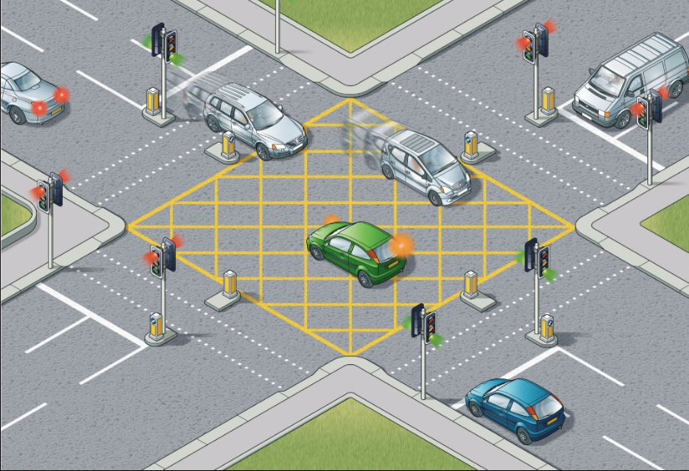
Introduction
Urban traffic congestion remains a critical challenge, particularly during peak hours when vehicle flow is highly dynamic and unpredictable. Traditional fixed-time traffic light systems operate on pre-set intervals, often causing unnecessary delays at low-density lanes while overcrowded routes experience prolonged waiting times. To address this inefficiency, this project proposes an intelligent, adaptive traffic signal control system based on Reinforcement Learning (RL) techniques—specifically Q-Learning for single-junction optimization and Deep Q-Networks (DQN) for complex multi-junction coordination.

Slide 3
Problem Statement
Most cities rely on pre-defined traffic signal timers that do not consider current road conditions. During peak hours, this rigidity leads to unnecessary idling of vehicles, higher fuel consumption, and longer queues.
Fixed signal timers cannot adapt to fluctuating vehicle densities.
Longer waiting times lead to increased congestion and emissions.
Need for a real-time, data-driven traffic management approach.
Goal: Optimize traffic signal timing dynamically using AI and IoT.
Motivation
To make transportation smarter, eco-friendly, and time-efficient.
Reinforcement Learning enables systems to learn from experience and adapt.
IoT integration (IR/camera sensors) enables real-time traffic monitoring.
Smart cities need scalable, intelligent traffic control systems.

Slide 4
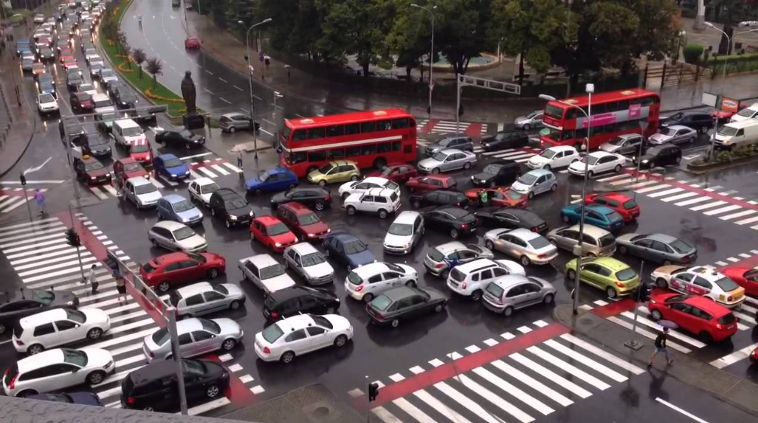
Objectives
To design a reinforcement learning-based adaptive traffic signal system capable of adjusting signal durations in real-time.
To implement Q-Learning and Deep Q-Network algorithms that optimize traffic flow based on current conditions.
To develop a hardware prototype using Raspberry Pi and IoT sensors for real-world simulation.
To reduce congestion and waiting times, especially during peak hours.
To integrate data analytics and cloud capabilities for future smart city scalability.
Each of these objectives contributes to making traffic systems intelligent, responsive, and sustainable.

Slide 5
Literature Review & Research Gap
Previous research, such as IntelliLight (Wei et al., 2019), explored reinforcement learning for traffic control but was limited to single intersections and simulation environments. Another study by Khampuria and Pandey (2021) implemented DQN for optimizing signal patterns, yet it lacked real-world hardware testing and IoT integration.
Our project bridges this gap by combining AI-driven decision-making with hardware simulation and embedded control. By integrating IR or camera sensors with a Raspberry Pi, our model physically demonstrates how adaptive control can function in a real-world scenario, forming a foundation for smart city infrastructure.

Slide 6
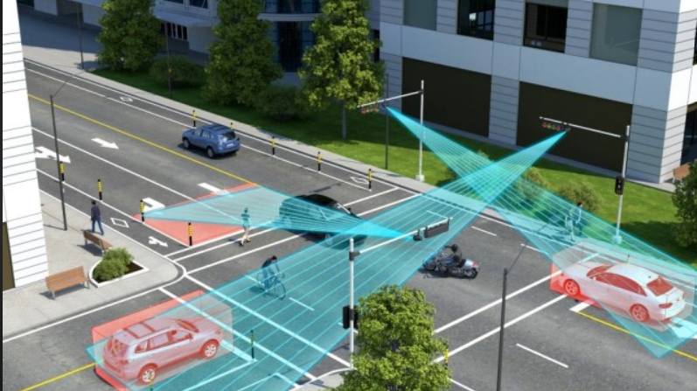
Methodology / System Architecture Components:
Sensors: IR or camera module for vehicle detection.
Controller: Raspberry Pi / Arduino for signal control.
Algorithm: Q-Learning logic decides optimal green light time.
Output: LEDs represent red, yellow, green lights.
Relay modules switch LED signals dynamically.
Flow:
Sensors detect traffic density.
Data sent to Q-Learning agent.
Agent adjusts green light timing.
System learns optimal patterns over time.

Slide 7
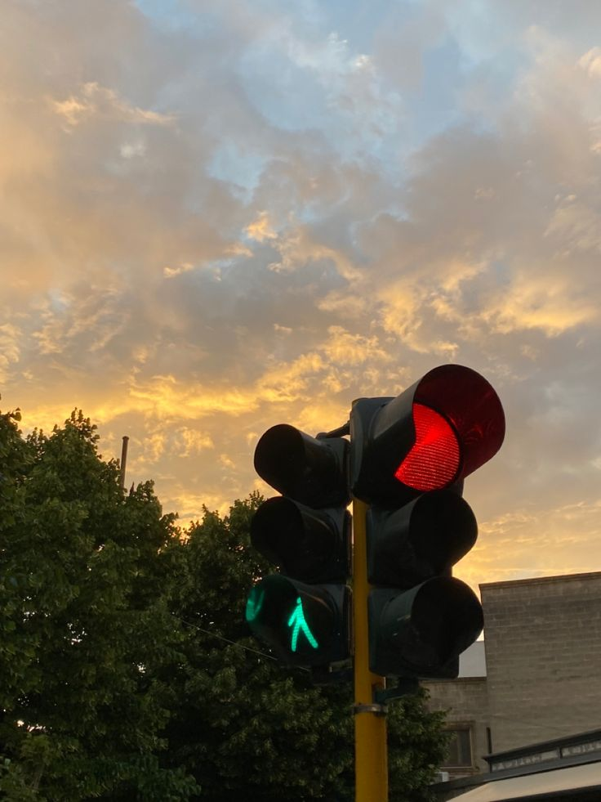
Hardware & Software Components
Hardware:
Raspberry Pi 4 or ESP32 microcontroller
IR Sensors or Camera Module
Traffic Signal LEDs with Relay Module
Breadboard, Jumper Wires, Power Supply
Software:
Python (for RL algorithms)
TensorFlow Lite / NumPy / OpenCV
Tinkercad for Simulation

Slide 8
Algorithm — Q-Learning & DQN
Q-Learning:
Model-free RL algorithm that learns optimal actions using reward feedback.
Agent updates Q-values based on traffic density and waiting time.
Deep Q-Network (DQN):
Uses a neural network to approximate Q-values.
Enables better scalability and generalization in complex environments.

Slide 9
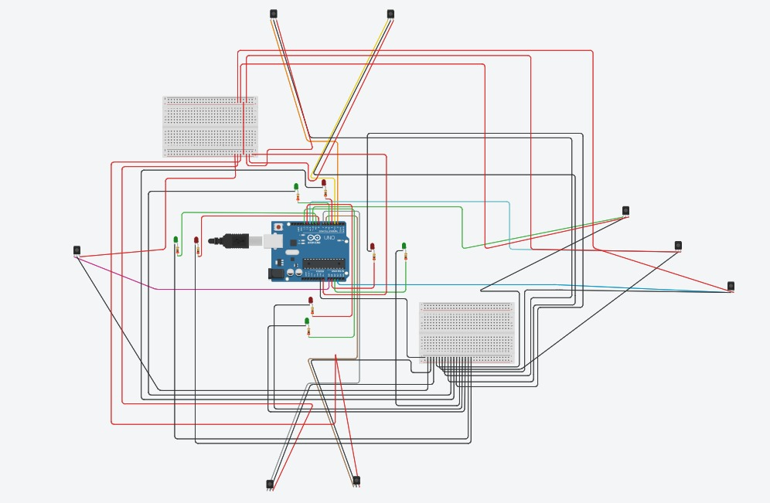
Circuit Description and Working Principle
The circuit comprises 8 IR sensors interfaced with an Arduino UNO to detect vehicle density on each road.
Four red and four green LEDs represent the traffic lights for four directions — North, East, South, and West.
Each LED pair is controlled through digital output pins, while IR sensors send input signals via digital and analog pins. The adaptive timing control is achieved using Q-Learning logic, which dynamically adjusts the green-light duration based on traffic density.
Simulation & Results
Simulated using Tinkercad and Python for logic testing.
LEDs act as real-world traffic lights.
The model adjusts light duration dynamically based on density.
Results:
Reduced waiting time by 2% compared to fixed-time systems.
Improved fuel efficiency and smoother traffic flow.
Limitations
Currently tested for single intersections only.
Requires real-world data for large-scale deployment.
Camera-based systems need better lighting and calibration.

Slide 10
Future Work & Conclusion
Future Enhancements:
This project can be further enhanced by integrating a Raspberry Pi for real-time data processing and machine learning model execution. A camera module can replace IR sensors to enable image-based vehicle detection and congestion analysis. The system can also be expanded to support Deep Q-Networks (DQN) for multi-junction optimization, making it suitable for deployment in smart city traffic management systems.
Conclusion:
Our project successfully demonstrates how artificial intelligence and IoT can work together to create adaptive, sustainable, and efficient traffic management systems — a crucial step toward realizing the vision of smart cities.

Slide 11


