Slide 1
VIDEO ONE · CAPABILITY FORMATION
How I Changed Jobs Without Starting My Career Over
Temidayo Afonja · temidayoafonja.com
Notes:
Single-state frame — main slide 1.
Timing: approximately 1:00.
Slide 1 — Title.
Cue — the line that lands on this slide: “I’m Temidayo Afonja.”
Do NOT open on this slide. Begin full screen on Temidayo and let the whole opening land: the viewer's exposure, the rescinded offer, driving Uber, and the promise of three practices.
Bring the title card in only on “I’m Temidayo Afonja.”
The on-screen deck title reads “How I Changed Jobs Without Starting My Career Over” and differs from the public title on purpose. Do not change it.
What follows on this slide is the honest promise — not everything transfers, markets change, skills go stale, and the next opportunity may not arrive quickly. That paragraph is what earns the rest of the video. Do not trim it for pace.
Single state. Reveal frame 1 in the build deck.

Slide 2

MY CAREER PATH
What connected those career changes
Accounting and audit trained me to look for evidence, controls, risk and what a system was failing to reveal. I carried that way of seeing into cybersecurity and later into people strategy.
ACCOUNTING & AUDIT
CYBERSECURITY
PEOPLE STRATEGY
CAPABILITY FORMATION
Along the way: consulting, life sciences, technology
Notes:
Single-state frame — main slide 2.
Timing: approximately 1:37.
Slide 2 — My Career Path.
Cue — the line that lands on this slide: “The role had disappeared.”
This slide holds the belonging beat and then the career sequence, in that order. Hold the career-path artwork back until “My path has crossed accounting and audit”. Before that, stay on Temidayo.
FACTUAL BOUNDARY, exact: an accepted job offer; an acquisition rescinded the role before she ever got to start it; within a few months she was driving Uber; later a recruiter found her on LinkedIn and asked whether she would consider returning to Deloitte. Nothing else is established. No passenger referral, no networking while driving, no dates, no income, no duration beyond “within a few months”, no recruiter dialogue.
CAUSALITY BOUNDARY — ABSOLUTE. “Driving Uber did not lead to Deloitte. They were simply two parts of the same career-transition chapter.” That protection must stay immediately adjacent to the recruiter line. Do not cut it, do not move it, do not separate them with a graphic.
NO re-enactment, no car or rideshare footage, no app graphics, no comeback music. This is a recognition story about income uncertainty and loss of context, not a triumph.
“The role had disappeared. My experience had not.” is the hinge of the video. Hold on her face. No music swell.
Single state. Reveal frame 2 in the build deck.

Slide 3
THREE THINGS I LEARNED TO DO
01
Look underneath the title
What has the work actually trained you to do?
Notes:
Single-state frame — main slide 3.
Timing: approximately 4:14.
Slide 3 — 01 Look Underneath the Title.
Cue — the line that lands on this slide: “The first one is to look underneath your title.”
Section break only. Four words on screen, then straight through.
The framework does not arrive until here, about four minutes in, and that is deliberate. Recognition first. Do not move this earlier in the edit.
Single state. Reveal frame 3 in the build deck.

Slide 4
MOVE ONE
Look underneath the title.
Name what the work has trained you to notice, decide and solve.
01
What problems do people trust me to solve?
Notes:
Reveal frame 1 of 3 — main slide 4.
Timing: approximately 4:18.
Slide 4 — Move One.
Cue — the line that lands on this slide: “Your title tells people where your work sat.”
The three questions reveal one at a time, in the order spoken.
“A word is not evidence. Calling yourself strategic proves nothing.” Keep it — it is what stops the exercise turning into résumé language.
The verb list is spoken quickly. Do not put five words on screen and hold them; a light single-line treatment is enough.
The closing paragraph carries the limit: something can travel while the context still has to be learned. That is the honest boundary in this section. Do not cut it to save time.
Reveal states: 3. Reveal frame 4–6 in the build deck.

Slide 5
MOVE ONE
Look underneath the title.
Name what the work has trained you to notice, decide and solve.
01
What problems do people trust me to solve?
02
What decisions can I now make with better judgment?
Notes:
Reveal frame 2 of 3 — main slide 4.
Timing: approximately 4:18.
Slide 4 — Move One.
Cue — the line that lands on this slide: “Your title tells people where your work sat.”
The three questions reveal one at a time, in the order spoken.
“A word is not evidence. Calling yourself strategic proves nothing.” Keep it — it is what stops the exercise turning into résumé language.
The verb list is spoken quickly. Do not put five words on screen and hold them; a light single-line treatment is enough.
The closing paragraph carries the limit: something can travel while the context still has to be learned. That is the honest boundary in this section. Do not cut it to save time.
Reveal states: 3. Reveal frame 4–6 in the build deck.

Slide 6
MOVE ONE
Look underneath the title.
Name what the work has trained you to notice, decide and solve.
01
What problems do people trust me to solve?
02
What decisions can I now make with better judgment?
03
What could I do in another setting because of what I learned here?
Notes:
Reveal frame 3 of 3 — main slide 4.
Timing: approximately 4:18.
Slide 4 — Move One.
Cue — the line that lands on this slide: “Your title tells people where your work sat.”
The three questions reveal one at a time, in the order spoken.
“A word is not evidence. Calling yourself strategic proves nothing.” Keep it — it is what stops the exercise turning into résumé language.
The verb list is spoken quickly. Do not put five words on screen and hold them; a light single-line treatment is enough.
The closing paragraph carries the limit: something can travel while the context still has to be learned. That is the honest boundary in this section. Do not cut it to save time.
Reveal states: 3. Reveal frame 4–6 in the build deck.

Slide 7
THREE THINGS I LEARNED TO DO
02
Explain what the work changed
What changed because you were there?
Notes:
Single-state frame — main slide 5.
Timing: approximately 5:46.
Slide 5 — 02 Explain What the Work Changed.
Cue — the line that lands on this slide: “The second practice is to explain what the work changed.”
Section break only. Then straight into the before-and-after.
Single state. Reveal frame 7 in the build deck.

Slide 8
MOVE TWO
Explain what the work changed.
Ask: What changed because I was there?
Internal description
Led an onboarding redesign.
Notes:
Reveal frame 1 of 2 — main slide 6.
Timing: approximately 5:50.
Slide 6 — Move Two.
Cue — the line that lands on this slide: “You may be describing your projects in language that only works on people who were in the room.”
The before line and the after line are the whole point of this slide. Reveal the before, let it sit, then the after.
Set them in the same weight. If the after line is styled as the “good” version with color or emphasis, the comparison stops being honest.
Reveal states: 2. Reveal frame 8–9 in the build deck.

Slide 9
MOVE TWO
Explain what the work changed.
Ask: What changed because I was there?
Internal description
What another employer can understand
Led an onboarding redesign.
I led an onboarding redesign with my team. One measure of how well new hires felt integrated moved from 47 to 75.
→
Notes:
Reveal frame 2 of 2 — main slide 6.
Timing: approximately 5:50.
Slide 6 — Move Two.
Cue — the line that lands on this slide: “You may be describing your projects in language that only works on people who were in the room.”
The before line and the after line are the whole point of this slide. Reveal the before, let it sit, then the after.
Set them in the same weight. If the after line is styled as the “good” version with color or emphasis, the comparison stops being honest.
Reveal states: 2. Reveal frame 8–9 in the build deck.

Slide 10
ONE RESULT
One measure of new-hire integration
A team result from a redesign I led
47
Before the redesign
Notes:
Reveal frame 1 of 2 — main slide 7.
Timing: approximately 6:21.
Slide 7 — One Result — 47 to 75.
Cue — the line that lands on this slide: “It is stronger because somebody who was not there can hear what I led and what changed.”
FACTUAL BOUNDARY: one measure of how well new hires felt integrated moved from 47 to 75. It is NOT retention, turnover, cost or engagement, and it is not a claim about everything the redesign touched. It was team work that Temidayo led.
No 30% and no $2M anywhere in this video.
The precision paragraph is the trust beat. “People trust the person who tells them the edges of their own claim.” Keep it on her face.
The three questions that follow reveal one at a time.
Reveal states: 2. Reveal frame 10–11 in the build deck.

Slide 11
ONE RESULT
One measure of new-hire integration
A team result from a redesign I led
47
75
→
Before the redesign
After the redesign
Notes:
Reveal frame 2 of 2 — main slide 7.
Timing: approximately 6:21.
Slide 7 — One Result — 47 to 75.
Cue — the line that lands on this slide: “It is stronger because somebody who was not there can hear what I led and what changed.”
FACTUAL BOUNDARY: one measure of how well new hires felt integrated moved from 47 to 75. It is NOT retention, turnover, cost or engagement, and it is not a claim about everything the redesign touched. It was team work that Temidayo led.
No 30% and no $2M anywhere in this video.
The precision paragraph is the trust beat. “People trust the person who tells them the edges of their own claim.” Keep it on her face.
The three questions that follow reveal one at a time.
Reveal states: 2. Reveal frame 10–11 in the build deck.

Slide 12
THREE THINGS I LEARNED TO DO
03
Keep evidence before you need it
Capture the context, your role and what changed.
Notes:
Single-state frame — main slide 8.
Timing: approximately 7:11.
Slide 8 — 03 Keep Evidence Before You Need It.
Cue — the line that lands on this slide: “The third practice is to keep the evidence before you need it.”
Section break only.
Single state. Reveal frame 12 in the build deck.

Slide 13
MOVE THREE
Keep evidence before you need it.
Write a permitted, high-level account in your own words. Leave confidential and employer-owned material out.
Situation
New hires needed a stronger integration experience.
Notes:
Reveal frame 1 of 4 — main slide 9.
Timing: approximately 7:16.
Slide 9 — Move Three.
Cue — the line that lands on this slide: “Most of us wait until there is a CV to update, or an interview on Thursday.”
The four evidence lines reveal one at a time: the situation, your role, what changed, what this shows.
“When the role went away, the hardest thing to reconstruct was not what I had done. It was the detail that made it believable.” This ties the practice back to the opening story. Do not cut it — it is the reason this section is in this video rather than a generic tip.
EVIDENCE BOUNDARY: in your own words, nothing confidential, nothing belonging to the employer. Spoken plainly, not as fine print.
Reveal states: 4. Reveal frame 13–16 in the build deck.

Slide 14
MOVE THREE
Keep evidence before you need it.
Write a permitted, high-level account in your own words. Leave confidential and employer-owned material out.
Situation
New hires needed a stronger integration experience.
My role
I led the onboarding redesign with my team.
Notes:
Reveal frame 2 of 4 — main slide 9.
Timing: approximately 7:16.
Slide 9 — Move Three.
Cue — the line that lands on this slide: “Most of us wait until there is a CV to update, or an interview on Thursday.”
The four evidence lines reveal one at a time: the situation, your role, what changed, what this shows.
“When the role went away, the hardest thing to reconstruct was not what I had done. It was the detail that made it believable.” This ties the practice back to the opening story. Do not cut it — it is the reason this section is in this video rather than a generic tip.
EVIDENCE BOUNDARY: in your own words, nothing confidential, nothing belonging to the employer. Spoken plainly, not as fine print.
Reveal states: 4. Reveal frame 13–16 in the build deck.

Slide 15
MOVE THREE
Keep evidence before you need it.
Write a permitted, high-level account in your own words. Leave confidential and employer-owned material out.
Situation
New hires needed a stronger integration experience.
My role
I led the onboarding redesign with my team.
What changed
One measure of how well new hires felt integrated moved from 47 to 75.
Notes:
Reveal frame 3 of 4 — main slide 9.
Timing: approximately 7:16.
Slide 9 — Move Three.
Cue — the line that lands on this slide: “Most of us wait until there is a CV to update, or an interview on Thursday.”
The four evidence lines reveal one at a time: the situation, your role, what changed, what this shows.
“When the role went away, the hardest thing to reconstruct was not what I had done. It was the detail that made it believable.” This ties the practice back to the opening story. Do not cut it — it is the reason this section is in this video rather than a generic tip.
EVIDENCE BOUNDARY: in your own words, nothing confidential, nothing belonging to the employer. Spoken plainly, not as fine print.
Reveal states: 4. Reveal frame 13–16 in the build deck.

Slide 16
MOVE THREE
Keep evidence before you need it.
Write a permitted, high-level account in your own words. Leave confidential and employer-owned material out.
Situation
New hires needed a stronger integration experience.
My role
I led the onboarding redesign with my team.
What changed
One measure of how well new hires felt integrated moved from 47 to 75.
What this shows
I can diagnose a weak point in the employee experience and lead a redesign that improves it.
Notes:
Reveal frame 4 of 4 — main slide 9.
Timing: approximately 7:16.
Slide 9 — Move Three.
Cue — the line that lands on this slide: “Most of us wait until there is a CV to update, or an interview on Thursday.”
The four evidence lines reveal one at a time: the situation, your role, what changed, what this shows.
“When the role went away, the hardest thing to reconstruct was not what I had done. It was the detail that made it believable.” This ties the practice back to the opening story. Do not cut it — it is the reason this section is in this video rather than a generic tip.
EVIDENCE BOUNDARY: in your own words, nothing confidential, nothing belonging to the employer. Spoken plainly, not as fine print.
Reveal states: 4. Reveal frame 13–16 in the build deck.

Slide 17
THREE THINGS I LEARNED TO DO
What helped me carry my experience forward.
01
02
03
Look underneath the title
Explain what the work changed
Keep evidence before you need it
Notes:
Single-state frame — main slide 10.
Timing: approximately 8:46.
Slide 10 — Three Things I Learned to Do.
Cue — the line that lands on this slide: “So those are the three.”
The three practices come back on screen together for the first time.
Then the two mistakes, then the honest limits. The limits paragraph names the things this does not control — restructures, hiring markets, money, caregiving, health, timing, location — and says plainly that it would not have stopped her own role being rescinded or made the next opportunity arrive sooner.
That paragraph is not a disclaimer. It is the reason the viewer can believe the rest. Do not shorten it.
Single state. Reveal frame 17 in the build deck.

Slide 18
BEFORE YOUR NEXT MOVE
Write down your answers to these three questions.
01
What can I solve now that I could not solve two years ago?
Notes:
Reveal frame 1 of 3 — main slide 11.
Timing: approximately 9:45.
Slide 11 — Before Your Next Move.
Cue — the line that lands on this slide: “So before your next move, sit with three questions.”
Three questions, revealed one at a time, then held together.
Leave a real beat after “Pause here if you want to write them down.” The pause is part of the design.
THE IDENTITY EXIT sits at the end of this slide: “I want you to reach the point where a change in your circumstances does not make you forget what you know how to do.” It answers the opening story directly. If the edit runs long, cut something else.
Reveal states: 3. Reveal frame 18–20 in the build deck.

Slide 19
BEFORE YOUR NEXT MOVE
Write down your answers to these three questions.
01
What can I solve now that I could not solve two years ago?
02
What result can I describe in language another employer would understand?
Notes:
Reveal frame 2 of 3 — main slide 11.
Timing: approximately 9:45.
Slide 11 — Before Your Next Move.
Cue — the line that lands on this slide: “So before your next move, sit with three questions.”
Three questions, revealed one at a time, then held together.
Leave a real beat after “Pause here if you want to write them down.” The pause is part of the design.
THE IDENTITY EXIT sits at the end of this slide: “I want you to reach the point where a change in your circumstances does not make you forget what you know how to do.” It answers the opening story directly. If the edit runs long, cut something else.
Reveal states: 3. Reveal frame 18–20 in the build deck.

Slide 20
BEFORE YOUR NEXT MOVE
Write down your answers to these three questions.
01
What can I solve now that I could not solve two years ago?
02
What result can I describe in language another employer would understand?
03
What could I still do if the title, employer or industry changed?
Notes:
Reveal frame 3 of 3 — main slide 11.
Timing: approximately 9:45.
Slide 11 — Before Your Next Move.
Cue — the line that lands on this slide: “So before your next move, sit with three questions.”
Three questions, revealed one at a time, then held together.
Leave a real beat after “Pause here if you want to write them down.” The pause is part of the design.
THE IDENTITY EXIT sits at the end of this slide: “I want you to reach the point where a change in your circumstances does not make you forget what you know how to do.” It answers the opening story directly. If the edit runs long, cut something else.
Reveal states: 3. Reveal frame 18–20 in the build deck.

Slide 21

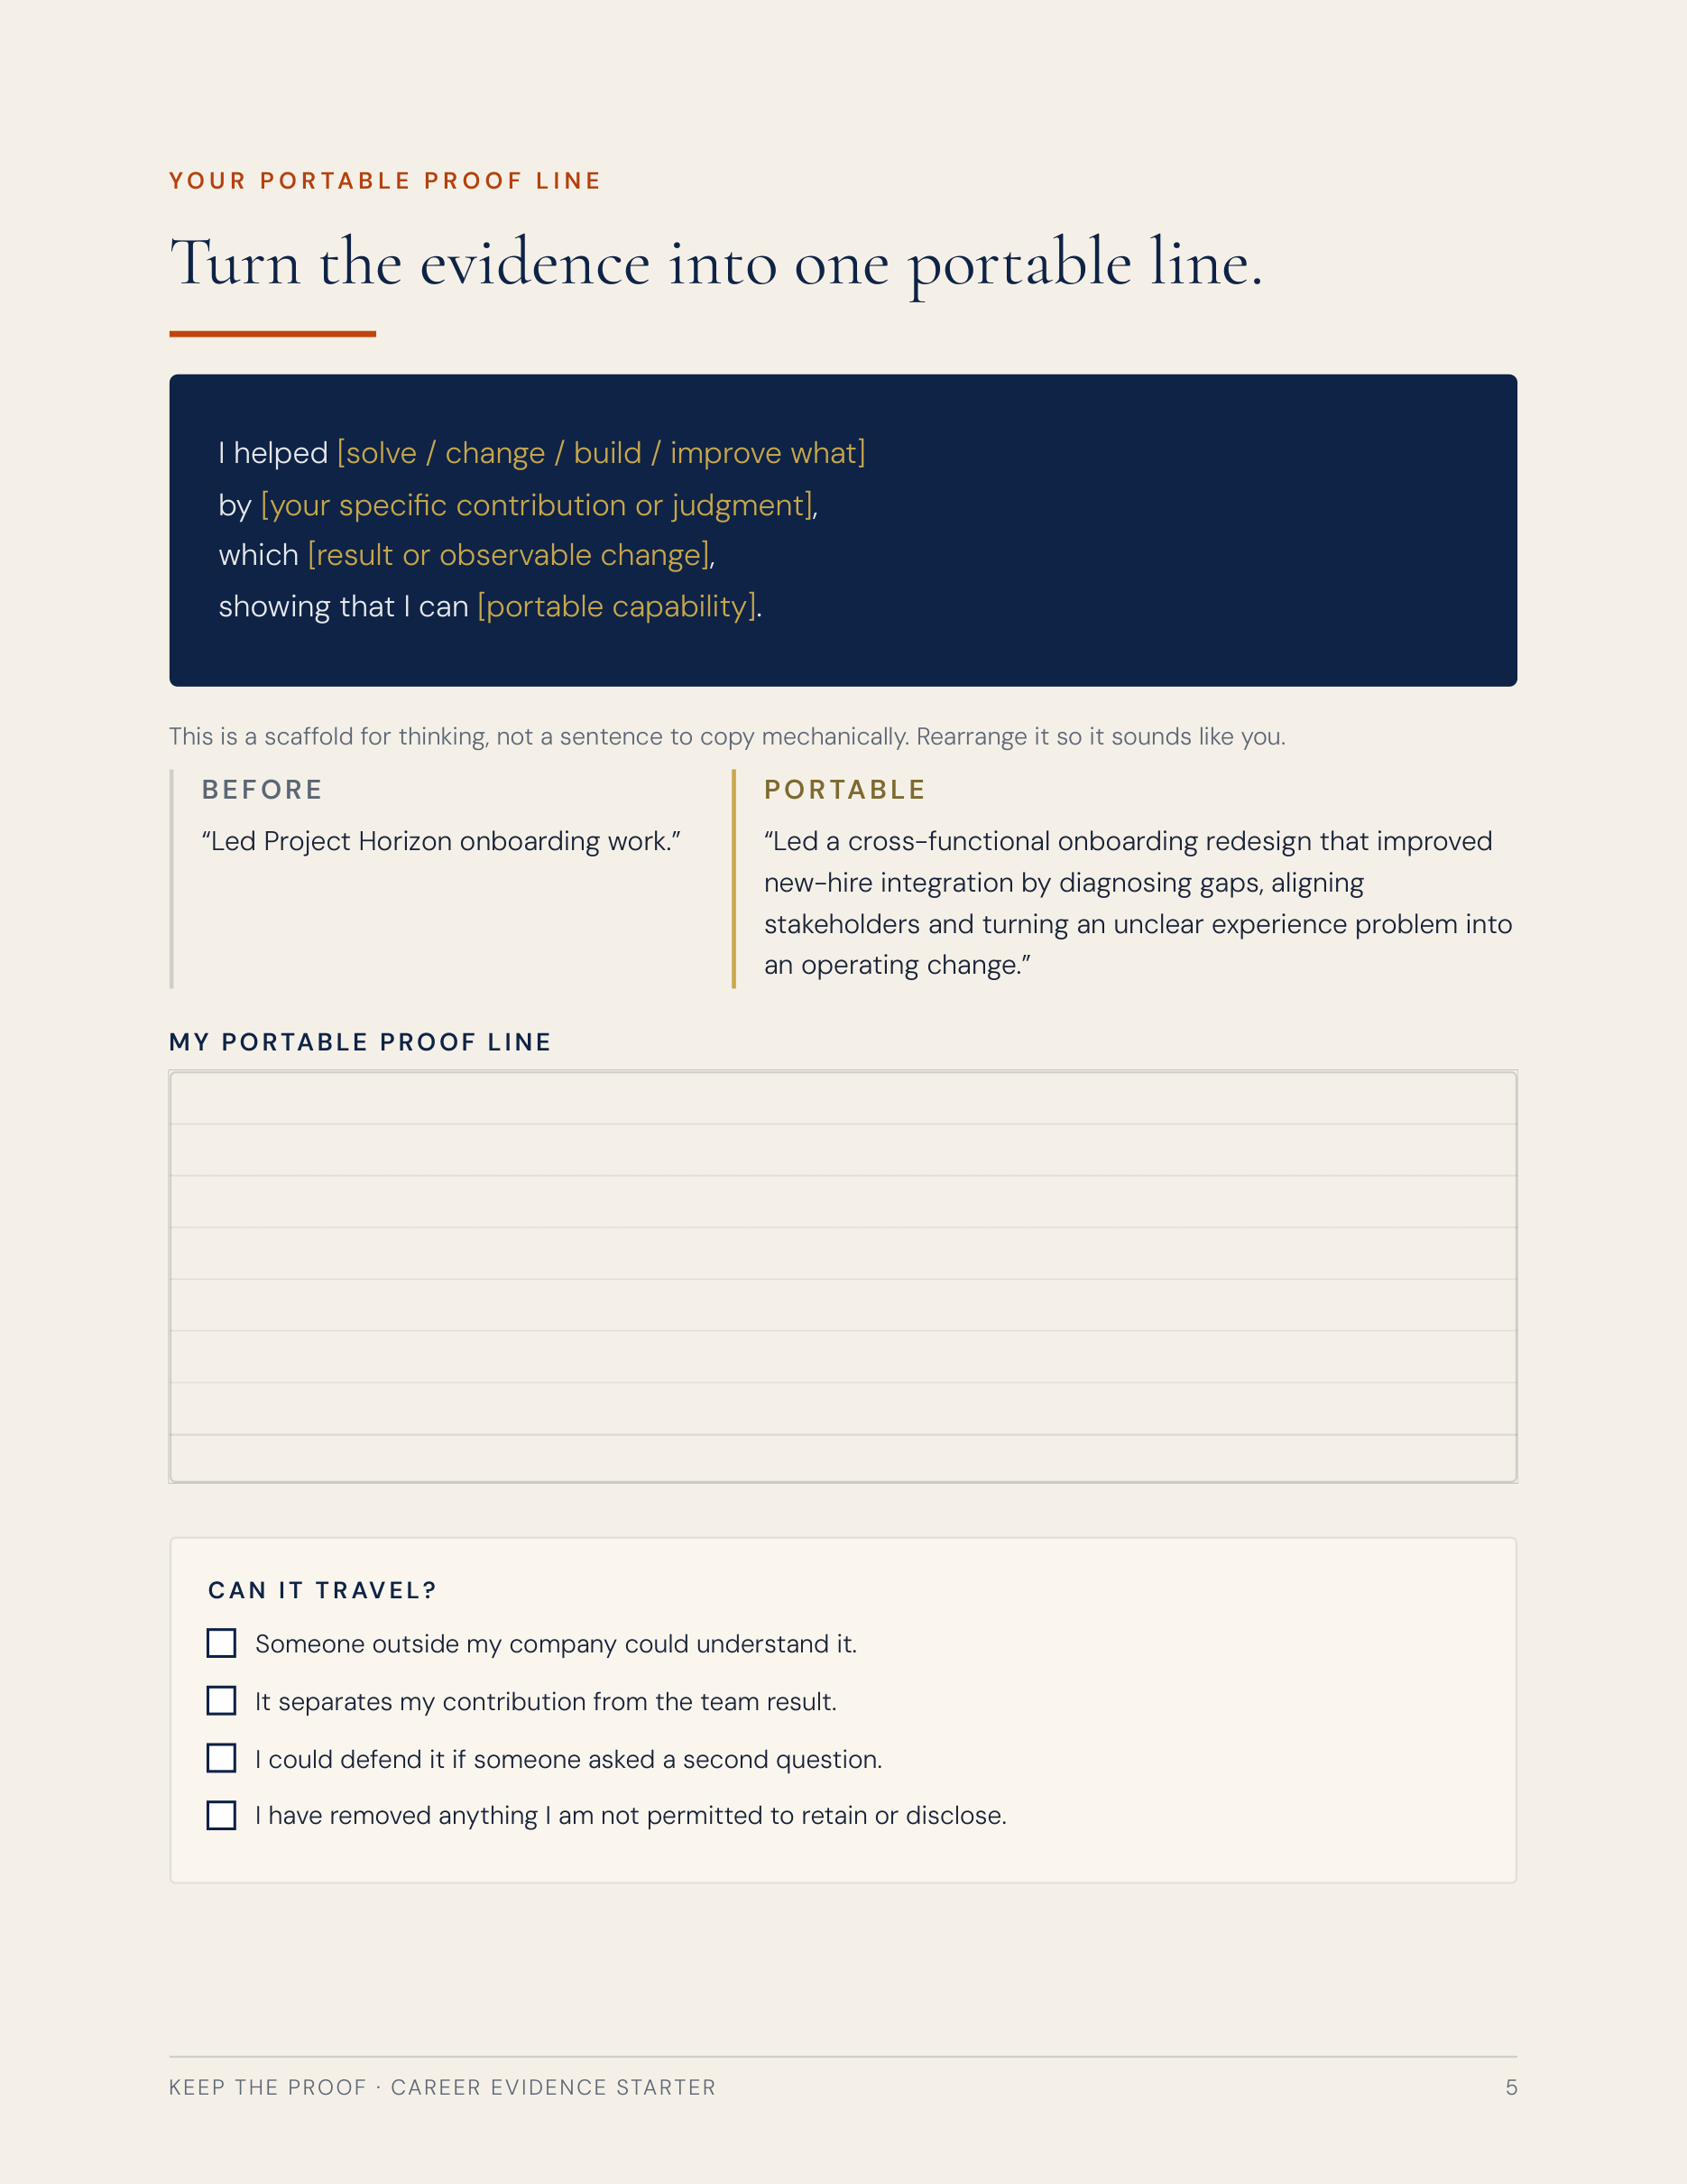
FREE CAREER EVIDENCE STARTER
ONE ACCOMPLISHMENT → ONE PORTABLE PROOF LINE
Turn one accomplishment into proof you can use in a performance review, interview, internal move or career pivot.
temidayoafonja.com/career-evidence-starter
Notes:
Single-state frame — main slide 12.
Timing: approximately 10:55.
Slide 12 — Career Evidence Starter.
Cue — the line that lands on this slide: “If you want to try this on one real thing you have done, I made a free Career Evidence Starter.”
Show the REAL Career Evidence Starter artifact, briefly. Do not redraw it, do not mock one up, do not substitute Field Kit imagery, and do not show the direct PDF URL — the landing page URL only.
One CTA in this video. Do not add the Field Kit or a second offer.
Single state. Reveal frame 21 in the build deck.

Slide 22
WATCH NEXT
Is Your Job Making You Less Marketable?
Notes:
Single-state frame — main slide 13.
Timing: approximately 11:15.
Slide 13 — Watch Next.
Cue — the line that lands on this slide: “Having experience that can travel is not the same as having a job that is still adding to it.”
The Video 2 route. Card reads “Is Your Job Making You Less Marketable?”.
The last two lines are the sign-off. Let them land clean, with no music sting and no end-card animation over her face.
Single state. Reveal frame 22 in the build deck.

