Slide 1
VIDEO TWO · CAPABILITY FORMATION
Is Your Job Making You Less Marketable?
Temidayo Afonja · temidayoafonja.com
Notes:
Single-state frame — main slide 1.
Timing: approximately 0:34.
Slide 1 — Title.
Cue — the line that lands on this slide: “I’m Temidayo Afonja.”
Do NOT open on this slide. Begin full screen on Temidayo. The opening is four beats: the compliment, the private question, “I have had to answer that question about myself more than once”, and the three tests.
Bring the title card in only on “I’m Temidayo Afonja.”
NON-ALARMIST IS A HARD RULE for this whole video. What follows on this slide is the explicit reassurance — being valuable where you are is real value, it is not a trap and not a warning sign. If the edit makes praise, pay or being relied on look like a symptom, the video has failed.
Single state. Reveal frame 1 in the build deck.

Slide 2
TWO DIFFERENT QUESTIONS
Being valuable here answers only one question.
Valuable here
Legible elsewhere
The second question is whether another context can recognize and use what you have built.
Notes:
Single-state frame — main slide 2.
Timing: approximately 1:33.
Slide 2 — Valuable Here / Legible Elsewhere.
Cue — the line that lands on this slide: “Here is what makes this so hard to notice.”
The mechanism slide. Reveal the contrast, then let her talk over it.
“The people around you may know exactly why you matter, because they have seen the work.” This is a compliment and must be delivered as one. The claim is deliberately bounded — it says the people around you MAY know, not that every company reads its people correctly.
“They are not being unfair when they cannot see it. They simply cannot read the evidence.” — this is the line that keeps the video generous about other employers. Keep it.
Her own crossings across functions, employers and industries are the proof here. No employer, client, metric or result is attached to this beat, and there is no number anywhere in this video.
Single state. Reveal frame 2 in the build deck.

Slide 3
THREE MARKETABILITY TESTS
01
Remove the company nouns
Can the capability still be described?
Notes:
Single-state frame — main slide 3.
Timing: approximately 2:54.
Slide 3 — 01 Remove the Company Nouns.
Cue — the line that lands on this slide: “The first test is to remove the company nouns.”
Section break only. The three tests do not arrive until about 2:52, which is deliberate — recognition first.
Single state. Reveal frame 3 in the build deck.

Slide 4
TEST ONE
Remove the company nouns.
Cross out the employer, the internal programs, the systems, the product names and the acronyms. Read what is left.
Company-bound description
I own the QBR process for this business unit.
Notes:
Reveal frame 1 of 2 — main slide 4.
Timing: approximately 2:57.
Slide 4 — Test One.
Cue — the line that lands on this slide: “Take one sentence you would use to describe your work, and delete every word that only exists inside your employer.”
The before and after sentence is the center of this slide. Reveal the before, let it sit, then the after.
FACTUAL BOUNDARY: the QBR sentence is a generic worked example. There is no client, employer, number or result behind it. Do not caption it as a case study, do not add a logo, do not imply it is real.
“It is a diagnostic” — not CV advice. Keep that framing.
Reveal states: 2. Reveal frame 4–5 in the build deck.

Slide 5
TEST ONE
Remove the company nouns.
Cross out the employer, the internal programs, the systems, the product names and the acronyms. Read what is left.
Company-bound description
What another employer can understand
I own the QBR process for this business unit.
I combine incomplete operating data, surface the decision leaders are avoiding, and create a shared view of what needs to happen next.
→
Notes:
Reveal frame 2 of 2 — main slide 4.
Timing: approximately 2:57.
Slide 4 — Test One.
Cue — the line that lands on this slide: “Take one sentence you would use to describe your work, and delete every word that only exists inside your employer.”
The before and after sentence is the center of this slide. Reveal the before, let it sit, then the after.
FACTUAL BOUNDARY: the QBR sentence is a generic worked example. There is no client, employer, number or result behind it. Do not caption it as a case study, do not add a logo, do not imply it is real.
“It is a diagnostic” — not CV advice. Keep that framing.
Reveal states: 2. Reveal frame 4–5 in the build deck.

Slide 6
THREE MARKETABILITY TESTS
02
Find outside-context evidence
Has the usefulness survived a change in context?
Notes:
Single-state frame — main slide 5.
Timing: approximately 4:12.
Slide 5 — 02 Find Outside-Context Evidence.
Cue — the line that lands on this slide: “The second test is to find outside-context evidence.”
Section break only.
Single state. Reveal frame 6 in the build deck.

Slide 7
TEST TWO
Find outside-context evidence.
The evidence can be small. It only has to show the usefulness survived some distance from where it was formed.
01
Cross-functional project
Another group used or sought your judgment.
Notes:
Reveal frame 1 of 4 — main slide 6.
Timing: approximately 4:15.
Slide 6 — Test Two.
Cue — the line that lands on this slide: “Think of a time your judgment was useful beyond your immediate role, your immediate team, or your employer.”
The examples of outside-context evidence reveal one at a time.
“It is the only evidence that has already been tested on people who did not owe you the benefit of the doubt.” That is the reason the test exists. Do not cut it.
The paragraph about deep versus wide is the non-alarmist safeguard in this section. Finding little outside-context evidence is not a verdict on the viewer. Keep both sentences.
Reveal states: 4. Reveal frame 7–10 in the build deck.

Slide 8
TEST TWO
Find outside-context evidence.
The evidence can be small. It only has to show the usefulness survived some distance from where it was formed.
01
Cross-functional project
Another group used or sought your judgment.
02
External client or customer
The capability created value beyond your immediate team.
Notes:
Reveal frame 2 of 4 — main slide 6.
Timing: approximately 4:15.
Slide 6 — Test Two.
Cue — the line that lands on this slide: “Think of a time your judgment was useful beyond your immediate role, your immediate team, or your employer.”
The examples of outside-context evidence reveal one at a time.
“It is the only evidence that has already been tested on people who did not owe you the benefit of the doubt.” That is the reason the test exists. Do not cut it.
The paragraph about deep versus wide is the non-alarmist safeguard in this section. Finding little outside-context evidence is not a verdict on the viewer. Keep both sentences.
Reveal states: 4. Reveal frame 7–10 in the build deck.

Slide 9
TEST TWO
Find outside-context evidence.
The evidence can be small. It only has to show the usefulness survived some distance from where it was formed.
01
Cross-functional project
Another group used or sought your judgment.
02
External client or customer
The capability created value beyond your immediate team.
03
Former colleague
They sought your judgment after the original context changed.
Notes:
Reveal frame 3 of 4 — main slide 6.
Timing: approximately 4:15.
Slide 6 — Test Two.
Cue — the line that lands on this slide: “Think of a time your judgment was useful beyond your immediate role, your immediate team, or your employer.”
The examples of outside-context evidence reveal one at a time.
“It is the only evidence that has already been tested on people who did not owe you the benefit of the doubt.” That is the reason the test exists. Do not cut it.
The paragraph about deep versus wide is the non-alarmist safeguard in this section. Finding little outside-context evidence is not a verdict on the viewer. Keep both sentences.
Reveal states: 4. Reveal frame 7–10 in the build deck.

Slide 10
TEST TWO
Find outside-context evidence.
The evidence can be small. It only has to show the usefulness survived some distance from where it was formed.
01
Cross-functional project
Another group used or sought your judgment.
02
External client or customer
The capability created value beyond your immediate team.
03
Former colleague
They sought your judgment after the original context changed.
04
Another setting or industry contribution
A similar problem or approach remained useful elsewhere.
Notes:
Reveal frame 4 of 4 — main slide 6.
Timing: approximately 4:15.
Slide 6 — Test Two.
Cue — the line that lands on this slide: “Think of a time your judgment was useful beyond your immediate role, your immediate team, or your employer.”
The examples of outside-context evidence reveal one at a time.
“It is the only evidence that has already been tested on people who did not owe you the benefit of the doubt.” That is the reason the test exists. Do not cut it.
The paragraph about deep versus wide is the non-alarmist safeguard in this section. Finding little outside-context evidence is not a verdict on the viewer. Keep both sentences.
Reveal states: 4. Reveal frame 7–10 in the build deck.

Slide 11
THREE MARKETABILITY TESTS
03
Read the last 90 days
What new judgment did the work build?
Notes:
Single-state frame — main slide 7.
Timing: approximately 5:36.
Slide 7 — 03 Read the Last 90 Days.
Cue — the line that lands on this slide: “The third test is to read your last 90 days.”
Section break only.
Single state. Reveal frame 11 in the build deck.

Slide 12
TEST THREE
Read the last 90 days.
What can you now do, see or decide that you could not do ninety days ago?
New judgment
Same work faster
Notes:
Reveal frame 1 of 4 — main slide 8.
Timing: approximately 5:40.
Slide 8 — Test Three.
Cue — the line that lands on this slide: “Not whether you were busy.”
The questions reveal one at a time.
The skipped question — new judgment, or the same work faster — is the payoff of the section. Give it room before the answer.
“Both are fine. You just want to know which one you have been doing.” No judgement in the delivery, and no visual that codes speed as bad.
Reveal states: 4. Reveal frame 12–15 in the build deck.

Slide 13
TEST THREE
Read the last 90 days.
What can you now do, see or decide that you could not do ninety days ago?
New judgment
Same work faster
01
What unfamiliar problem did I have to solve?
Notes:
Reveal frame 2 of 4 — main slide 8.
Timing: approximately 5:40.
Slide 8 — Test Three.
Cue — the line that lands on this slide: “Not whether you were busy.”
The questions reveal one at a time.
The skipped question — new judgment, or the same work faster — is the payoff of the section. Give it room before the answer.
“Both are fine. You just want to know which one you have been doing.” No judgement in the delivery, and no visual that codes speed as bad.
Reveal states: 4. Reveal frame 12–15 in the build deck.

Slide 14
TEST THREE
Read the last 90 days.
What can you now do, see or decide that you could not do ninety days ago?
New judgment
Same work faster
01
What unfamiliar problem did I have to solve?
02
What decision can I now make with less help?
Notes:
Reveal frame 3 of 4 — main slide 8.
Timing: approximately 5:40.
Slide 8 — Test Three.
Cue — the line that lands on this slide: “Not whether you were busy.”
The questions reveal one at a time.
The skipped question — new judgment, or the same work faster — is the payoff of the section. Give it room before the answer.
“Both are fine. You just want to know which one you have been doing.” No judgement in the delivery, and no visual that codes speed as bad.
Reveal states: 4. Reveal frame 12–15 in the build deck.

Slide 15
TEST THREE
Read the last 90 days.
What can you now do, see or decide that you could not do ninety days ago?
New judgment
Same work faster
01
What unfamiliar problem did I have to solve?
02
What decision can I now make with less help?
03
What constraint, audience or context did I learn to work across?
Notes:
Reveal frame 4 of 4 — main slide 8.
Timing: approximately 5:40.
Slide 8 — Test Three.
Cue — the line that lands on this slide: “Not whether you were busy.”
The questions reveal one at a time.
The skipped question — new judgment, or the same work faster — is the payoff of the section. Give it room before the answer.
“Both are fine. You just want to know which one you have been doing.” No judgement in the delivery, and no visual that codes speed as bad.
Reveal states: 4. Reveal frame 12–15 in the build deck.

Slide 16
THE THREE TESTS
Together they separate internal value from external marketability.
01
02
03
Remove the company nouns
Find outside-context evidence
Read the last 90 days
Notes:
Single-state frame — main slide 9.
Timing: approximately 6:37.
Slide 9 — The Three Tests.
Cue — the line that lands on this slide: “So those are the three.”
The three tests together on screen for the first time. Short slide.
Single state. Reveal frame 16 in the build deck.

Slide 17
READING THE PATTERN
Read them together.
Is my judgment growing?
Can another context use it?
One familiar sign is not a diagnosis. Read the pattern across growth and portability, and keep the reading provisional.
Notes:
Single-state frame — main slide 10.
Timing: approximately 6:44.
Slide 10 — Read the Pattern.
Cue — the line that lands on this slide: “And I want to tell you how to read them, because one test on one bad quarter tells you nothing.”
The two questions held side by side.
“Do not diagnose your career from a single quarter.” This slide exists to stop the video producing anxiety from one bad stretch. It is not optional.
Close on “Not panic. Attention.” Let it land.
Single state. Reveal frame 17 in the build deck.

Slide 18
BEFORE YOU LEAVE
What can I change before I leave?
A concern in one test does not mean the answer is to resign. Choose one thing to test in the next thirty days.
01
Ask for work that creates new judgment, not only more volume.
Notes:
Reveal frame 1 of 4 — main slide 11.
Timing: approximately 7:31.
Slide 11 — Before You Leave.
Cue — the line that lands on this slide: “Which brings me to the part you might assume is coming, and it is not.”
The things the viewer could do without going anywhere reveal one at a time.
Then the honest limits: this will not stop a restructure, control a hiring market, or turn a bad year into a good one.
THE IDENTITY EXIT sits at the end of this slide: “Not a plan for leaving. The habit of checking.” It is the point of the video. If the edit runs long, cut something else.
Reveal states: 4. Reveal frame 18–21 in the build deck.

Slide 19
BEFORE YOU LEAVE
What can I change before I leave?
A concern in one test does not mean the answer is to resign. Choose one thing to test in the next thirty days.
01
Ask for work that creates new judgment, not only more volume.
02
Make the capability visible outside the immediate team or function.
Notes:
Reveal frame 2 of 4 — main slide 11.
Timing: approximately 7:31.
Slide 11 — Before You Leave.
Cue — the line that lands on this slide: “Which brings me to the part you might assume is coming, and it is not.”
The things the viewer could do without going anywhere reveal one at a time.
Then the honest limits: this will not stop a restructure, control a hiring market, or turn a bad year into a good one.
THE IDENTITY EXIT sits at the end of this slide: “Not a plan for leaving. The habit of checking.” It is the point of the video. If the edit runs long, cut something else.
Reveal states: 4. Reveal frame 18–21 in the build deck.

Slide 20
BEFORE YOU LEAVE
What can I change before I leave?
A concern in one test does not mean the answer is to resign. Choose one thing to test in the next thirty days.
01
Ask for work that creates new judgment, not only more volume.
02
Make the capability visible outside the immediate team or function.
03
Document knowledge or results that exist mainly in your head.
Notes:
Reveal frame 3 of 4 — main slide 11.
Timing: approximately 7:31.
Slide 11 — Before You Leave.
Cue — the line that lands on this slide: “Which brings me to the part you might assume is coming, and it is not.”
The things the viewer could do without going anywhere reveal one at a time.
Then the honest limits: this will not stop a restructure, control a hiring market, or turn a bad year into a good one.
THE IDENTITY EXIT sits at the end of this slide: “Not a plan for leaving. The habit of checking.” It is the point of the video. If the edit runs long, cut something else.
Reveal states: 4. Reveal frame 18–21 in the build deck.

Slide 21
BEFORE YOU LEAVE
What can I change before I leave?
A concern in one test does not mean the answer is to resign. Choose one thing to test in the next thirty days.
01
Ask for work that creates new judgment, not only more volume.
02
Make the capability visible outside the immediate team or function.
03
Document knowledge or results that exist mainly in your head.
04
Take on an adjacent problem that forces the capability into a different context.
Notes:
Reveal frame 4 of 4 — main slide 11.
Timing: approximately 7:31.
Slide 11 — Before You Leave.
Cue — the line that lands on this slide: “Which brings me to the part you might assume is coming, and it is not.”
The things the viewer could do without going anywhere reveal one at a time.
Then the honest limits: this will not stop a restructure, control a hiring market, or turn a bad year into a good one.
THE IDENTITY EXIT sits at the end of this slide: “Not a plan for leaving. The habit of checking.” It is the point of the video. If the edit runs long, cut something else.
Reveal states: 4. Reveal frame 18–21 in the build deck.

Slide 22

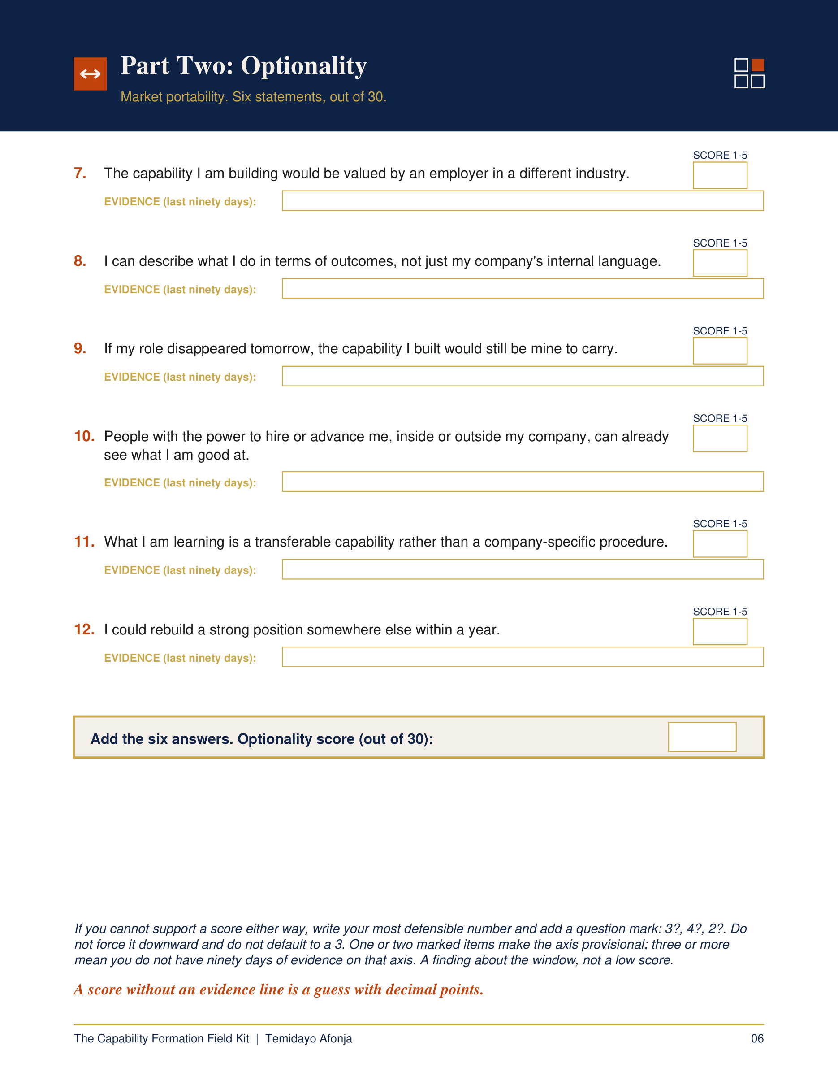
THE CAPABILITY FORMATION FIELD KIT
Is your job still building you?
Complete a private, evidence-led career position assessment using the last 90 days of your actual work.
temidayoafonja.com/fieldkit
Notes:
Single-state frame — main slide 12.
Timing: approximately 8:48.
Slide 12 — Capability Formation Field Kit.
Cue — the line that lands on this slide: “If you want a fuller read than three tests can give you, I made the Capability Formation Field Kit.”
Show the real Field Kit artwork briefly. One CTA in this video — do not add Keep the Proof or the Career Evidence Starter.
Before publishing, verify the live /fieldkit redirect and the current listing.
Single state. Reveal frame 22 in the build deck.

Slide 23
WATCH NEXT
3 Things to Do Before Quitting Your Job
Notes:
Single-state frame — main slide 13.
Timing: approximately 9:09.
Slide 13 — Watch Next.
Cue — the line that lands on this slide: “And if you are further along than checking — if some part of you has already decided — there is a different conversation to have.”
The Video 3 route. This card already carries the corrected title, “3 Things to Do Before Quitting Your Job”. Verify it on the recording screen.
“I am not going to try to talk you into staying. I want to help you leave with more than exhaustion.” — that is the Video 3 promise, previewed honestly.
Sign off clean. No music sting over the last two lines.
Single state. Reveal frame 23 in the build deck.

