Slide 1
VIDEO ONE · CAPABILITY FORMATION
How I Changed Jobs Without Starting My Career Over
Temidayo Afonja · temidayoafonja.com
Notes:
Timing: 0:00-0:35
Begin full-screen on Temidayo rather than on the slide.
Exact opening:
"If you are considering a different job, function or industry, one of the
hardest questions is whether the experience you already have will still
count. I have changed the kind of work I do several times without treating
each move as a return to zero. In this video, I will show you three
questions I use to identify what my experience has built, explain one
result in language another employer can understand and decide what
evidence to preserve before I move."
Move to the title slide after introducing the three questions.

Slide 2

MY CAREER PATH
What connected those career changes
Accounting and audit trained me to look for evidence, controls, risk and what a system was failing to reveal. I carried that way of seeing into cybersecurity and later into people strategy.
ACCOUNTING & AUDIT
CYBERSECURITY
PEOPLE STRATEGY
CAPABILITY FORMATION
Along the way: consulting, life sciences, technology
Notes:
Timing: 0:35-1:35
Speak naturally from the career sequence. Do not read the slide.
Use this transition:
"The continuity was not always visible in the job titles. I had to look
underneath them and ask what the work had actually trained me to do."
Keep the camera in the upper-left safe area while the timeline is up.

Slide 3
THREE THINGS I LEARNED TO DO
These helped me carry my experience forward.
01
Look underneath the title
Notes:
Timing: 1:35-1:50
Introduce the three ideas briefly. Do not explain all three on this slide.
Reveal one card at a time.

Slide 4
THREE THINGS I LEARNED TO DO
These helped me carry my experience forward.
01
02
Look underneath the title
Explain what the work changed
Notes:
Timing: 1:35-1:50
Introduce the three ideas briefly. Do not explain all three on this slide.
Reveal one card at a time.

Slide 5
THREE THINGS I LEARNED TO DO
These helped me carry my experience forward.
01
02
03
Look underneath the title
Explain what the work changed
Keep evidence before you need it
Notes:
Timing: 1:35-1:50
Introduce the three ideas briefly. Do not explain all three on this slide.
Reveal one card at a time.

Slide 6
MOVE ONE
Look underneath the title.
Name what the work has trained you to notice, decide and solve.
01
What problems do people trust me to solve?
Notes:
Timing: 1:50-3:10
Explain that the title identifies where the work sat, while the questions
reveal what the experience developed.
Reveal one question at a time.
Viewer action:
Write down your current title. Under it, name three problems people now
trust you to solve.

Slide 7
MOVE ONE
Look underneath the title.
Name what the work has trained you to notice, decide and solve.
01
What problems do people trust me to solve?
02
What decisions can I now make with better judgment?
Notes:
Timing: 1:50-3:10
Explain that the title identifies where the work sat, while the questions
reveal what the experience developed.
Reveal one question at a time.
Viewer action:
Write down your current title. Under it, name three problems people now
trust you to solve.

Slide 8
MOVE ONE
Look underneath the title.
Name what the work has trained you to notice, decide and solve.
01
What problems do people trust me to solve?
02
What decisions can I now make with better judgment?
03
What could I do in another setting because of what I learned here?
Notes:
Timing: 1:50-3:10
Explain that the title identifies where the work sat, while the questions
reveal what the experience developed.
Reveal one question at a time.
Viewer action:
Write down your current title. Under it, name three problems people now
trust you to solve.

Slide 9
MOVE TWO
Explain what the work changed.
Ask: What changed because I was there?
Internal description
Led an onboarding redesign.
Notes:
Timing: 3:10-4:10
Explain that "onboarding redesign" names the project but does not yet tell
an unfamiliar viewer what improved.
State clearly that you led the redesign with your team.
Reveal the portable description only after the internal one has been read
aloud and explained.

Slide 10
MOVE TWO
Explain what the work changed.
Ask: What changed because I was there?
Internal description
What another employer can understand
Led an onboarding redesign.
I led an onboarding redesign with my team. One measure of how well new hires felt integrated moved from 47 to 75.
→
Notes:
Timing: 3:10-4:10
Explain that "onboarding redesign" names the project but does not yet tell
an unfamiliar viewer what improved.
State clearly that you led the redesign with your team.
Reveal the portable description only after the internal one has been read
aloud and explained.

Slide 11
ONE RESULT
One measure of new-hire integration
A team result from a redesign I led
47
Before the redesign
Notes:
Timing: 4:10-4:55
Say:
"One measure of how well new hires felt integrated moved from 47 to 75
after the onboarding redesign I led with my team. The number becomes
useful because I can explain what it measured, what changed and what I
was responsible for."
Reveal 47 first, then 75.

Slide 12
ONE RESULT
One measure of new-hire integration
A team result from a redesign I led
47
75
→
Before the redesign
After the redesign
Notes:
Timing: 4:10-4:55
Say:
"One measure of how well new hires felt integrated moved from 47 to 75
after the onboarding redesign I led with my team. The number becomes
useful because I can explain what it measured, what changed and what I
was responsible for."
Reveal 47 first, then 75.

Slide 13
MOVE THREE
Keep evidence before you need it.
Write a permitted, high-level account in your own words. Leave confidential and employer-owned material out.
Situation
New hires needed a stronger integration experience.
Notes:
Timing: 4:55-6:40
Explain that professionals often remember project names while losing the
evidence, context and explanation that make the work useful later.
Teach the card one row at a time.
Keep the account permitted and high level. Nothing confidential and no
employer-owned material.

Slide 14
MOVE THREE
Keep evidence before you need it.
Write a permitted, high-level account in your own words. Leave confidential and employer-owned material out.
Situation
New hires needed a stronger integration experience.
My role
I led the onboarding redesign with my team.
Notes:
Timing: 4:55-6:40
Explain that professionals often remember project names while losing the
evidence, context and explanation that make the work useful later.
Teach the card one row at a time.
Keep the account permitted and high level. Nothing confidential and no
employer-owned material.

Slide 15
MOVE THREE
Keep evidence before you need it.
Write a permitted, high-level account in your own words. Leave confidential and employer-owned material out.
Situation
New hires needed a stronger integration experience.
My role
I led the onboarding redesign with my team.
What changed
One measure of how well new hires felt integrated moved from 47 to 75.
Notes:
Timing: 4:55-6:40
Explain that professionals often remember project names while losing the
evidence, context and explanation that make the work useful later.
Teach the card one row at a time.
Keep the account permitted and high level. Nothing confidential and no
employer-owned material.

Slide 16
MOVE THREE
Keep evidence before you need it.
Write a permitted, high-level account in your own words. Leave confidential and employer-owned material out.
Situation
New hires needed a stronger integration experience.
My role
I led the onboarding redesign with my team.
What changed
One measure of how well new hires felt integrated moved from 47 to 75.
What this shows
I can diagnose a weak point in the employee experience and lead a redesign that improves it.
Notes:
Timing: 4:55-6:40
Explain that professionals often remember project names while losing the
evidence, context and explanation that make the work useful later.
Teach the card one row at a time.
Keep the account permitted and high level. Nothing confidential and no
employer-owned material.

Slide 17
BEFORE YOUR NEXT MOVE
Write down your answers to these three questions.
01
What can I solve now that I could not solve two years ago?
Notes:
Timing: 6:40-7:45
Ask one question at a time and pause.
Leave five to seven seconds after the third question before moving to the
Field Kit invitation.

Slide 18
BEFORE YOUR NEXT MOVE
Write down your answers to these three questions.
01
What can I solve now that I could not solve two years ago?
02
What result can I describe in language another employer would understand?
Notes:
Timing: 6:40-7:45
Ask one question at a time and pause.
Leave five to seven seconds after the third question before moving to the
Field Kit invitation.

Slide 19
BEFORE YOUR NEXT MOVE
Write down your answers to these three questions.
01
What can I solve now that I could not solve two years ago?
02
What result can I describe in language another employer would understand?
03
What could I still do if the title, employer or industry changed?
Notes:
Timing: 6:40-7:45
Ask one question at a time and pause.
Leave five to seven seconds after the third question before moving to the
Field Kit invitation.

Slide 20

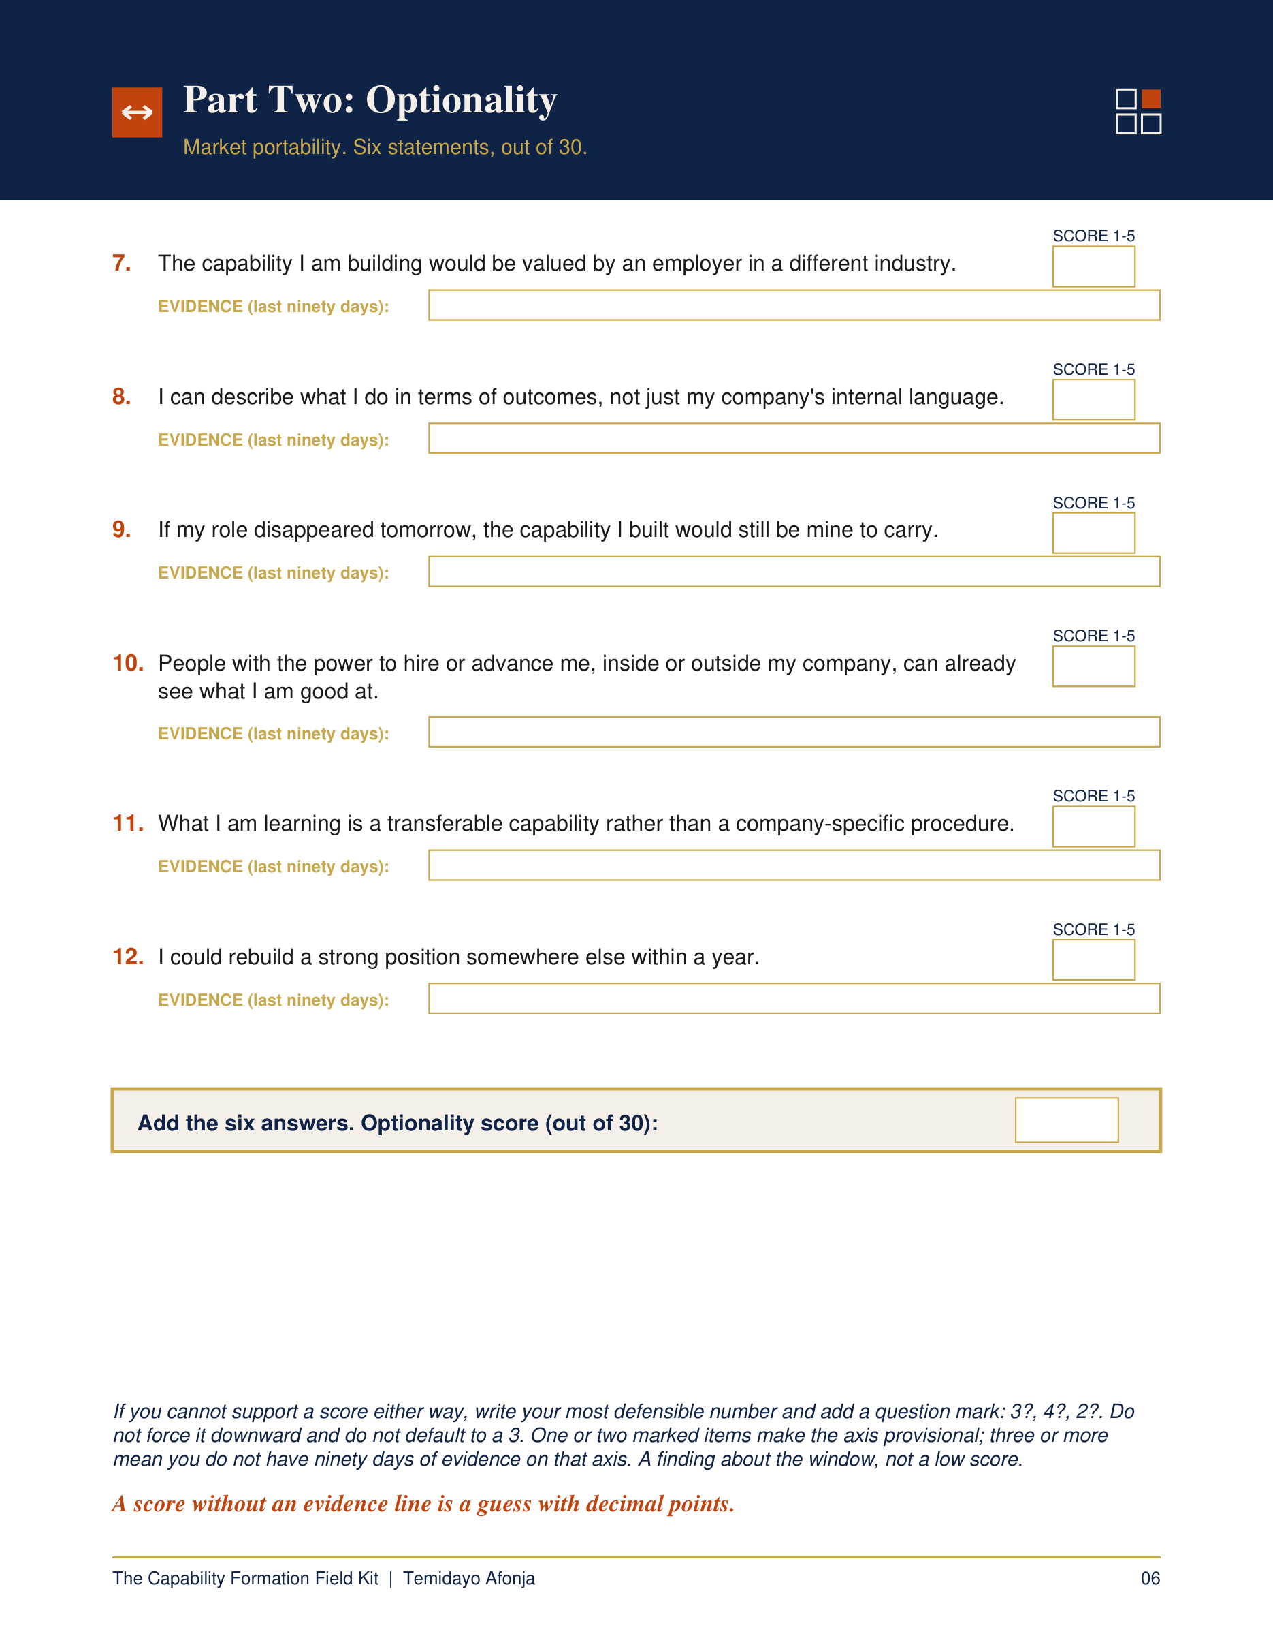
THE CAPABILITY FORMATION FIELD KIT
Is your job still building you?
Complete a private, evidence-led career position assessment using the last 90 days of your actual work.
temidayoafonja.com/fieldkit
Notes:
Timing: 7:45-8:20
Exact invitation:
"If these questions are showing you that you need a fuller reading of what
your current work is building, the Capability Formation Field Kit will help
you complete that assessment privately using evidence from the last 90
days."
Keep the delivery calm and brief. This is the only purchase invitation in
the video.

Slide 21
WATCH NEXT
Is Your Job Making You Less Marketable?
Notes:
Timing: 8:20-9:00
Exact bridge:
"In the next video, I will show you how to recognize when you are still
performing well but the work is no longer expanding your skills or future
options."
Do not summarize the current video again.
The right side of this frame is left open for the YouTube linked-video
end-screen element. Hold the final frame for at least 12 seconds.

