Slide 1
VIDEO TWO · CAPABILITY FORMATION
Is Your Job Making You Less Marketable?
Temidayo Afonja · temidayoafonja.com
Notes:
Timing: 0:00-0:45
Begin full-screen on Temidayo, not on this slide.
Exact opening:
"A job can make you more valuable inside one company while making you harder
to understand everywhere else. That can happen while you are being praised,
well paid, and the person everyone depends on. In this video, I am going to
give you three tests for whether your current success is expanding your
marketability or quietly narrowing it. By the end, you will know what to strip
away from the way you describe your work, what outside-context evidence to
look for, and what the last 90 days have actually added to your judgment. I am
Temidayo Afonja. On this channel, I help experienced professionals make
clearer career decisions by looking at what their work is actually building in
them."
Move to the title only after the three-test promise and the channel line are
clear. Do not make the opening alarmist.

Slide 2
TWO DIFFERENT QUESTIONS
Success answers one of them at a time.
Valuable here
Legible elsewhere
Current success can answer one question while leaving the other unresolved.
Notes:
Timing: 0:45-1:55
Speak from ideas. Keep this mostly on camera; the slide is visual tension,
not a lecture frame.
Beats: praise can rise while the work becomes more context-bound; pay and
responsibility can rise because you know one environment extremely well;
dependence can come from undocumented knowledge, internal relationships or a
fragile process. None of that is a reason to panic or leave.
Exact landing line:
"Praise can tell you that you matter here. It cannot tell you how easily your
value travels."

Slide 3
THREE MARKETABILITY TESTS
01
Remove the company nouns
Can the capability still be described?
Notes:
Timing: 1:55-2:03
A section break, four to seven seconds. Say: "The first test is to remove the
company nouns."
Do not teach it here. The example slide follows.
Only this test is on screen. The second and third come later, each in its own
moment.

Slide 4
TEST ONE
Remove the company nouns.
Cross out the employer, the internal programs, the systems, the product names and the acronyms. Read what is left.
Company-bound description
I own the QBR process for this business unit.
Notes:
Timing: 2:03-3:15
Speak from ideas. Show the company-bound sentence first, then the clearer
description.
What remains after the nouns come out should still tell another person what
problem you solve and what judgment the work requires.
Viewer action: take one sentence from your resume, your LinkedIn profile or
the way you introduce your work. Remove the company nouns. If the sentence
collapses, rewrite it around the problem you solve and the judgment you bring.
The example is generic. Keep it that way; no employer-specific or
confidential material.

Slide 5
TEST ONE
Remove the company nouns.
Cross out the employer, the internal programs, the systems, the product names and the acronyms. Read what is left.
Company-bound description
What another employer can understand
I own the QBR process for this business unit.
I combine incomplete operating data, surface the decision leaders are avoiding, and create a shared view of what needs to happen next.
→
Notes:
Timing: 2:03-3:15
Speak from ideas. Show the company-bound sentence first, then the clearer
description.
What remains after the nouns come out should still tell another person what
problem you solve and what judgment the work requires.
Viewer action: take one sentence from your resume, your LinkedIn profile or
the way you introduce your work. Remove the company nouns. If the sentence
collapses, rewrite it around the problem you solve and the judgment you bring.
The example is generic. Keep it that way; no employer-specific or
confidential material.

Slide 6
THREE MARKETABILITY TESTS
02
Find outside-context evidence
Has the usefulness survived a change in context?
Notes:
Timing: 3:15-3:23
A section break, four to seven seconds. Say: "The second test is to find
evidence that your capability has been useful outside its original context."
Do not restate the first test. The evidence slide follows.

Slide 7
TEST TWO
Find outside-context evidence.
The evidence can be small. It only has to show the usefulness survived some distance from where it was formed.
01
Cross-functional project
Another group used or sought your judgment.
Notes:
Timing: 3:23-4:35
Speak from ideas. Reveal one source at a time. Keep it simple; this is not a
list of credentials.
Outside-context evidence does not mean job offers or public visibility. Do not
count visibility by itself as proof. The question is whether the judgment was
actually useful beyond the original context.
Viewer action: write down one example where your judgment was useful beyond
your immediate role, team or employer. If you cannot find one yet, that is
useful information to investigate.
Say why indispensability can mislead: an organization may depend on you
because knowledge, relationships or a fragile process run through you. That
raises internal importance without raising what you can do somewhere else.

Slide 8
TEST TWO
Find outside-context evidence.
The evidence can be small. It only has to show the usefulness survived some distance from where it was formed.
01
Cross-functional project
Another group used or sought your judgment.
02
External client or customer
The capability created value beyond your immediate team.
Notes:
Timing: 3:23-4:35
Speak from ideas. Reveal one source at a time. Keep it simple; this is not a
list of credentials.
Outside-context evidence does not mean job offers or public visibility. Do not
count visibility by itself as proof. The question is whether the judgment was
actually useful beyond the original context.
Viewer action: write down one example where your judgment was useful beyond
your immediate role, team or employer. If you cannot find one yet, that is
useful information to investigate.
Say why indispensability can mislead: an organization may depend on you
because knowledge, relationships or a fragile process run through you. That
raises internal importance without raising what you can do somewhere else.

Slide 9
TEST TWO
Find outside-context evidence.
The evidence can be small. It only has to show the usefulness survived some distance from where it was formed.
01
Cross-functional project
Another group used or sought your judgment.
02
External client or customer
The capability created value beyond your immediate team.
03
Former colleague
They sought your judgment after the original context changed.
Notes:
Timing: 3:23-4:35
Speak from ideas. Reveal one source at a time. Keep it simple; this is not a
list of credentials.
Outside-context evidence does not mean job offers or public visibility. Do not
count visibility by itself as proof. The question is whether the judgment was
actually useful beyond the original context.
Viewer action: write down one example where your judgment was useful beyond
your immediate role, team or employer. If you cannot find one yet, that is
useful information to investigate.
Say why indispensability can mislead: an organization may depend on you
because knowledge, relationships or a fragile process run through you. That
raises internal importance without raising what you can do somewhere else.

Slide 10
TEST TWO
Find outside-context evidence.
The evidence can be small. It only has to show the usefulness survived some distance from where it was formed.
01
Cross-functional project
Another group used or sought your judgment.
02
External client or customer
The capability created value beyond your immediate team.
03
Former colleague
They sought your judgment after the original context changed.
04
Another setting or industry contribution
A similar problem or approach remained useful elsewhere.
Notes:
Timing: 3:23-4:35
Speak from ideas. Reveal one source at a time. Keep it simple; this is not a
list of credentials.
Outside-context evidence does not mean job offers or public visibility. Do not
count visibility by itself as proof. The question is whether the judgment was
actually useful beyond the original context.
Viewer action: write down one example where your judgment was useful beyond
your immediate role, team or employer. If you cannot find one yet, that is
useful information to investigate.
Say why indispensability can mislead: an organization may depend on you
because knowledge, relationships or a fragile process run through you. That
raises internal importance without raising what you can do somewhere else.

Slide 11
THREE MARKETABILITY TESTS
03
Read the last 90 days
What new judgment did the work build?
Notes:
Timing: 4:35-4:43
A section break, four to seven seconds. Say: "The third test is to read the
last 90 days."
Do not restate the first two. The judgment slide follows.

Slide 12
TEST THREE
Read the last 90 days.
What can you now do, see or decide that you could not do ninety days ago?
New judgment
Same work faster
Notes:
Timing: 4:43-5:55
Speak from ideas. Hold the contrast first, then reveal the prompts one at a
time. Let the contrast breathe.
New judgment might come from a more ambiguous problem, a decision made with
incomplete information, influencing a different group, working across a new
constraint, or building judgment where you previously needed help.
Gem to land: "Speed has value. New judgment tells you something different."
Do not ask only whether you were busy or whether you performed well.

Slide 13
TEST THREE
Read the last 90 days.
What can you now do, see or decide that you could not do ninety days ago?
New judgment
Same work faster
01
What unfamiliar problem did I have to solve?
Notes:
Timing: 4:43-5:55
Speak from ideas. Hold the contrast first, then reveal the prompts one at a
time. Let the contrast breathe.
New judgment might come from a more ambiguous problem, a decision made with
incomplete information, influencing a different group, working across a new
constraint, or building judgment where you previously needed help.
Gem to land: "Speed has value. New judgment tells you something different."
Do not ask only whether you were busy or whether you performed well.

Slide 14
TEST THREE
Read the last 90 days.
What can you now do, see or decide that you could not do ninety days ago?
New judgment
Same work faster
01
What unfamiliar problem did I have to solve?
02
What decision can I now make with less help?
Notes:
Timing: 4:43-5:55
Speak from ideas. Hold the contrast first, then reveal the prompts one at a
time. Let the contrast breathe.
New judgment might come from a more ambiguous problem, a decision made with
incomplete information, influencing a different group, working across a new
constraint, or building judgment where you previously needed help.
Gem to land: "Speed has value. New judgment tells you something different."
Do not ask only whether you were busy or whether you performed well.

Slide 15
TEST THREE
Read the last 90 days.
What can you now do, see or decide that you could not do ninety days ago?
New judgment
Same work faster
01
What unfamiliar problem did I have to solve?
02
What decision can I now make with less help?
03
What constraint, audience or context did I learn to work across?
Notes:
Timing: 4:43-5:55
Speak from ideas. Hold the contrast first, then reveal the prompts one at a
time. Let the contrast breathe.
New judgment might come from a more ambiguous problem, a decision made with
incomplete information, influencing a different group, working across a new
constraint, or building judgment where you previously needed help.
Gem to land: "Speed has value. New judgment tells you something different."
Do not ask only whether you were busy or whether you performed well.

Slide 16
THE THREE TESTS
Together they separate internal value from external marketability.
01
02
03
Remove the company nouns
Find outside-context evidence
Read the last 90 days
Notes:
Timing: 5:55-6:25
The first and only moment all three tests appear together.
Name them once, in order: remove the company nouns, find outside-context
evidence, read the last 90 days. Do not teach them again.
Gem to land: "Internal value and external marketability are two different
questions."

Slide 17
READING THE PATTERN
Read them together.
Is my judgment growing?
Can another context use it?
One familiar sign is not a diagnosis. Read the pattern across growth and portability, and keep the reading provisional.
Notes:
Timing: 6:25-7:10
Keep this quiet and provisional. Do not turn the four patterns into a dramatic
diagnosis of the viewer.
Spoken, not on the slide: if judgment is deepening and the capability is
useful across contexts, the work is compounding. If expertise is deepening but
its usefulness is trapped inside one environment, that can be a Depth Trap. If
visibility is growing but the work is not building depth, the position may be
fragile. If neither the capability nor the options are growing, the role may
be stagnant even while performance stays strong.
Do not diagnose from one familiar sign.

Slide 18
BEFORE YOU LEAVE
What can I change before I leave?
A concern in one test does not mean the answer is to resign. Choose one thing to test in the next thirty days.
01
Ask for work that creates new judgment, not only more volume.
Notes:
Timing: 7:10-8:00
Speak from ideas. Reveal one option at a time.
Viewer action: choose one thing you can test during the next thirty days.
Sometimes the first move is to change the work before changing the employer.
Gem to land: "Before you change the employer, test whether you can change what
the work is building."

Slide 19
BEFORE YOU LEAVE
What can I change before I leave?
A concern in one test does not mean the answer is to resign. Choose one thing to test in the next thirty days.
01
Ask for work that creates new judgment, not only more volume.
02
Make the capability visible outside the immediate team or function.
Notes:
Timing: 7:10-8:00
Speak from ideas. Reveal one option at a time.
Viewer action: choose one thing you can test during the next thirty days.
Sometimes the first move is to change the work before changing the employer.
Gem to land: "Before you change the employer, test whether you can change what
the work is building."

Slide 20
BEFORE YOU LEAVE
What can I change before I leave?
A concern in one test does not mean the answer is to resign. Choose one thing to test in the next thirty days.
01
Ask for work that creates new judgment, not only more volume.
02
Make the capability visible outside the immediate team or function.
03
Document knowledge or results that exist mainly in your head.
Notes:
Timing: 7:10-8:00
Speak from ideas. Reveal one option at a time.
Viewer action: choose one thing you can test during the next thirty days.
Sometimes the first move is to change the work before changing the employer.
Gem to land: "Before you change the employer, test whether you can change what
the work is building."

Slide 21
BEFORE YOU LEAVE
What can I change before I leave?
A concern in one test does not mean the answer is to resign. Choose one thing to test in the next thirty days.
01
Ask for work that creates new judgment, not only more volume.
02
Make the capability visible outside the immediate team or function.
03
Document knowledge or results that exist mainly in your head.
04
Take on an adjacent problem that forces the capability into a different context.
Notes:
Timing: 7:10-8:00
Speak from ideas. Reveal one option at a time.
Viewer action: choose one thing you can test during the next thirty days.
Sometimes the first move is to change the work before changing the employer.
Gem to land: "Before you change the employer, test whether you can change what
the work is building."

Slide 22

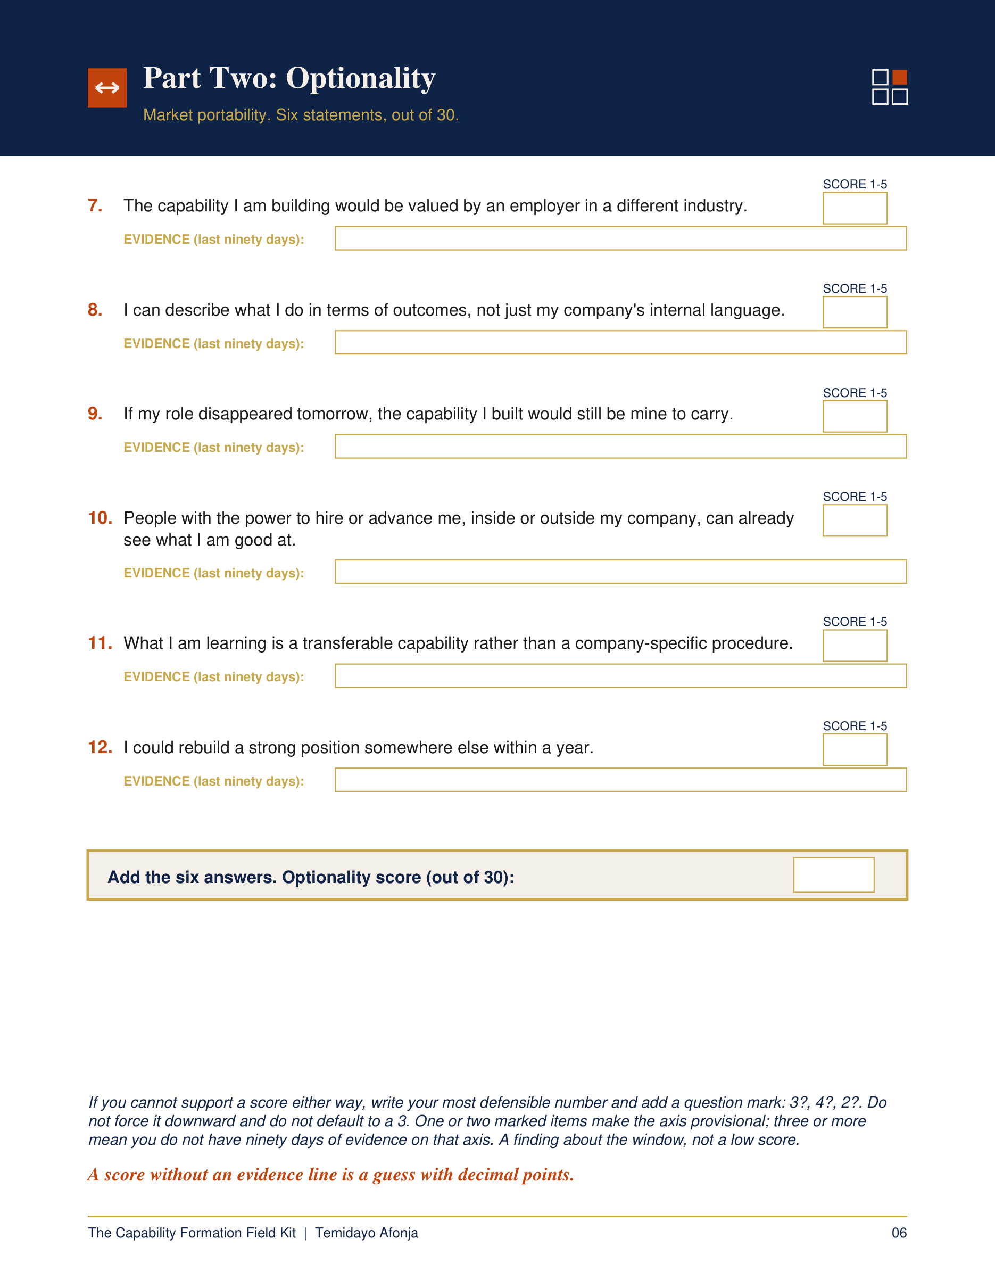
THE CAPABILITY FORMATION FIELD KIT
Is your job still building you?
Complete a private, evidence-led career position assessment using the last 90 days of your actual work.
temidayoafonja.com/fieldkit
Notes:
Timing: 8:00-8:30
Exact invitation:
"If these three tests show that you need a fuller read of what your current
work is building and how portable it is, the Capability Formation Field Kit
gives you a private, evidence-led assessment using the last 90 days of your
actual work. It helps you read the position before you decide what comes next.
You can find it at temidayoafonja.com/fieldkit."
Calm and brief. This is the only purchase invitation in the video. Show the
real Field Kit artwork briefly.
Before publishing, verify the live /fieldkit redirect and the current Gumroad
listing.

Slide 23
WATCH NEXT
Before You Quit Your Job, Check These 3 Things
Notes:
Timing: 8:30-9:00
Exact bridge:
"Before you decide that a concern means you should resign, there are three
things I want you to check. That is the next video: Before You Quit Your Job,
Check These 3 Things. Watch that one next."
Do not summarize this video again.
The right side of the frame is left open for the YouTube linked-video
end-screen element. Hold the final frame for at least 12 seconds.

